Slide 1






DETECTING SPAM E-MAIL
Student Details :
Name:LOKESHWARAN.N
NM Id:au513521114008
Dept : MECHANICAL ENGG
College Name:AMCET

Slide 2
Disclaimer
The content is curated from online/offline resources and used for educational purpose only
Source :

Slide 3
Course Outline
Abstract
Problem Statement
Aims, Objective & Proposed System/Solution
System Deployment Approach
Model Development & Algorithm
Future Scope
Output of the Project
Conclusion
Reference

Slide 4
Abstract
Spam email detection is a crucial task in modern email communication systems to protect users from unsolicited and potentially harmful messages.
This paper presents an overview of various techniques and approaches employed in spam email detection, including rule-based filtering, machine learning algorithms, and deep learning models.
The challenges associated with spam detection, such as evolving spamming techniques and the balance between false positives and false negatives, are discussed.
Furthermore, we discuss recent advancements in spam detection, including the utilization of contextual information, behavioral analysis, and ensemble learning strategies.
Source :

Slide 5

Problem Statement
High volume of spam emails overwhelms detection systems.
Spammers continually evolve tactics to evade detection.
Imbalance between spam and legitimate emails in datasets affects model training.
Balancing false positives (misclassifying legitimate emails) and false negatives (missing spam) is challenging.
Identifying relevant features from email content and metadata is difficult.
Source :

Slide 6

Identifying relevant features from email content and metadata is difficult.
Understanding contextual cues in email content requires advanced NLP.
Systems must adapt to new spam patterns without frequent updates.
Scalability is crucial to handle increasing email traffic efficiently.
Privacy concerns arise from inspecting email content for spam.
Choosing appropriate evaluation metrics to assess detection performance is important.
Real-time processing demands quick and accurate spam classification.

Slide 7

Aim & Objective
Aim: The aim of spam email detection is to accurately identify and filter out unsolicited and potentially harmful messages from users' email inboxes, while allowing legitimate emails to reach their intended recipients.
Protect users from spam-related threats like phishing and malware.
Enhance email productivity by reducing clutter.
Adapt to evolving spamming techniques.
Maintain a balance between accuracy and efficiency in filtering.
Source :

Slide 8
Objectives:
Maintaining the integrity and reputation of email service providers and organizations.
Safeguarding sensitive information and preventing identity theft or fraud facilitated through spam emails.
Providing transparent and user-friendly spam filtering mechanisms.
Educating users about potential spam threats and best practices for email security.
Enhancing the scalability and efficiency of spam detection systems to handle increasing email volumes.
Detecting and mitigating sophisticated spamming tactics, such as spoofing and social engineering
Source :

Slide 9

Proposed Solution
This involves analyzing the content of the email, including the subject line, body text, and attachments, to identify patterns or keywords commonly associated with spam emails.
This technique checks the reputation of the sender's email address or domain against blacklists or whitelists maintained by anti-spam organizations or services.
This is a statistical method that uses machine learning algorithms to classify emails as spam or legitimate based on the occurrence of certain words or patterns in the content.
This approach uses predefined rules and heuristics to identify characteristics commonly found in spam emails, such as excessive use of capitalization, excessive punctuation, or suspicious URLs.

Slide 10
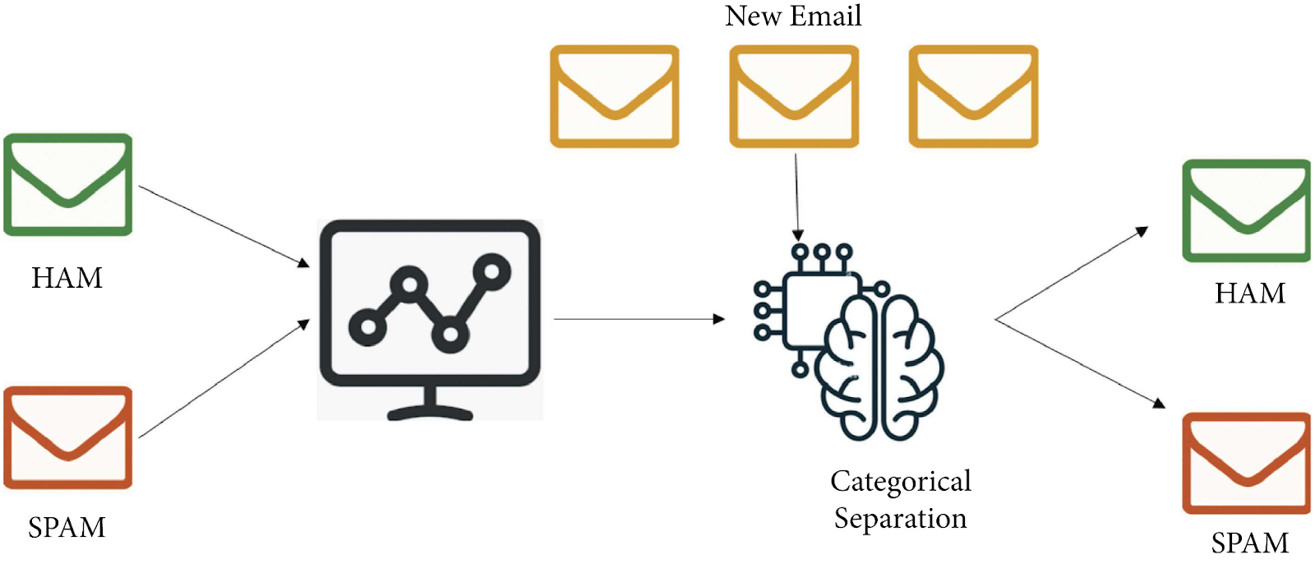
System Deployment Approach

Slide 11
Model Development & Algorithm
Data set description:
The dataset contains multiple emails in csv format.
Size of the dataset is 5500.
Categorized into Two classes.
Ham, Spam
Each classes contains more than 2500 mails
Source :

Slide 12
Model Development & Algorithm
Email Receiving: The email server or client receives incoming emails from various sources.
Pre-processing: The email content is prepared for analysis by performing tasks such as:
Decoding and parsing the email headers, body, and attachments
Removing HTML tags, scripts, and other markup elements
Converting the email body to plain text
Normalizing text (e.g., converting to lowercase, removing punctuation)
Feature Extraction: Relevant features are extracted from the email content, including:
Word and phrase frequencies
Presence of specific keywords or patterns
Sender information
Email headers
URLs and link properties
Image and attachment properties

Slide 13
Scoring and Thresholding: Some models provide a probability or confidence score for the spam classification. A threshold can be set to determine the minimum score required to classify an email as spam.
Post-processing and Action: Based on the classification result, appropriate actions can be taken, such as:
Moving spam emails to a designated spam folder
Rejecting or quarantining spam emails
Applying additional security measures
Allowing legitimate emails to reach the user's inbox
User Feedback: Many spam detection systems allow users to provide feedback on misclassified emails, which can be used to improve the model's accuracy over time.
Model Updates and Retraining: As new spam patterns emerge or user feedback is collected, the spam detection models may need to be updated or retrained periodically to maintain high accuracy.

Slide 14
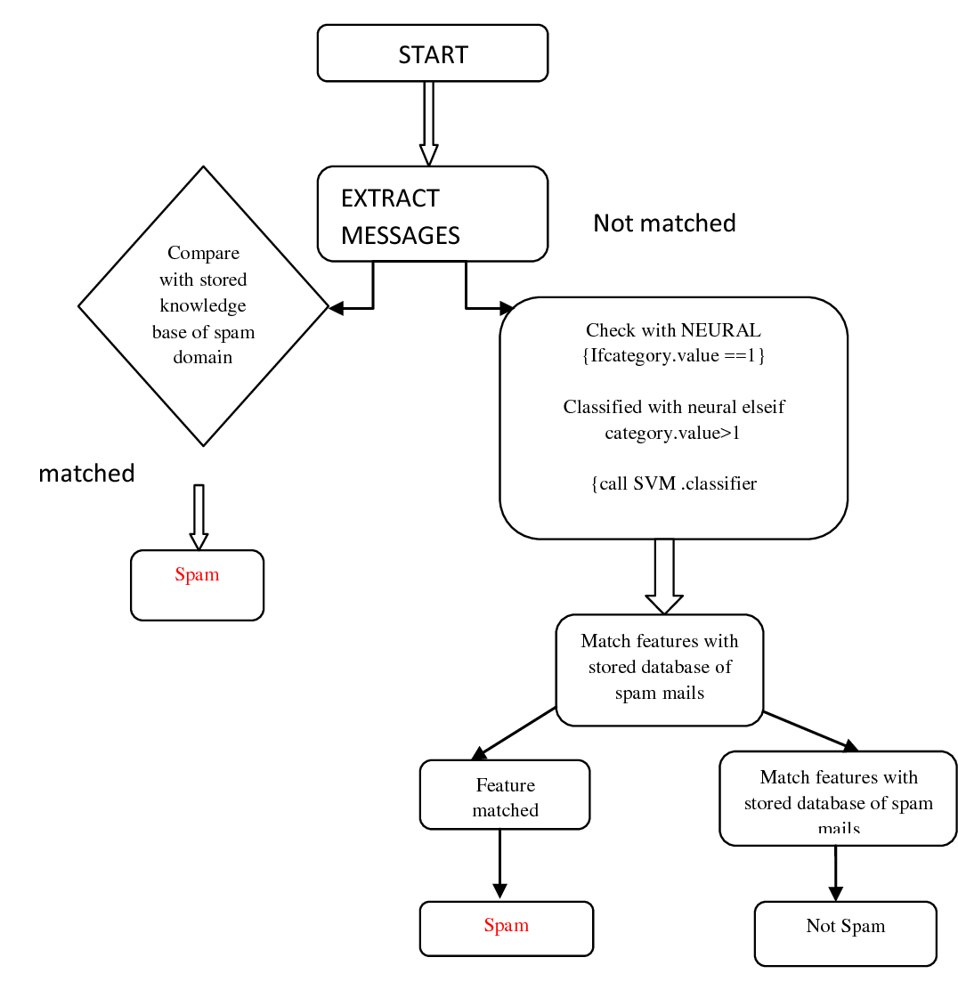
Model Development & Algorithm
Flow chart

Slide 15
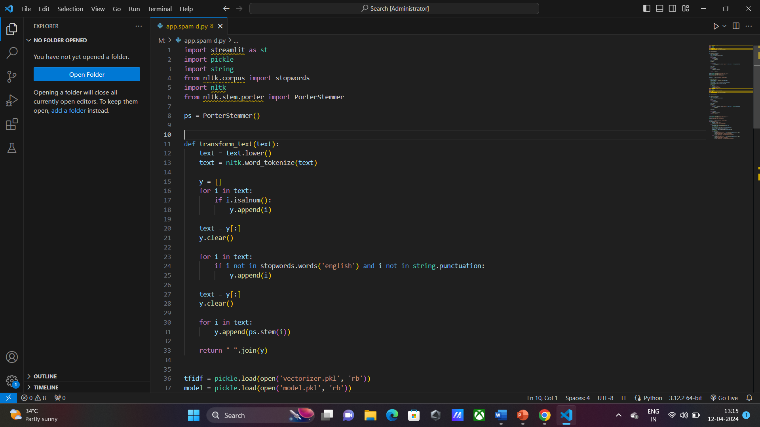
working:

Slide 16
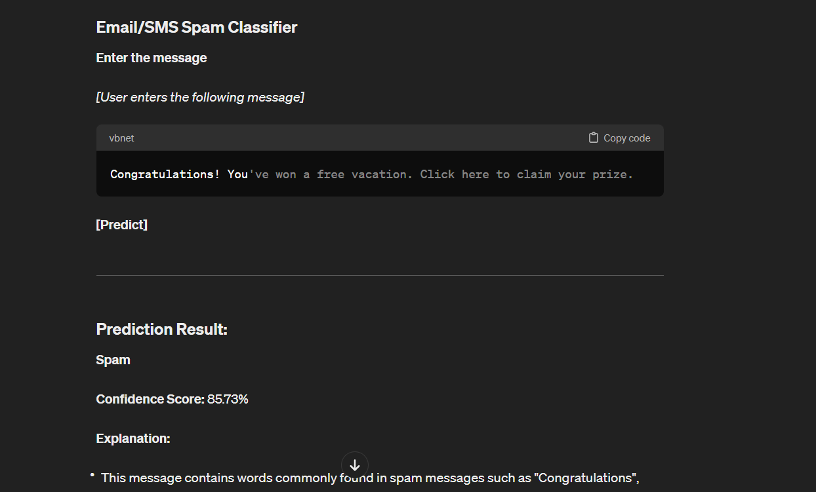
RESULT:

Slide 17
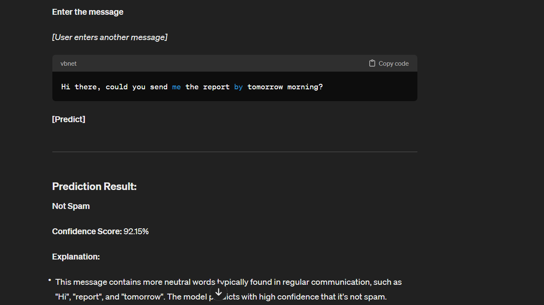
RESULT:

Slide 18
Future Enhancements:
Deep Learning Architectures: Experiment with more advanced deep learning architectures like recurrent neural networks (RNNs), long short-term memory networks (LSTMs), or transformers. These models might capture more intricate patterns and dependencies in email content.
Adversarial Training: Train the model against adversarial examples generated specifically to evade spam detection. This could improve the model's robustness against sophisticated spamming techniques.
Multi-Modal Learning: Incorporate not only the email text but also metadata, attachments, and sender information into the model. Multi-modal learning can provide a more comprehensive understanding of the email content and context.
Active Learning: Implement active learning techniques to iteratively improve the classifier by selecting the most informative emails for manual labeling. This approach can help maximize the effectiveness of the classifier with minimal human effort

Slide 19
Conclusion
In conclusion, spam email classification remains an ongoing challenge in the realm of cybersecurity and email filtering. Despite advancements in machine learning and natural language processing, the battle against spam continues as spammers develop increasingly sophisticated techniques to evade detection.
Future enhancements in spam email classification are likely to focus on leveraging deep learning models, ensemble methods, and adversarial training to create more robust classifiers. Feature engineering, active learning, semi-supervised learning, and cross-domain learning are also promising avenues for improving classification accuracy and generalization.
Source :

Slide 20
Thank You!
Notes:
Thank You !!

