Slide 1
AVANCERET SOFTWAREUDVIKLING 1
EKSAMENSPRÆSENTATION

Slide 2
INDHOLD
PROJEKTBESKRIVELSE
LIVE DEMONSTRATION
TECH STACK
ROADMAP
UDVIKLINGSPROCES

Slide 3
PROJEKTETS OMFANG
Hybrid Container Orkestrering med WASM GUI og Reverse Proxy
Project Loom
Inkluderede temaer fra Avanceret Softwareudvikling 1:
Grafiske Brugergrænseflader
Asynkron Programmering
Tråde (Threads)
ORM via Sqlalchemy
GraphQL API
Skalerbare Systemdesigns

Slide 4
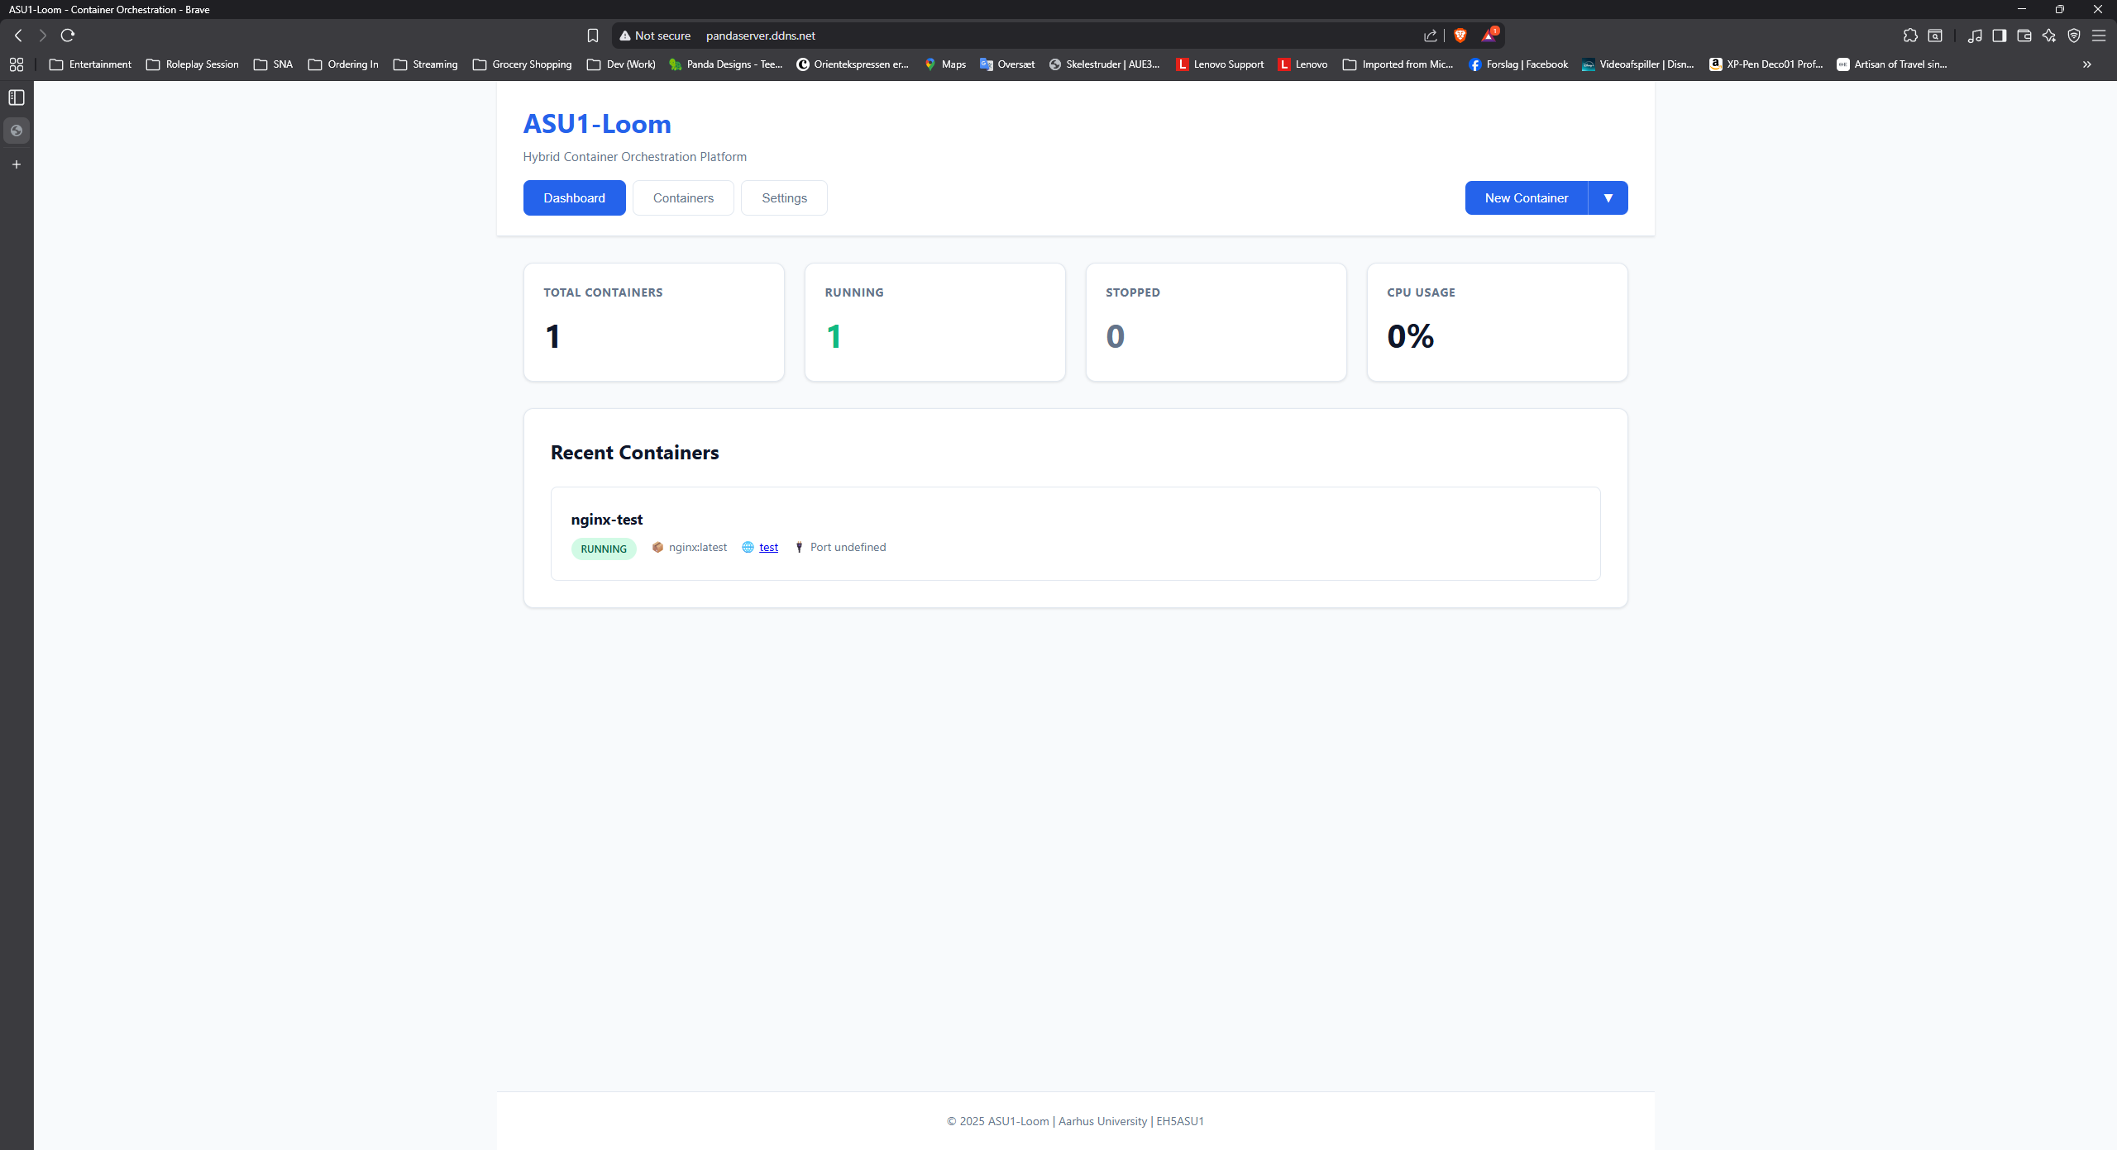
DEMONSTRATION

Slide 5






TECH STACK
FRONTEND / GUI
WebAssembly (WASM)
Pyodide (Python runtime in the browser)
HTML5
CSS3
JavaScript
BACKEND / API
Python 3.11+
FastAPI
GraphQL
AsyncIO
CONTAINER AND ORCHESTRATION
Docker
Docker SDK for Python
Docker Swarm
REVERSE PROXY AND NETWORKING
Traefik (dynamic routing and subdomains)
DATABASE AND PERSISTENCE
PostgreSQL
SQLAlchemy (ORM)
INFRASTRUCTURE AND TOOLING
Git / GitHub
Environmentbased configuration (.env)
Crossplatform development scripts (Windows / Linux)

Slide 6
GraphQL Data Flow (Request/Response)
Browser
GraphQL Query
Nginx
Proxy
FastAPI
/graphql
Resolver
@strawberry
Service Layer
Docker Manager
Request
Response
Docker API
Container Info
PostgreSQL
Metadata

