Slide 1


Data Structures Using C++ 2E
Algorithm Analysis: big O()

Slide 2
Algorithm Analysis: The Big-O Notation
Analyze algorithm after design
Example
  50 packages delivered to 50 different houses
  50 houses one mile apart, in the same area
FIGURE 1-1 Gift shop and each dot representing a house
Data Structures Using C++ 2E

Slide 3
Algorithm Analysis: The Big-O Notation (cont’d.)
Example (cont’d.)
  Driver picks up all 50 packages
  Drives one mile to first house, delivers first package
  Drives another mile, delivers second package
  Drives another mile, delivers third package, and so on
  Distance driven to deliver packages
    1+1+1+… +1 = 50 miles
  Total distance traveled: 50 + 50 = 100 miles
FIGURE 1-2 Package delivering scheme
Data Structures Using C++ 2E

Slide 4

Algorithm Analysis: The Big-O Notation (cont’d.)
Example (cont’d.)
  Similar route to deliver another set of 50 packages
    Driver picks up first package, drives one mile to the first house, delivers package, returns to the shop
    Driver picks up second package, drives two miles, delivers second package, returns to the shop
  Total distance traveled
    2 * (1+2+3+…+50) = 2550 miles
FIGURE 1-3 Another package delivery scheme
Data Structures Using C++ 2E

Slide 5
Algorithm Analysis: The Big-O Notation (cont’d.)
Example (cont’d.)
  n packages to deliver to n houses, each one mile apart
  First scheme: total distance traveled
    1+1+1+… +n = 2n miles
    Function of n
  Second scheme: total distance traveled
    2 * (1+2+3+…+n) = 2*(n(n+1) / 2) = n²+n
    Function of n²
Data Structures Using C++ 2E

Slide 6
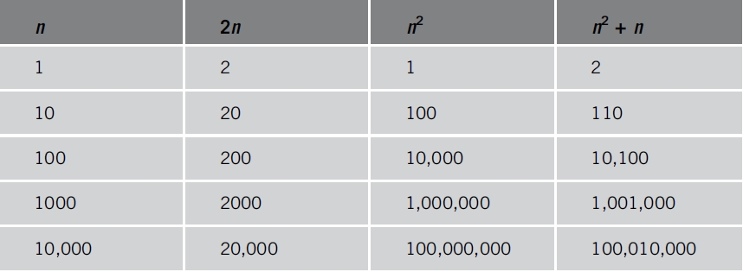
Algorithm Analysis: The Big-O Notation (cont’d.)
Analyzing an algorithm
  Count number of operations performed
    Not affected by computer speed
TABLE 1-1 Various values of n, 2n, n², and n² + n
Data Structures Using C++ 2E

Slide 7
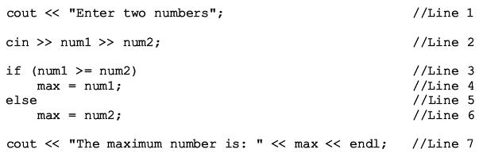
Algorithm Analysis: The Big-O Notation (cont’d.)
Example 1-1
  Illustrates fixed number of executed operations
Data Structures Using C++ 2E

Slide 8
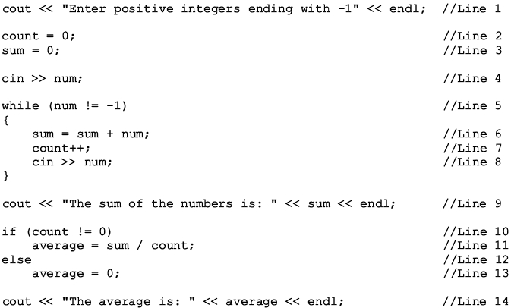
Algorithm Analysis: The Big-O Notation (cont’d.)
Example 1-2
  Illustrates dominant operations
Data Structures Using C++ 2E

Slide 9
Algorithm Analysis: The Big-O Notation (cont’d.)
Search algorithm
  n: represents list size
  f(n): count function
    Number of comparisons in search algorithm
  c: units of computer time to execute one operation
  cf(n): computer time to execute f(n) operations
  Constant c depends computer speed (varies)
  f(n): number of basic operations (constant)
  Determine algorithm efficiency
    Knowing how function f(n) grows as problem size grows
Data Structures Using C++ 2E

Slide 10
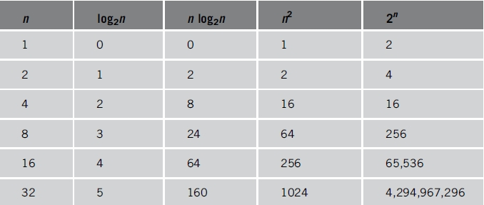
Algorithm Analysis: The Big-O Notation (cont’d.)
TABLE 1-2 Growth rates of various functions
Data Structures Using C++ 2E

Slide 11
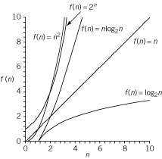
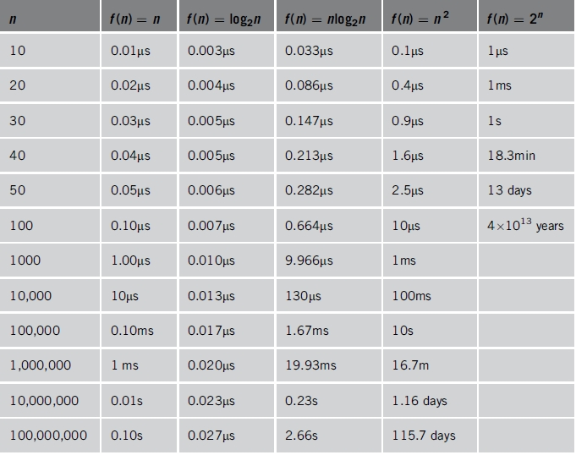
Algorithm Analysis: The Big-O Notation (cont’d.)
TABLE 1-3 Time for f(n) instructions on a computer that executes 1 billion instructions per second
Figure 1-4 Growth rate
of functions in Table 1-3
Data Structures Using C++ 2E

Slide 12
Algorithm Analysis: The Big-O Notation (cont’d.)
Notation useful in describing algorithm behavior
  Shows how a function f(n) grows as n increases without bound
Asymptotic
  Study of the function f as n becomes larger and larger without bound
  Examples of functions
    g(n)=n² (no linear term)
    f(n)=n² + 4n + 20
Data Structures Using C++ 2E

Slide 13
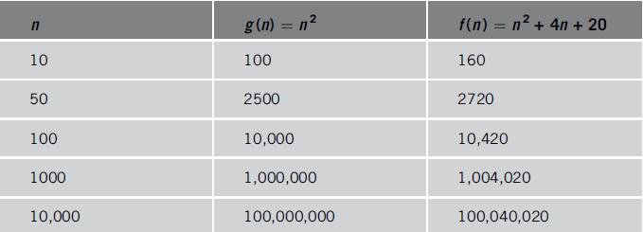
Algorithm Analysis: The Big-O Notation (cont’d.)
As n becomes larger and larger
  Term 4n + 20 in f(n) becomes insignificant
  Term n² becomes dominant term
TABLE 1-4 Growth rate of n² and n² + 4n + 20n
Data Structures Using C++ 2E

Slide 14
Algorithm Analysis: The Big-O Notation (cont’d.)
Algorithm analysis
  If function complexity can be described by complexity of a quadratic function without the linear term
    We say the function is of O(n²) or Big-O of n²
Let f and g be real-valued functions
  Assume f and g nonnegative
    For all real numbers n, f(n) >= 0 and g(n) >= 0
f(n) is Big-O of g(n): written f(n) = O(g(n))
  If there exists positive constants c and n₀ such that f(n) <= cg(n) for all n >= n₀
Data Structures Using C++ 2E

Slide 15
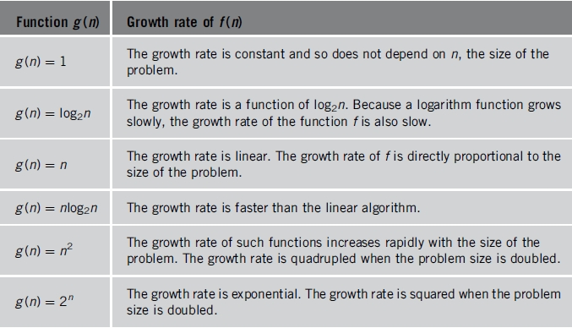
Algorithm Analysis: The Big-O Notation (cont’d.)
TABLE 1-5 Some Big-O functions that appear in algorithm analysis
Data Structures Using C++ 2E

