Slide 1

Data Structures Using C++ 2E
Chapter 9
Searching Algorithms

Slide 2
Objectives
Learn the various search algorithms
Explore how to implement the sequential and binary search algorithms
Discover how the sequential and binary search algorithms perform
Become aware of the lower bound on comparison-based search algorithms
Learn about hashing
Data Structures Using C++ 2E

Slide 3
Search Algorithms
Item key
  Unique member of the item
  Used in searching, sorting, insertion, deletion
Number of key comparisons
  Comparing the key of the search item with the key of an item in the list
Can use class arrayListType (Chapter 3)
  Implements a list and basic operations in an array
Data Structures Using C++ 2E

Slide 4
Sequential Search
Array-based lists
  Covered in Chapter 3
Linked lists
  Covered in Chapter 5
Works the same for array-based lists and linked lists
See code on page 499
Data Structures Using C++ 2E

Slide 5
Sequential Search Analysis
Examine effect of for loop in code on page 499
Different programmers might implement same algorithm differently
Computer speed affects performance
Data Structures Using C++ 2E

Slide 6
Sequential Search Analysis (cont’d.)
Sequential search algorithm performance
  Examine worst case and average case
  Count number of key comparisons
Unsuccessful search
  Search item not in list
  Make n comparisons
Conducting algorithm performance analysis
  Best case: make one key comparison
  Worst case: algorithm makes n comparisons
Data Structures Using C++ 2E

Slide 7
Sequential Search Analysis (cont’d.)
Determining the average number of comparisons
  Consider all possible cases
  Find number of comparisons for each case
  Add number of comparisons, divide by number of cases
Data Structures Using C++ 2E

Slide 8
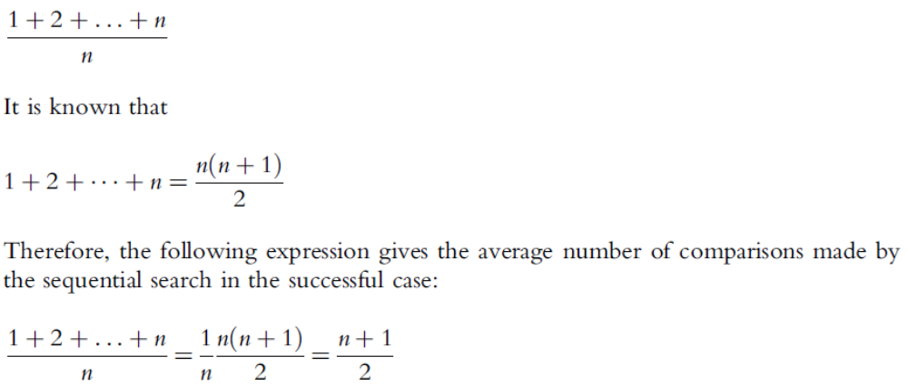
Sequential Search Analysis (cont’d.)
Determining the average number of comparisons (cont’d.)
Data Structures Using C++ 2E

Slide 9
Ordered Lists
Elements ordered according to some criteria
  Usually ascending order
Operations
  Same as those on an unordered list
    Determining if list is empty or full, determining list length, printing the list, clearing the list
Defining ordered list as an abstract data type (ADT)
  Use inheritance to derive the class to implement the ordered lists from class arrayListType
  Define two classes
Data Structures Using C++ 2E

Slide 10
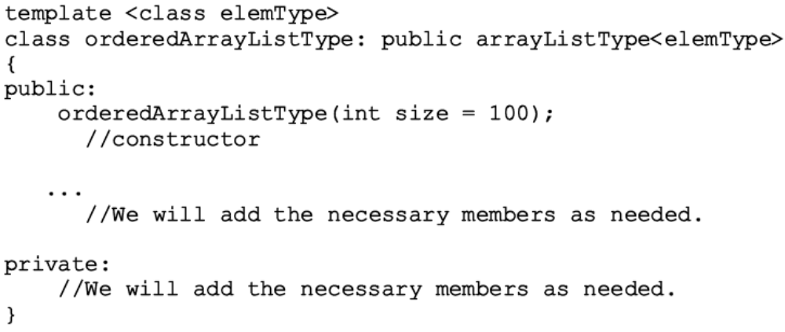
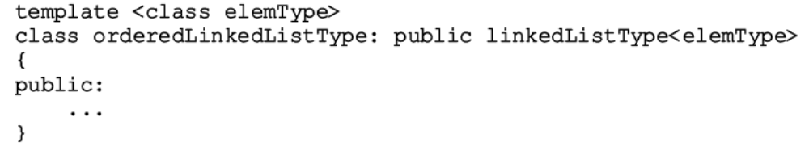
Ordered Lists (cont’d.)
Data Structures Using C++ 2E

Slide 11
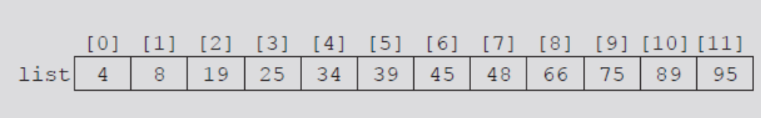
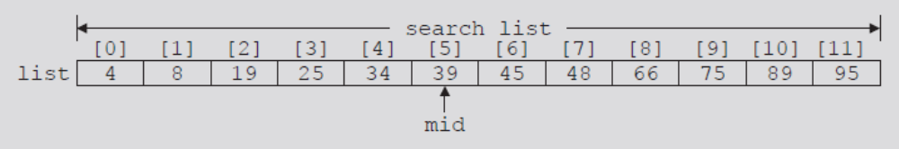
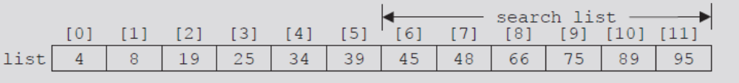
Binary Search
Performed only on ordered lists
Uses divide-and-conquer technique
FIGURE 9-1 List of length 12
FIGURE 9-2 Search list, list[0]...list[11]
FIGURE 9-3 Search list, list[6]...list[11]
Data Structures Using C++ 2E

Slide 12
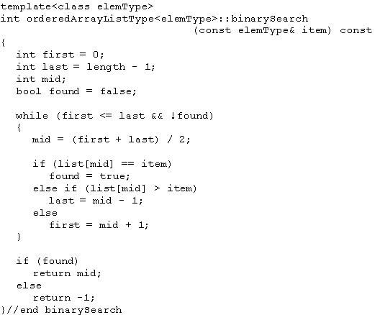
Binary Search (cont’d.)
C++ function implementing binary search algorithm
Data Structures Using C++ 2E

Slide 13

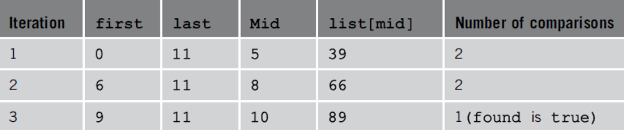
Binary Search (cont’d.)
Example 9-1
FIGURE 9-4 Sorted list for a binary search
TABLE 9-1 Values of first, last, and mid and the number of comparisons for search item 89
Data Structures Using C++ 2E

Slide 14
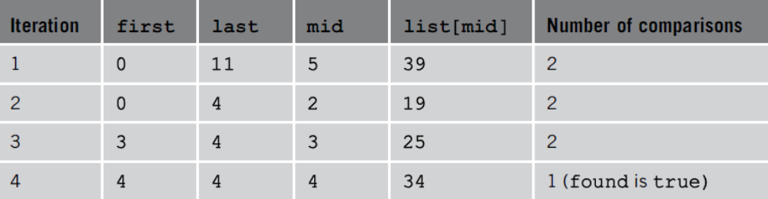
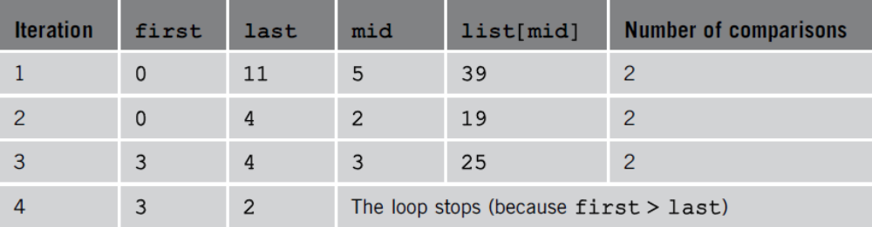
Binary Search (cont’d.)
TABLE 9-2 Values of first, last, and mid and the
number of comparisons for search item 34
TABLE 9-3 Values of first, last, and mid and the number of comparisons for search item 22
Data Structures Using C++ 2E

Slide 15
Insertion into an Ordered List
After insertion: resulting list must be ordered
  Find place in the list to insert item
    Use algorithm similar to binary search algorithm
  Slide list elements one array position down to make room for the item to be inserted
  Insert the item
    Use function insertAt (class arrayListType)
Data Structures Using C++ 2E

Slide 16
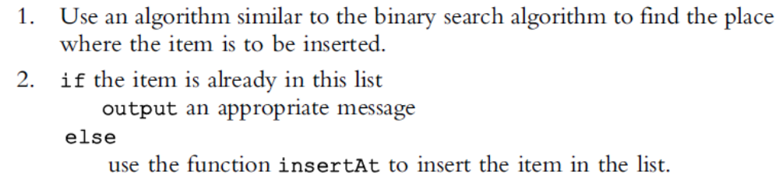
Insertion into an Ordered List (cont’d.)
Algorithm to insert the item
Function insertOrd implements algorithm
Data Structures Using C++ 2E

Slide 17
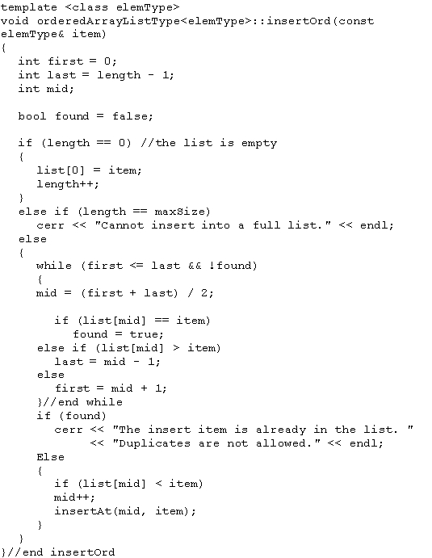
Data Structures Using C++ 2E

Slide 18
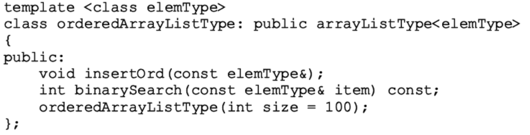
Insertion into an Ordered List (cont’d.)
Add binary search algorithm and the insertOrd algorithm to the class orderedArrayListType
Data Structures Using C++ 2E

Slide 19
Insertion into an Ordered List (cont’d.)
class orderedArrayListType
  Derived from class arrayListType
  List elements of orderedArrayListType
    Ordered
Must override functions insertAt and insertEnd of class arrayListType in class orderedArrayListType
  If these functions are used by an object of type orderedArrayListType, list elements will remain in order
Data Structures Using C++ 2E

Slide 20
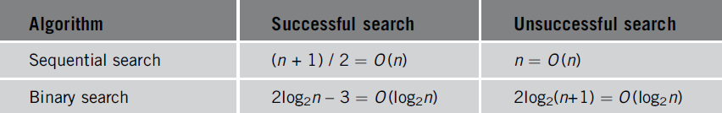
Insertion into an Ordered List (cont’d.)
Can also override function seqSearch
  Perform sequential search on an ordered list
    Takes into account that elements are ordered
TABLE 9-4 Number of comparisons for a list of length n
Data Structures Using C++ 2E

Slide 21
Lower Bound on Comparison-Based Search Algorithms
Comparison-based search algorithms
  Search list by comparing target element with list elements
Sequential search: order n
Binary search: order log₂n
Data Structures Using C++ 2E

Slide 22
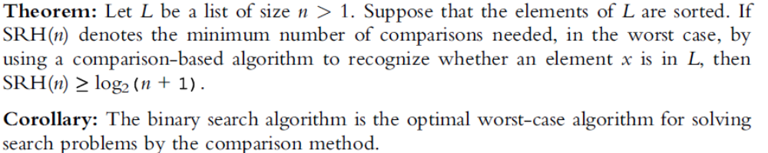
Lower Bound on Comparison-Based Search Algorithms (cont’d.)
Devising a search algorithm with order less than log₂n
  Obtain lower bound on number of comparisons
Cannot be comparison based
Data Structures Using C++ 2E

Slide 23
Summary
Sequential search
  Order n
Ordered lists
  Elements ordered according to some criteria
Binary search
  Order log₂n
Data Structures Using C++ 2E

Slide 24
Summary (cont’d.)
Hash functions
  Mid-square
  Folding
  Division (modular arithmetic)
Collision resolution technique categories
  Open addressing (closed hashing)
  Chaining (open hashing)
Search analysis
  Review number of key comparisons
  Worst case, best case, average case
Data Structures Using C++ 2E

