Slide 1
Search Algorithms
Sequential Search (Linear Search)
Binary Search
Data Structures Using C++

Slide 2
Sequential Search
O (n)
A sequential search of a list/array begins at the beginning of the list/array and continues until the item is found or the entire list/array has been searched
Data Structures Using C++

Slide 3
Sequential Search
bool LinSearch(double x[ ], int n, double item){
for(int i=0;i<n;i++){
if(x[i]==item) return true;
else return false;
}
return false;
}
Data Structures Using C++

Slide 4



Search Algorithms
Suppose that there are n elements in the array. The following expression gives the average number of comparisons:
It is known that
Therefore, the following expression gives the average number of comparisons made by the sequential search in the successful case:
Data Structures Using C++

Slide 5
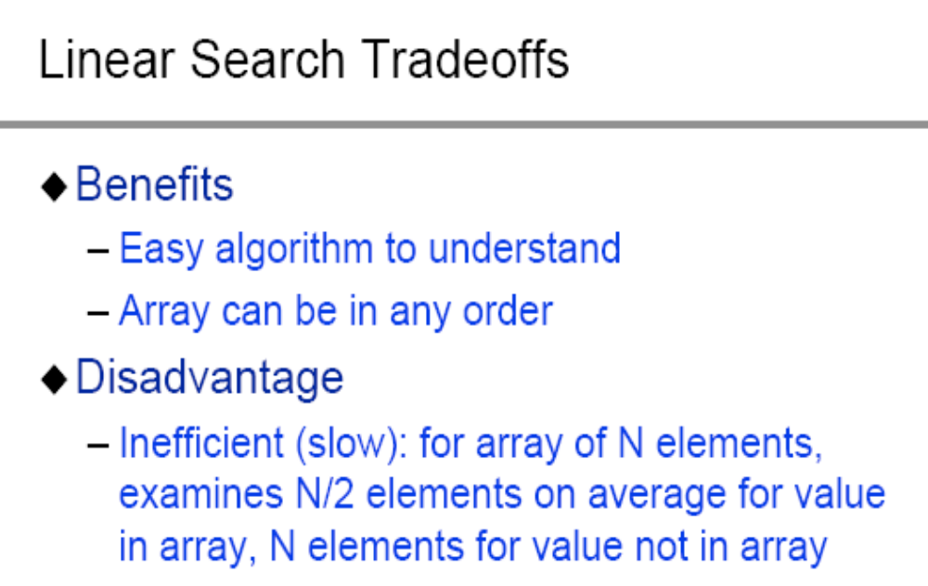
Search Algorithms
Data Structures Using C++

Slide 6
Binary Search
O(log2 n)
A binary search looks for an item in a list using a divide-and-conquer strategy
Data Structures Using C++

Slide 7
Binary Search
  Binary search algorithm assumes that the items in the array being searched are sorted
  The algorithm begins at the middle of the array in a binary search
  If the item for which we are searching is less than the item in the middle, we know that the item won’t be in the second half of the array
  Once again we examine the “middle” element
  The process continues with each comparison cutting in half the portion of the array where the item might be
Data Structures Using C++

Slide 8
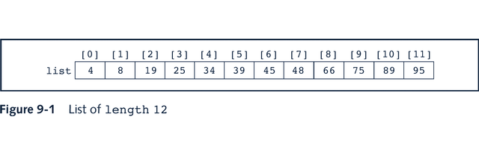
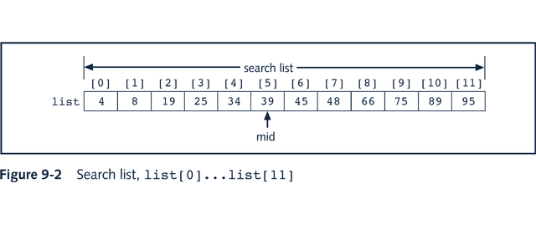
Binary Search
Data Structures Using C++

Slide 9
Binary Search: middle element
left + right
mid =
2
Data Structures Using C++

Slide 10
Binary Search
bool BinSearch(double list[ ], int n, double item, int&index){
int left=0;
int right=n-1;
int mid;
while(left<=right){
mid=(left+right)/2;
if(item> list [mid]){ left=mid+1; }
else if(item< list [mid]){right=mid-1;}
else{
item= list [mid];
index=mid;
return true; }
}// while
return false;
}
Data Structures Using C++

Slide 11
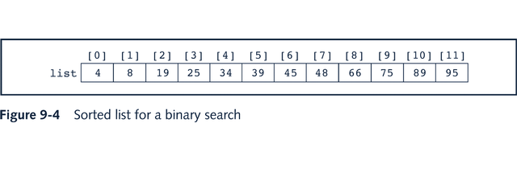
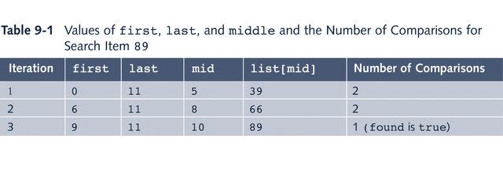
Binary Search: Example
Data Structures Using C++

Slide 12
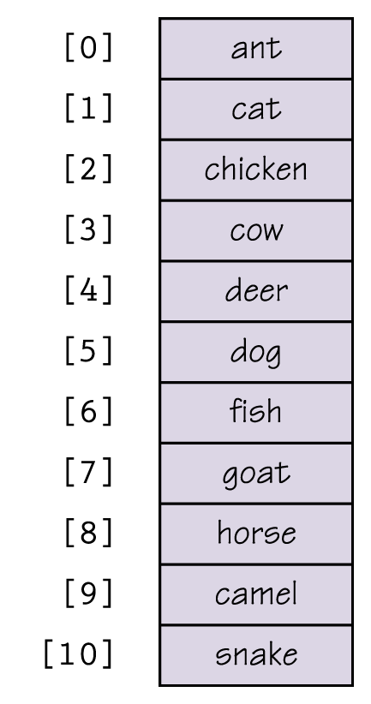
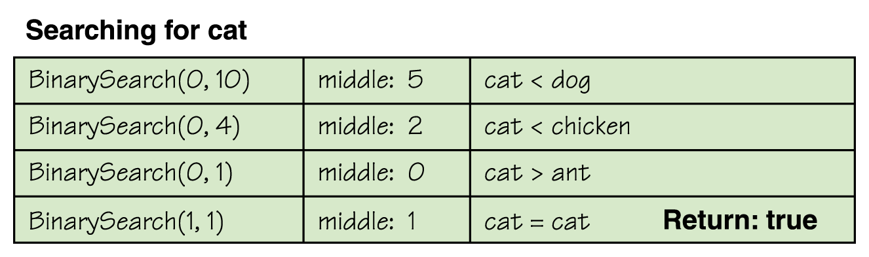
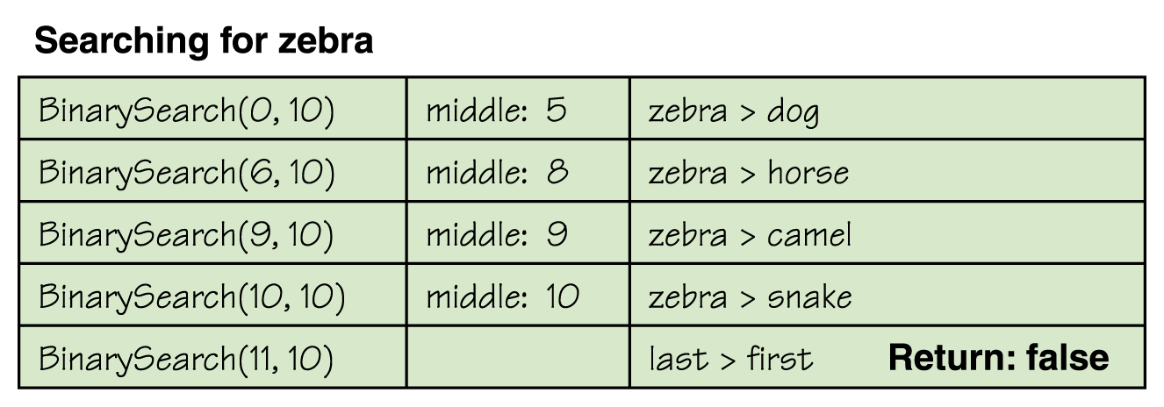
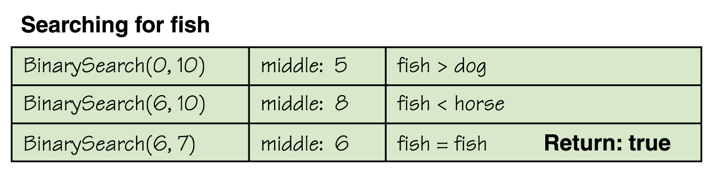
Binary Search
Data Structures Using C++

Slide 13
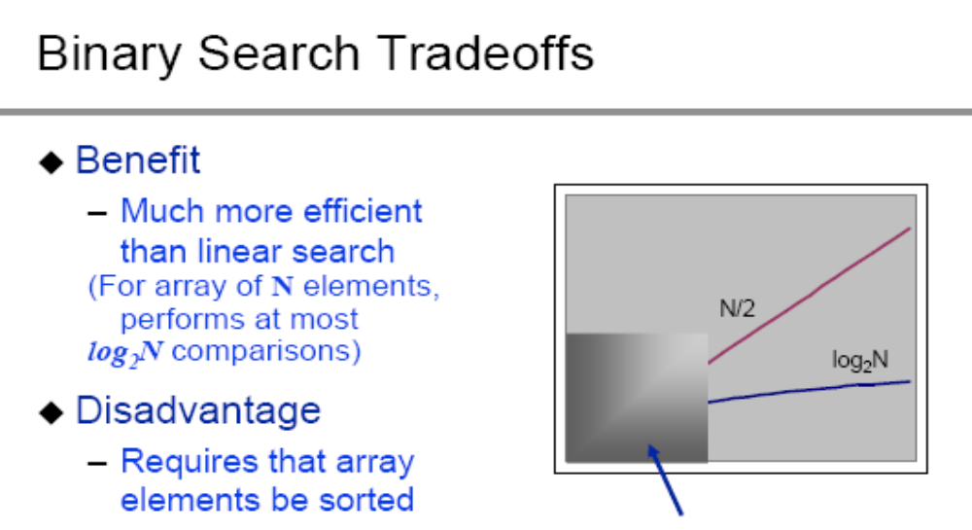
Binary Search
Data Structures Using C++

Slide 14
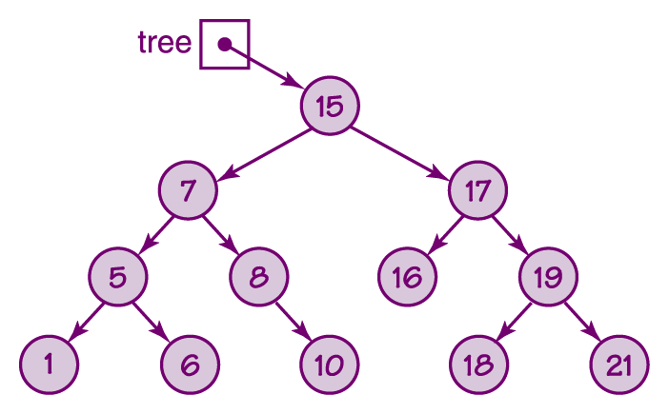
Binary Search Tree
Data Structures Using C++

Slide 15
Binary Search Tree
O(log2 n)
bool search(Node * root, int id) {
bool found = false;
if(root == NULL) return false;
if(root->data == id) {
cout<<" The node is found "<<endl; found = true;
}
if(!found) found = search(root->left, id);
if(!found) found = search(root->right, id);
return found;
}
Data Structures Using C++

Slide 16
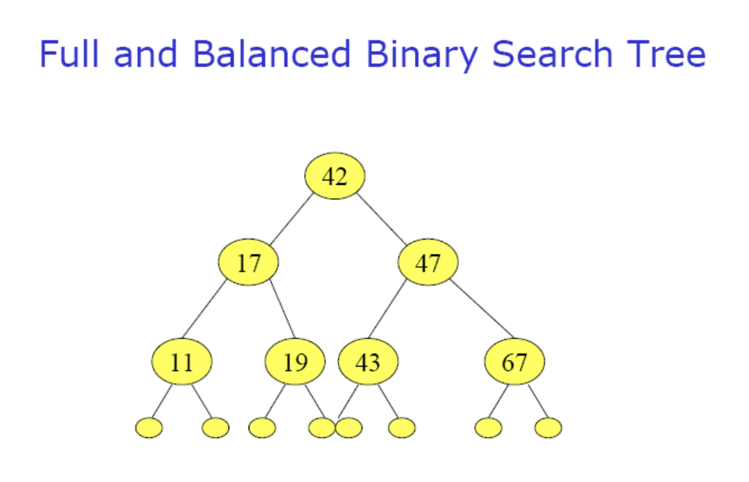
Binary Search Tree
Data Structures Using C++

Slide 17
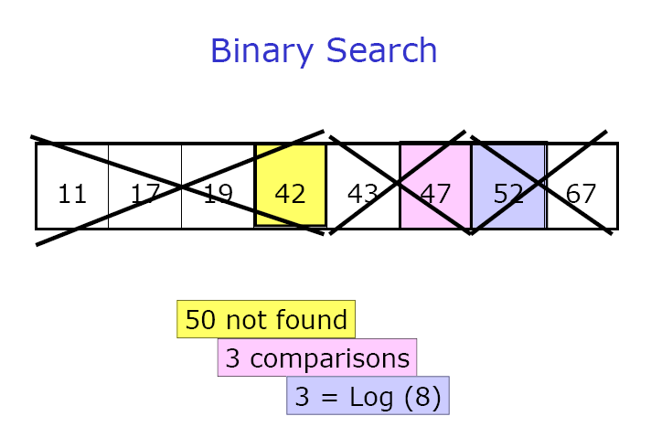
Binary Search Tree
Data Structures Using C++

Slide 18
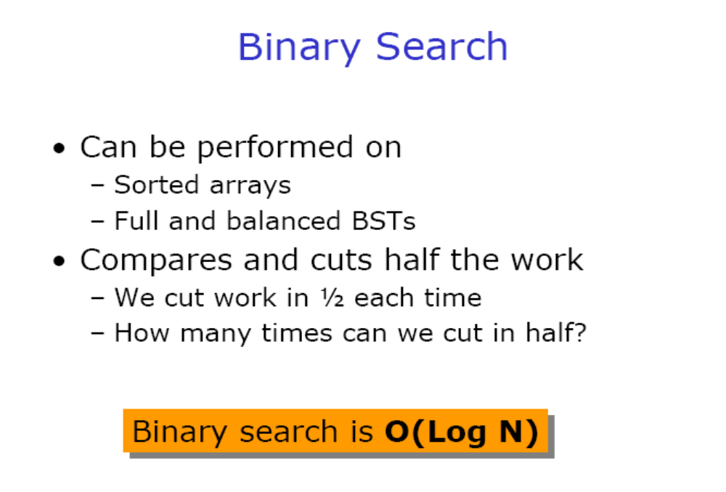
Binary Search Tree
Data Structures Using C++

