Slide 1

Data Structures Using C++ 2E
Chapter 7
Stacks

Slide 2
Objectives
Learn about stacks
Examine various stack operations
Learn how to implement a stack as an array
Learn how to implement a stack as a linked list
Discover stack applications
Learn how to use a stack to remove recursion
Data Structures Using C++ 2E

Slide 3
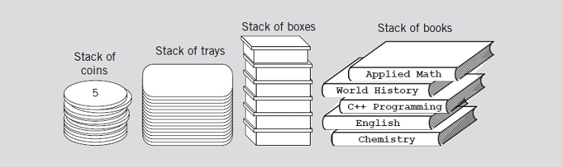
Stacks
Data structure
  Elements added, removed from one end only
  Last In First Out (LIFO)
FIGURE 7-1 Various examples of stacks
Data Structures Using C++ 2E

Slide 4
Stacks (cont’d.)
push operation
  Add element onto the stack
top operation
  Retrieve top element of the stack
pop operation
  Remove top element from the stack
Data Structures Using C++ 2E

Slide 5

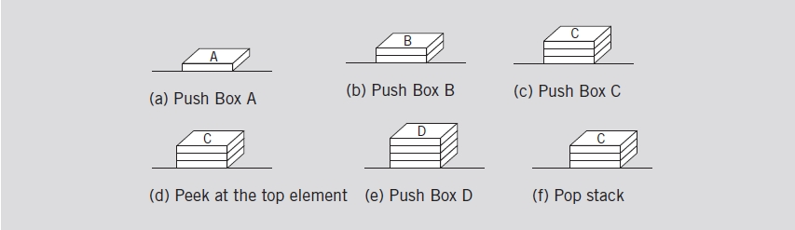
Stacks (cont’d.)
FIGURE 7-2 Empty stack
FIGURE 7-3 Stack operations
Data Structures Using C++ 2E

Slide 6
Stacks (cont’d.)
Stack element removal
  Occurs only if something is in the stack
Stack element added only if room available
isFullStack operation
  Checks for full stack
isEmptyStack operation
  Checks for empty stack
initializeStack operation
  Initializes stack to an empty state
Data Structures Using C++ 2E

Slide 7
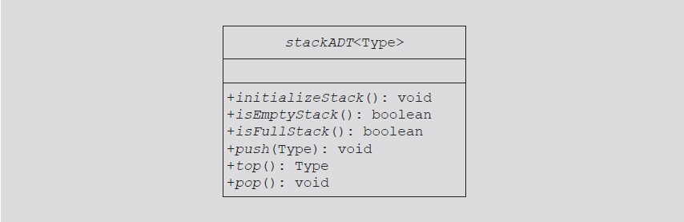
Stacks (cont’d.)
Review code on page 398
  Illustrates class specifying basic stack operations
FIGURE 7-4 UML class diagram of the class stackADT
Data Structures Using C++ 2E

Slide 8
Implementation of Stacks as Arrays
First stack element
  Put in first array slot
Second stack element
  Put in second array slot, and so on
Top of stack
  Index of last element added to stack
Stack element accessed only through the top
  Problem: array is a random access data structure
  Solution: use another variable (stackTop)
    Keeps track of the top position of the array
Data Structures Using C++ 2E

Slide 9
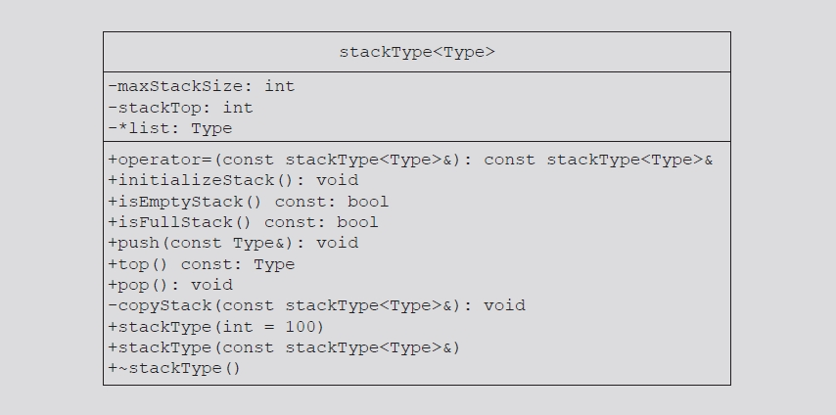
Implementation of Stacks as Arrays (cont’d.)
Review code on page 400
  Illustrates basic operations on a stack as an array
FIGURE 7-5 UML class diagram of the class stackType
Data Structures Using C++ 2E

Slide 10
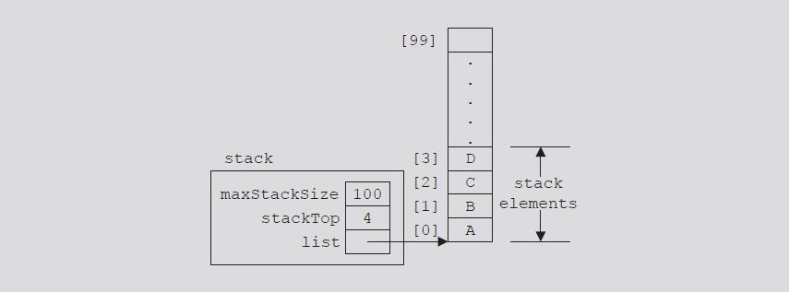
Implementation of Stacks as Arrays (cont’d.)
FIGURE 7-6 Example of a stack
Data Structures Using C++ 2E

Slide 11
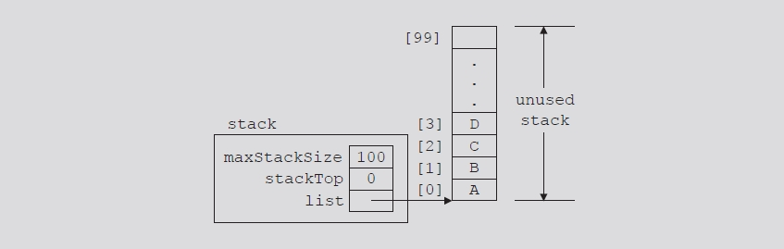
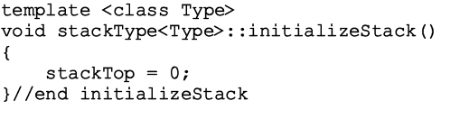
Initialize Stack
Value of stackTop if stack empty
  Set stackTop to zero to initialize the stack
Definition of function initializeStack
FIGURE 7-7 Empty stack
Data Structures Using C++ 2E

Slide 12
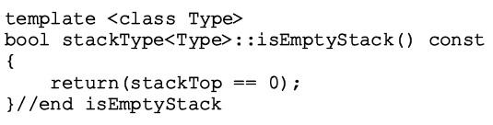
Empty Stack
Value of stackTop indicates if stack empty
  If stackTop = zero: stack empty
  Otherwise: stack not empty
Definition of function isEmptyStack
Data Structures Using C++ 2E

Slide 13
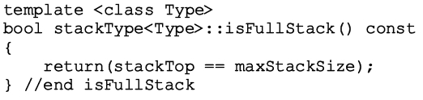
Full Stack
Stack full
  If stackTop is equal to maxStackSize
Definition of function isFullStack
Data Structures Using C++ 2E

Slide 14
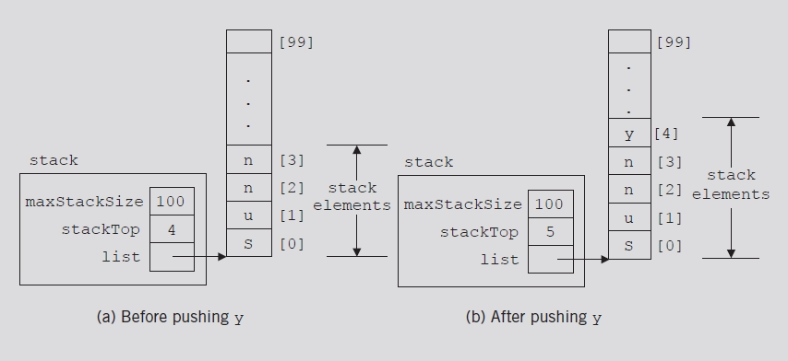
Push
Two-step process
  Store newItem in array component indicated by stackTop
  Increment stackTop
FIGURE 7-8 Stack before and after the push operation
Data Structures Using C++ 2E

Slide 15
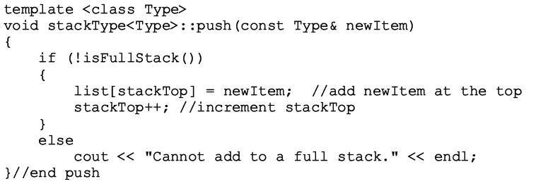
Push (cont’d.)
Definition of push operation
Data Structures Using C++ 2E

Slide 16
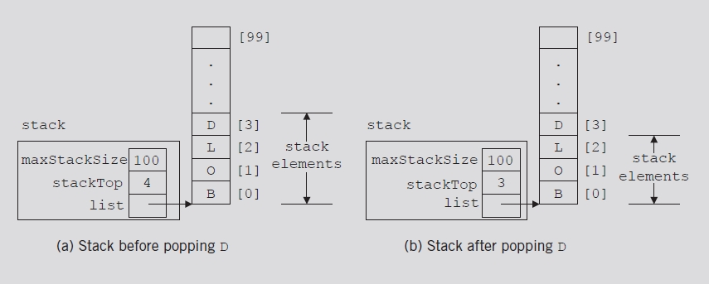
Pop
Remove (pop) element from stack
  Decrement stackTop by one
FIGURE 7-9 Stack before and after the pop operation
Data Structures Using C++ 2E

Slide 17
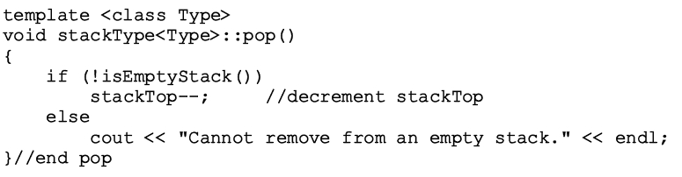
Pop (cont’d.)
Definition of pop operation
Underflow
  Removing an item from an empty stack
    Check within pop operation (see below)
    Check before calling function pop
Data Structures Using C++ 2E

Slide 18
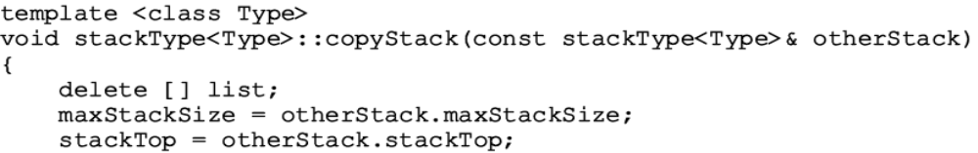
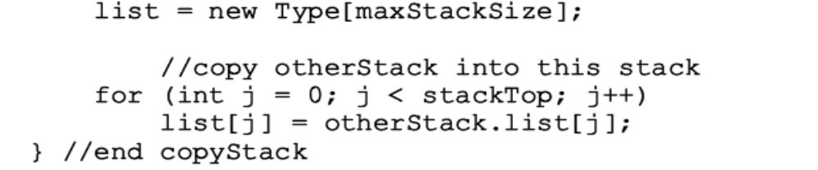
Copy Stack
Definition of function copyStack
Data Structures Using C++ 2E

Slide 19
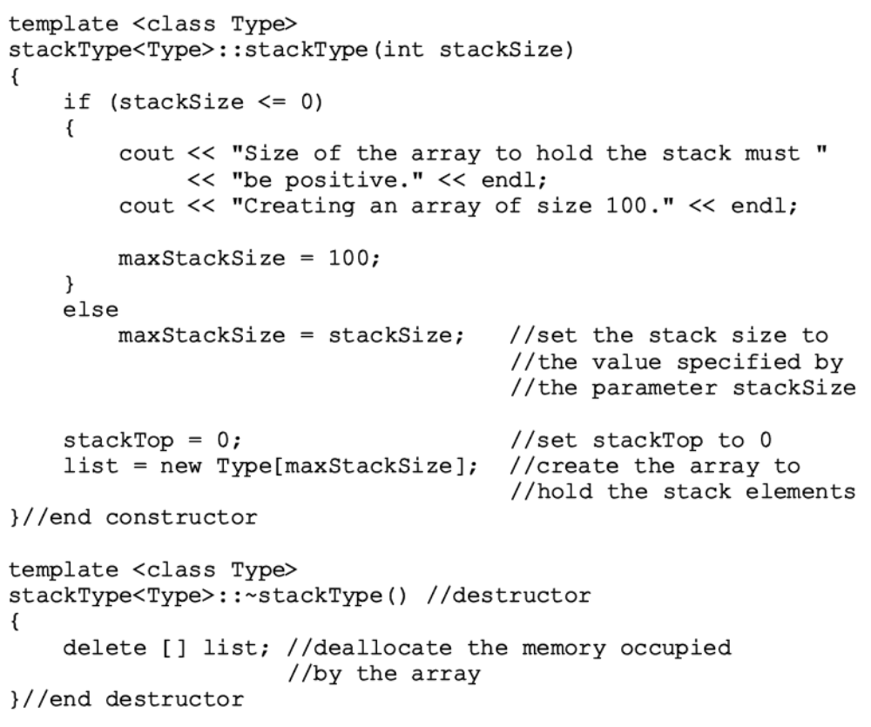
Constructor and Destructor
Data Structures Using C++ 2E

Slide 20
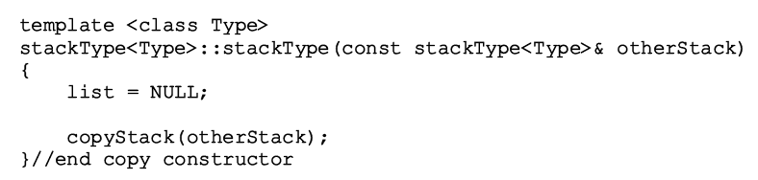
Copy Constructor
Definition of the copy constructor
Data Structures Using C++ 2E

Slide 21
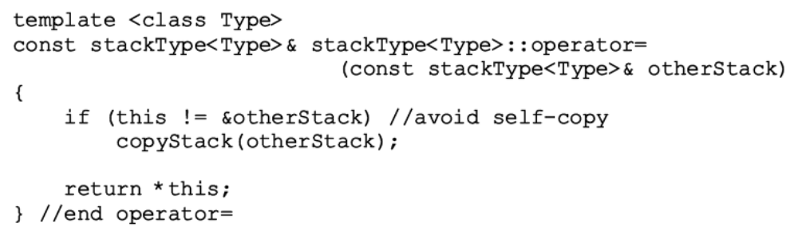
Overloading the Assignment Operator (=)
Classes with pointer member variables
  Assignment operator must be explicitly overloaded
Function definition to overload assignment operator for class stackType
Data Structures Using C++ 2E

Slide 22
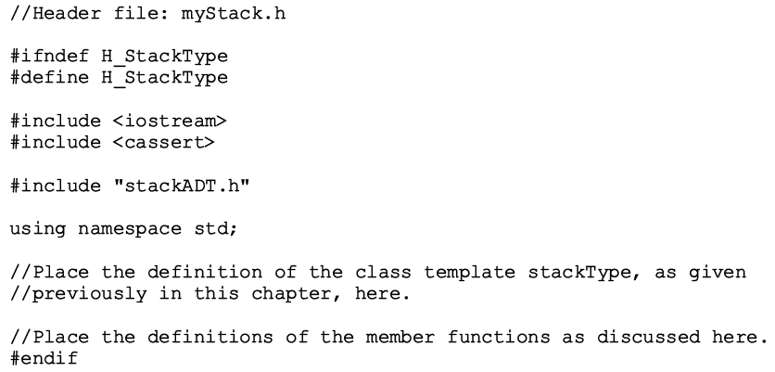
Stack Header File
myStack.h
  Header file name containing class stackType definition
Data Structures Using C++ 2E

Slide 23
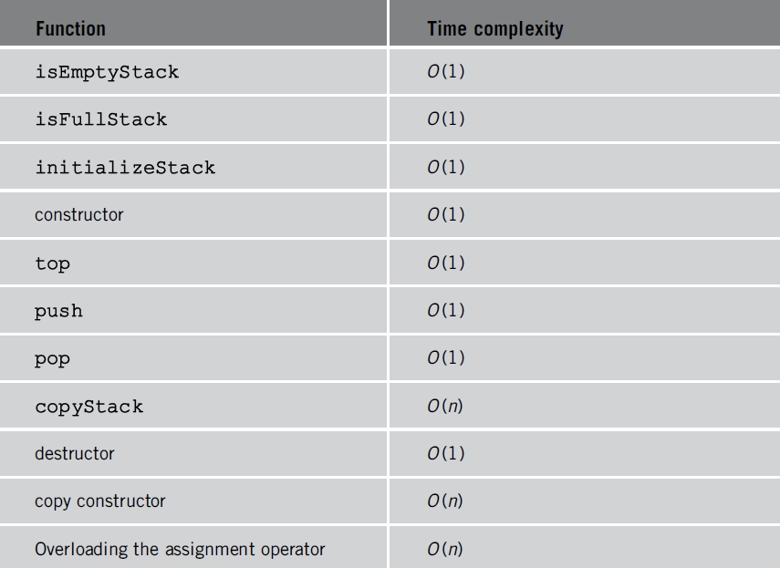
Stack Header File (cont’d.)
Stack operations analysis
  Similar to class arrayListType operations
TABLE 7-1 Time complexity of the operations of
the class stackType on a stack with n elements
Data Structures Using C++ 2E

Slide 24
Linked Implementation of Stacks
Disadvantage of array (linear) stack representation
  Fixed number of elements can be pushed onto stack
Solution
  Use pointer variables to dynamically allocate, deallocate memory
  Use linked list to dynamically organize data
Value of stackTop: linear representation
  Indicates number of elements in the stack
    Gives index of the array
  Value of stackTop – 1
    Points to top item in the stack
Data Structures Using C++ 2E

Slide 25
Linked Implementation of Stacks (cont’d.)
Value of stackTop: linked representation
  Locates top element in the stack
    Gives address (memory location) of the top element of the stack
Review program on page 415
  Class specifying basic operation on a stack as a linked list
Data Structures Using C++ 2E

Slide 26
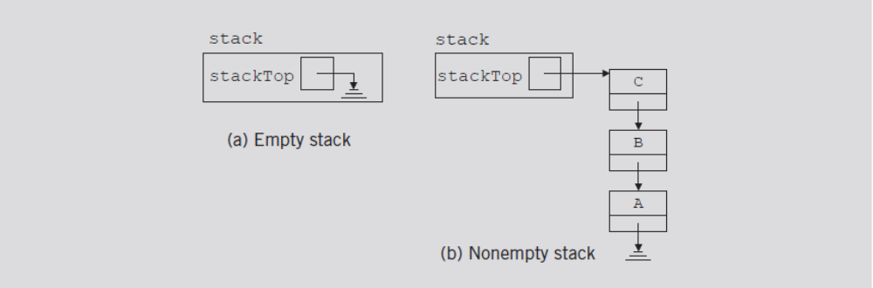
Linked Implementation of Stacks (cont’d.)
Example 7-2
  Stack: object of type linkedStackType
FIGURE 7-10 Empty and nonempty linked stacks
Data Structures Using C++ 2E

Slide 27
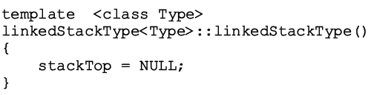
Default Constructor
When stack object declared
  Initializes stack to an empty state
  Sets stackTop to NULL
Definition of the default constructor
Data Structures Using C++ 2E

Slide 28
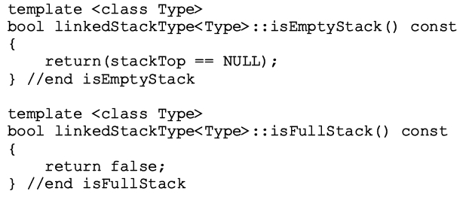
Empty Stack and Full Stack
Stack empty if stackTop is NULL
Stack never full
  Element memory allocated/deallocated dynamically
  Function isFullStack always returns false value
Data Structures Using C++ 2E

Slide 29
Initialize Stack
Reinitializes stack to an empty state
Because stack might contain elements and you are using a linked implementation of a stack
  Must deallocate memory occupied by the stack elements, set stackTop to NULL
Definition of the initializeStack function
Data Structures Using C++ 2E

Slide 30
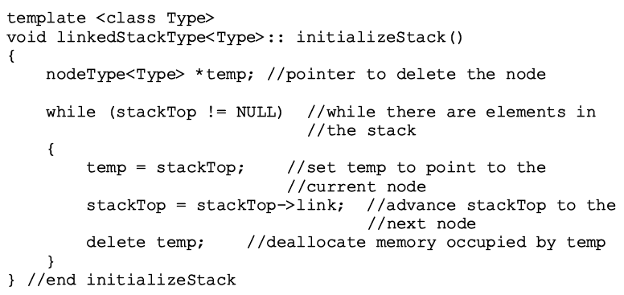
Initialize Stack (cont’d.)
Data Structures Using C++ 2E

Slide 31

Push
newElement added at the beginning of the linked list pointed to by stackTop
Value of pointer stackTop updated
FIGURE 7-11 Stack before the push operation
Data Structures Using C++ 2E

Slide 32
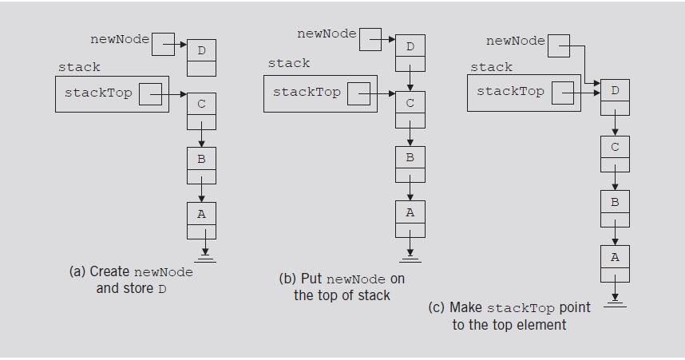
Push (cont’d.)
FIGURE 7-12 Push operation
Data Structures Using C++ 2E

Slide 33
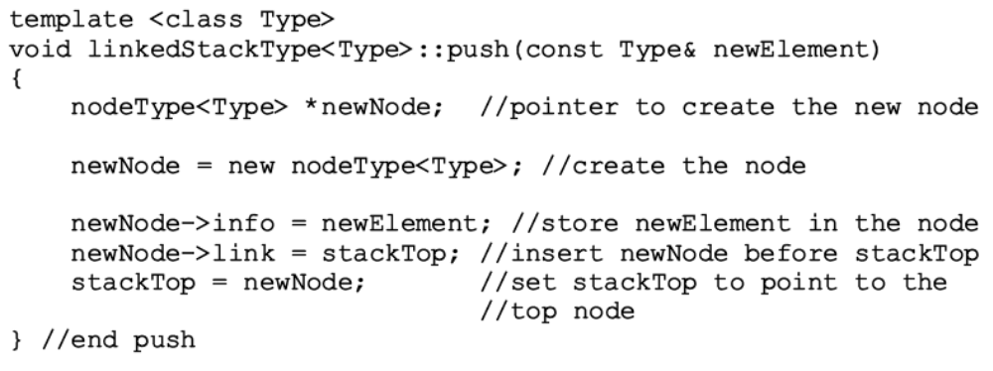
Push (cont’d.)
Definition of the push function
Data Structures Using C++ 2E

Slide 34
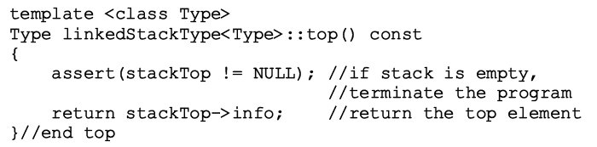
Return the Top Element
Returns information of the node to which stackTop pointing
Definition of the top function
Data Structures Using C++ 2E

Slide 35

Pop
Removes top element of the stack
  Node pointed to by stackTop removed
  Value of pointer stackTop updated
Data Structures Using C++ 2E

Slide 36
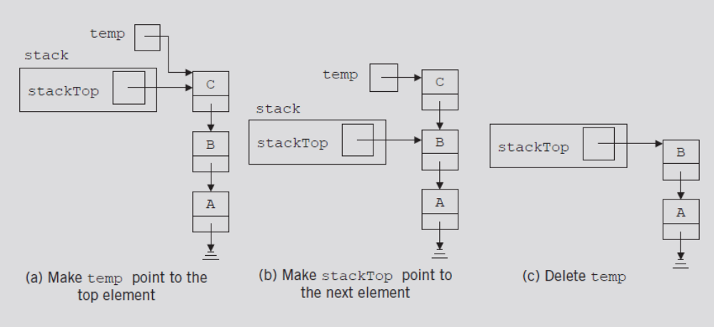
Pop (cont’d.)
FIGURE 7-14 Pop operation
Data Structures Using C++ 2E

Slide 37
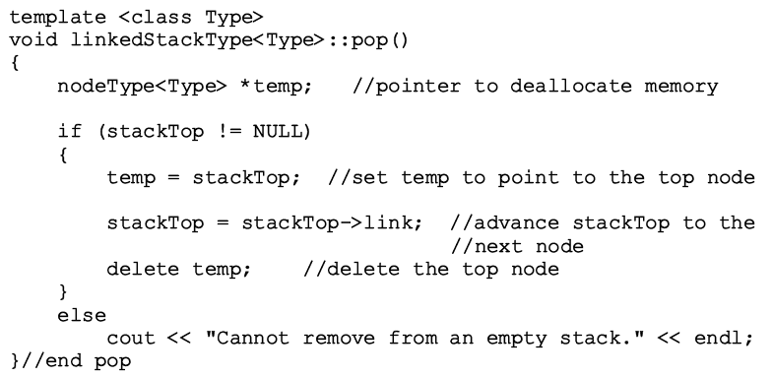
Pop (cont’d.)
Definition of the pop function
Data Structures Using C++ 2E

Slide 38
Copy Stack
Makes an identical copy of a stack
Definition similar to the definition of copyList for linked lists
Definition of the copyStack function
Data Structures Using C++ 2E

Slide 39
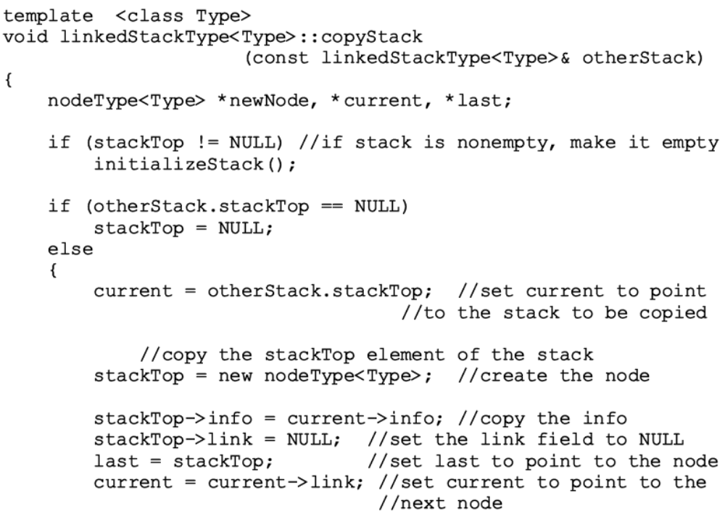
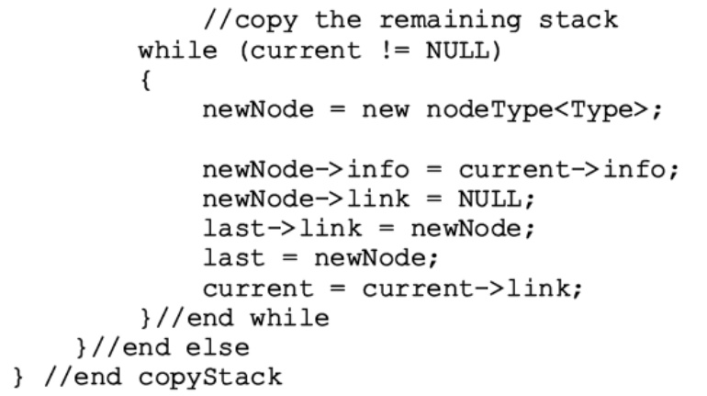
Data Structures Using C++ 2E

Slide 40
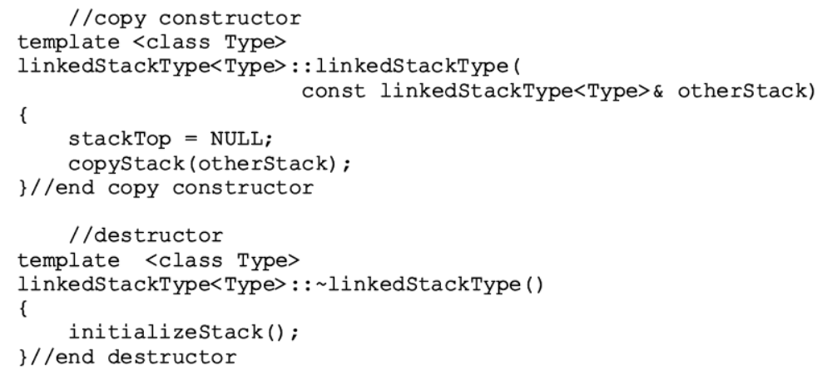
Constructors and Destructors
Definition of the functions to implement the copy constructor and the destructor
Data Structures Using C++ 2E

Slide 41
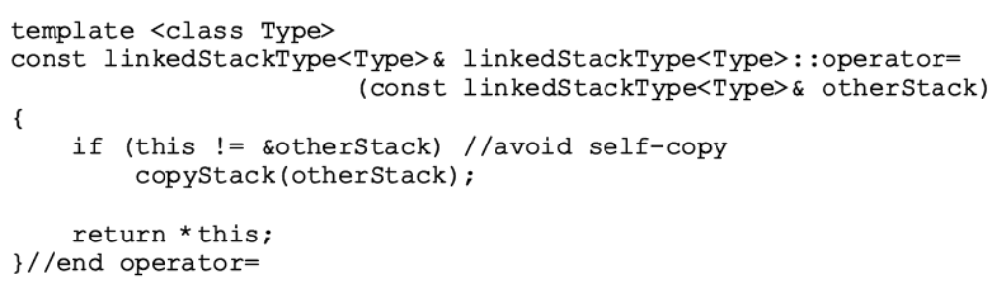
Overloading the Assignment Operator (=)
Definition of the functions to overload the assignment operator
Data Structures Using C++ 2E

Slide 42

Overloading the Assignment Operator (=) (cont’d.)
TABLE 7-2 Time complexity of the operations of the class linkedStackType on a stack with n elements
Data Structures Using C++ 2E

Slide 43
Stack as Derived from the class unorderedLinkedList
Stack push function, list insertFirst function
  Similar algorithms
  initializeStack and initializeList, isEmptyList and isEmptyStack, etc.
  Shows that class linkedStackType is derived from class linkedListType
Functions pop and isFullStack implemented for linked stack
  class linkedListType: abstract class
  class unorderedLinkedListType: derived from class linkedListType
Data Structures Using C++ 2E

Slide 44
Application of Stacks: Postfix Expressions Calculator
Arithmetic notations
  Infix notation: operator between operands
  Prefix (Polish) notation: operator precedes operands
  Reverse Polish notation: operator follows operands
Stack use in compliers
  Translate infix expressions into some form of postfix notation
  Translate postfix expression into machine code
Data Structures Using C++ 2E

Slide 45
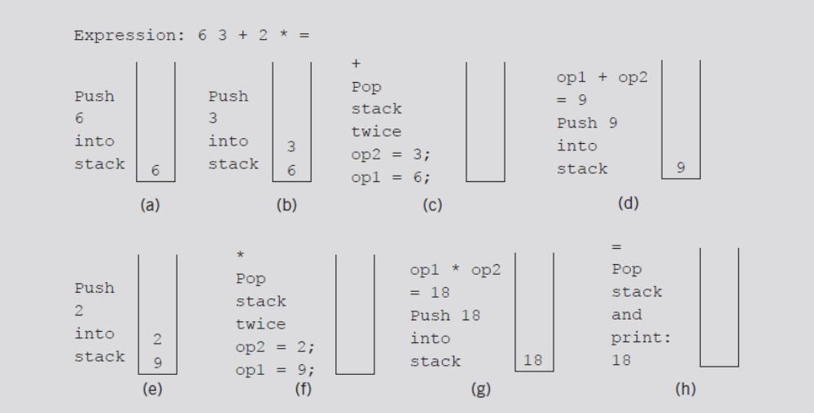
Application of Stacks: Postfix Expressions Calculator (cont’d.)
Postfix expression: 6 3 + 2 * =
FIGURE 7-15 Evaluating the postfix expression: 6 3 + 2 * =
Data Structures Using C++ 2E

Slide 46
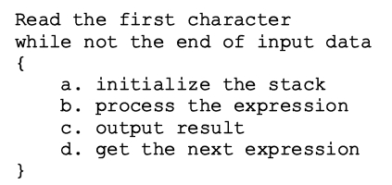
Application of Stacks: Postfix Expressions Calculator (cont’d.)
Main algorithm pseudocode
  Broken into four functions for simplicity
    Function evaluateExpression
    Function evaluateOpr
    Function discardExp
    Function printResult
Data Structures Using C++ 2E

Slide 47
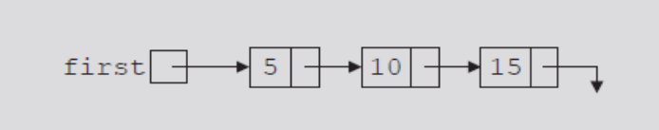
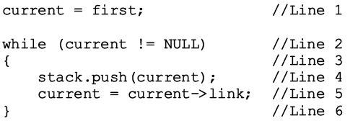
Removing Recursion: Nonrecursive Algorithm to Print a Linked List Backward
Stack
  Used to design nonrecursive algorithm
    Print a linked list backward
Use linked implementation of stack
FIGURE 7-16 Linked list
Data Structures Using C++ 2E

Slide 48
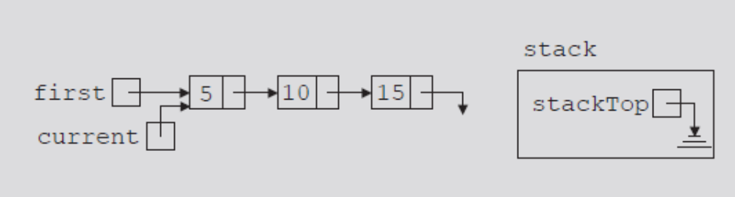
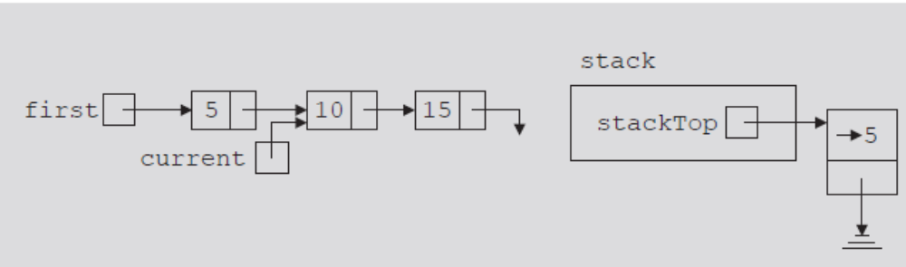
FIGURE 7-17 List after the statement
current = first; executes
FIGURE 7-18 List and stack after the statements stack.push(current); and current = current->link; execute
Data Structures Using C++ 2E

Slide 49
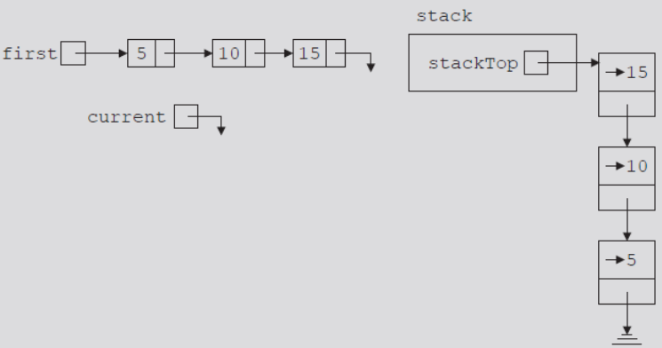
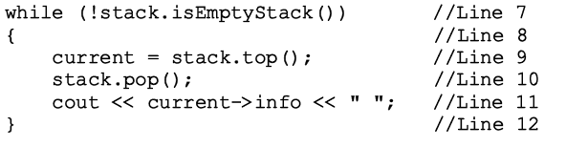
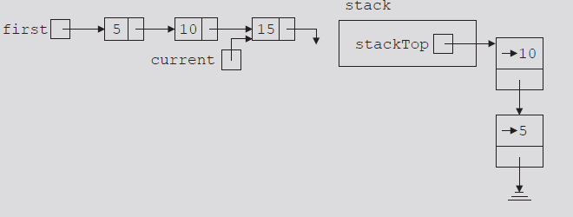
FIGURE 7-19 List and stack after the
while statement executes
FIGURE 7-20 List and stack after the statements current = stack.top(); and stack.pop(); execute
Data Structures Using C++ 2E

Slide 50
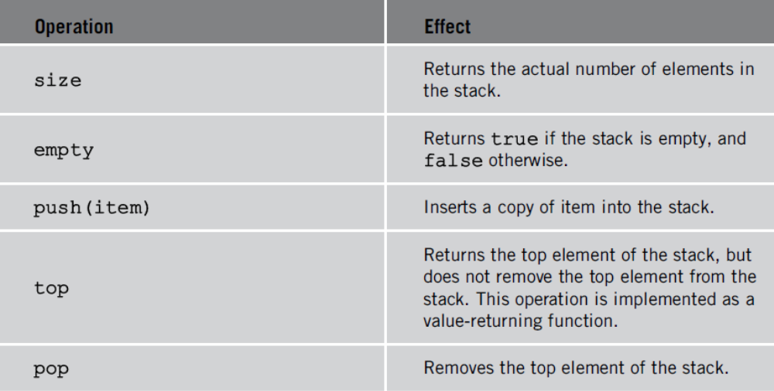
STL class stack
Standard Template Library (STL) library class defining a stack
Header file containing class stack definition
  stack
TABLE 7-3 Operations on a stack object
Data Structures Using C++ 2E

Slide 51
Summary
Stack
  Last In First Out (LIFO) data structure
  Implemented as array or linked list
  Arrays: limited number of elements
  Linked lists: allow dynamic element addition
Stack use in compliers
  Translate infix expressions into some form of postfix notation
  Translate postfix expression into machine code
Standard Template Library (STL)
  Provides a class to implement a stack in a program
Data Structures Using C++ 2E

