Slide 1

Data Structures Using C++ 2E
Chapter 11
Binary Trees and B-Trees

Slide 2
Objectives
Learn about binary trees
Explore various binary tree traversal algorithms
Learn how to organize data in a binary search tree
Discover how to insert and delete items in a binary search tree
Data Structures Using C++ 2E

Slide 3
Objectives (cont’d.)
Explore nonrecursive binary tree traversal algorithms
Learn about AVL (height-balanced) trees
Learn about B-trees
Data Structures Using C++ 2E

Slide 4
Binary Trees
Definition: a binary tree, T, is either empty or such that
  T has a special node called the root node
  T has two sets of nodes, L_{T} and R_{T}, called the left subtree and right subtree of T, respectively
  L_{T} and R_{T} are binary trees
Can be shown pictorially
  Parent, left child, right child
Node represented as a circle
  Circle labeled by the node
Data Structures Using C++ 2E

Slide 5
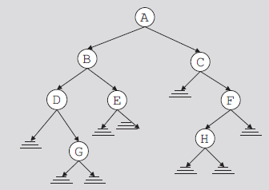
Binary Trees (cont’d.)
Root node drawn at the top
  Left child of the root node (if any)
    Drawn below and to the left of the root node
  Right child of the root node (if any)
    Drawn below and to the right of the root node
Directed edge (directed branch): arrow
FIGURE 11-1 Binary tree
Data Structures Using C++ 2E

Slide 6
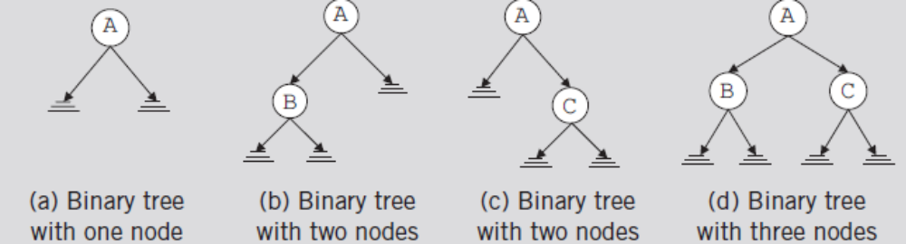
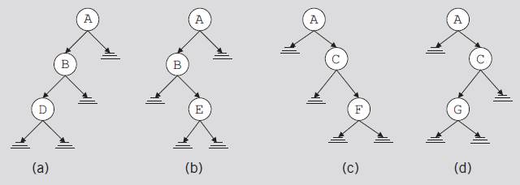
Binary Trees (cont’d.)
FIGURE 11-2 Binary tree with one, two, or three nodes
FIGURE 11-3 Various binary trees with three nodes
Data Structures Using C++ 2E

Slide 7
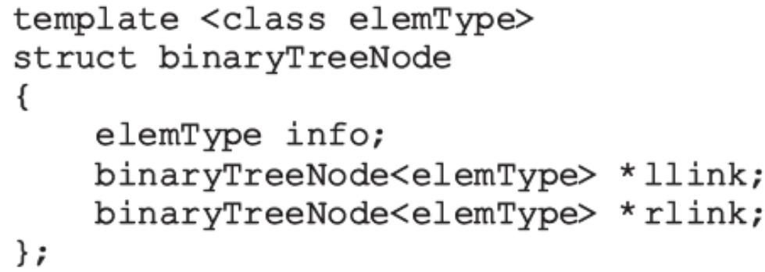
Binary Trees (cont’d.)
Every node in a binary tree
  Has at most two children
struct defining node of a binary tree
  For each node
    The data stored in info
    A pointer to the left child stored in llink
    A pointer to the right child stored in rlink
Data Structures Using C++ 2E

Slide 8
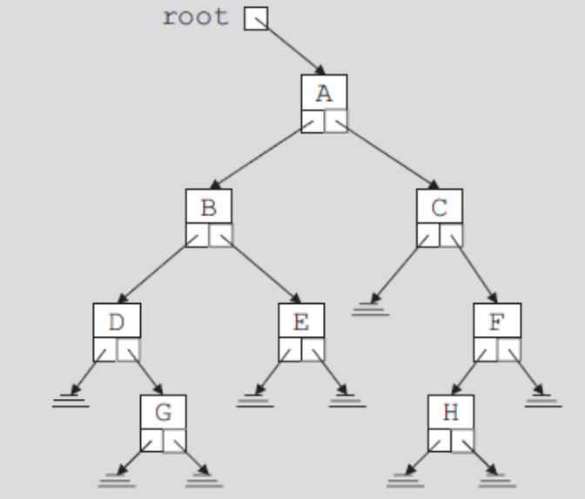
Binary Trees (cont’d.)
Pointer to root node is stored outside the binary tree
  In pointer variable called the root
    Of type binaryTreeNode
FIGURE 11-4 Binary tree
Data Structures Using C++ 2E

Slide 9
Binary Trees (cont’d.)
Level of a node
  Number of branches on the path
Height of a binary tree
  Number of nodes on the longest path from the root to a leaf
  See code on page 604
Data Structures Using C++ 2E

Slide 10
Copy Tree
Shallow copy of the data
  Obtained when value of the pointer of the root node used to make a copy of a binary tree
Identical copy of a binary tree
  Need to create as many nodes as there are in the binary tree to be copied
  Nodes must appear in the same order as in the original binary tree
Function copyTree
  Makes a copy of a given binary tree
  See code on pages 604-605
Data Structures Using C++ 2E

Slide 11
Binary Tree Traversal
Must start with the root, and then
  Visit the node first or
  Visit the subtrees first
Three different traversals
  Inorder
  Preorder
  Postorder
Data Structures Using C++ 2E

Slide 12
Binary Tree Traversal (cont’d.)
Inorder traversal
  Traverse the left subtree
  Visit the node
  Traverse the right subtree
Preorder traversal
  Visit the node
  Traverse the left subtree
  Traverse the right subtree
Data Structures Using C++ 2E

Slide 13
Binary Tree Traversal (cont’d.)
Postorder traversal
  Traverse the left subtree
  Traverse the right subtree
  Visit the node
Each traversal algorithm: recursive
Listing of nodes
  Inorder sequence
  Preorder sequence
  Postorder sequence
Data Structures Using C++ 2E

Slide 14
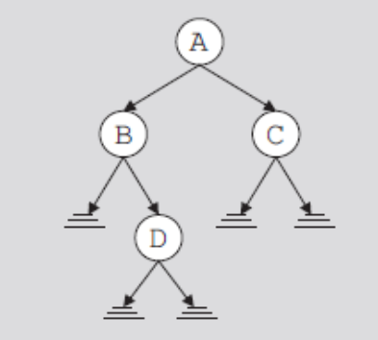
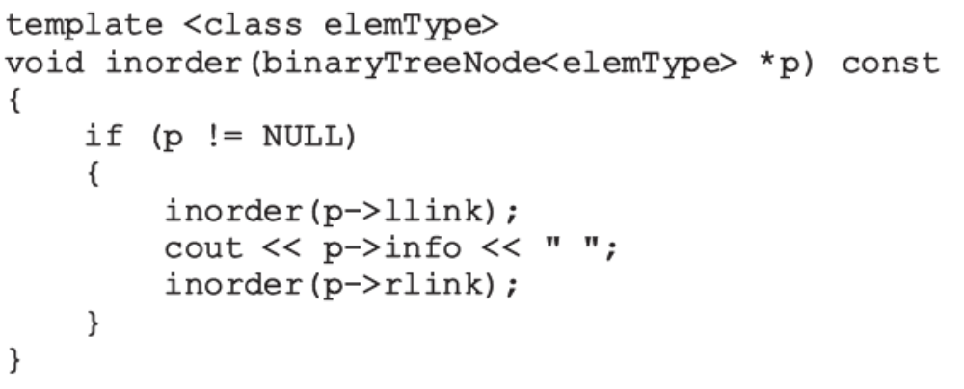
Binary Tree Traversal (cont’d.)
FIGURE 11-5 Binary tree
for an inorder traversal
Data Structures Using C++ 2E

Slide 15
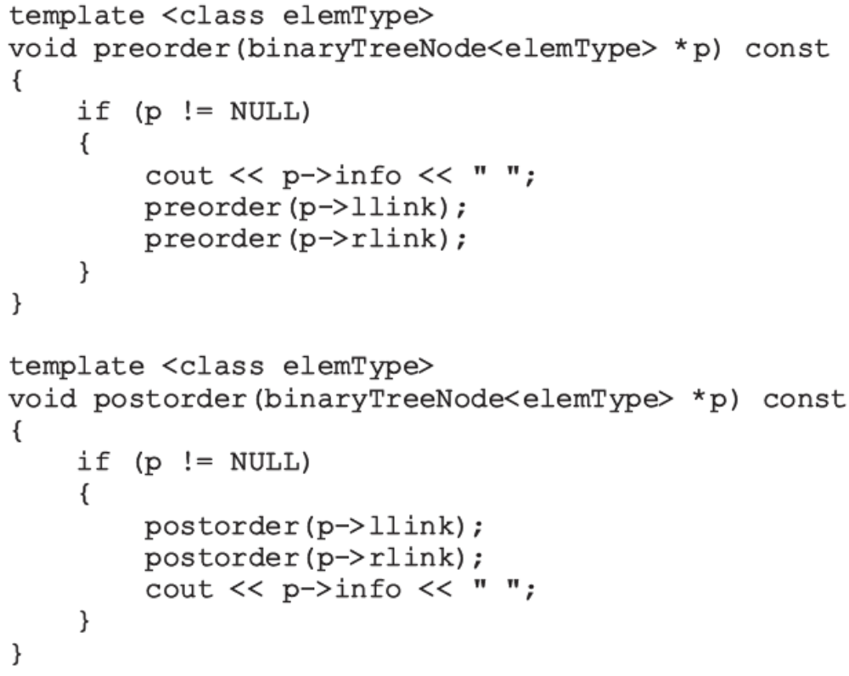
Binary Tree Traversal (cont’d.)
Functions to implement the preorder and postorder traversals
Data Structures Using C++ 2E

Slide 16
Implementing Binary Trees
Operations typically performed on a binary tree
  Determine if binary tree is empty
  Search binary tree for a particular item
  Insert an item in the binary tree
  Delete an item from the binary tree
  Find the height of the binary tree
  Find the number of nodes in the binary tree
  Find the number of leaves in the binary tree
  Traverse the binary tree
  Copy the binary tree
Data Structures Using C++ 2E

Slide 17
Implementing Binary Trees (cont’d.)
class binaryTreeType
  Specifies basic operations to implement a binary tree
  See code on page 609
    Contains statement to overload the assignment operator, copy constructor, destructor
    Contains several member functions that are private members of the class
Binary tree empty if root is NULL
  See isEmpty function on page 611
Data Structures Using C++ 2E

Slide 18
Implementing Binary Trees (cont’d.)
Default constructor
  Initializes binary tree to an empty state
  See code on page 612
Other functions for binary trees
  See code on pages 612-613
Functions: copyTree, destroy, destroyTree
  See code on page 614
Copy constructor, destructor, and overloaded assignment operator
  See code on page 615
Data Structures Using C++ 2E

Slide 19
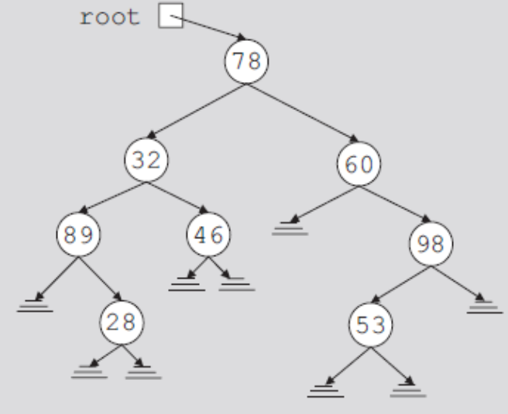
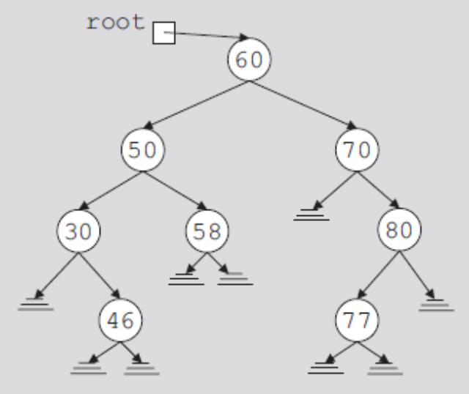
Binary Search Trees
Data in each node
  Larger than the data in its left child
  Smaller than the data in its right child
FIGURE 11-6 Arbitrary binary tree
FIGURE 11-7 Binary search tree
Data Structures Using C++ 2E

Slide 20
Binary Search Trees (cont’d.)
A binary search tree, T, is either empty or the following is true:
  T has a special node called the root node
  T has two sets of nodes, L_{T} and R_{T} , called the left subtree and right subtree of T, respectively
  The key in the root node is larger than every key in the left subtree and smaller than every key in the right subtree
  L_{T} and R_{T} are binary search trees
Data Structures Using C++ 2E

Slide 21
Binary Search Trees (cont’d.)
Operations performed on a binary search tree
  Search the binary search tree for a particular item
  Insert an item in the binary search tree
  Delete an item from the binary search tree
  Find the height of the binary search tree
  Find the number of nodes in the binary search tree
  Find the number of leaves in the binary search tree
  Traverse the binary search tree
  Copy the binary search tree
Data Structures Using C++ 2E

Slide 22
Binary Search Trees (cont’d.)
Every binary search tree is a binary tree
Height of a binary search tree
  Determined the same way as the height of a binary tree
Operations to find number of nodes, number of leaves, to do inorder, preorder, postorder traversals of a binary search tree
  Same as those for a binary tree
    Can inherit functions
Data Structures Using C++ 2E

Slide 23
Binary Search Trees (cont’d.)
class bSearchTreeType
  Illustrates basic operations to implement a binary search tree
  See code on page 618
Function search
Function insert
Function delete
Data Structures Using C++ 2E

Slide 24
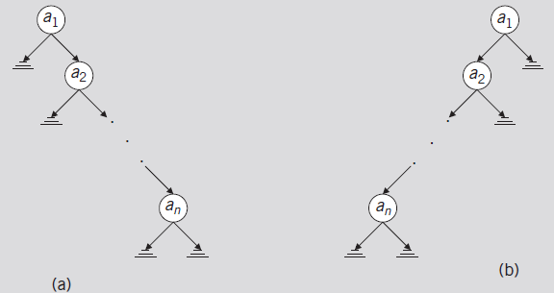
Binary Search Tree: Analysis
Worst case
  T: linear
  Successful case
    Algorithm makes (n + 1) / 2 key comparisons (average)
  Unsuccessful case: makes n comparisons
FIGURE 11-10 Linear binary trees
Data Structures Using C++ 2E

Slide 25
Binary Search Tree: Analysis (cont’d.)
Average-case behavior
  Successful case
    Search would end at a node
    n items exist, providing n! possible orderings of the keys
  Number of comparisons required to determine whether x is in T
    One more than the number of comparisons required to insert x in T
  Number of comparisons required to insert x in T
    Same as number of comparisons made in the unsuccessful search reflecting that x is not in T
Data Structures Using C++ 2E

Slide 26
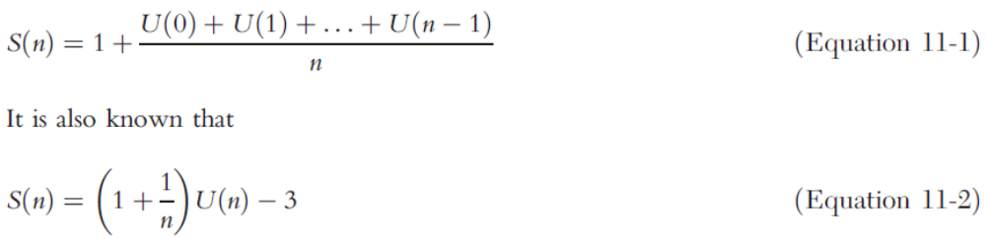
Binary Search Tree: Analysis (cont’d.)
Data Structures Using C++ 2E

Slide 27
Binary Search Tree: Analysis (cont’d.)
Theorem: let T be a binary search tree with n nodes, where n> 0
  The average number of nodes visited in a search of T is approximately 1.39log₂n =O(log₂n)
  The number of key comparisons is approximately 2.77 log₂n = O(log₂n)
Data Structures Using C++ 2E

Slide 28
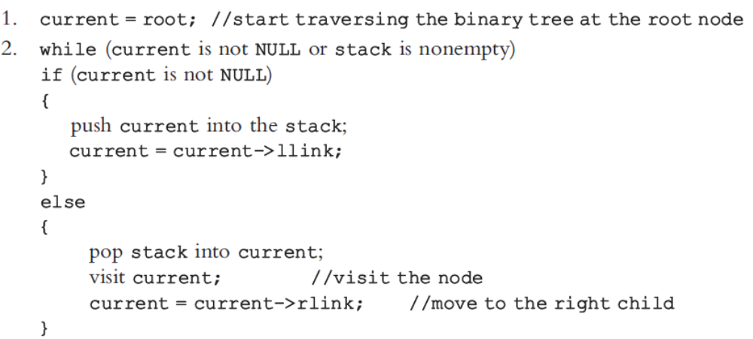
Nonrecursive Inorder Traversal
Data Structures Using C++ 2E

Slide 29
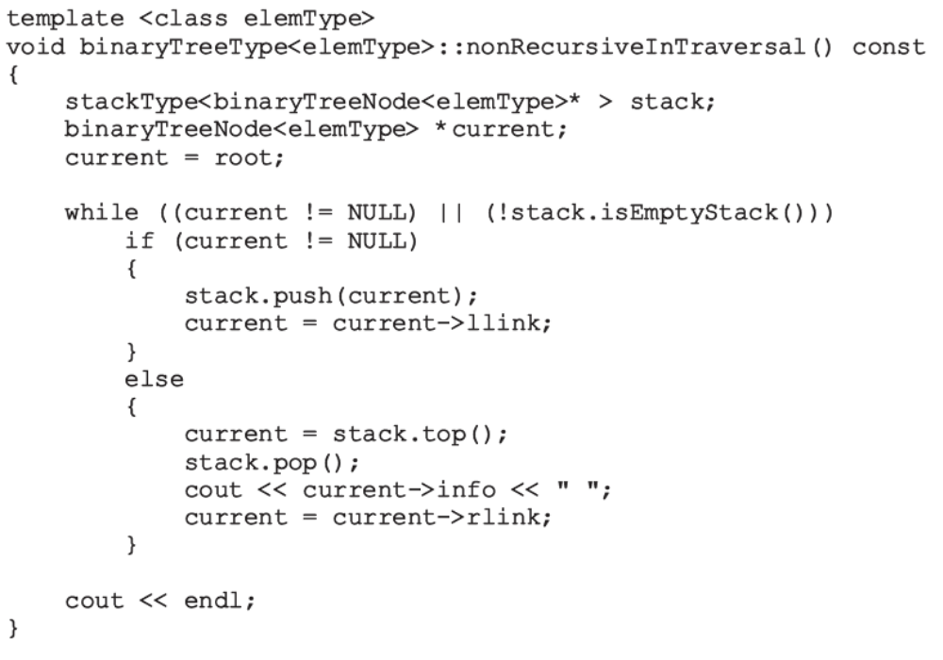
Nonrecursive Inorder Traversal (cont’d.)
Data Structures Using C++ 2E

Slide 30
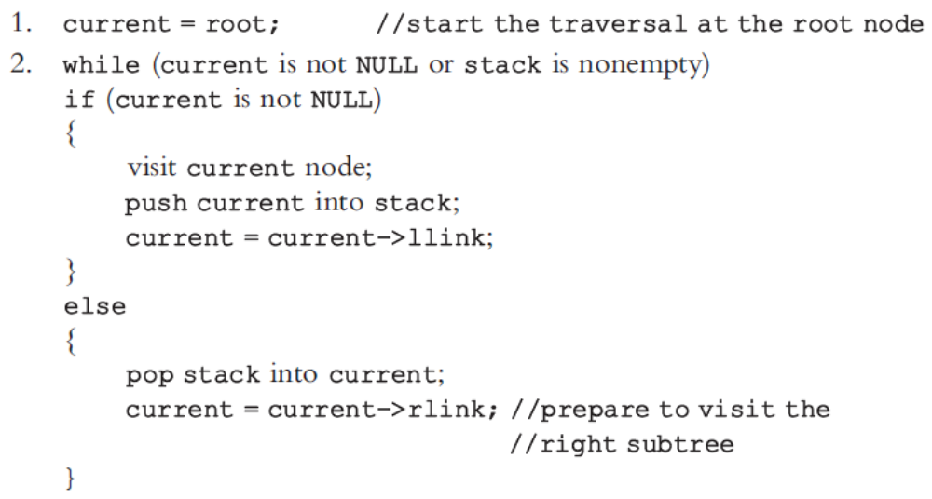
Nonrecursive Preorder Traversal
Data Structures Using C++ 2E

Slide 31
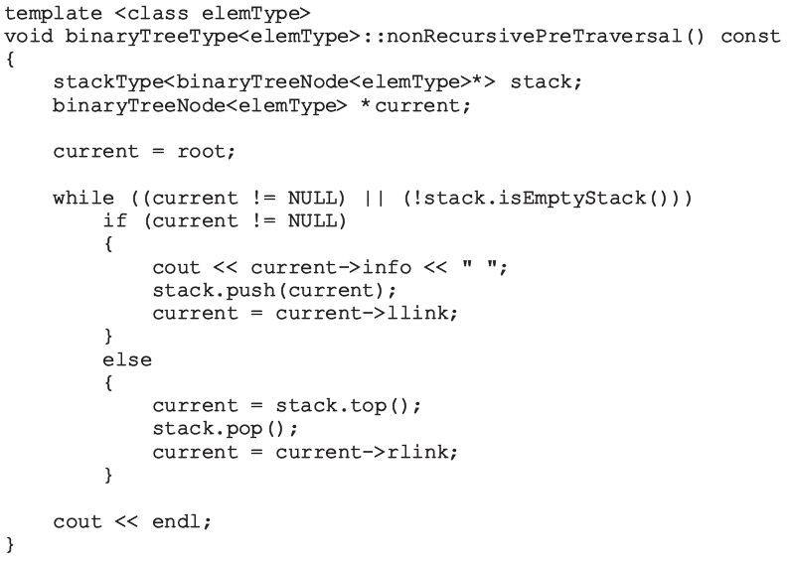
Nonrecursive Preorder Traversal (cont’d.)
Data Structures Using C++ 2E

Slide 32
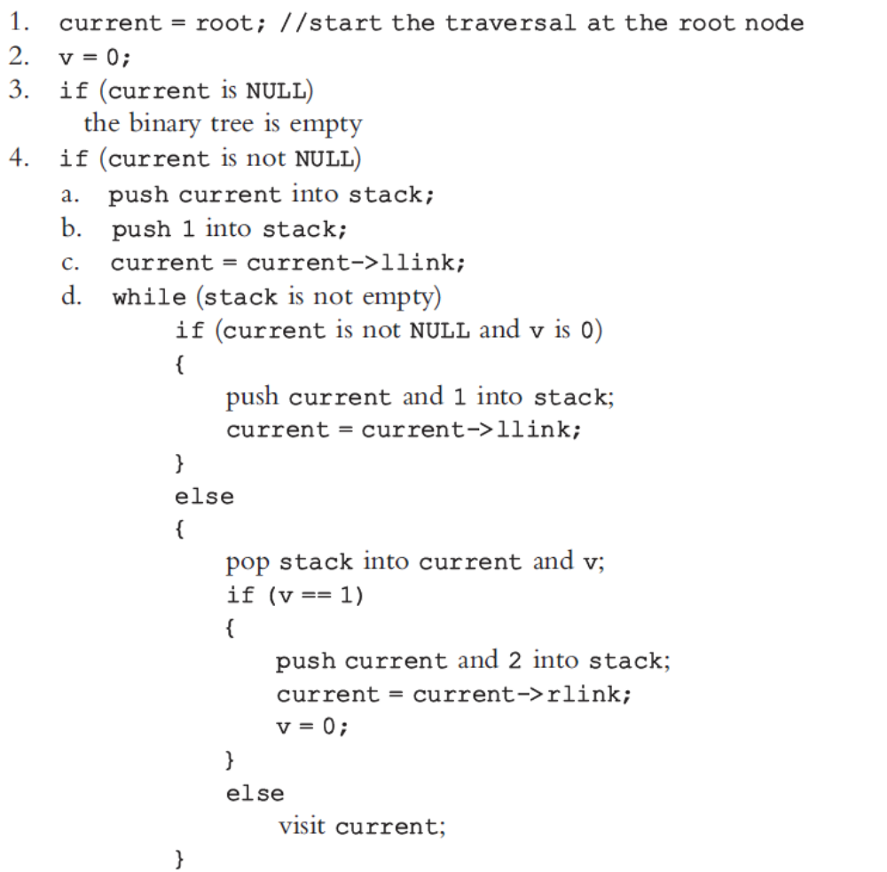
Nonrecursive Postorder Traversal
Data Structures Using C++ 2E

Slide 33
Binary Tree Traversal and Functions as Parameters
Passing a function as a parameter to the traversal algorithms
  Enhances program’s flexibility
C++ function name without any parentheses
  Considered a pointer to the function
Specifying a function as a formal parameter to another function
See Example 11-3
Data Structures Using C++ 2E

Slide 34
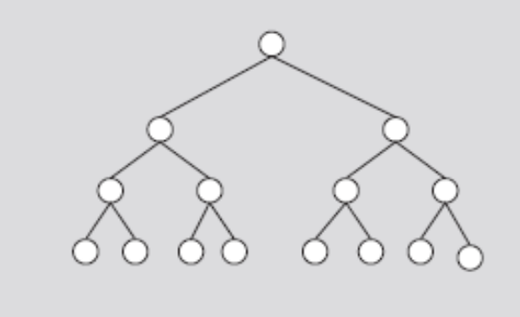
AVL (Height-Balanced) Trees
AVL tree (height-balanced tree)
  Resulting binary search is nearly balanced
Perfectly balanced binary tree
  Heights of left and right subtrees of the root: equal
  Left and right subtrees of the root are perfectly balanced binary trees
FIGURE 11-12 Perfectly balanced binary tree
Data Structures Using C++ 2E

Slide 35
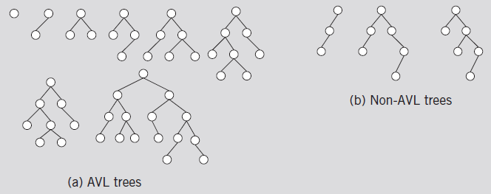
AVL (Height-Balanced) Trees (cont’d.)
An AVL tree (or height-balanced tree) is a binary search tree such that
  The heights of the left and right subtrees of the root differ by at most one
  The left and right subtrees of the root are AVL trees
FIGURE 11-13 AVL and non-AVL trees
Data Structures Using C++ 2E

Slide 36
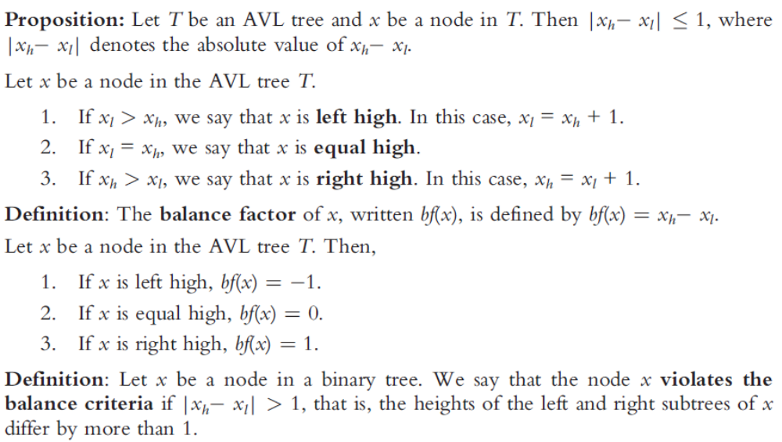
AVL (Height-Balanced) Trees (cont’d.)
Data Structures Using C++ 2E

Slide 37
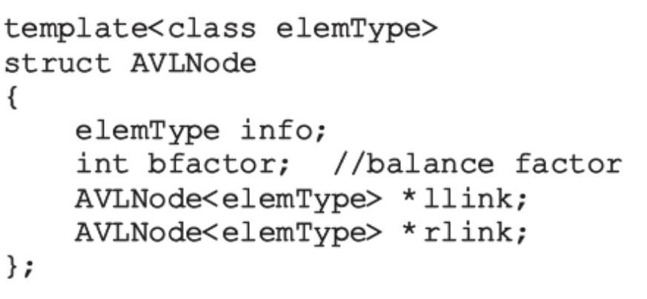
AVL (Height-Balanced) Trees (cont’d.)
Definition of a node in the AVL tree
Data Structures Using C++ 2E

Slide 38
AVL (Height-Balanced) Trees (cont’d.)
AVL binary search tree search algorithm
  Same as for a binary search tree
  Other operations on AVL trees
    Implemented exactly the same way as binary trees
  Item insertion and deletion operations on AVL trees
    Somewhat different from binary search trees operations
Data Structures Using C++ 2E

Slide 39
Insertion
First search the tree and find the place where the new item is to be inserted
  Can search using algorithm similar to search algorithm designed for binary search trees
  If the item is already in tree
    Search ends at a nonempty subtree
    Duplicates are not allowed
  If item is not in AVL tree
    Search ends at an empty subtree; insert the item there
After inserting new item in the tree
  Resulting tree might not be an AVL tree
Data Structures Using C++ 2E

Slide 40
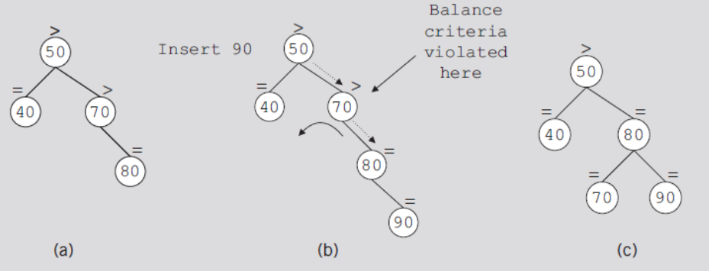
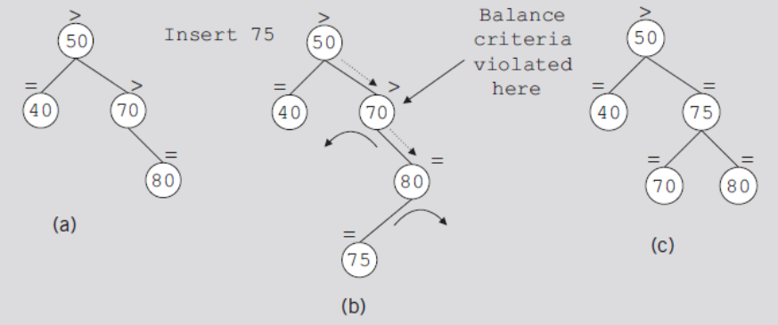
Insertion (cont’d.)
FIGURE 11-14 AVL tree before and after inserting 90
FIGURE 11-15 AVL tree before and after inserting 75
Data Structures Using C++ 2E

Slide 41
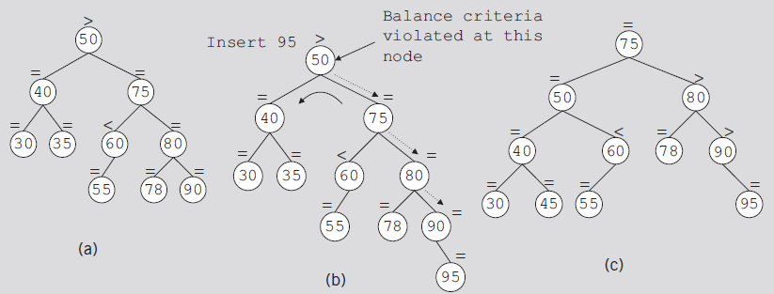
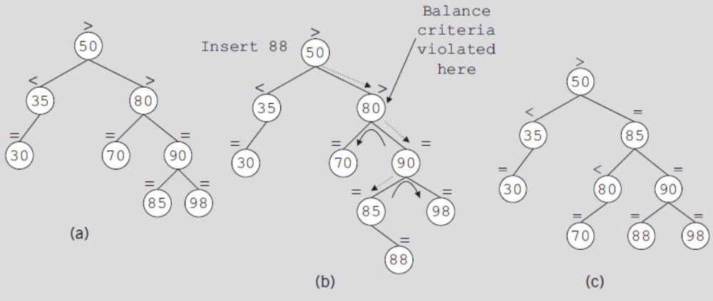
Insertion (cont’d.)
FIGURE 11-16 AVL tree before and after inserting 95
FIGURE 11-17 AVL tree before and after inserting 88
Data Structures Using C++ 2E

Slide 42
AVL Tree Rotations
Rotating tree: reconstruction procedure
Left rotation and right rotation
Suppose that the rotation occurs at node x
  Left rotation: certain nodes from the right subtree of x move to its left subtree; the root of the right subtree of x becomes the new root of the reconstructed subtree
  Right rotation at x: certain nodes from the left subtree of x move to its right subtree; the root of the left subtree of x becomes the new root of the reconstructed subtree
Data Structures Using C++ 2E

Slide 43
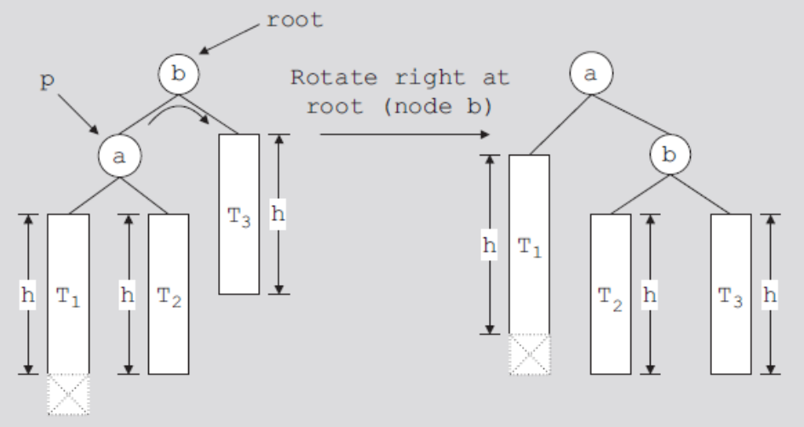
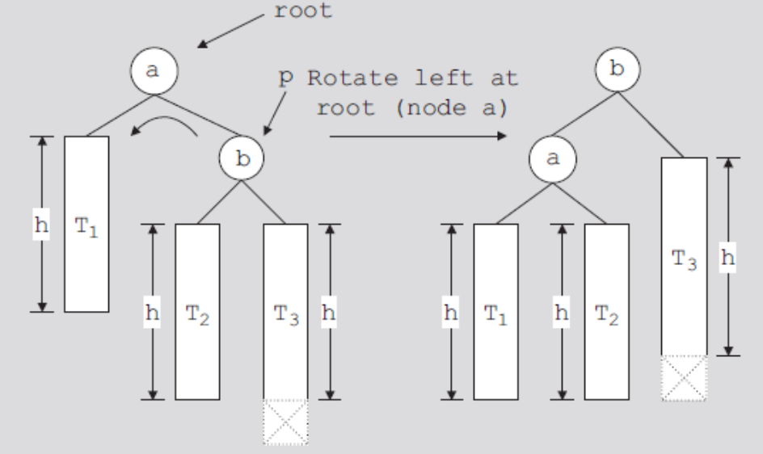
FIGURE 11-18 Right rotation at b
FIGURE 11-19 Left rotation at a
Data Structures Using C++ 2E

Slide 44
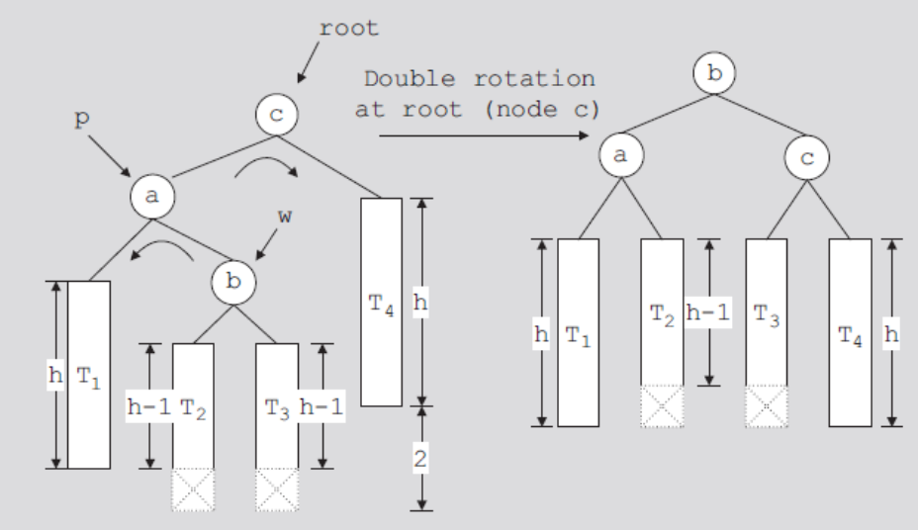
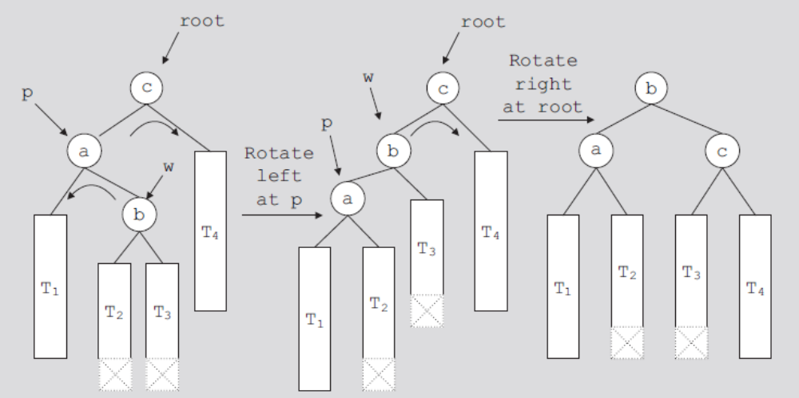
FIGURE 11-20 Double rotation: First rotate left at a and then right at c
FIGURE 11-21 Left rotation at a followed by a right rotation at c
Data Structures Using C++ 2E

Slide 45
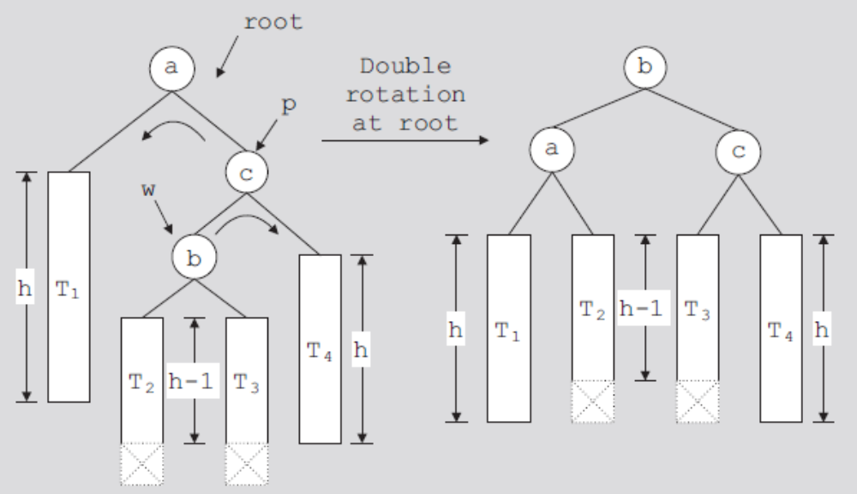
AVL Tree Rotations (cont’d.)
FIGURE 11-22 Double rotation: First rotate right at c,
then rotate left at a
Data Structures Using C++ 2E

Slide 46
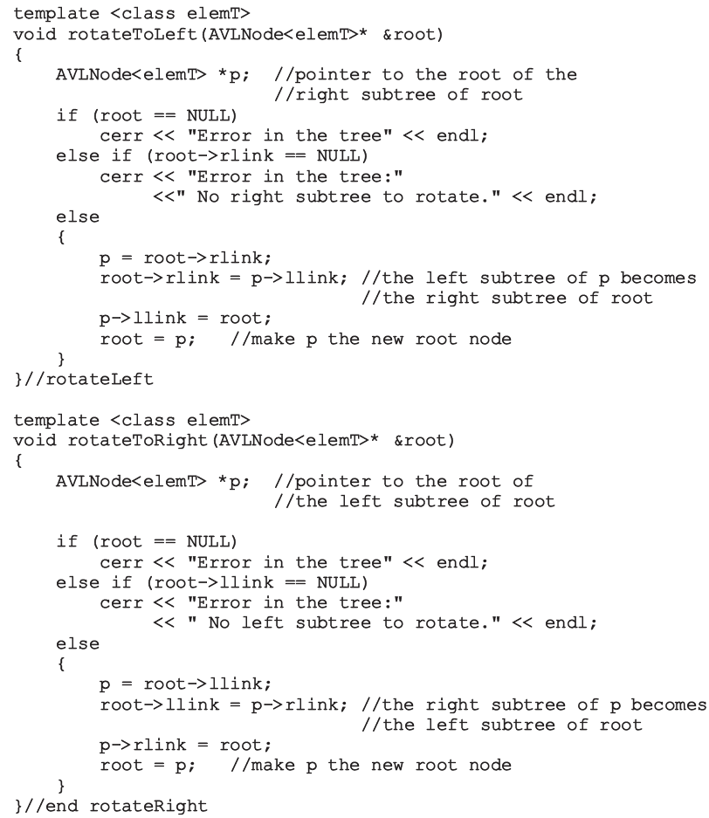
Data Structures Using C++ 2E

Slide 47
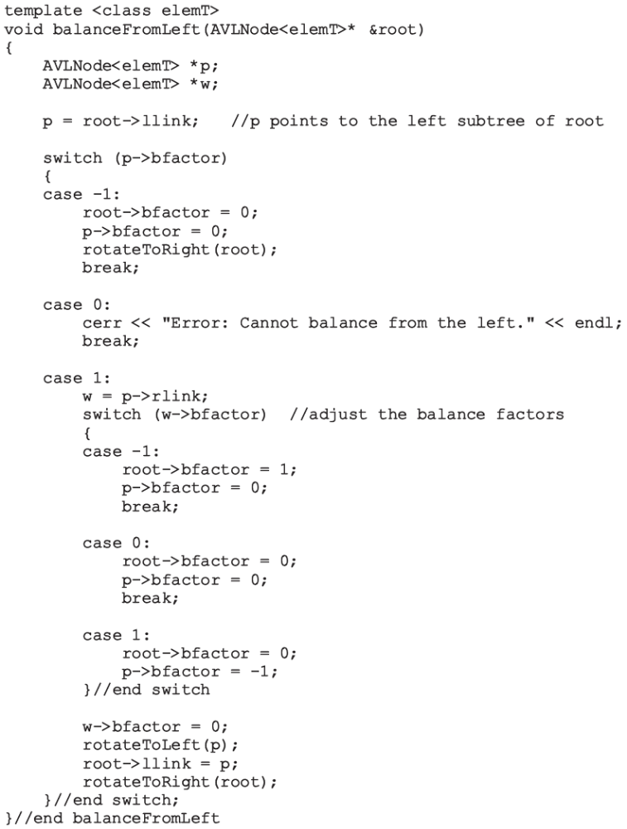
Data Structures Using C++ 2E

Slide 48
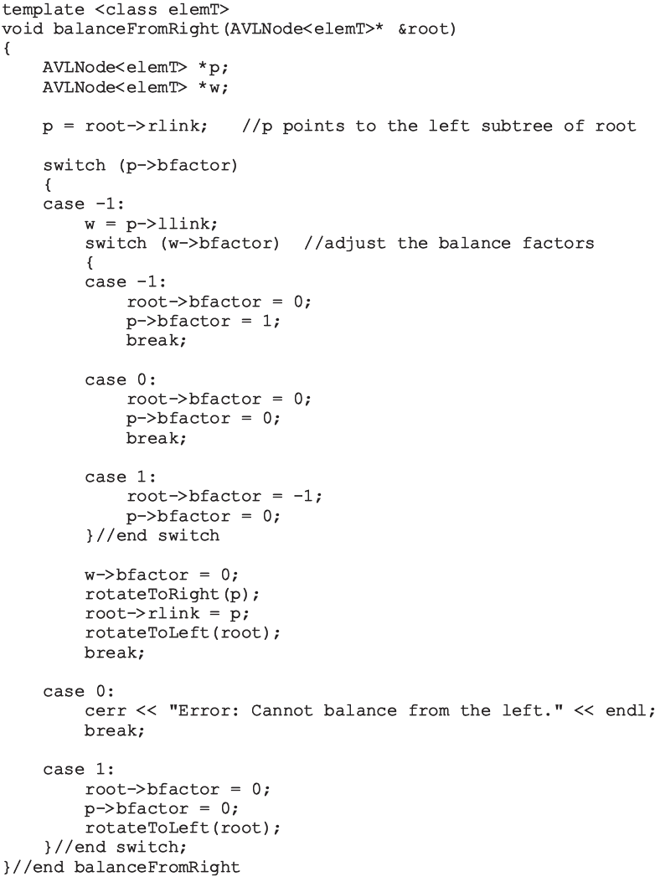
Data Structures Using C++ 2E

Slide 49
AVL Tree Rotations (cont’d.)
Steps describing the function insertIntoAVL
  Create node and copy item to be inserted into the newly created node
  Search the tree and find the place for the new node in the tree
  Insert new node in the tree
  Backtrack the path, which was constructed to find the place for the new node in the tree, to the root node
    If necessary, adjust balance factors of the nodes, or reconstruct the tree at a node on the path
Data Structures Using C++ 2E

Slide 50
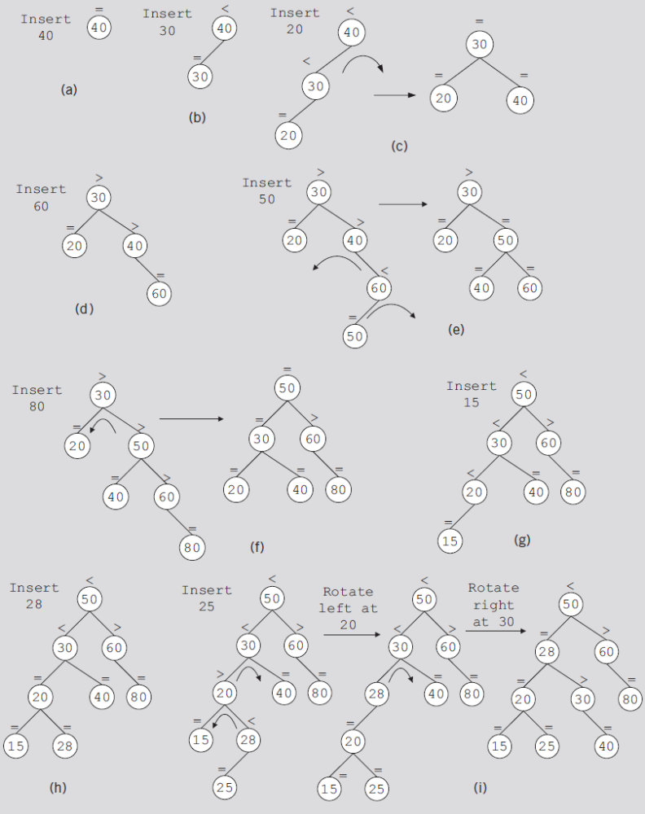
FIGURE 11-23 Item insertion into an initially empty AVL tree
Data Structures Using C++ 2E

Slide 51
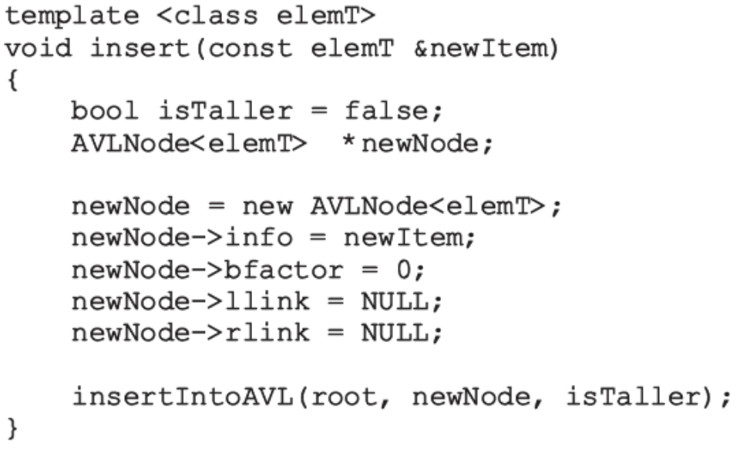
AVL Tree Rotations (cont’d.)
Function insert
  Creates a node, stores the info in the node, and calls the function insertIntoAVL to insert the new node in the AVL tree
Data Structures Using C++ 2E

Slide 52
Deletion from AVL Trees
Four cases
  Case 1: The node to be deleted is a leaf
  Case 2: The node to be deleted has no right child, that is, its right subtree is empty
  Case 3: The node to be deleted has no left child, that is, its left subtree is empty
  Case 4: The node to be deleted has a left child and a right child
Cases 1–3
  Easier to handle than Case 4
Data Structures Using C++ 2E

Slide 53

Analysis: AVL Trees
Consider all possible AVL trees of height h
  Let T_{h} be an AVL tree of height h such that T_{h} has the fewest number of nodes
  Let T_{hl} denote the left subtree of T_{h} and T_{hr} denote the right subtree of T_{h}
  Then:
    where |T_{h}| denotes the number of nodes in T_{h}
Data Structures Using C++ 2E

Slide 54

Analysis: AVL Trees (cont’d.)
Suppose:
  T_{hl} is of height h – 1 and T_{hr} is of height h – 2
    T_{hl} is an AVL tree of height h – 1 such that T_{hl} has the fewest number of nodes among all AVL trees of height h – 1
  T_{hr} is an AVL tree of height h – 2 that has the fewest number of nodes among all AVL trees of height h – 2
    T_{hl} is of the form T_{h} -1 and T_{hr} is of the form T_{h} -2
  Hence:
Data Structures Using C++ 2E

Slide 55
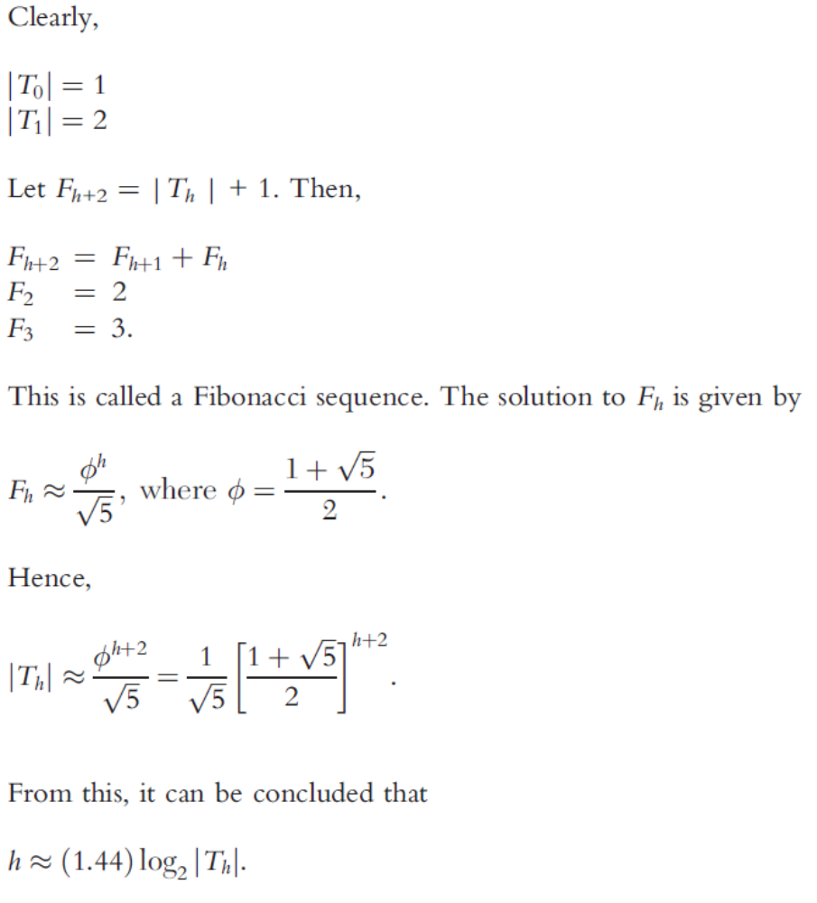
Data Structures Using C++ 2E

Slide 56
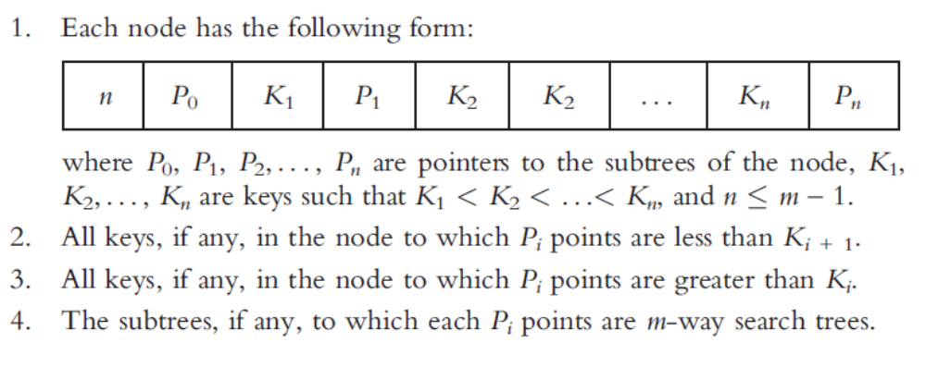
B-Trees
Leaves on the same level
  Not too far from the root
m-way search tree
  Tree in which each node has at most m children
    If the tree is nonempty, it has the following properties:
Data Structures Using C++ 2E

Slide 57
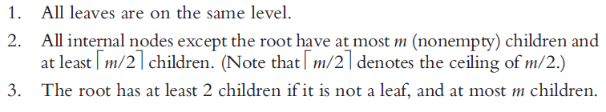
B-Trees (cont’d.)
B-tree of order m
  m-way search tree
  Either empty or has the following properties:
Basic operations
  Search the tree, insert an item, delete an item, traverse the tree
Data Structures Using C++ 2E

Slide 58
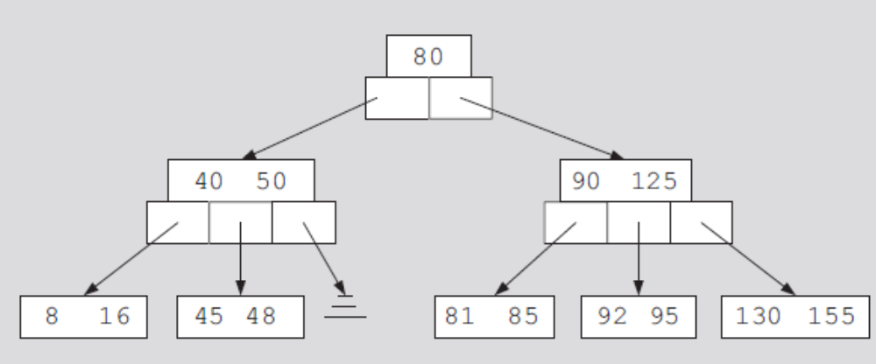
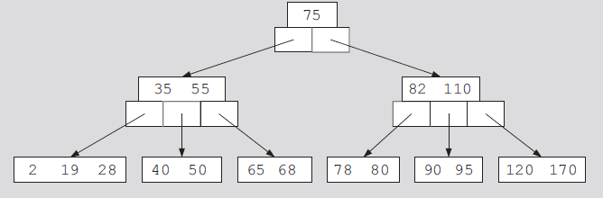
B-Trees (cont’d.)
FIGURE 11-24 A 5-way search tree
FIGURE 11-25 A B-tree of order 5
Data Structures Using C++ 2E

Slide 59
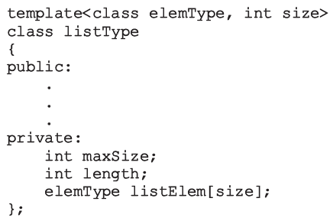
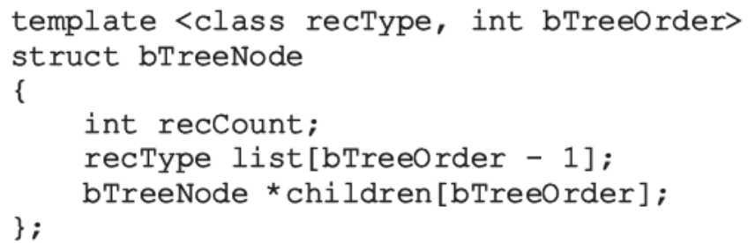
B-Trees (cont’d.)
Constant expressions
  May be passed as parameters to templates
Definition of a B-tree node
Class implementing B-tree properties
  See code on pages 664-665
    Implements B-tree basic properties as an ADT
Data Structures Using C++ 2E

Slide 60
Search
Searches binary search tree for a given item
  If item found in the binary search tree: returns true
  Otherwise: returns false
Search must start at root node
More than one item in a node (usually)
  Must search array containing the data
Two functions required
  Function search
  Function searchNode
    Searches a node sequentially
Data Structures Using C++ 2E

Slide 61
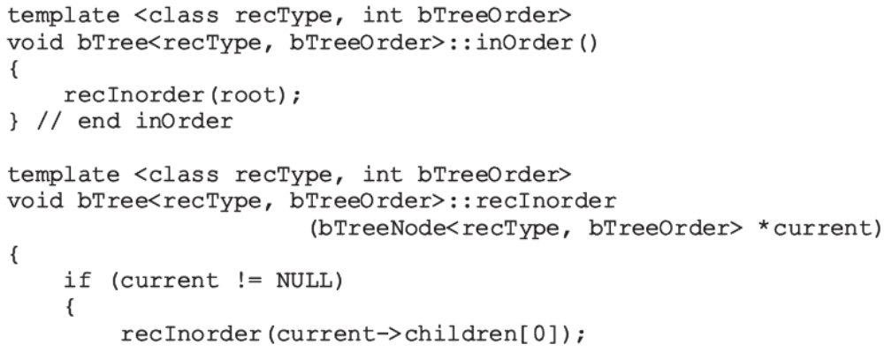
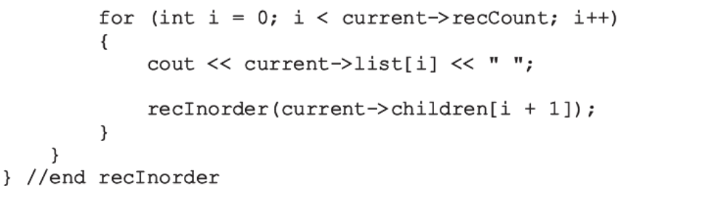
Traversing a B-Tree
B-tree traversal methods
  Inorder, preorder, postorder
Data Structures Using C++ 2E

Slide 62
Insertion into a B-Tree
Algorithm: search tree to see if key already exists
  If key already in the tree: output an error message
  If key not in the tree: search terminates at a leaf
  Record inserted into the leaf: if room exists
    If leaf full: split node into two nodes
    Median key moved to parent node (median determined by considering all keys in the node and new key)
  Splitting can propagate upward (even to the root)
    Causing tree to increase in height
Data Structures Using C++ 2E

Slide 63
Insertion into a B-Tree (cont’d.)
Function insertBTree
  Recursively inserts an item into a B-tree
Function insert uses function insertBTree
Function insertNode
  Inserts item in the node
Function splitNode
  Splits node into two nodes
  Inserts new item in the relevant node
  Returns median key and pointer to second half of the node
Data Structures Using C++ 2E

Slide 64
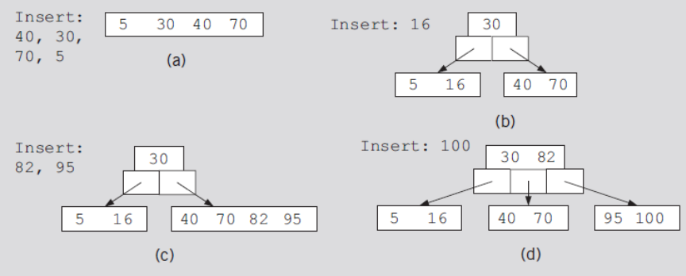
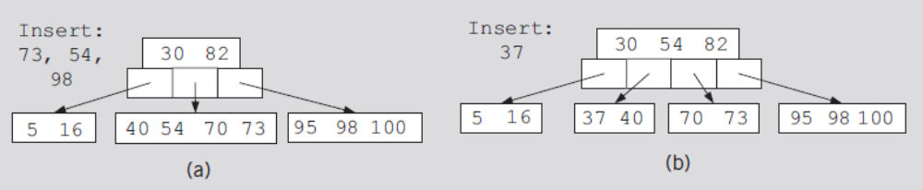
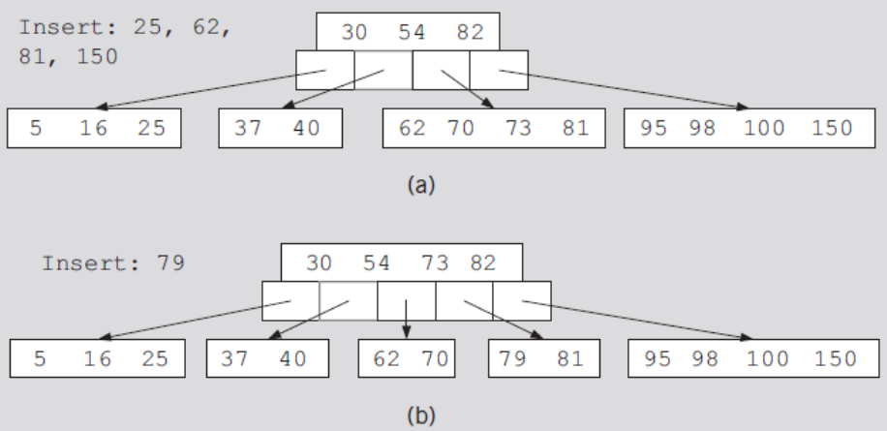
FIGURE 11-26 Item insertion into a B-tree of order 5
FIGURE 11-27 Insertion of 73, 54, 98, and 37
FIGURE 11-28 Insertion of 25, 62, 81, 150, and 79
Data Structures Using C++ 2E

Slide 65
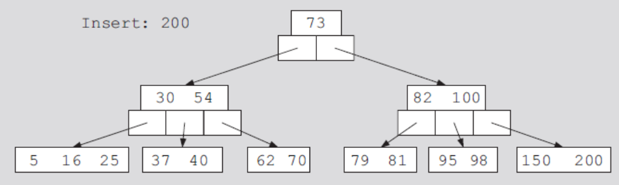
FIGURE 11-29 Insertion of 200
Data Structures Using C++ 2E

Slide 66
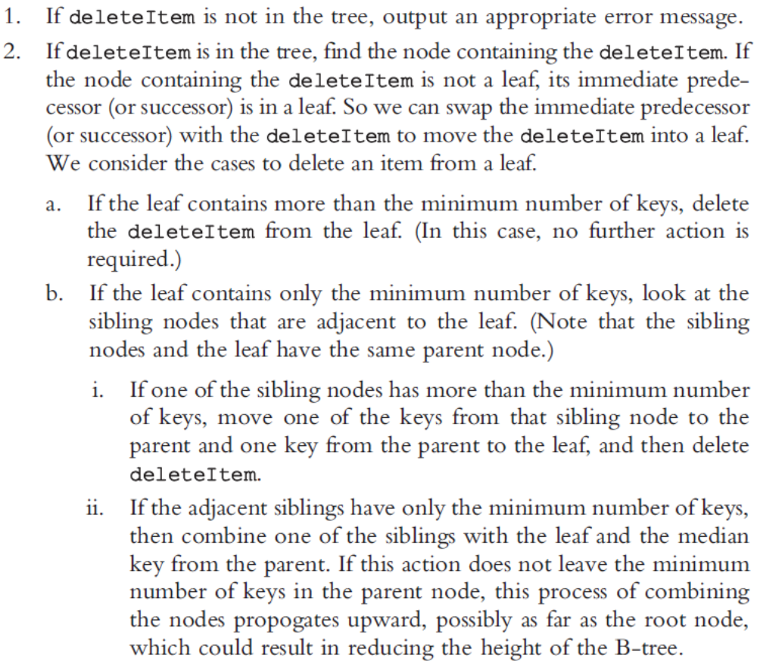
Deletion from a B-Tree
Case to consider
Data Structures Using C++ 2E

Slide 67
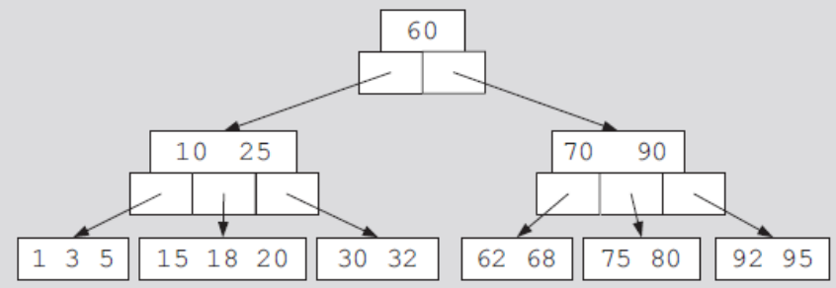


FIGURE 11-30 A B-tree of order 5
FIGURE 11-31 Deleting 18 from
a B-tree of order 5
FIGURE 11-32 B-tree before and after deleting 30
Data Structures Using C++ 2E

Slide 68

FIGURE 11-33 Deletion of 70 from the B-tree
Data Structures Using C++ 2E

Slide 69
Summary
This chapter discussed
  Binary trees
  Binary search trees
  Recursive traversal algorithms
  Nonrecursive traversal algorithms
  AVL trees
  B-trees
Data Structures Using C++ 2E

