Slide 1


Data Structures Using C++ 2E
Chapter 10
Heap Sort-Priority Queues

Slide 2
Objectives
Learn the various sorting algorithms
Explore how to implement selection sort, insertion sort, Shellsort, quicksort, mergesort, and heapsort
Discover how the sorting algorithms discussed in this chapter perform
Learn how priority queues are implemented
Data Structures Using C++ 2E

Slide 3
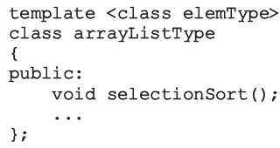
Sorting Algorithms
Several types in the literature
  Discussion includes most common algorithms
Analysis
  Provides a comparison of algorithm performance
Functions implementing sorting algorithms
  Included as public members of related class
Data Structures Using C++ 2E

Slide 4
Heapsort: Array-Based Lists
Overcomes quicksort worst case
Heap: list in which each element contains a key
  Key in the element at position k in the list
    At least as large as the key in the element at position 2k + 1 (if it exists) and 2k + 2 (if it exists)
C++ array index starts at zero
  Element at position k
    k + 1th element of the list
FIGURE 10-41 A heap
Data Structures Using C++ 2E

Slide 5
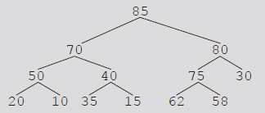
Heapsort: Array-Based Lists (cont’d.)
Data given in Figure 10-41
  Can be viewed in a complete binary tree
Heapsort
  First step: convert list into a heap
    Called buildHeap
  After converting the array into a heap
    Sorting phase begins
FIGURE 10-42 Complete binary tree
corresponding to the list in Figure 10-41
Data Structures Using C++ 2E

Slide 6
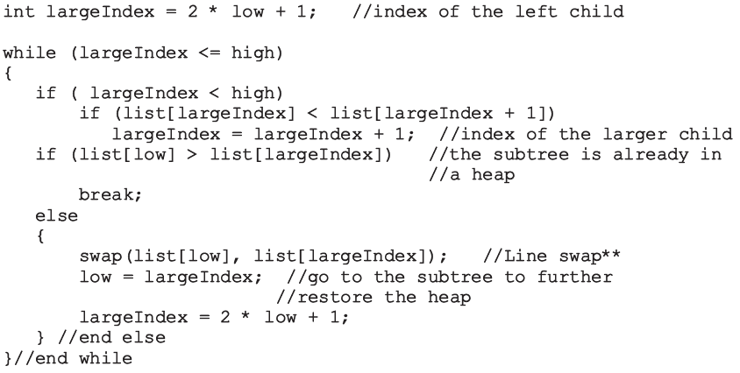
Build Heap
Data Structures Using C++ 2E

Slide 7
Build Heap (cont’d.)
Function heapify
  Restores the heap in a subtree
  Implements the buildHeap function
    Converts list into a heap
Data Structures Using C++ 2E

Slide 8
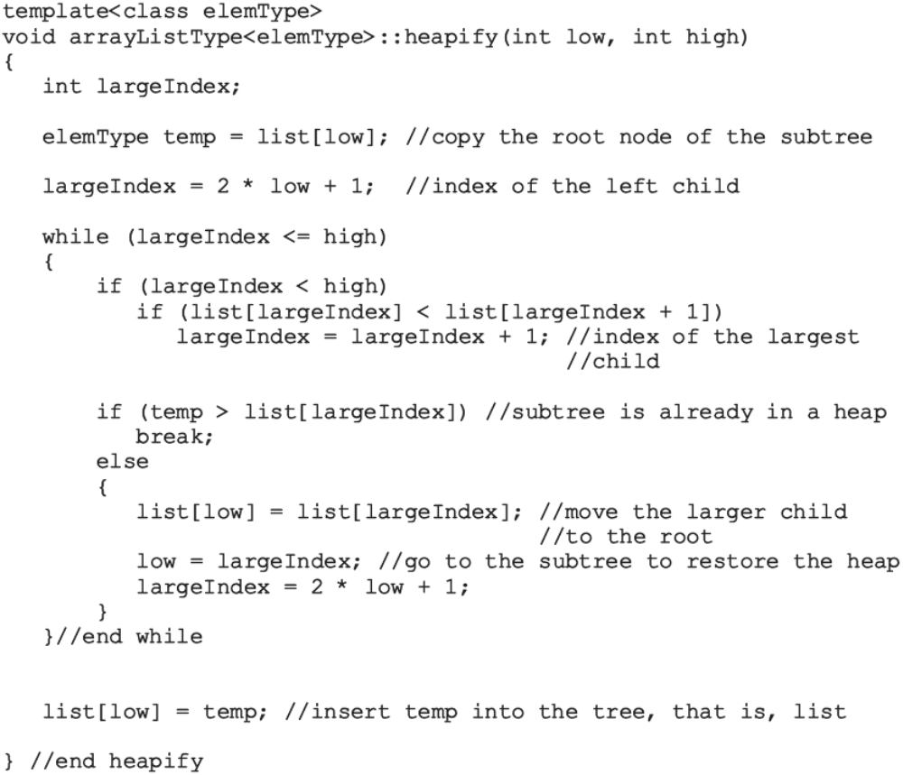
Data Structures Using C++ 2E

Slide 9
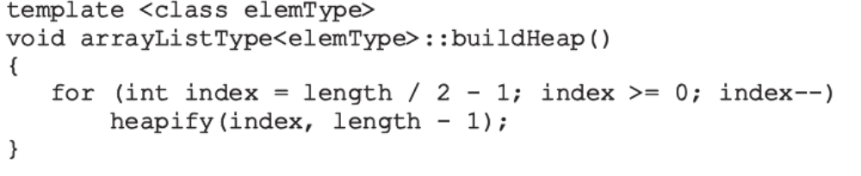
Build Heap (cont’d.)
Data Structures Using C++ 2E

Slide 10
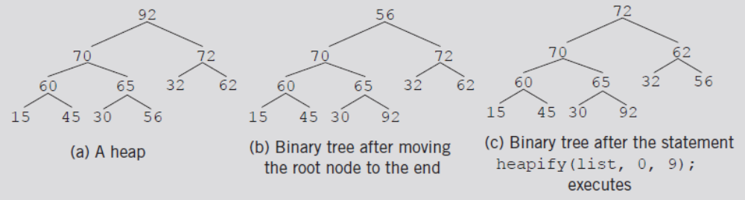
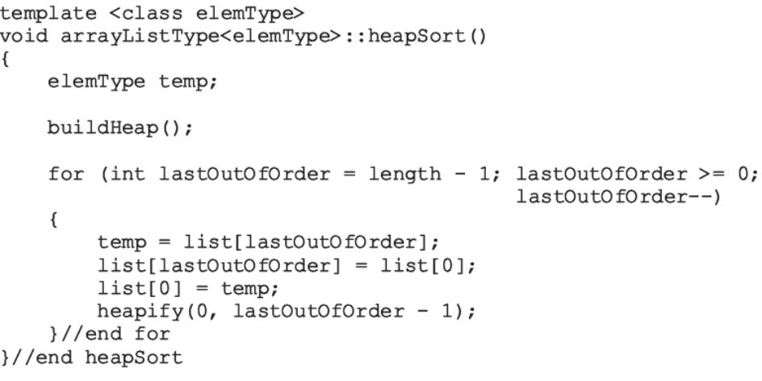
Build Heap (cont’d.)
The heapsort algorithm
FIGURE 10-48 Heapsort
Data Structures Using C++ 2E

Slide 11
Analysis: Heapsort
Given L a list of n elements where n > 0
Worst case
  Number of key comparisons to sort L
    2nlog₂n + O(n)
  Number of item assignments to sort L
    nlog₂n + O(n)
Average number of comparisons to sort L
  O(nlog₂n)
Heapsort takes twice as long as quicksort
  Avoids the slight possibility of poor performance
Data Structures Using C++ 2E

Slide 12
Summary
Search algorithms may require sorted data
Several sorting algorithms available
  Selection sort, insertion sort, Shellsort, quicksort, mergesort, and heapsort
    Can be applied to either array-based lists or linked lists
Compare algorithm performance through analysis
  Number of key comparisons
  Number of data movements
Functions implementing sorting algorithms
  Included as public members of the related class
Data Structures Using C++ 2E

