Slide 1
Chapter 22
Elementary Graph Algorithms

Slide 2
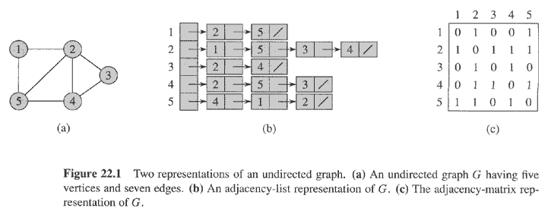
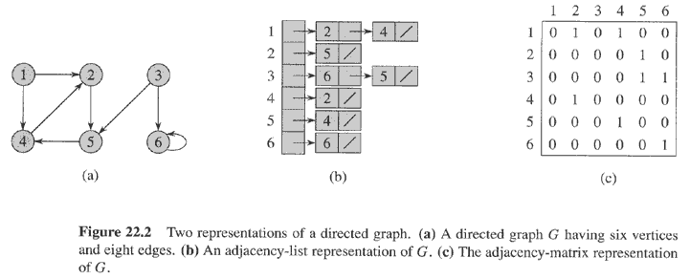
Introduction
G=(V, E)
  V = vertex set
  E = edge set
Graph representation
  Adjacency list
  Adjacency matrix
Graph search
  Breadth-first search (BFS)
  Depth-first search (DFS)
    Topological sort
    Strongly connected components
Undirected Graph
Directed Graph

Slide 3
Representation of Graphs
Adjacency list: Θ(V+E)
  Preferred for sparse graph
    |E| << |V|²
  Adj[u] contains all the vertices v such that there is an edge (u, v) ∈E
  Weighted graph: w(u, v) is stored with vertex v in Adj[u]
  No quick way to determine if a given edge is present in the graph
Adjacency matrix: Θ(V²)
  Preferred for dense graph
  Symmetry for undirected graph
  Weighted graph: store w(u, v) in the (u, v) entry
  Easy to determine if a given edge is present in the graph

Slide 4
Representation For A Undirected Graph

Slide 5
Representation For A Directed Graph
1 bit per entry

Slide 6
Breadth-First Search (BFS)
Graph search: given a source vertex s, explores the edges of G to discover every vertex that is reachable from s
  Compute the distance (smallest number of edges) from s to each reachable vertex
  Produce a breadth-first tree with root s that contains all reachable vertices
  Compute the shortest path from s to each reachable vertex
BFS discovers all vertices at distance k from s before discovering any vertices at distance k+1

Slide 7
Data Structure for BFS
Adjacency list
color[u] for each vertex
  WHITE if u has not been discovered
  BLACK if u and all its adjacent vertices have been discovered
  GRAY if u has been discovered, but has some adjacent white vertices
    Frontier between discovered and undiscovered vertices
d[u] for the distance from s to u
π[u] for predecessor of u
FIFO queue Q to manage the set of gray vertices
  Q stores all the gray vertices

Slide 8
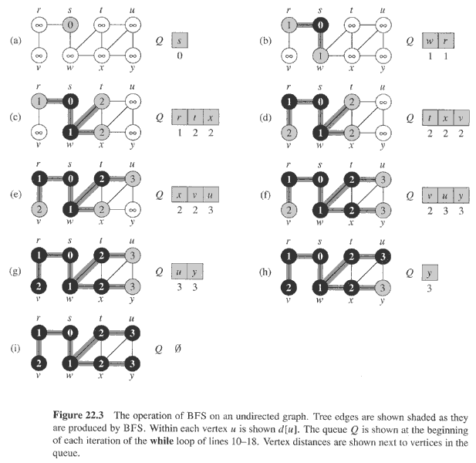

Slide 9
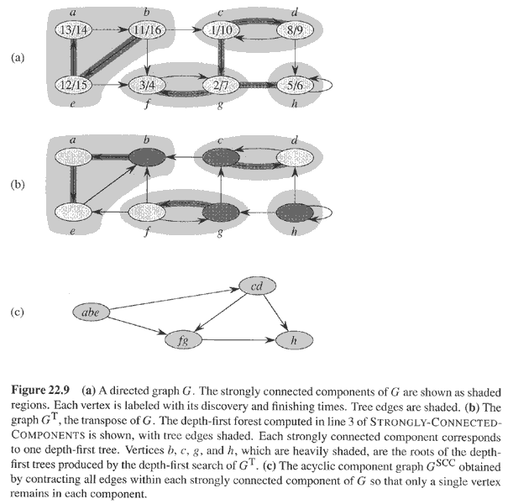
Another Example of DFS

Slide 10
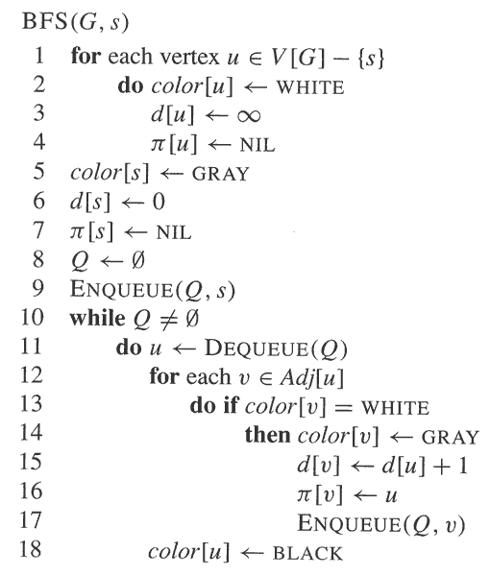
Initialization
Set up s and initialize Q
Explore all the vertices adjacent to
u and update d, π and Q

Slide 11
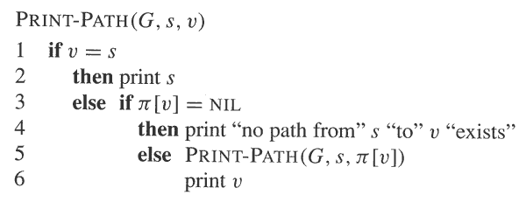
Analysis of BFS
O(V+E)
  Each vertex is en-queued (O(1)) at most once ➔ O(V)
  Each adjacency list is scanned at most once ➔ O(E)
Print out the vertices on a shortest path from s to v

Slide 12
PRINT-PATH Illustration
PRINT-PATH(G, s, y)
PRINT-PATH(G, s, x)
y
PRINT-PATH(G, s, w)
x
y
PRINT-PATH(G, s, s)
w
x
y
s
w
x
y

Slide 13
Depth-First Search (DFS)
DFS: search deeper in the graph whenever possible
  Edges are explored out of the most recently discovered vertex v that still has unexplored edges leaving it
  When all of v’s edges have been explored (finished), the search backtracks to explore edges leaving the vertex from which v was discovered
  This process continues until we have discovered all the vertices that are reachable from the original source vertex
  If any undiscovered vertices remain, then one of them is selected as a new source and the search is repeated from that source
  The entire process is repeated until all vertices are discovered
DFS will create a forest of DFS-trees

Slide 14
Data Structure for DFS
Adjacency list
color[u] for each vertex
  WHITE if u has not been discovered
  GRAY if u is discovered but not finished
  BLACK if u is finished
Timestamps: 1 ≤ d[u] < f[u] ≤ 2|V|
  d[u] records when u is first discovered (and grayed)
  f[u] records when the search finishes examining u’s adjacency list (and blacken u)
π[u] for predecessor of u

Slide 15
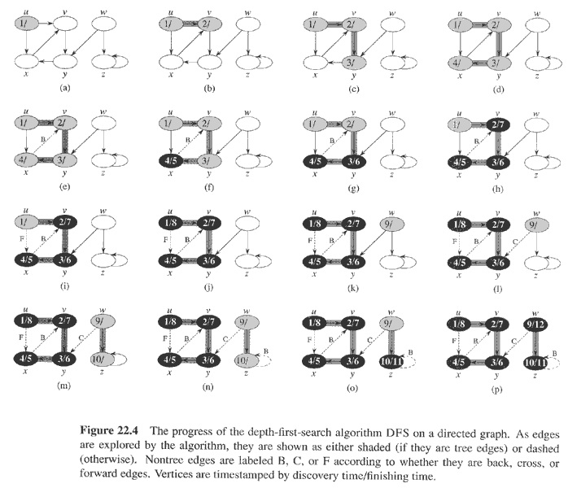

Slide 16
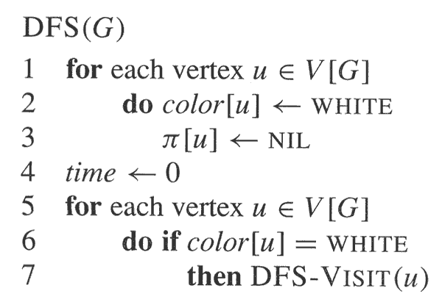
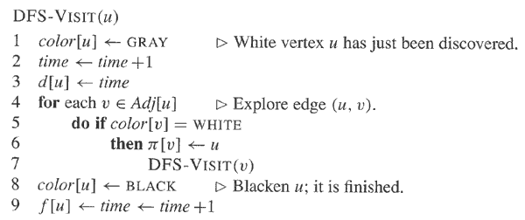

Slide 17
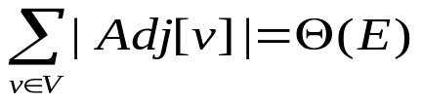
Properties of DFS
Time complexity: Θ(V+E)
  Loops on lines 1-3 and 5-7 of DFS: Θ(V)
  DFS-VISIT
    Called exactly once for each vertex
    Loops on lines 4-7 for a vertex v: |Adj[v]|
    Total time =
DFS results in a forest of trees
Discovery and finishing times have parenthesis structure
  Theorem 22.7

Slide 18
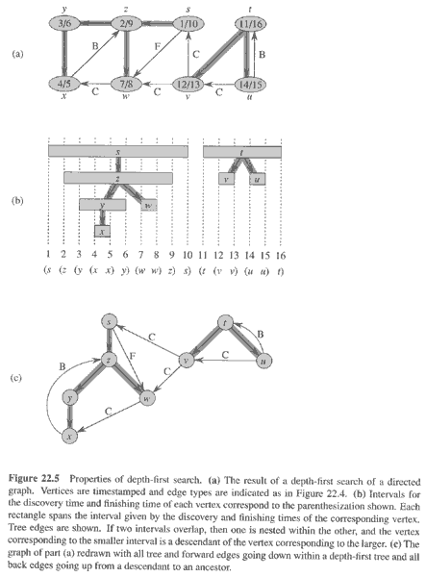

Slide 19
Classification of Edges
Tree edges are edges in the DFS forest. Edge (u, v) is a tree edge if it was first discovered by exploring edge (u, v).
  v is WHITE
Back edges are those edges (u, v) connecting a vertex u to an ancestor v in a DFS tree. Self-loops, which may occur in directed graphs, are considered to be back edges.
  v is GRAY
Forward edges are those non-tree edges (u, v) containing a vertex u to a descendant v in a DFS tree
  v is BLACK and d[u] < d[v]
Cross edges are all other edges. They can go between vertices in the same tree, as long as one vertex is not an ancestor of the other, or they can go between vertices in different DFS trees.
  v is BLACK and d[u] > d[v]
In a depth-first search of an undirected graph G, every edge of G is either a tree edge or a back edge. (Theorem 22.10)

Slide 20
Topological Sort
A topological sort of a directed acyclic graph (DAG) is a linear order of all its vertices such that if G contains an edge (u, v), then u appears before v in the ordering
  If the graph is not acyclic, then no linear ordering is possible.
  A topological sort can be viewed as an ordering of its vertices along a horizontal line so that all directed edges go from left to right
DAG are used in many applications to indicate precedence among events

Slide 21
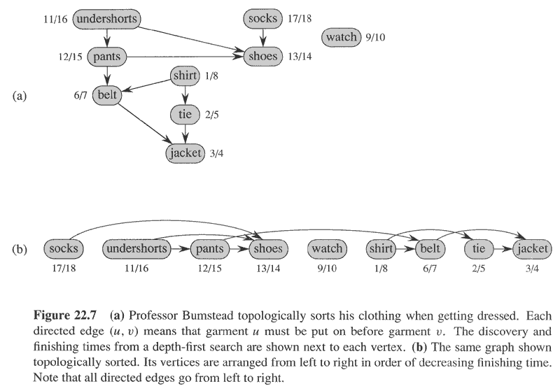

Slide 22
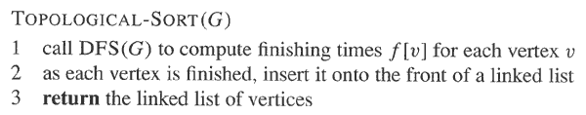
Topological Sort
Θ(V+E)

Slide 23
Lemma 22.11
DAG is acyclic if and only if DFS of G yields no back edges
  ➔Suppose that there is a back edge (u, v). Then vertex v is an ancestor of vertex u in the depth-first forest. There is thus a path from v to u in G, and the back edge (u, v) completes a cycle
  ⬅Suppose that G contains a cycle c. We show that a DFS of G yields a back edge. Let v be the first vertex to be discovered in c, and let (u, v) be the preceding edge in c. At time d[v], the vertices of c form a path of white vertices from v to u. By the white-path theorem (Theorem 22.9), vertex u becomes a descendant of v in the depth-first forest. Therefore, (u, v) is a back edge.

Slide 24
Theorem 22.12
TOPOLOGICAL-SORT(G) produces a topological sort of a directed acyclic graph G
  Suppose that DFS is run on a given DAG G to determine finishing times for its vertices. It suffices to show that for any pair of distinct vertices u, v, if there is an edge in G from u to v, then f[v] < f[u].
    The linear ordering is corresponding to finishing time ordering
  Consider any edge (u, v) explored by DFS(G). When this edge is explored, v cannot be gray (otherwise, (u, v) will be a back edge). Therefore v must be either white or black
    If v is white, v becomes a descendant of u, f[v] < [u] (ex. pants & shoes)
    If v is black, it has already been finished, so that f[v] has already been set ➔ f[v] < f[u] (ex. belt & jacket)

