Slide 1
CSE 326: Data Structures
Graph Algorithms
Graph Search
Lecture 23

Slide 2
Problem: Large Graphs
It is expensive to find optimal paths in large graphs, using BFS or Dijkstra’s algorithm (for weighted graphs)
How can we search large graphs efficiently by using “commonsense” about which direction looks most promising?

Slide 3
Example
53nd St
52nd St
G
51st St
S
50th St
10th Ave
9th Ave
8th Ave
7th Ave
6th Ave
5th Ave
4th Ave
3rd Ave
2nd Ave
Plan a route from 9th & 50th to 3rd & 51st

Slide 4
Example
53nd St
52nd St
G
51st St
S
50th St
10th Ave
9th Ave
8th Ave
7th Ave
6th Ave
5th Ave
4th Ave
3rd Ave
2nd Ave
Plan a route from 9th & 50th to 3rd & 51st

Slide 5
Best-First Search
The Manhattan distance (Δ x+ Δ y) is an estimate of the distance to the goal
  It is a search heuristic
Best-First Search
  Order nodes in priority to minimize estimated distance to the goal
Compare: BFS / Dijkstra
  Order nodes in priority to minimize distance from the start

Slide 6
Best-First Search
Open – Heap (priority queue)
Criteria – Smallest key (highest priority)
h(n) – heuristic estimate of distance from n to closest goal
Best_First_Search( Start, Goal_test)
insert(Start, h(Start), heap);
repeat
if (empty(heap)) then return fail;
Node := deleteMin(heap);
if (Goal_test(Node)) then return Node;
for each Child of node do
if (Child not already visited) then
insert(Child, h(Child),heap);
end
Mark Node as visited;
end

Slide 7
Obstacles
Best-FS eventually will expand vertex to get back on the right track
S
52nd St
G
51st St
50th St
10th Ave
9th Ave
8th Ave
7th Ave
6th Ave
5th Ave
4th Ave
3rd Ave
2nd Ave

Slide 8
Non-Optimality of Best-First
Path found by Best-first
53nd St
52nd St
S
G
51st St
50th St
10th Ave
9th Ave
8th Ave
7th Ave
6th Ave
5th Ave
4th Ave
3rd Ave
2nd Ave
Shortest Path

Slide 9
Improving Best-First
Best-first is often tremendously faster than BFS/Dijkstra, but might stop with a non-optimal solution
How can it be modified to be (almost) as fast, but guaranteed to find optimal solutions?
A* - Hart, Nilsson, Raphael 1968
  One of the first significant algorithms developed in AI
  Widely used in many applications

Slide 10
A*
Exactly like Best-first search, but using a different criteria for the priority queue:
minimize (distance from start) +
(estimated distance to goal)
priority f(n) = g(n) + h(n)
  f(n) = priority of a node
  g(n) = true distance from start
  h(n) = heuristic distance to goal

Slide 11
Optimality of A*
Suppose the estimated distance is always less than or equal to the true distance to the goal
  heuristic is a lower bound
Then: when the goal is removed from the priority queue, we are guaranteed to have found a shortest path!

Slide 12
A* in Action
h=6+2
h=7+3
53nd St
52nd St
S
G
51st St
50th St
10th Ave
9th Ave
8th Ave
7th Ave
6th Ave
5th Ave
4th Ave
3rd Ave
2nd Ave
H=1+7

Slide 13
Application of A*: Speech Recognition
(Simplified) Problem:
  System hears a sequence of 3 words
  It is unsure about what it heard
    For each word, it has a set of possible “guesses”
    E.g.: Word 1 is one of { “hi”, “high”, “I” }
  What is the most likely sentence it heard?

Slide 14
Speech Recognition as Shortest Path
Convert to a shortest-path problem:
  Utterance is a “layered” DAG
  Begins with a special dummy “start” node
  Next: A layer of nodes for each word position, one node for each word choice
  Edges between every node in layer i to every node in layer i+1
    Cost of an edge is smaller if the pair of words frequently occur together in real speech
      Technically: - log probability of co-occurrence
  Finally: a dummy “end” node
  Find shortest path from start to end node

Slide 15
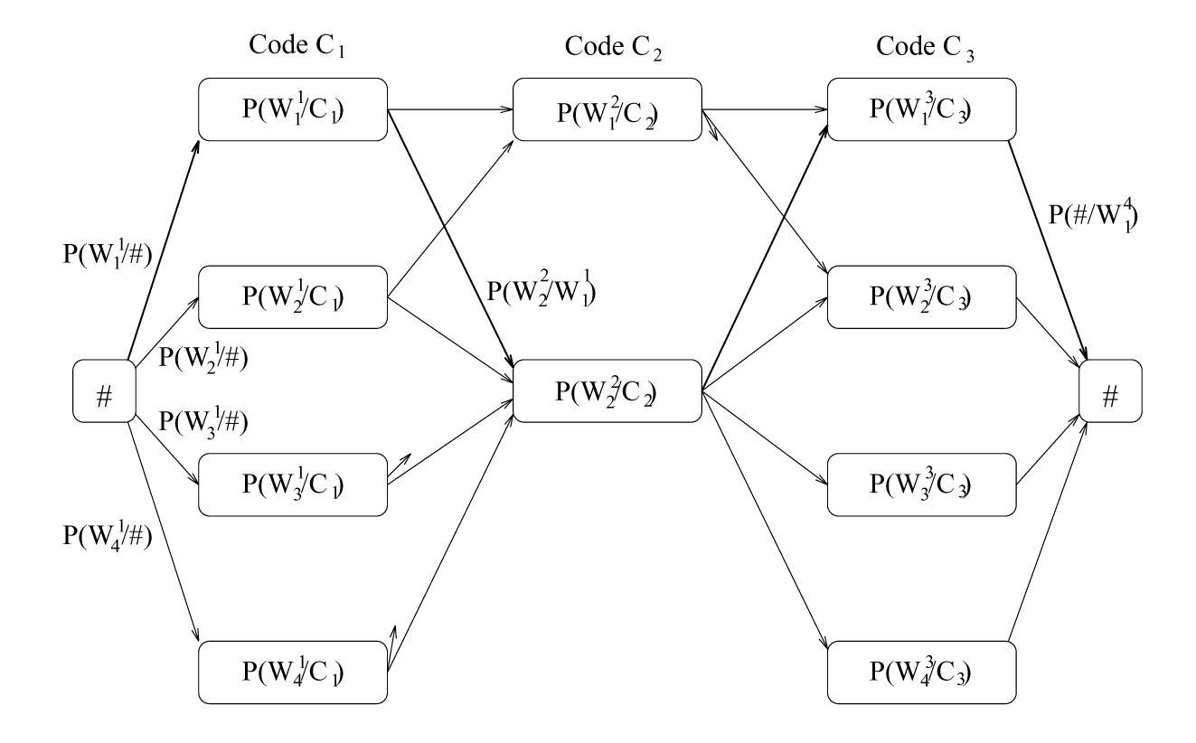
W₁¹
W₁²
W₁³
W₂¹
W₂³
W₂²
W₃¹
W₁¹
W₃³
W₄¹
W₄³

Slide 16
Summary: Graph Search
Depth First
  Little memory required
  Might find non-optimal path
Breadth First
  Much memory required
  Always finds optimal path
Iterative Depth-First Search
  Repeated depth-first searches, little memory required
Dijskstra’s Short Path Algorithm
  Like BFS for weighted graphs
Best First
  Can visit fewer nodes
  Might find non-optimal path
A*
  Can visit fewer nodes than BFS or Dijkstra
  Optimal if heuristic estimate is a lower-bound

Slide 17
Dynamic Programming
Algorithmic technique that systematically records the answers to sub-problems in a table and re-uses those recorded results (rather than re-computing them).
Simple Example: Calculating the Nth Fibonacci number.
Fib(N) = Fib(N-1) + Fib(N-2)

Slide 18
Floyd-Warshall
for (int k = 1; k =< V; k++)
for (int i = 1; i =< V; i++)
for (int j = 1; j =< V; j++)
if ( ( M[i][k]+ M[k][j] ) < M[i][j] )
M[i][j] = M[i][k]+ M[k][j]
Invariant: After the kth iteration, the matrix includes the shortest paths for all pairs of vertices (i,j) containing only vertices 1..k as intermediate vertices
Notes:
An example of dynamic programming
Assume there are no negative weighted cycles. (neg. weight edges are o.k.)
Initially a is an adjacency matrix - contains either the cost of an edge if it exists, or infinity.

Slide 19
2
b
a
-2
Initial state of the matrix:
1
-4
3
c
1
d
e
 | a | b | c | d | e
a | 0 | 2 | - | -4 | -
b | - | 0 | -2 | 1 | 3
c | - | - | 0 | - | 1
d | - | - | - | 0 | 4
e | - | - | - | - | 0
4
M[i][j] = min(M[i][j], M[i][k]+ M[k][j])

Slide 20
2
b
a
-2
Floyd-Warshall - for All-pairs shortest path
1
-4
3
c
1
d
e
4
 | a | b | c | d | e
a | 0 | 2 | 0 | -4 | 0
b | - | 0 | -2 | 1 | -1
c | - | - | 0 | - | 1
d | - | - | - | 0 | 4
e | - | - | - | - | 0
Final Matrix Contents

Slide 21
CSE 326: Data Structures
Network Flow

Slide 22
Network Flows
Given a weighted, directed graph G=(V,E)
Treat the edge weights as capacities
How much can we flow through the graph?
1
F
11
A
B
7
H
3
5
2
12
6
9
C
G
6
4
11
10
13
20
I
D
4
E

Slide 23
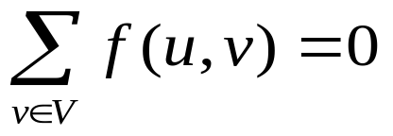
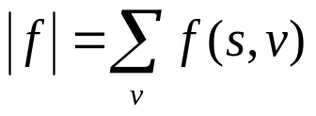
Network flow: definitions
Define special source s and sink t vertices
Define a flow as a function on edges:
  Capacity: f(v,w) <= c(v,w)
  Conservation: for all u
  except source, sink
  Value of a flow:
  Saturated edge: when f(v,w) = c(v,w)

Slide 24
Network flow: definitions
Capacity: you can’t overload an edge
Conservation: Flow entering any vertex must equal flow leaving that vertex
We want to maximize the value of a flow, subject to the above constraints

Slide 25
Network Flows
Given a weighted, directed graph G=(V,E)
Treat the edge weights as capacities
How much can we flow through the graph?
1
F
11
s
B
7
H
3
5
2
12
6
9
C
G
6
4
11
10
13
20
t
D
4
E

Slide 26
A Good Idea that Doesn’t Work
Start flow at 0
“While there’s room for more flow, push more flow across the network!”
  While there’s some path from s to t, none of whose edges are saturated
  Push more flow along the path until some edge is saturated
  Called an “augmenting path”

Slide 27
How do we know there’s still room?
Construct a residual graph:
  Same vertices
  Edge weights are the “leftover” capacity on the edges
  If there is a path s→t at all, then there is still room

Slide 28
Example (1)
Initial graph – no flow
B
2
C
3
4
1
A
D
2
4
2
E
2
F
Flow / Capacity

Slide 29
Example (2)
Include the residual capacities
B
0/2
C
2
0/3
0/4
4
3
0/1
A
D
2
0/2
1
2
0/4
0/2
4
E
0/2
F
2
Flow / Capacity
Residual Capacity

Slide 30
Example (3)
Augment along ABFD by 1 unit (which saturates BF)
B
0/2
C
2
1/3
0/4
4
2
1/1
A
D
2
0/2
0
2
1/4
0/2
3
E
0/2
F
2
Flow / Capacity
Residual Capacity

Slide 31
Example (4)
Augment along ABEFD (which saturates BE and EF)
B
0/2
C
2
3/3
0/4
4
0
1/1
A
D
0
2/2
0
2
3/4
0/2
1
E
2/2
F
0
Flow / Capacity
Residual Capacity

Slide 32
Now what?
There’s more capacity in the network…
…but there’s no more augmenting paths

Slide 33
Network flow: definitions
Define special source s and sink t vertices
Define a flow as a function on edges:
  Capacity: f(v,w) <= c(v,w)
  Skew symmetry: f(v,w) = -f(w,v)
  Conservation: for all u
  except source, sink
  Value of a flow:
  Saturated edge: when f(v,w) = c(v,w)

Slide 34
Network flow: definitions
Capacity: you can’t overload an edge
Skew symmetry: sending f from u→v implies you’re “sending -f”, or you could “return f” from v→u
Conservation: Flow entering any vertex must equal flow leaving that vertex
We want to maximize the value of a flow, subject to the above constraints

Slide 35
Main idea: Ford-Fulkerson method
Start flow at 0
“While there’s room for more flow, push more flow across the network!”
  While there’s some path from s to t, none of whose edges are saturated
  Push more flow along the path until some edge is saturated
  Called an “augmenting path”

Slide 36
How do we know there’s still room?
Construct a residual graph:
  Same vertices
  Edge weights are the “leftover” capacity on the edges
  Add extra edges for backwards-capacity too!
  If there is a path s→t at all, then there is still room

Slide 37
Example (5)
Add the backwards edges, to show we can “undo” some flow
B
0/2
C
3
2
3/3
0/4
1
4
0
A
1/1
D
2
0
2/2
0
2
3/4
0/2
1
E
2/2
F
3
0
Flow / Capacity
Residual Capacity
Backwards flow
2

Slide 38
Example (6)
Augment along AEBCD (which saturates AE and EB, and empties BE)
B
2/2
C
3
0
3/3
2/4
1
2
0
A
1/1
D
2
2
0/2
0
0
3/4
2/2
1
2
E
F
2/2
3
0
Flow / Capacity
Residual Capacity
Backwards flow
2

Slide 39
Example (7)
Final, maximum flow
B
2/2
C
3/3
2/4
A
1/1
D
0/2
3/4
2/2
E
2/2
F
Flow / Capacity
Residual Capacity
Backwards flow

Slide 40
How should we pick paths?
Two very good heuristics (Edmonds-Karp):
  Pick the largest-capacity path available
    Otherwise, you’ll just come back to it later…so may as well pick it up now
  Pick the shortest augmenting path available
    For a good example why…

Slide 41
Don’t Mess this One Up
B
0/2000
0/2000
A
D
0/1
C
0/2000
0/2000
Augment along ABCD, then ACBD, then ABCD, then ACBD…
Should just augment along ACD, and ABD, and be finished

Slide 42
Running time?
Each augmenting path can’t get shorter…and it can’t always stay the same length
  So we have at most O(E) augmenting paths to compute for each possible length, and there are only O(V) possible lengths.
  Each path takes O(E) time to compute
Total time = O(E²V)

Slide 43
Network Flows
What about multiple sources?
1
F
11
s
B
7
H
3
5
2
12
6
9
C
G
6
4
11
10
13
20
t
s
4
E

Slide 44
Network Flows
Create a single source, with infinite capacity edges connected to sources
Same idea for multiple sinks
1
F
11
s
B
7
H
3
5
∞
2
s!
12
6
9
C
G
6
∞
4
11
10
13
20
t
s
4
E

Slide 45
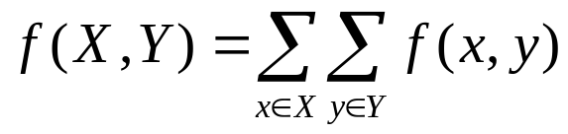
One more definition on flows
We can talk about the flow from a set of vertices to another set, instead of just from one vertex to another:
  Should be clear that f(X,X) = 0
  So the only thing that counts is flow between the two sets

Slide 46
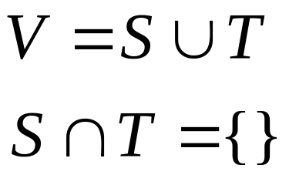
Network cuts
Intuitively, a cut separates a graph into two disconnected pieces
Formally, a cut is a pair of sets (S, T), such that
and S and T are connected subgraphs of G

Slide 47
Minimum cuts
If we cut G into (S, T), where S contains the source s and T contains the sink t,
Of all the cuts (S, T) we could find, what is the smallest (max) flow f(S, T) we will find?

Slide 48
Min Cut - Example (8)
T
S
B
2
C
3
4
1
A
D
2
4
2
E
2
F
Capacity of cut = 5

Slide 49
Coincidence?
NO! Max-flow always equals Min-cut
Why?
  If there is a cut with capacity equal to the flow, then we have a maxflow:
    We can’t have a flow that’s bigger than the capacity cutting the graph! So any cut puts a bound on the maxflow, and if we have an equality, then we must have a maximum flow.
  If we have a maxflow, then there are no augmenting paths left
    Or else we could augment the flow along that path, which would yield a higher total flow.
  If there are no augmenting paths, we have a cut of capacity equal to the maxflow
    Pick a cut (S,T) where S contains all vertices reachable in the residual graph from s, and T is everything else. Then every edge from S to T must be saturated (or else there would be a path in the residual graph). So c(S,T) = f(S,T) = f(s,t) = |f| and we’re done.

Slide 50
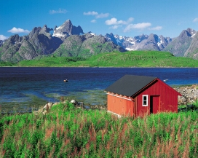
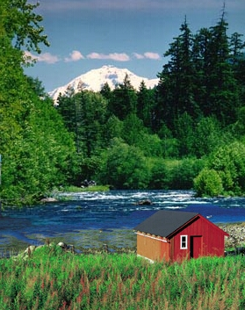
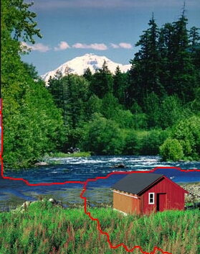
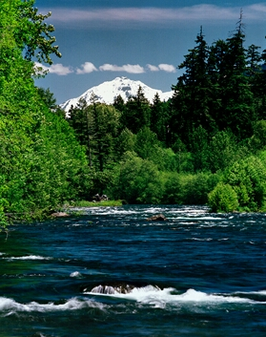
GraphCut
http://www.cc.gatech.edu/cpl/projects/graphcuttextures/

Slide 51
CSE 326: Data Structures
Dictionaries for Data Compression

Slide 52
Dictionary Coding
Does not use statistical knowledge of data.
Encoder: As the input is processed develop a dictionary and transmit the index of strings found in the dictionary.
Decoder: As the code is processed reconstruct the dictionary to invert the process of encoding.
Examples: LZW, LZ77, Sequitur,
Applications: Unix Compress, gzip, GIF

Slide 53
LZW Encoding Algorithm
Repeat
find the longest match w in the dictionary
output the index of w
put wa in the dictionary where a was the
unmatched symbol

Slide 54
LZW Encoding Example (1)
Dictionary
a b a b a b a b a
0 a
1 b

Slide 55
LZW Encoding Example (2)
Dictionary
a b a b a b a b a
0
0 a
1 b
2 ab

Slide 56
LZW Encoding Example (3)
Dictionary
a b a b a b a b a
0 1
0 a
1 b
2 ab
3 ba

Slide 57
LZW Encoding Example (4)
Dictionary
a b a b a b a b a
0 1 2
0 a
1 b
2 ab
3 ba
4 aba

Slide 58
LZW Encoding Example (5)
Dictionary
a b a b a b a b a
0 1 2 4
0 a
1 b
2 ab
3 ba
4 aba
5 abab

Slide 59
LZW Encoding Example (6)
Dictionary
a b a b a b a b a
0 1 2 4 3
0 a
1 b
2 ab
3 ba
4 aba
5 abab

Slide 60
LZW Decoding Algorithm
Emulate the encoder in building the dictionary. Decoder is slightly behind the encoder.
initialize dictionary;
decode first index to w;
put w? in dictionary;
repeat
decode the first symbol s of the index;
complete the previous dictionary entry with s;
finish decoding the remainder of the index;
put w? in the dictionary where w was just decoded;

Slide 61
LZW Decoding Example (1)
Dictionary
0 1 2 4 3 6
a
0 a
1 b
2 a?

Slide 62
LZW Decoding Example (2a)
Dictionary
0 1 2 4 3 6
a b
0 a
1 b
2 ab

Slide 63
LZW Decoding Example (2b)
Dictionary
0 1 2 4 3 6
a b
0 a
1 b
2 ab
3 b?

Slide 64
LZW Decoding Example (3a)
Dictionary
0 1 2 4 3 6
a b a
0 a
1 b
2 ab
3 ba

Slide 65
LZW Decoding Example (3b)
Dictionary
0 1 2 4 3 6
a b ab
0 a
1 b
2 ab
3 ba
4 ab?

Slide 66
LZW Decoding Example (4a)
Dictionary
0 1 2 4 3 6
a b ab a
0 a
1 b
2 ab
3 ba
4 aba

Slide 67
LZW Decoding Example (4b)
Dictionary
0 1 2 4 3 6
a b ab aba
0 a
1 b
2 ab
3 ba
4 aba
5 aba?

Slide 68
LZW Decoding Example (5a)
Dictionary
0 1 2 4 3 6
a b ab aba b
0 a
1 b
2 ab
3 ba
4 aba
5 abab

Slide 69
LZW Decoding Example (5b)
Dictionary
0 1 2 4 3 6
a b ab aba ba
0 a
1 b
2 ab
3 ba
4 aba
5 abab
6 ba?

Slide 70
LZW Decoding Example (6a)
Dictionary
0 1 2 4 3 6
a b ab aba ba b
0 a
1 b
2 ab
3 ba
4 aba
5 abab
6 bab

Slide 71
LZW Decoding Example (6b)
Dictionary
0 1 2 4 3 6
a b ab aba ba bab
0 a
1 b
2 ab
3 ba
4 aba
5 abab
6 bab
7 bab?

Slide 72
Decoding Exercise
Base Dictionary
0 1 4 0 2 0 3 5 7
0 a
1 b
2 c
3 d
4 r

Slide 73
Bounded Size Dictionary
Bounded Size Dictionary
  n bits of index allows a dictionary of size 2^{n}
  Doubtful that long entries in the dictionary will be useful.
Strategies when the dictionary reaches its limit.
  Don’t add more, just use what is there.
  Throw it away and start a new dictionary.
  Double the dictionary, adding one more bit to indices.
  Throw out the least recently visited entry to make room for the new entry.

Slide 74
Notes on LZW
Extremely effective when there are repeated patterns in the data that are widely spread.
Negative: Creates entries in the dictionary that may never be used.
Applications:
  Unix compress, GIF, V.42 bis modem standard

Slide 75
LZ77
Ziv and Lempel, 1977
Dictionary is implicit
Use the string coded so far as a dictionary.
Given that x₁x₂...x_{n} has been coded we want to code x_{n+1}x_{n+2}...x_{n+k} for the largest k possible.

Slide 76
Solution A
If x_{n+1}x_{n+2}...x_{n+k} is a substring of x₁x₂...x_{n} then x_{n+1}x_{n+2}...x_{n+k} can be coded by <j,k> where j is the beginning of the match.
Example
ababababa babababababababab....
coded
ababababa babababa babababab....
<2,8>

Slide 77
Solution A Problem
What if there is no match at all in the dictionary?
Solution B. Send tuples <j,k,x> where
  If k = 0 then x is the unmatched symbol
  If k > 0 then the match starts at j and is k long and the unmatched symbol is x.
ababababa cabababababababab....
coded

Slide 78
Solution B
If x_{n+1}x_{n+2}...x_{n+k} is a substring of x₁x₂...x_{n} and x_{n+1}x_{n+2}... x_{n+k}x_{n+k+1} is not then x_{n+1}x_{n+2}...x_{n+k} x_{n+k+1} can be coded by
<j,k, x_{n+k+1} >
where j is the beginning of the match.
Examples
ababababa cabababababababab....
ababababa c ababababab ababab....
<0,0,c> <1,9,b>

Slide 79
Solution B Example
a bababababababababababab.....
<0,0,a>
a b ababababababababababab.....
<0,0,b>
a b aba bababababababababab.....
<1,2,a>
a b aba babab ababababababab.....
<2,4,b>
a b aba babab abababababa bab.....
<1,10,a>

Slide 80
Surprise Code!
a bababababababababababab$
<0,0,a>
a b ababababababababababab$
<0,0,b>
a b ababababababababababab$
<1,22,$>

Slide 81
Surprise Decoding
<0,0,a><0,0,b><1,22,$>
<0,0,a> a
<0,0,b> b
<1,22,$> a
<2,21,$> b
<3,20,$> a
<4,19,$> b
...
<22,1,$> b
<23,0,$> $

Slide 82
Surprise Decoding
<0,0,a><0,0,b><1,22,$>
<0,0,a> a
<0,0,b> b
<1,22,$> a
<2,21,$> b
<3,20,$> a
<4,19,$> b
...
<22,1,$> b
<23,0,$> $

Slide 83
Solution C
The matching string can include part of itself!
If x_{n+1}x_{n+2}...x_{n+k} is a substring of
x₁x₂...x_{n} x_{n+1}x_{n+2}...x_{n+k}
that begins at j < n and x_{n+1}x_{n+2}... x_{n+k}x_{n+k+1} is not then x_{n+1}x_{n+2}...x_{n+k} x_{n+k+1} can be coded by
<j,k, x_{n+k+1} >

Slide 84
Bounded Buffer – Sliding Window
We want the triples <j,k,x> to be of bounded size. To achieve this we use bounded buffers.
  Search buffer of size s is the symbols x_{n-s+1}...x_{n}
  j is then the offset into the buffer.
  Look-ahead buffer of size t is the symbols x_{n+1}...x_{n+t}
Match pointer can start in search buffer and go into the look-ahead buffer but no farther.
match pointer
uncoded text pointer
Sliding window
tuple
<2,5,a>
aaaabababaaab$
search buffer look-ahead buffer
coded uncoded

