Slide 1
Based on slides by Y. Peng
University of Maryland
Representing Graphs and
Graph Isomorphism
(Chapter 9.3)
Connectivity
(Chapter 9.4)

Slide 2
Representing Graphs
a
a
d
b
b
d
c
c
Vertex
Adjacent Vertices
Initial Vertex
Terminal Vertices
a
b, c, d
a
c
b
a, d
b
a
c
a, d
c
d
a, b, c
d
a, b, c

Slide 3
Representing Graphs
Definition: Let G = (V, E) be a simple graph with |V| = n. Suppose that the vertices of G are listed in arbitrary order as v₁, v₂, …, v_{n}.
The adjacency matrix A (or A_{G}) of G, with respect to this listing of the vertices, is the n×n zero-one matrix with 1 as its (i, j) entry when v_{i} and v_{j} are adjacent, and 0 otherwise.
In other words, for an adjacency matrix A = [a_{ij}],
a_{ij} = 1 if {v_{i}, v_{j}} is an edge of G,
a_{ij} = 0 otherwise.

Slide 4
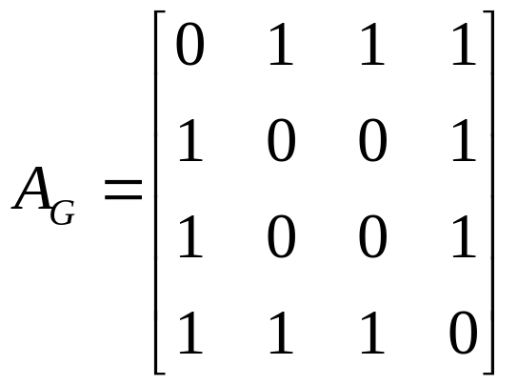
Representing Graphs
Example: What is the adjacency matrix A_{G} for the following graph G based on the order of vertices a, b, c, d ?
a
b
d
c
Solution:
Note: Adjacency matrices of undirected graphs are always symmetric.

Slide 5
Representing Graphs
Definition: Let G = (V, E) be an undirected graph with |V| = n. Suppose that the vertices and edges of G are listed in arbitrary order as v₁, v₂, …, v_{n} and e₁, e₂, …, e_{m}, respectively.
The incidence matrix of G with respect to this listing of the vertices and edges is the n×m zero-one matrix with 1 as its (i, j) entry when edge e_{j} is incident with v_{i}, and 0 otherwise.
In other words, for an incidence matrix M = [m_{ij}],
m_{ij} = 1 if edge e_{j} is incident with v_{i}
m_{ij} = 0 otherwise.

Slide 6
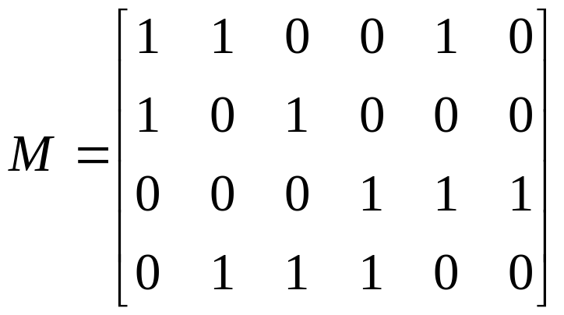
Representing Graphs
Example: What is the incidence matrix M for the following graph G based on the order of vertices a, b, c, d and edges 1, 2, 3, 4, 5, 6?
a
1
2
b
d
3
5
4
c
6
Solution:
Note: Incidence matrices of directed graphs contain two 1s per column for edges connecting two vertices and one 1 per column for loops.

Slide 7
Isomorphism of Graphs
Definition: The simple graphs G₁ = (V₁, E₁) and G₂ = (V₂, E₂) are isomorphic if there is a bijection (an one-to-one and onto function) f from V₁ to V₂ with the property that a and b are adjacent in G₁ if and only if f(a) and f(b) are adjacent in G₂, for all a and b in V₁.
Such a function f is called an isomorphism.
In other words, G₁ and G₂ are isomorphic if their vertices can be ordered in such a way that the adjacency matrices M_{G1} and M_{G2} are identical.

Slide 8
Isomorphism of Graphs
From a visual standpoint, G₁ and G₂ are isomorphic if they can be arranged in such a way that their displays are identical (of course without changing adjacency).
Unfortunately, for two simple graphs, each with n vertices, there are n! possible isomorphisms that we have to check in order to show that these graphs are isomorphic.
However, showing that two graphs are not isomorphic can be easy.

Slide 9
Isomorphism of Graphs
For this purpose we can check invariants, that is, properties that two isomorphic simple graphs must both have.
For example, they must have
the same number of vertices,
the same number of edges, and
the same degrees of vertices.
Note that two graphs that differ in any of these invariants are not isomorphic, but two graphs that match in all of them are not necessarily isomorphic.

Slide 10
Isomorphism of Graphs
Example I: Are the following two graphs isomorphic?
a
a
b
e
e
b
c
d
c
d
Solution: Yes, they are isomorphic, because they can be arranged to look identical. You can see this if in the right graph you move vertex b to the left of the edge {a, c}. Then the isomorphism f from the left to the right graph is: f(a) = e, f(b) = a,
f(c) = b, f(d) = c, f(e) = d.

Slide 11
Isomorphism of Graphs
Example II: How about these two graphs?
a
a
b
e
e
b
c
c
d
d
Solution: No, they are not isomorphic, because they differ in the degrees of their vertices.
Vertex d in right graph is of degree one, but there is no such vertex in the left graph.

Slide 12
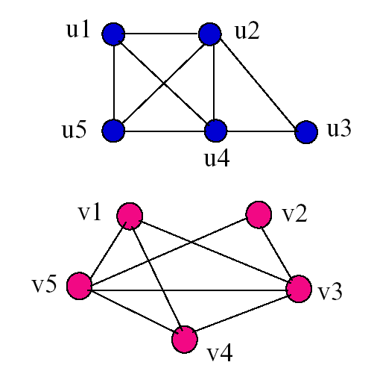
Examples
Determine if the following two graphs G₁ and G₂ are isomorphic:
Question 35, p. 619, and 41, p. 620

Slide 13
Connectivity
Definition: A path of length n from u to v, where n is a positive integer, in an undirected graph is a sequence of edges e₁, e₂, …, e_{n} of the graph such that e₁ = {x₀, x₁}, e₂ = {x₁, x₂}, …, e_{n} = {x_{n-1}, x_{n}}, where x₀ = u and x_{n} = v.
When the graph is simple, we denote this path by its vertex sequence x₀, x₁, …, x_{n}, since it uniquely determines the path.
The path is a circuit if it begins and ends at the same vertex, that is, if u = v.

Slide 14
Connectivity
Definition (continued): The path or circuit is said to pass through or traverse x₁, x₂, …, x_{n-1}.
A path or circuit is simple if it does not contain the same edge more than once.

Slide 15
Connectivity
Let us now look at something new:
Definition: An undirected graph is called connected if there is a path between every pair of distinct vertices in the graph.
For example, any two computers in a network can communicate if and only if the graph of this network is connected.
Note: A graph consisting of only one vertex is always connected, because it does not contain any pair of distinct vertices.

Slide 16
Connectivity
Example: Are the following graphs connected?
a
b
a
b
e
e
d
d
c
c
Yes.
No.
a
b
a
b
e
e
d
c
d
f
c
Yes.
No.

Slide 17
Connectivity
Definition: A graph that is not connected is the union of two or more connected subgraphs, each pair of which has no vertex in common. These disjoint connected subgraphs are called the connected components of the graph.
Definition: A connected component of a graph G is a maximal connected subgraph of G.
E.g., if vertex v in G belongs to a connected component, then all other vertices in G that is connected to v must also belong to that component.

Slide 18
Connectivity
Example: What are the connected components in the following graph?
i
h
d
a
e
g
b
c
f
j
Solution: The connected components are the graphs with vertices {a, b, c, d}, {e}, {f}, {i, g, h, j}.

Slide 19
Connectivity
Definition: An directed graph is strongly connected if there is a path from a to b and from b to a whenever a and b are vertices in the graph.
Definition: An directed graph is weakly connected if there is a path between any two vertices in the underlying undirected graph.

Slide 20
Connectivity
Example: Are the following directed graphs strongly or weakly connected?
a
Weakly connected, because, for example, there is no path from b to d.
b
d
c
a
Strongly connected, because there are paths between all possible pairs of vertices.
b
d
c

Slide 21
Cut vertices and edges
If one can remove a vertex (and all incident edges) and produce a graph with more components, the vertex is called a cut vertex or articulation point.
Similarly if removal of an edge creates more components the edge is called a cut edge or bridge.

Slide 22
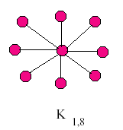
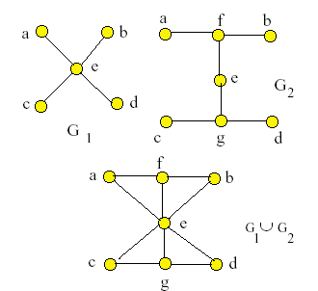
In the star network the
center vertex is a cut vertex.
All edges are cut edges.
In the graphs G₁ and G₂ every edge is a cut edge.
In the union, no edge is a cut edge.
Vertex e is a cut vertex in all graphs.

Slide 23
Isomorphic graphs must have ‘the same’ paths.
If one is a simple circuit of length k,
then so must be the other.
Theorem. Let M be the adjacency matrix for graph G.
Then each (i, j) entry in M^{r} is the number of paths of
length r from vertex i to vertex j.
Note: This is the standard power of m,
not a Boolean product.
Proof is given below. First an example.

Slide 24
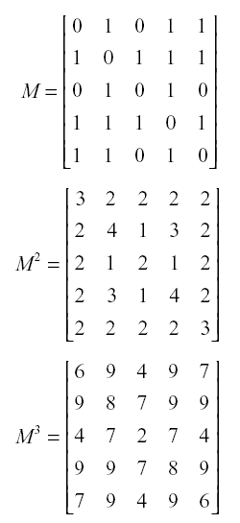
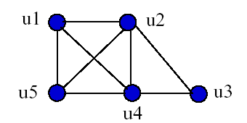
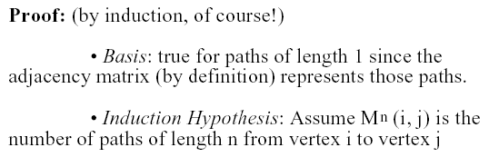

Slide 25
