Slide 1
NP-Completeness
Lecture for CS 302

Slide 2
Traveling Salesperson Problem
You have to visit n cities
You want to make the shortest trip
How could you do this?
What if you had a machine that could guess?

Slide 3
Non-deterministic polynomial time
Deterministic Polynomial Time: The TM takes at most O(n^{c}) steps to accept a string of length n
Non-deterministic Polynomial Time: The TM takes at most O(n^{c}) steps on each computation path to accept a string of length n

Slide 4
The Class P and the Class NP
P = { L | L is accepted by a deterministic Turing Machine in polynomial time }
NP = { L | L is accepted by a non-deterministic Turing Machine in polynomial time }
They are sets of languages

Slide 5
P vs NP?
Are non-deterministic Turing machines really more powerful (efficient) than deterministic ones?
Essence of P vs NP problem

Slide 6
Does Non-Determinism matter?
Finite Automata?
No!
Push Down Automata?
Yes!
DFA not ≈ NFA
DFA ≈ NFA
(PDA)

Slide 7


Slide 8
P = NP?
No one knows if this is true
How can we make progress on this problem?

Slide 9
Progress
P = NP if every NP problem has a deterministic polynomial algorithm
We could find an algorithm for every NP problem
Seems… hard…
We could use polynomial time reductions to find the “hardest” problems and just work on those

Slide 10
Reductions
Real world examples:
  Finding your way around the city reduces to reading a map
  Traveling from Richmond to Cville reduces to driving a car
  Other suggestions?

Slide 11
Polynomial time reductions
PARTITION = { n₁,n₂,… n_{k} | we can split the integers into two sets which sum to half }
SUBSET-SUM = { <n₁,n₂,… n_{k},m> | there exists a subset which sums to m }
1) If I can solve SUBSET-SUM, how can I use that to solve an instance of PARTITION?
2) If I can solve PARTITION, how can I use that to solve an instance of SUBSET-SUM?

Slide 12
Polynomial Reductions
1) Partition REDUCES to Subset-Sum
  Partition <_{p} Subset-Sum
2) Subset-Sum REDUCES to Partition
  Subset-Sum <_{p} Partition
Therefore they are equivalently hard

Slide 13
How long does the reduction take?
How could you take advantage of an exponential time reduction?

Slide 14
NP-Completeness
How would you define NP-Complete?
They are the “hardest” problems in NP
NP-Complete
P
NP

Slide 15
Definition of NP-Complete
Q is an NP-Complete problem if:
1) Q is in NP
2) every other NP problem polynomial time reducible to Q
Notes:
Informally describe this: picture of complexity classes

Slide 16
Getting Started
How do you show that EVERY NP problem reduces to Q?
One way would be to already have an NP-Complete problem and just reduce from that
P₁
P₂
Mystery NP-Complete Problem
P₃
Q
P₄
Notes:
Reference halting problem and undecidability

Slide 17
Reminder: Undecidability
How do you show a language is undecidable?
One way would be to already have an undecidable problem and just reduce from that
L₁
L₂
Halting Problem
L₃
Q
L₄

Slide 18
SAT
SAT = { f | f is a Boolean Formula with a satisfying assignment }
Is SAT in NP?

Slide 19
Cook-Levin Theorem (1971)
SAT is NP-Complete
If you want to see the proof it is Theorem 7.37 in Sipser (assigned reading!) or you can take CS 660 – Graduate Theory. You are not responsible for knowing the proof.
Notes:
If you want to see the proof it’s in Sipser (Thm 7.37) or CS660

Slide 20
3-SAT
3-SAT = { f | f is in Conjunctive Normal Form, each clause has exactly 3 literals and f is satisfiable }
3-SAT is NP-Complete
(2-SAT is in P)

Slide 21
NP-Complete
To prove a problem is NP-Complete show a polynomial time reduction from 3-SAT
Other NP-Complete Problems:
  PARTITION
  SUBSET-SUM
  CLIQUE
  HAMILTONIAN PATH (TSP)
  GRAPH COLORING
  MINESWEEPER (and many more)

Slide 22
NP-Completeness Proof Method
To show that Q is NP-Complete:
1) Show that Q is in NP
2) Pick an instance, R, of your favorite NP-Complete problem (ex: Φ in 3-SAT)
3) Show a polynomial algorithm to transform R into an instance of Q

Slide 23
Example: Clique
CLIQUE = { <G,k> | G is a graph with a clique of size k }
A clique is a subset of vertices that are all connected
Why is CLIQUE in NP?

Slide 24
Reduce 3-SAT to Clique
Pick an instance of 3-SAT, Φ, with k clauses
Make a vertex for each literal
Connect each vertex to the literals in other clauses that are not the negation
Any k-clique in this graph corresponds to a satisfying assignment

Slide 25
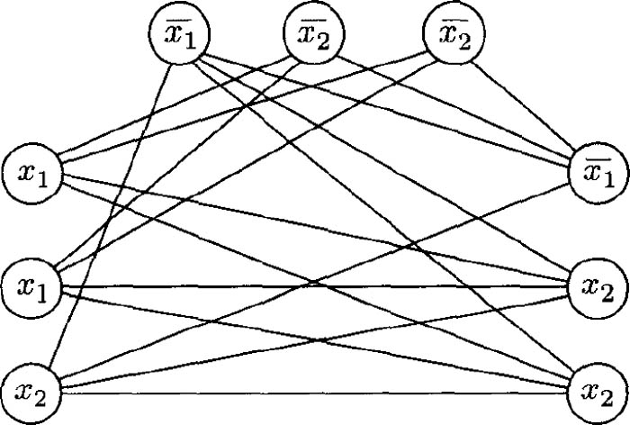

Slide 26
Example: Independent Set
INDEPENDENT SET = { <G,k> | where G has an independent set of size k }
An independent set is a set of vertices that have no edges
How can we reduce this to clique?

Slide 27
Independent Set to CLIQUE
This is the dual problem!

Slide 28
Doing Your Homework
Think hard to understand the structure of both problems
Come up with a “widget” that exploits the structure
These are hard problems
Work with each other!
Advice from Grad Students: PRACTICE THEM

Slide 29
Take Home Message
NP-Complete problems are the HARDEST problems in NP
The reductions MUST take polynomial time
Reductions are hard and take practice
Always start with an instance of the known NP-Complete problem
Next class: More examples and Minesweeper!

Slide 30
Papers
Read one (or more) of these papers:
  March Madness is (NP-)Hard
  Some Minesweeper Configurations
  Pancakes, Puzzles, and Polynomials: Cracking the Cracker Barrel
and Knuth’s Complexity of Songs
Each paper proves that a generalized version of a somewhat silly problem is NP-Complete by reducing 3SAT to that problem (March Madness pools, win-able Minesweeper configurations, win-able pegboard configurations)
Optional, but it is hard to imagine any student who would not benefit from reading a paper by Donald Knuth including the sentence, “However, the advent of modern drugs has led to demands for still less memory…”

