Slide 1
NAAN MUDHALVAN DATASCIENCE FUDAMANETAL PROJECT
PROJECT TITLE
ENERGY CONSUMPTION
PRESENTED BY:
Vivek.V
SACS M.A.V.M.M. ENGINEERING COLLEGE
III YR CIVIL DEPT

Slide 2
Project statement
Audio analysis refers to the extraction of information and meaning from audio signals for analysis, classification, storage, retrieval, synthesis
Fourier Transform: The Fourier Transform is a mathematical operation that decomposes a time- domain signal into its constituent frequencies. …
Spectrogram: A spectrogram is a visual representation of the frequency content of a signal over time.

Slide 3
Problem statement
⚫
⚫
Level and gain
Frequency domain analysis
Frequency response
Total Harmonic Distortion plus Noise (THD+N)
Phase
Crosstalk
Intermodulation distortion (IMD)
Stereo and Surround

Slide 4
System approach
Building the proposed solution would involve a combination of data processing, pyth0n programming and visualization skills.
System requirements:
Hardware :
A computer with sufficient processing power, preferably with multiple cores or a GPU for faster training of machine learning models.
Adequate RAM to handle the size of the dataset and computational requirements.
Software:
- An operating system compatible with the required python libraries (e.g., windows,linux,macOS).

Slide 5
System approach – CONT.
Library Requirements:
Data processing and analysis:
Pandas : For data manipulation and analysis.
Numpy : For numerical operations on data.
Data visualization:
Matplotlib and seaborn: For creating visualizations to understand data patterns.
Plotly or Bokeh: Interactive visualization libraries for more complex visualizations.

Slide 6
ALGORITHM & DEPLOYMENT
Algorithm selection
Data exploration :
Explore the movie rating structure, features and variables.
Identify potential patterns, correlations and outliners.
Problem formulation:
Define the problem: Predict optimal booking times, likelihood of special requests based on historical data.
Algorithm selection:
Regression tasks(e.g., predicting daily rates)
Consider linear regression, decision tree, or ensemble methods
classification tasks(e.g., predicting special requests);
Consider logistic regressive, decision trees or random forests.

Slide 7
ALGORITHM & DEPLOYMENT
Data input:
Data collection:
Gather historical data including booking dates ,special requests,and relevant details.
Data cleaning:
Handle missing values, outliners, and any inconsistencies in the dataset.
Convert categorical variables into numerical representation through encoding techniques.
Feature Engineering:
Create new features or modify existing ones based on domain knowledge.
Extract meaningful information from date variables, such as day-of-week or month.

Slide 8
ALGORITHM & DEPLOYMENT
Training process:
Data splitting:
Divide the dataset into training and testing sets to evaluate the model’s
performance.
Feature scaling:
Standardize or normalize numerical features to ensure they have consistent scale.
Modeling training:
Use the selected algorithm to train the model on the all sites scores dataset.
Adjust hyperparameters to optimize model performance.
Model evaluation:
Evaluate the model on the dataset using appropriate metrics(e.g., Mean Squared Error for regression,accuracy,precision, recall for classification).
Fine-tune the model if necessary.

Slide 9
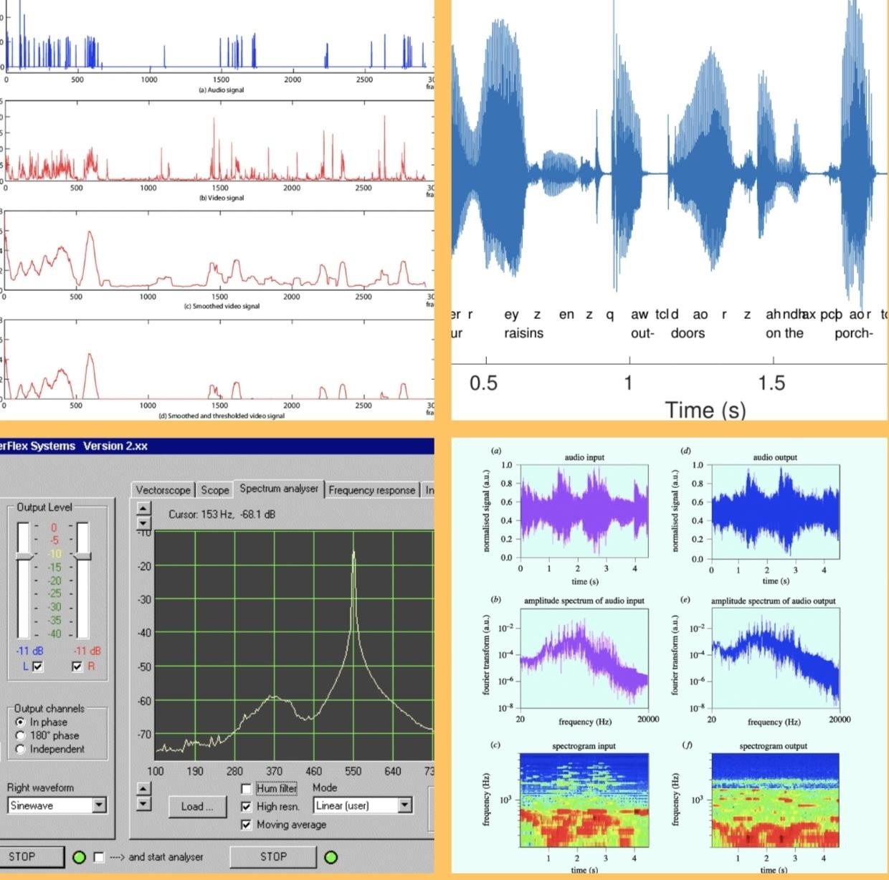
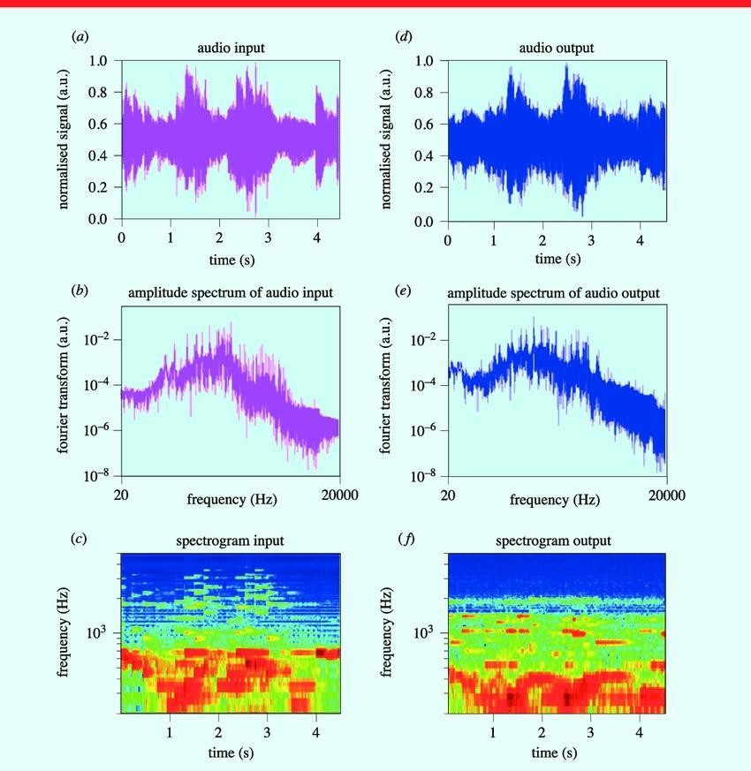
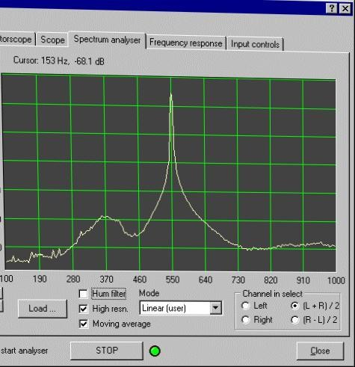
RESULT

Slide 10
CONCLUSION
Our final program takes an acoustic wave signal, strips out all audible frequencies using a Fourier transform, then shifts a range of the ultrasound frequencies into the audible range in order to qualitatively investigate the properties of the audio signal

Slide 11
REFERENCES
http://www.kaggle.com/datasets
http://pandas.pydata.org/pandas-docs/stable/user guide/ index.html
http://seaborn.pydata.org/
http://matplotlib.org/stable/contents.html

Slide 12
Thank you

