Slide 1
Credit Card Default Prediction
Presented by,
R.karthikeyan,
au923821105021,
BE.EEE,
Mangayarkarasi College Of Engineering.

Slide 2
Problem Statement Proposed System/Solution System Development Approach Algorithm & Deployment Result Conclusion Future Scope References
OUTLINE

Slide 3
PROBLEM STATEMENT
An explanation of the dataset's significance
Analyzing unstructured e-commerce website logs presents
difficulties
To extract meaningful insights, exploratory data analysis and
visualization are required.

Slide 4
PROPOSED SOLUTION
Overview of the suggested remedy:
Making use of exploratory data analysis (EDA) methods
Using data visualization to enhance comprehension
The significance of comprehending consumer behavior and
refining sales tactics

Slide 5
SYSTEM APPROACH
Synopsis of the approach to system development:
Gathering and preparing data
Analyzing exploratory data
Techniques for visualizing data
Interpretation and the creation of insights

Slide 6
ALGORITHM & DEPLOYMENT
Algorithms (if any) employed in data analysis
Methodology for deploying the analysis:
Technologies and tools used for on-premises installation
or cloud-based deployment

Slide 7
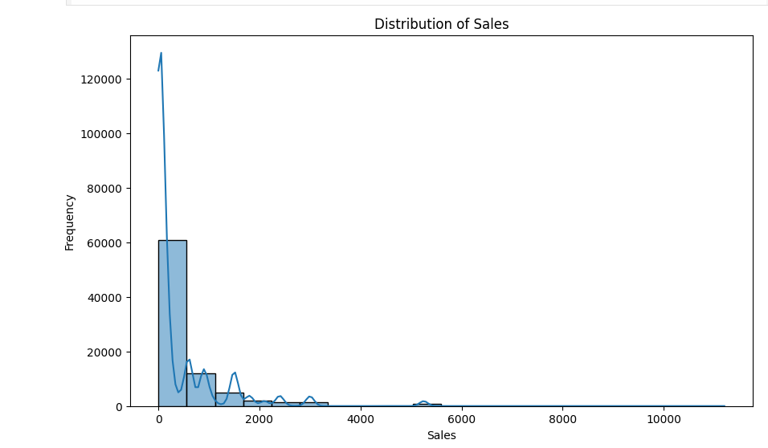
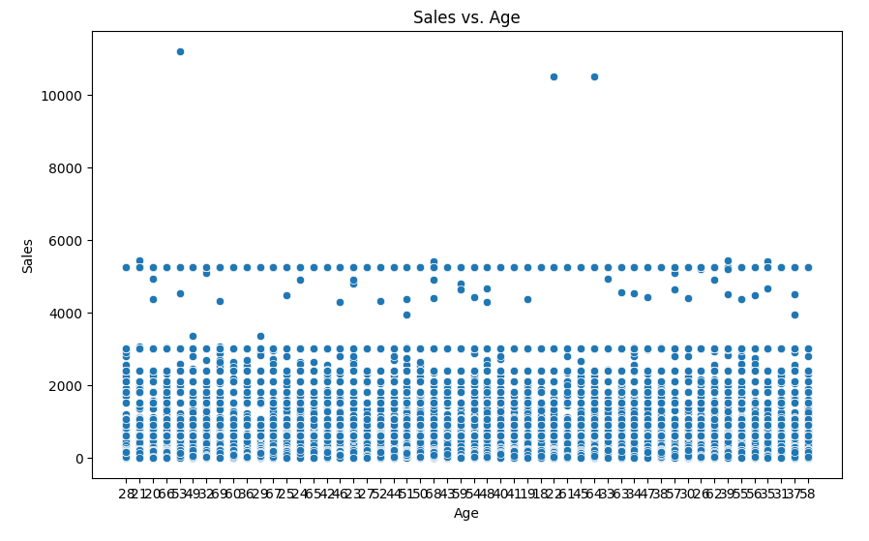
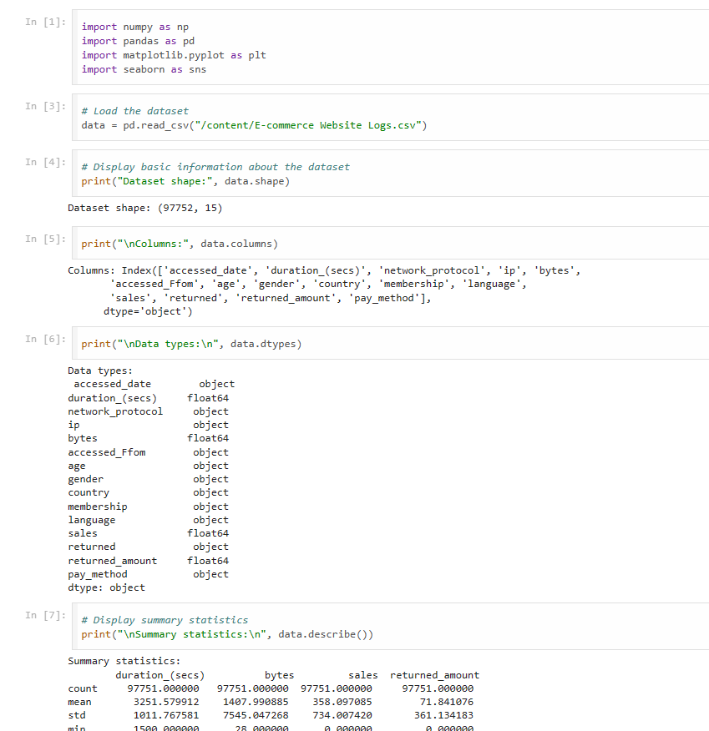
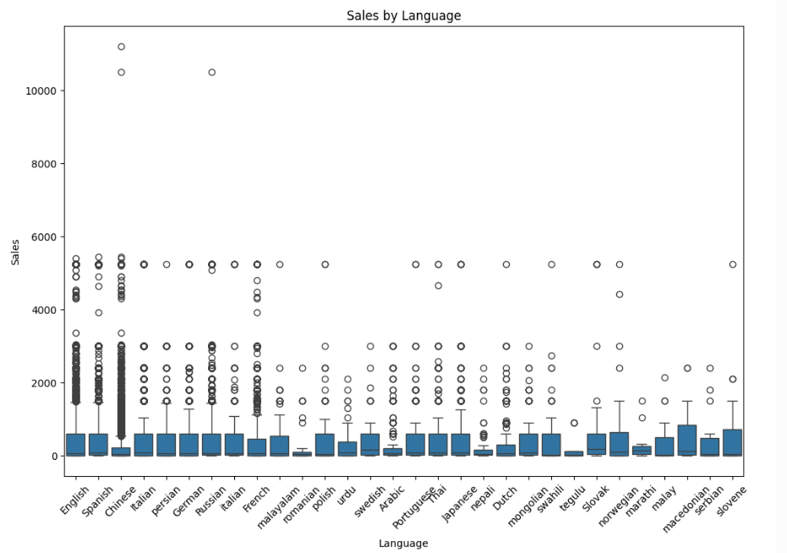
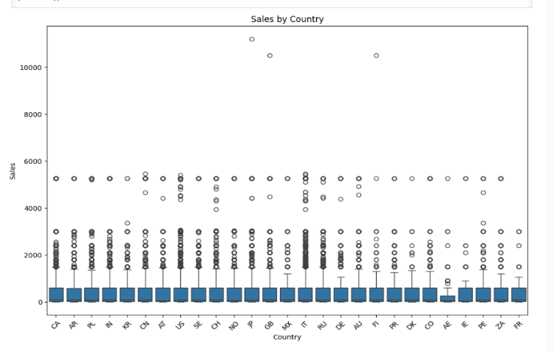
RESULT

Slide 8
CONCLUSION
A synopsis of the main conclusions and observations
The role that data visualization and EDA play in informing
business decisions
consequences for marketing campaigns and e-commerce
strategies

Slide 9
THANK YOU

