Slide 1
BITCOIN PRICE PREDICTION
Capstone project
Presented by :
G.Nagalingam,
Mangayarkarasi College of Engineering ,
Electrical and Electronics Engineering .

Slide 2
OUTLINE
Problem statement
Proposed System/Solution
System Development Approach
Alogorithm & Depolyment
Result
Conclusion
Future Scope
References

Slide 3
PROBLEM STATEMENT
Bitcoin uses Blockchain concept which is peer-to-peer technology to operate with no central authority or banks; managing transactions and the issuing of bitcoins is carried out collectively by the network. Bitcoin is open-source; its design is public, nobody owns or controls Bitcoin and everyone can take part.

Slide 4
PROPOSED SOLUTION
Machine learning models including Random Forest, XGBoost, Quadratic Discriminant Analysis, Support Vector Machine and Long Short-term Memory for Bitcoin 5-minute interval price prediction are superior to statistical methods, with accuracy reaching 67.2%.

Slide 5
SYSTEM APROACH
For Bitcoin daily price with higher dimensional features, we implement two statistical methods: logistic regression (LR) and linear discriminant analysis (LDA), and the 5-minute interval price with a few features is predicted using machine learning models including random forest (RF), XGBoost (XGB), quadratic ...

Slide 6
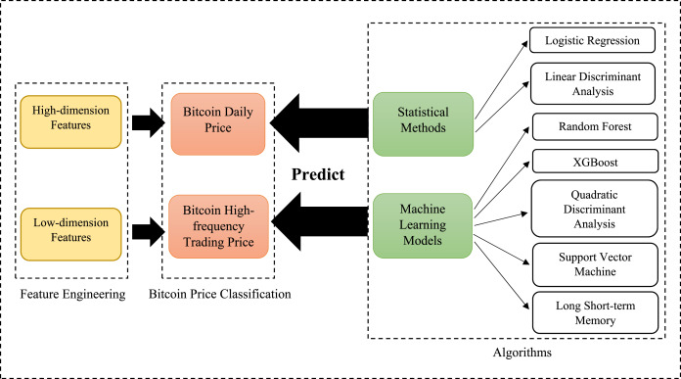
ALGORITHM & DEPOLYMENT
Random forest regression has the better price prediction accuracy than LSTM. In previous research, LSTM was widely used and recognized as an algorithm with high accuracy when predicting Bitcoin prices

Slide 7
RESULT
The price of Bitcoin is predicted to rise by 30.77% and reach $ 85,595 by May 1, 2024.

Slide 8
CONCLUSION
Random forest regression has the better price prediction accuracy than LSTM. In previous research, LSTM was widely used and recognized as an algorithm with high accuracy when predictinr3rfg Bitcoin prices.

Slide 9
FUTURE SCOPE
Our most recent Bitcoin price forecast indicates that its value will increase by 11.17% and reach $75,061 by April 06, 2024. Our technical indicators signal about the Bullish Bullish 83% market sentiment on Bitcoin, while the Fear & Greed Index is displaying a score of 70 (Greed).

Slide 10
REFERENCES
Technical Analysis: Many traders and analysts use technical analysis to forecast future price movements based on historical price data and trading volume. They employ various indicators and chart patterns to identify trends and potential price levels. Common indicators include Moving Averages, Relative Strength Index (RSI), and Fibonacci retracement levels.
Fundamental Analysis: This approach involves analyzing the underlying factors that could influence Bitcoin's value, such as adoption rate, regulatory developments, macroeconomic trends, and technological advancements. Fundamental analysts attempt to assess Bitcoin's intrinsic value based on these factors.
Market Sentiment Analysis: Monitoring market sentiment through social media, forums, and news outlets can provide insights into investors' perceptions and expectations regarding Bitcoin's price. Sentiment analysis tools are used to gauge whether market sentiment is bullish or bearish.
Machine Learning and AI Models: Some researchers and analysts use machine learning algorithms and artificial intelligence models to analyze vast amounts of data and identify patterns that could help predict Bitcoin's price movements.

Slide 11


