Slide 1
URL Categorization using Natural Language Processing(NLP)
Presented By:-
Abhijeet Upadhyay, 00211503115 Swati, 04011503115

Slide 2
DATESET
The dataset includes category which each URL belongs to. The goal of the project is to predict the
category of URL, among as many categories.
The database has the following characteristics:
25 categories:
1 News and Media
2 Career and Education
3 Internet and Telecom
4 Sports
5 Games
6 Books and Literature
7 Law and Government
8 Travel
9 Finance
10 Arts and Entertainment
11 Reference
12 Autos and Vehicles
13 Adult
14 Business and Industry
15 People and Society
16 Shopping
17 Health
18 Pets and Animals
19 Home and Garden
20 Beauty and Fitness
21 Gambling
22 Recreation and Hobbies
23 Science
24 Computer and Electronics
25 Food and Drink

Slide 3
Description of our approach
The implementation of the project according to the tasks:
1. Design any preprocessing of the web pages in the dataset.
2. Define and learn the classifier using the training data.
3. Design the validation method to evaluate the accuracy of the proposed classification approach.

Slide 4
Pre-Processing
Input Data
Setup Variables
URL pre-processing can significantly increase the reliability of a classifier. URL pre-processing is the technique of enhancing data prior to computational processing.
Limiter and CV number
URLopen and BS4
NLTK and LangDetect
Corpus of top words

Slide 5
Classifiers
The classifiers that we have selected for now are:
Logistic regression
Decision Trees
Kneighbors
The classifiers will be learnt by using the train data and computing the accuracy in the test data.

Slide 6
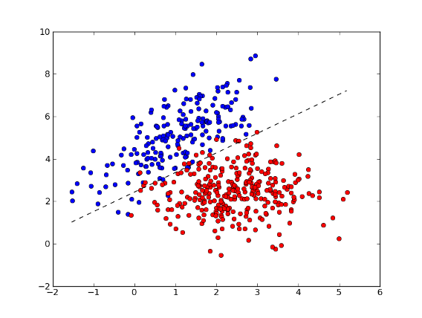
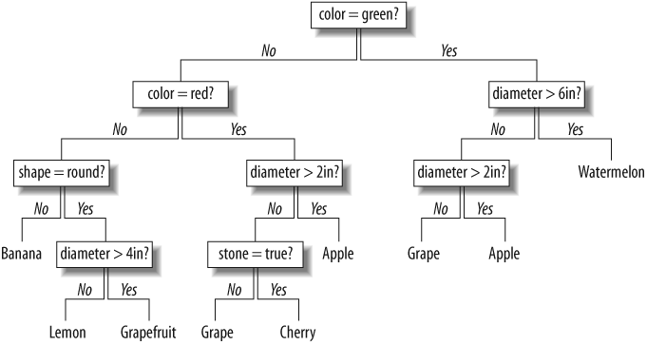
Decision tree classifier example
Logistic Regression

Slide 7
Feature Extraction
Feature Extraction is used to obtain the appropriate characteristics which are used by the classifier to distinguish between each symbol.
The extraction of the features of the characters is done such a way that the complete portion of the binary image covered and there is a distinct property associated with each position.
Feature Extraction is one of the most important parts of a system that uses pattern recognition.

Slide 8
Future Work
Further scope of this project can be implementing tools to identify a website’s reputation level using factors that include rank, location, history, age, network, links, and other related aspects. Careful analysis of these factors provides a realistic picture to helps administrators fine tune security settings. This makes it easy to protect a site against any type of malicious attack.
We have currently worked on URL Pre processing and feature extraction for the URLs
The results of these techniques will be passed to URL categorization algorithms.
There are also some other feature techniques left to explore which may be needed to improve recognition accuracy.

