Slide 1
Future Event List
Priority Queue Data Structures

Slide 2
Outline
Introduction
Performance Evaluation Methodology
An early empirical study
Splay Tree
Calendar Queue
Ladder Queue

Slide 3
Event-Oriented World View
  Event handler procedures
state variables
Arrival Event
{
…
}
Landed Event
{
…
}
Departure Event
{
…
}
Integer: InTheAir;
Integer: OnTheGround;
Boolean: RunwayFree;
Simulation application
Simulation executive
  Event processing loop
Now = 8:45
While (simulation not finished)
E = smallest time stamp event in FEL
Remove E from FEL
Now := time stamp of E
call event handler procedure
Future Event List (FEL)
9:00
10:10
9:16

Slide 4
Future Event List (FEL)
A data structure is needed to store events that have been scheduled, but not yet processed (FEL)
For many simulations, the amount of computation within the event handler function is small; the time to access the FEL will dominate the execution time if the FEL holds many events
Required data structure is called a priority queue
Efficient implementation of the priority queue has been considered by many researchers

Slide 5
Priority Queue: Operations
Required Operations
  Insert (FEL, ev, ts); /* aka enqueue */
    Add event ev with timestamp ts to event list FEL
  Event = Delete (FEL); /* aka dequeue */
    Remove smallest time stamp event and return a pointer to it
  DeleteArbitrary (FEL, ev);
    Unschedule an event
    Delete an arbitrary event ev (not necessarily smallest timestamped item)
Constraints for a general simulation executive
  Maximum number of events required at one time unknown
    Memory allocation issues
  Sequence of Insert and Delete operations unknown
  Distribution of timestamps on successive Insert operations unknown

Slide 6
Data Structures
Linked lists
  Single linked list
  Double linked list
Tree Based
  Heap
  Splay tree, …
Hybrid
  Henricksen’s algorithm
Hashing schemes
  Calendar queue
  Ladder queue

Slide 7
Outline
Introduction
Performance Evaluation Methodology
An early empirical study
Splay Tree
Calendar Queue
Ladder Queue

Slide 8
Performance: HOLD Model
Used for empirical performance evaluations
Based on “hold” primitive [AdvanceTime(T)]
  Schedule a new event some time into the simulated future
  T: timestamp of new event
While ()
E = Delete (FEL)
Now := time stamp of E
Insert (FEL, E’, Now+ΔT)
/* Measure time of single interation */
Parameters:
  Number of events in FEL
  Distribution to compute new timestamp (ΔT)

Slide 9
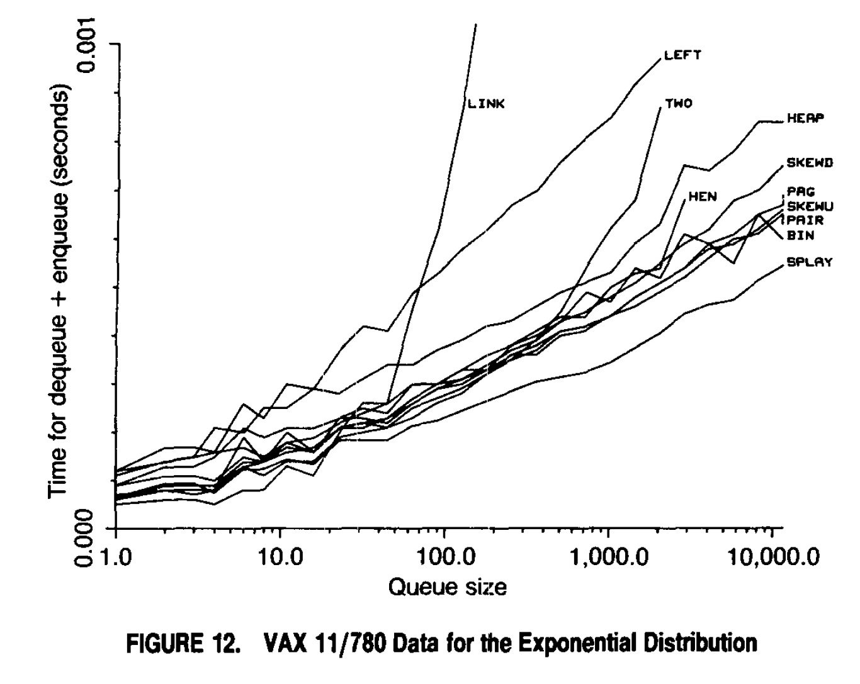
Performance Comparison
Hold model: fixed number of elements; repeat (dequeue, enqueue) operations
Comparison of different data structures using exponential timestamp increment (see paper for other distributions)
Empirical measurement of time for (dequeue+enqueue) operation for different queue sizes
D. Jones, “An Empirical Comparison of Priority-Queue and Event Set Implementations”, Communications of the ACM, 29, 4 (April 1986), 300-311.

Slide 10
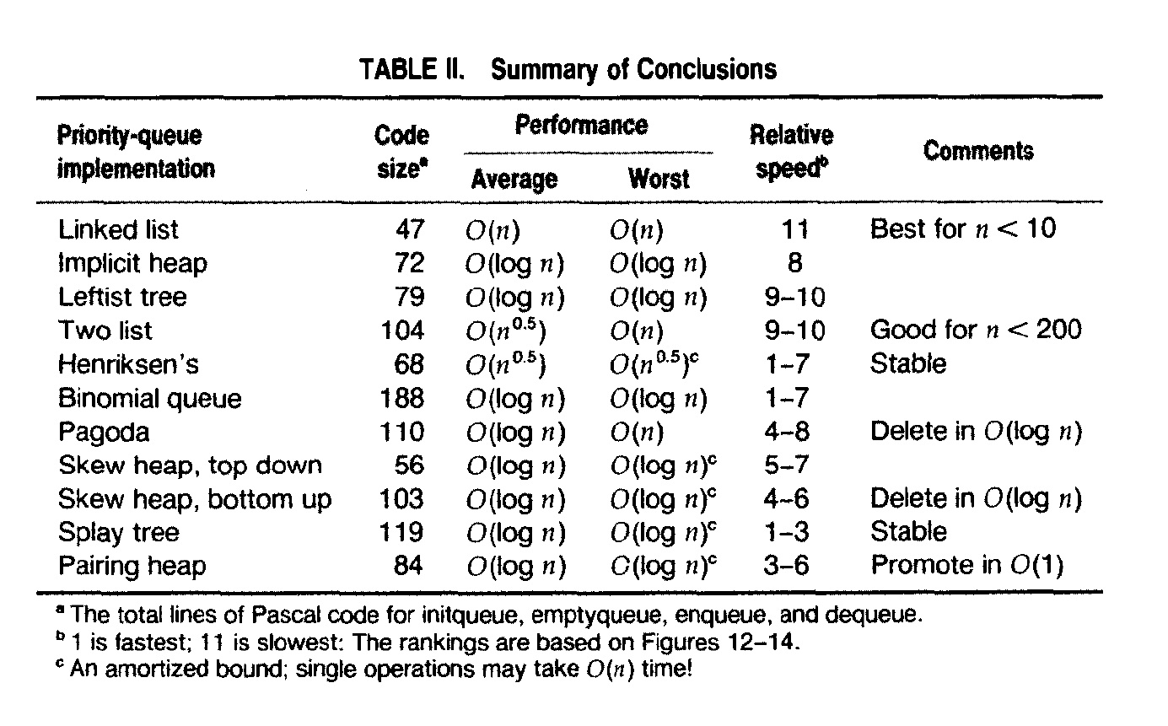
Conclusions [Jones]
Linear list fastest n<10, but very slow if n>50
Splay trees
  Stable: items with same priority treated in FIFO order
  Supports delete arbitrary operation
  Reasonably good performance across different distributions
Results tend to be architecture dependent (caches)

Slide 11
Outline
Introduction
Performance Evaluation Methodology
An early empirical study
Splay Tree
Calendar Queue
Ladder Queue

Slide 12
Splay Trees
D. Sleator, R. Tarjan, “Self-Adjusting Binary Search Trees”, Journal of the ACM, 32, 3 (July 1985), 652-686.
Binary search tree; for any node (timestamp t)
  Left subtree nodes have timestamp < t
  Right subtree nodes have timestamp ≥ t
Operations
  Delete: where is smallest item?
  Insert: how does insertion work?

Slide 13
Binary Search Tree Operations
100
40
180
20
80
130
210
10
30
70
90
110
170
200
Delete: remove leftmost item (leaf, or has one child)
Insert: traverse tree downward, insert at proper location
Repeated insert/delete operations unbalance tree
Performance of average of O(log(n))

Slide 14
Splay Trees (cont.)
Repeated insert/delete operations (e.g., repeated deletes) leaves unbalanced tree
Could carefully rebalance after each operation (AVL tree)
Splay tree
  Heuristic to blindly restructure tree using rotation operations
  Does not guarantee tree will be rebalanced; worst case time per operation is O(n), but…
  Amortized complexity (average over many operations) O(log₂ n)

Slide 15
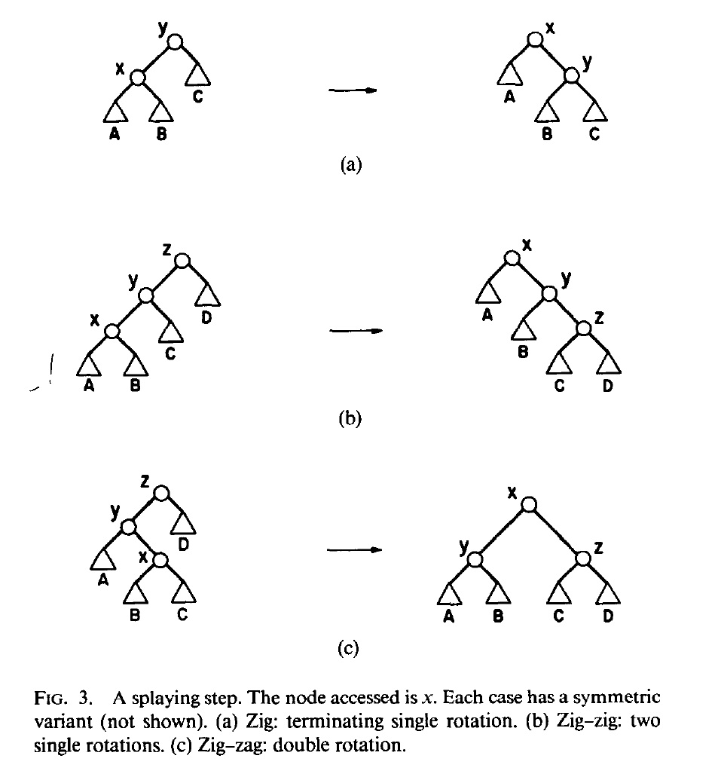
Splaying Operation
Splay(x): travel up tree from x to root, moving x to root
Insert(x): insert x at leaf, splay(x)
Delete: remove node, splay at parent of removed node
Apply splaying operations in traversal up tree
  Visit x; p(x) = parent of x; three cases:
  (a) p(x) root
  (b) x and p(x) both left or both right children
  (c ) x right child and p(x) left child or vice versa

Slide 16
Calendar Queues
R. Brown, “Calendar Queues: A Fast O(1) Priority Queue Implementation for the Simulation Event Set Problem,” Communications of the ACM, 31, 10 (October 1988), 1220-1227.
Analogous to desk calendar
Array of “buckets” denoting a time interval (e.g., 365 buckets, 1 day/bucket, spanning a year)
Each bucket covers a fixed interval of time (day)
Each bucket points to sorted linear list of events scheduled for that day
Events scheduled for next year simply placed in corresponding bucket (day)
Keep pointer to bucket with smallest timestamp event (today)

Slide 17
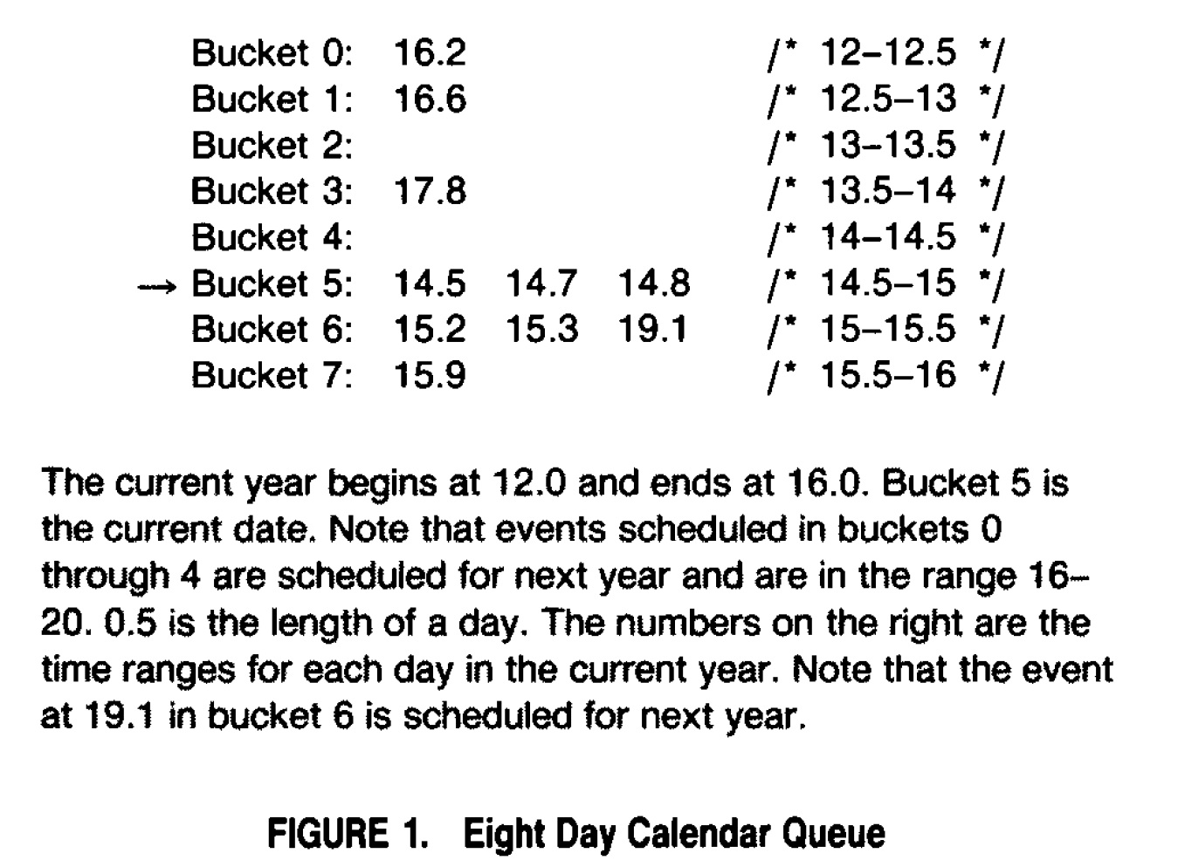
Calendar Queue Example

Slide 18
Calendar Queue Operations
(preliminary version)
Insert
  Map timestamp to appropriate bucket
  Perform linear list insertion into list
Delete
  Starting from current (today) bucket
    If first event in current year, remove it
    Else, go to next bucket (if last bucket, advance to next year) and go back to the previous step
Potential problems
  Long linear list
  Need to scan many buckets on delete operation

Slide 19
Problems and Solutions
Wrong number of buckets
  If #events >> #buckets
    Long linear list, long insert time
  If #events << #buckets
    Long delete time (scan many empty buckets)
  Solution: resize number of buckets
    If #events > 2 * # buckets, double # buckets
    If #events < 0.5 * #buckets, halve # buckets
    Resizing requires copying events; expensive
Poor choice of length for a “day”
  Ideally, about one event per day
  If day too long, many events in “today” bucket (long insert time)
  If day too short, many events in later years (long delete time)
  Solution: Sample some events to estimate average time between events and set day length to that value; perform at each resize operation

Slide 20
Problems and Solutions (cont.)
Bimodal distribution of events (many “near future” events and many “far future” events)
  After removing “near future” events, must cycle through all buckets repeatedly to reach far future events
  Solution: If scan through all buckets w/o success, search for smallest timestamp event by scanning all buckets

Slide 21
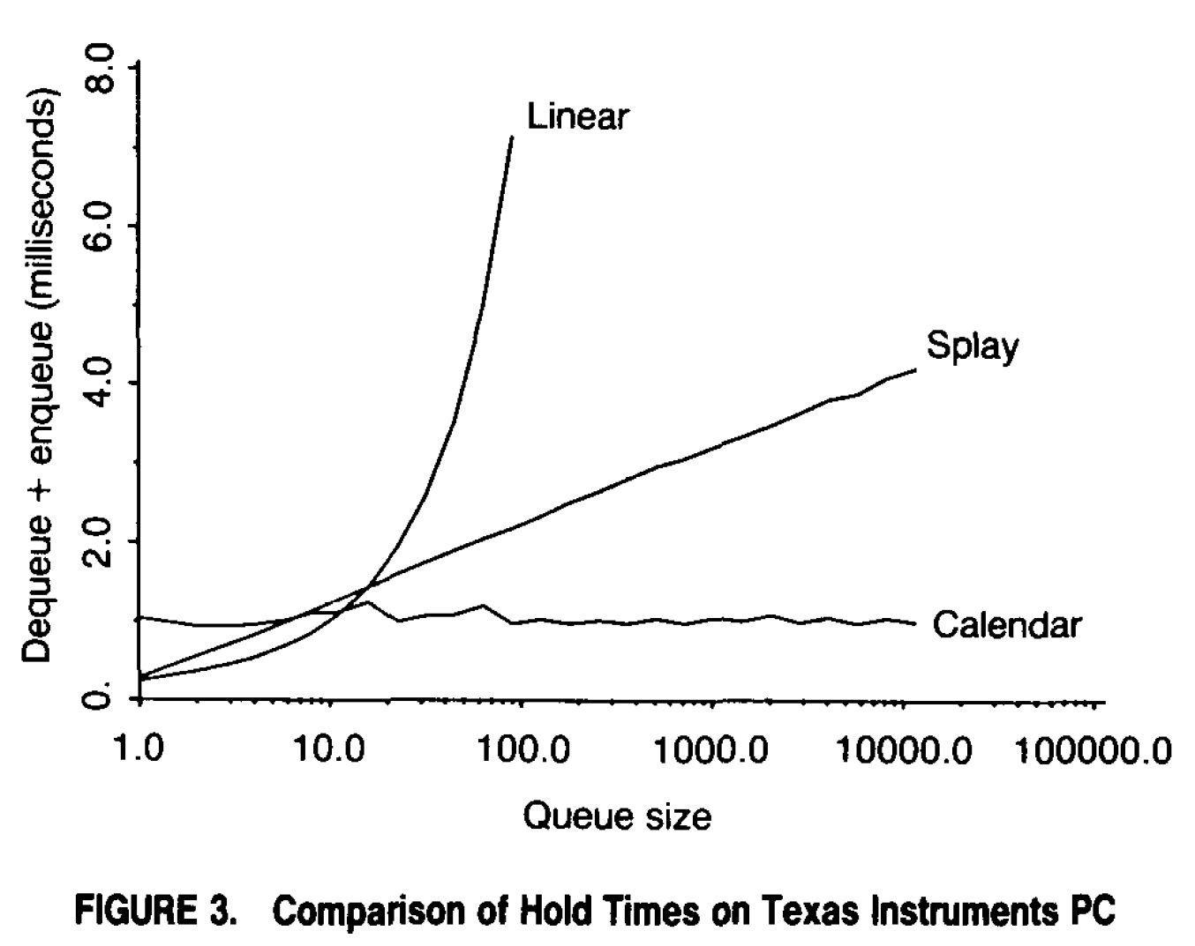
Performance Measurements
Hold model, exponential distribution

Slide 22
Calendar Queues
“Well behaved” (i.e., hold like) behavior results in excellent performance for test cases
  Often significantly faster the O (log n) data structures
In practice, extremely poor performance sometimes observed, due to excessive resizing operations or many items mapping to the same bucket (e.g., see [Rönngren, Ayani, 1997])
More recent refinements (e.g., Ladder Queue) offer variations on original calendar queue idea

Slide 23
Calendar Queue Critique
Calendar queue performs well when number of elements in the queue (n) and mean timestamp increment (μ) constant [Ronngren and Ayani 1997]
May yield O(n) performance if μ varies, even if n remains constant
  Many events in small number of buckets (long insertion time)
  Many empty buckets (long deletion time)
  Attributed to size-based trigger to resize queue
Large changes in n can cause poor performance
  May trigger resize operation when not necessary if size fluctuates by factor of two
  Resize operation expensive

Slide 24
Calendar Queue Critique (cont.)
Sampling heuristic for CQ parameters (number of buckets and bucket width) ineffective for skewed event distributions
  CQ heuristic to set bucket width to average time between events fails for skewed distributions
  High variance in inter-event time leads to inappropriate settings (e.g., small bucket size leading to many empty buckets that must be skipped on deletion operation)
Sorting events on enqueue operation
  Makes enqueue operation expensive for long sublists
  Sorting effort wasted if resize operation is triggered

Slide 25
Ladder Queue Data Structure
Top
  Unsorted list of “far future” events
  Maintain: MaxTS (largest timestamp), MinTS (smallest timestamp) and NTop (number of events) in list
  TopStart: all events in Top have timestamp at least this large
Middle
  Multi-level form of calendar queue
Bottom
  Sorted list of “near future” events
  Nbot: Number of events in list
W. T. Tang, R.S.M. Goh, L-J. Thng, “Ladder Queue: An O(1) Priority Queue Structure for Large-Scale Discrete Event Simulation,” ACM Transactions on Modeling and Computer Simulation, 15, 3 (July 2005), 175-204.

Slide 26
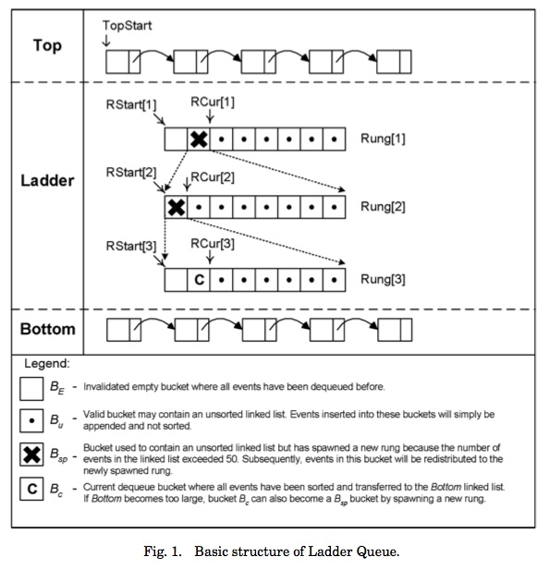
Ladder Queue
Top
  Unsorted list of “far future” events
Ladder (middle)
  Several “rungs” of buckets (rung like a CQ)
  Each bucket holds unsorted events
  If a rung has a bucket with too many events (event timestamps not uniformly distributed over bucket), “spawn” new rung
Bottom
  Sorted list of “near future” events
  Dequeue events here

Slide 27
Ladder (middle tier)
Spawning
If a bucket has “too many” events, form a new calendar queue (rung) containing events within that bucket
Repeat the above step for the new calendar queue (rung)
Process of creating a new rung called “spawning”

Slide 28
Ladder: Main Ideas
Each rung of ladder has a different bucket size, accommodating different timestamp distributions
Delay sorting events until small timestamped events about to be dequeued
  Insertion to Ladder and Top simply append to list; only Bottom list is sorted
  Avoids sorting list, then discarding work due to resize operation
Resize operation from an insertion only occurs in Bottom
  Size of Bottom limited to threshold, limiting cost of resize, independent of number of events in the queue
Theoretical complexity is O(1), amortized over multiple operations

Slide 29
LQ Operation: Epoch
Initially, all events reside in the Top
Epoch starts with first Dequeue operation
Move events from top to form a single rung of ladder (middle section)
If first non-empty list of events in ladder has fewer events than threshold
  Then: sort them and move to Bottom
  Else: spawn; move list of events into a new rung (form a new CQ with its own bucket size parameters based on events in the new CQ), and repeat this step
Dequeue first event from Bottom

Slide 30
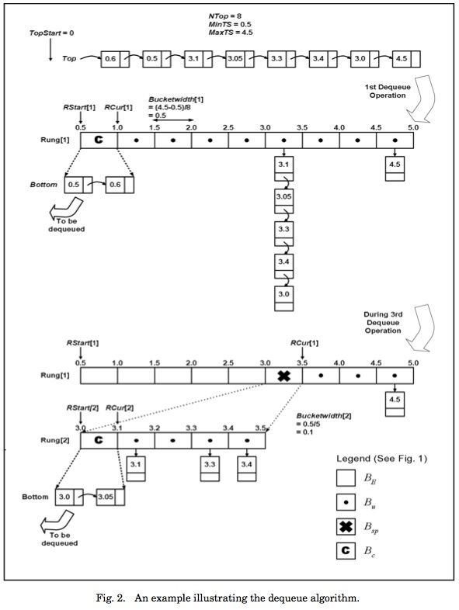
LQ: Spawn Example
Initially, all events in Top
Dequeue:
  Move Top events to ladder
  Move first two events in ladder to Bottom
  Return first event from Bottom (ts=0.5)
Dequeue:
  Return event from Bottom (ts=0.6)
Dequeue:
  List too long (length exceeds threshold)
  Triggers spawn operation
  Move first two events to Bottom
  Return first event (ts=3.0)

Slide 31
Enqueue Operation
Determine which part (Bottom, ladder, Top) will receive event based on the event timestamp
  Top: Unsorted insertion
  Ladder: Find rung, then insert (like CalQ insert)
  Bottom: Sorted insertion; if Bottom contains too many events (= threshold)
    Spawn a new rung in Ladder
    Populate new rung with events from Bottom
    First list in new rung becomes the new Bottom

Slide 32
Summary
Priority queue performance can be important for some very large simulations (hundreds of thousands to millions of events in FEL)
Variety of implementations exist
  Linear list generally fastest for small event lists
  O (log n) data structures (e.g., heap, splay tree) give predictable performance, though often not the fastest available approach
  Calendar Queue data structure offer best performance (constant time insert/delete) for many applications, but can yield surprisingly poor performance in some cases
  Ladder Queue addresses unstable property of calendar queue

