Slide 1
Modeling and Simulation: Fundamentals and Implementation
Dr. Brian Swenson
Content from required textbooks and slides created by Dr. Richard Fujimoto

Slide 2
Lecture 1 Introduction

Slide 3
Class Notes
I do not currently have any updates on the wait list. I have asked about it. I currently have no control on who gets into the class.
I wish I had better answers, but I currently do not
Readings:
Sayama: Chapter 2
Birta-Arbez: Chapters 1 & 2

Slide 4
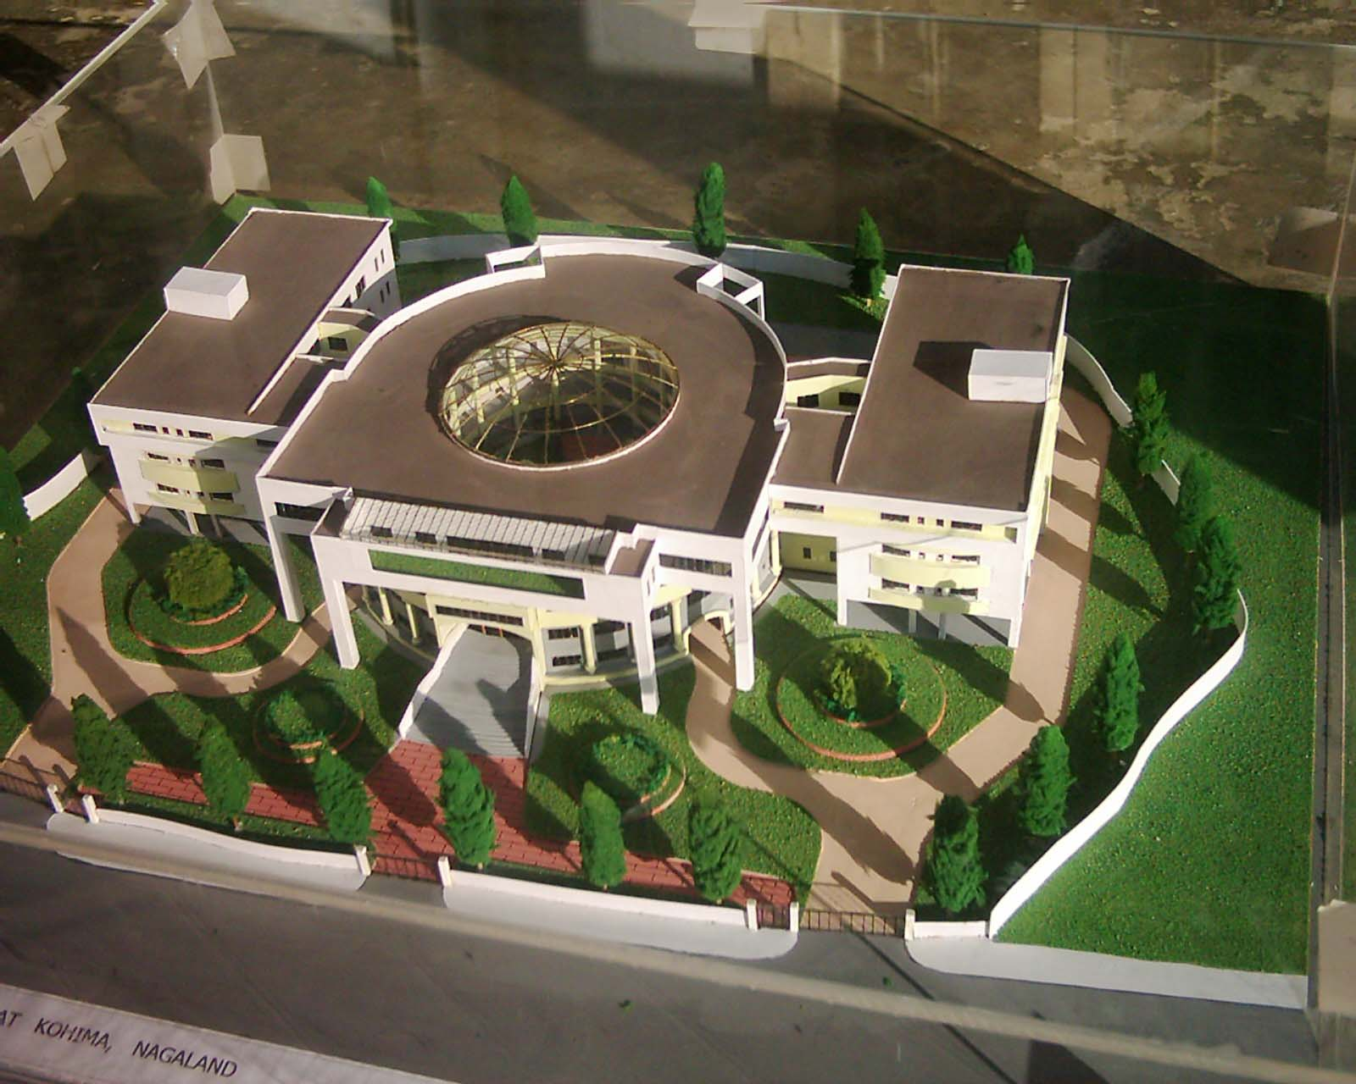
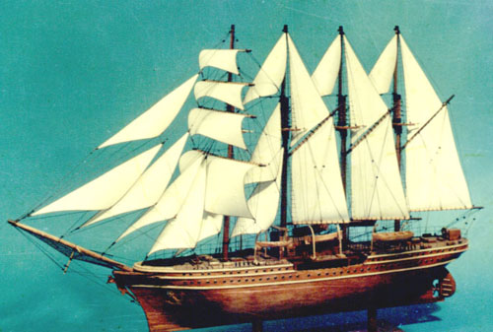

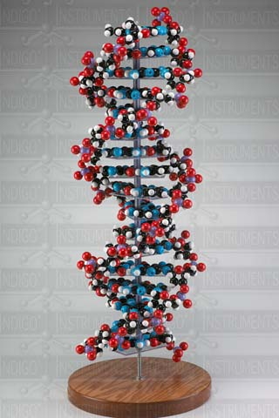
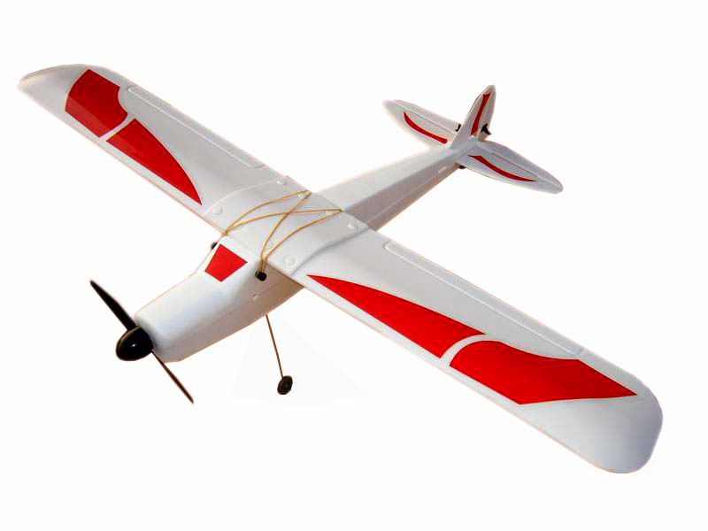
What is a model?

Slide 5
Model
A model is a simplified representation of a system
It can be conceptual, verbal, diagrammatic, physical or formal (mathematical)
H. Sayama, Introduction to the Modeling and Analysis of Complex Systems, p 13.

Slide 6
Model
You create models in your mind all of the time to understand or analyze something
Examples of models in science
F = M A
One cannot “prove” a model is correct
We can only observe that a model is consistent with the experiment; this does not “prove” it is correct
A model can be disproved

Slide 7
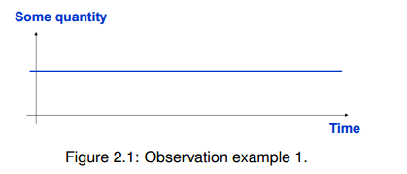
Create a model!

Slide 8


Create a model!

Slide 9
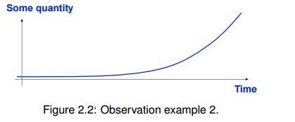
Create a model

Slide 10

Create a model

Slide 11
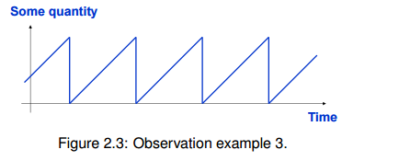
Create a model

Slide 12
Terminology
System Under Investigation (SUI) or Physical System
The real or imagined system that is to be modeled
Here, we are interested in models of dynamic systems, i.e, systems that exhibit behavior over time
“… a dynamic system is a collection of interacting entities that produces some form of behavior that can be observed over an interval of time”

Slide 13
Computer Simulation
A computer simulation is a computer program that uses computation to construct a representation of the behavior of a model of a particular system over time.
Computer simulations build on purely mathematical models in science, engineering and social sciences.

Slide 14
Why Simulate?

Slide 15
Why Simulate?
Observing an operational system may be
Too expensive (e.g., computer chips)
Too dangerous (e.g., forest fires or chemical spills)
Too disruptive (e.g., traffic signal timing)
Too time consuming (e.g. weather)
Not possible (e.g., creation of the universe)
Morally or ethically unacceptable (e.g., spread of disease)
Parts of the system may not be observable (e.g., internals of a silicon chip or biological system)

Slide 16
Why Simulate?
Uses of simulations
Analyze systems before they are built
Reduce the number of design mistakes
Optimized design
As a replacement for purely mathematical representations to explore physical systems
Analyze and/or optimize operational systems
Create virtual environments for training, entertainment

Slide 17
Applications: System Analysis
“Classical” applications of simulation to analyze, design, optimize systems
Weather, climate, astrophysics
Aerospace, automotive design
Telecommunication networks
Transportation networks
Microelectronics, computer systems
Battlefield simulations
Manufacturing systems
Typically focus on planning, system design, optimizationt

Slide 18
Simulation vs Data Analysis
Data analysis focuses on using observational data to infer properties or behavior of a system
Requires there be data for the SUI
Does not includes rules concerning how the system behaves
Less useful for non-recurring phenomena, what-if? Analysis
Data analysis and simulation are synergistic
Data analysis used to characterize inputs to the simulation (input analysis)
Data analysis used to make inferences concerning simulation results (output analysis)

Slide 19
History of Computer Simulation
1940’s – Earliest electronic computers used to determine trajectories of projectiles
1950’s – Analog computers commercially available and used for continuous simulations (solving differential equations), e.g., weather prediction
1960’s – The digital computer offers an alternative to analog computer and provides a means for simulating discrete event systems incorporating stochastic phenomena
1970’s and 80’s – Numerous modeling and simulation applications are developed
1980’s and 90’s – Emergence of parallel and distributed simulation

Slide 20
Simulation Taxonomy
Real machines
Simulated machines
Real people
Live
Virtual
Simulated people
Hardware in the loop
Constructive
Types of simulation (LVC)
Live: real people operating real equipment
Virtual: real people operating simulated equipment (simulator)
Constructive: simulated people operating simulated equipment

Slide 21
Simulation Taxonomy
Real machines
Simulated machines
Real people
Live
Virtual
Simulated people
Hardware in the loop
Constructive
Major application areas
Analysis: Wargamming, logistics
Training: Platform level, Command Level
Test and evaluation: Hardware-in-the-loop

Slide 22
Types of Simulation Models
System Model
Deterministic
Stochastic
Static
Dynamic
Static
Dynamic
Continuous
Discrete
Continuous
Discrete

Slide 23
Types of Simulation Models
Stochastic simulation: A simulation that contains random (probabilistic) elements
Examples
Inter-arrival time or service time of customers at a restaurant or store
Amount of time required to service a customer
Output is a random quantity (multiple runs required to analyze output)

Slide 24
Types of Simulation Models
Deterministic simulation: A simulation containing no random elements
Examples
Simulation of a digital circuit
Simulation of a chemical reaction based on differential equations
Output is deterministic for a given set of inputs

Slide 25
Static vs Dynamic Models
Static Models
Arguably, these are not simulations
Model where time is not a significant variable
Examples
Determine the probability of a winning solitaire hand
Dynamic Models
Model focusing on the evolution of the system under investigation over time
Main focus of this course

Slide 26
Continuous vs Discrete
Discrete Time
State of the system is viewed as changing at discrete points in time
An event is associated with each state transition
Events contain time stamps
Continuous Time
State of the system is viewed as changing continuously across time
System typically described by a set of differential equations
Distinction is conceptual; in practice continuous simulations discretize time
Why do they need to do this?

Slide 27
Discrete Event Simulation
State changes can occur at irregular points in time
In practice, one can always discretize the time scale and map a discrete event simulation to a time stepped model

Slide 28
Summary
Primary concern here is computer simulations of dynamic systems; capture the behavior of the system over time
Modeling and simulation used everywhere
System analysis, design and optimization
Training and entertainment
Test and evaluation
Vocabulary
Model, simulation, system under investigation
Virtual, constructive, live simulation
Stochastic vs. deterministic: out of stochastic model is a random variable, so multiple runs are required
Static vs dynamic simulation (here, focus on dynamic)
Continuous vs discrete

