Slide 1
Modeling and Simulation: Fundamentals and Implementation
Dr. Brian Swenson
Content from required textbooks and slides created by Dr. Richard Fujimoto

Slide 2
Lecture 2 Modeling and Simulation Process
Reference: Birta&Arbez, chpt 2

Slide 3
Class Notes
Hopefully everyone here is registered for the class!
At this point, no one else can be added
I will be out of town next week, there will be class however
Monday: github overview Eric Hein
Wednesday: guest lecturer Philip Pecher
Syllabus has been updated with office hours info

Slide 4
How NOT to do a modeling and simulation study
Develop an understanding of the system under investigation
Build the simulation program
Drink coffee and relax because your job is complete

Slide 5
Why is M&S Hard?
Key questions every model must answer
What to represent in the model?
What not to represent?
How much detail is required?
Knowing the answer to these questions requires one to know what you plan to do with the model
What questions do you hope to answer

Slide 6
A good rule of thumb
“Everything should be as simple as possible, but no simpler”
Albert Einstein

Slide 7
Modeling and Simulation Process

Slide 8
Modeling and Simulation Process

Slide 9
Goals/Objectives
What do you (or the customer) hope to accomplish with the model?
Example: Optimize a manufacturing process or develop the most cost effective means to reduce traffic congestion in some part of a city
Often requires developing a business case to justify the cost
Improved efficiency will save the company $$$
Goals may not be known when you start the project!
One often learns things along the way; goals may change

Slide 10
Project Description
What to include
Statement of goals of the project
Description of behavioral features of SUI relevant to the project goals
Informal language, colored by SUI related jargon
Informal sketches used to represent structural features
Communications tool to understand the problem

Slide 11
Full Service Gas Station
Two islands and four service lanes
Depending on time of day, one or two attendants serve the customers
A significant portion of customers drive vans and light trucks
Large trucks take more time to fill
Drivers of smaller cars wait longer for service behind these vans or light trucks. They get impatient.

Slide 12
Full Service Gas Station
Management is considering restricting the vans and light trucks to 2 lanes to improve the flow of vehicles
Servicing a customer has three phases
During the first phase, the attendant determines customer’s requirements and starts pumping the gas, cleans windshield, checks fuel levels, etc.
Delivery phase during which gas is pumped (attendant need not be present)
The payment phase when the attendant receives payment by cash or credit card

Slide 13
Modeling and Simulation Process

Slide 14
Conceptual Model
An abstract (i.e., not directly executable) representation of the system
Specifies what is included in the model (and implicitly, what is left out)
What abstractions should be used
Level of detail (granularity)
Often a variation of standard abstractions
Queueing networks, differential equations
What are the inputs and outputs? What metrics will be produced by the model?
Appropriate choice depends on the purpose of the model
Need to verify conceptual model is consistent with the problem description

Slide 15
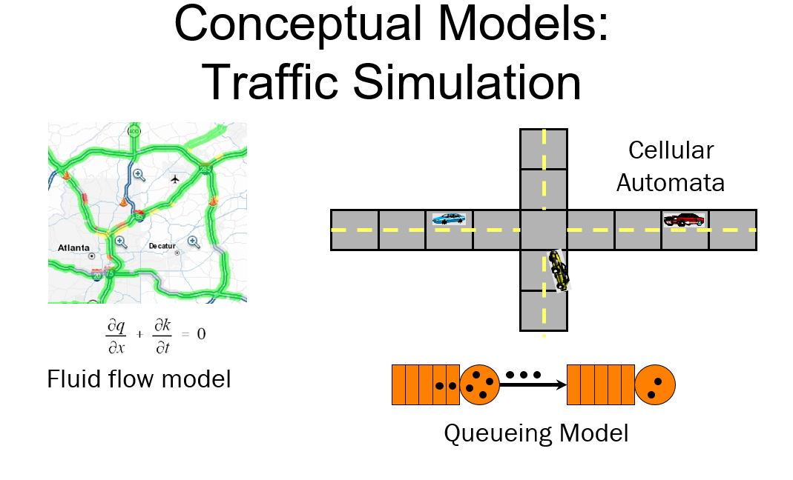

Slide 17
Conceptual vs Simulation Model
Conceptual Model: A representation of the SUI using some type of formalism (mathematics/symbolic in nature)
Provides the means to capture and discuss the model using some well understood “language”
Represents the salient aspects of the SUI consistent with the purpose of the simulation model
Simulation Model: Representation of the model as a computer program that can be executed
Example simulation techniques: discrete event, continuous, agent-based, parallel/distributed simulations

Slide 18
Preliminary Steps
Need to collect data to populate model
For traffic: Road geometry, signal timing, expected traffic demand
Empirical data or probability distributions often used
Need to collect additional behavioral information to define specifics of model, e.g., algorithms and other details
Path planning for vehicles, driver behavior

Slide 19
Simulation Model / Program
Representation of conceptual model as an executable computer program
Several software approaches
General purpose language (C, C++, FORTRAN, …)
Special purpose simulation language (Simula, GPSS, …)
Simulation package (Arena, AutoMod, …)
Choice may depend on need for customization, economics, performance, interoperability
Economic factors may constrain choice (build vs buy)
Is the goal creating the simulator or getting simulation results

Slide 20
Simulation Model / Program
Simulation Model: Code making up the model
Simulation Program: Services and execution environment
Databases, I/O, visualization., …)

Slide 21
Verification
Did I build the model correctly?
Does the simulation model/program match the conceptual model?
Largely a software engineering activity (debugging)
Not to be confused with correctness (model validation)

Slide 22
VALIDATION

Slide 23
Validation
Verification: Did I build the model right?
Validation: Did I build the right model?
Does the simulation model match the actual system?
Typically compared against
Measurements of actual system
An analytical (mathematical) model of the system
Another simulation model
By necessity, always an incomplete activity!
Often can only validate portions of the model
If you can validate the simulation with 100% certainty, why build the system?
Goal is to improve credibility and confidence in the model

Slide 24
Validation Methods
Face validation
Observed behavior appears correct by means of animation, graphical displays or the values of designated variables
More qualitative than quantitative
Naïve approach but still useful when the judgement of “domain experts” are included
Behavior validation
Validating using a collection of anticipated known behaviors
Engine failure of aircraft leads to decrease in altitude
People wait a long time to get gas get irrate

Slide 25
Validation Methods
Replication validation
Collect input-output behavior of SUI in a database
Compare input-output behavior of model to observed SUI behavior
Validation of the data model is just as important as validation of the simulation

Slide 26
Experimentation
Presentation of Results

Slide 27
Experimentation and Presentation of Results
Design of experiments
Have clear questions before beginning experimentation
Develop experiment plan
What model configurations? How long?
How many runs?
What parameters? How are they varied?
Output analysis
Statistical analysis of results
Sensitivity analysis

Slide 28
Experimentation and Presentation of Results
Presentation
Important to keep customer informed throughout modeling process to build confidence
Effective visualization may trump model quality

Slide 29
Challenges to Modeling and Simulation
Inappropriate statement of goals
Inappropriate granularity of a model
Ignoring unexpected behavior
Inappropriate mix of essential skills
Inadequate flow of information to the customer

Slide 30
Creating a Simulation
Creating a computer simulation involves developing the mathematical or conceptual abstractions of systems, and converting these abstractions into efficient software

