Slide 1
Adhoc Test and Scan
Types of Scan, scan flops
Cost of Scan
Ack: Manuel d’Abreu
Santa Clara University
10/05/2009
M.d'Abreu

Slide 2
What is the Foundation for DFT?
Controllability
  Ability to drive a node to a known value (state)
Observability
  Ability to observe the value (state) of a node
Initialization
  Drive the “Circuit Under Test (CUT)” to a know and deterministic state.
10/05/2009
M.d'Abreu

Slide 3
Definition
Design for testability (DFT) refers to design techniques that make test generation and test application cost-effective.
DFT methods for digital circuits:
  Ad-hoc methods
  Structured methods:
    Scan
    Built-in self-test (BIST)
    Boundary scan
DFT method for mixed-signal circuits:
  Analog test bus
10/05/2009
M.d'Abreu

Slide 4
Ad-Hoc DFT Methods
Good design practices learnt through experience are used as guidelines, e.g.:
    Avoid asynchronous (unclocked) feedback.
    Avoid gated clocks.
    Avoid redundant gates. Avoid large fan-in gates.
    Make flip-flops initializable.
    Provide test control for difficult-to-control signals.
    Consider ATE requirements (tristates, etc.)
Design reviews conducted by experts or design auditing tools.
Disadvantages of ad-hoc DFT methods:
    Experts and tools not always available.
    Test generation is often manual with no guarantee of high fault coverage.
    Design iterations may be necessary.
10/05/2009
M.d'Abreu

Slide 5
The Scan Technique
Scan design goal is to reduce test generation
complexity for circuit containing storage devices
and feedback paths to the complexity of testing
combinational logic, and increase test coverage.
The philosophy is to divide & conquer with the
purpose to :
1. Set any internal state easily
2. Observe any state through a distinguishing
sequence
10/05/2009
M.d'Abreu

Slide 6
What is Scan Design
This DFT technique is used mainly for sequential circuit represented by the Huffman model presented in Chapter 3
We assume the use of D-flip-flops only
A mux is placed at the input of each flip-flop in such a way that all flip-flops can be connected in a shift register for one mux selection and to work in normal mode in the other
10/05/2009
M.d'Abreu

Slide 7
A Generalized Huffman Model
X
1
Z
1
X
2
Combinational Circuit
Z
X
2
3
Z
3
D
Q
D
Q
D
Q
1
2
n
clk
clk
clk
Clk
(a)
X
1
Z
Combinational Circuit
1
X
2
Z
2
X
3
Z
3
0
0
0
D
Q
D
Q
0
D
Q
1
1
1
1
SI
1
2
n
SO
clk
clk
clk
SE
Clk
10/05/2009
M.d'Abreu
(b)

Slide 8
How Scan DFT Works
The combinational part is partitioned:
  Each input to the FF is considered an output to the circuit
  each output of the FF is an input to the circuit
Connect the FF in a shift register and test them
Test the combinational part
10/05/2009
M.d'Abreu

Slide 9
Before Adding Scan
FF3
FF1
Combinational
Logic
FF4
FF2
FF5
10/05/2009
M.d'Abreu

Slide 10
After Adding Scan
FF3
FF1
Combinational
Logic
FF4
FF2
FF5
FFx
Scan Flip Flop (scan logic not shown)
10/05/2009
M.d'Abreu

Slide 11
Scan Design Techniques
Flip-flop of design→ Scan registers
Use of Multiplexer
Increased controllability and Observability
Special scan registers
10/05/2009
M.d'Abreu

Slide 12
Full scan
Additional wiring and mux : area and performance effect
Long test time
Less effort in ATPG
Cost increases with number of pins.
10/05/2009
M.d'Abreu

Slide 13
Comb. Test Vectors
I1
I2
O1
O2
PI
PO
SCANIN
TC
Combinational
logic
SCANOUT
S1
S2
N1
N2
Present
state
Next
state
10/05/2009
M.d'Abreu

Slide 14
Hierarchical Scan
Scan flip-flops are chained within subnetworks before chaining subnetworks.
Advantages:
    Automatic scan insertion in netlist
    Circuit hierarchy preserved – helps in debugging and design changes
Disadvantage: Non-optimum chip layout.
Scanin
Scanout
SFF1
SFF4
SFF1
SFF3
Scanin
Scanout
SFF2
SFF3
SFF4
SFF2
Hierarchical netlist
Flat layout
10/05/2009
M.d'Abreu

Slide 15
Optimum Scan Layout
X
X’
IO
pad
SFF
cell
SCANIN
Flip-
flop
cell
Y
Y’
TC
SCAN
OUT
Routing
channels
Interconnects
Active areas: XY and X’Y’
10/05/2009
M.d'Abreu

Slide 16
ATPG Example: S5378
Original
2,781
179
0
0.0%
4,603
35/49
70.0%
70.9%
5,533 s
414
414
Full-scan
2,781
0
179
15.66%
4,603
214/228
99.1%
100.0%
5 s
585
105,662
Number of combinational gates
Number of non-scan flip-flops (10 gates each)
Number of scan flip-flops (14 gates each)
Gate overhead
Number of faults
PI/PO for ATPG
Fault coverage
Fault efficiency
CPU time on SUN Ultra II, 200MHz processor
Number of ATPG vectors
Scan sequence length
10/05/2009
M.d'Abreu

Slide 17
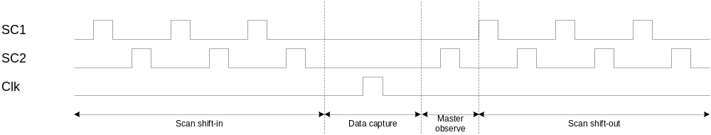
Scan Chain
Stuck@Fault made testable by adding scan
Scan protocol
Scan in
D
SET
Q
CLR
Q
D
SET
Q
0
S@1
0/1
D
SET
Q
D
SET
Q
SET
CLR
Q
Q
D
Q
CLR
CLR
Q
CLR
Q
D
SET
Q
1
SET
Q
Scan out
D
Q
CLR
Q
CLR
SET
D
Q
CLR
Q
10/05/2009
M.d'Abreu

Slide 18
Multiple Scan Chains
Instead of stringing all the flip-flops or the latches in one shift register
  Partition them is several chains
The advantages are:
  compatible with multiple clock designs
  Shorten test application time
  Simplify the stitching of the flip-flops
But, may require extra pins
10/05/2009
M.d'Abreu

Slide 19
Multiple Scan Chains
a1
a2
1
D
SET
Q
a3
5
D
SET
Q
Z1
a4
4
6
CLR
Q
CLR
Q
N1
2
N2
3
D
SET
Q
Z
8
D
SET
Q
12
D
SET
Q
7
9
10
D
SET
Q
13
CLR
Q
11
CLR
Q
CLR
Q
CLR
Q
Goal is to BALANCE the chains – chains must have the same number of flops
10/05/2009
M.d'Abreu

Slide 20
Delay Defects and Models
Types of Defects
  Resistive vias
  Metal extrusions and voids
  Imperfections in lattice structures
  Particles/contaminations
  Opens/voids
Types of Models
  Gate Delay Fault Model (Transition Fault Model)
  Path delay fault model
  Segment delay
  Inline Resistive Open
  Cross-talk
10/05/2009
M.d'Abreu

Slide 21
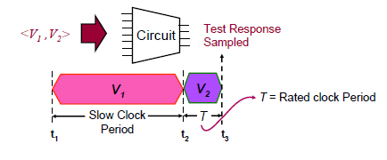
Scan-based at-speed testing
For testing of typically delay faults a vector pair {V1, V2} that perform following operations is needed.
  the vector V1 performs initialization at slow speed (V1)
  followed by vector (V2) that launches and captures the transition.
10/05/2009
M.d'Abreu

Slide 22
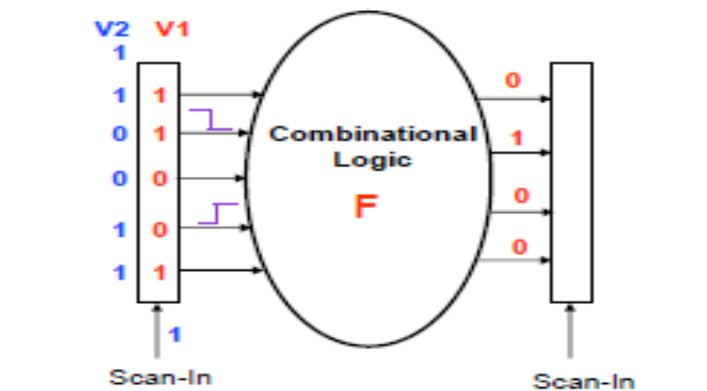
Techniques used in Industry
Launch of shift (LOS)
  Allows at speed transition from (V1) to (V2) during scan shifting.
  Vector V1 is loaded at slow speed as loaded in the previous scan cell.
  The last shift operation applies V2 at-speed using at-speed update signal.
10/05/2009
M.d'Abreu

Slide 23
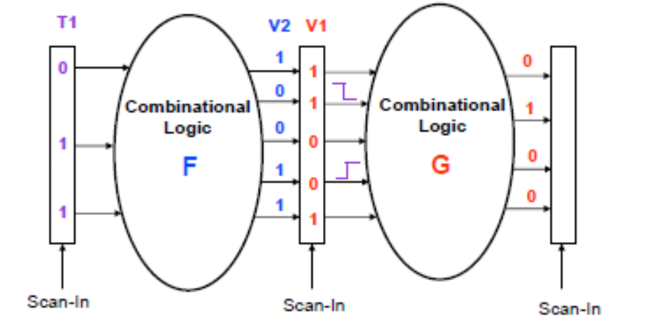
Techniques used in Industry
Launch of capture (LOC)
  allows creation of (V1) to (V2) through functional justification.
  Vector V1 is loaded at slow speed into scan cell while V2 is created as functional response of the scan cell values loaded into previous stage of scan cells.
10/05/2009
M.d'Abreu

