Slide 1
Committee Meeting Two
Chase Rushton
22 January 2018
Auburn University

Slide 2
Talk outline
Status update since Last meeting
Overview of findings
Ongoing/Future work

Slide 3
Since last meeting
Paper published – (Recombination rate plasticity: revealing mechanisms by design) : Philos Trans R Soc Lond B Biol Sci. 2017 Dec 19
Expanded project to whole genome
Expanded sample set
Switched to a Data driven approach

Slide 4
Findings so far
The majority of SV’s are shared between species
SV’s mutation rate is low relative to other mutations
SV frequency decreases with increase in size
Large portion of divergent regions are on the X Chromosome
Gene families in divergent regions are related to: Sex, immunity, and ecological functions
Questions to answer
Are these findings correlated?
How do they relate to Hybridization/Speciation

Slide 5
Both PCR and Denovo assembly failed to recover the 15mb INV on Chr5

Slide 6
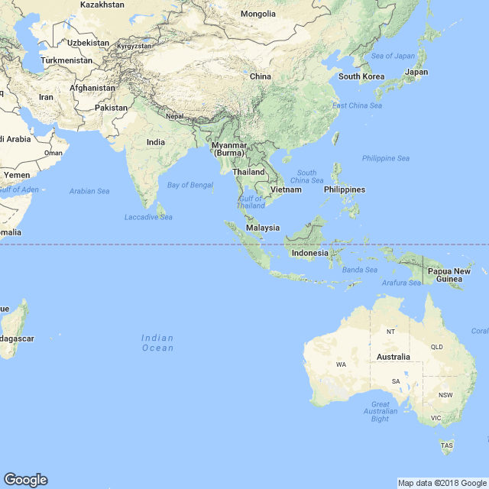



Sample | Location | Accession
Rhesus | India | SRR278739
Rhesus | South China | SRP003590
Rhesus | Yunnan Province China | SRA023856
Rhesus | Unknown -Using mt DNA | SRP10359
Rhesus | Unknown-Using mt DNA | SRP103539
Rhesus | Unknown – Using mt DNA | SRP103539
Fascicularis | Vietnam | SRP045755
Fascicularis(6) | Mauritius | PRJEB7871
Fascularis | Indonesia | SRA023856
Notes:
14 total samples 6 Rhesus, 8 Fas

Slide 7
Structural Variation Results
5 programs – SV had to hit 3/5 to be accepted
Rhesus | INV | DEL | INS | DUP
SMALL(1kb) | 113 | 160 | 0 | 0
MEDIUM(1-10kb) | 2674 | 3947 | 0 | 0
LARGE(10kb-1mb) | 5304 | 3340 | 0 | 0
EXLARGE(1mb+) | 21 | 22 | 0 | 0
Fascicularis | INV | DEL | INS | DUP
SMALL(1kb) | 640 | 0 | 0 | 0
MEDIUM(1-10kb) | 18 | 2 | 0 | 1532
LARGE(10kb-1mb) | 497 | 306 | 0 | 431
EXLARGE(1mb+) | 647 | 0 | 0 | 0
Notes:
4k fas ,14k rhesus

Slide 8
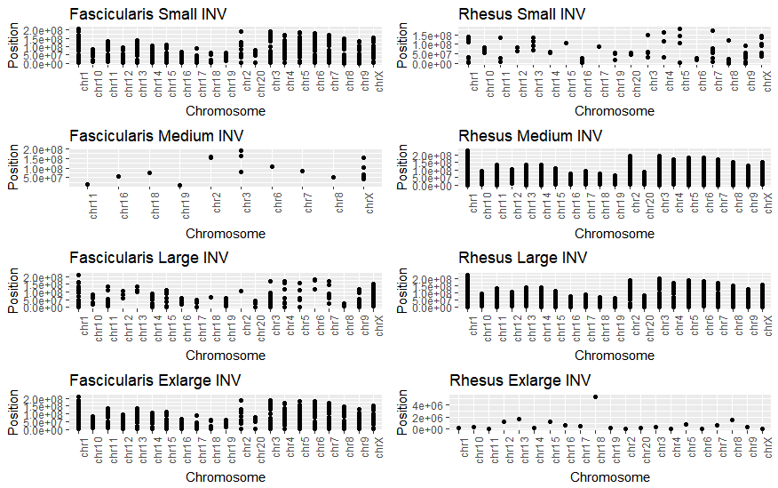

Slide 9
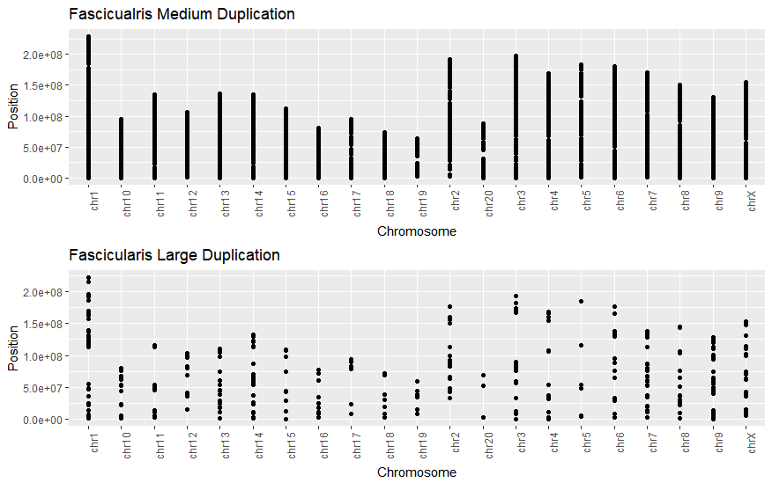

Slide 10
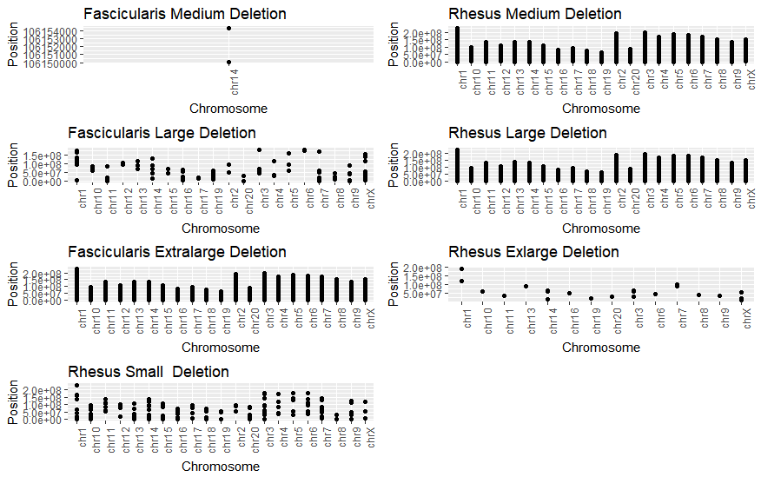

Slide 11
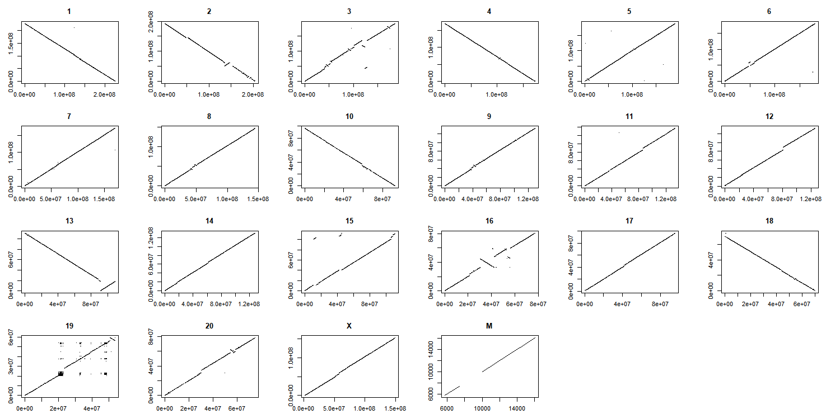
Pair Wise Alignments

Slide 12
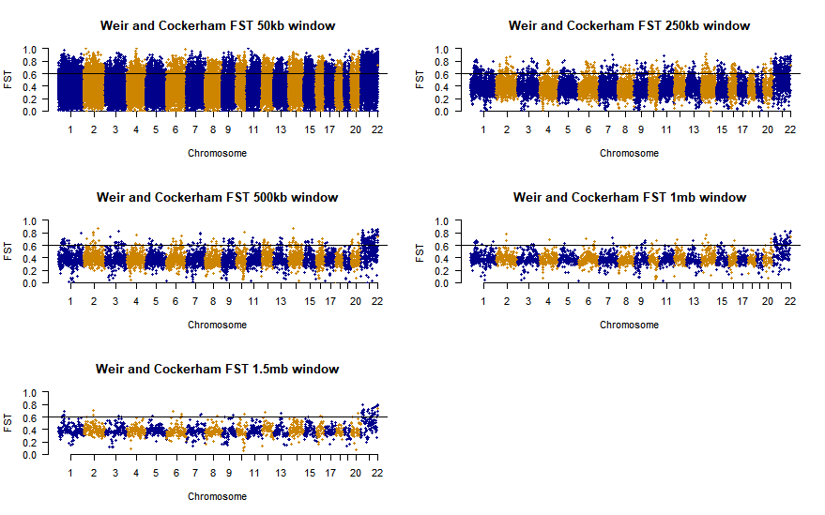
Diversity/Divergence scan(FST)
Notes:
Top FST 1% 0.83099535 50kb window with top 1% was used to reduce the confounding effect of the majority of the outliers being on the X

Slide 13
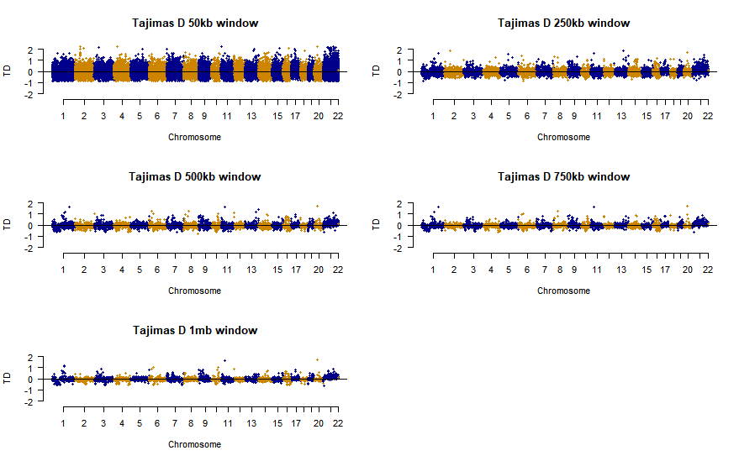
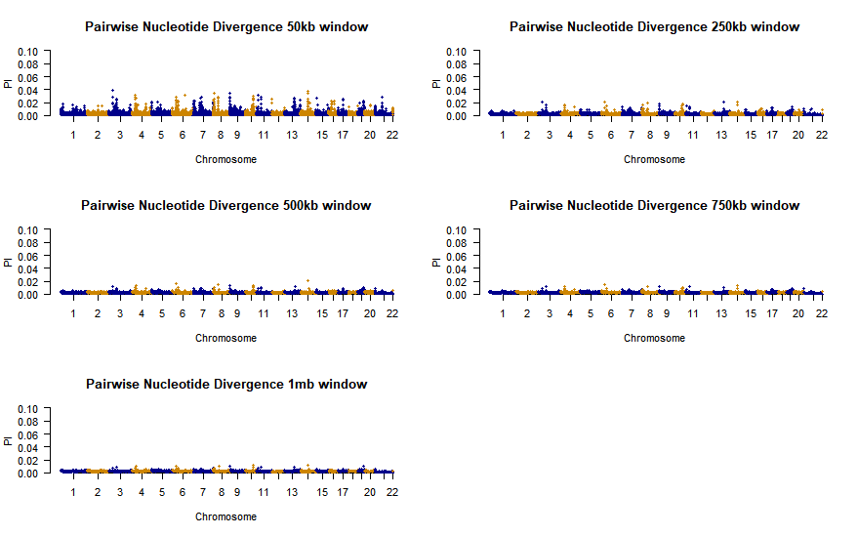
Matched top 1% FST with (-) TD
Low Pi
74 Regions were used for Gene ontology analysis

Slide 14
Divergence Outliers with Structural Variants
FST outliers and SV’s regions overlap
High FST appears to be correlated with SV position (ANOVA, T-test )
Looking for better statistical methods to compare these two datasets
Don’t meet the assumptions for ANOVA, KS, T-test

Slide 15
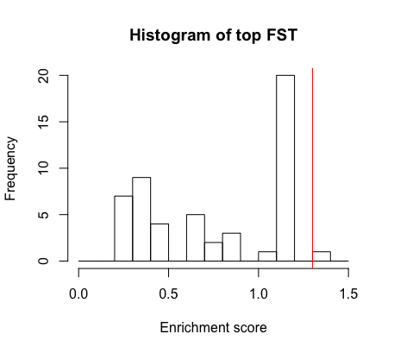
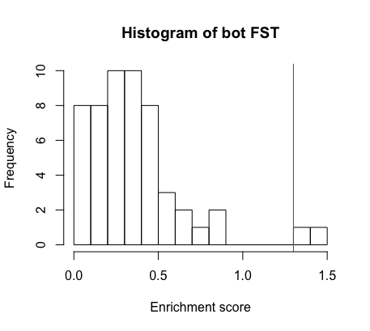
Results of GO analysis
Used an enrichment cutoff of <1.2
Notes:
An enrichment score of 1.2-1.3 is like a 0.05 P value

Slide 16
Results of GO analysis
Top 1% gene families | Bottom 1% gene families
Sperm | Metal Binding
Fertilization | Cell recognition
Reproductive processes | Cytokines
Immunoglobin | K/Na pumps
Metabolism | Transmembrane protein
Biosynthetic Pathways | Cellular composition
Metabolic Pathways | Transmembrane signal transduction
RNA Regulation | Zinc Finger Motif
Gene Expression Regulation | Gland Development
Mitochondrial transport | Cell Development
Notes:
Picked an FSTcutoff of 1% and an enrichment sore cutoff of 1.2

Slide 17
Faster X Evolution
Run dN/dS on X vs autosomes
Run dN/dS on PAR vs Non PAR regions with PAR1 and PAR 2
Expectation: PAR regions will have the same rate as Autosomes
Autosome: 0.155+-0.29
PAR:0.125+-0.296
NON PAR: 0.203303+-0.39
No evidence of PAR2 region in Macaques.
Notes:
Rate of dN/dS substitutions higher on genes that are on both sex chromosome copies(PAR) over one copy

Slide 18
Ongoing work
Faster X (ongoing)
Compare rate of diversity and divergence of Rhesus/Fascicularis compared to Baboon
Should be less divergence but more diversity between Rhe/Fas and Baboon
New X polymorphisms under stronger selection
Further analyze SV’s and Divergent region correlation
Overlay SV’s onto pairwise alignments for each bin
ID 3 unknown Rhesus samples
Compare results to other systems

Slide 19
Conclusion
The majority of SV’s are shared between species
SV frequency decreases with size
Large portion of divergent regions on the X Chromosome
Gene families in Divergent Regions are related to : Sex, Immunity, and ecological functions
Shed light on the complex history of primate admixture
Elucidate underlying biological processes
Help understand SV and X evolution related to speciation
Foundation for further research

Slide 20
Acknowledgements
Stevison lab
ASC
Hopper
Auburn University
Abby Beatty , Aundrea Westfall, Dr. Stephen Sefick
Committee:
PI: Dr. Laurie Stevison
Dr. Tonia Schwartz
Dr. Les Goertzen

Slide 21
Extract SRR files using SRA Toolkit
Version 2.8
Haplotype caller
GATK version 3.6
Alignment and sorting using BWA 0.7.12 and Samtools version 1.2
BQSR
GATK version 3.6
Repeat until 99% alike
Adding read group library information
PICARD tools version 1.79
VCF compare
Version 0.1.14
Merging files using PICARD tools version 1.79
Apply recalibration
GATK version 3.6
Sorting the newly merged bam with PICARD tools version 1.79
Lumpy
CNVnator
Delly
Breakdancer
Pindel
Marking the Duplicates using Picard tools version 1.79
Custom Python script
Indel realignment using GATK version 3.6
Multi-intersectbed

Slide 22
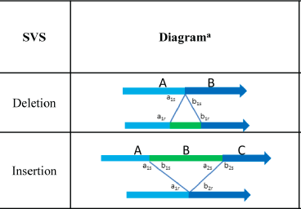
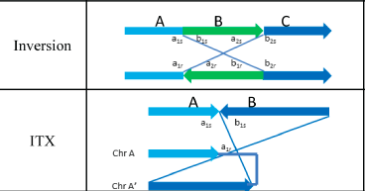
Structural Variant Algorithms
Detecting SVs uses one or more of the following:
Signals from read alignments: split-read
Read-pair [abnormal paired-end alignments]
Depth of-coverage
Junction-mapping
Assembly around potential breakpoints
Notes:
. The top sequence is experimental and bottom is reference.

