Slide 1


Diabetes Prediction Using Linear, Logistic Regression and Principal Component Analysis
Ayan Sengupta
Aubhik Mazumdar

Slide 2
Introduction
Classification of observations to predict whether individuals have Type-2 Diabetes
Based on 8 features present in the ‘PIMA Indians Diabetes’ dataset
768 observations
Techniques used:
Principal Component Analysis
Linear Regression
Logistic Regression

Slide 3
The Dataset - Pima Indians Diabetes
Features: (all numeric-valued, continuous) 1. Pregnancies - Number of times pregnant 2. Glucose - Plasma glucose concentration a 2 hours in an oral glucose tolerance test 3. Blood Pressure - Diastolic blood pressure (mm Hg) 4. Skin Thickness - Triceps skin fold thickness (mm) 5. Insulin - 2-Hour serum insulin (mu U/ml) 6. BMI - Body mass index (weight in kg/(height in m)^2) 7. Diabetes pedigree function- chance of Diabetes in the next 5 years 8. Age (years)

Slide 4
Steps Involved
Clean Data
Exploratory Data Analysis
Univariate analysis
Standardize/ Z-transformation (for PCA)
Observe correlation
Principal Component Analysis
Model Selection and Evaluation
Linear Regression
Logistic regression
Recommendation system for medicines to prescribe

Slide 5
Component Extraction Criterion
Eigenvalue Criterion - The eigenvalue criterion states that only components with eigenvalues greater than 1 should be retained. Note that if there are fewer than 20 variables, the eigenvalue criterion tends to recommend extracting too few components.
Proportion of Variance Explained Criterion - how much of the total variability he or she would like the principal components to account for.
Scree Plot Criterion - The maximum number of components that should be extracted is just prior to where the plot first begins to straighten out into a horizontal line

Slide 6
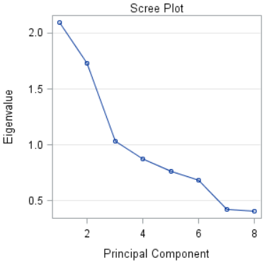
Scree Plot Analysis
Scree plot flattens after seventh eigenvalue.
We choose the first six eigenvalues as principal components.

Slide 7
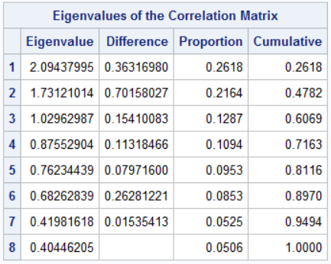
Analysis of Eigenvalues and Eigenvectors
3 eigenvalues >1
They explain only 61% of the variance of the data
We take into account the first 6 eigenvalues
They cover a reasonable 89% of the data.

Slide 8
Principal Component Analysis
Here is the analysis of using PCA for this dataset
PCA usually works on data with high feature count so that a reasonable proportion of them can be removed. However, in this scenario we have only 8 features.
Running the model using the principle components produced results worse than what was produced with the original set of components. Hence we can say that PCA isn’t suitable in this specific scenario.

Slide 9
Linear Regression
Developed 3 different models and evaluated their accuracies-
Original features and dataset with stepwise selection
Using all Principal Components and stepwise selection
Principal Components 1 to 6 as determined through extraction
Test for predicting all 1s and all 0s
Linear Regression Classification
Additional model to predict Diabetes Pedigree Function value to see if we can substitute the missing values in the dataset

Slide 10
Check Distribution
Predicting outcome=1 for all observations
Accuracy = 34.533%
Prediction outcome=0 for all observations
Accuracy = 65.104%
=> We should test for an alternative hypothesis

Slide 11
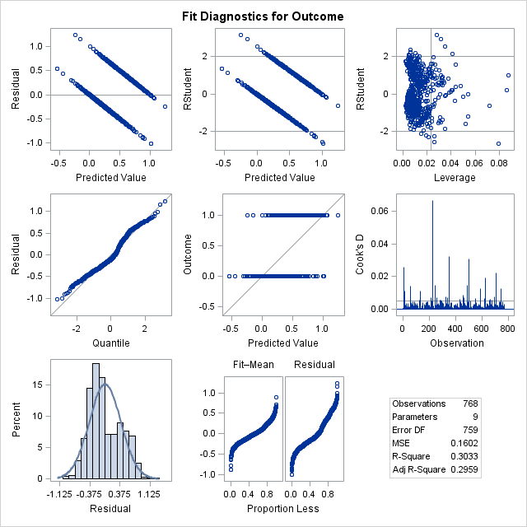
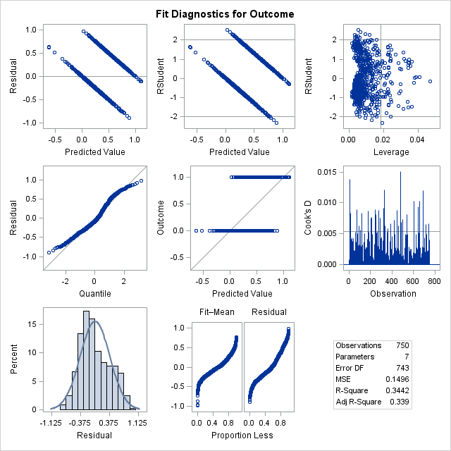
With leverage and influence points
Without leverage and influence points

Slide 12
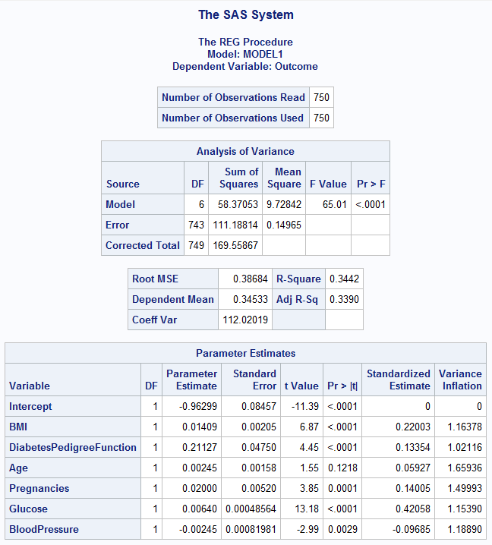
MODEL1- ANALYSIS
Model is significant (Pvalue < 0.0001)
F value is in the right range
All features are significant (<0.005), except age
Age is still in the model because stepwise selection has used the 0.15 level to decide which features are significant
Age has a very small parameter value (Beta) so it does not affect the model much
Glucose’s parameter value is also low
Final model
Outcome = -0.96299
+ 0.014*BMI
+ 0.211*DPF
+ 0.002*AGE
+ 0.02*PREGNANCIES
+ 0.006*GLUCOSE
- 0.00245*BloodPressure

Slide 13

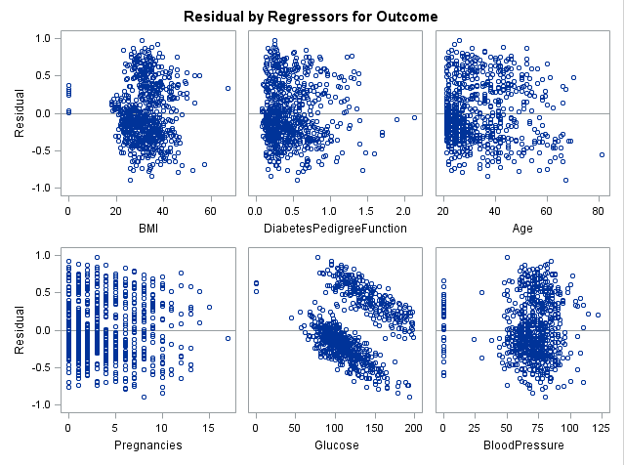
Residual Analysis

Slide 14
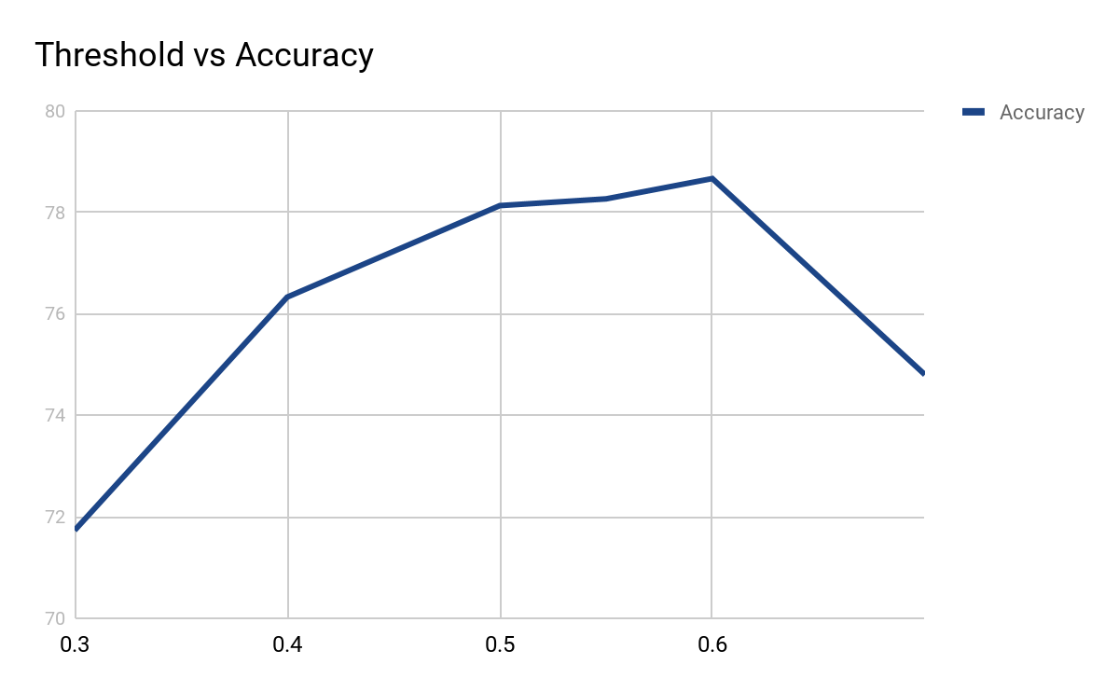
Linear Regression Classification
To convert the continuous values we get from our model into discrete values (1 or 0)
Choose a threshold value 𝛕 such that:
If predicted value >= 𝛕, predict 1
Else predict 0
We chose 𝛕=0.6

Slide 15
Results
MODEL | ACCURACY
1. Original features and dataset (stepwise) | 78.133%
2. Using all PCs (stepwise) | 76.562%
3. Using Prin1--Prin6 | 76.041%

Slide 16
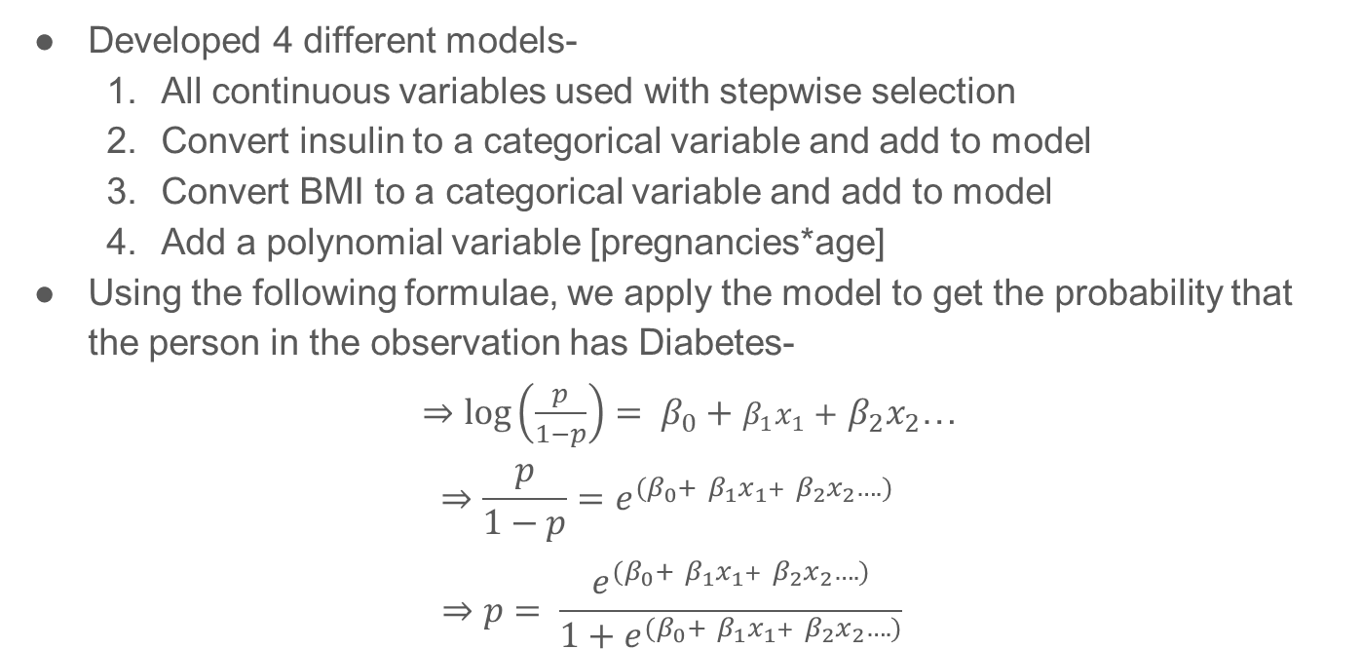
Logistic Regression
Developed 4 different models-
All continuous variables used with stepwise selection
Convert insulin to a categorical variable and add to model
Convert BMI to a categorical variable and add to model
Add a polynomial variable [pregnancies*age]
Using the following formulae, we apply the model to get the probability that the person in the observation has Diabetes-
$⇒log\left(\frac{p}{1−p}\right)= β_{0}+$ $β_{1}x_{1}+$ $β_{2}x_{2}$…
$$⇒\frac{p}{1−p}=e^{{(β}_{0}+ β_{1}x_{1}+ β_{2}x_{2}….) }$$
$$⇒p= \frac{e^{{(β}_{0}+ β_{1}x_{1}+ β_{2}x_{2}….)}}{1+e^{{(β}_{0}+ β_{1}x_{1}+ β_{2}x_{2}….)}}$$

Slide 17
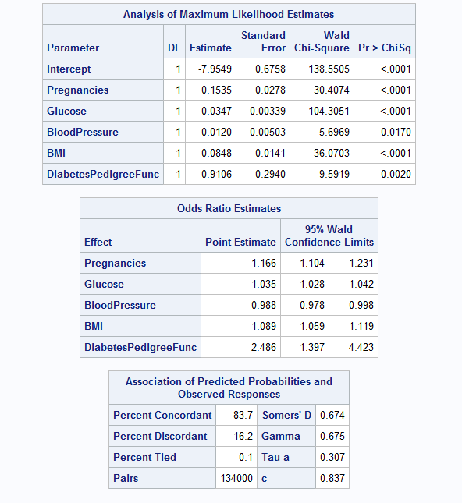
MODEL 1- ANALYSIS
All features chosen are significant (<0.005)
C value is good (close to 1)
Concordant percentage is high meaning that the predictions are mostly correct
FINAL MODEL
log(odds) = -7.9549 + 0.1535*Pregnancies
+ 0.0347*Glucose
- 0.012 * BloodPressure
+ 0.0848 * BMI
+ 0.91 * DPF
From this we can take out the probability of a person/observation having Diabetes.
If the probability is >0.5 => Predict outcome=1

Slide 18
Accuracy Evaluation
*I have used a simple python code to calculate the accuracy
MODEL | ACCURACY(%)
1 All features | 78.385
2 Add V_insulin (with stepwise) (!=0 => 1) | 77.604
3 Add V_bmi (>=35 => 1) | 76.823
4 Pregnancy*Age | 76.692

Slide 19
Recommender System
Using the information we have, we can recommend medicines to the people in the study
Four medicines: Novolin (short acting insulin T1D), Acarbose (T2D), Lisinopril (high BloodPressure), Diuril (low BloodPressure)
Create a rounded matrix for recommending medicines
Subject | Novolin | Acarbose | Lisinopril | Diuril
A (T2D and high BP) | 0 | 1 | 1 | 0
B (low BP) | 0 | 0 | 0 | 1
C (T1D and high BP) | 1 | 0 | 1 | 0

Slide 20
Future Work
Can help doctors to prescribe medicines. Reduce 500 to 20
Additional features for higher accuracy
Perform a similar analysis for other ailments

Slide 21
Questions?

