Slide 1
Jakarta Faces
Petr Aubrecht

Slide 2
Agenda
UI Development Evolution
web.xml, Page structure, EL
Form, CDI Bean, Validation
Messages, Navigation, Localization
Lists and Tables
Lifecycle
Templates

Slide 3
UI in the Tech Stack
client/web browser
AJAX
All Jakarta UI technologies are server-side rendered
They are all Java-based
presentation layer/JSF/JSP/Servlet
business logic layer/EJB
data layer/JPA
db

Slide 4
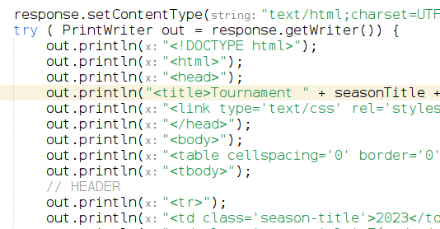
Servlet
Code everything in Java
Even simple HTML page is a LOT OF CODE
XSS vulnerability

Slide 5
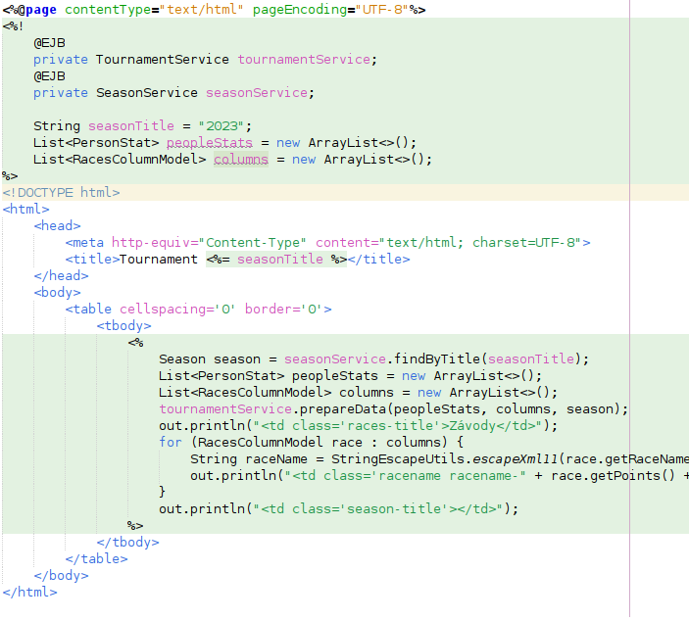
Jakarta Pages
(X)HTML + Java
Easy to display data
Nightmare to repopulate a form (display is different from update), especially listbox (<item… selected>), navigation
Still XSS vulnerable

Slide 6
UI Authoring Evolution
Sevlets hide HTTP transport
Pages hide Java code in Servlet out.println(“<html>”);
How to hide complexity with forms and their storage, repopulation in case of error, validation, error reporting?
How to write cool looking apps?
Who of us knows Javascript and CSS that well?
→ Faces and its component libraries

Slide 7

How to Start – web.xml
<servlet>
<servlet-name>Faces Servlet</servlet-name>
<servlet-class>jakarta.faces.webapp.FacesServlet</servlet-class>
<load-on-startup>1</load-on-startup>
</servlet>
<servlet-mapping>
<servlet-name>Faces Servlet</servlet-name>
<url-pattern>*.xhtml</url-pattern>
</servlet-mapping>
Mapping used to be /faces/* – but it has issues (strange relative paths)

Slide 8
Page Structure (XHTML)
<?xml version='1.0' encoding='UTF-8' ?>
<!DOCTYPE html PUBLIC "-//W3C//DTD XHTML 1.0 Transitional//EN" "http://www.w3.org/TR/xhtml1/DTD/xhtml1-transitional.dtd">
<html xmlns="http://www.w3.org/1999/xhtml"
xmlns:h="http://xmlns.jcp.org/jsf/html"
xmlns:f="http://xmlns.jcp.org/jsf/core"
xmlns:ui="http://xmlns.jcp.org/jsf/facelets">
<h:head>
<meta ... <title ...
</h:head>
<h:body>
<h:form id="nsdform">
<h:messages /> ...
</h:form>
</h:body>
</html>

Slide 9
Old JSP Page Structure, Removed in JEE 10
<%@page contentType="text/html"%>
<%@page pageEncoding="UTF-8"%>
<%@taglib prefix="f" uri="http://java.sun.com/jsf/core"%>
<%@taglib prefix="h" uri="http://java.sun.com/jsf/html"%>
<f:view>
<html> <head> <meta ... <title ... </head>
...
<h:form id="nsdform">
<h:messages /> ...
</h:form>
</body>
</html>
</f:view>
for record, it required f:view, used JSP tags like <%@ for page and taglib

Slide 10
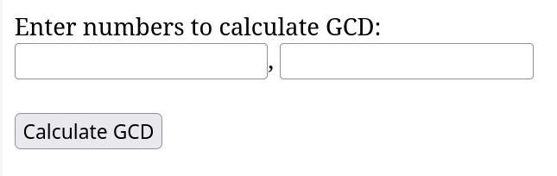
EL (Expression Language)
R/W property binding
method call
<h:form id="gcdform">
<h:inputText id="num1id" value="#{calculateBean.num1}" validator="#{calculateBean.validateNum}"/>
<h:commandButton action="#{calculateBean.calculateGCD}" value="Calculate GCD" />
</h:form>

Slide 11


Form and a Backing Bean
<h:inputText id="num1id" value="#{calculateBean.input1}" />
public Long getInput1()
public void setInput1(Long input1)
<h:commandButton value="Calculate GCD" action="#{calculateBean.calculateGCD}" />
public void calculateGCD()

Slide 12
Validation by Faces
<h:inputText id="num1id" value="#{calculateBean.input1}" required="true" requiredMessage="Enter value higher than 1">
<f:validateLongRange minimum="1" />
</h:inputText>

Slide 13
Validation by Code
<h:inputText id="num2id" value="#{calculateWithValidationsBean.input2}" validator="#{calculateWithValidationsBean.validateNum}" />
<h:inputText id="num1id" value="#{primeBack.num1}" validator="#{primeBack.validateNum}"/>
public void validateNum(FacesContext context, UIComponent component, Object value) throws ValidatorException {
...
FacesContext.getCurrentInstance().addMessage(component.getClientId(), new FacesMessage("Unable to convert to number!"));
...
throw new ValidatorException(new FacesMessage("Number must be >0"));
...
new FacesMessage(FacesMessage.SEVERITY_WARN, "Really? Odd number?", "Really? Odd number? Odd numbers are boring!")

Slide 14
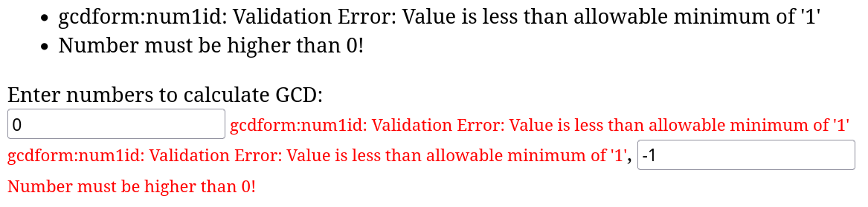
Display Messages
<h:messages />
Display all messages
<h:inputText id="num1id" .../>
<h:message for="num1id" style="color: red" />
Display messages for the given component

Slide 15
Navigation
Action method returns:
void – stays in the same form
String – name of the “view”, mostly simply the name of the next xhtml, null means same form
public String goToDetail() {
return null; // stays in the same form
or
return "table-detail.xhtml"; // go to table-detail.xhtml, no url change
return "table-detail.xhtml?faces-redirect=true"; // ...with redirect, url change
}

Slide 16
Localization I – Prepare Translations
src/main/resources/messages_en.properties
Hello=Hello
src/main/resources/messages_cs.properties
Hello=Ahoj
src/main/resources/messages_hi.properties
Hello=नमस्ते
Warning: encoded in Latin1/ISO-8859-1 (one of very few flaws), Java 9 started to use UTF-8
NetBeans convert automatically

Slide 17
Localization II – Configure Faces
faces-config.xml
<application>
<locale-config>
<default-locale>en</default-locale>
<supported-locale>en</supported-locale>
<supported-locale>cs</supported-locale>
<supported-locale>de</supported-locale>
...
</locale-config>
<message-bundle>messages</message-bundle>
</application>

Slide 18
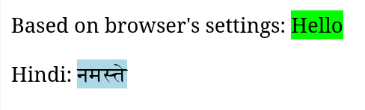



Localization III – Use
xhtml
<f:loadBundle basename="messages" var="msg" /> (based on browser)
#{msg.Hello}
<f:loadBundle basename="messages_hi" var="msgHi" /> (specifically Hindi)
<h:outputText value="#{msgHi.Hello}"/>

Slide 19
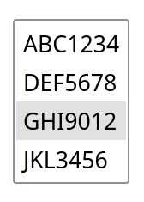
Listbox
<h:selectOneListbox value="#{carsBean.selectedCar}" converter="carConverter">
<f:selectItems value="#{carsBean.dbModel}" itemLabel="#{car.registration}" var="car"/>
</h:selectOneListbox>
value: expression to put the selected value to
converter: converter (next slide)
selectItems value: what will be the rows
ItemLabel and var: what to display in the list (by default: .toString())

Slide 20
Listbox Converter
HTML Listbox is based on strings, so we need to convert object to/from strings
@FacesConverter(value = "carConverter", managed = true)
public class CarConverter implements Converter {
public Object getAsObject(FacesContext context, UIComponent component, String value) {
public String getAsString(FacesContext context, UIComponent component, Object value) {

Slide 21
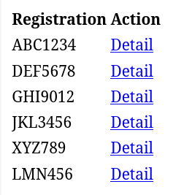
Tables
<h:dataTable value="#{tableCarsBean.carsList}" var="car">
<h:column>
<f:facet name="header">Registration</f:facet>
#{car.registration}
</h:column>
<h:column>
<f:facet name="header">Action</f:facet>
<h:commandLink value="Detail" action="#{tableCarsBean.goToDetail}"/>
</h:column>
</h:dataTable>

Slide 22
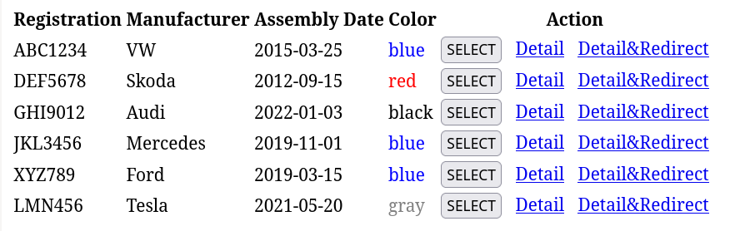
Tables, Few More Columns
<h:dataTable id="carTable" value="#{tableCarsBean.carsList}" var="car">
<h:column>
<f:facet name="header">Registration</f:facet>
#{car.registration}
</h:column>
<h:column>
<f:facet name="header">Manufacturer</f:facet>
#{car.manufacturer}
</h:column>
<h:column>
<f:facet name="header">Assembly Date</f:facet>
#{car.assembly}
</h:column>
<h:column>
<f:facet name="header">Color</f:facet>
<h:outputText style="color: #{car.color}" value="#{car.color}" />
</h:column>
<h:column>
<f:facet name="header">Action</f:facet>
<h:commandButton value="SELECT" action="#{tableCarsBean.selectCar}"/>
&nbsp;
<h:commandLink value="Detail" action="#{tableCarsBean.goToDetail}"/>
&nbsp;
<h:commandLink value="Detail&amp;Redirect" action="#{tableCarsBean.goToDetailRedirect}"/>
</h:column>
</h:dataTable>

Slide 23
Table and Model
Although List works well for a simple list, sometimes it’s necessary to work with the selected row in model – use DataModel. It is also more reliable.
DataModel<Car> carsList;
Car selectedCar = null;
carsList = new ListDataModel<>(listAllCars());
selectedCar = carsList.getRowData();

Slide 24
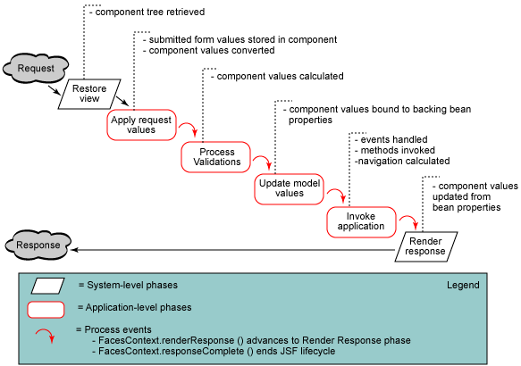
Lifecycle, Happy Path

Slide 25
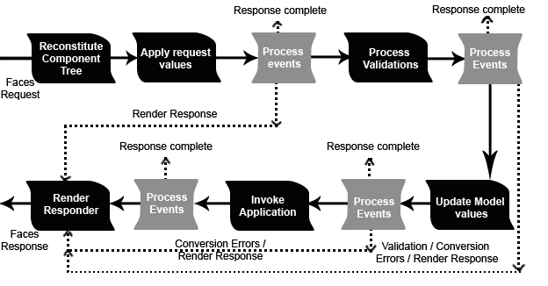
Lifecycle – exceptions

Slide 26
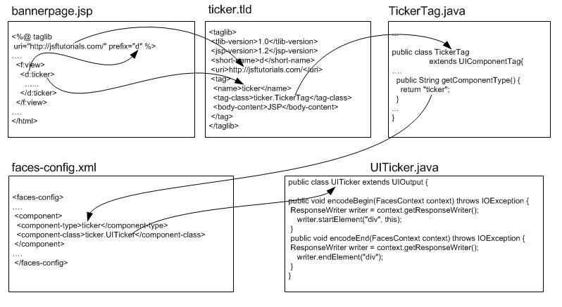
Custom Component
@FacesComponent

Slide 27
Partial Page Update
When you want to update just a part of a screen without refresh of whole page
<h:commandButton id="button1">
<f:ajax execute="..." render="..."/>
</h:commandButton>
Execute – what to process, render – what to update
Use space-separated list of ids or @form

Slide 28
Default Components
Button
Checkbox
Checkbox List
Component Label
Data Table
Dropdown List
Faces Form
Formatted Output
Grid Panel
Group Panel
Hidden Field
Hyperlink
Image
Inline Message
Link Action
Listbox
Message List
Multi Line Text Area
Multi Select Listbox
Output Text
Radio Button List
Secret Field
Text Field

Slide 29
Facelets – Template
<?xml version='1.0' encoding='UTF-8' ?>
<!DOCTYPE html PUBLIC "-//W3C//DTD XHTML 1.0 Transitional//EN" "http://www.w3.org/TR/xhtml1/DTD/xhtml1-transitional.dtd">
<html xmlns="http://www.w3.org/1999/xhtml"
xmlns:ui="http://java.sun.com/jsf/facelets">
<head>
<meta http-equiv="Content-Type" content="text/html; charset=UTF-8" />
<title>Facelets - Template Example</title>
</head>
<body>
<h1><ui:insert name="title">Default Title</ui:insert></h1>
<p><ui:insert name="body">Default Body</ui:insert></p>
</body>
</html>

Slide 30
Facelets – Usage
<?xml version='1.0' encoding='UTF-8' ?>
<!DOCTYPE html PUBLIC "-//W3C//DTD XHTML 1.0 Transitional//EN" "http://www.w3.org/TR/xhtml1/DTD/xhtml1-transitional.dtd">
<html xmlns="http://www.w3.org/1999/xhtml"
xmlns:ui="http://java.sun.com/jsf/facelets"
xmlns:h="http://java.sun.com/jsf/html">
<body>
This text above will not be displayed.
<ui:composition template="/template.xhtml">
This text will not be displayed.
<ui:define name="title">Facelets</ui:define>
This text will also not be displayed.
<ui:define name="body">Hello from the Facelets client template!</ui:define>
This text will not be displayed.
</ui:composition>
This text below will also not be displayed.
</body>
</html>

Slide 31
Conditional Rendering
Many components have rendered attribute, so hiding it, use:
rendered=”#{bean.doRender}”
If you want to hide a part of a page, use:
<h:panelGroup rendered=”…”
Interestingly, if works also for a dataTable column

Slide 32
Bookmarkable Pages
<h:link outcome=“success“> <f:param name=“foo“ value=“param“ /> </h:link>
<f:metadata> <f:viewParam name=“foo“ value=“bean.attr“ /> <f:event type=“preRenderView“ listener=“#{bean.prepareData}“ /> </f:metadata>

Slide 33
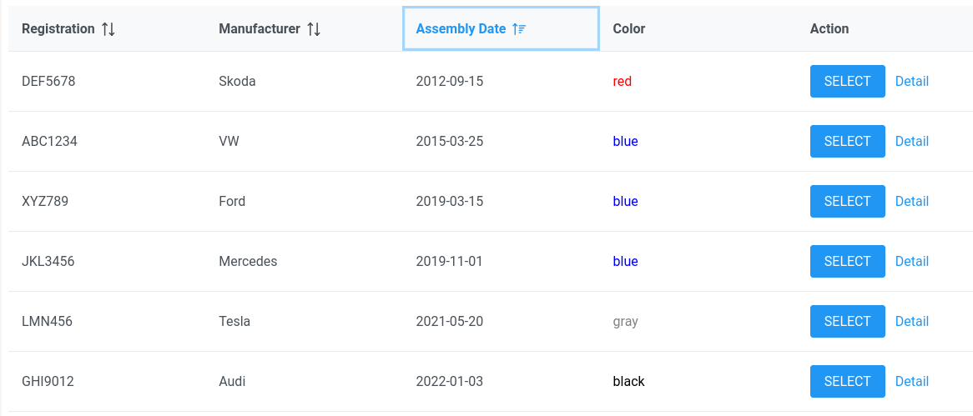
The Best at the End – Full of CSS and JavaScript
Primefaces
Very interactive
Reasonably nice, theme support
h:dataTable → p:dataTable
And the best – we (Java devs) didn’t need to touch JS or CSS at all!

Slide 34
That’s all, folks!
Questions?

Slide 35
Resources
Book: The Definitive Guide to Jakarta Faces in Jakarta EE 10, Building Java-Based Enterprise Web Applications
Standard library: https://javaee.github.io/javaserverfaces-spec/
Primefaces https://www.primefaces.org/showcase/
Omnifaces: https://showcase.omnifaces.org/
Utilizing JSF Front Ends with Microservices, Jakarta Tech Talks - April 2020: https://www.youtube.com/watch?v=bGuxtWP6Xfk

