Slide 1
Computational Identification of Common Intron Motifs
Adam Howard
In Cooperation with the Kirienko Lab

Slide 2
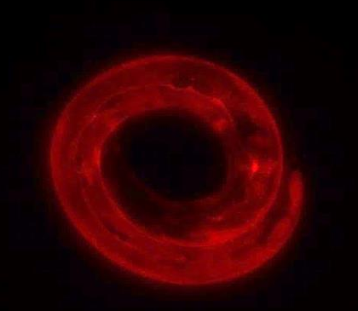
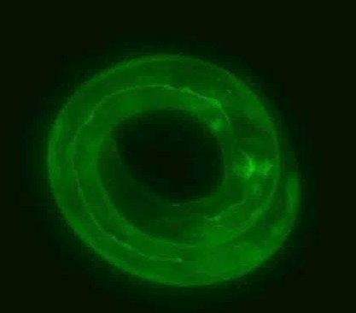
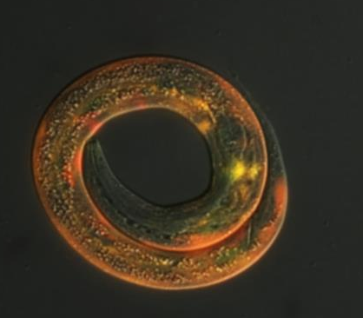
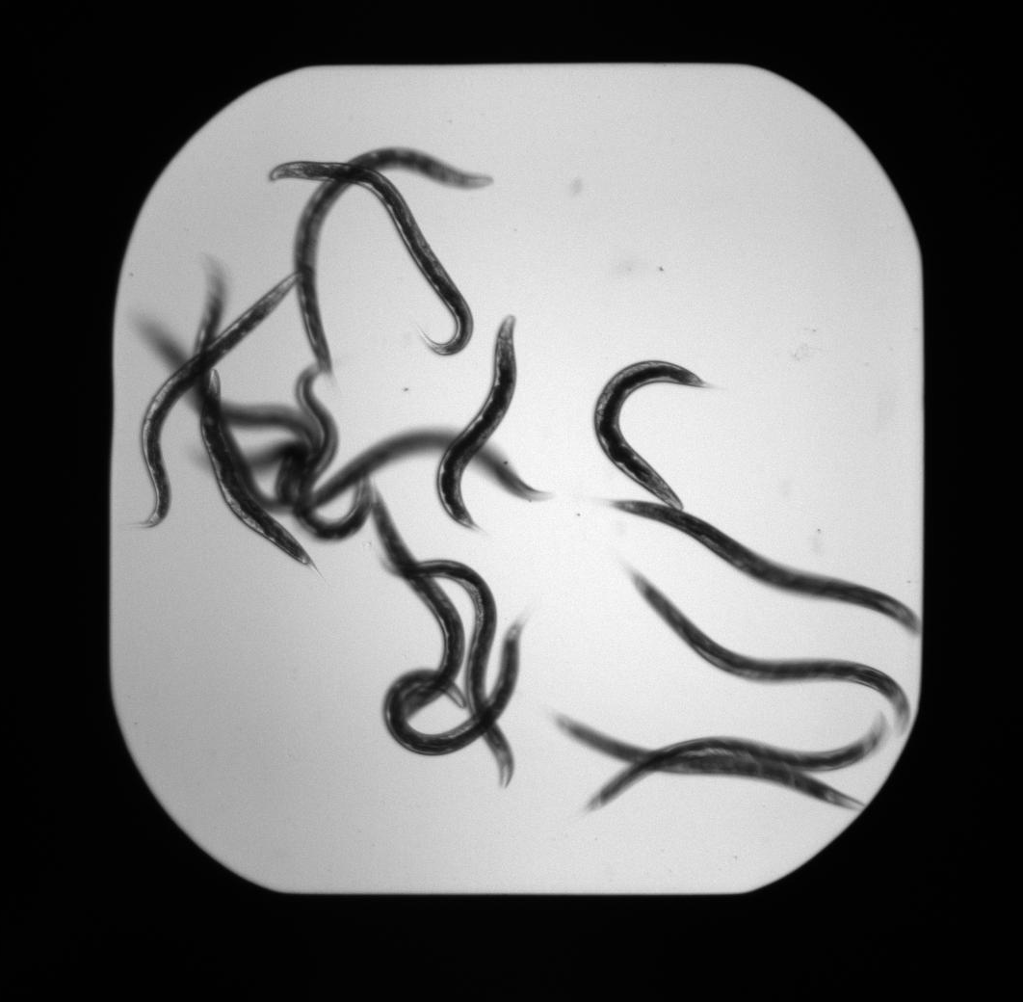
Our Model: C. elegans
Bacterivorous nematode
Advantages
Highly fecund
Evolutionary conservation
Extensive genetic tools
Susceptible to Human pathogens
Compact genome with Short Introns
~1300 pb average intron length
Narasimhan K et al. (2015). Mapping and analysis of Caenorhabditis elegans transcription factor sequence specificities. Elife 4: e06967. doi: 10.7554/eLife.06967
Images Courtesy of Dr. Kirienko

Slide 3
Innate Immunity & Small Molecules
Probe worms with small molecules and measure rescue from pathogen killing, here Pseudomonas aeruginosa.
Compare microarray transcripts to known stressors
Other pathogens
Bacterial toxins
Immune Activated Pathways
Chemical stressors
Stress conditions
Stress Pathways
Focus on chemical stressor comparison

Slide 4
Chemical Stress Condition
Genes
N = 939
LK32
LK56
LK16
RPW
LK34
LK38
LK35
Phenan-throline
Hygromycin
Cadmium

Slide 5
Two Current Aims
Expand the number of microarrays analyzed in the clustering between stress conditions
Employ a more specific clustering method to examine genes for common pathways
Gene Ontology
Transcription factor binding motifs

Slide 6
Overview of Approach
Clustering from microarray data
Sort genes & populate a structure with relevant information
Read in genome and find promotor regions
Search for Motifs
Known Ethanol Stress Response Motif
Attempt to characterize Other Motifs

Slide 7
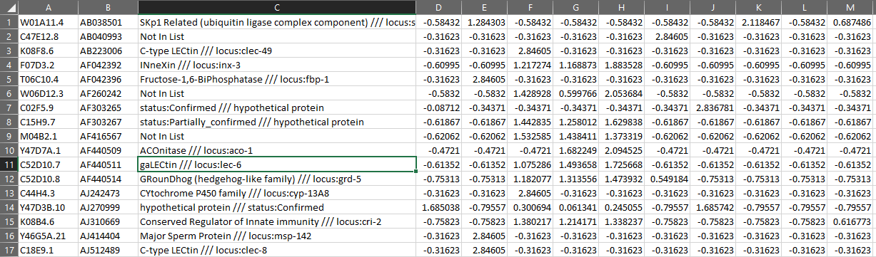
Reading in Data and K-Means Clustering
Excel format stores microarray data
“xlsread” command reads in excel data into text & numerical matricies
Set Cluster number & run “kmeans” on numerical matrix
“kmeans” returns a list of cluster IDs
Only genes with a GenBank ID included (N = 697)

Slide 8
Reading in Data and K-Means Clustering
Excel format stores microarray data
“xlsread” command reads in excel data into text & numerical matrices
Set Cluster number & run “kmeans” on numerical matrix
“kmeans” returns a list of cluster IDs

Slide 9
Chemical Stress Condition
Genes
N = 939
LK32
LK56
LK16
RPW
LK34
LK38
LK35
Phenan-throline
Hygromycin
Cadmium

Slide 10
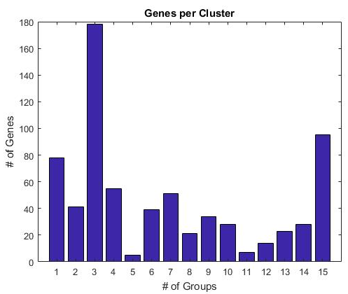
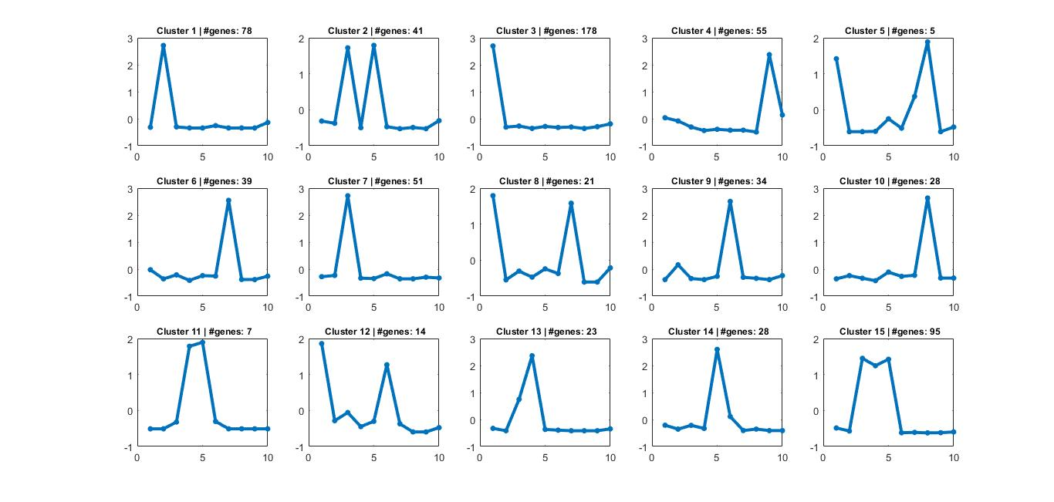
Reading in Data and K-Means Clustering
15 clusters used
Only genes with a GenBank ID included (N = 697)

Slide 11
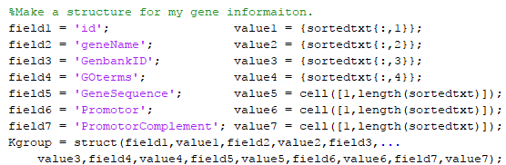
Gene Sorting & Gene Structure generation
Sorted the text matrix based on index number.
Saved gene information into a structure “Kgroup”

Slide 12

Genome Reading
Localblast is ideal, but requires several additional software installations
As an initial search, genome read into memory from saved fasta file.
Two genome fasta files used
Chromosomes saved from European Nucleotide Archive (bp = 165,107,330 )
Whole worm genome from WormBase ParaSite (bp = 200,572,802)
Sequence and complement saved together

Slide 13
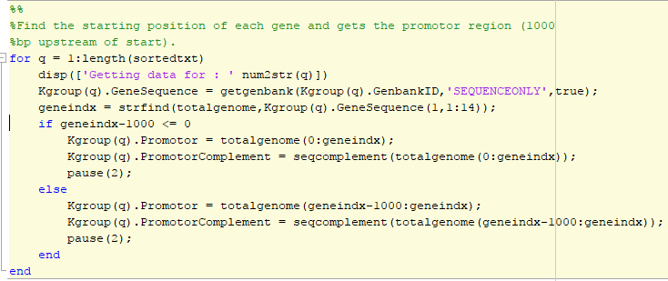
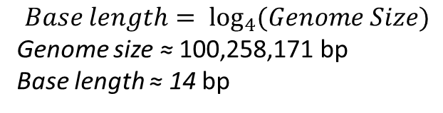
Finding Promotor regions
$$Base length= \log_{4}{(Genome Size)}$$
Genome size ≈ 100,258,171 bp
Base length ≈ 14 bp

Slide 14
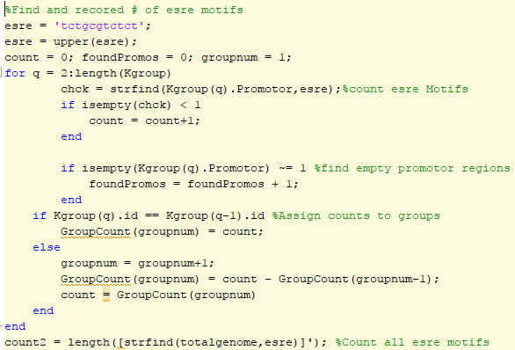
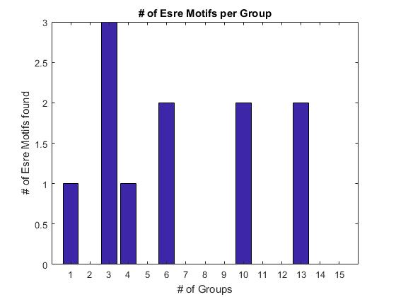
Motif Search
ESRE is known to be upstream of Innate immunity genes
Genome wide ESRE = 1433
My Search found 11
P > 0.992 (Hypergeometric Dist.)
197 genes failed to find a promotor

Slide 15
Motif Search
ESRE is known to be upstream of Innate immunity genes
Genome wide ESRE = 1433
My Search found 11
P > 0.992 (Hypergeometric Dist.)
197 genes failed to find a promotor

Slide 16

Alternate Motif finders
MathWork’s “FindOverRepressentedWords” function
File Exchange
Motif Finding by Michael Chan
MotifCatcher by Phillip Seitzer
Extensive literature reviews on the topic
Proves to be both controversial as to its value and computationally challenging
Still requires benchwork to verify hits
Das MK and Dai H. (2007) A survey of DNA motif finding algorithms. BMC Bioinformatics 8(supp7):S21

Slide 17
Conclusions & Future Directions
Employing a string finding approach is not sufficient due to variances in the data base. A blast search will improve my search and allow more flexibility.
ESRE motifs are not represented in my data set
242 genes from microarray analysis could not be included.
Finding a way to search these could generate more results.
Examination of the Gene Ontologies for similar pathways in groups

Slide 18


Acknowledgements
Special Thanks
Dr. Natasha Kirienko
Dr. Aryeh Warmflash
Nick Hummel
The Kirienko Lab
Funding
Rice University, BioSciences dept.

