Slide 1

Internal Systems
Digestive - obtain and assimilate food, remove waste products
Excretory - remove nitrogenous waste products, involved in internal chemical and water balance
Respiratory - obtain oxygen and removal of carbon dioxide

Slide 2
Internal Systems
Muscular - “movement,” internally and through the environment
Circulatory - transportation of items throughout the body, wound healing, storage
Nervous - system of communication between stimuli and the organism

Slide 3
Internal Systems
Reproductive - procreation
Endocrine - growth, reproduction, “change,” internal communication

Slide 4
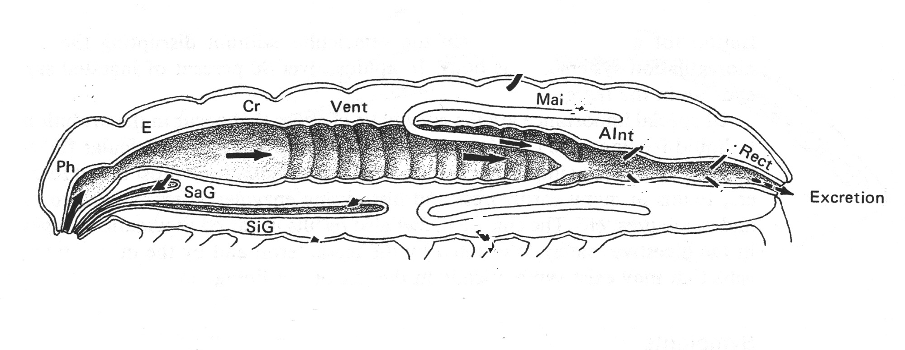
The Insect Digestive System

Slide 5
Functions of the digestive tract
Ingestion - process of feeding, taking food into the body
  Remember different types of mouthparts?
Digestion - breakdown of “food” into a form that can be assimilated by the body

Slide 6
Functions of the digestive tract
Absorption - passage of digested food molecules from the digestive tract to the blood and body cavity
Egestion - elimination of undigested food waste from the body

Slide 7
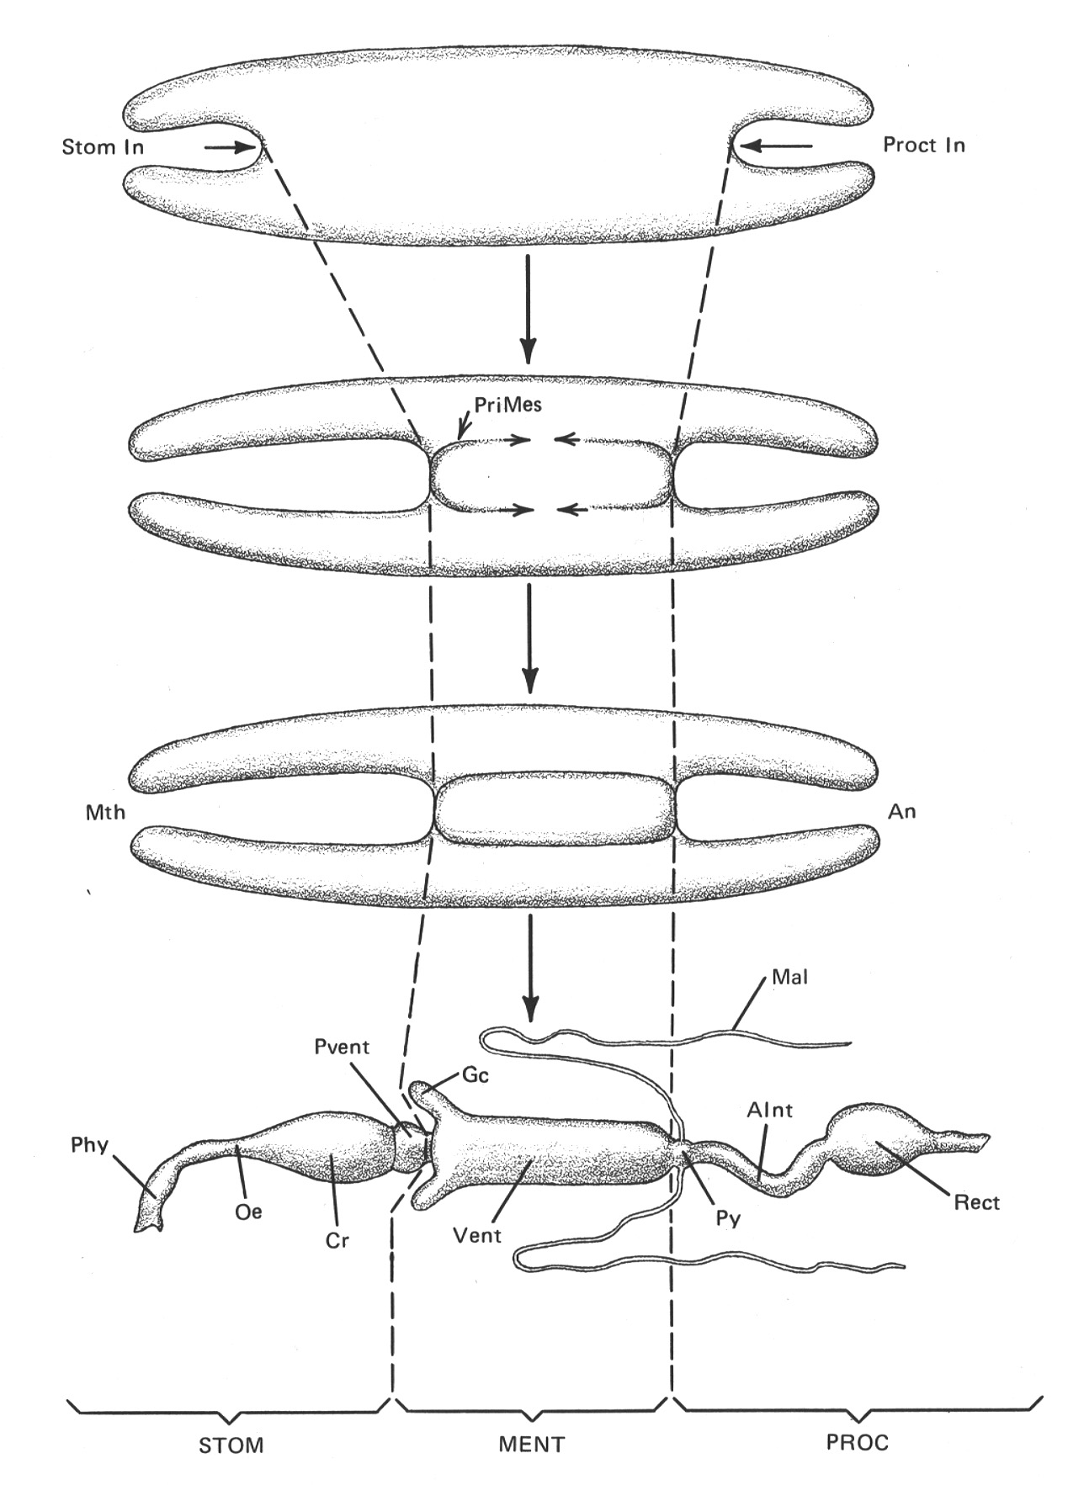
The Insect Digestive System

Slide 8
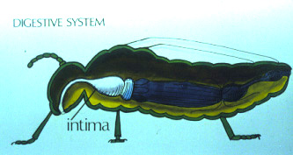
The Insect Digestive System
Foregut

Slide 9
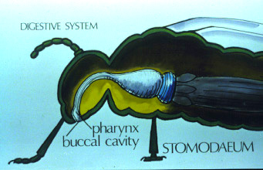
The Insect Digestive System
Foregut

Slide 10
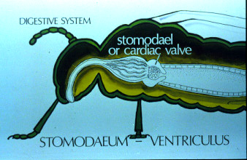
The Insect Digestive System
Foregut - Midgut

Slide 11
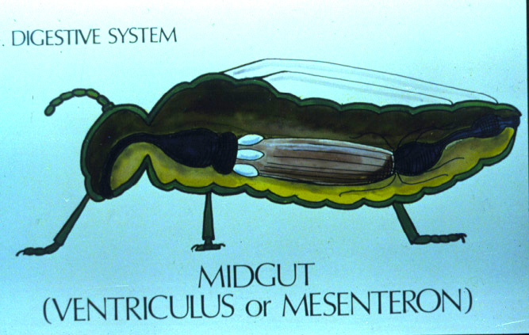
The Insect Digestive System
Midgut

Slide 12
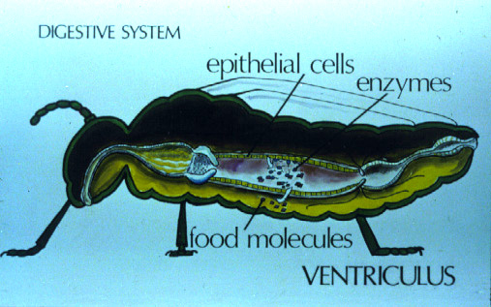
The Insect Digestive System
Midgut

Slide 13
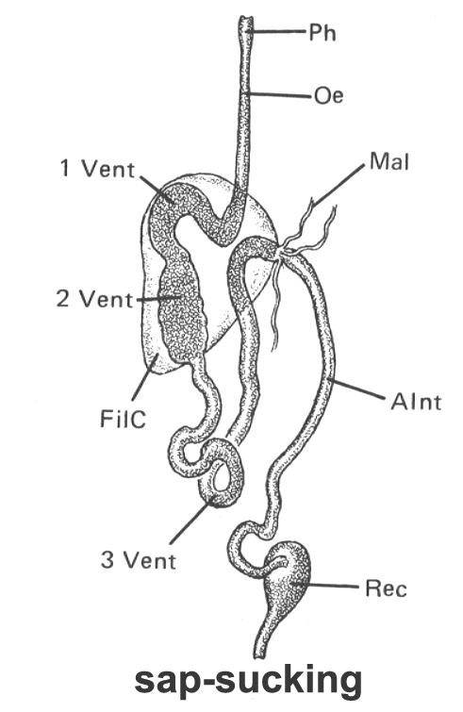
The Insect Digestive System
Midgut - variation

Slide 14
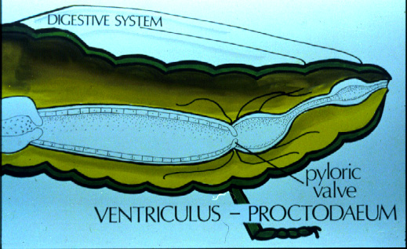
The Insect Digestive System
Midgut - Hindgut

Slide 15
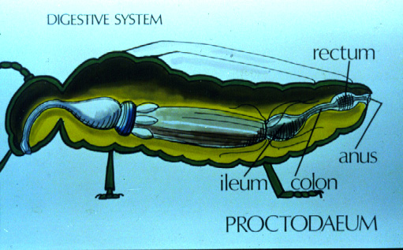
The Insect Digestive System
Hindgut

Slide 16
The Insect Excretory
System
Elimination of nitrogenous waste products
Regulation of water and ionic balance
The Malpighian Tubules

Slide 17
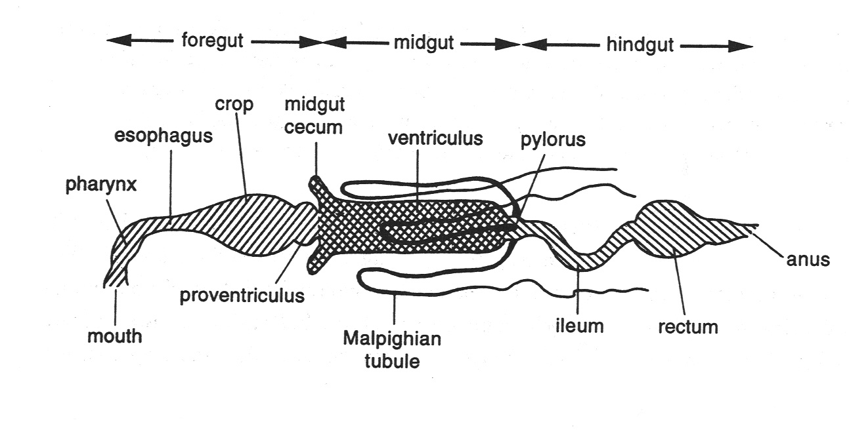
The Insect Excretory
System

Slide 18
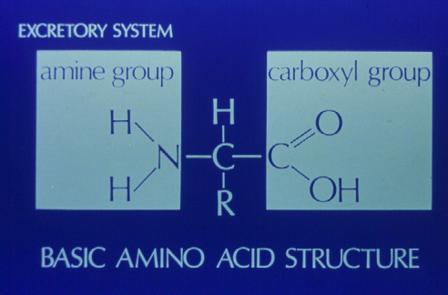
The Excretory System

Slide 19
The Excretory System
Excretory product = amine group + hydrogen (from water)
Three products found in animals
  Ammonia - easy to produce but toxic
  Urea - not as easy to produce, not as toxic
  Uric Acid - difficult to produce, not toxic

Slide 20
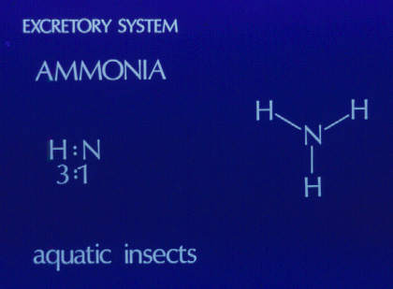
Ammonia - Excretion in small insects in moist environments

Slide 21
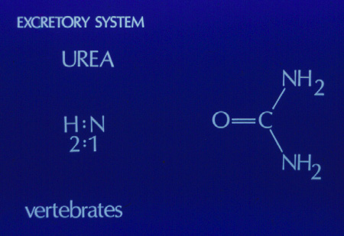
Urea - Most Vertebrates

Slide 22
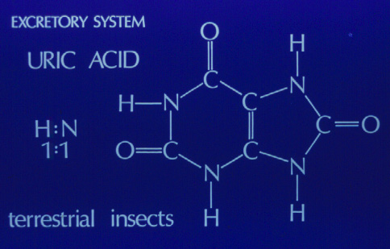
Uric Acid - Most Terrestrial Insects

Slide 23
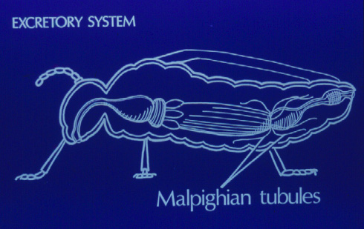
Malphigian Tubules

Slide 24
The Insect Respiratory System
As all animals, insects need Oxygen
As all animals, insects need to rid themselves of Carbon Dioxide
Insects do not transport oxygen through the circulatory system!

Slide 25
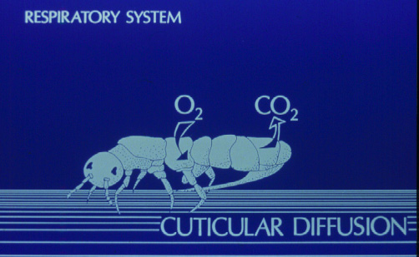
The Insect Respiratory System
Option - small and moist

Slide 26
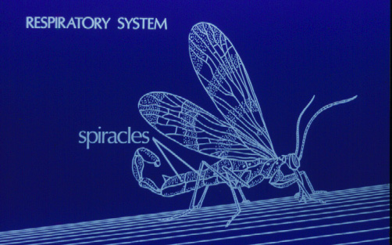
The Insect Respiratory System
Tracheal System - Spiracles

Slide 27
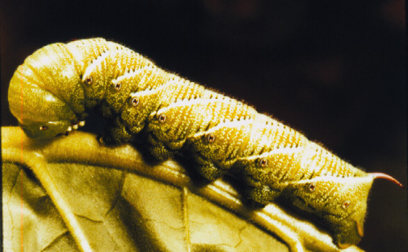
The Insect Respiratory System
Spiracles

Slide 28
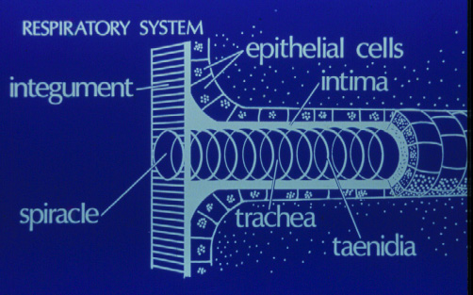
The Insect Respiratory System

Slide 29
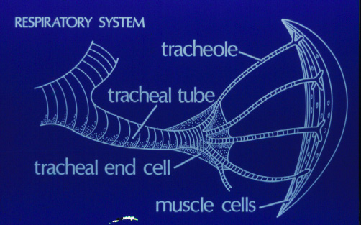
The Insect Respiratory System

Slide 30
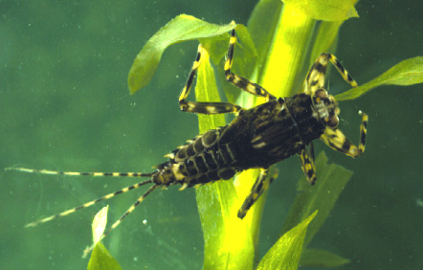
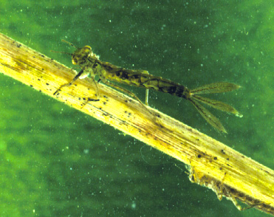
The Insect Respiratory System
Aquatic Insects - Gills

Slide 31
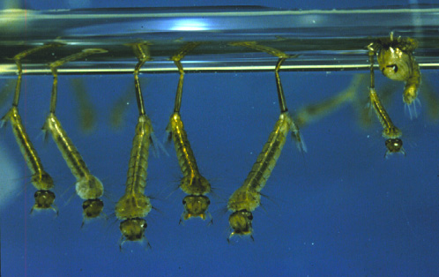
The Insect Respiratory System
Aquatic Insects - Spiracular Tube

Slide 32
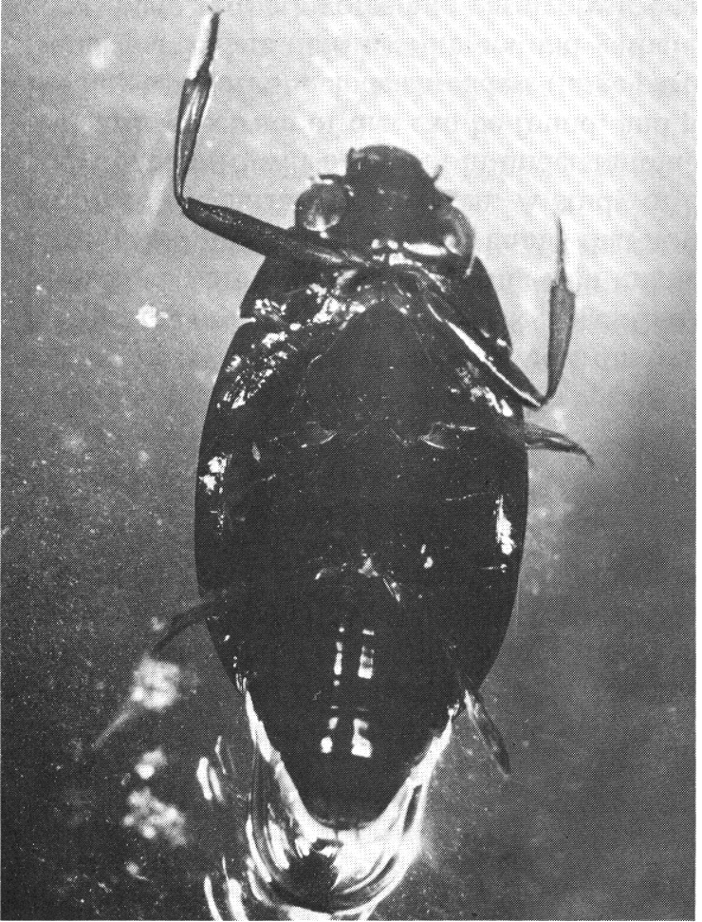
The Insect Respiratory System
Aquatic Insects - Plastrons

Slide 33
The Insect Circulatory System
Not significantly involved in the movement of oxygen and carbon dioxide through body
Movement of “information” throughout the body
Important in storage,

Slide 34
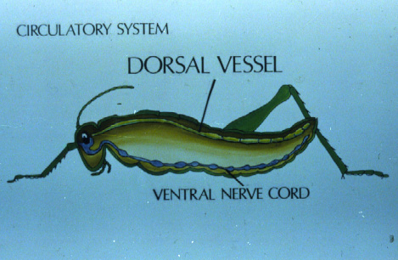
The Insect Circulatory System

Slide 35
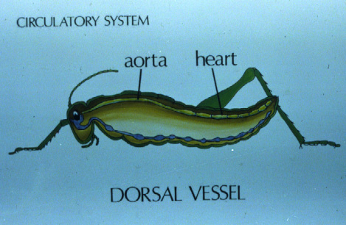
The Insect Circulatory System

Slide 36
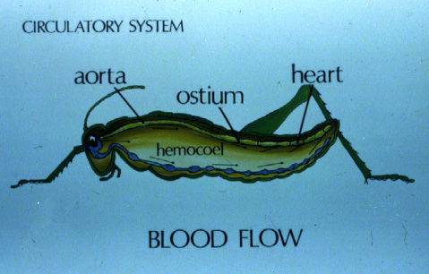
The Insect Circulatory System

Slide 37
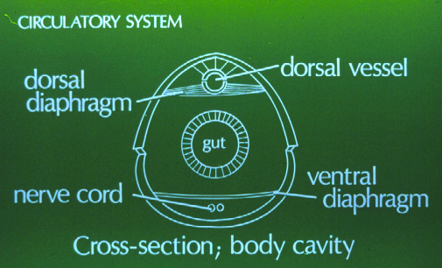
The Insect Circulatory System

Slide 38
The Insect Circulatory System
Hemolymph = insect “blood”
  Hemocytes
    “blood” cells serving various functions
  H₂O (water)
  Inorganic ions
  Organic molecules

Slide 39
Hemolymph Functions
Transport
  Nutrients
  Waste products
  Hormones
Storage
  Water
  Ions
Hydraulic Function
  Internal pressure

Slide 40
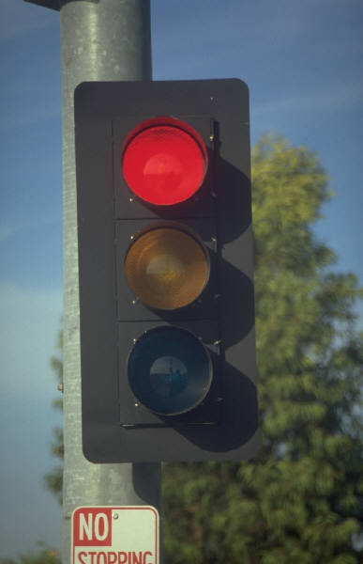
Remember
Insect Blood does not contain hemoglobin.
It does not transport oxygen!

Slide 41
Some Hemocyte Functions
Phagocytosis
Coagulation
Wound Healing
Encapsulation

Slide 42
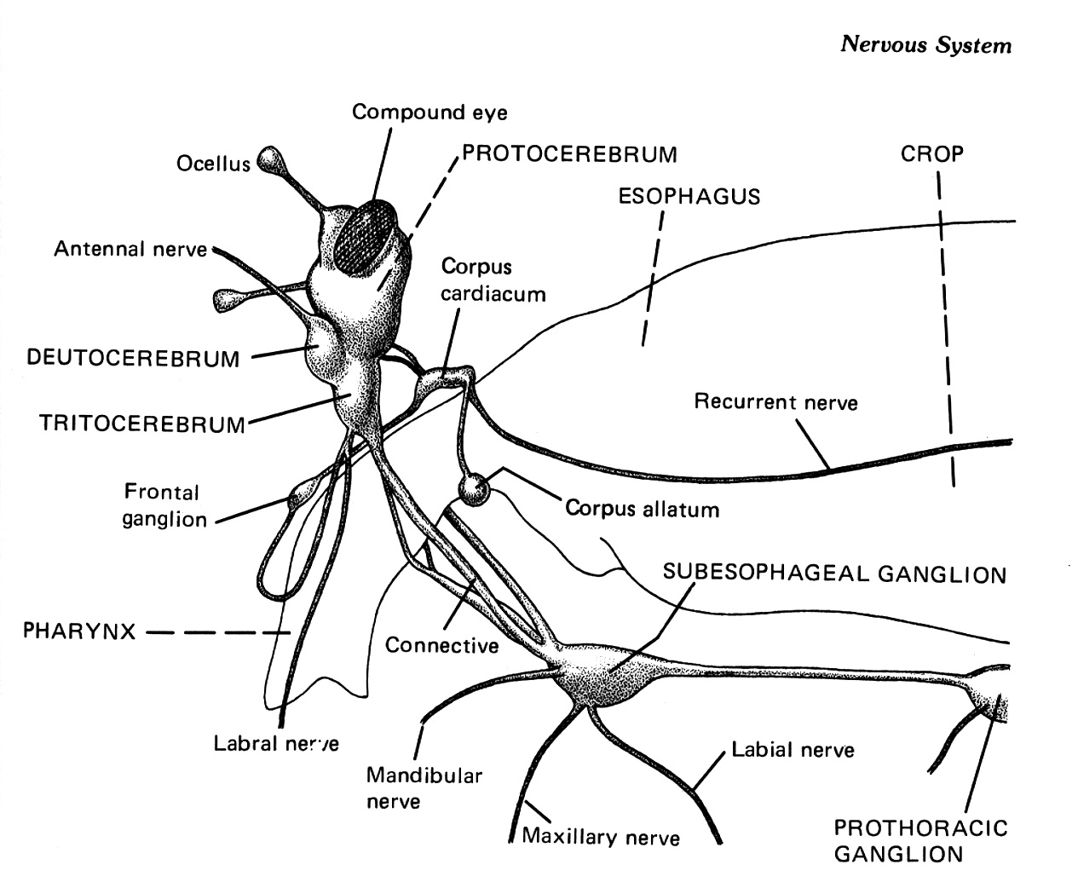
The Insect Nervous System

Slide 43
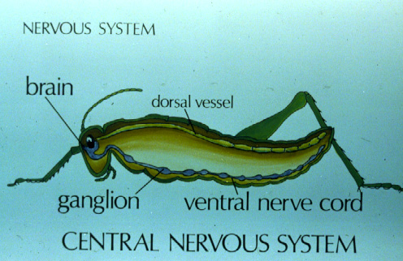
The Central Nervous System

Slide 44
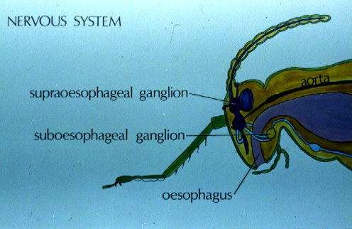
The Central Nervous System

Slide 45
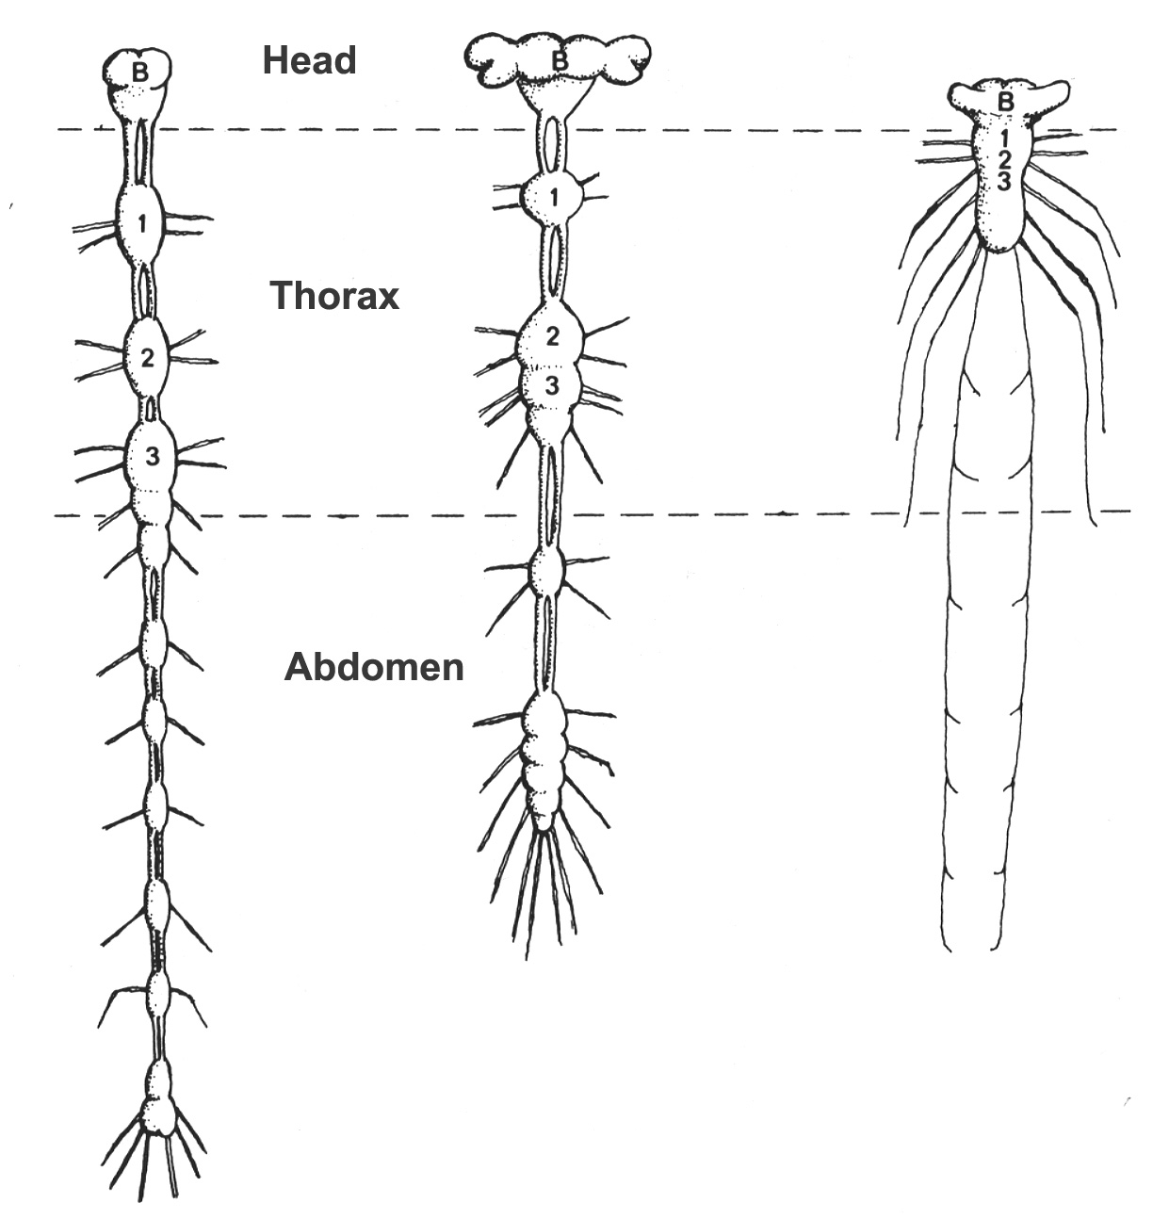
The Peripheral Nervous System

Slide 46
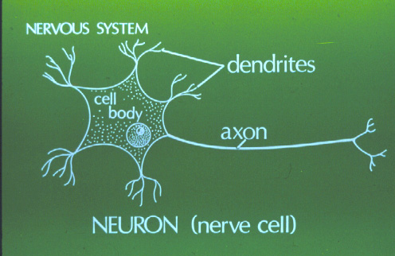
Neurons - Nerve Cells

Slide 47
Neuron Types
Sensory
  Associated with sensory structures
Motor
  Associated with muscles and glands
Association
  Witin CNS

Slide 48
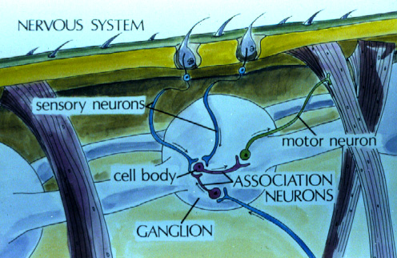
The Nervous System

