Slide 1

Applied Entomology
Agricultural Concerns

Slide 2
A Short History of Humans
Genus Homo perhaps 1.5-2 mybp
  Homo sapiens perhaps 200,000 ybp
  H. s. sapiens - (Cro-Magnon Man) perhaps 30-40,000 ybp
A Hunter/Gatherer history

Slide 3
A Short History of Agriculture
“The most important event in the cultural evolution of the human species”
12,000-18,000 ybp first implements and storage containers found
  Middle East
  Egypt
    Wheat, lentils, chickpeas, dates

Slide 4
What allowed the development of an agricultural society?
Development of cereals
  Wheat, rye, barley
  Corn (maize)
  Rice
  Sorghum
Domestication of herbivorous animals

Slide 5
How did agriculture affect the development of human society?
As hunter/gathers
  Mobile
  Low fertility
  Active involvement
An agricultural society
  Sedentary
  Increased fertility
  Few individuals involved in food procurement

Slide 6
Advancements in Agriculture
12,000 ybp to 1700s - little change
  Most of human population involved in “production agriculture”
Recent changes
  Improved mechanization
  Improved crop plants
    The “Green Revolution” - N. Borlaug, WSU
    GMOs
  Increased energy input

Slide 7
Where do the insects come in?
Insects are direct competitors with humans for “our” food and fiber!

Slide 8
Where do the Conflicts Exist?
Plants and plant products
  30-40% of insects are herbivores
  Vector plant diseases
Stored products
Structures
Humans and domesticated animals
  Arthropod vectored diseases
    Arbodiseases
  nuisances

Slide 9
Are Insects Inherently Pests?
What is a Pest?
Are all insects pests?
  Subeconomic pests
  Occasional pests
  Key, perennial, or severe pests

Slide 10
The Concept of an
Economic Injury Level (EIL)
•The lowest number of insects that will cause an economic loss
•The point at which the loss due to damage is greater than the cost of control.
•Usually measured in number of insects/unit of measure

Slide 11
Economic threshold
Also called Action Threshold – Insect density that would justify intervention
May be a fixed economic threshold: e.g. if EIL is 6 insects per plant, intervene at 4 insects per plant;

Slide 12
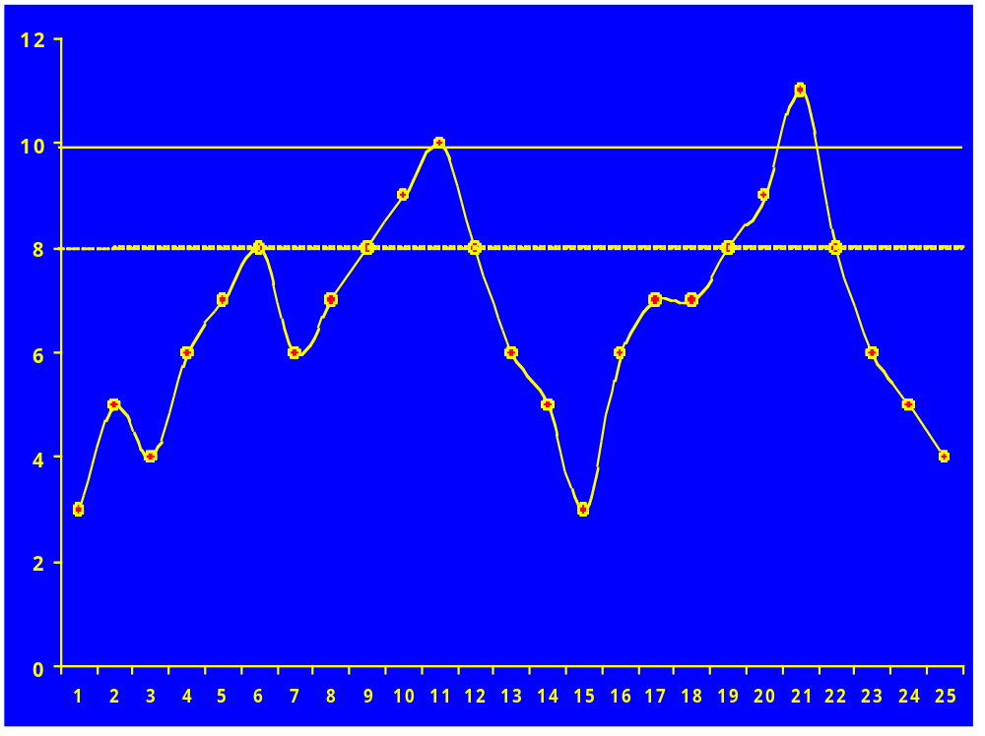
Economic loss
Non-economic loss
Number of Insects
No loss
Time

Slide 13
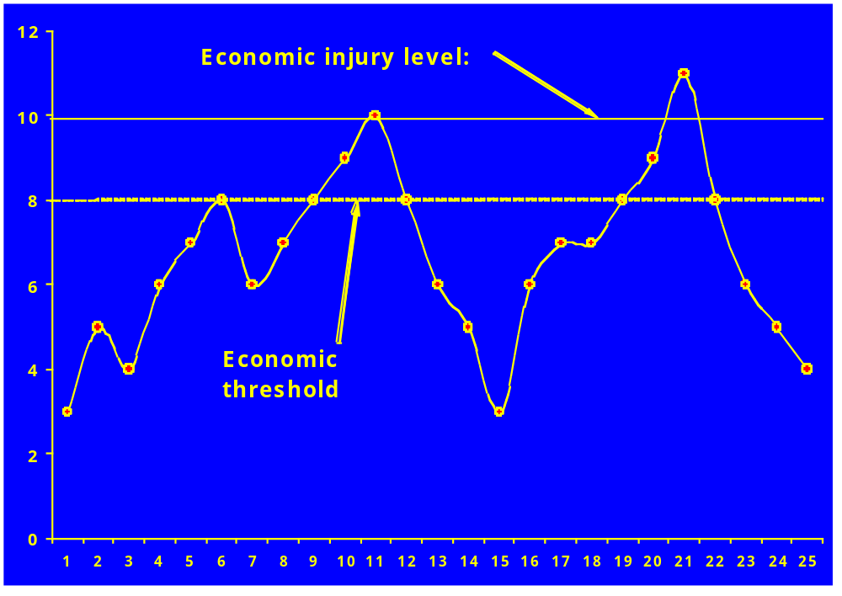
Number of Insects
Time

Slide 14
IPM Options:
Biological control
Physical control
Cultural control
Chemical control
Monitoring insect numbers is the cornerstone
of IPM

Slide 15
Approaches to monitoring:
Various methods:
Direct counts
Traps
Damage estimates
Prediction: degree-days

Slide 16
Benefits of monitoring:
Track numbers of pests and natural enemies;
Able to target insecticide applications at the correct time;
Enhances conservation of natural enemies;
Indicate efficacy of treatments.

Slide 17
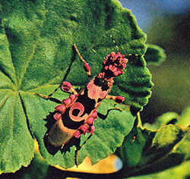
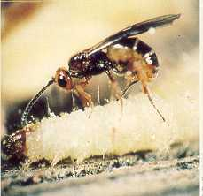
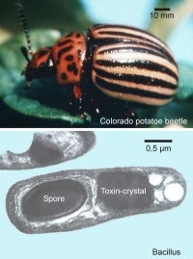
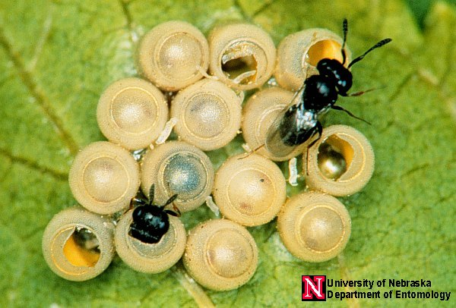
Biological control:
Natural enemies of pests cause mortality;
Can maintain pest population at below-threshold levels
Predators
Parasitoids
Pathogens

Slide 18
Types of BC:
Import natural enemies - establish in field - Classical BC;
Augmentative releases: inundative or inoculative releases each season;
“Conservation” BC: depend upon local natural enemies.
All these approaches require conservation of natural enemies to be effective.

Slide 19
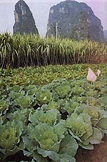
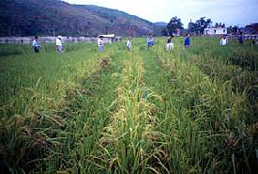
Conserving natural enemies
Reduce insecticide use;
Use softer chemicals;
Manipulate habitats, e.g. intercropping.

Slide 20
Concerns: Biological Control
Non-target effects?
“Necessary evils: murder, drugs and biological control” (Lockwood 1999)
Host specificity testing
Risk assessment protocols?

Slide 21
Insecticides
Insecticides as resources:
Huge financial investment for development;
Potential for Use or Abuse of this resource;
Can play an important role in providing options for pest management.

Slide 22
Problems with insecticides:
Kill or disrupt natural enemies
Secondary pests
Residues on produce
Build-up of resistance – insecticide “treadmill”
Environmental concerns

Slide 23
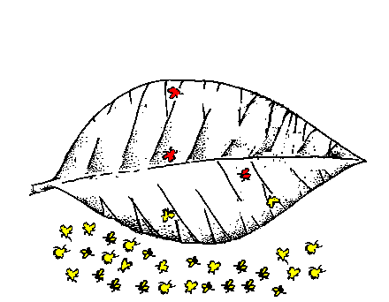
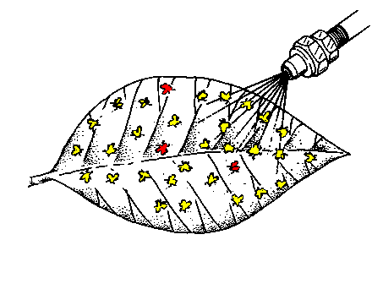
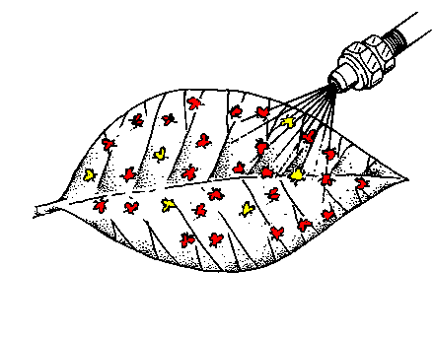
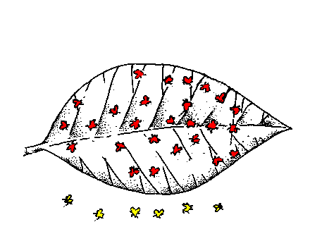
Build-up of resistance:
1
2
3
4

Slide 24
Dealing with resistance
Wrong approach:
Raised concentrations of active ingredients!
Increased frequency of application!
Correct approach:
Reduce reliance on chemicals.
Alternation of chemical groups.
Targeted insecticide applications.

Slide 25
Example of rotation program:
Pyrethroids
IGR’s
Organophosphates
Carbamates
“Organics”
CHC’s

Slide 26
Benefits of insecticides:
Can be effective if used correctly
Can provide an immediate solution
New formulations are safer
Target-specific modes of action are being developed
Effective chemicals should be conserved as a component of sustainable pest management programs.

Slide 27
Calculating an EIL
Total cost of managing a potential pest
  “pesticides”
  Application equipment
  Time involvement
  Need to hire expertise or help
  Value of crop
  Etc.
Note - these costs can fluctuate with time!

Slide 28
Calculating an EIL
K
No. of insects
Time

Slide 29
Calculating an EIL
EIL
No. of insects
Time

Slide 30
Pest Levels
Subeconomic Pests
Amount of damage done by “pest” is not sufficiently costly to manage
  Costs more to manage a pest than the damage that it does is worth
Rarely if ever managed

Slide 31
Pest Levels
Subeconomic Pests
EIL
No. of insects
K
Time

Slide 32
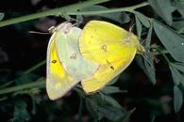
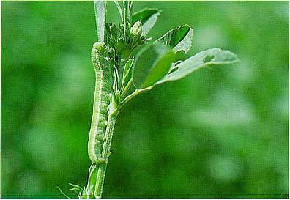
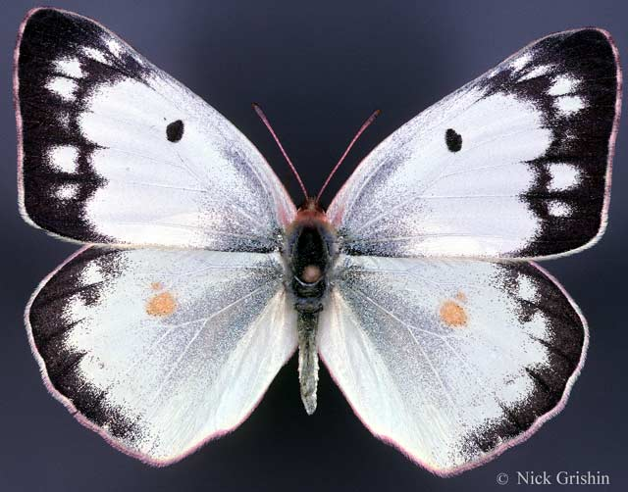
Subeconomic Pests

Slide 33
Pest Levels
Occasional Pests
Do not usually do enough damage to justify management
Favorable conditions may place the population above the EIL (may be cyclical over multi-year periods)

Slide 34
Pest Levels
Occasional Pests
EIL
No. of insects
K
Time (years)

Slide 35
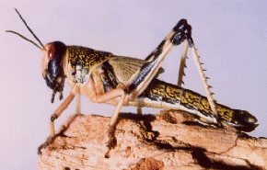
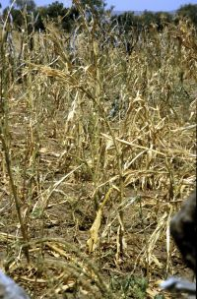
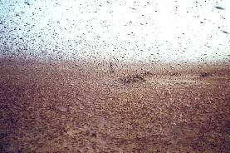
Occasional Pests
Desert Locust

Slide 36
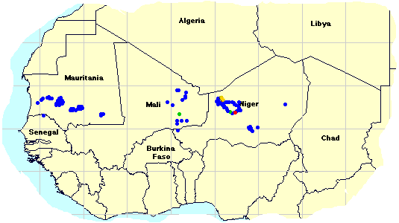
Desert Locust

Slide 37
Pest Levels
Key, Perennial, Severe Pests
Cause regular and serious damage
High numbers or low numbers in high value crops
Aesthetic damage
Sometimes managed on a prophylactic basis
Other management often revolves around this pest(s)
Perhaps 200 species in United States, 2,000 in world

Slide 38
Pest Levels
Key, Perennial, Severe Pests
K
No. of insects
EIL
Time

Slide 39
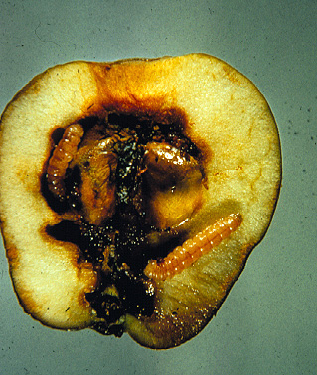
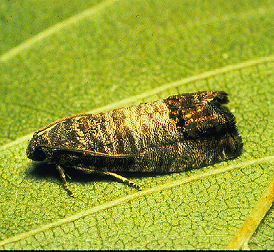
Key Pests
Codling Moth

Slide 40
Where Would You Place
Head Lice
Mosquitoes that vector malaria
A beetle that sometimes is found in your box of corn flakes
Gnats that fly around lights at night

Slide 41
Why do Certain Insects Become Pests?
Insect population numbers and ecosystem modifications
  Agricultural monocultures
  r and K selection

Slide 42
r and K Selection
Imagine a continuum
  r----------------------------------------------K
  r-selected organisms
    High reproductive capacity, little care of young
    Often short-lived
    Rebound quickly after change
    Many insects
    Most pests

Slide 43
r and K Selection
Imagine a continuum
  r----------------------------------------------K
  K-selected organisms
    Low reproductive capacity, great care of young
    Often long-lived
    Have difficulty dealing with change
    Humans, elephants, mammals, few insects

Slide 44
Why do Certain Insects Become Pests?
Transportation
  Moved in association with humans and products
  Anthropogenic
  Most key pests are “exotic”
    Released from natural controls

Slide 45
Why do Certain Insects Become Pests?
Human attitudes
  Human standards
    No lice on our children
    No fleas on our pests
    No fecal material on our corn
    Blemish free fruit

Slide 46
Economic/Applied Entomology
Managing Pest Populations
The reason I have a job!

Slide 47
How do we Manage Insects?
Appeal to a higher power
The Romans had a festival called Robigalia intended to appease Robigus the god of wheat rust (Robigus sp.)
https://en.wikipedia.org/wiki/Robigalia

Slide 48
How do we Manage Insects?
Chemicals
  Early pesticides (insecticides)
    1,000BC - “pest averting sulfur”
    200 BC - Bitumen - mineral pitch, asphalt
    40-90 AD - Arsenic
    1690 - Botanicals including nicotine
    1860s - inorganic materials

Slide 49
How do we Manage Insects?
Chemicals
  Mid-modern pesticides
    Late 1800s to WWI and WWII
    Synthetic materials including organics
      Many natural products were not available
      Studies of “nerve” poisons

Slide 50
DDT dichlorodiphenylTrichloroethane
Formulated in 1873 by Othmar Zeidler
1939, Paul Muller was looking for a moth-proofing agent, discovered insecticidal properties
Broad spectrum, residual, low mammalian toxicity
Saved many lives during WWII and post war
The “Silver Bullet”

Slide 51
The Demise of DDT
1941-1976, 4.5 million tons produced
“Bioaccumulation” in fat cells
“Biomagnification” in food chain
1962, Rachel Carson wrote Silent Spring
DDT banned in the late 1960s
1970, establishment of US Environmental Protection Agency (EPA)

Slide 52
Pesticide Terminology
Pesticide - designed to kill
  Active vs. inert ingredient
  Broad-spectrum vs. narrow-spectrum
  Residual vs. nonresidual
  LD₅₀ and LC₅₀
    Lethal dose to kill 50% of a test population

Slide 53
Pesticide Terminology
Mode of action
  The way in which a pesticide “works”
    Metabolic poison
    Physical Poison
    Nerve Poison

Slide 54
Pesticide Terminology
Types of chemical pesticides
  Inorganic
    Do not contain carbon, not “organic”
    Most with high mammalian toxicity
    Mercury, tin, boron, arsenic, sulfur, zinc
    Rarely used today
      Old orchards in WA

Slide 55
Pesticide Terminology
Types of chemical pesticides
  Organic
    Contain carbon as the “backbone” element
    “Natural” organics - refined, naturally occurring
      Oils, highly refined, can by phytotoxic, often applied at dormant state of plant
      Botanicals
        Derived from plants
        Can be natural or synthetic
        Various mammalian toxicities
        Nicotine
        pyrethrum

Slide 56
Pesticide Terminology
Types of chemical pesticides
  Organic
    Contain carbon as the “backbone” element
    “Synthetic” organics - “man-made” materials
      Most of the materials used today
      Mammalian toxicity varies greatly
      Can be very specific to certain pests (narrow-spectrum)
      Thousands of products available

Slide 57
Advantages of Traditional Pesticides
Can treat a problem while it is in progress
Killing action is rapid
Chemical pesticides are generally economical
Chemical pesticides are generally easy to use

Slide 58
Disadvantages of Traditional Pesticides
Development of resistance in the pest
Pest resurgence and pest replacement
Effects on non-target organisms
Risks to the applicator

Slide 59
Are there other ways to manage pests?

Slide 60
Chemical Modifiers of Development and Behavior
Based on knowledge of pest physiology
Disrupt “normal” development
Practical beginnings in 1960s
Insect Growth Regulators (IGRs)
  Juvenile hormone mimics (JH)
  Molting hormone mimics

Slide 61
Chemicals that Modify Behavioral Patterns
Pheromones
  Sex pheromones
    Can be synthesized
    Sampling and monitoring
    Mating disruption or confusion
Allomones (benefit sender)
Kairomones (benefit receiver)

Slide 62
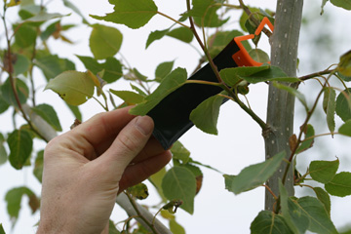
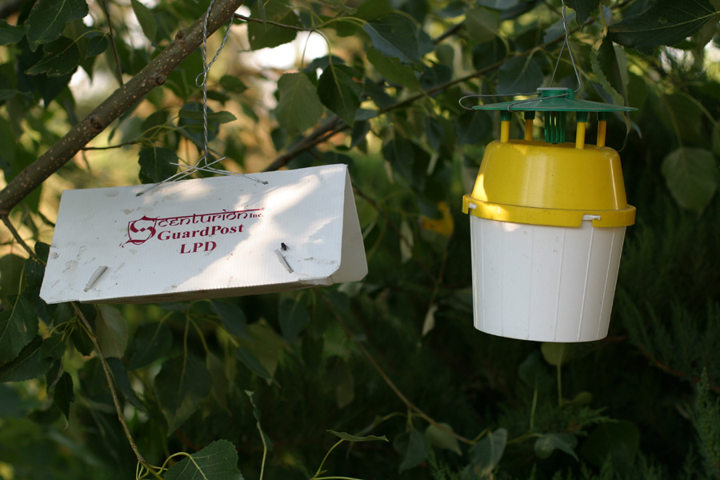
Pheromones

Slide 63
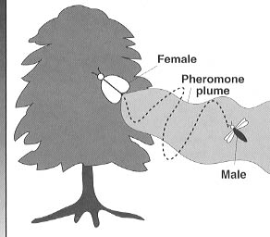
Mating Disruption

Slide 64
Sterile Insect Technique
(SIT)
Developed in the 1930s
Sterile individuals released into the environment in high numbers to mate with fertile individuals
Geographically isolated pests
Very costly
Screwworm fly

Slide 65

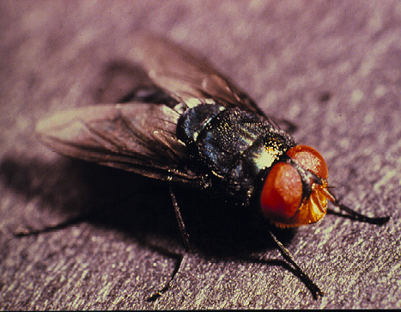
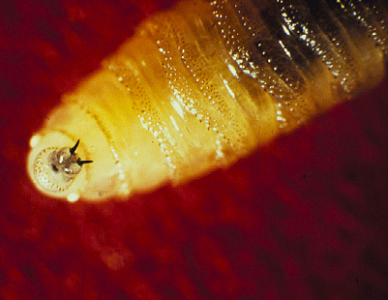
Screwworm Fly

Slide 66
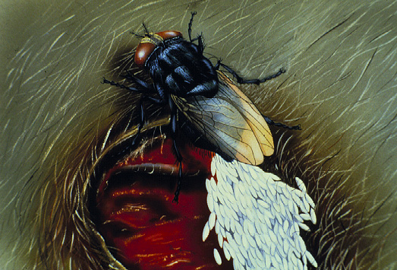
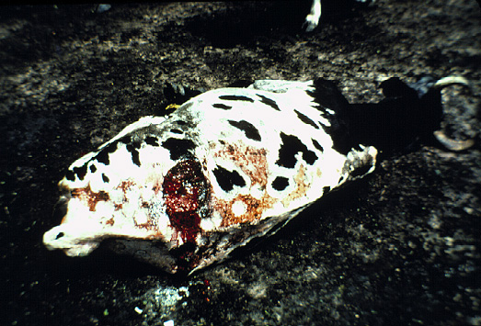
Screwworm Fly - Damage
Myiasis causing fly

Slide 67
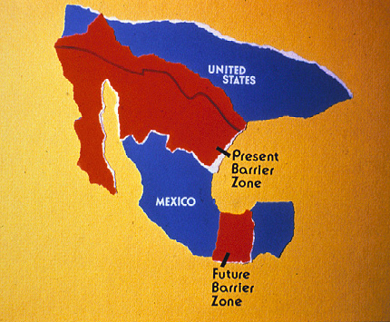
Screwworm Fly - Distribution

Slide 68
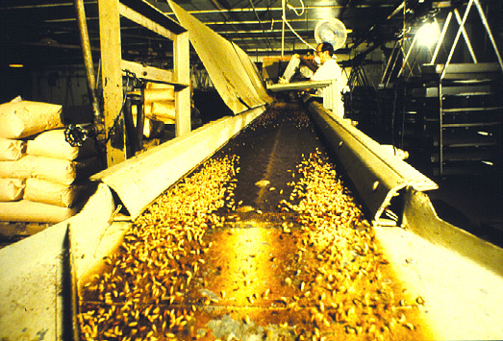
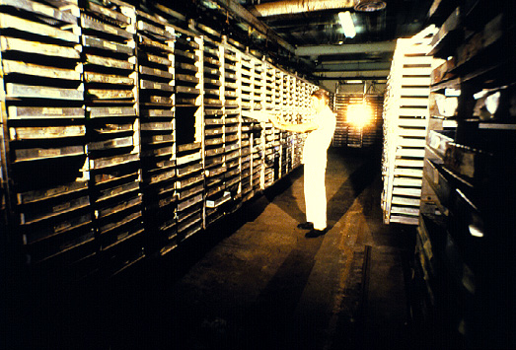
Screwworm Fly - SIT Facilities

Slide 69
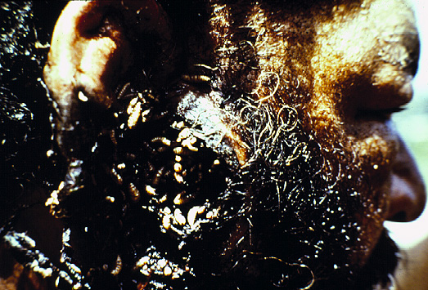
Screwworm Fly - Human Myiasis

Slide 70
Microbial Control
The use of “microbes (e.g, bacteria, viruses, fungi) to manage insects
Little mammalian toxicity
Bacillus thuringiensis (Bt)
  Several varieties
  Little mammalian toxicity
  Often used in large-scale programs

Slide 71
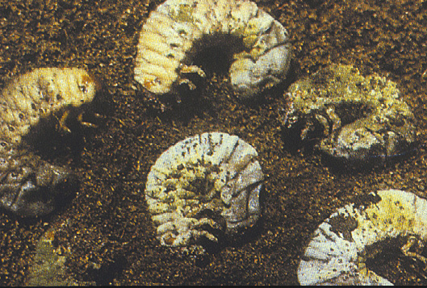
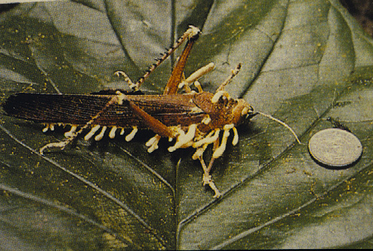
Microbial Control

Slide 72
Genetically Modified Organisms
(GMOs)
Incorporate genetic material from one organisms into another (e.g., endotoxin from Bt)
Transgenic plants
Public acceptance has been a problem

Slide 73
Cultural and Physical Management Techniques
Manipulation of the pest’s environment
  Sanitation
  Tillage
  Crop rotation
Physical removal or containment
  Screens
  Fly swatter
  Hopper dozer

Slide 74
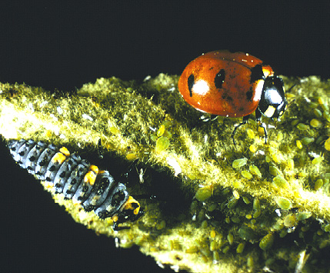
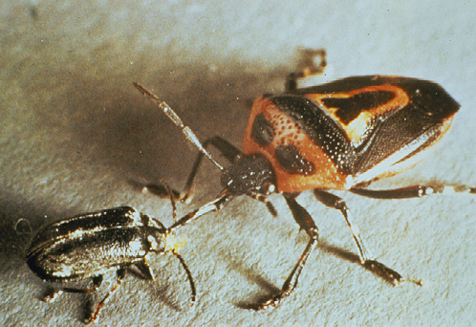
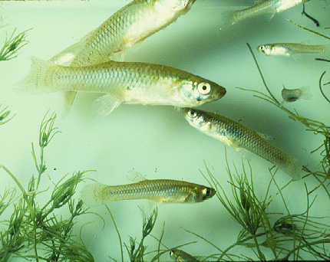
Biological Control - Predators

Slide 75
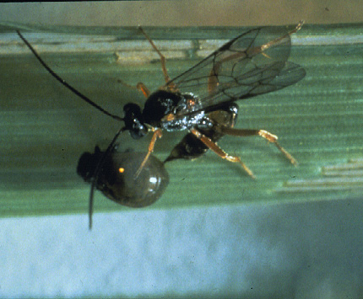
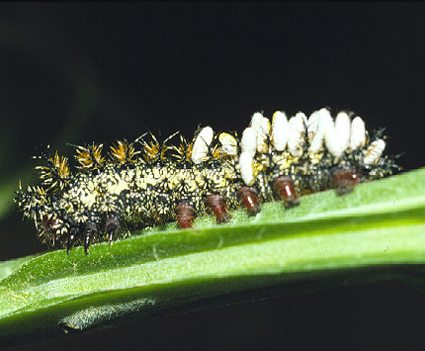
Biological Control - Parasitoids

