Slide 1


CRB BIOLOGY
Know your enemy.
Aubrey Moore
CNMI CRB Project Teleconference
23 February 2021

Slide 2




Thanks for support and funding from:
US Dept of the Interior
Office of Insular Affairs
US Dept of Agriculture
Forest Service
Legislature of Guam
US Dept of Agriculture
Animal Plant Inspection Service
Notes:
Add DOI-OIA

Slide 3
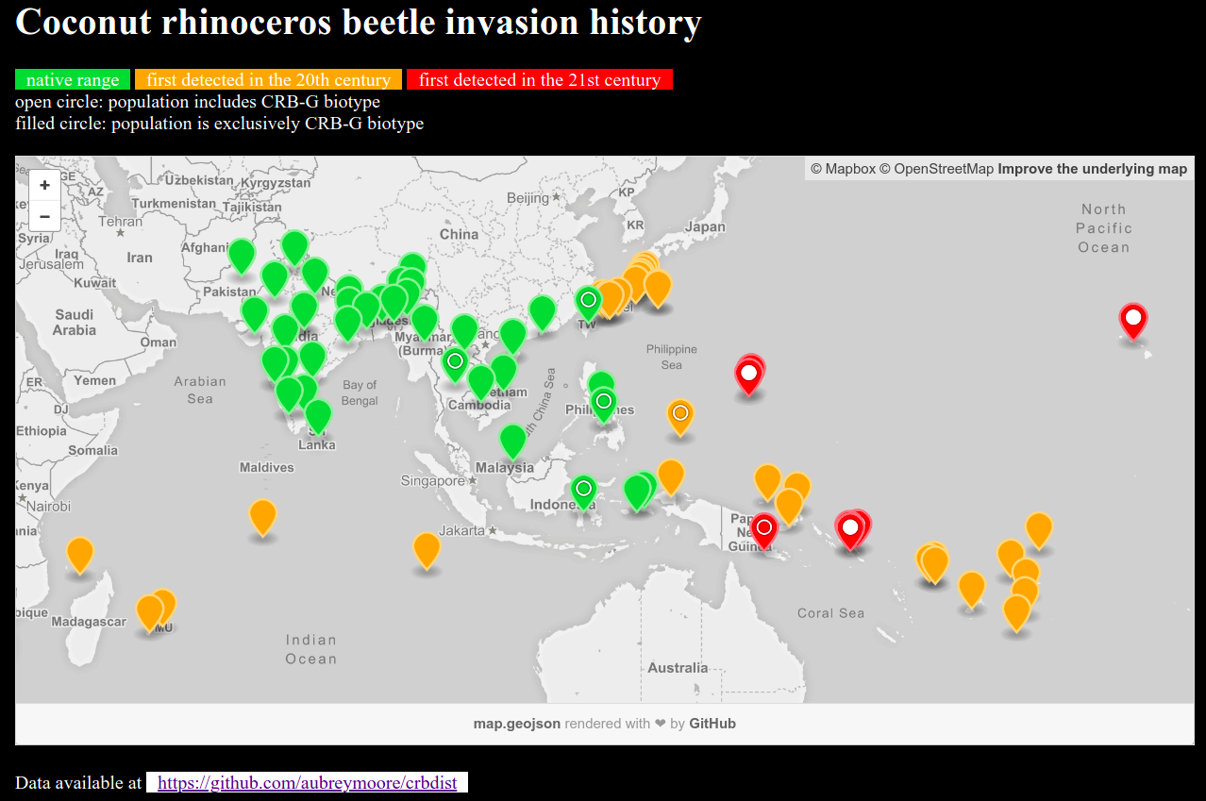
Screen capture from http://aubreymoore.github.io/crbdist/mymap.html 2018-08-05

Slide 4
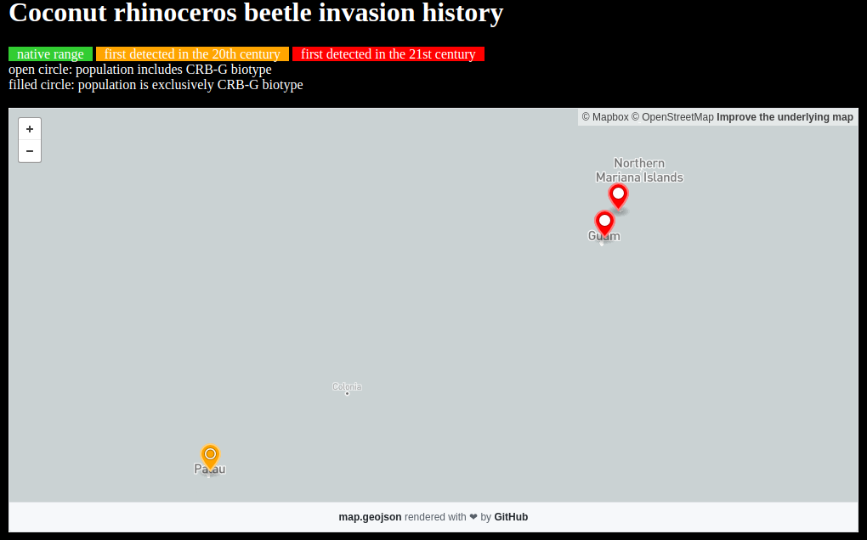
Screen capture from http://aubreymoore.github.io/crbdist/mymap.html 2021-02-20

Slide 5
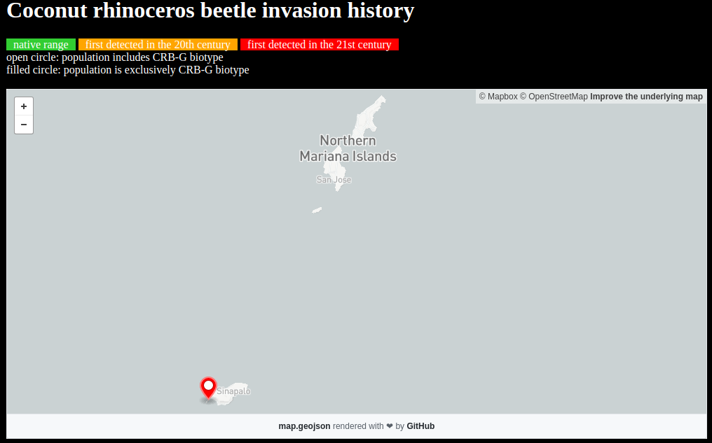
Saipan 2006, 2017
Aguiguan 2019
Rota 2018
Screen capture from http://aubreymoore.github.io/crbdist/mymap.html 2021-02-20

Slide 6
Discovery of the CRB-G Biotype
Marshall, S. D. G., Moore, A., Vaqalo, M., Noble, A., & Jackson, T. A. (2017).
A new haplotype of the coconut rhinoceros beetle, Oryctes rhinoceros, has escaped biological control by Oryctes rhinoceros nudivirus and is invading Pacific Islands.
Journal of Invertebrate Pathology, 149, 127–134. https://doi.org/10.1016/j.jip.2017.07.006

Slide 7
Characteristics of CRB-G
genetically distinct
resistant to all available isolates of OrNV
more invasive (except for Vanuata, all recent invasions involve CRB-G)
behavioral differences ???
not highly attracted to oryctalure
higher per-capita damage

Slide 8

100 eggs per female
Notes:
Generation time: 6 to 9 months
Female lays about 100 eggs (biotic potential of 50
which equals an increase of 5000% per generation)
Only adults do damage.

Slide 9
Potential Population Growth
Each female lays 60 eggs
No mortality
Sex ratio is 1:1
Generation | CRB Population
1 | 60
2 | 1,800
3 | 54,000
4 | 1,620,000
5 | 48,600,000
6 | 1,458,000,000
7 | 43,740,000,000
8 | 1,312,200,000,000

Slide 10

Notes:
CRB adults damage developing fronds when boring into the crown.
When these fronds unfurl, this damage is seen as distinctive v-shaped cuts.

Slide 11

Notes:
- Adults bore into crowns of coconuts or other palms to feed on sap.
- Adults leave the bore hole after 2 or 3 days.
- Adults feed several times.
- Developing fronds are damaged when a beetle bores through them.
- Palms are killed if the meristem is damaged.
- Palms may regrow a full canopy of CRB damage is stopped. However, bore holes do not heal, leaving palm structurally week and susceptible to beheading in strong winds.

Slide 12
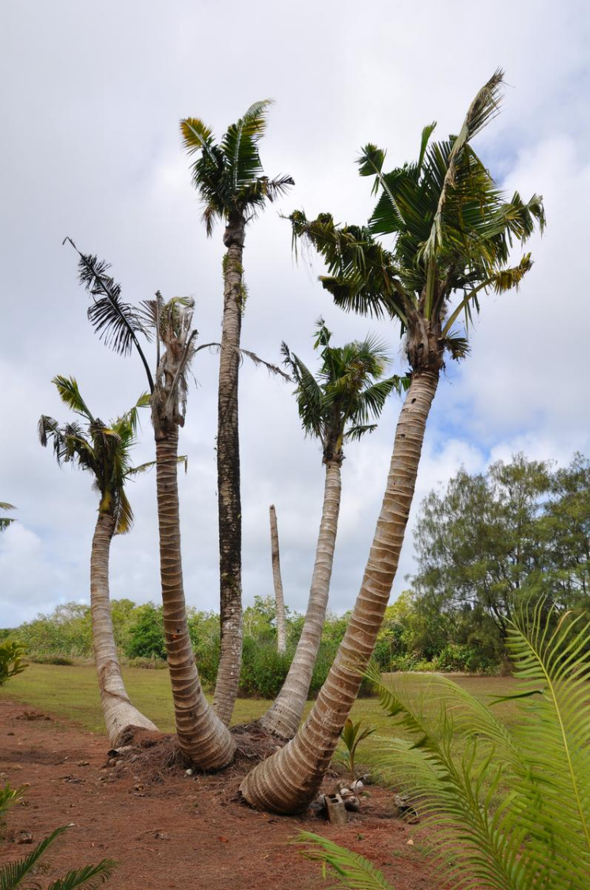

Slide 13

Notes:
Palms killed by adults become preferred breeding sites which generate several generations of grubs.
If CRB adults are abundant, many palms will be killed creating breeding sites which generate even more adults.
This positive feedback cycle may not stop until CRB run out of food after killing most palms.

Slide 14

The current outbreak was triggered by Typhoon Dolphin which visited Guam in May 2015. Adult CRB emerging from abundant breeding sites where numerous enough to start killing mature coconut palms.
Dead standing coconuts are now generating further generations of CRB which are killing even more palms.

Slide 15
How to Eradicate CRB
Sanitation: Locate and destroy all active and potential breeding sites.
Quarantine: Close pathways to prevent re-introduction and accidental transport to uninfested areas.
Note: Only one of many CRB eradication programs has succeeded (Niuatoputapu Is., aka Keppel Is., Tonga; 16 km² )

Slide 16
Research Priorities
Establishment of effective self-sustaining biological control
Development of automated detecting and monitoring of CRB damage
Precision pesticide application using drones
Improved methods for detecting CRB breeding sites

Slide 17
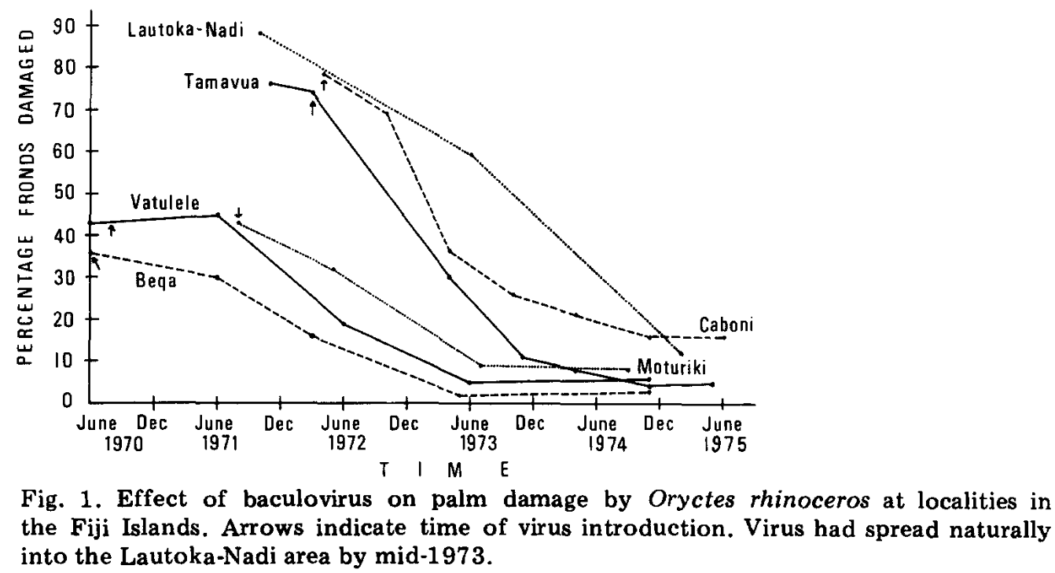
Establishment of self-sustaining biological control
Reduction in CRB damage after introduction of Oryctes nudivirus in Fiji (Bedford 1985)

Slide 18
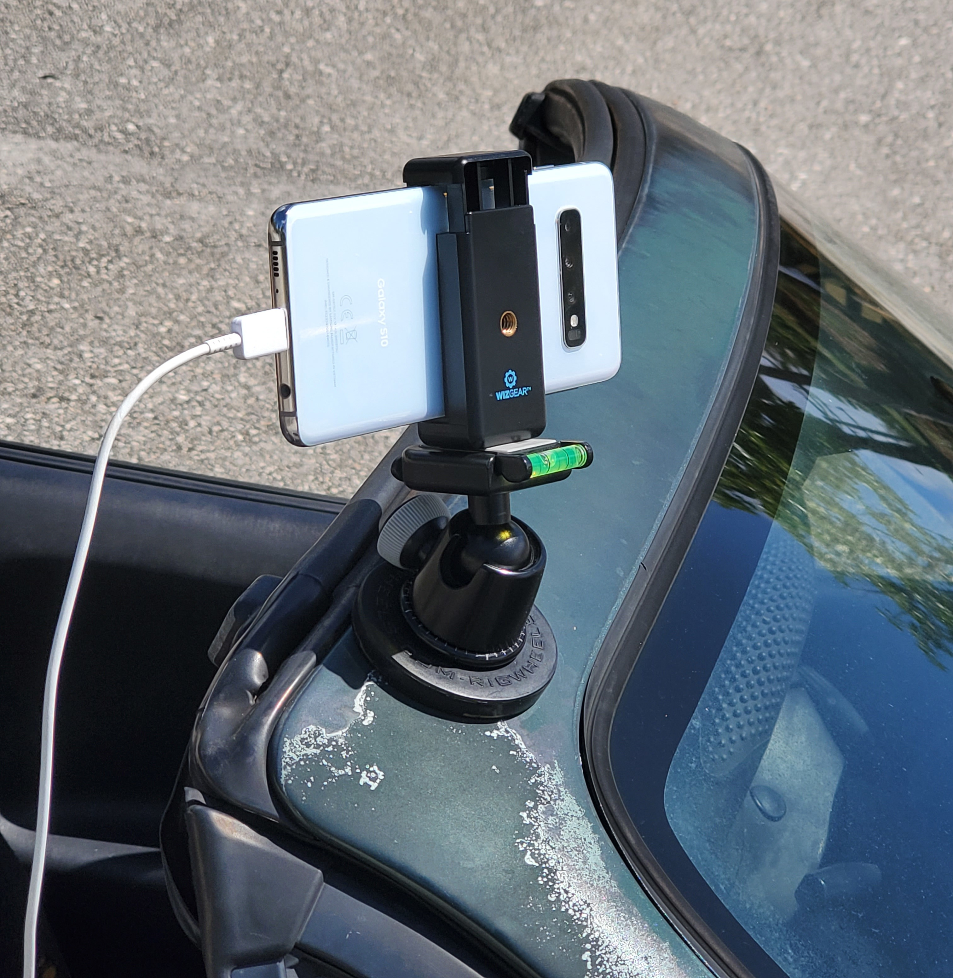
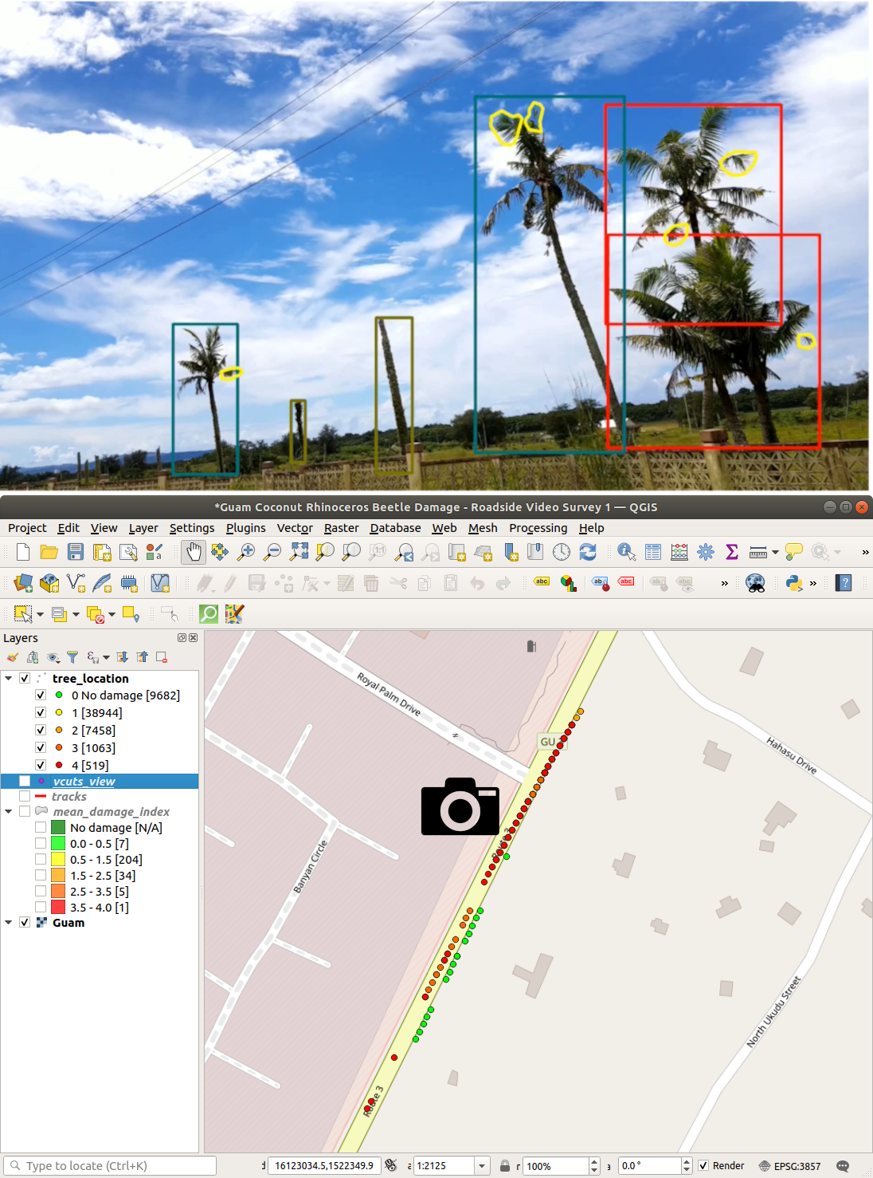
Automated detection and monitoring of CRB damage

Slide 19
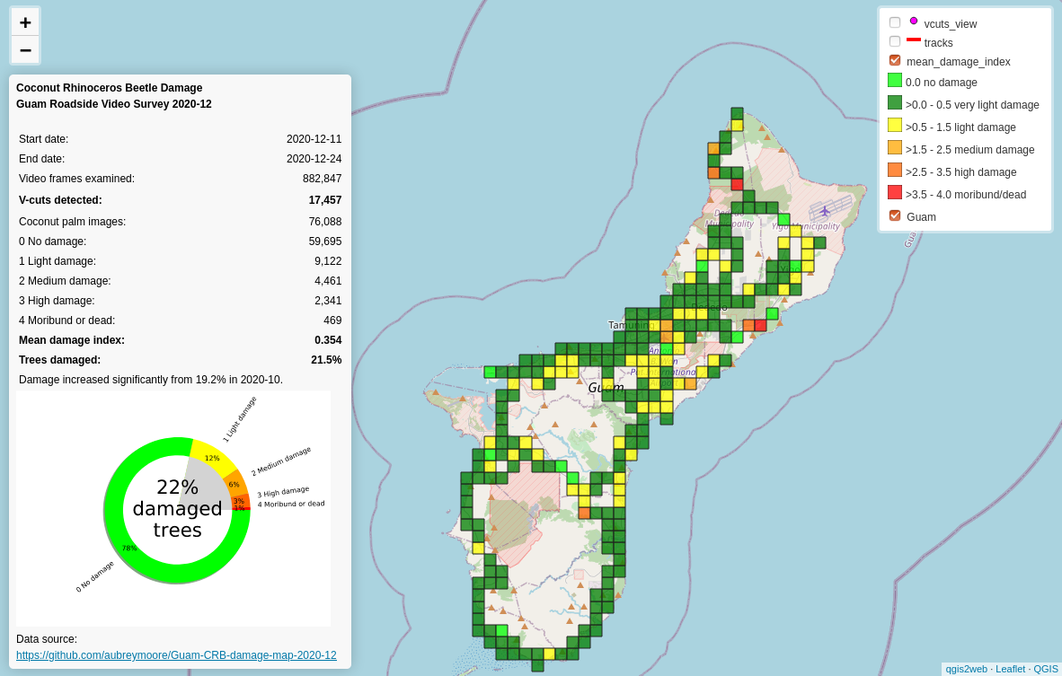
Automated detection and monitoring of CRB damage
Screenshot of https://aubreymoore.github.io/Guam-CRB-damage-map-2020-12/webmap/v1

Slide 20
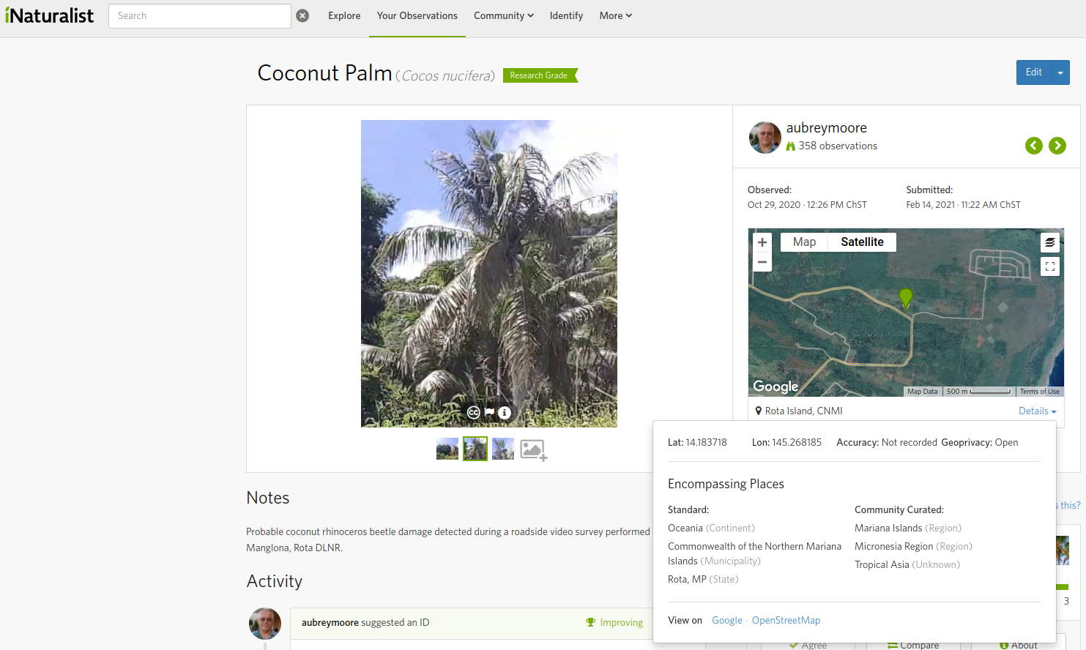
Automated detection and monitoring of CRB damage
Screenshot of https://www.inaturalist.org/observations/69534809

Slide 21
Precision pesticide application using drones
Get precise location of coconut palms with v-shaped cuts using drone imagery and AI
Program an applicator drone to apply pesticide to crowns of damaged palms

Slide 22



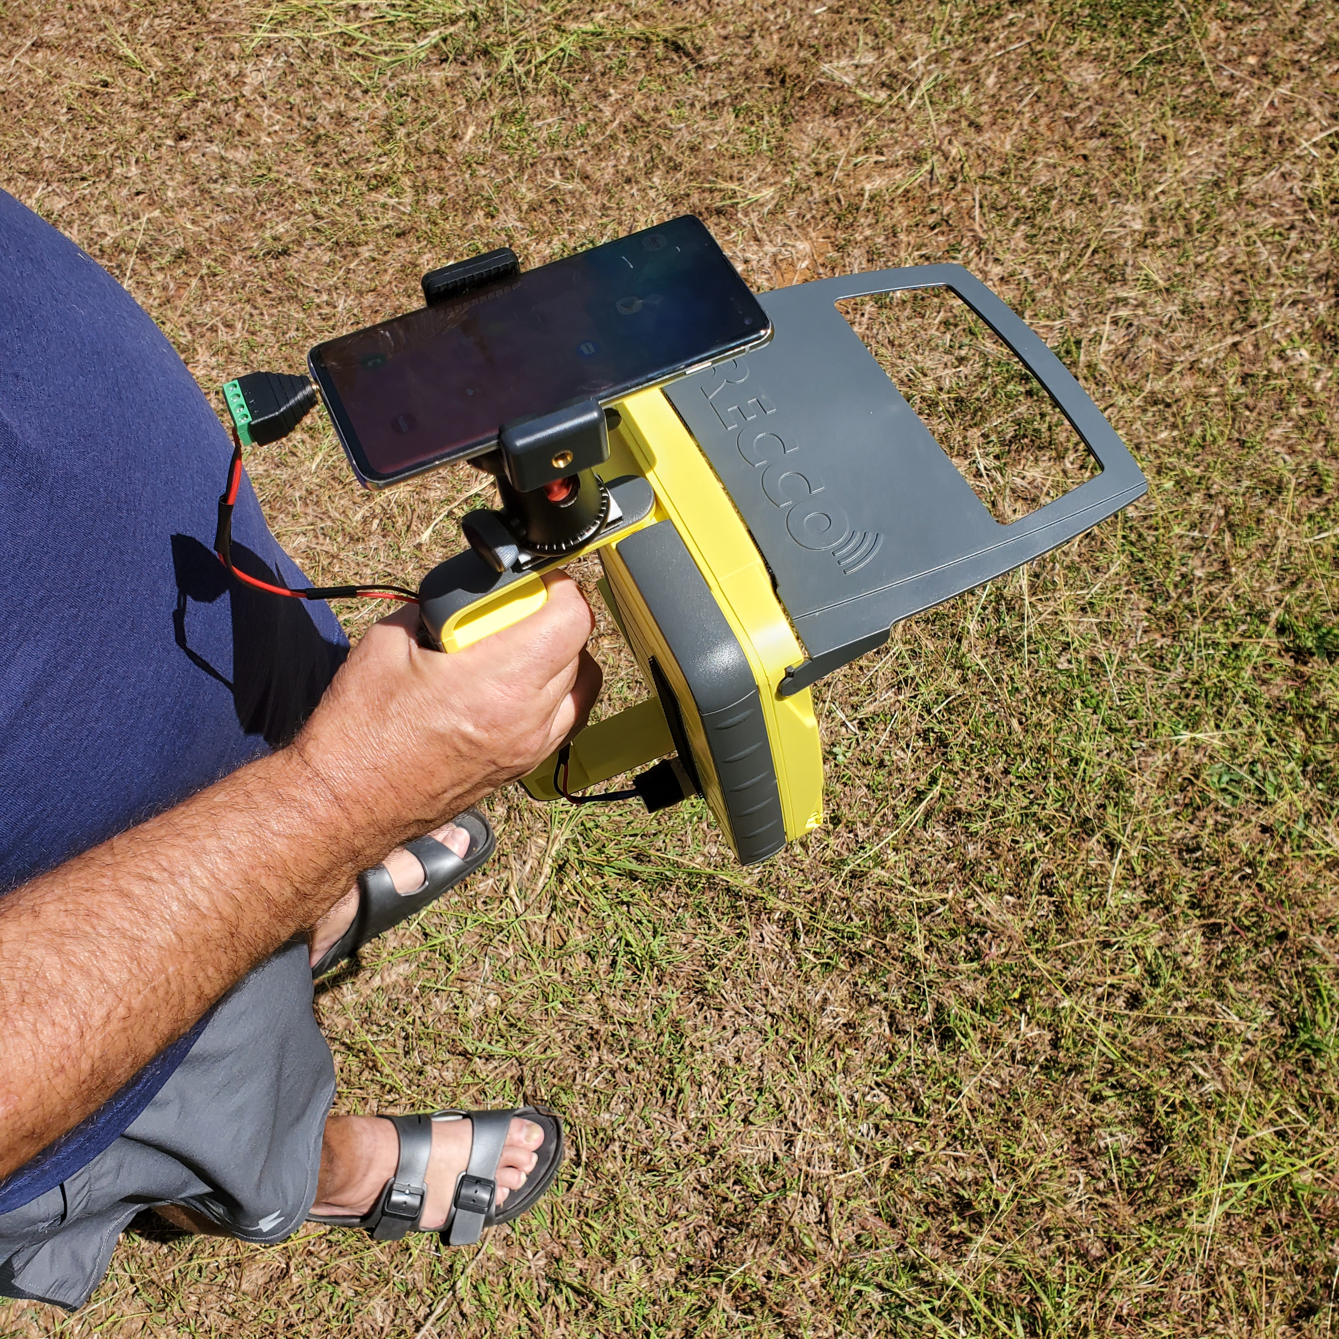
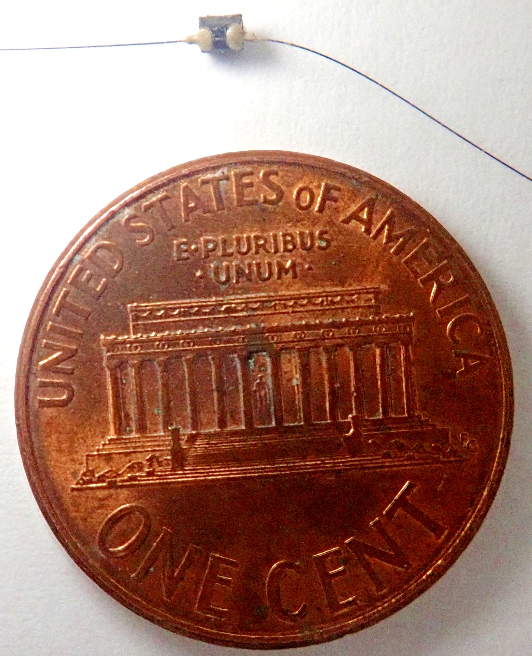
Improved methods for detecting CRB breeding sites
Detector dogs
Detector Beetles
(radio-tracking)
Detector Beetles
(harmonic radar)

Slide 23


Notes:
Loss of coconuts on smaller islands and atolls where people rely on coconut as the “tree of life” will be a human disaster.

