Slide 1
Biological Invasion of Forests on Guam and Other Islands in Micronesia
Aubrey Moore
Cooperative Extension Service / Western Pacific Tropical Research Center
College of Natural and Applied Sciences
University of Guam
Native and Invasive Pest Issues of the Pacific Islands
Western Forest Insect Work Conference
Sacramento, CA
April 1, 2014

Slide 2
Topics to be Covered
overview of emerging forest insect problems in Micronesia; to include coconut termite, other termites, various other invasive species, etc.
cycad aulacaspis scale and other invasive insects attacking Guam's endemic cycad has killed 90% of what used to be the most populous tree in Guam's forests.
Coconut rhinoceros beetle threatens coconut palm, the second most populous tree in Guam's forest.
Islands are unique: erythrina gall wasp not a problem on Guam
impediments to EDRR in Micronesia

Slide 3
Outline
Introduction to Guam and Micronesia
Major Animal Invaders
  Ungulates: deer, pigs, caribao
  Brown treesnake
  Asian Cycad Scale and Associates
  Coconut Rhinoceros Beetle
  Little Fire Ant
Other Animal Invaders of Concern
  Termites
  Hemipterans
  Bark beetles
  Erythrina gall wasp
  Casuarina gall wasp
  Snails and slugs

Slide 4
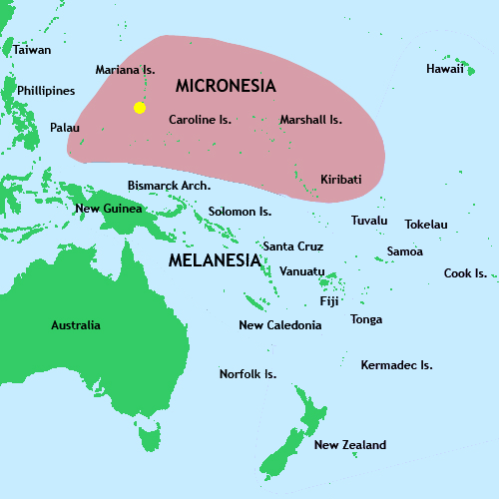
Where is Guam?

Slide 5
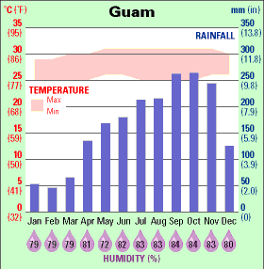

Slide 6
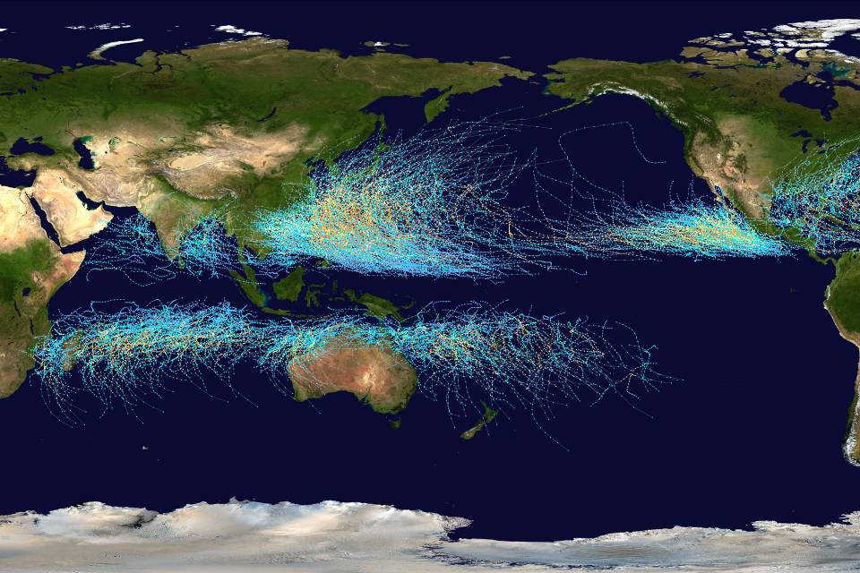
This map shows the tracks of all Tropical cyclones which formed worldwide from 1985 to 2005.

Slide 7
Air and sea traffic patterns in the Asia-Pacific region

Slide 8
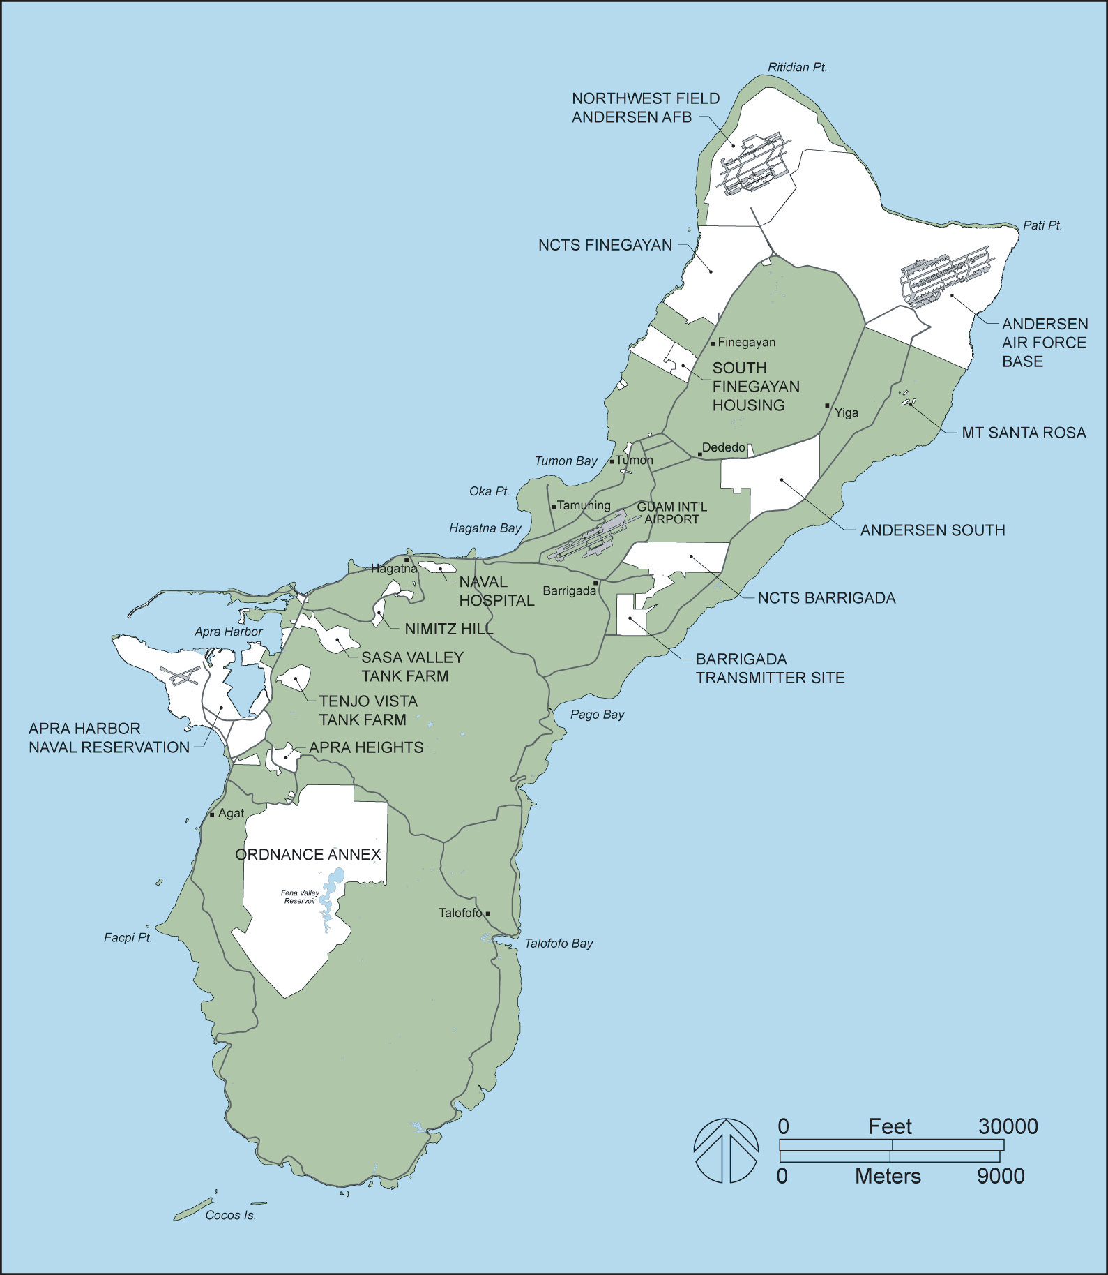

Slide 9
Major Animal Invaders of Guam's Forests
Ungulates: deer, pigs, caribao
Brown treesnake
Asian Cycad Scale and Associates
Coconut Rhinoceros Beetle
Little Fire Ant

Slide 10
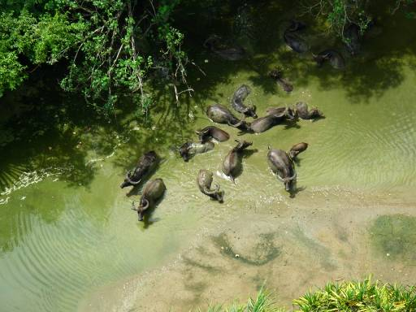
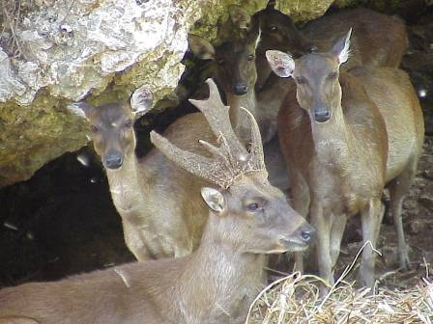
Ungulates

Slide 11
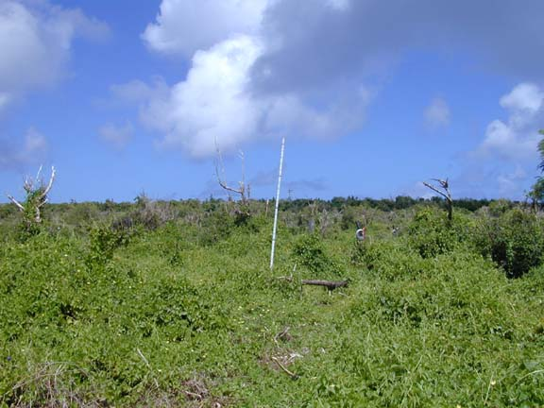
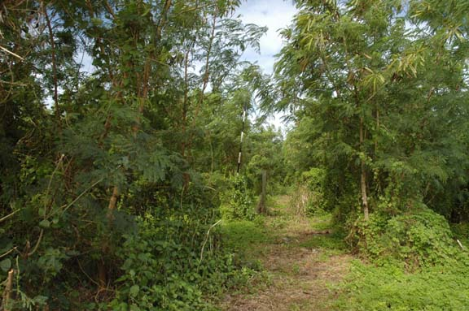
Loss of native forest
Few young trees survive intensive browsing
Before deer and pig fence erected March 2004 (NW Field AAFB)‏
22 months after deer and pigs
excluded January 2006

Slide 12
Major Animal Invaders of Guam's Forests
Ungulates: deer, pigs, caribao
Brown treesnake
Asian Cycad Scale and Associates
Coconut Rhinoceros Beetle
Little Fire Ant

Slide 13
Major Animal Invaders of Guam's Forests
Ungulates: deer, pigs, caribao
Brown treesnake
Asian Cycad Scale and Associates
Coconut Rhinoceros Beetle
Little Fire Ant

Slide 14
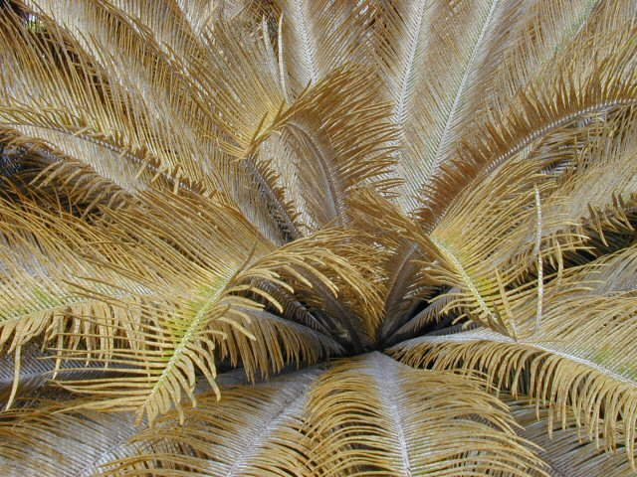
Case Study:
Aulacaspis Cycad Scale

Slide 15
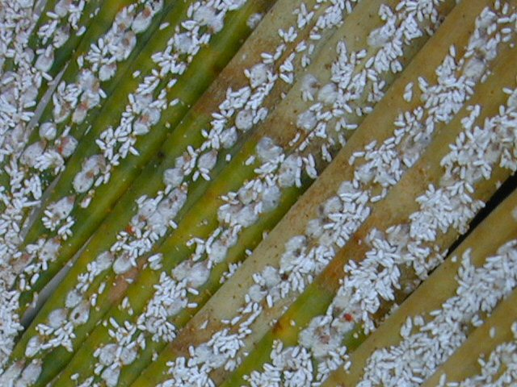
Case Study:
Aulacaspis Cycad Scale

Slide 16
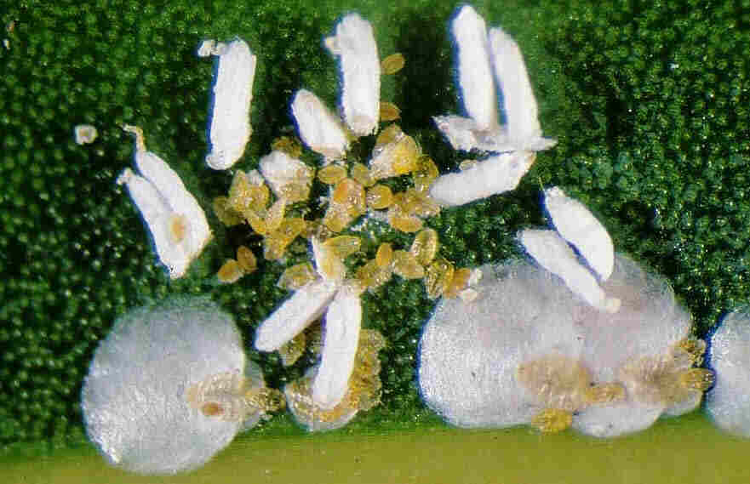
Case Study:
Aulacaspis Cycad Scale

Slide 17
Timeline for Cycad Aulacaspis Scale
Dec-2003 Detected in Tumon Hotel district on ornamental cycads
Spreads to wild cycads island-wide within 1 year (Cycas micronesica is a major species in Guam’s ecosystem)‏
Feb-2004 A lady beetle,Rhyzobius lophanthae, is released for biocontrol
2006 Cycas micronesica listed as a “Threatened Species”

Slide 18
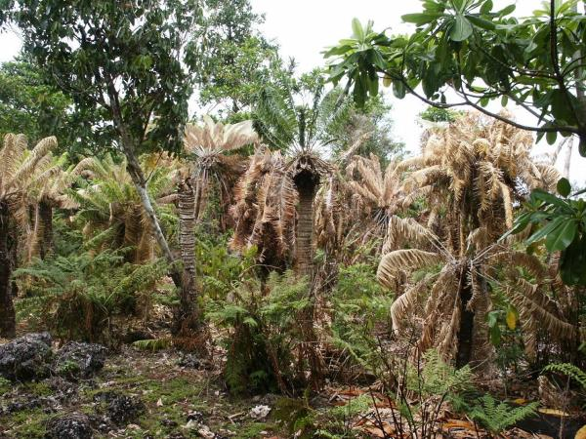
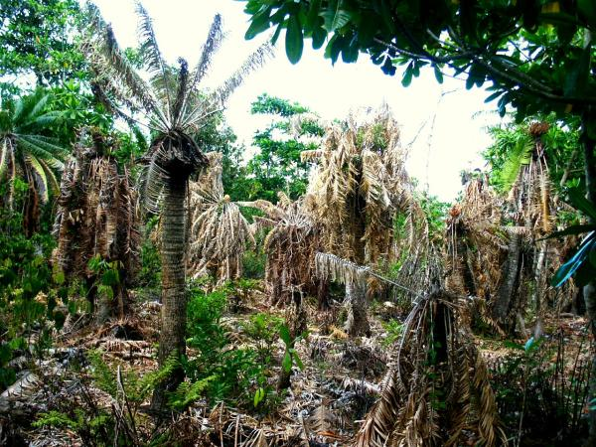

Slide 19
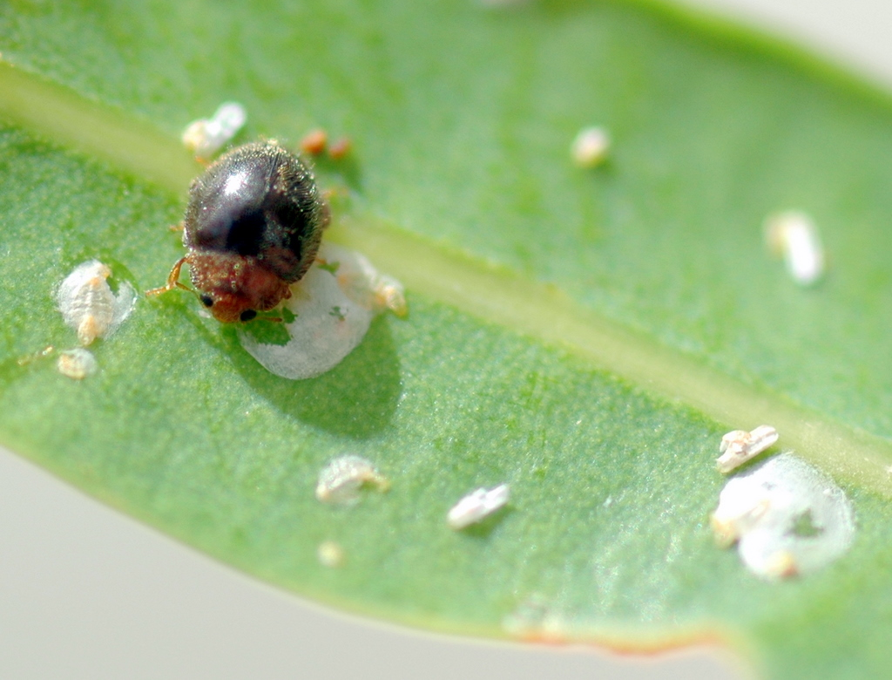
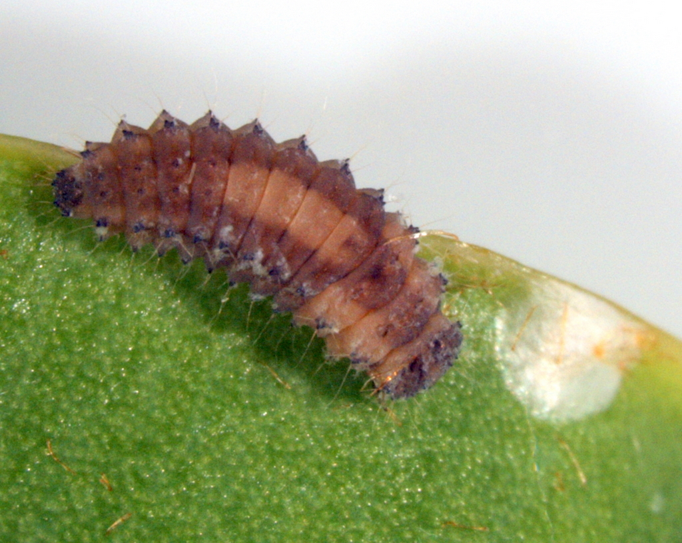

Slide 20
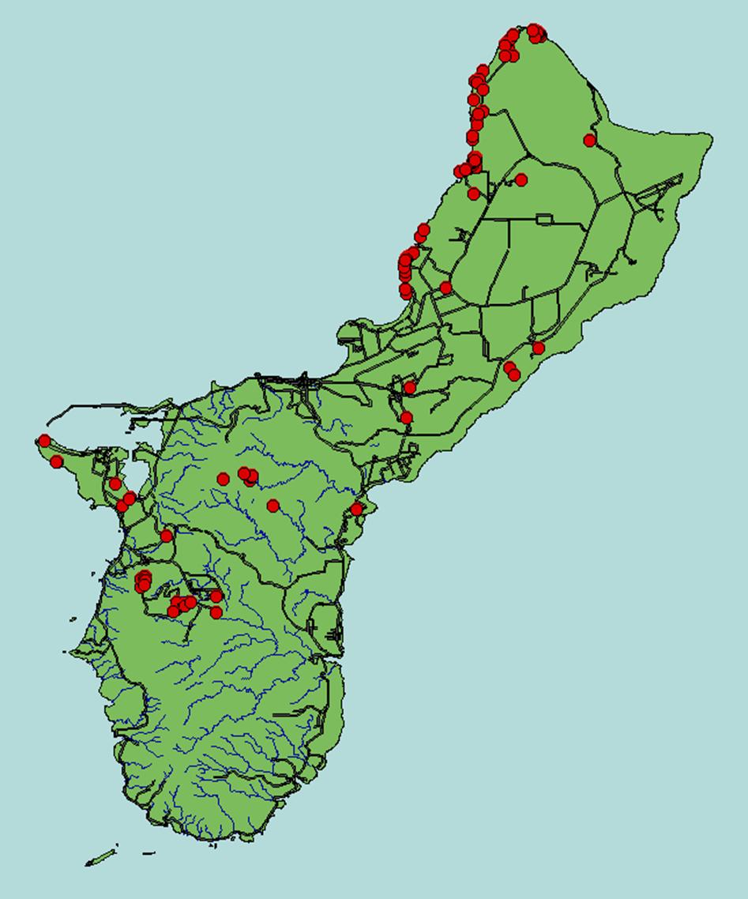
Rhyzobius lophanthae
Release Sites

Slide 21
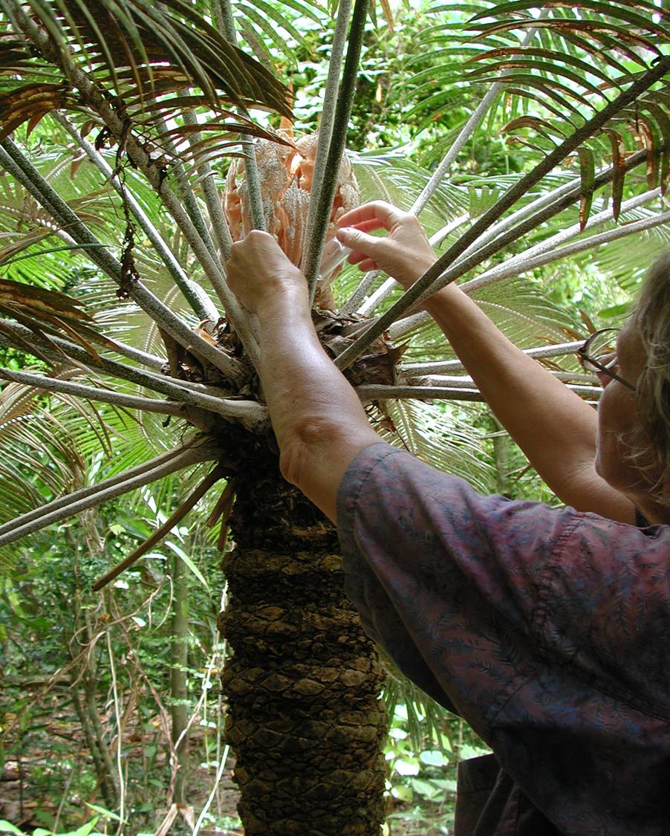

Slide 22
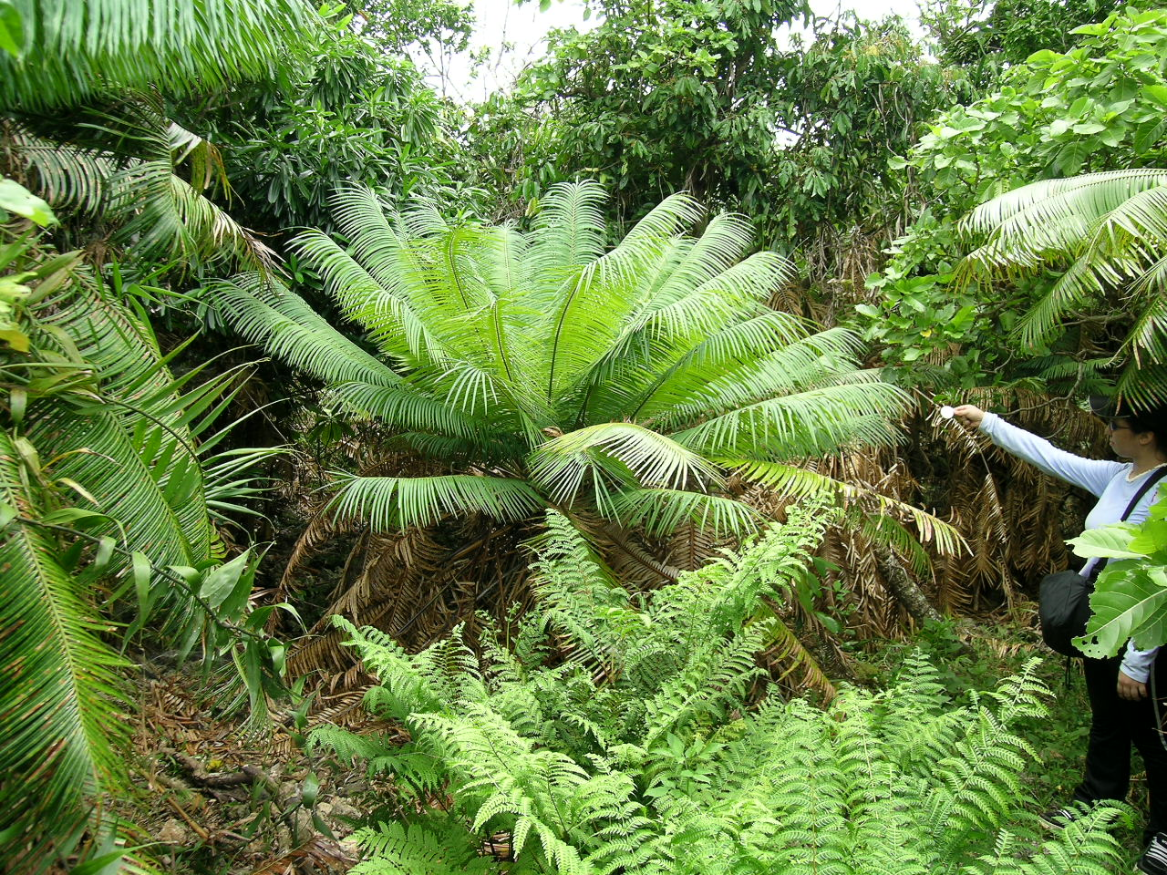
Fadang plants flush at start of 2005 rainy season

Slide 23
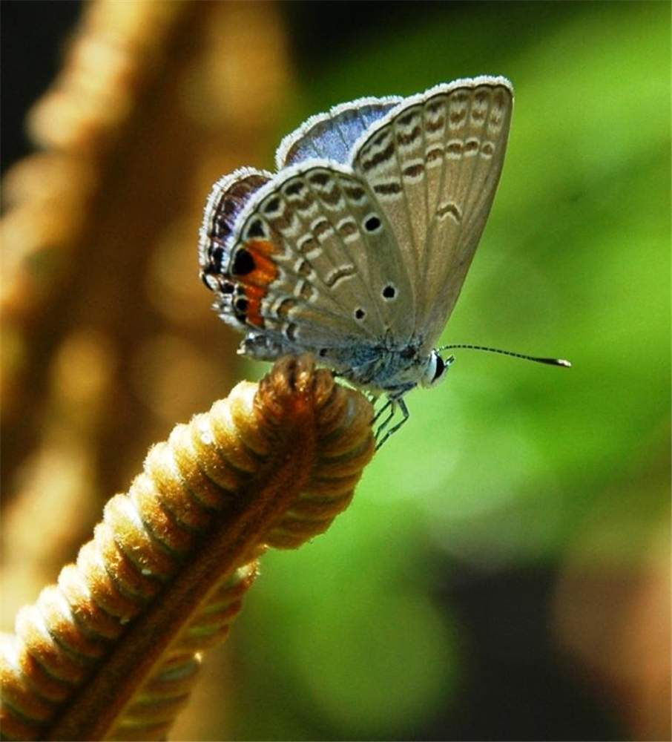
Cycad Blue Butterfly
Chilades pandava

Slide 24
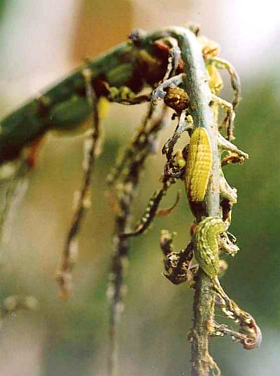
New cycad growth defoliated by Chilades pandava larvae

Slide 25
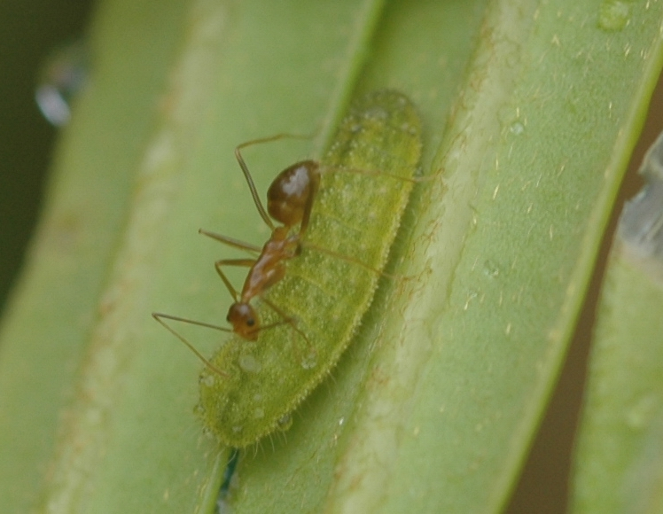
Chilades pandava larva on Cycas micronesica with attendant ant, Aplopolepis gracilipes

Slide 27
Major Animal Invaders of Guam's Forests
Ungulates: deer, pigs, caribao
Brown treesnake
Asian Cycad Scale and Associates
Coconut Rhinoceros Beetle
Little Fire Ant

Slide 28

First Coconut Rhinoceros Beetle
Collected on Guam 11-Sep-2007
Tumon Bay

Slide 29
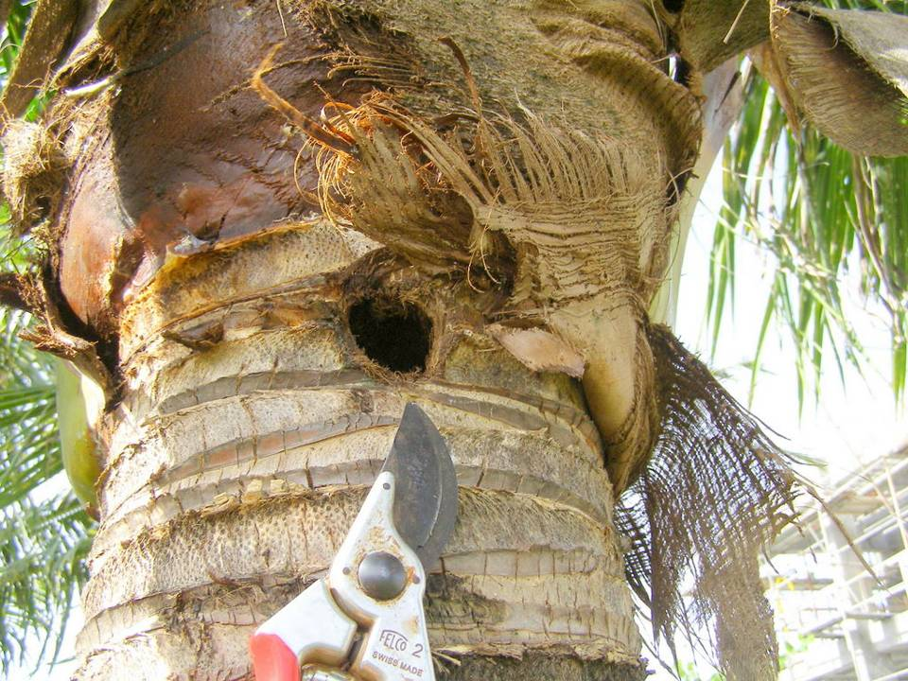

Slide 30
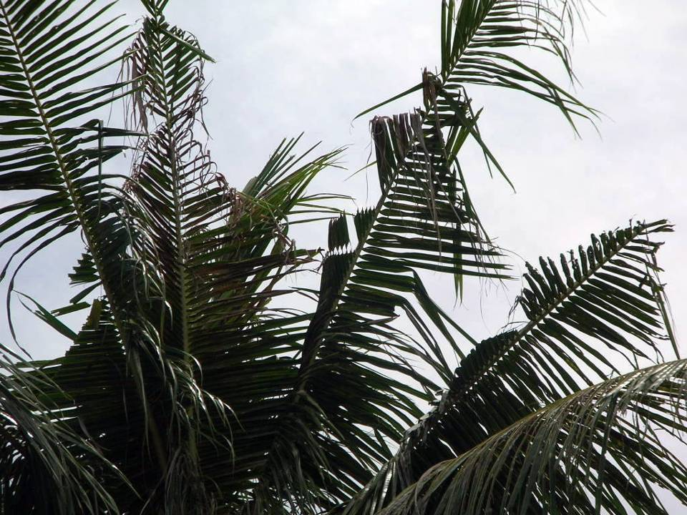

Slide 31
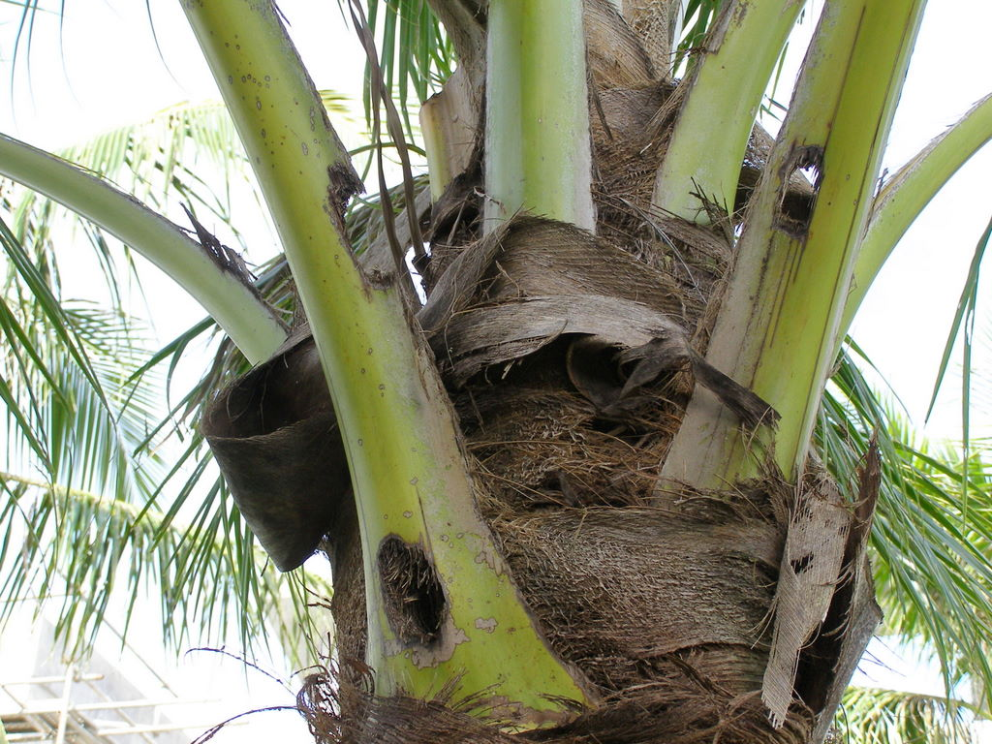

Slide 32
Major Animal Invaders of Guam's Forests
Ungulates: deer, pigs, caribao
Brown treesnake
Asian Cycad Scale and Associates
Coconut Rhinoceros Beetle
Little Fire Ant

Slide 33
Other Animal Invaders of Concern
Termites
Hemipterans
Bark beetles
Erythrina gall wasp
Casuarina gall wasp
Snails and slugs

Slide 34
Other Animal Invaders of Concern
Termites
Hemipterans
Bark beetles
Erythrina gall wasp
Casuarina gall wasp
Snails and slugs

Slide 35
New Insect Pests Detected on Guam Since Jan. 2002
Paracoccus marginatus
papaya mealybug
2002
Aulacaspis yasumatsui
Asian cycad scale
2003
Myllocerus sp.
calamansi weevil
2004
Pseudaulacaspis cockerelli
false oleander scale
2004
Metaleurodes cardini
Cardin's whitefly
2004
Nipaecoccus nipae
coconut mealybug
2004
Orthezia insignis
greenhouse ensign coccid
2004
Aleurotrachelus trachoides
neotropical solanum whitefly
2004
Chilades pandava
cycad blue butterfly
2005
Daphnis nerii
oleander hawk moth
2005
Quadrastichus erythrinae
Erythrina gall wasp
2006
Lepisiota frauenfeldi
ant
2006
Diaphorina citri
Asian citrus psyllid
2007
Tetraleurodes acaciae
acacia whitefly
2007
Henosepilachna sp.
cucurbit lady beetle
2007
Oryctes rhinoceros
coconut rhinoceros beetle
2007

Slide 36
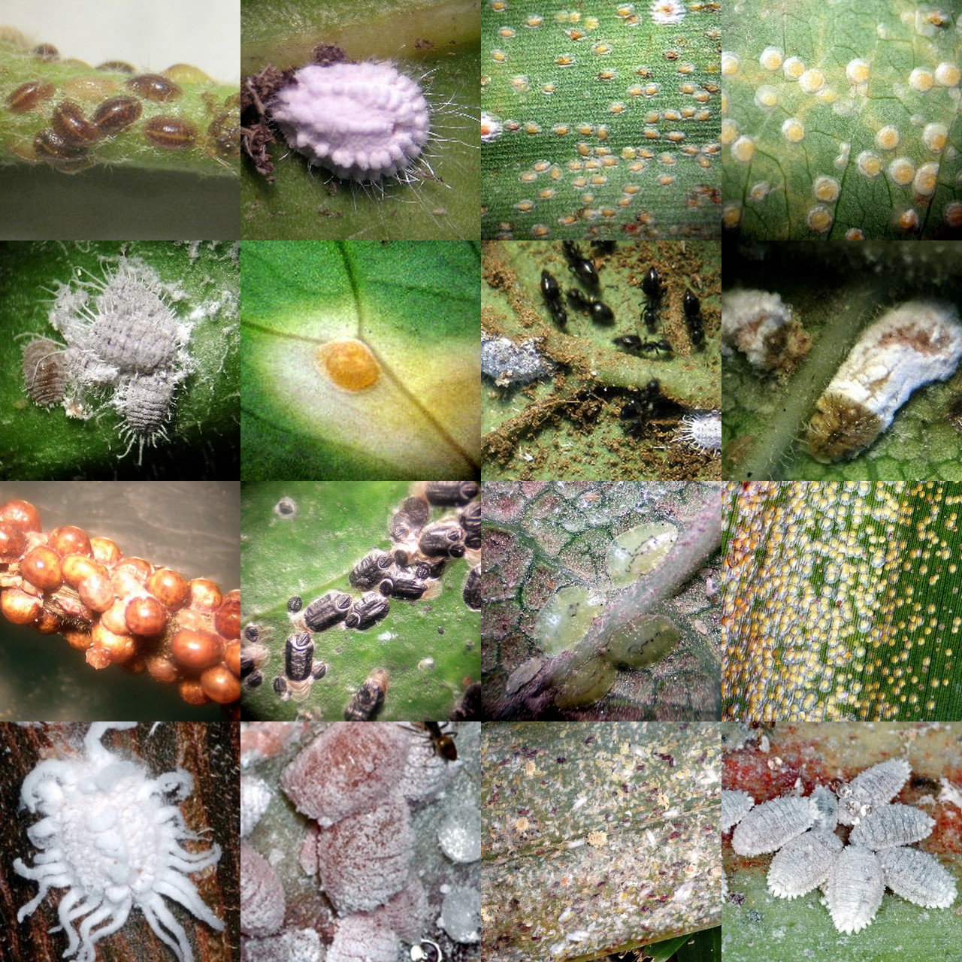

Slide 37
Other Animal Invaders of Concern
Termites
Hemipterans
Bark beetles
Erythrina gall wasp
Casuarina gall wasp
Snails and slugs

Slide 38
Other Animal Invaders of Concern
Termites
Hemipterans
Bark beetles
Erythrina gall wasp
Casuarina gall wasp
Snails and slugs

Slide 39
Other Animal Invaders of Concern
Termites
Hemipterans
Bark beetles
Erythrina gall wasp
Casuarina gall wasp
Snails and slugs

Slide 40
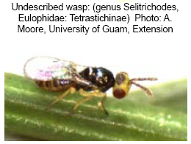
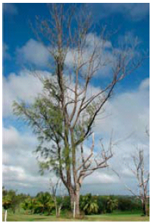
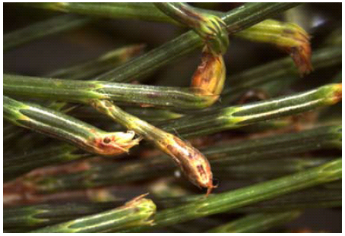

Slide 41
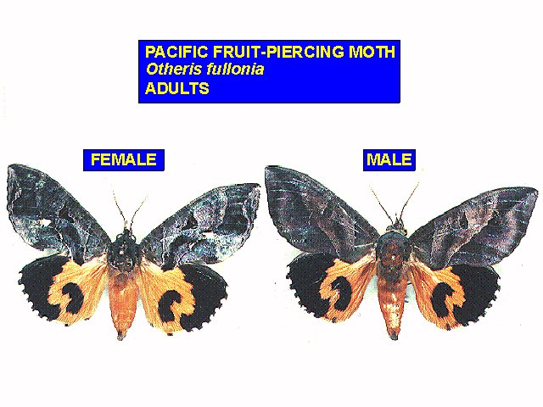
Important Invasive Insects on Guam
Pacific Fruit-Piercing Moth
Eudocimia fullonia

Slide 42
Other Animal Invaders of Concern
Termites
Hemipterans
Bark beetles
Erythrina gall wasp
Casuarina gall wasp
Snails and slugs

Slide 43
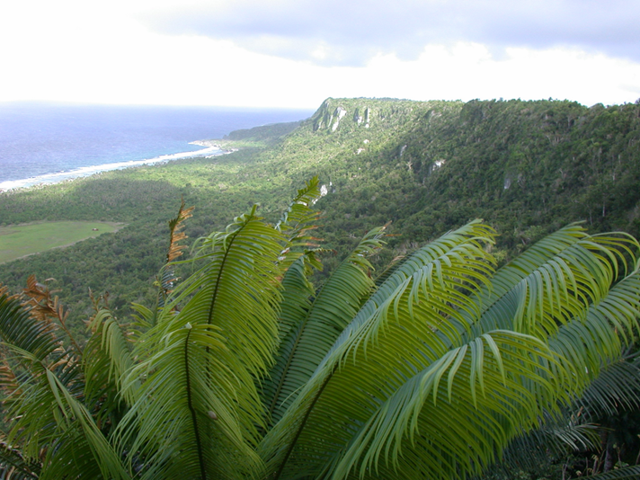
Invasive species aren’t all bad.
They provide job security for biologists.

