Slide 1



Status of a Major Outbreak of Coconut Rhinoceros Beetle, Oryctes rhinoceros Biotype G, on Guam and Attempts at Establishing Biological Control
Aubrey Moore
James J. Grasela
XIX International Plant Protection Congress
Hyderabad, India
11 November 2019
Sean D. G. Marshall

Slide 2




Thanks for support and funding from:
US Dept of Agriculture
Animal Plant Inspection Service
US Dept of Agriculture
Forest Service
Legislature of Guam
US Dept of the Interior
Office of Insular Affairs
Notes:
Add DOI-OIA

Slide 3
Outline
Introduction
CRB Invasion History
CRB Population Dynamics
Recent CRB Activity on Guam
  Biological Control
  Damage Survey
  Online Resources

Slide 4
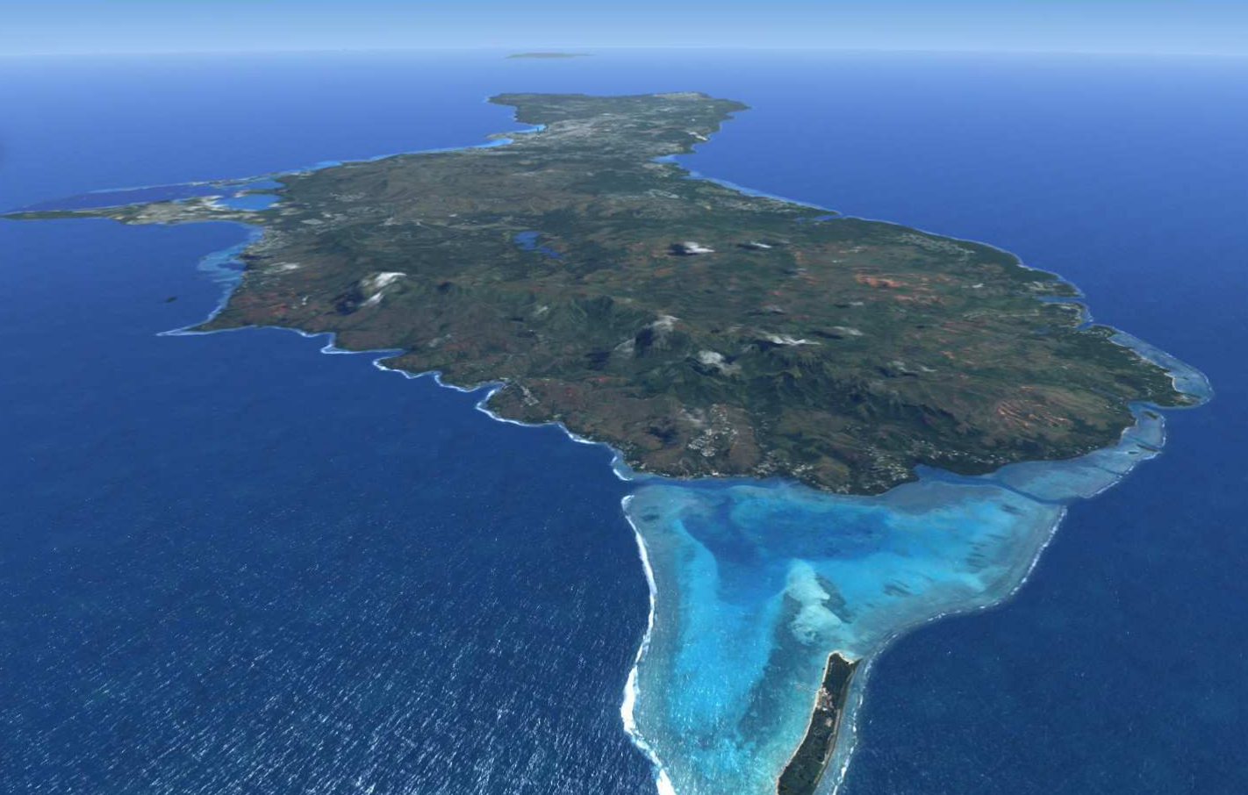
Guam

Slide 5
Notes:
This is the first CRB collected on Guam
Sept. 11, 2007

Slide 6


Slide 7

Notes:
A delimiting survey indicated that CRB had invaded only a small area of Guam (Tumon Bay and Fafai Beach).
Based on this information, an eradication program was launched.

Slide 8


Slide 9
How to Eradicate CRB
Sanitation: Locate and destroy all active and potential breeding sites.
Quarantine: Close pathways to prevent re-introduction and accidental transport to uninfested areas.
Note: Only one of many CRB eradication programs has succeeded (Niuatoputapu Is., aka Keppel Is., Tonga; 16 km² ).

Slide 10
Trap Map

Slide 11


Biocontrol
Oryctes rhinoceros nudivirus (OrNV)
Green muscardine fungus (GMF)
Metarhizium majus
Notes:
There are few effective biocontrol agents for CRB.
OrNV is the preferred BC agent. Unfortunately the Guam CRB population is apparently resistant to all available isolates.
GMF is usually used as a biological insecticide. It has been successfully established on Guam as a classical BC agent. Based on 21 day mortality data for 1,466 CRB collected from 75
sample sites, it is estimated that between 10% and 38% are being killed by GMF infection.

Slide 12
Discovery of the CRB-G Biotype
Marshall, S. D. G., Moore, A., Vaqalo, M., Noble, A., & Jackson, T. A. (2017).
A new haplotype of the coconut rhinoceros beetle, Oryctes rhinoceros, has escaped biological control by Oryctes rhinoceros nudivirus and is invading Pacific Islands.
Journal of Invertebrate Pathology, 149, 127–134. https://doi.org/10.1016/j.jip.2017.07.006

Slide 13
Characteristics of CRB-G
genetically distinct
resistant to all available isolates of OrNV
more invasive (all recent invasions involve CRB-G)
behavioral differences ???
not highly attracted to oryctalure
higher per-capita damage

Slide 14
Outline
Introduction
CRB Invasion History
CRB Population Dynamics
Recent CRB Activity on Guam
  Biological Control
  Damage Survey
  Online Resources

Slide 15
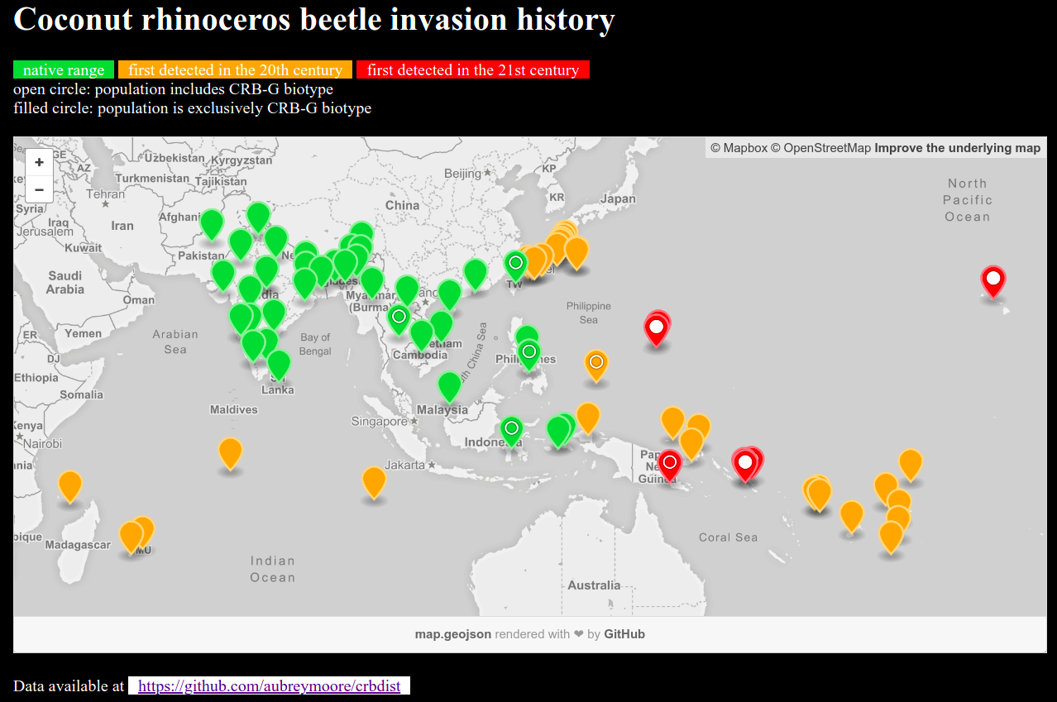
Screen capture from http://aubreymoore.github.io/crbdist/mymap.html 2018-08-05

Slide 16
Outline
Introduction
CRB Invasion History
CRB Population Dynamics
Recent CRB Activity on Guam
  Biological Control
  Damage Survey
  Online Resources

Slide 17

100 eggs per female
Notes:
Generation time: 6 to 9 months
Female lays about 100 eggs (biotic potential of 50
which equals an increase of 5000% per generation)
Only adults do damage.

Slide 18
CRB Population Growth May Be Explosive
Generation | Number of Beetles
0 | 2
1 | 100
2 | 5,000
3 | 250,000
4 | 12,500,000
5 | 625,000,000
6 | 31,250,000,000
7 | 1,562,500,000,000
8 | 78,125,000,000,000

Slide 19

Notes:
Typical habitat for grubs.
Grubs are found in many types of substrate high in organic matter such as decaying vegetation, manure piles, sawdust piles
In the lab, we rear CRB from egg to adult in a store-bought blend of steer manure and soil.

Slide 20


Notes:
Artificial habitat for grubs.
CRB grubs often found in packaged soil products.

Slide 21

Notes:
- Adults bore into crowns of coconuts or other palms to feed on sap.
- Adults leave the bore hole after 2 or 3 days.
- Adults feed several times.
- Developing fronds are damaged when a beetle bores through them.
- Palms are killed if the meristem is damaged.
- Palms may regrow a full canopy of CRB damage is stopped. However, bore holes do not heal, leaving palm structurally week and susceptible to beheading in strong winds.

Slide 22

Notes:
CRB adults damage developing fronds when boring into the crown.
When these fronds unfurl, this damage is seen as distinctive v-shaped cuts.

Slide 23

Notes:
Palms killed by adults become preferred breeding sites which generate several generations of grubs.
If CRB adults are abundant, many palms will be killed creating breeding sites which generate even more adults.
This positive feedback cycle may not stop until CRB run out of food after killing most palms.

Slide 24

The current outbreak was triggered by Typhoon Dolphin which visited Guam in May 2015. Adult CRB emerging from abundant breeding sites where numerous to start killing mature coconut palms.
Dead standing coconuts are now generating further generations of CRB which are killing even more palms.

Slide 25

Notes:
Sanitation is labor intensive.

Slide 26
Additional CRB Control Tactics
Sanitation
Quarantine
Trapping
Chemical control
Biological control
Notes:
While trapping and chemical control are commonly used for population suppression as part of an eradication program, biological control is not.
We were advised not to use resources for biocontrol if we intended to eradicate.

Slide 27

Trapping
Pheromone traps baited with oryctalure proved useless for population suppression
Pheromone traps are useful for detection and monitoring
Notes:
Mass trapping established in Tumon Bay did not protect palms from CRB damage.
Mark-release-recapture studies indicate that panel traps catch only about 1% of the available adult CRB population.

Slide 28


Slide 29

Pheromone Trap Development

Slide 30

UV LED increases Trap Catch
Notes:
Addition of a UV light emitting diode increased pheromone trap catch by 2-3X.
Works as a synergist. Light alone traps very few CRB.

Slide 31

Tekken Trap
Notes:
A specific size of fish gill net, referred to as “tekken” on Guam traps CRB when twine drops into gap behind pronotum.

Slide 32

Tekken Trap (fish net)

Slide 33

Tekken Trap
Notes:
Tekken is highly scalable; can be used to cover small or very large piles of breeding site material

Slide 34

DeFence Trap
Notes:
The DeFence trap is an efficient pheromone trap which captures CRB using tekken.

Slide 35
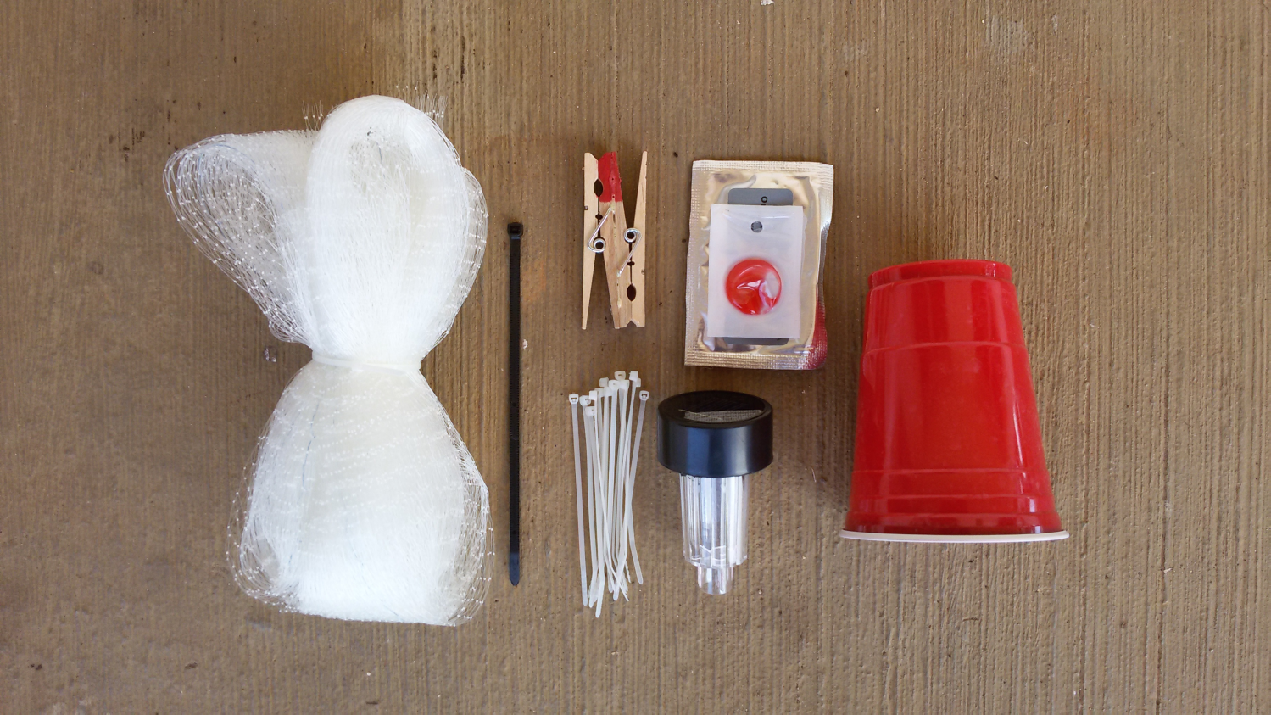
DeFence Trap
Notes:
DeFence trap kit.

Slide 36
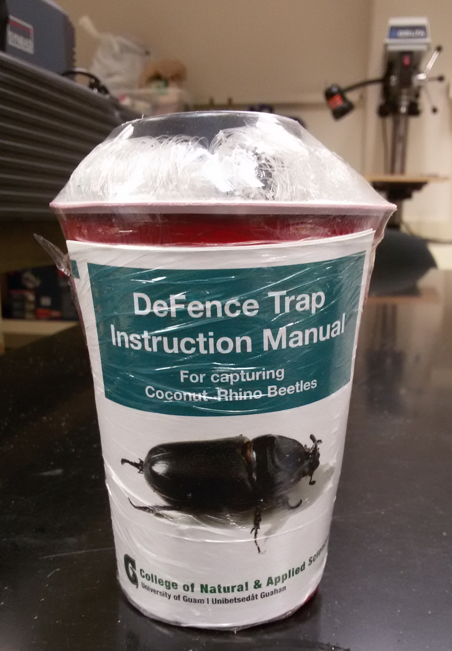

Slide 37

Detector Dogs for Locating Breeding Sites

Slide 38

Detector Beetles for Locating Breeding Sites

Slide 39

Detector Beetles for Locating Breeding Sites
Notes:
33 beetles were tagged and released at 2 sites
19 were successfully tracked to landing sites, 11 of which were considered to be active or potential breeding sites
The remaining 14 beetles were lost when they flew beyond the range of receivers.
Even though all beetles were released in the vicinity of barrel traps (blue dots on this figure) only one (out of 32) was trapped

Slide 40

Chemical Control
Notes:
Palms can be brought back to apparent good health by frequent (biweekly) sprays of cypermethrin
However, bore holes do not heal and attacked palm will always be structurally week.
The spray runs down the petioles and pools where they meet the trunk. This is where CRB initiated their bore holes.

Slide 41
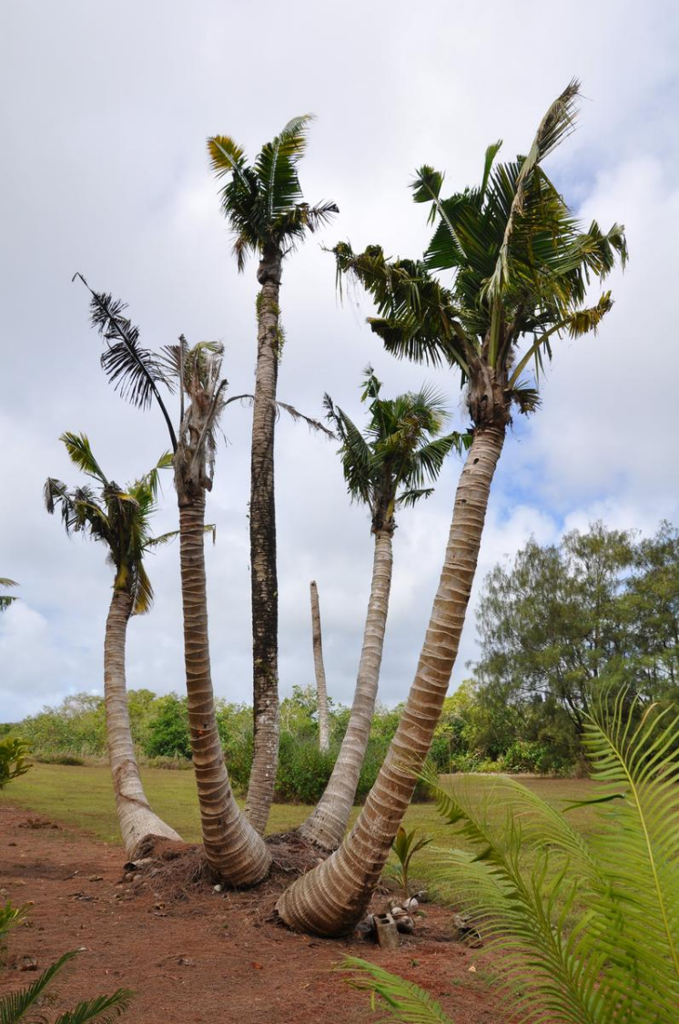
Current CRB Situation on Guam
An uncontrolled CRB outbreak is killing large numbers of coconut palms.

Slide 42
Outline
Introduction
CRB Invasion History
CRB Population Dynamics
Recent CRB Activity on Guam
  Biological Control
  Damage Survey
  Online Resources

Slide 43
Current Prognosis for Guam
Current tactics of sanitation, trapping, application of Metarhizium may reduce local damage, but will do little to protect palms on an island-wide basis because most breeding sites are inaccessible (in jungle and/or on military bases).
Based on historical data from Palau and elsewhere, it is likely that Guam will loose 50% or more of its coconut palms.
Risk of accidental export of CRB to other islands is high.

Slide 44
What Can Be Done?
Effective biocontrol for CRB-G is probably our best chance of saving Guam's coconut palms on an island wide basis.
The biocontrol agent will probably be an isolate of OrNV from an endemic CRB-G population in Asia.

Slide 45
Metarhizium majus (GMF)
We imported GMF spores from Ambrosio Alfiler's Philippine Coconut Authority lab in Legaspi.
Distributed by autodissemination and direct application to breeding sites
Released on Guam as a classical biocontrol agent, this fungus established rapidly and spread island-wide

Slide 46
Guam GMF Survey - Methods
1,466 CRB grubs and adults were collected from 77 breeding sites between Oct. 30, 2014 and May 26, 2015.
Beetles were individually collected into Mason jars containing a commercial steer manure blend.
At 21 days, each beetle was examined for mortality an fungal infection.
Technical report available at:
http://guaminsects.net/anr/sites/default/files/1555%20yearend%20report.pdf

Slide 47
Guam GMF Survey - Results
38% of beetles died
10% of beetles died and had signs of fungal infection
We concluded that the mortality caused by GMF was between 10% and 38%
Mortality rate was not correlated with rainfall.

Slide 48
Guam GMF – Current Status 1
Population suppression from GMF and other tactics was not enough to stop the uncontrolled CRB outbreak triggered by Typhoon Dolphin

Slide 49
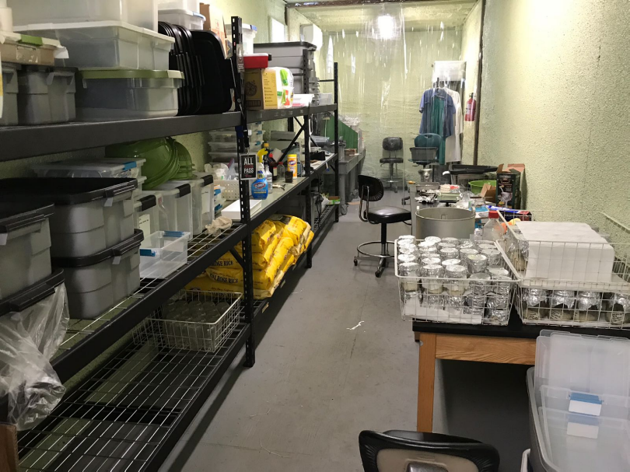
Guam GMF – Current Status 2
Roland Quitugua has established a production facility to provide GMF spores for use as a biological insecticide

Slide 50
OrNV
Our first attempt to find an effective OrNV for biocontrol of CRB-G was an expedition to Negros Island, Philippines in January 2017
Sean Marshall, Ian Iriarte, Aubrey Moore
Technical report: Marshall, Sean and Aubrey Moore 2017. Molecular analyses of Oryctes rhinoceros collected from Philippines (January 2017).

Slide 51
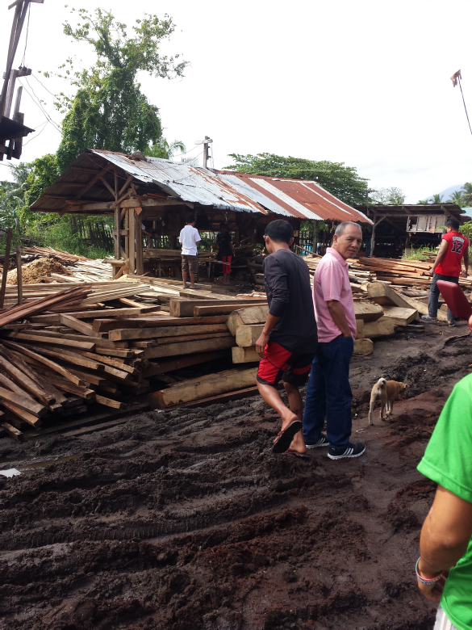
OrNV – Negros Island – Methods 1
We collected grubs and adults by hand and by using pheromone traps

Slide 52
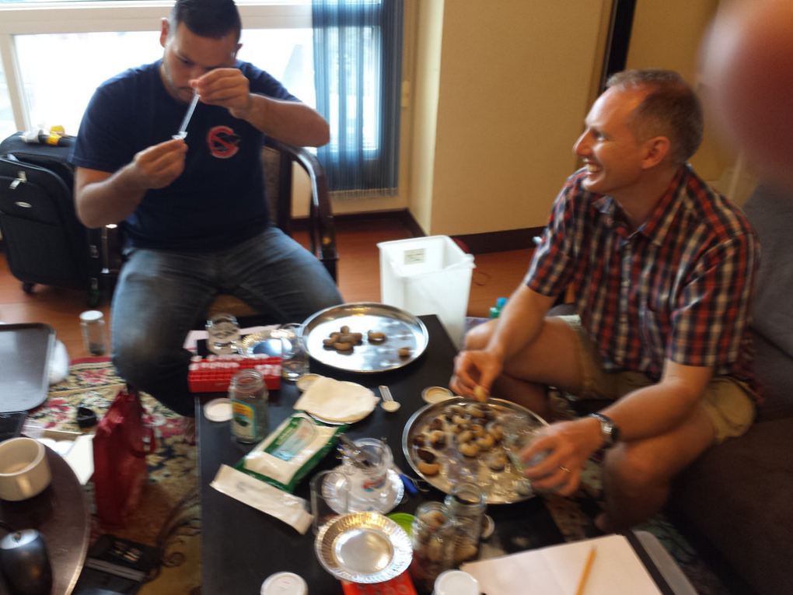
OrNV – Negros Island – Methods 2
Specimens were dissected and gut samples were preserved for molecular analysis and and histology.

Slide 53
OrNV – Negros Island – Results 1
A total of 214 CRB larvae, pupae, and adults were collected
All larvae were collected by hand from breeding sites.
Adults were collected by three methods:
  by hand from breeding sites (n=39)
  attracted to household lighting (n=3)
  in pheromone traps (n=1)
A single OrNV-infected beetle was caught by hand at an illuminated house window.
Pheromone traps were ineffective. Only a single beetle was caught in six traps deployed for a total of 31 trap-nights (0.03 beetles per trap-night)

Slide 54
OrNV – Negros Island – Results 2
CO1 barcoding indicated that all tissue samples were from CRB-G
OrNV was detected in tissue samples from only one of 94 beetles using 3 separate methods: visual, DNA, and histology). This sample, Dug42, was from an adult attracted to a household light.
OrNV isolated from Dug42 was propagated in insect cell culture.

Slide 55
OrNV – Negros Island – Results 3
Bioassays of the Dug42 OrNV isolate were performed on Guam using field-collected adults:
  Beetles dosed by application of OrNV to mouthparts resulted no significant response
  Beetles dosed by injection into the haemocoel resulted in no significant response

Slide 56
OrNV – Current Plans
Next foreign exploration will be in Taiwan were there is a population of CRB-G with an OrNV infection rate of 82% (Shizu Watanabe, personal communication).

Slide 57
CRB-G is a Regional Problem
Jackson, Trevor (2015).
Need for emergency response for a new variant of rhinoceros beetle (Guam biotype).
International Association for the Plant Protection Sciences Newsletter (XI). November, 2015.
Available on-line at
Vaqalo, Maclean, Sean Marshall, Trevor Jackson, Aubrey Moore (2015).
An Emerging Biotype of the Coconut Rhinoceros Beetle Discovered in the Pacific.
Secretariat of the Pacific Community, Land Resources Division.
Available on-line at
Notes:
This OrNV resistant biotype has the potential to invade all coconut growing areas,including new islands and counties in SE Asia where CRB is naturally controlled by OrNV. Effects on coconut and oil palm crops could be disastrous
An emergency response to CRB-G is needed to minimize damage on newly invaded islands, thereby reducing risk of further spread.

Slide 58


Notes:
Loss of coconuts on smaller islands and atolls where people rely on coconut as the “tree of life” will be a human disaster.

Slide 59

Link to Climate Change
Notes:
Sea level in the Solomons has risen 8 mm per year since 1993, killing coconuts which protect the islands from erosion.
Typhoons trigger CRB outbreaks even in areas where the beetle is endemic and under biocontrol by OrNV.
Climate change models predict stronger and more frequent typhoons.

Slide 61
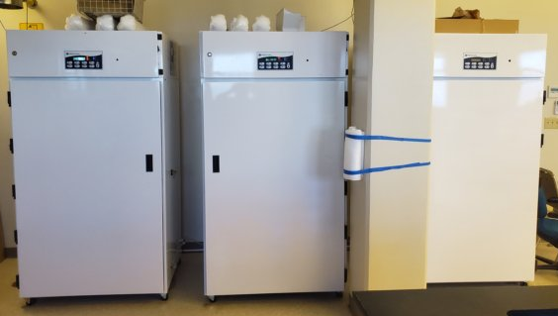
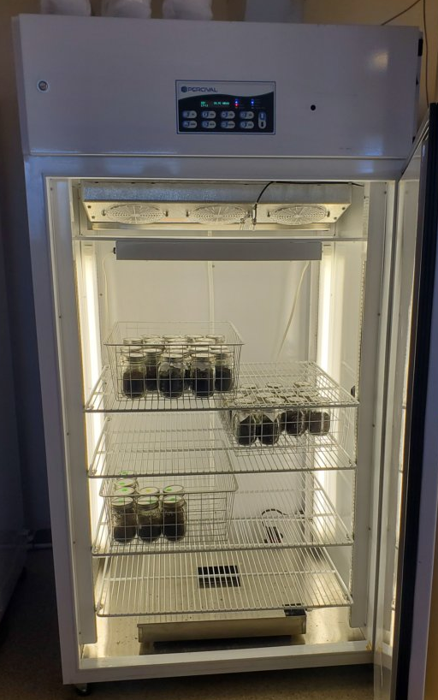
CRB Rearing

Slide 62
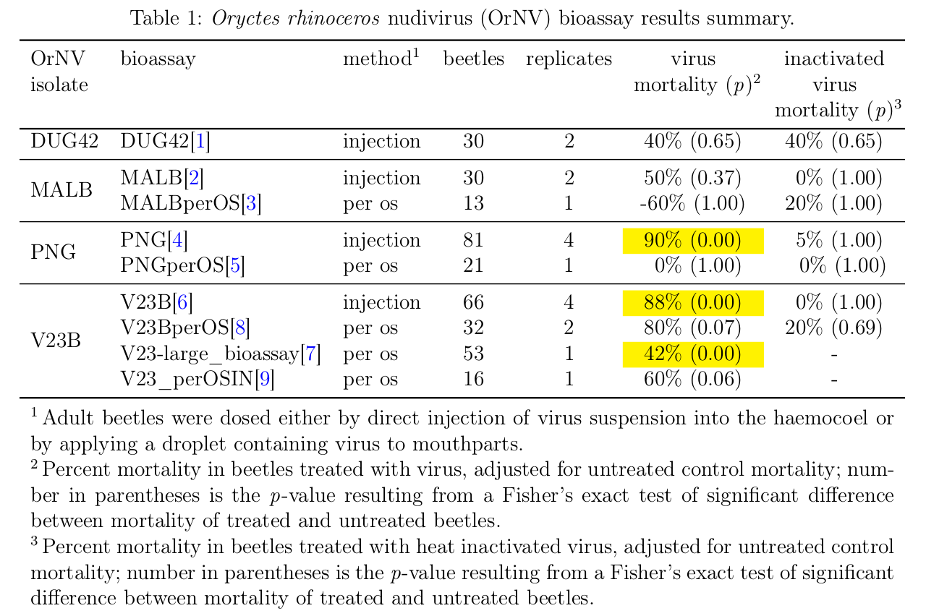
Recent OrNV / CRB-G Bioassay Results

Slide 63
Outline
Introduction
CRB Invasion History
CRB Population Dynamics
Recent CRB Activity on Guam
  Biological Control
  Damage Survey
  Online Resources

Slide 64
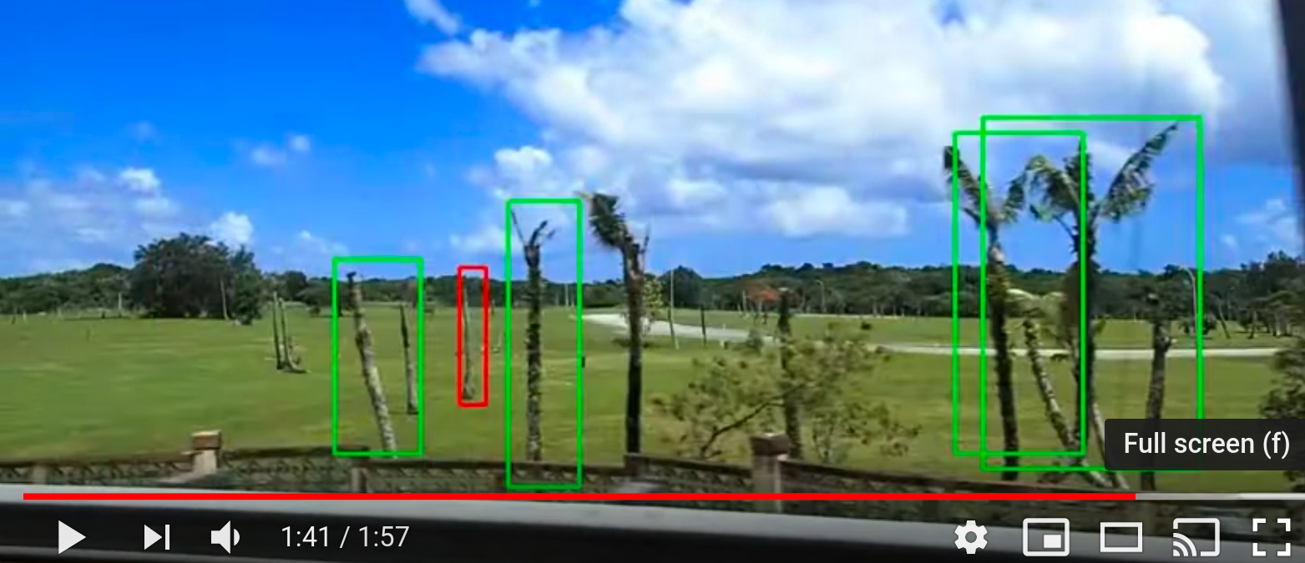
Automated Mapping of CRB Damage from Roadside Video Surveys
Screen capture from https://www.youtube.com/watch?v=zzSorqcmt9U 2019-11-04

Slide 65
Outline
Introduction
CRB Invasion History
CRB Population Dynamics
Recent CRB Activity on Guam
  Biological Control
  Damage Survey
  Online Resources

Slide 66
Online Resources

