Slide 1
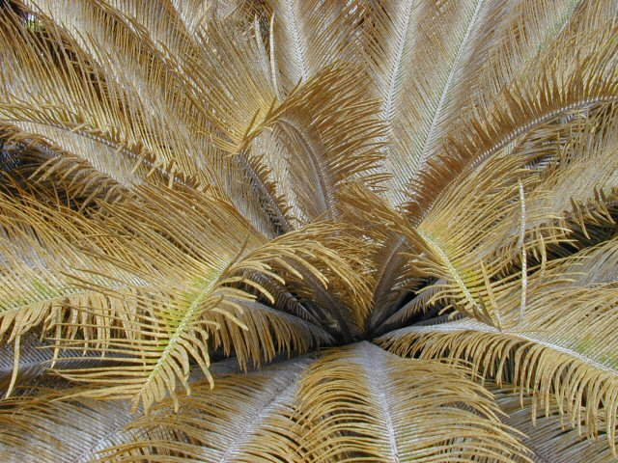
Biological Control of
Cycad Scale, Aulacaspis yasumatsui, Attacking Guam's Endemic Cycad,
Cycas micronesica
Aubrey Moore, Tom Marler, Ross Miller & Lee Yudin
Western Pacific Tropical Research Center
University of Guam

Slide 2
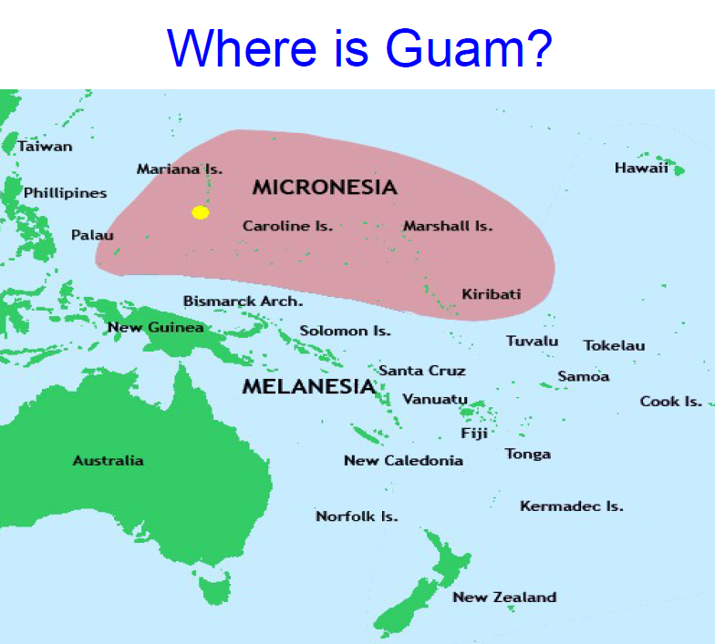

Slide 6
Recent New Island Records for Cycad Associates on Guam
2013-01-25 DIASPIDIDAE Lingaspis rossi infesting Cycas micronesica
2013-01-25 APHELINIDAE
Aphyitis sp.? parasitizing Lingaspis rossi
2013-01-25 DIASPIDIDAE Pseudaonidia sp. infesting Cycas revoluta
2013-02-10 ENCYRTIDAE
Arrhenophagus? sp. parasitizing male Aulacaspis yasumatsui infesting Cycas micronesica

Slide 7
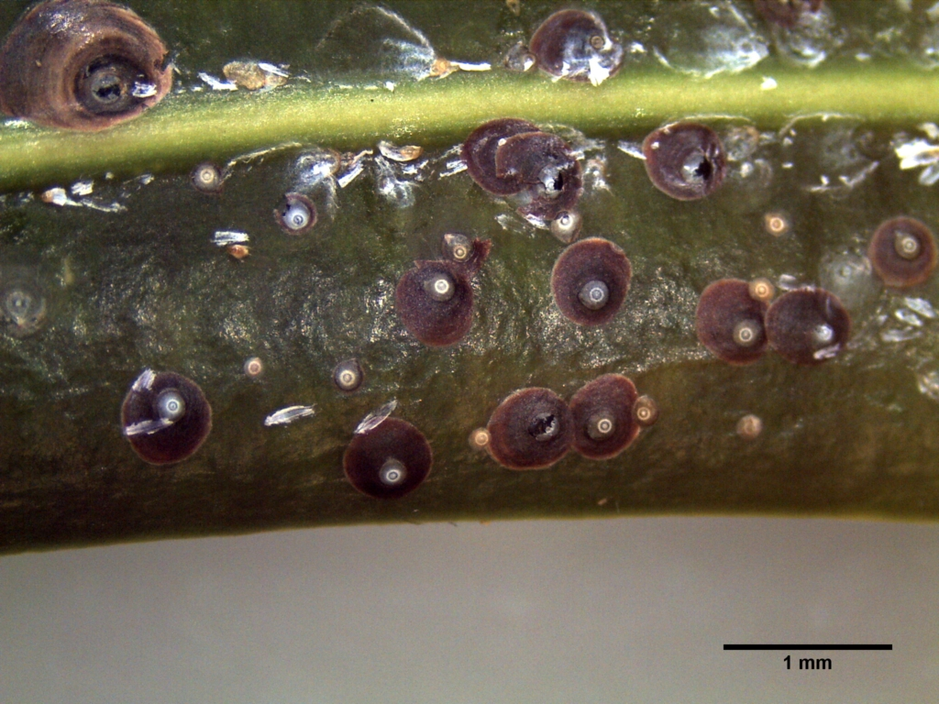
2013-01-25 DIASPIDIDAE Lingaspis rossi infesting Cycas micronesica
2013-01-25 APHELINIDAE
Aphytis? sp. parasitizing Lingaspis rossi

Slide 8
2013-01-25 DIASPIDIDAE Pseudaonidia sp. infesting Cycas revoluta

Slide 9
2013-02-10 ENCYRTIDAE Arrhenophagus? sp. parasitizing male Aulacaspis ysumatsui infesting Cycas micronesica

Slide 10
Asian Cycad Scale
Aulacaspis yasumatsui Tagaki 1972
DIASPIDIDAE

Slide 11
Asian Cycad Scale
Chronology
1996 – Scale detected in Florida on cycads growing in a botanical garden
1998 – Scale detected in Hawaii
2003 – Scale detected on cycads used for landscaping in Tumon hotel district on Guam
2004 – Scale spreads to Cycas revoluta and C. micronesica throughout of Guam
2006 – Scale infests C. micronesica on Rota

Slide 12
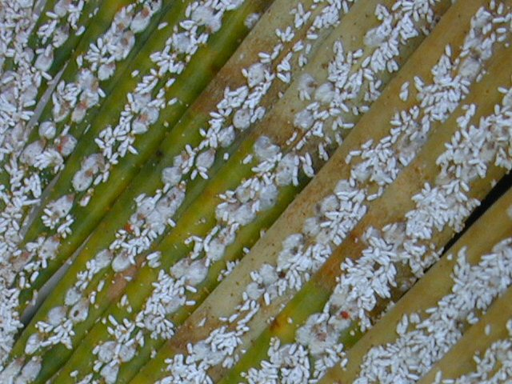

Slide 13
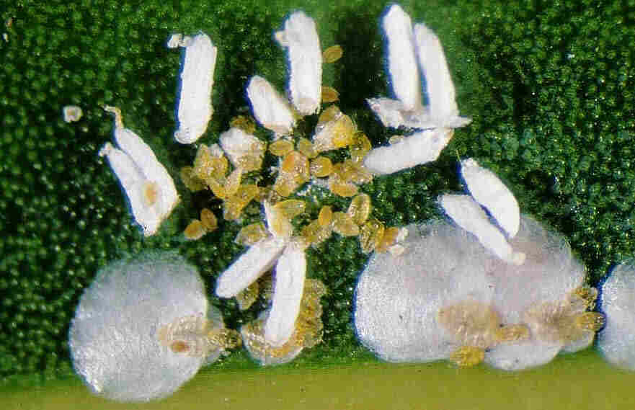

Slide 14
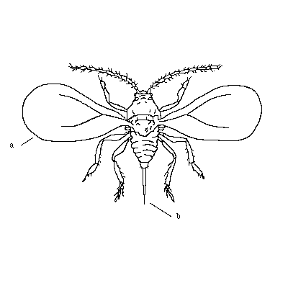
Scale Morphology & Life History
Eggs
Male
cocoon
Adult male
Female
scale
Crawlers

Slide 15
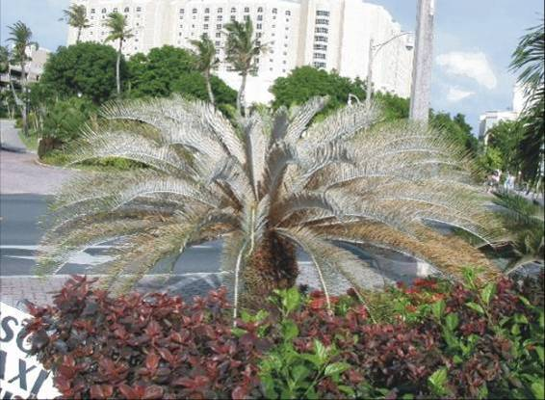

Slide 16
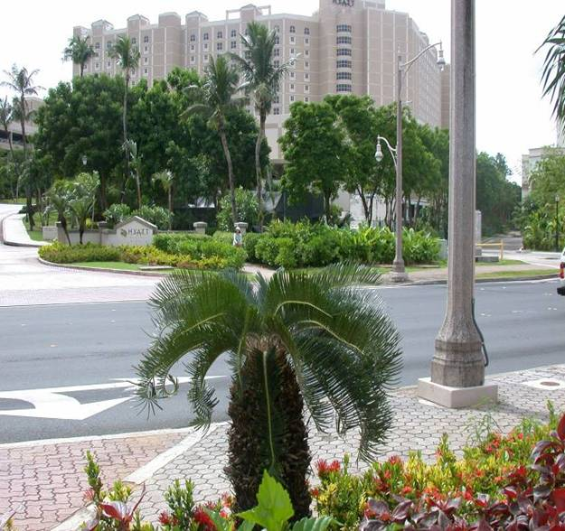

Slide 17
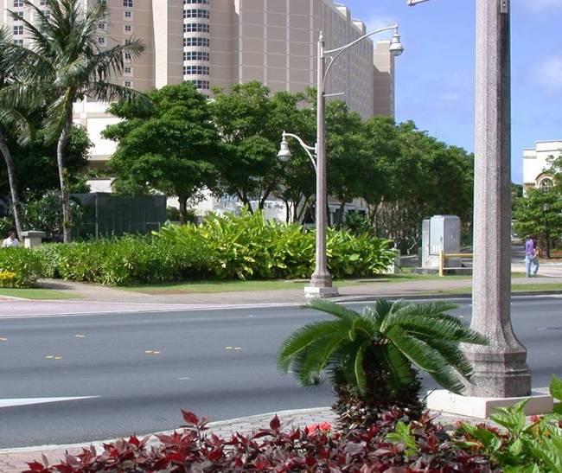

Slide 18
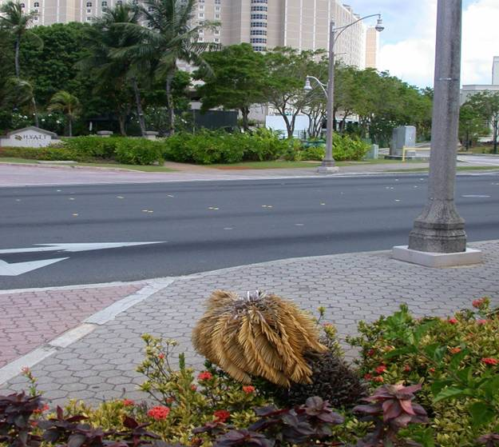

Slide 19
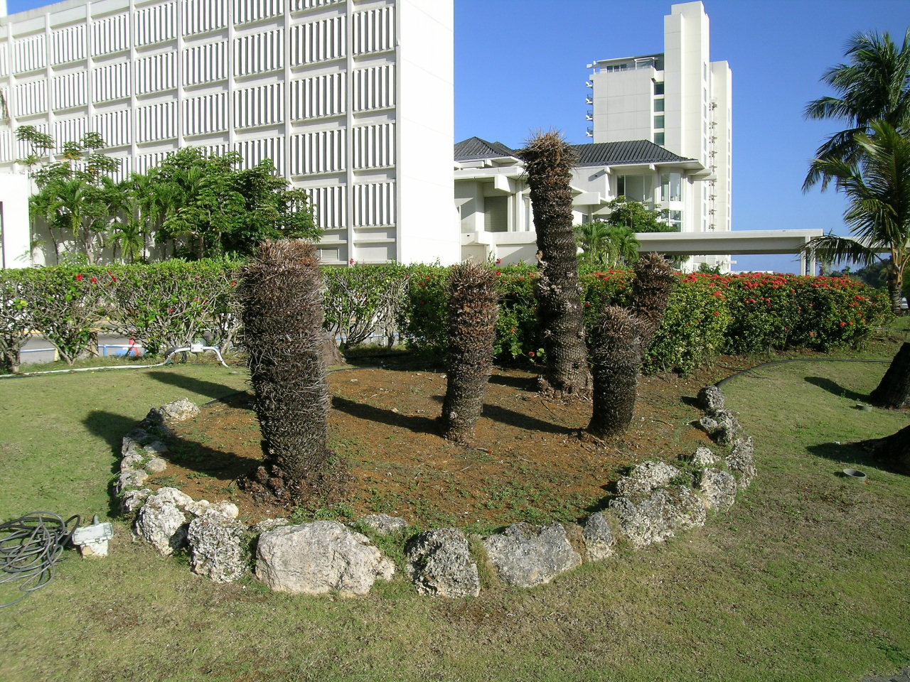

Slide 20
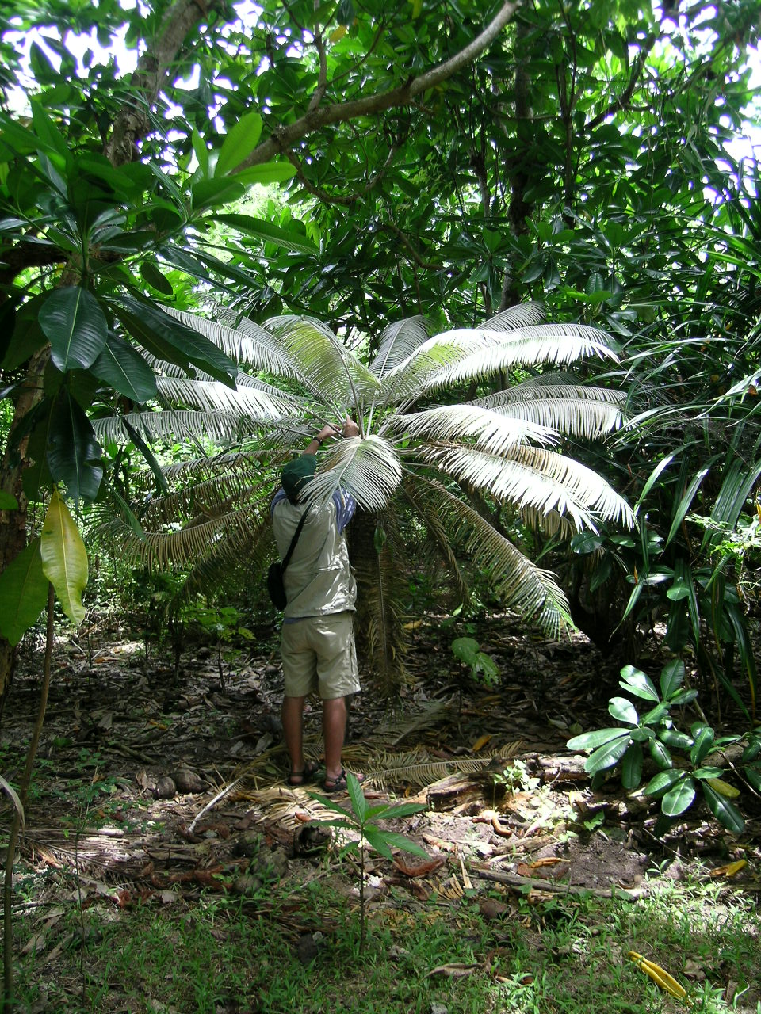

Slide 21
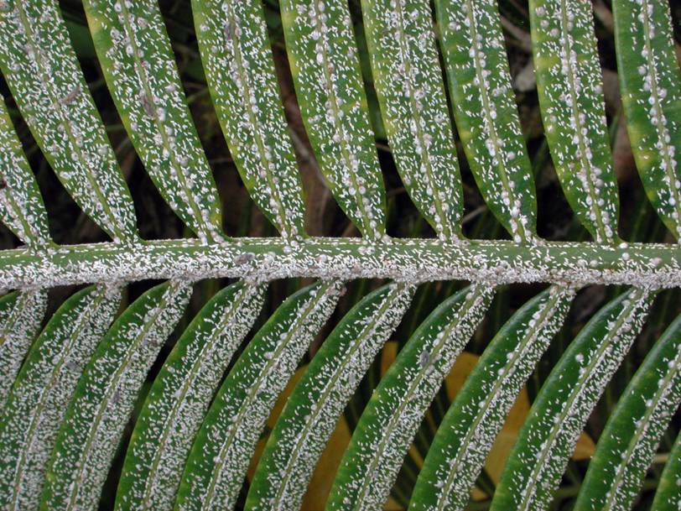

Slide 22
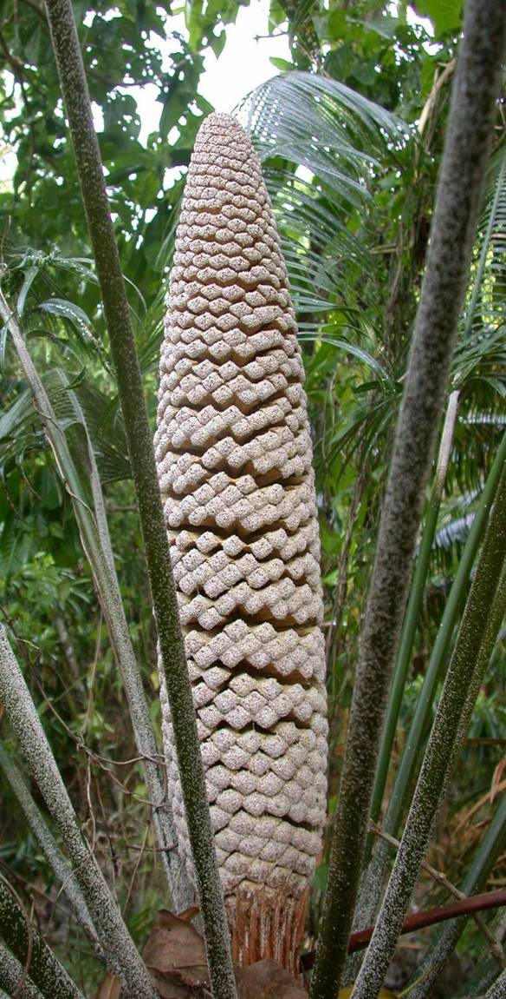

Slide 23
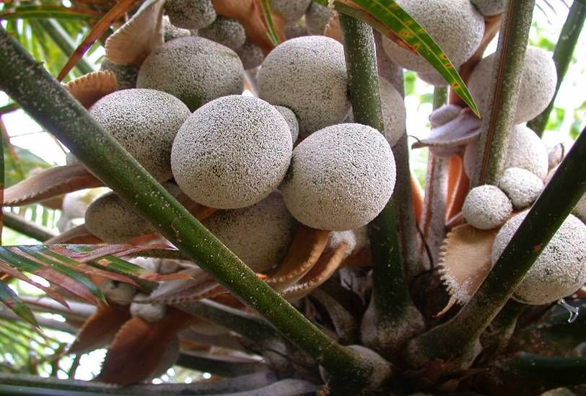

Slide 24
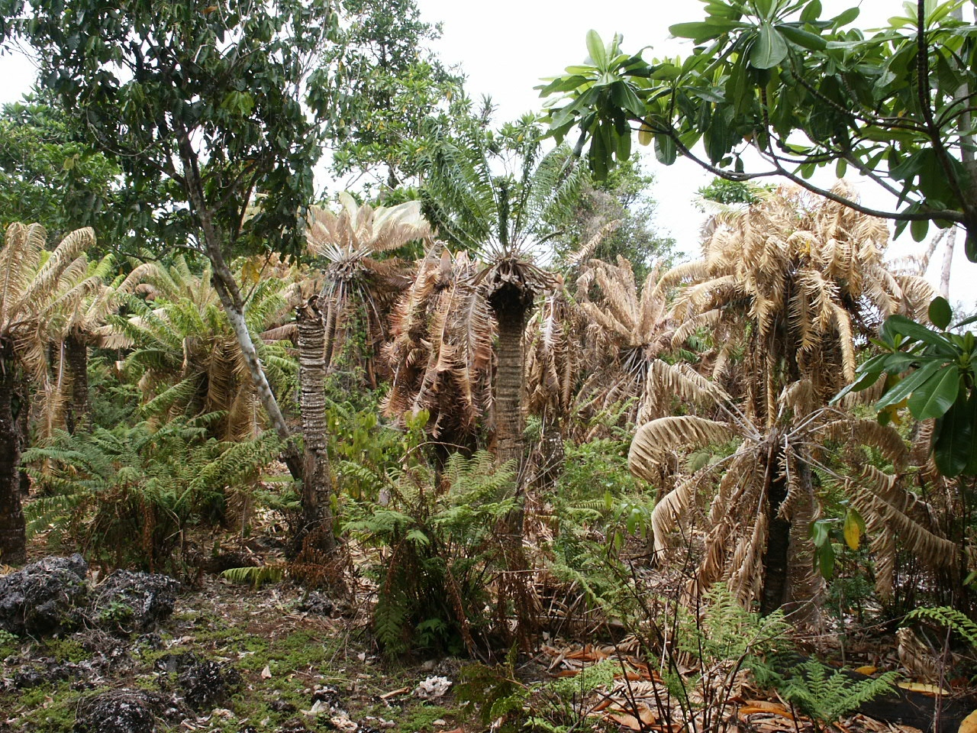

Slide 25
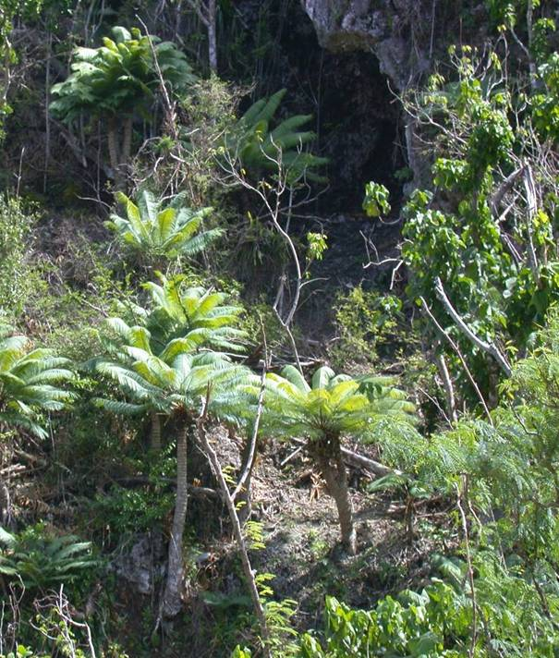

Slide 26
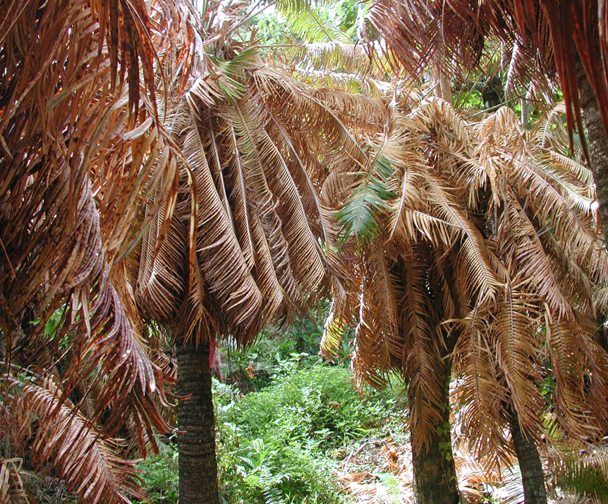

Slide 27
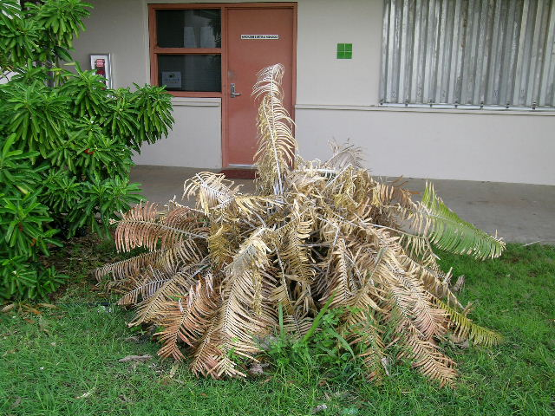
29 DEC 2004

Slide 28
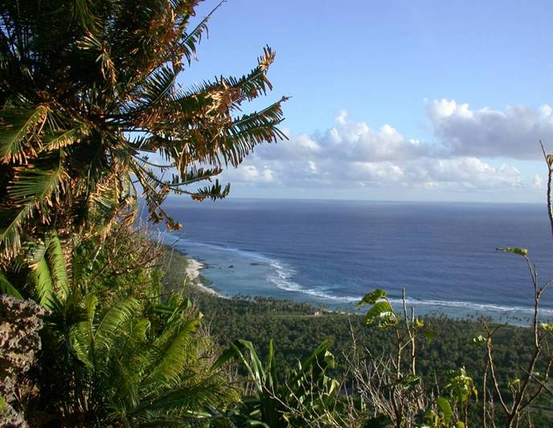

Slide 29
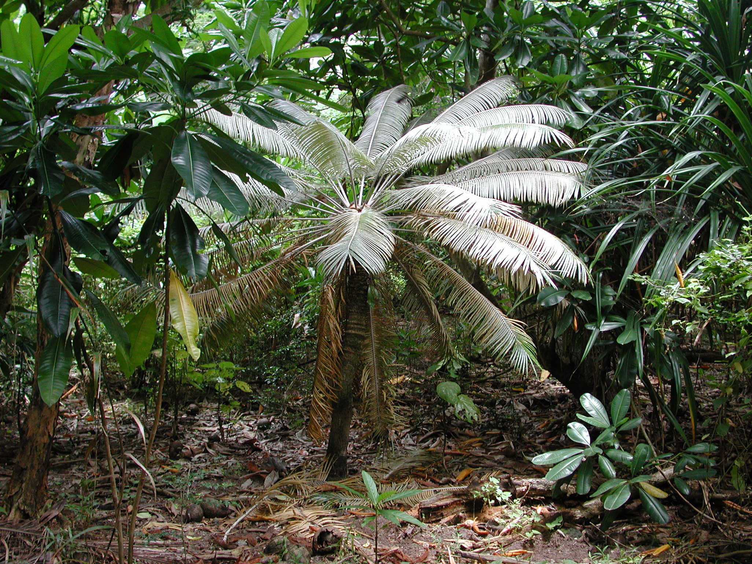

Slide 30
Rhyzobius lophanthae Biology

Slide 31
Rhyzobius lophanthae
COCCINELLIDAE
Purple scale destroyer
Both adults and larvae feed on Diaspidids, armored scales
Introduced from Australia to California in 1892; from California to Hawaii in 1894
Released on Guam in 1925 & 1926, but was never recovered

Slide 32
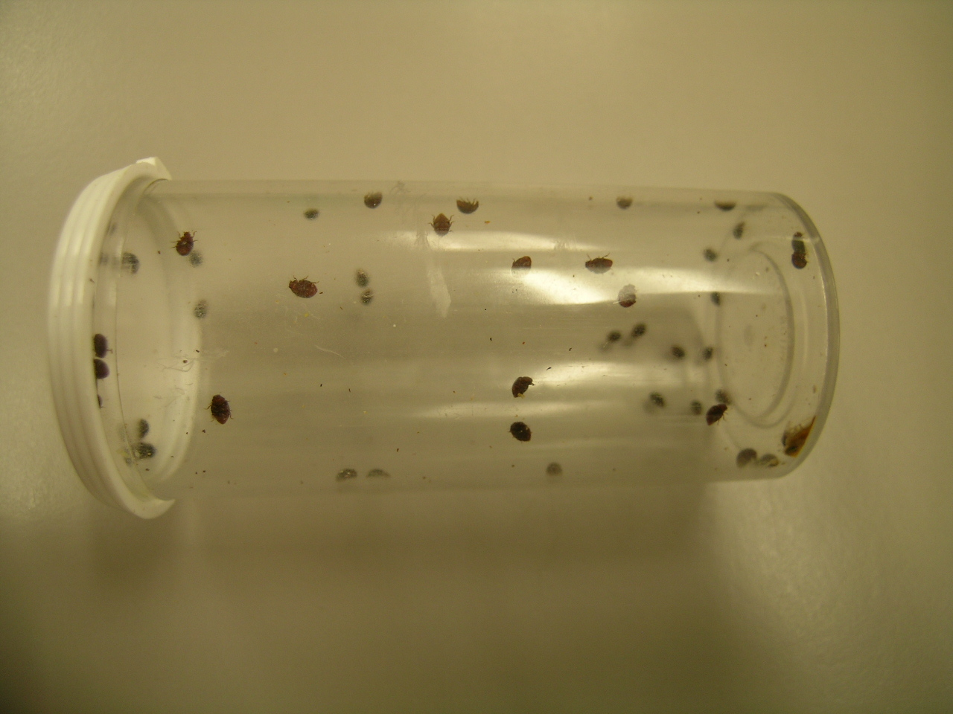

Slide 33
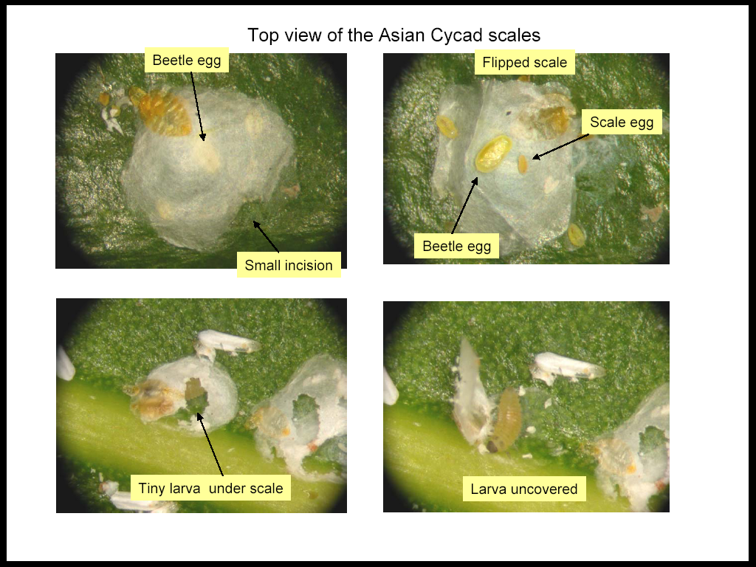
Photos courtesy of Stacey Chun, University of Hawaii, Hilo

Slide 34
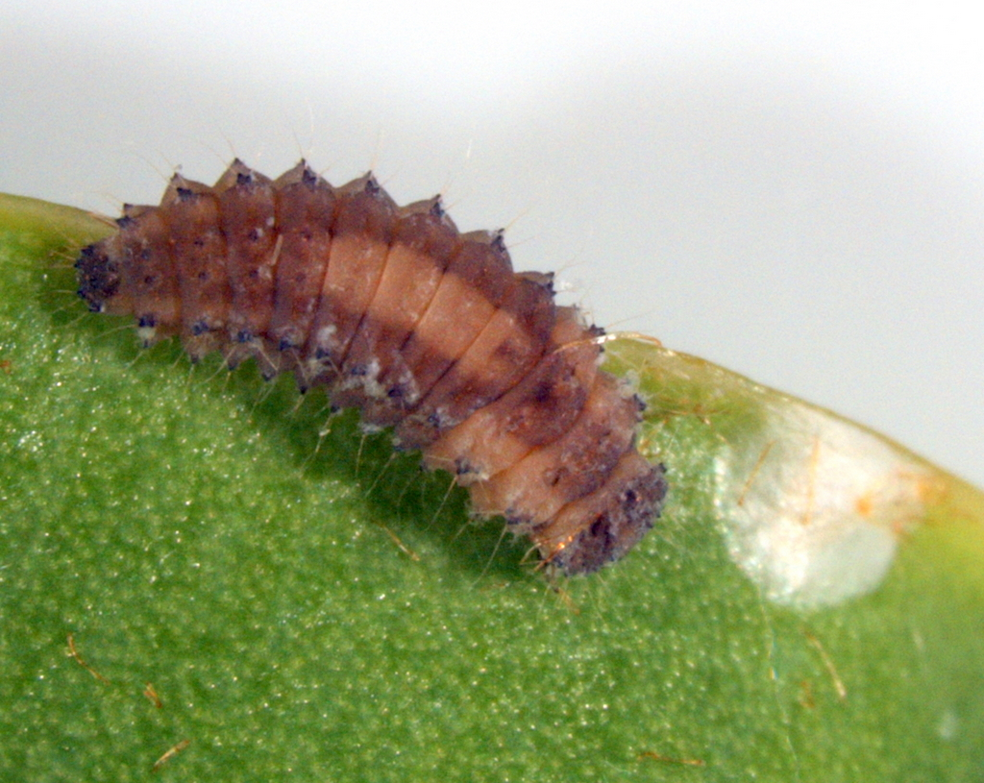

Slide 35
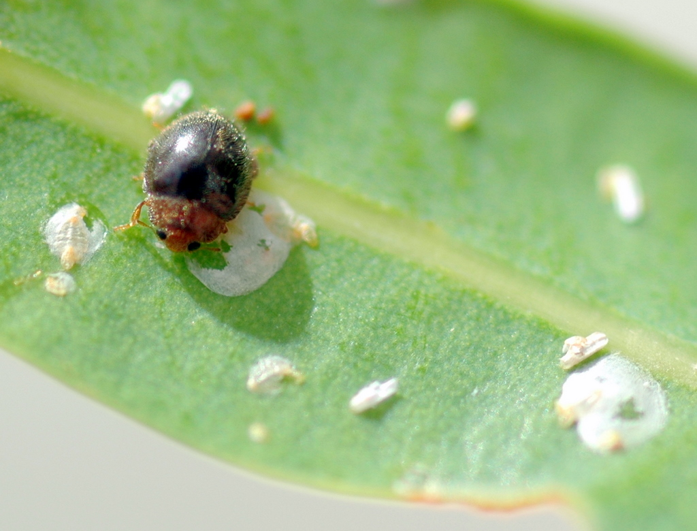

Slide 36
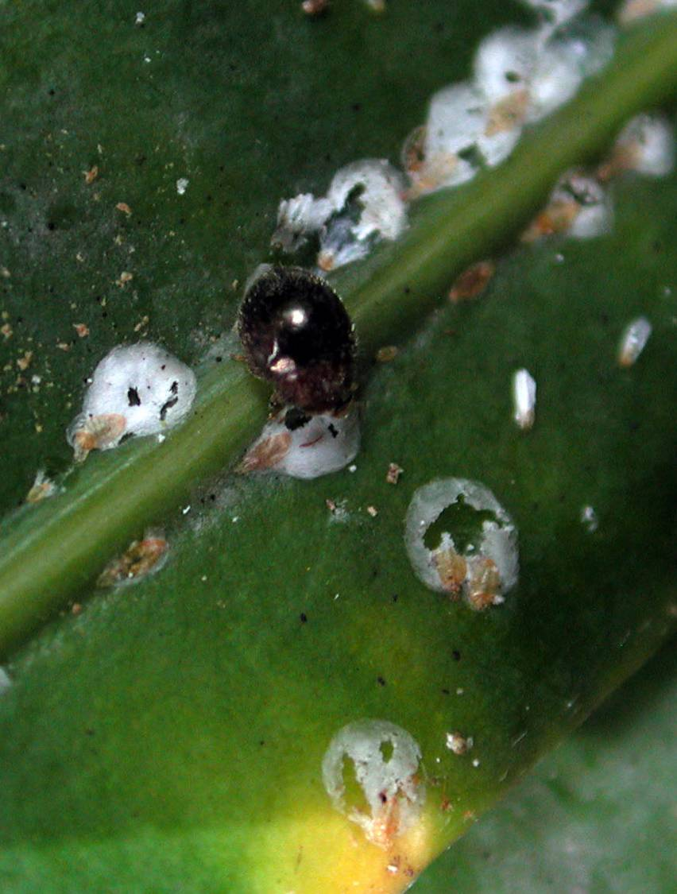

Slide 37
Importation / Propogation / Field Releases

Slide 38
Rhyzobius lophanthae
Chronology
10 June 04 – Import permits requested
17 Aug 04 – Permits approved
12 Nov 04 – ~100 adults collected on Maui were hand-carried to Guam; quarantined for 1 month
16 Feb 2005 – First field releases at Ritidian Pt.
20 May 2005 – First adults recovered
7 July 2005 – High density of beetles observed within 1 km radius of release sites
12 Aug 2005 – Live scales very hard to find at Ritidian Pt.

Slide 39
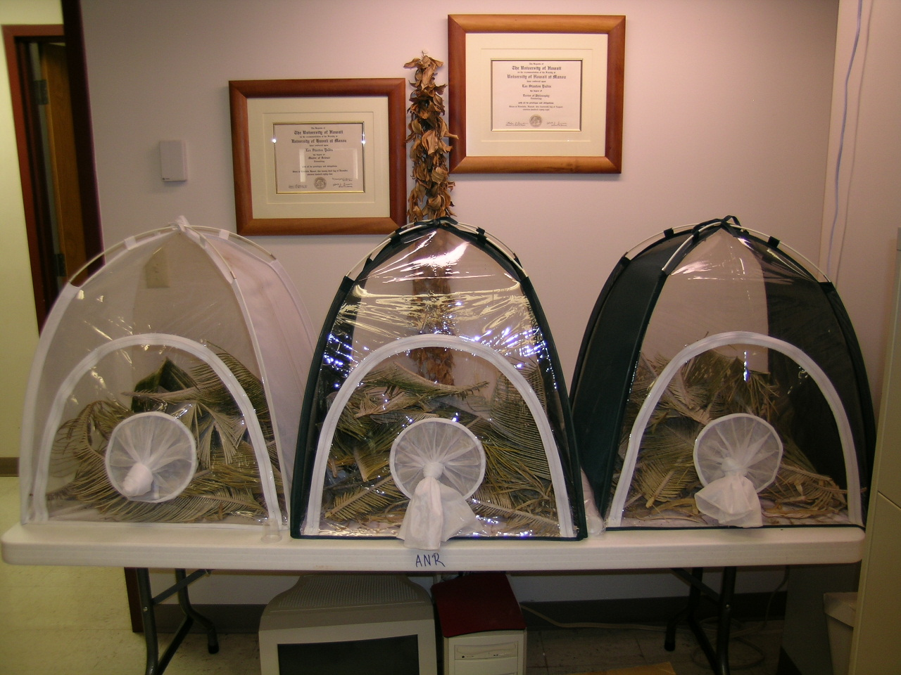

Slide 40
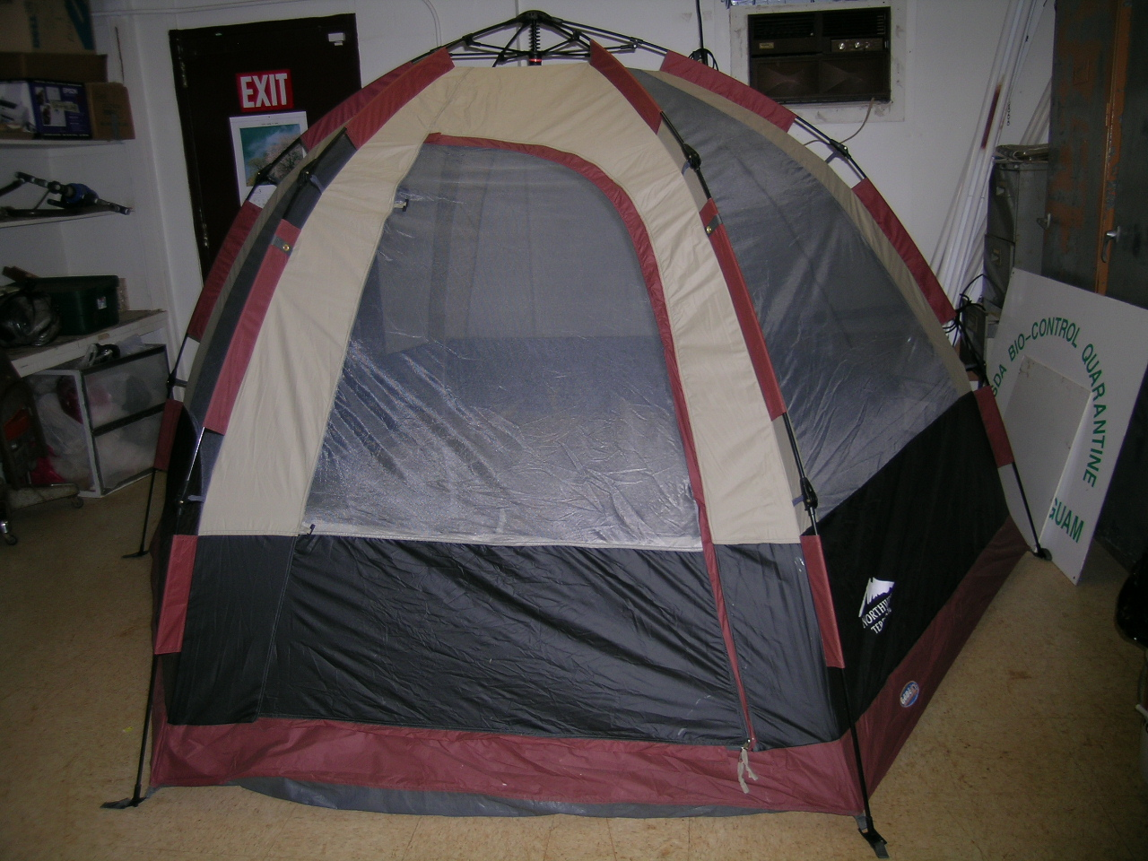

Slide 41
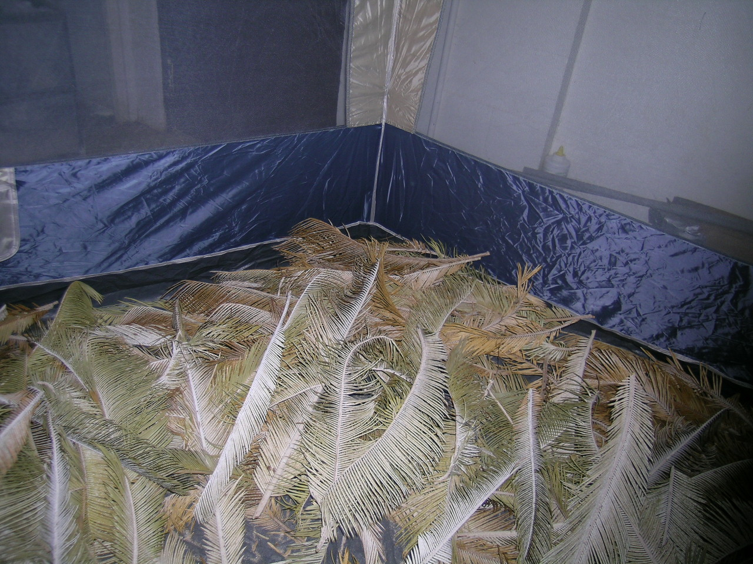

Slide 42
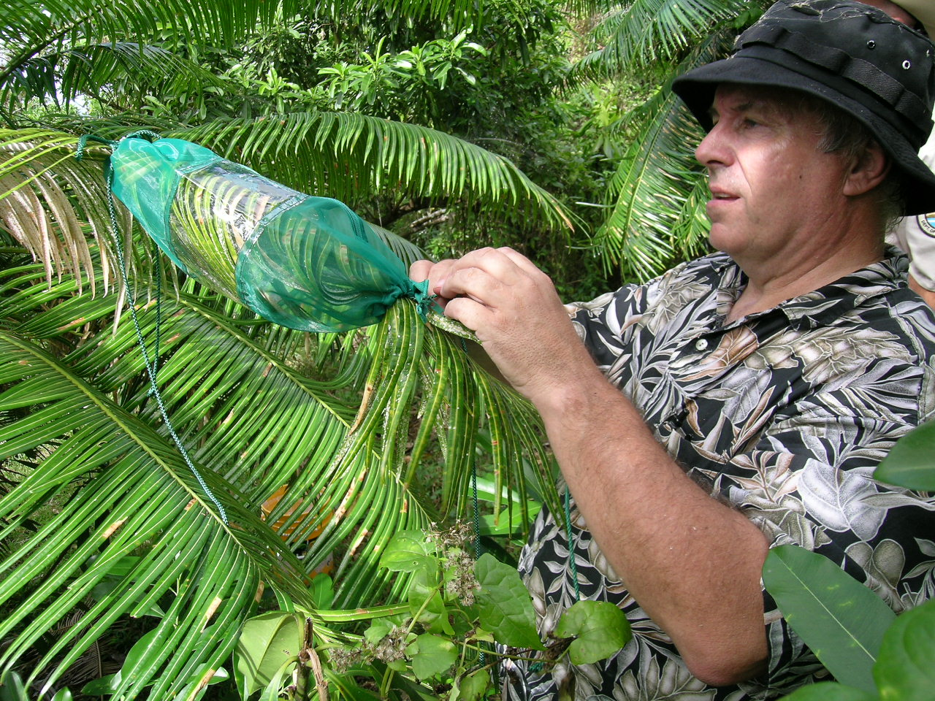

Slide 43
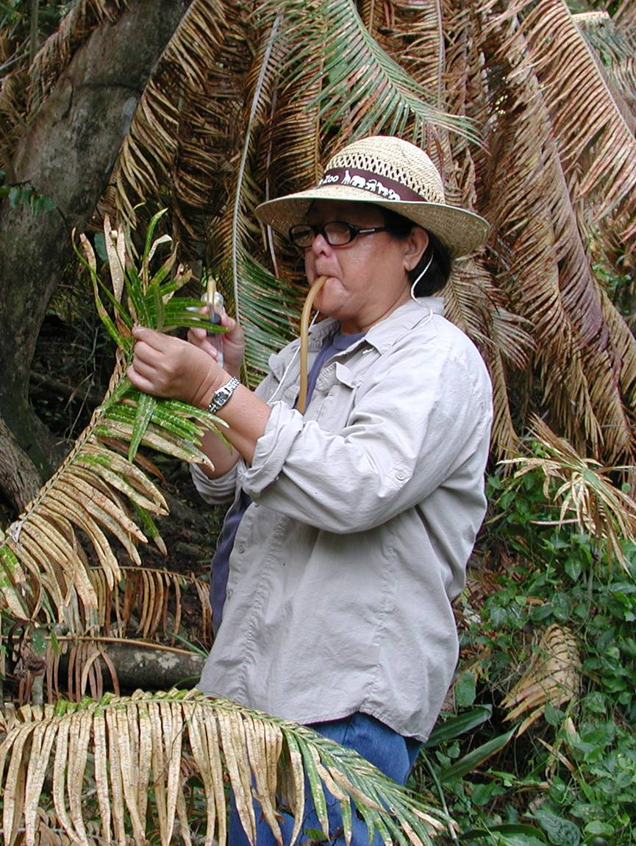

Slide 44
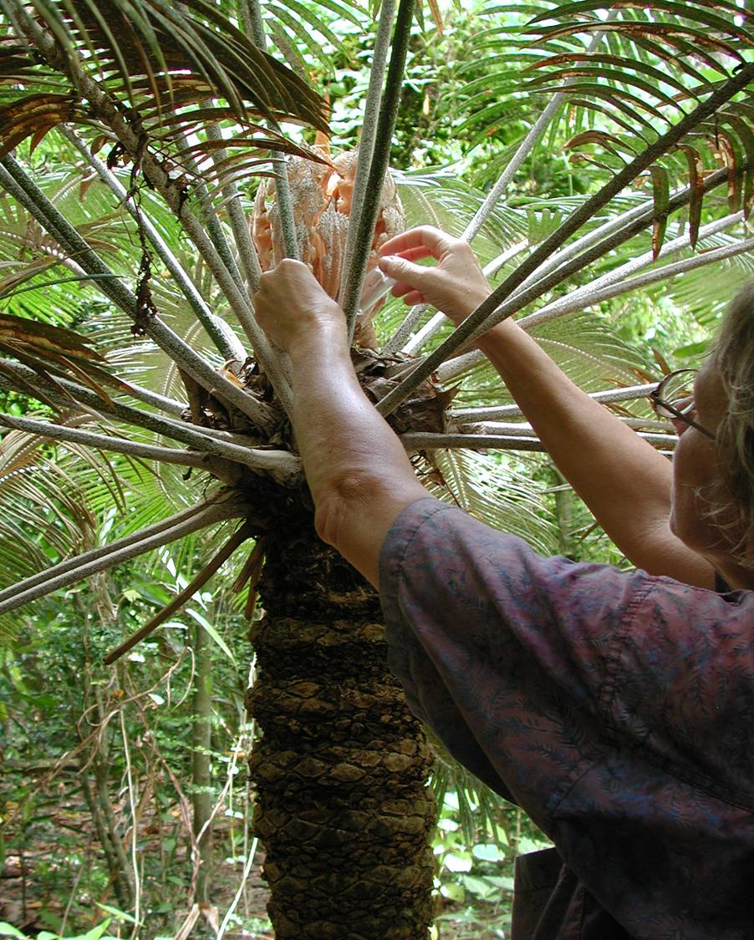

Slide 45
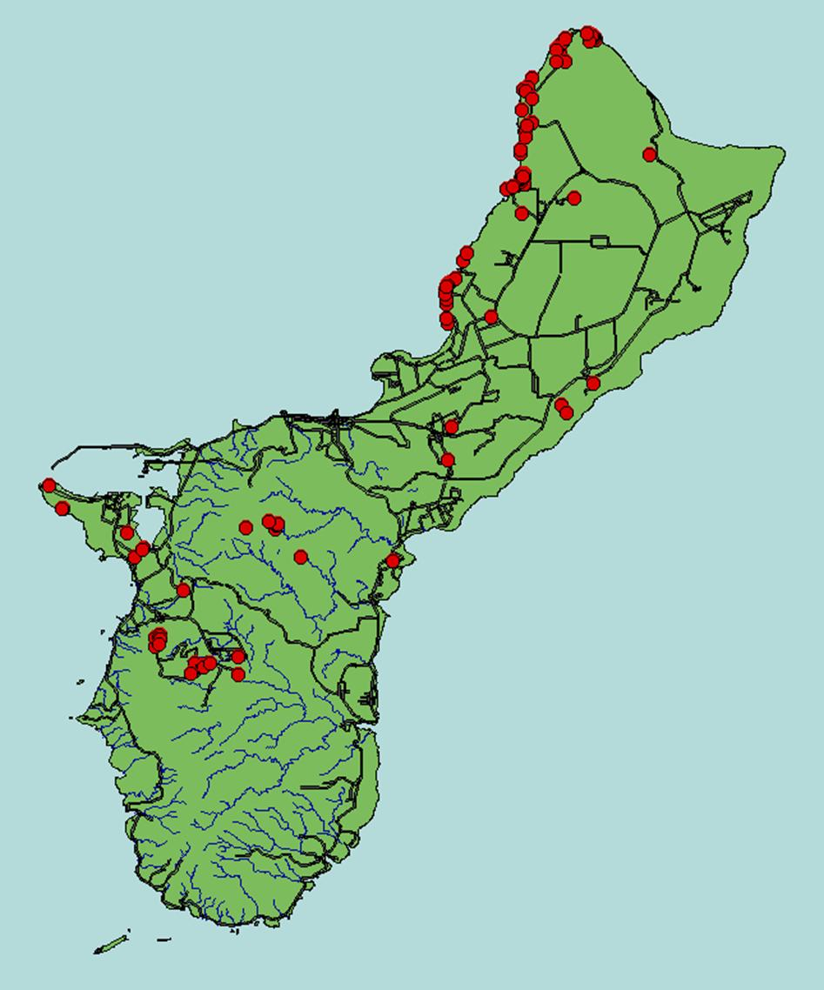
Rhyzobius lophanthae
Release Sites

Slide 46
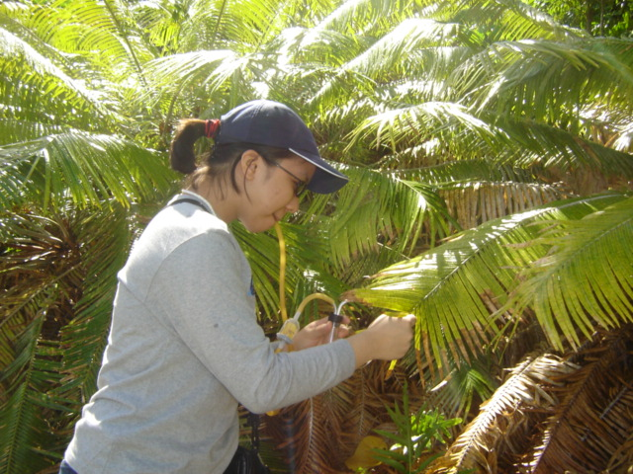
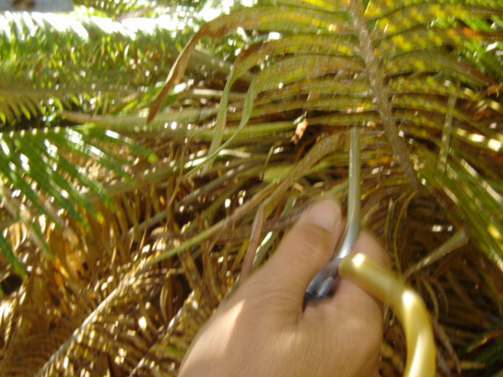
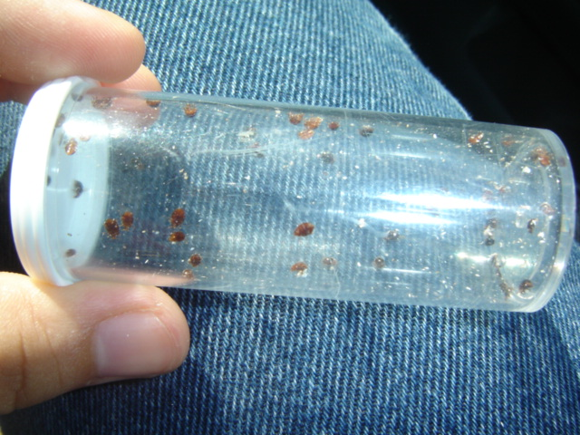
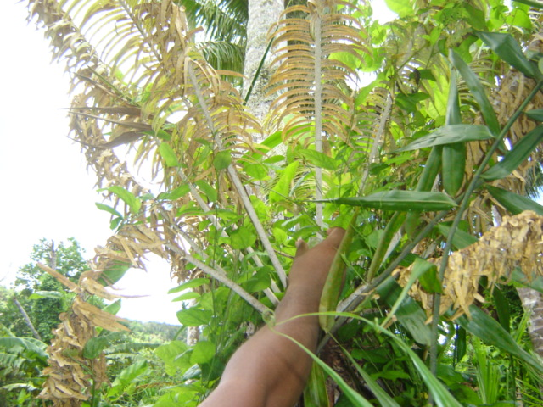
Beetle Collections and Releases

Slide 47
Monitoring

Slide 48
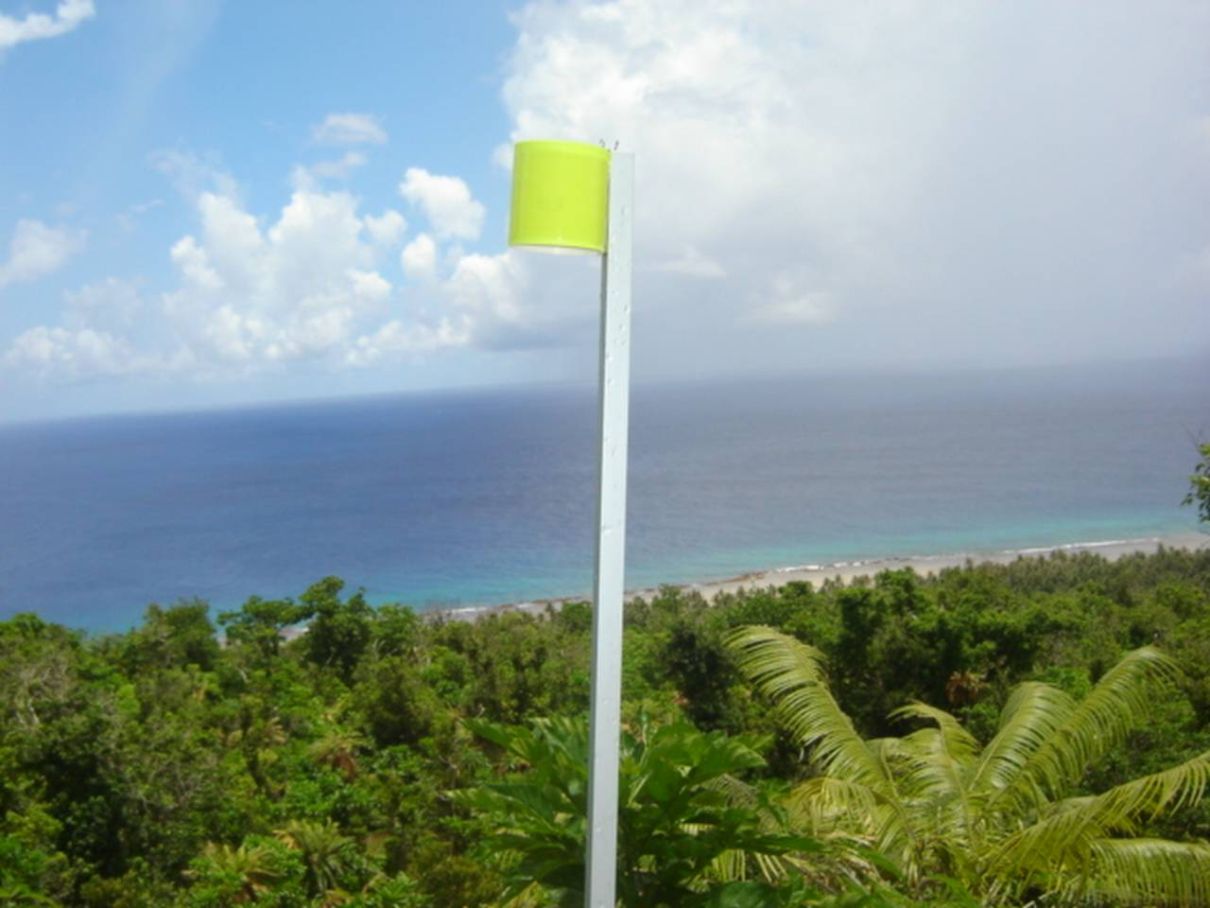
Sticky Traps

Slide 49
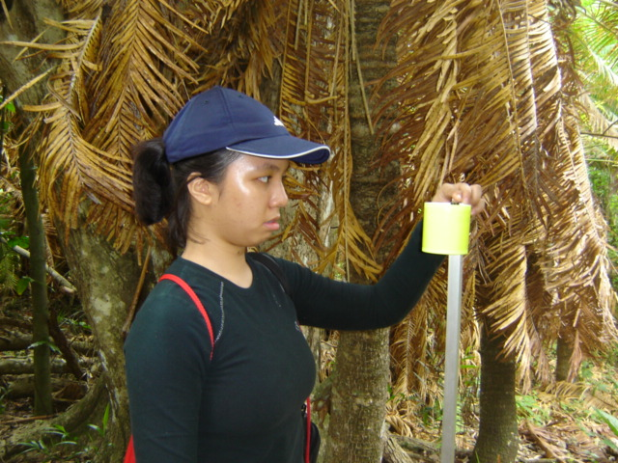
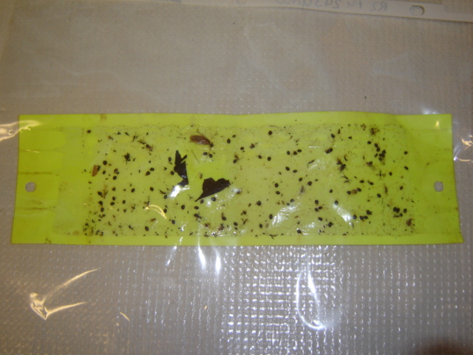

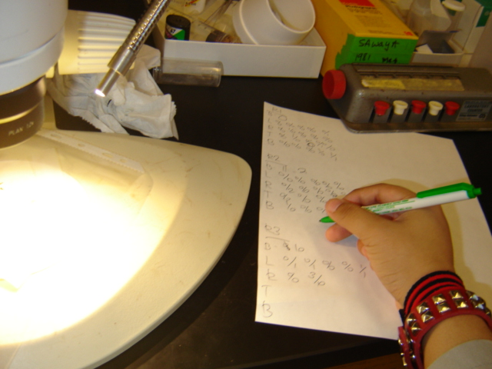

Slide 50
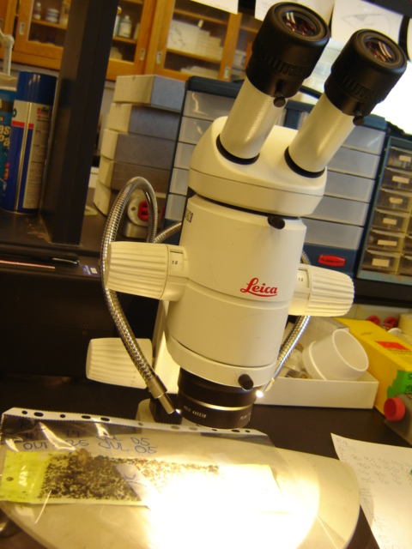
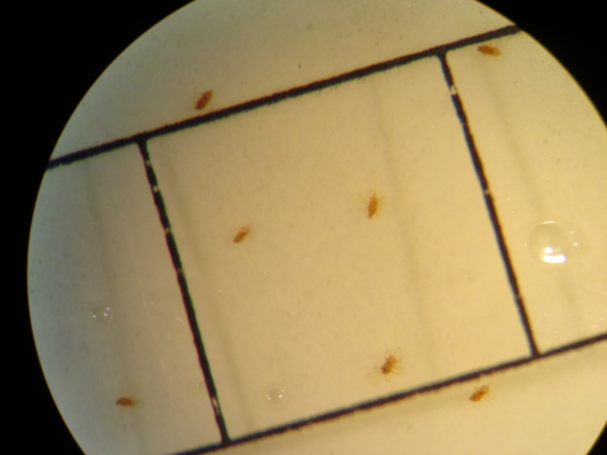
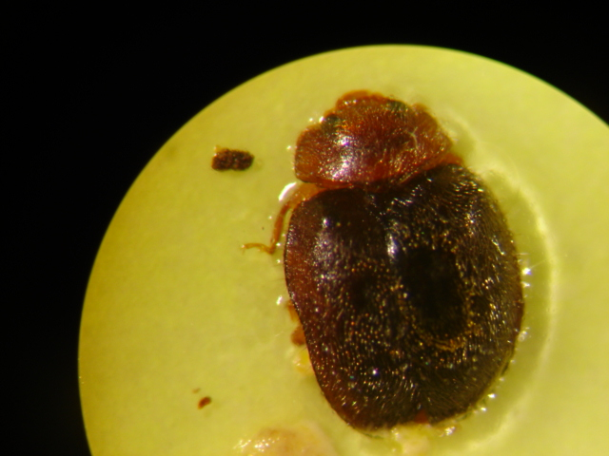
Aulacaspis yasumatsui
Adult males & Crawlers
Stereoscope
Rhyzobius lopanthae
Adults

Slide 51
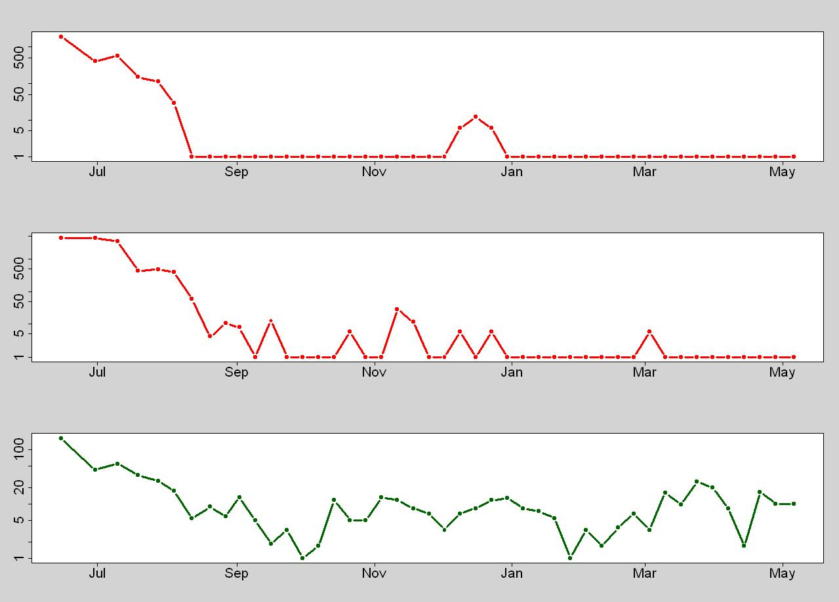
Insects per m² per day on Sticky Traps
Ritidian Pt.; June 2005 - May 2006
1,868
Aulacaspis yasumatsui crawlers
0
4,404
Aulacaspis yasumatsui males
0
161
Rhyzobius lophanthae adults
0

Slide 52
One Minute Beetle Counts

Slide 53
One minute adult Rhyzobius lophanthae counts
Ritidian Pt.; September 2006
Plants examined: 86
Plants with adult beetles: 54 (63%)
Plants without adult beetles: 32 (37%)
Mean number of adult beetles counted on each plant: 4.1

Slide 54
Leaf Samples

Slide 55
Leaf Sample Analysis
Ritidian Pt.; January 2007
 | Untreated | Treated | P (Fisher’s exact test)
Leaf Samples | 105 | 69
Samples with scale predation by beetles | 99 94% | 33 48% | 0.000 ***
Samples with live beetle larvae | 17 16% | 5 7% | 0.545 ns

Slide 56
Conclusions

Slide 57
Current Conditions on Guam
Rhyzobius lophanthae has established throughout the island and is helping to control the Asian cycad scale infestation on wild and ornamental cycads

Slide 58
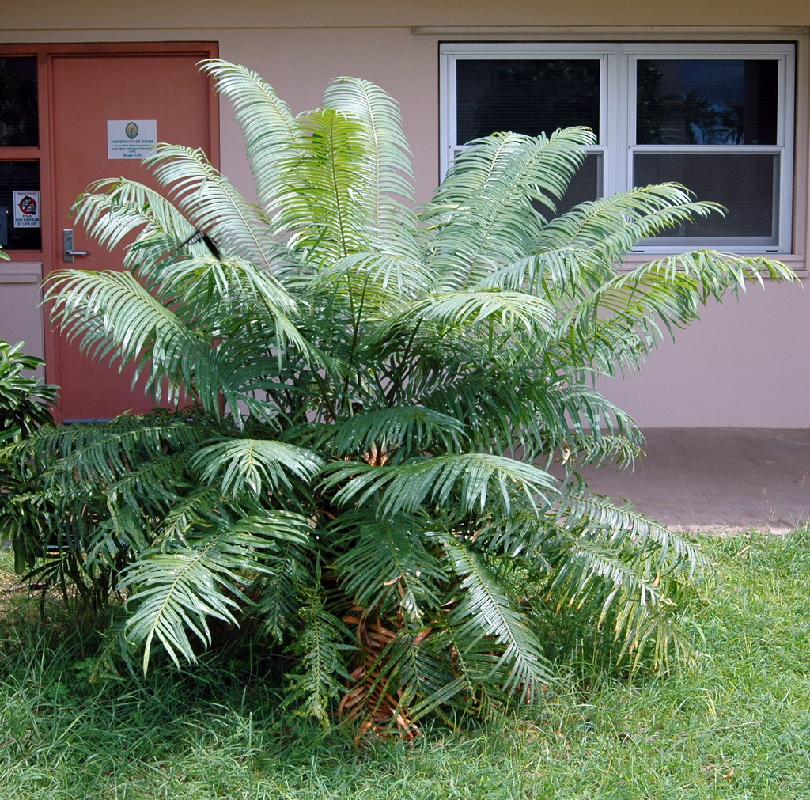
29 DEC 2004
14 OCT 2007

Slide 60
However
Most ornamental cycads have been killed and between one-third and two-thirds of the endemic Cycas micronesica have died from attacks by ACS and other recently arrived invasive insects.
C. micronesica, which was Guam’s most populous tree in 2002, is now on the on the IUCN Red List of Threatened Species.

Slide 61
Acknowledgments
Hawaii DOA
Guam National Wildlife Refuge
Stacey Chun, UH
Nenita Dumaliang
Kristine Bataclan
John Brown
Tom Marler
Marin Rowe
Anne Brooke
Jesse Bamba
Rudy Estoy

Slide 62


