Slide 1
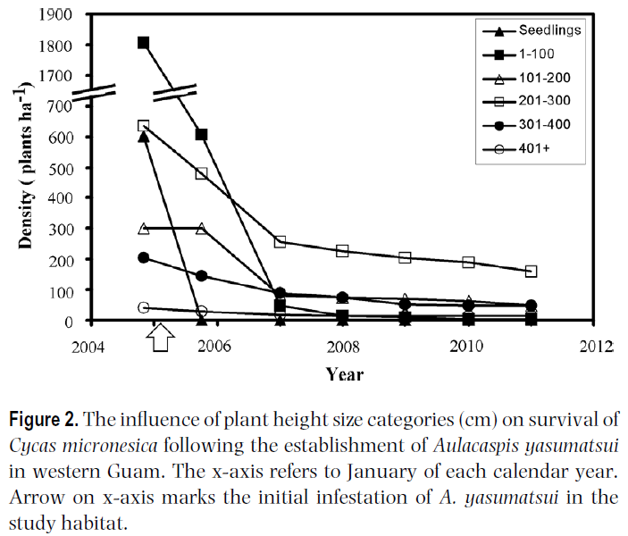
Decline of Cycas micronesica Following Infestation by Aulacaspis yasumatsui
There has been no reproduction since 2005
Only 7% of original population survives (January 2013)
Local extirpation predicted in 2019
Source: Marler, T.E. and J.H. Lawrence 2012. Demography of Cycas micronesica on Guam following introduction of the armoured scale Aulacaspis yasumatsui. Journal of Tropical Ecology, 28:233-242.

Slide 2
Major Biological Invasions on Guam
Brown Treesnake (~1945)
  Killed most of Guam's birds and small mammals. Caused 7 bird extinctions.
Asian Cycad Scale (detected 2003)
  Threatens survival of Guam's endemic Cycas micronesica, listed as most numerous tree in the 2002 Guam Forest Survey
Coconut Rhinoceros Beetle (detected 2007)
  Threatens Guam's coconut palms, listed as 2nd most numerous tree in 2002 Guam Forest Survey
Little Fire Ant (detected 2011)
  Threatens most animals remaining in Guam's forests

