Slide 1
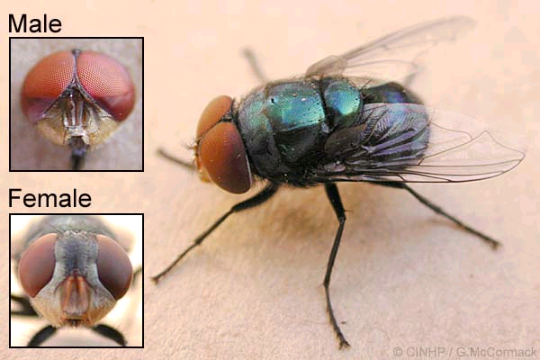
Chrysomya megacephala (Diptera: Calliphoridae) oriental latrine fly

Slide 2
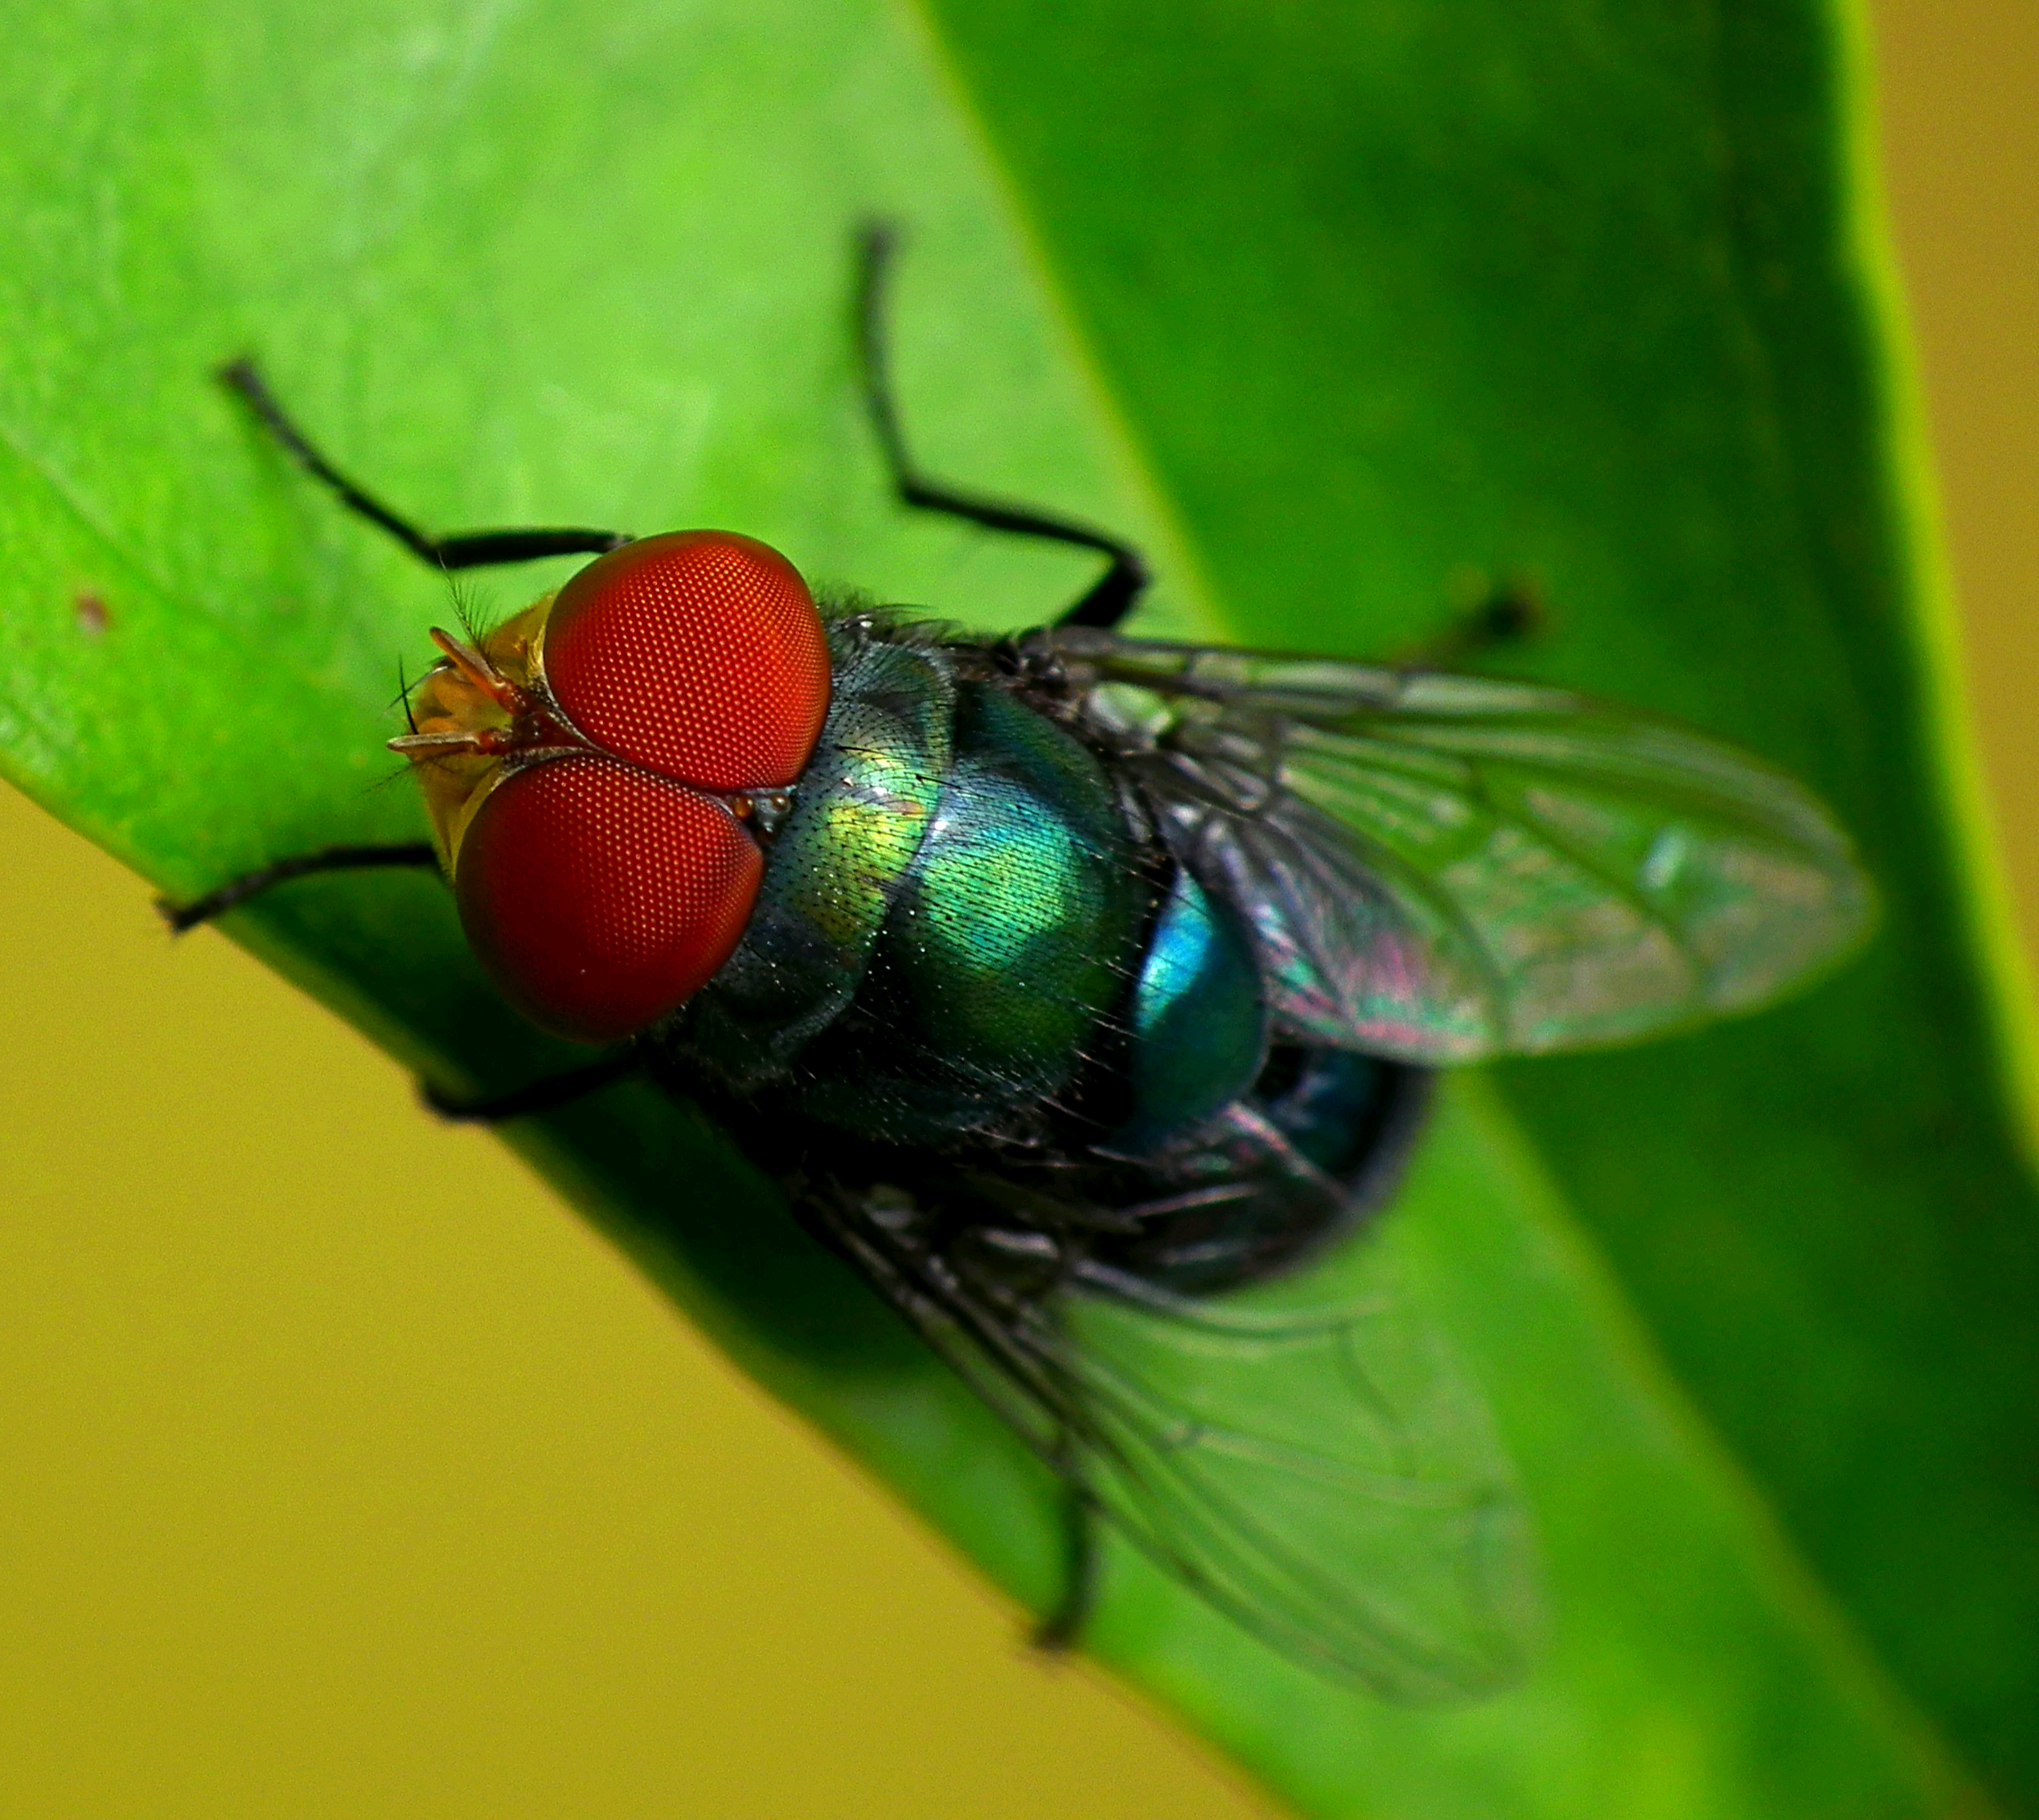
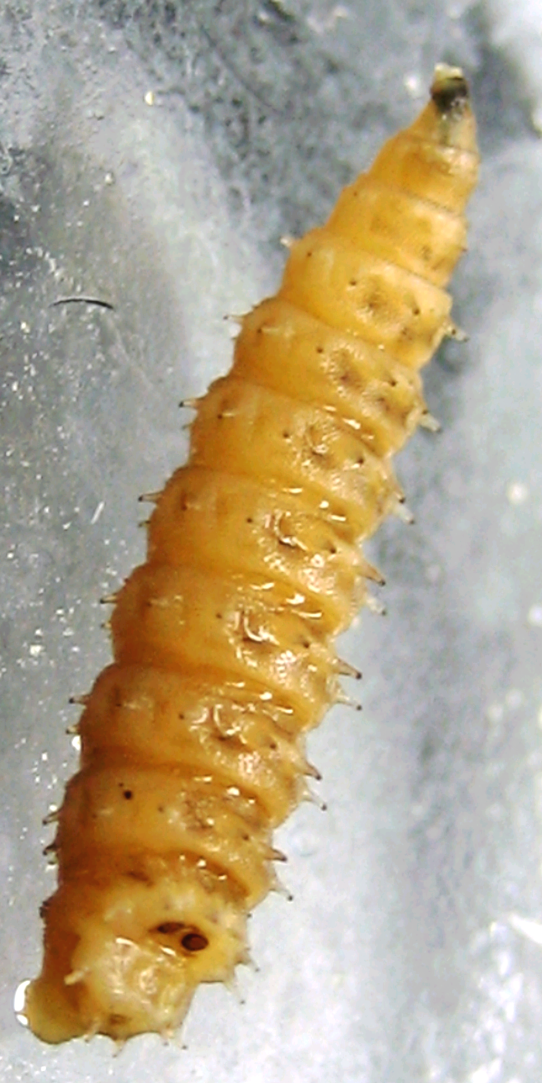
Chrysomya rufifacies (Diptera: Calliphoridae) hairy maggot blow fly

Slide 3
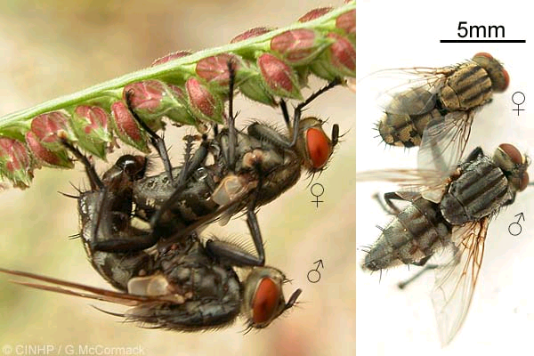
Sarcophaga dux (Diptera: Sarcophagidae) miser flesh fly

Slide 4
Forensic Entomology Research on Guam
Bohart, George E. and J. Linsley Gressitt 1951. Filth-inhabiting Flies Of Guam. Bishop Museum Bulletin 254. 152 pages.
http://hbs.bishopmuseum.org/pubs-online/pdf/bull204.pdf
Jenson, Lynda M. and Ross H. Miller 2001. Estimating filth fly (Diptera: Calliphoridae) development in carrion in Guam. Micronesica 34(1) p. 11-25.
http://www.wptrc.org/userfiles/file/jensen_miller.pdf
Lopez, Joseph D. Sr., Ross H. Miller and Aubrey Moore [in preparation]. Decomposition of pigs on Guam.,

Slide 5
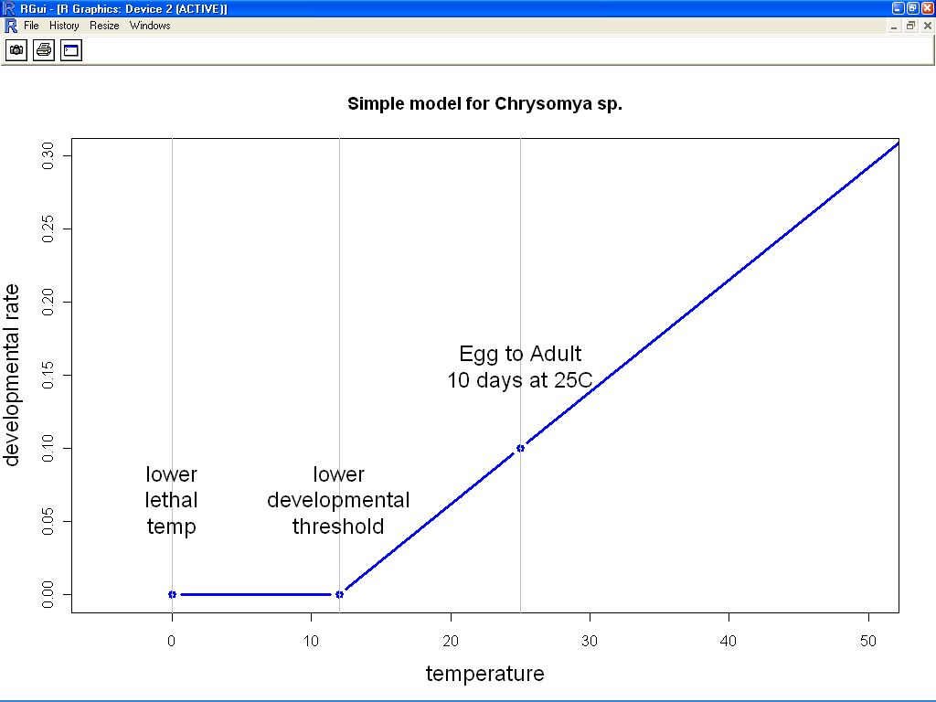

Slide 6
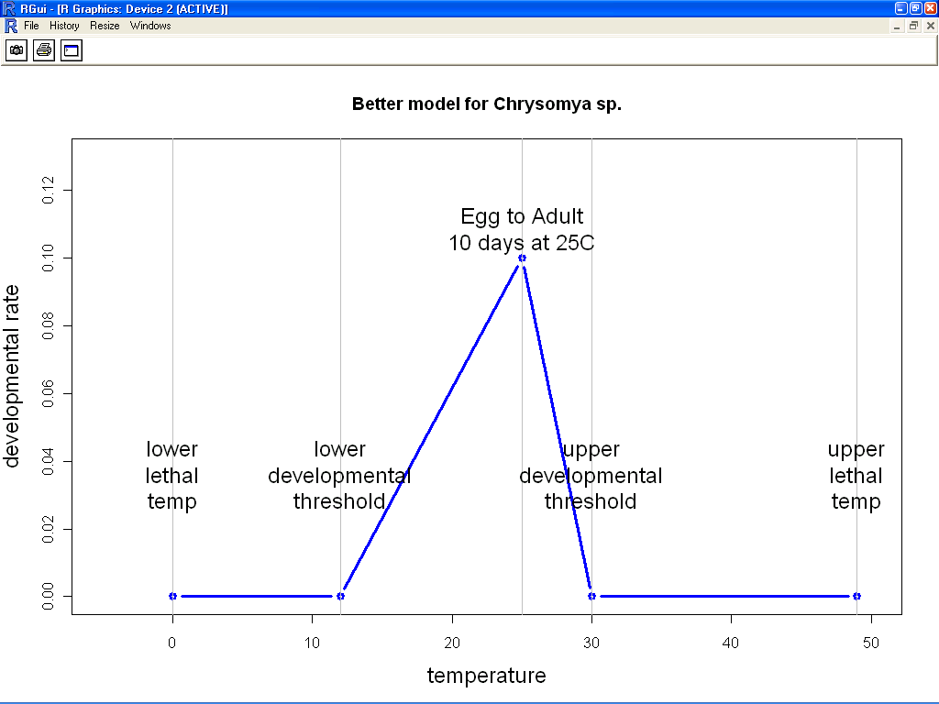

Slide 7
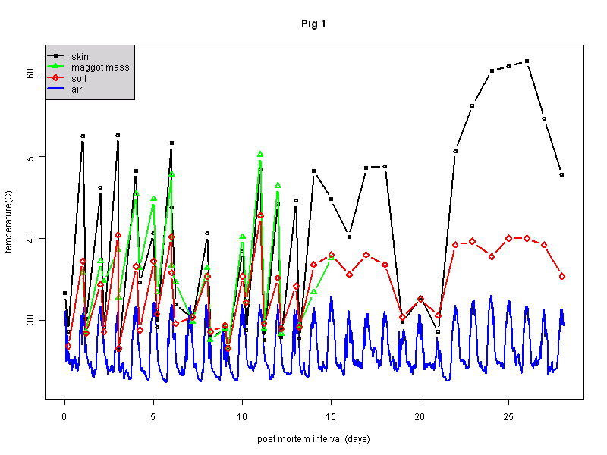
Data from Lopez Pig Study

Slide 8
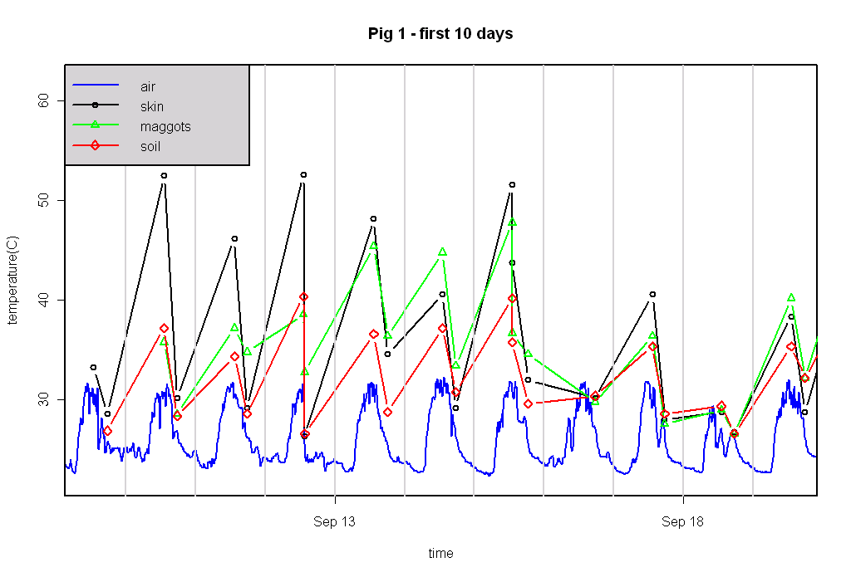
Data from Lopez Pig Study

Slide 9
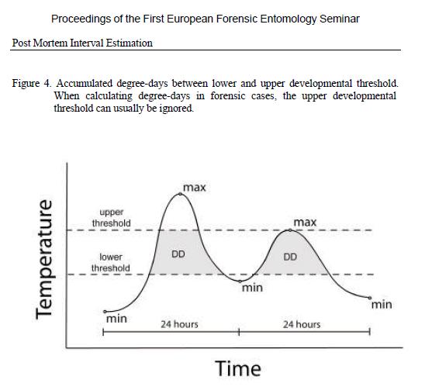
From Reiter, C. and M. Grassberger 2002. Post-mortem interval estimation using insect development data. Proceedings of the First European Forensic Entomology Seminar

Slide 10


