Slide 1




Invasion of Guam by the Coconut Rhinoceros Beetle
Aubrey Moore
Roland J. Quitugua
Trevor A. Jackson
Sean D.G. Marshall
Matthew Siderhurst
8th Regional Island Sustainability Conference, Guam, April 20, 2017

Slide 2



Thanks for support and funding from:
USDA-APHIS
US Forest Service
Legislature of Guam

Slide 3
Notes:
This is the first CRB collected on Guam
Sept. 11, 2007

Slide 4
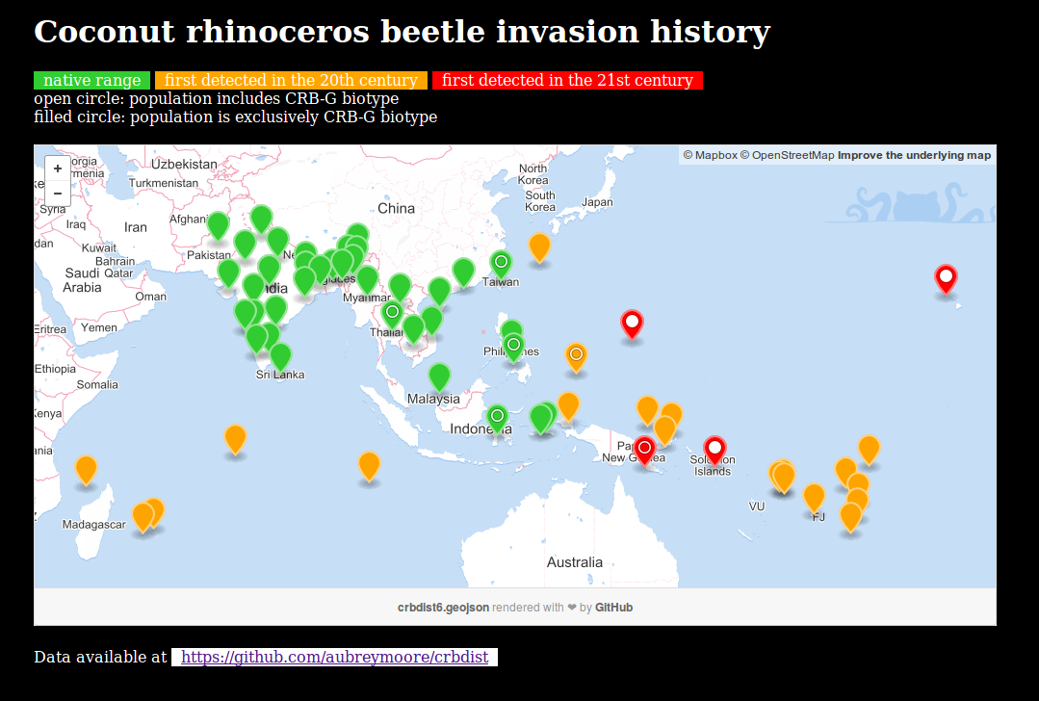
Notes:
-
- native range is SE Asia
- CRB arrived in the South Pacific with shipments of rubber plants from Ceylon to Samoa in the early 1900s
- arrived in Palau during WWII
- only 1 successful eradication out of several attempts. Signified by red star. Niuatoputapu Island (16 sq. km.)
- no range expansion between 1975 and 2006
- new infestations on Guam(2007), Port Moresby, PNG (2009), Hawaii (2013), and Honiara, Solomon Islands (2015).

Slide 5

Notes:
Generation time: 6 to 9 months
Female lays about 100 eggs (biotic potential of 50
which equals an increase of 5000% per generation)
Only adults do damage.

Slide 6

Notes:
Typical habitat for grubs.
Grubs are found in many types of substrate high in organic matter such as decaying vegetation, manure piles, sawdust piles
In the lab, we rear CRB from egg to adult in a store-bought blend of steer manure and soil.

Slide 7


Notes:
Artificial habitat for grubs.
CRB grubs often found in packaged soil products.

Slide 8

Notes:
- Adults bore into crowns of coconuts or other palms to feed on sap.
- Adults leave the bore hole after 2 or 3 days.
- Adults feed several times.
- Developing fronds are damaged when a beetle bores through them.
- Palms are killed if the meristem is damaged.
- Palms may regrow a full canopy of CRB damage is stopped. However, bore holes do not heal, leaving palm structurally week and succeptible to beheading in strong winds.

Slide 9

Notes:
CRB adults damage developing fronds when boring into the crown.
When these fronds unfurl, this damage is seen as distinctive v-shaped cuts.

Slide 10

Notes:
Palms killed by adults become preferred breeding sites which generate several generations of grubs.
If CRB adults are abundant, many palms will be killed creating breeding sites which generate even more adults.
This positive feedback cycle may not stop until CRB run out of food after killing most palms.

Slide 11


Slide 12

Notes:
A delimiting survey indicated that CRB had invaded only a small area of Guam (Tumon Bay and Fafai Beach).
Based on this information, an eradication program was launched.

Slide 13
How to Eradicate CRB
Sanitation: Locate and destroy all active and potential breeding sites.
Quarantine: Close pathways to prevent re-introduction and accidental transport to uninfested areas.

Slide 14

Notes:
Sanitation is labor intensive.

Slide 15


Slide 16
Additional CRB Control Tactics
Sanitation
Quarantine
Trapping
Chemical control
Biological control
Notes:
While trapping and chemical control are commonly used for population suppression as part of an eradication program, biological control is not.
We were advised not to use resources for biocontrol if we intended to eradicate.

Slide 17

Trapping
Pheromone traps baited with oryctalure proved useless for population suppression
Pheromone traps are useful for detection and monitoring
Notes:
Mass trapping established in Tumon Bay did not protect palms from CRB damage.
Mark-release-recapture studies indicate that panel traps catch only about 1% of the available adult CRB population.

Slide 18


Slide 19

Pheromone Trap Development

Slide 20

UV LED increases Trap Catch
Notes:
Addition of a UV light emitting diode increased pheromone trap catch by 2-3X.
Works as a synergist. Light alone traps very few CRB.

Slide 21

Tekken Trap
Notes:
A specific size of fish gill net, referred to as “tekken” on Guam traps CRB when twine drops into gap behind pronotum.

Slide 22

Tekken Trap

Slide 23

Tekken Trap
Notes:
Tekken is highly scalable; can be used to cover small or very large piles of breeding site material

Slide 24

DeFence Trap
Notes:
The DeFence trap is an efficient pheromone trap which captures CRB using tekken.

Slide 25
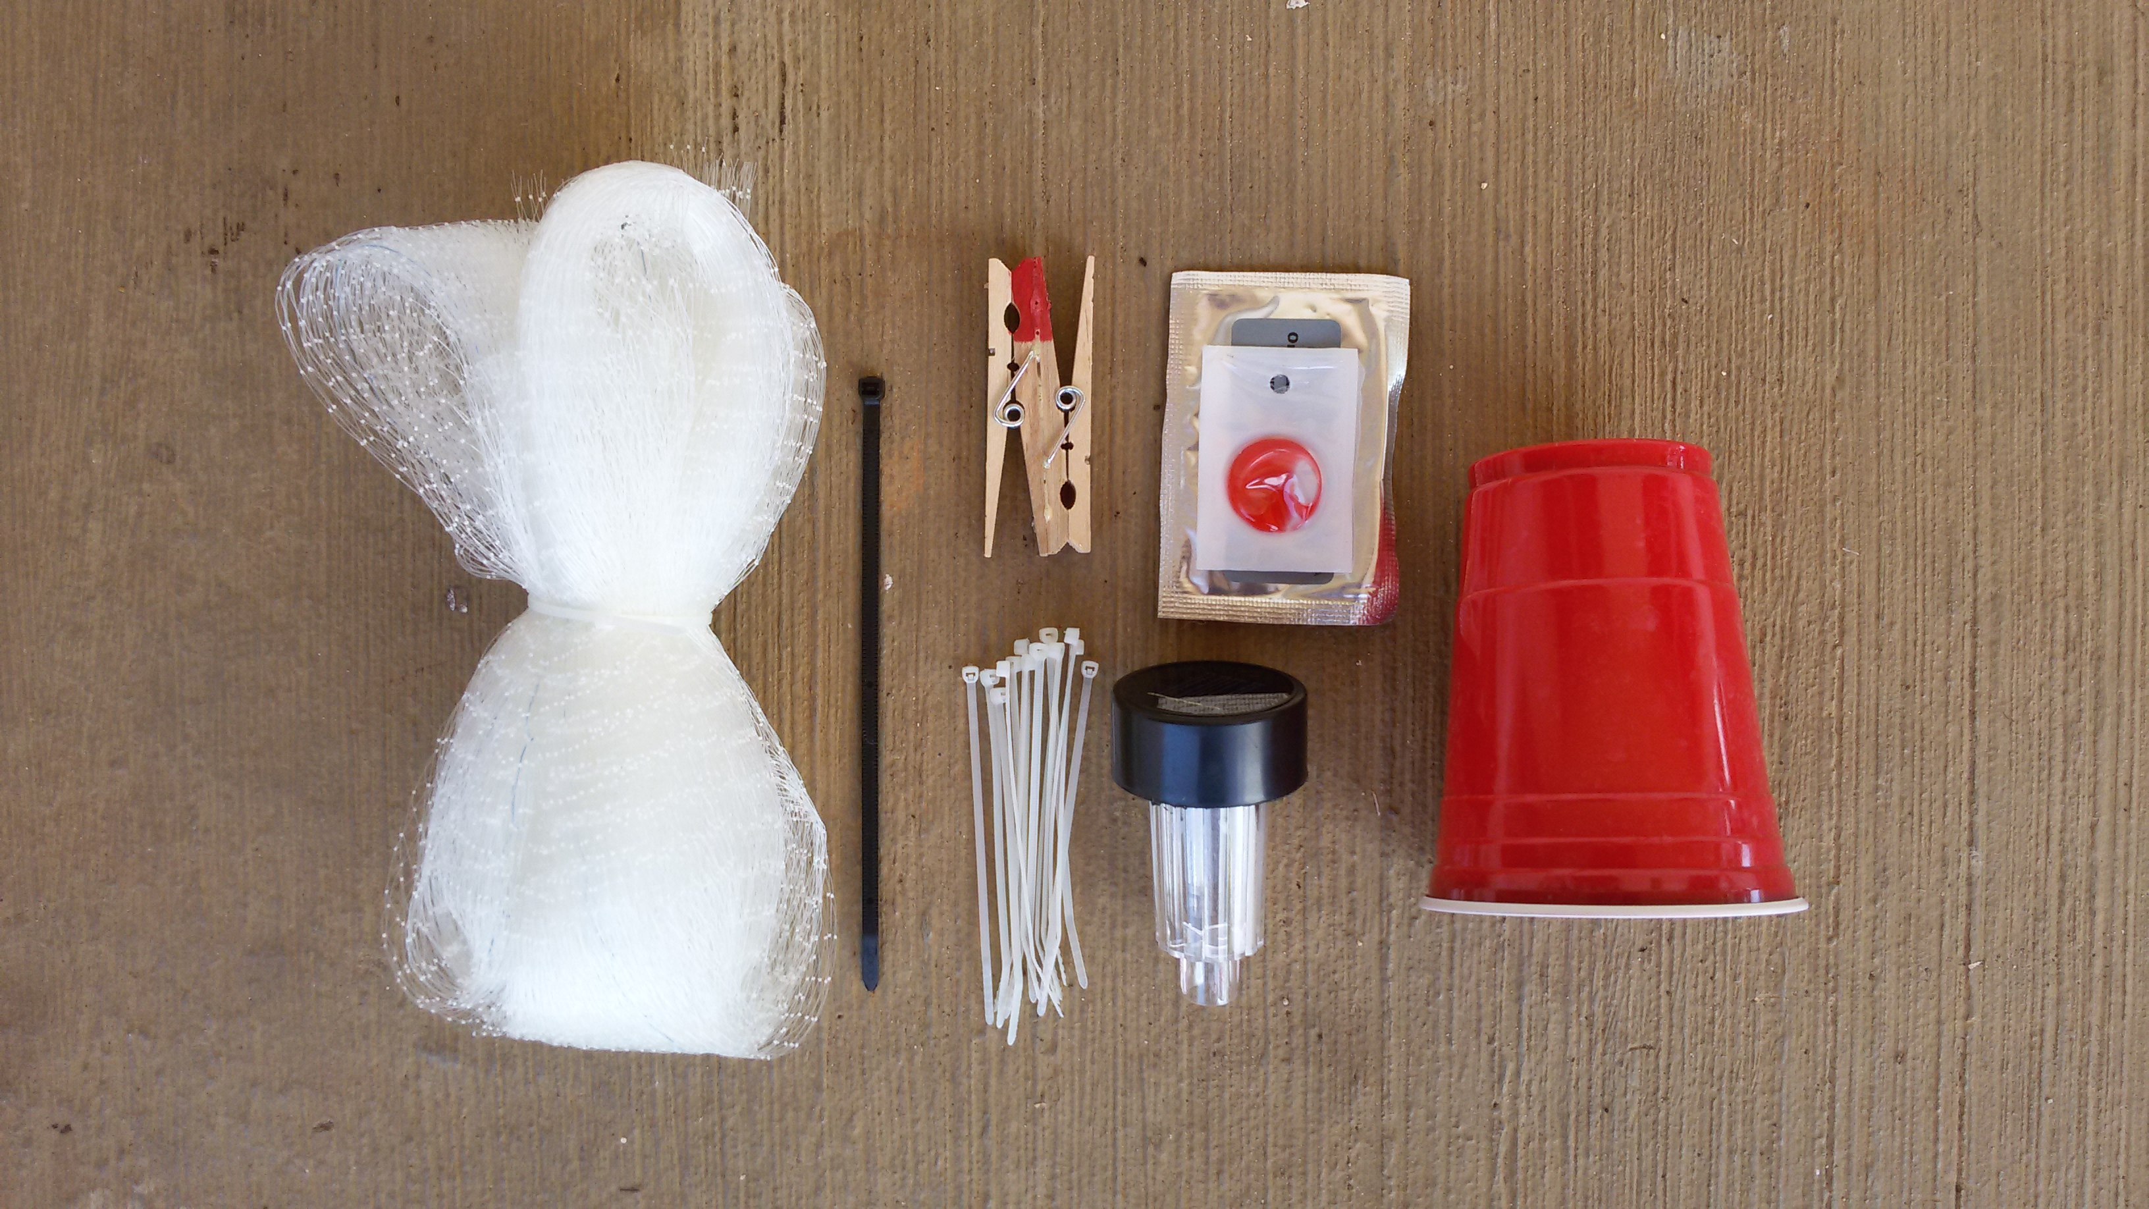
DeFence Trap
Notes:
DeFence trap kit.

Slide 26
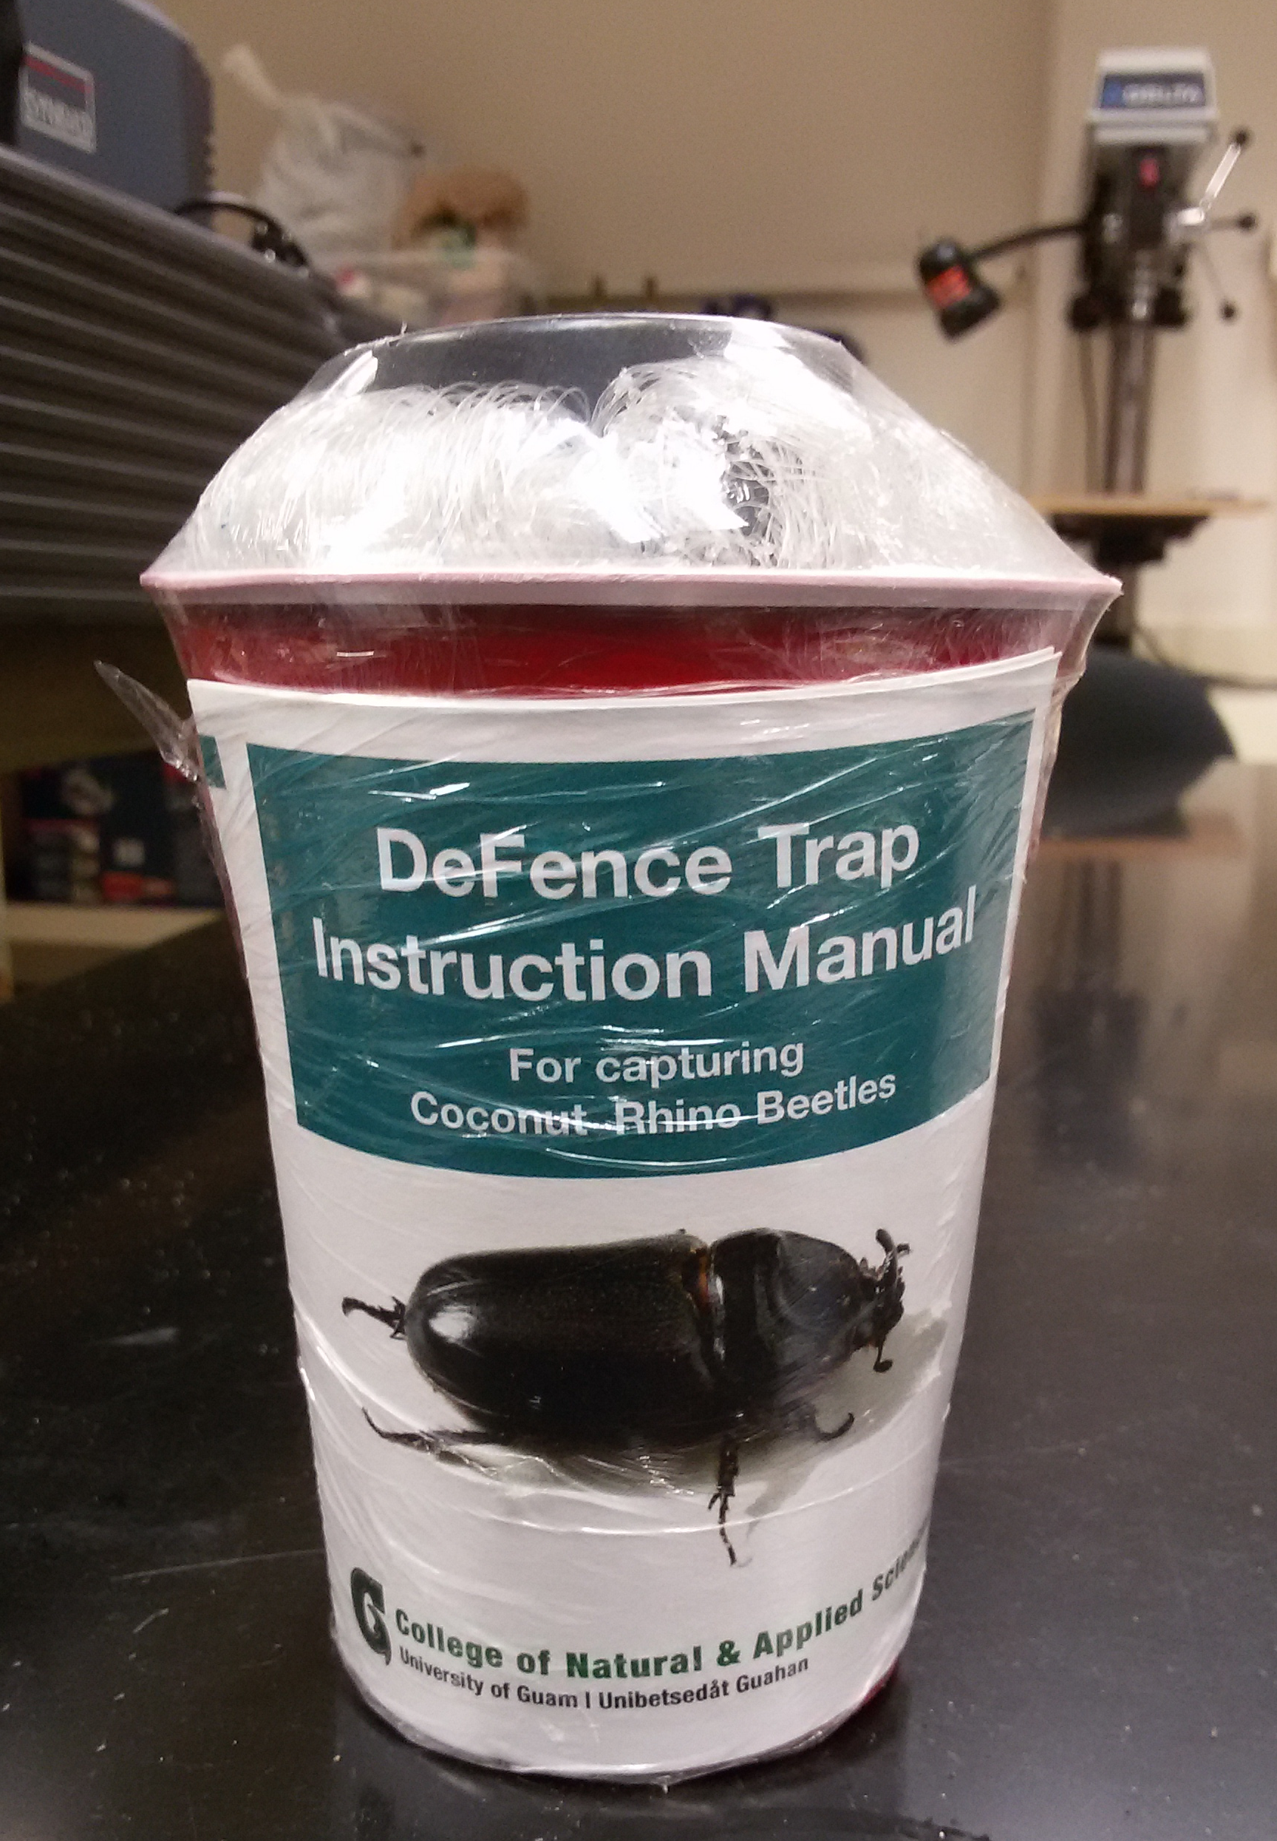

Slide 27

Detector Dogs for Locating Breeding Sites

Slide 28

Detector Beetles for Locating Breeding Sites

Slide 29

Detector Beetles for Locating Breeding Sites
Notes:
33 beetles were tagged and released at 2 sites
19 were successfully tracked to landing sites, 11 of which were considered to be active or potential breeding sites
The remaining 14 beetles were lost when they flew beyond the range of receivers.
Even though all beetles were released in the vicinity of barrel traps (blue dots on this figure) only one (out of 32) was trapped

Slide 30

Chemical Control
Notes:
Palms can be brought back to apparent good health by frequent (biweekly) sprays of cypermethrin
However, bore holes do not heal and attacked palm will always be structurally week.
The spray runs down the petioles and pools where they meet the trunk. This is where CRB initiated their bore holes.

Slide 31


Biocontrol
Oryctes rhinoceros nudivirus (OrNV)
Green muscardine fungus (GMF)
Metarhizium majus
Notes:
There are few effective biocontrol agents for CRB.
OrNV is the preferred BC agent. Unfortunately the Guam CRB population is apparently resistant to all available isolates.
GMF is usually used as a biological insecticide. It has been successfully established on Guam as a classical BC agent. Based on 21 day mortality data for 1,466 CRB collected from 75
sample sites, it is estimated that between 10% and 38% are being killed by GMF infection.

Slide 32
Discovery of the CRB-G Biotype
Marshall, Sean, Maclean Vaqalo, Aubrey Moore, Roland Quitugua, and Trevor Jackson (2015). A new invasive biotype of the coconut rhinoceros beetle (Oryctes rhinoceros) has escaped from biological control by Oryctes rhinoceros nudivirus.
Presented at the International Congress on Invertebrate Pathology and Microbial Control and the 48th Annual Meeting of the Society for Invertebrate Pathology, Vancouver, BC, August 2015.

Slide 33
Characteristics of CRB-G
genetically distinct
resistant to all available isolates of OrNV
more invasive (all 4 recent invasions involve CRB-G)
behavioral differences ???
      not highly attracted to oryctalure
      higher per-capita damage

Slide 34
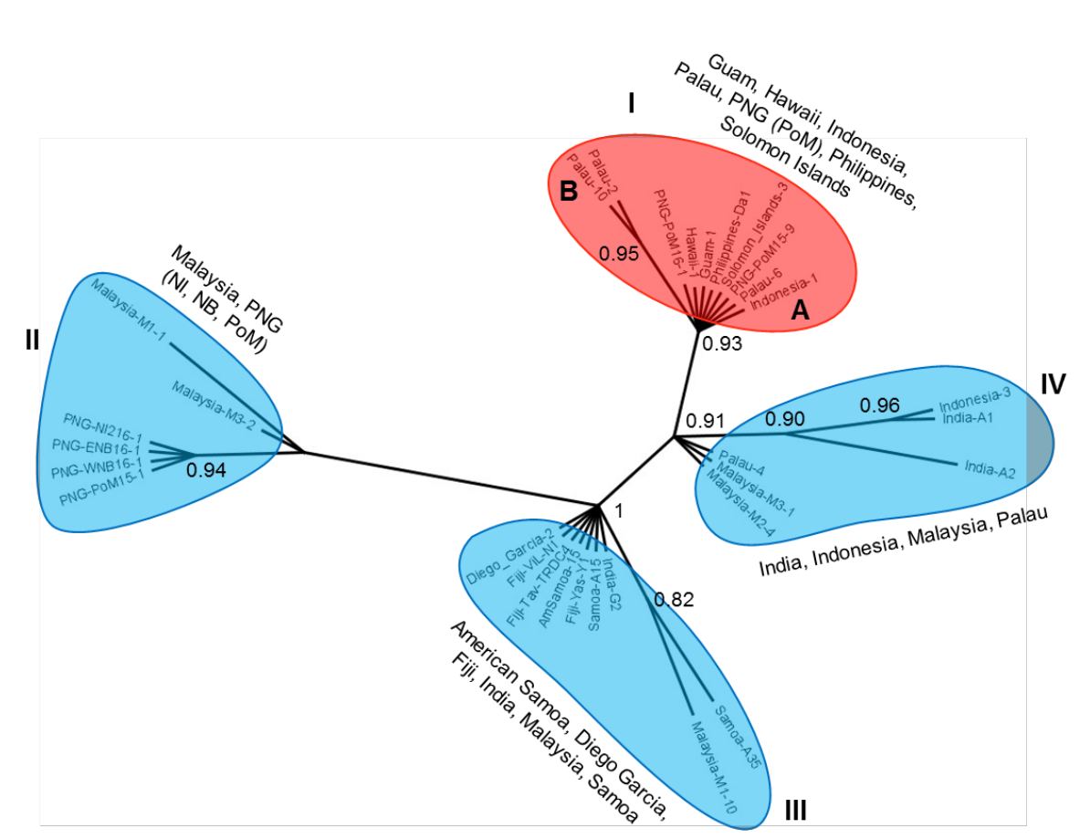

Slide 35
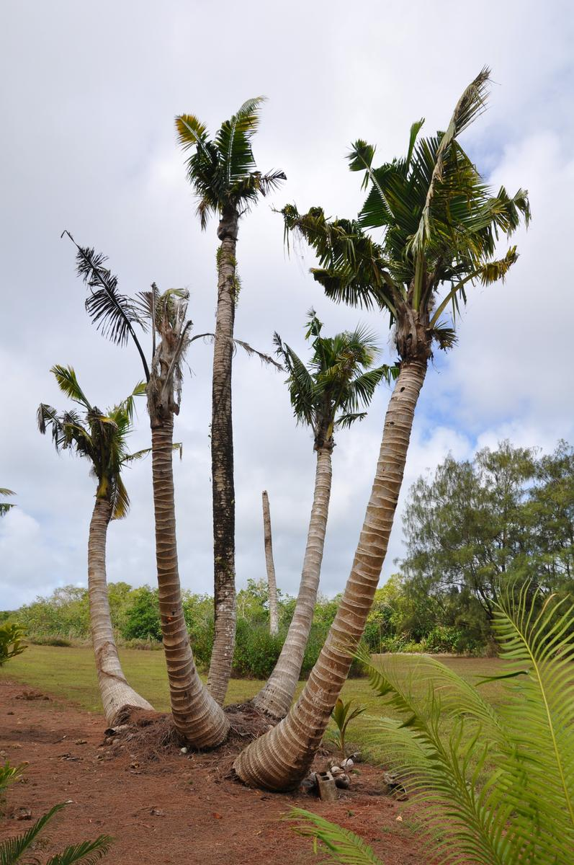
Current CRB Situation on Guam
An uncontrolled CRB outbreak is killing large numbers of coconut palms.

Slide 36

The current outbreak was triggered by Typhoon Dolphin which visited Guam in May 2015. Adult CRB emerging from abundant breeding sites where numerous to start killing mature coconut palms.
Dead standing coconuts are now generating further generations of CRB which are killing even more palms.

Slide 37
Current Prognosis for Guam
Current tactics of sanitation, trapping, application of Metarhizium may reduce local damage, but will do little to protect palms on an island-wide basis because most breeding sites are inaccessible (in jungle and/or on military bases).
Based on historical data from Palau and elsewhere, it is likely that Guam will loose 50% or more of its coconut palms.
Risk of accidental export of CRB to other islands is high.

Slide 38
What Can Be Done?
Effective biocontrol is probably our best chance of saving Guam's coconut palms on an island wide basis.
There is an urgent need to find an effective biocontrol agent for CRB-G. This will probably be an isolate of OrNV from an endemic CRB-G population in Asia.

Slide 39
CRB-G is a Regional Problem
Jackson, Trevor (2015).
Need for emergency response for a new variant of rhinoceros beetle (Guam biotype).
International Association for the Plant Protection Sciences Newsletter (XI). November, 2015.
Available on-line at
Vaqalo, Maclean, Sean Marshall, Trevor Jackson, Aubrey Moore (2015).
An Emerging Biotype of the Coconut Rhinoceros Beetle Discovered in the Pacific.
Secretariat of the Pacific Community, Land Resources Division.
Available on-line at
Notes:
This OrNV resistant biotype has the potential to invade all coconut growing areas,including new islands and counties in SE Asia where CRB is naturally controlled by OrNV. Effects on coconut and oil palm crops could be disastrous
An emergency response to CRB-G is needed to minimize damage on newly invaded islands, thereby reducing risk of further spread.

Slide 40


Notes:
Loss of coconuts on smaller islands and atolls where people rely on coconut as the “tree of life” will be a human disaster.

Slide 41

Link to Climate Change
Notes:
Sea level in the Solomons has risen 8 mm per year since 1993, killing coconuts which protect the islands from erosion.
Typhoons trigger CRB outbreaks even in areas where the beetle is endemic and under biocontrol by OrNV.
Climate change models predict stronger and more frequent typhoons.

