Slide 1
CIDM 6312 HW4
Aubrey Skinner

Slide 2
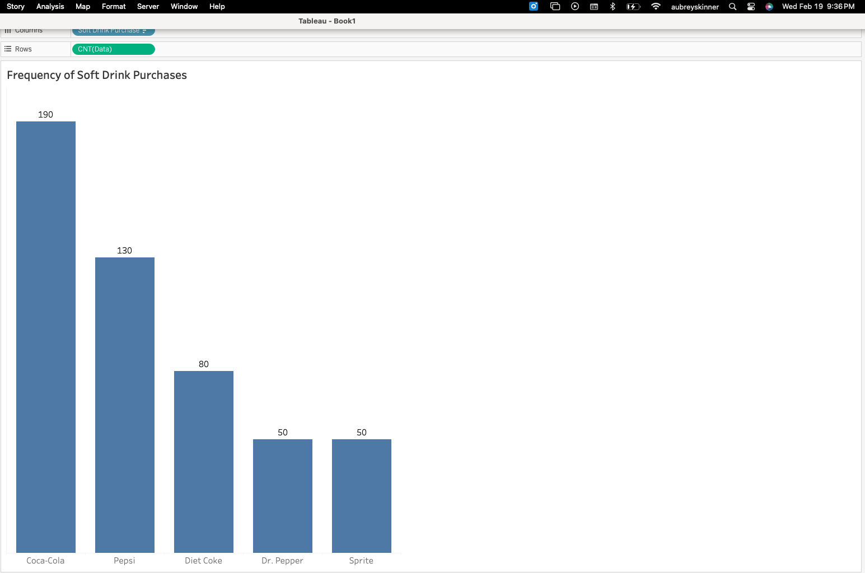
Part One- Task One: Frequency Distributions for Categorical Variables
Frequency Distribution Chart for Soft Drink Purchases Data-AS

Slide 3
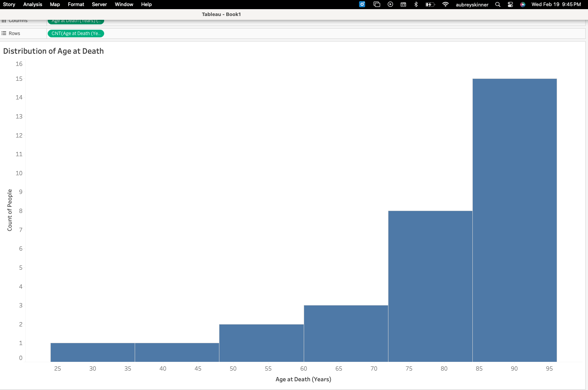
Part One- Task Two: Distributions for Quantitative Variables
Histogram for Age at Death Data- AS

Slide 4
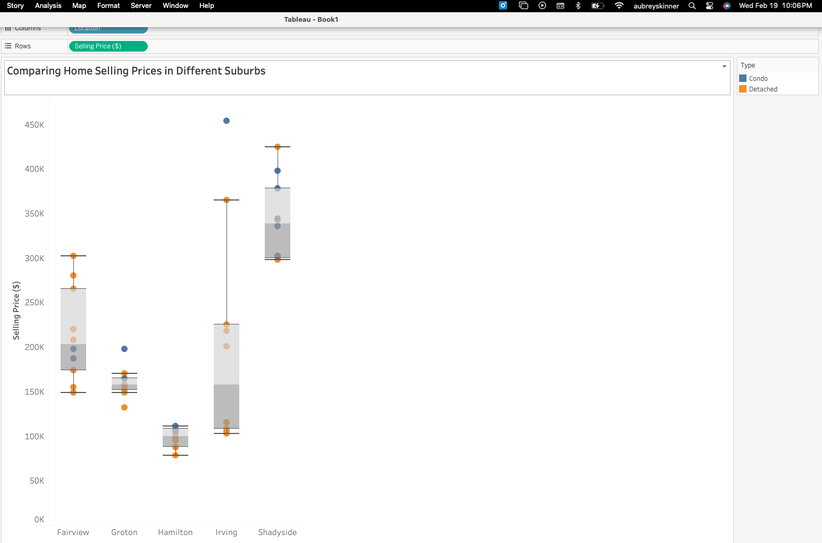
Part One- Task Three: Creating Box and Whisker Charts for Quantitative Variables
Box and Whisker Chart for Home Sales Data-AS

Slide 5
Part One- Task Three: Interpret
The Box and Whisker Charts for the Home Sales Data helps me understand the data distribution through quartiles. By reading the sets of values within each quartile, you can determine outliers, mean, median, and see where the data is centralizing. For example, we can see Irving has an outlier that is a condo with a selling price of $454,000. I can also determine Shadyside has the highest median home price, while Hamilton has the lowest. Overall, by interpreting the IQR, height, and spread of the boxes, you can easily compare property types, locations, and home prices.

Slide 6
Part Three- Task Three: Compare and Analyze
This data provides us with home sales distributions across five suburbs- Hamilton, Groton, Irving, Fairview, and Shadyside. Hamilton shows to have the lowest home prices with a median of $100,000. We see condos tend to fall above this, while detached homes fall below. Groton has a median home price of $158,000. There are a couple of outliers in this suburb with one being a condo for $198,000 and the other being a detached home for $132,000. Irving has a long upper whisker which represents a large range of home prices. As the prices still fall within 1.5 times the IQR, they are not considered outliers, making the upper whisker account for a broader range. However, there is an outlier for a condo priced at $454,000. Overall, the median price for this suburb is $158,000. Fairview has a median price of $203,000 with detached homes being pricier and condos falling below the median price. Lastly, Shadyside has the highest priced homes with a median of $339,000.

Slide 7
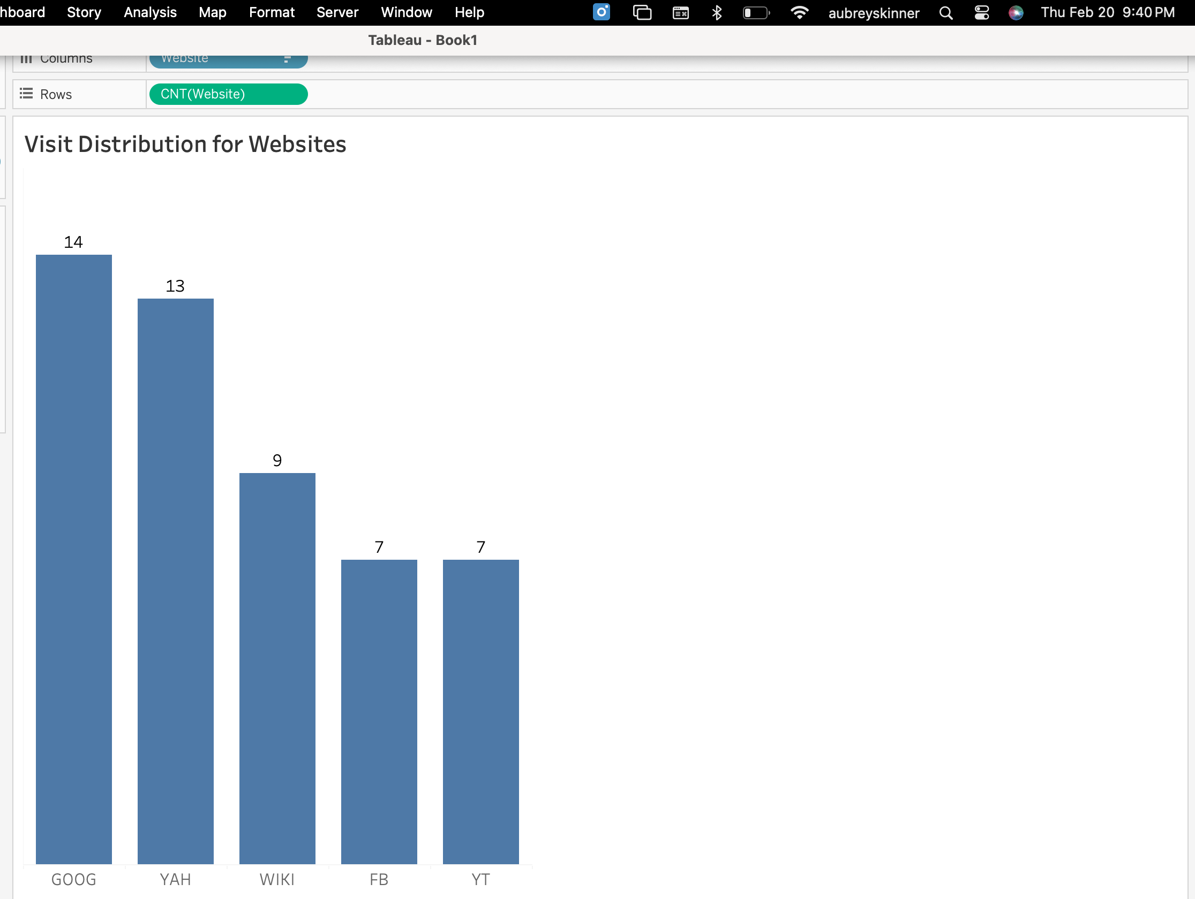
Part Two- Problem 1
Column Chart for Website Visit Distribution Data- AS

Slide 8
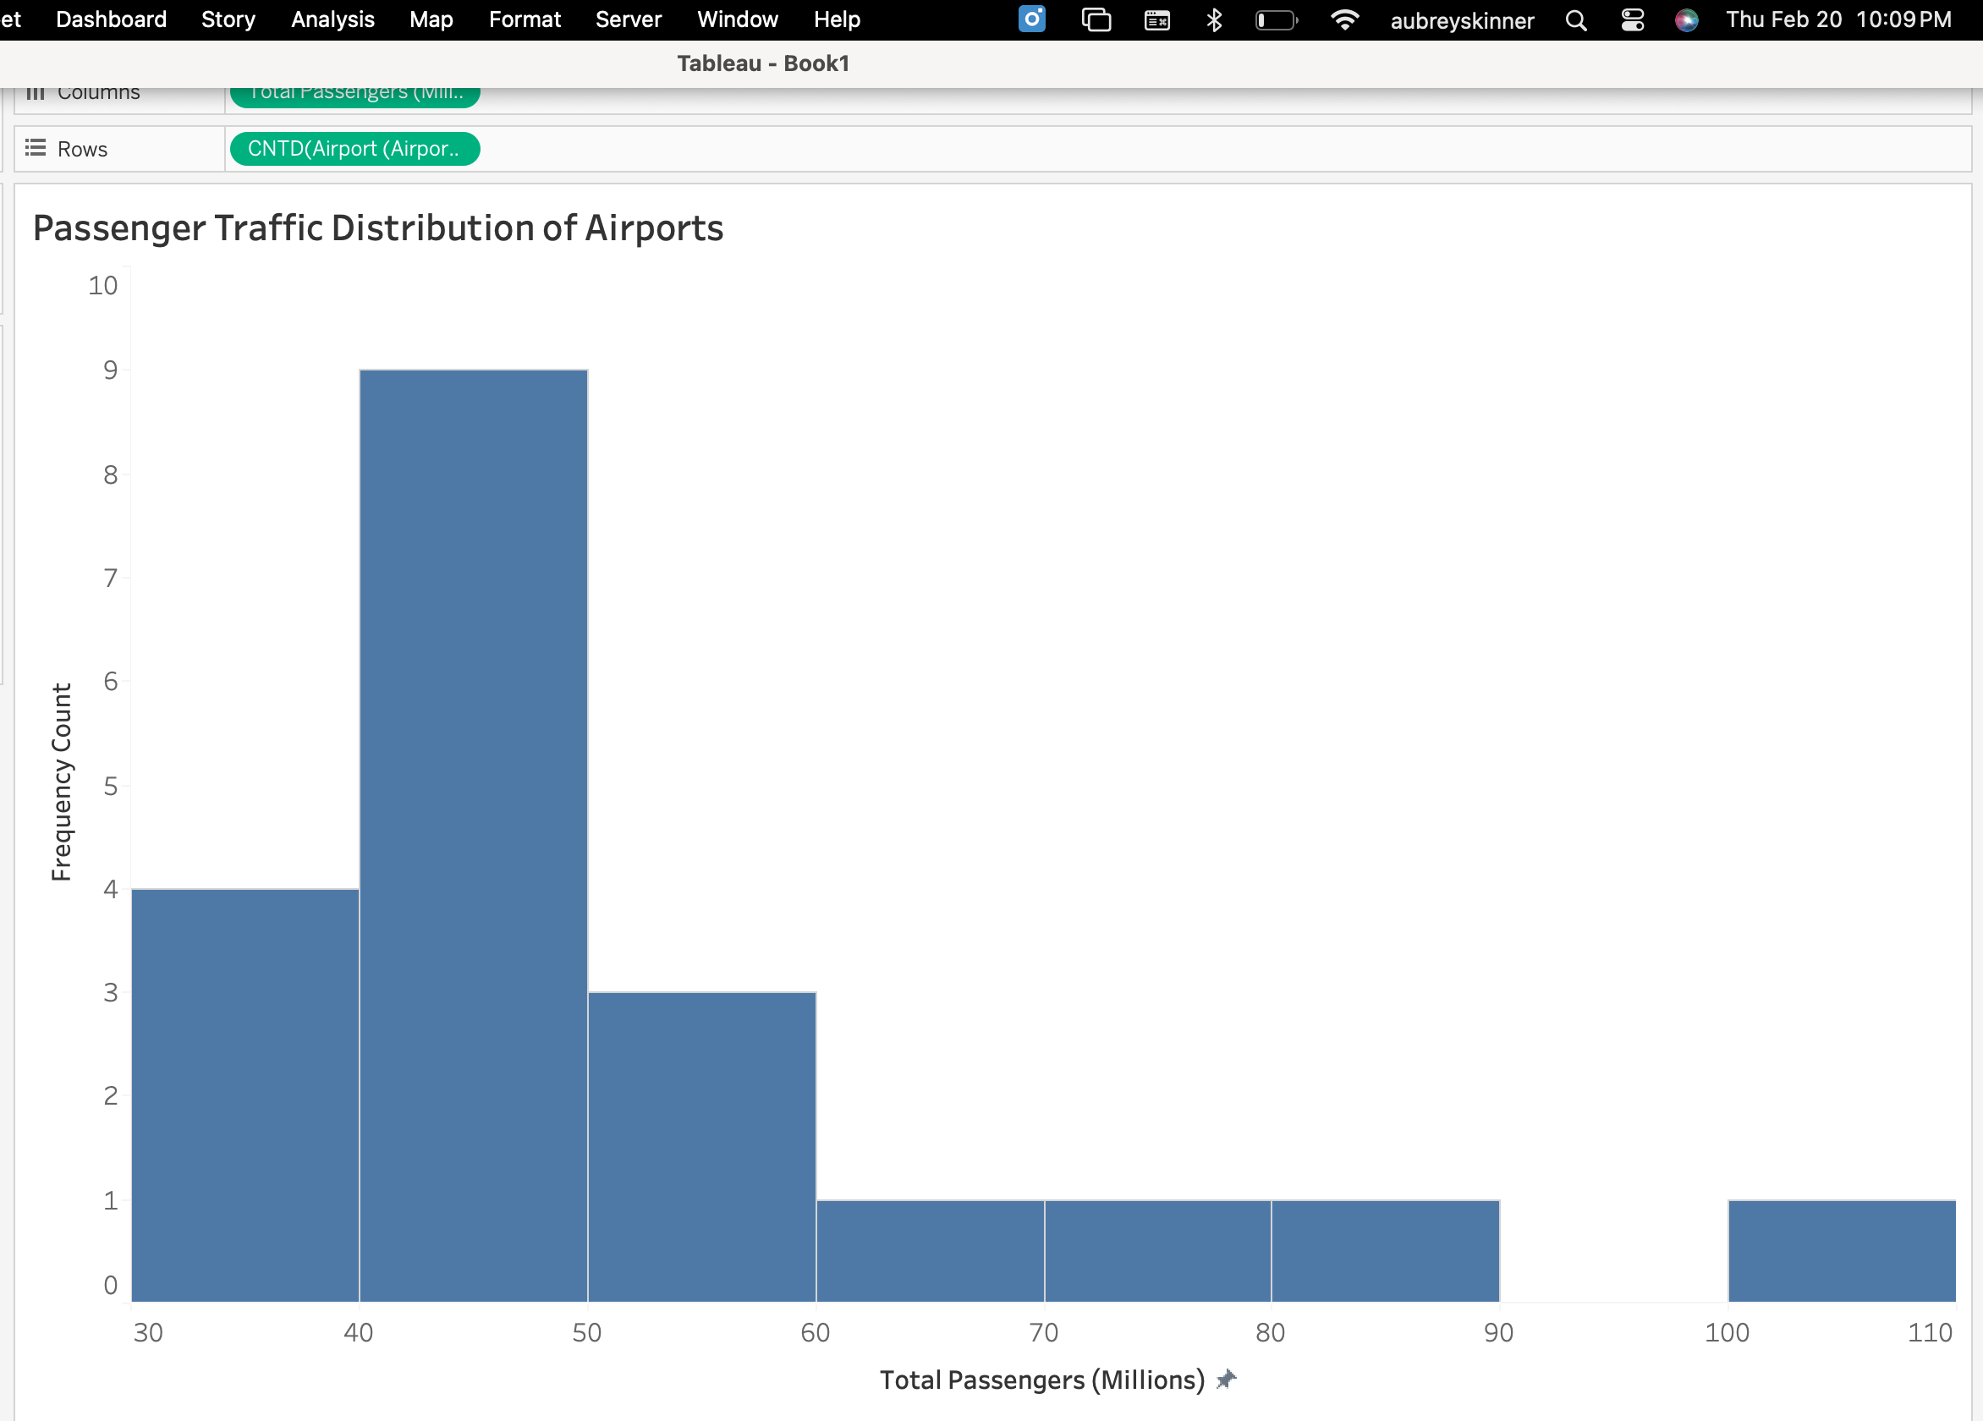
Part Two- Problem 2
Histogram for Passenger Traffic Distribution of Airports Data- AS

Slide 9
Part Two- Description of Histogram Shape
The distribution for passenger traffic is skewed to
the right due to a couple of very busy airports.
The most common passenger traffic range is 40 to 50
million. In this histogram, we see one main peak
where most airports are falling. This histogram is
not symmetrical due to this.

Slide 10
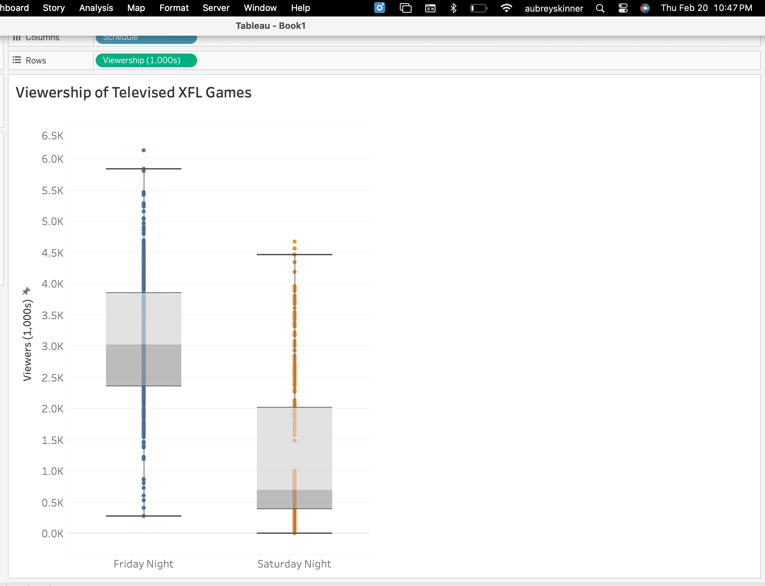
Part Two- Problem 3
Box and Whisker Chart for Viewership of Televised XFL Games Data-AS

Slide 11
Part Two- Comparison of Friday vs. Saturday Night Viewership Distributions
Based on the box and whisker chart we can determine Friday night has a larger viewership than Saturday night. The 25th percentile of Friday nights viewership is larger than the 75th percentile for Saturday night. The median for Friday night is 3K, which is much larger than Saturday at 0.7K. Friday night viewership is symmetric around a single node and Saturday night is positively skewed with most games having low viewership.

