Slide 1

AuburnHacks
Introduction to AWS

Slide 2
Cloud Background
Resilient: redundancy and failover systems
On-demand: resources whenever you need them
Elastic: able to scale resources on demand

Slide 3

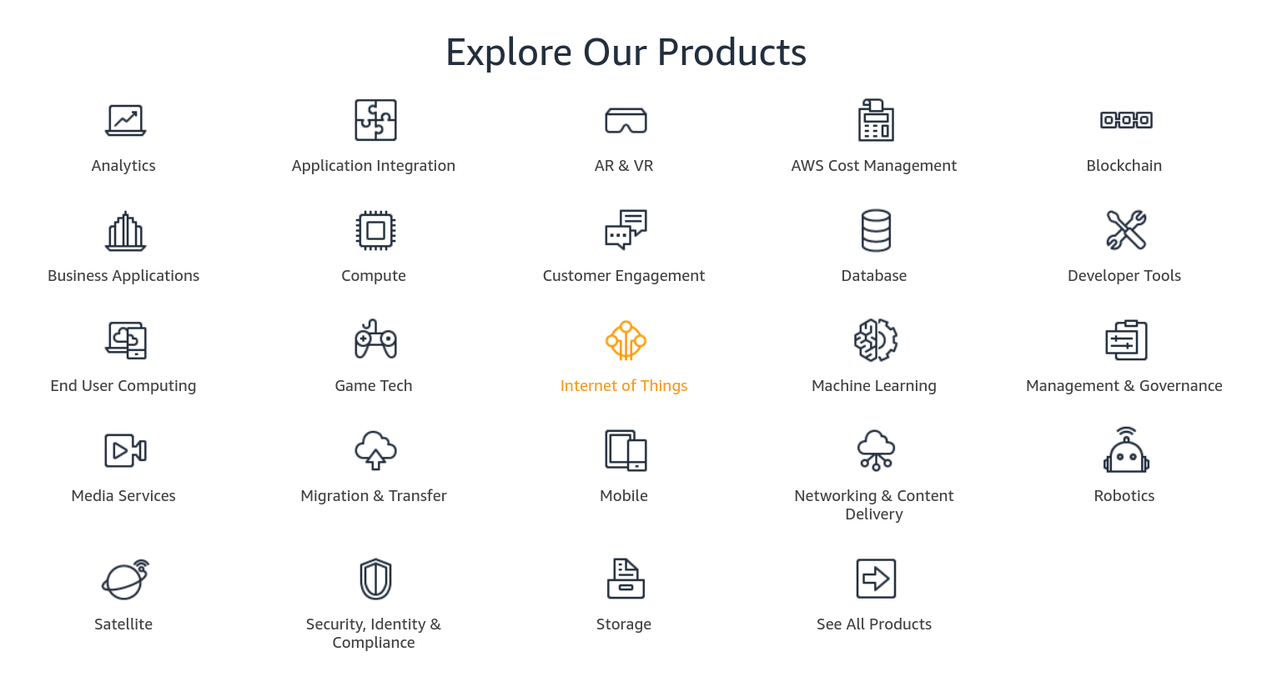
What is AWS?
Amazon Web Services (AWS) is one of the largest cloud providers and offer many services for your cloud solutions
There is a lot of documentation and numerous tutorials for you to get started on something today.
Some of their clients include big names like Netflix, Airbnb, and Adobe

Slide 4
Getting started
Sign up for a new account:
https://portal.aws.amazon.com/billing/signup#/start
Make sure to write down or save your Access key ID and secret access key
Download the code that is being used in this tutorial:
https://github.com/auburnhacks/hacker-resources/tree/master/aws_techtalk

Slide 5
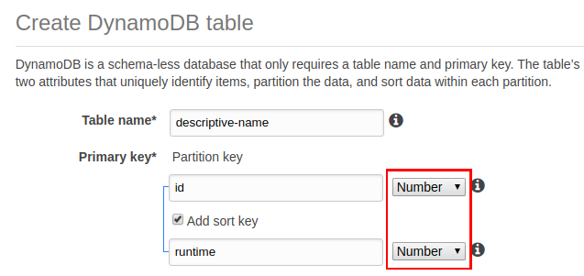
DynamoDB
Click ‘Create table’
Give your table a descriptive name
Name the Partition key ‘id’
Name the sort key ‘runtime’
Make sure to make both of these Numbers

Slide 6
Adding items to DynamoDB
You can either add an item via the console or through the command line
First install the AWS CLI:
sudo apt-get install awscli (or with your other installer if not on linux)
Configure:
aws configure
Then enter your access key ID, secret, region name, and output format
Write the items to the table
aws dynamodb batch-write-item --request-items file://items.json

Slide 7
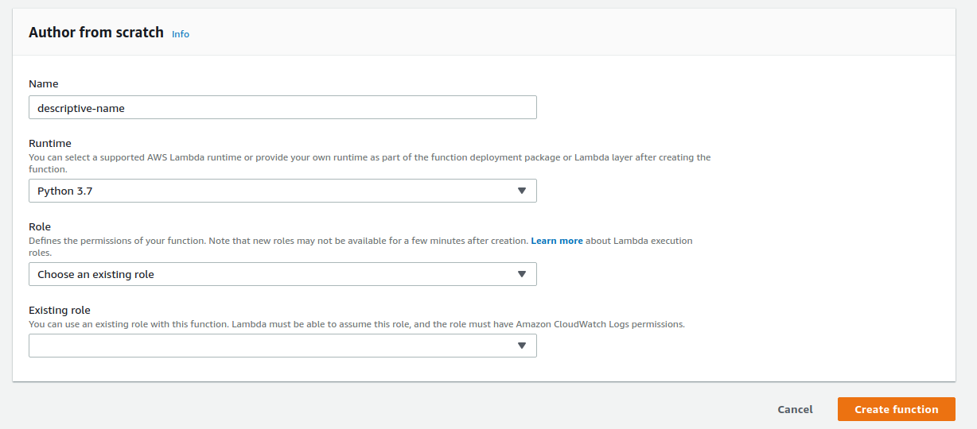
Lambda
Click ‘Create function’
Give your function a descriptive name
Select language
Select ‘Create a custom role’. A new window will pop up taking you to the IAM console

Slide 8
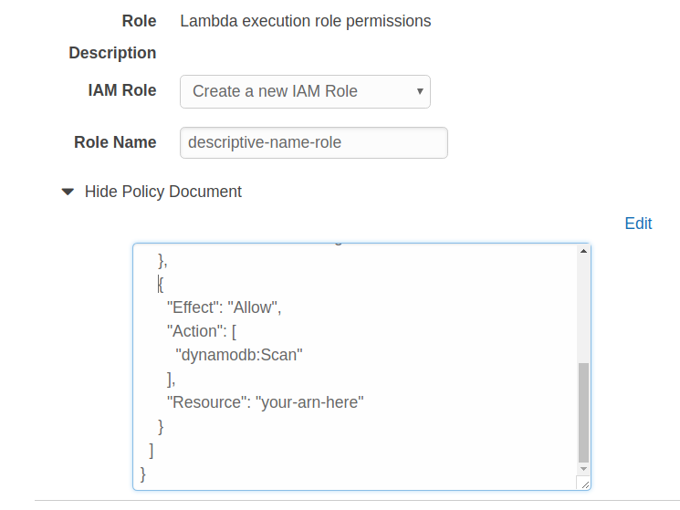
Create new execution role
Give your role a descriptive name
Edit the policy document
Add this in the ‘Statement’ array:
{
"Effect": "Allow",
"Action": [
"dynamodb:Scan"
],
"Resource": "your-arn-here"
}
(You can find your resource arn in the overview section of your table)

Slide 9
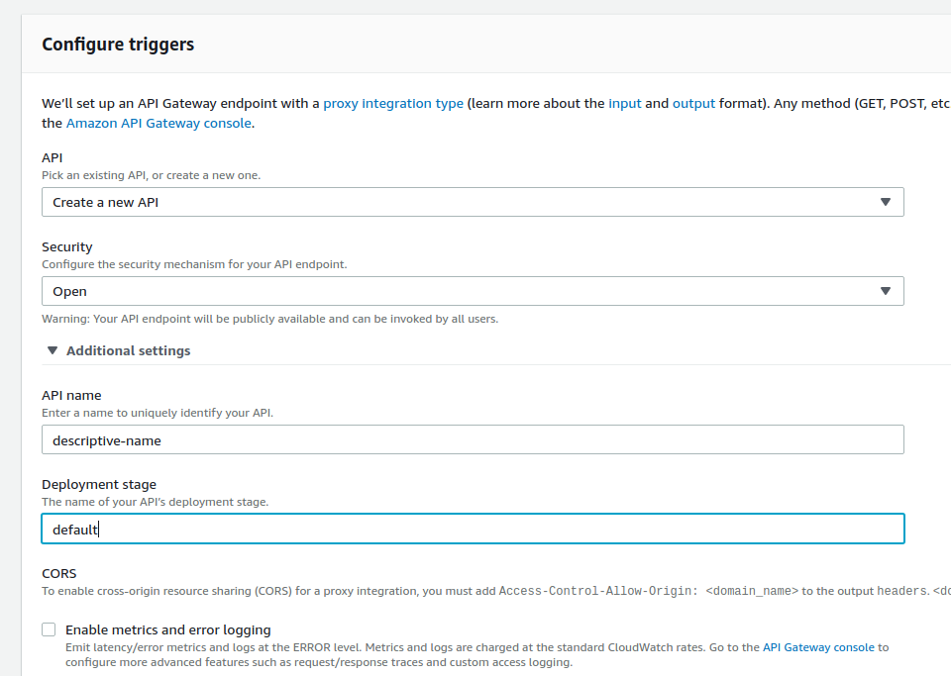
Lambda
Select APIGateway from the left
For ‘Security’ just select Open for now
Give your API a descriptive name
The rest can stay default for now
Click ‘Add’, then click ‘Save’ at the top
Click on the blue link to open up your new API in APIGateway

Slide 10
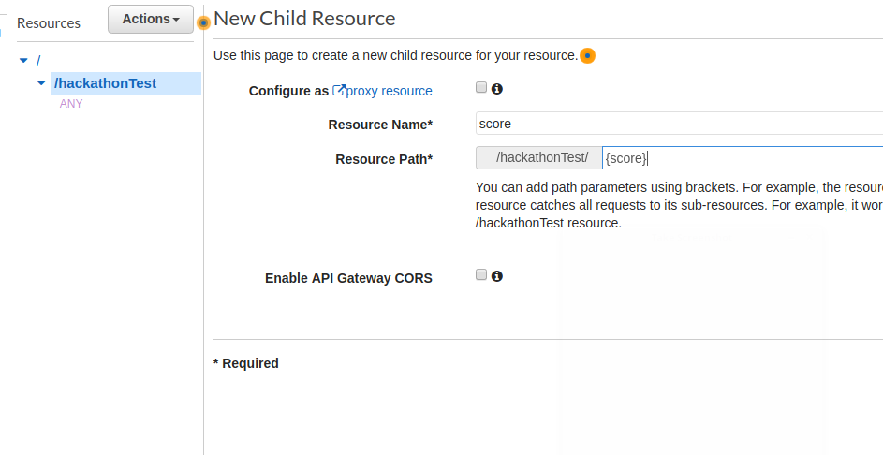
APIGateway
Click on ‘Actions’ then ‘Create Resource’
Name your resource ‘score’
Make the ‘Resource Path’ ‘{score}
Click ‘Create Resource’

Slide 11
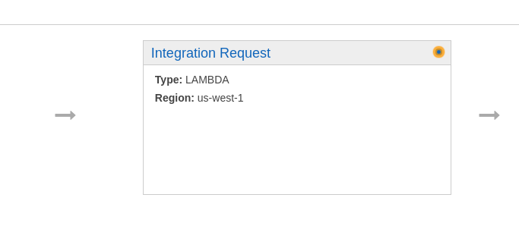
APIGateway
Click on ‘Actions’ then ‘Create Method’ and select ‘GET’
In ‘Lambda Function’ type the name of your Lambda function
Click Save and then OK
Next, click ‘Integration Request’

Slide 12
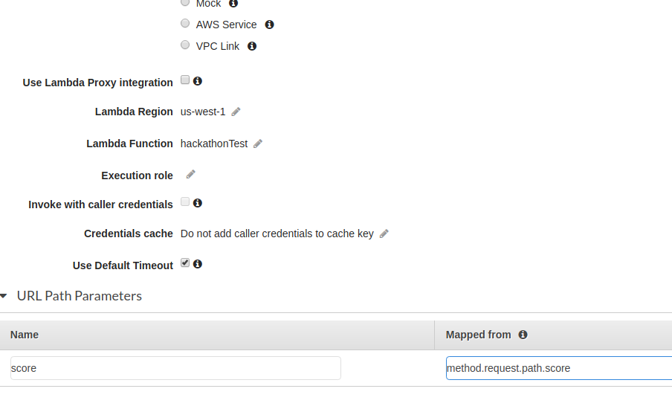
APIGateway
Click on ‘URL Path Parameters’
Type ‘score’ under Name
Type the path that you want to capture the path parameter from
‘method.request.path.score’
Click the check mark

Slide 13
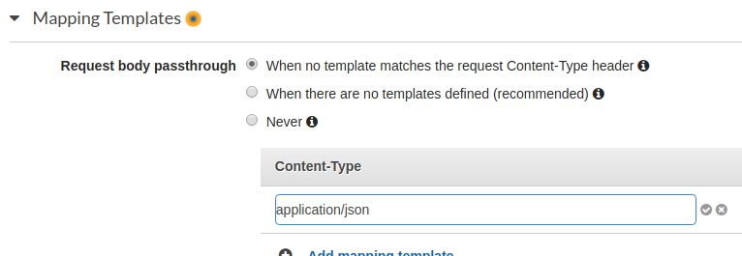
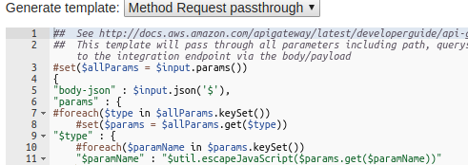
APIGateway
Click on ‘Mapping Templates’
Click ‘Add mapping template’
Type ‘application/json’ and click the check mark
Click ‘Yes, secure this integration’
Next, click on ‘Generate template:’ and select ‘Method Request passthrough’
Click Save

Slide 14
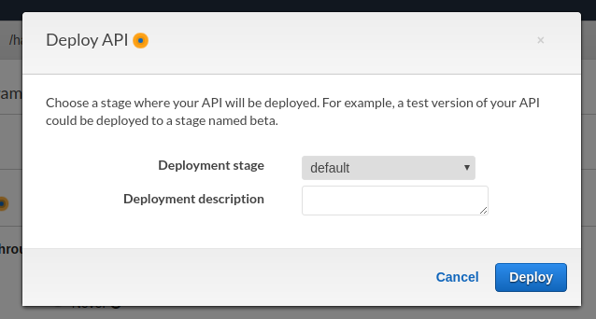
APIGateway
Click on ‘Actions’ then click on ‘Deploy API’
Choose ‘default’ as the deployment stage or create a new one for testing or something
Click Deploy
Now you can click on your blue invoke URL

Slide 15
Code
Remember that the code for this project can be found here:
https://github.com/auburnhacks/hacker-resources/tree/master/aws_techtalk

Slide 16
Thanks for attending!

