Slide 1

CCMF APPLICATION
Coach! What to do?
Asia's First AI-Driven B2B2C
Smart Coaching Ecosystem
An innovative HealthTech SaaS platform that turns coaching operations into an AI-scalable growth engine — with a live MVP ready for commercialization.
LIVE PRODUCT
fitclub-pearl.vercel.app
Cyberport Creative Micro Fund (CCMF) · Business Proposal
Founder & PIC: [Your Full Name]
Funding Ask: HK$100,000

Slide 2
01 EXECUTIVE SUMMARY
Vision, Mission & Positioning
VISION
MVP STATUS
To democratize professional health coaching and become the leading AI-driven operational ecosystem for the fitness industry in the APAC region.
✓
Full-stack MVP live
MISSION
✓
PWA + mobile-ready
Empower fitness professionals with AI automation that scales their business, while giving individuals proactive, real-time dietary and training navigation tailored to localized Asian lifestyles.
✓
AI food / OCR flows
POSITIONING
✓
Coach portal ready
Coach! What to do? is an innovative B2B2C HealthTech SaaS. Unlike passive B2C calorie trackers, we deliver Proactive Pre-meal AI Navigation — combining Computer Vision (OCR) with AI to remove diet-tracking friction and reduce coaches' admin workload by ~80%.
✓
Stripe billing integrated
✓
Ready to commercialize

Slide 3
02 THE PROBLEM
A market polarized against both sides
Current tools fail consumers with friction — and fail coaches with unscalable operations.
B2C PAIN
B2B PAIN
Passive & Friction-heavy
Unscalable Operations
• Existing apps (e.g. MyFitnessPal) rely on post-meal manual entry.
• Coaches spend hours reviewing food photos via WhatsApp.
• Creates an “eat first, regret later” behaviour loop.
• Manual “customer service” caps earning potential.
• Weak localization for Asian meals, HK convenience stores and local eateries.
• No intelligent tracking / auto-grading workflow.
• High friction drives drop-off and weak long-term adherence.
• Limits how many clients a coach can serve effectively.

Slide 4
03 SOLUTION & INNOVATION
Three breakthroughs that redefine coaching ops
From passive tracking to proactive AI navigation — with a growing local data moat.
01
02
03
Proactive AI Navigation
Computer Vision (OCR)
Crowdsourced Moat
Shift UX from post-meal logging to pre-meal intervention. AI calculates remaining macros and suggests next-meal options tailored to local lifestyle.
Users scan a nutrition label. AI extracts calories and macros instantly, eliminating friction and manual entry errors.
Each OCR scan enriches a localized Asian food repository. As usage grows, accuracy compounds — creating a network effect hard for global giants to replicate.

Slide 5
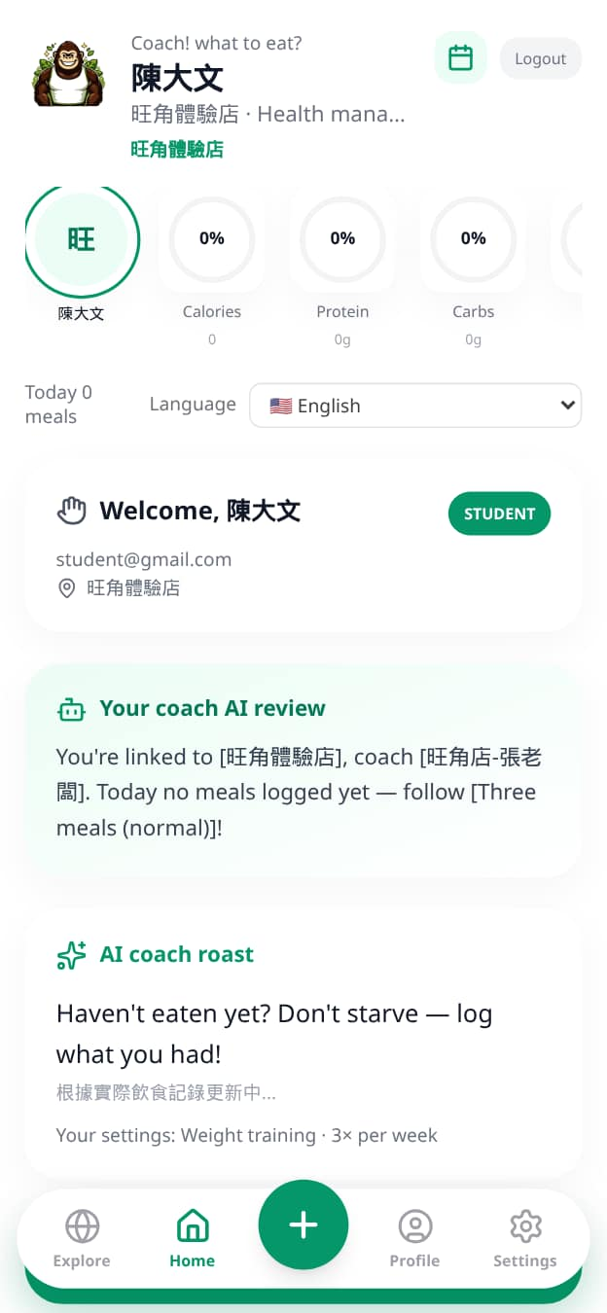
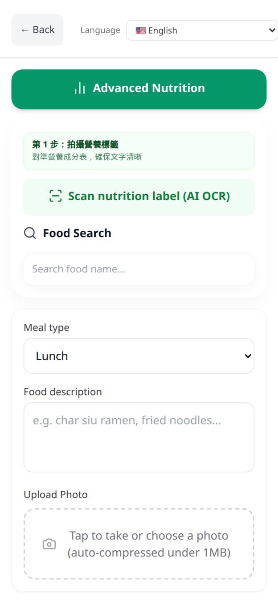
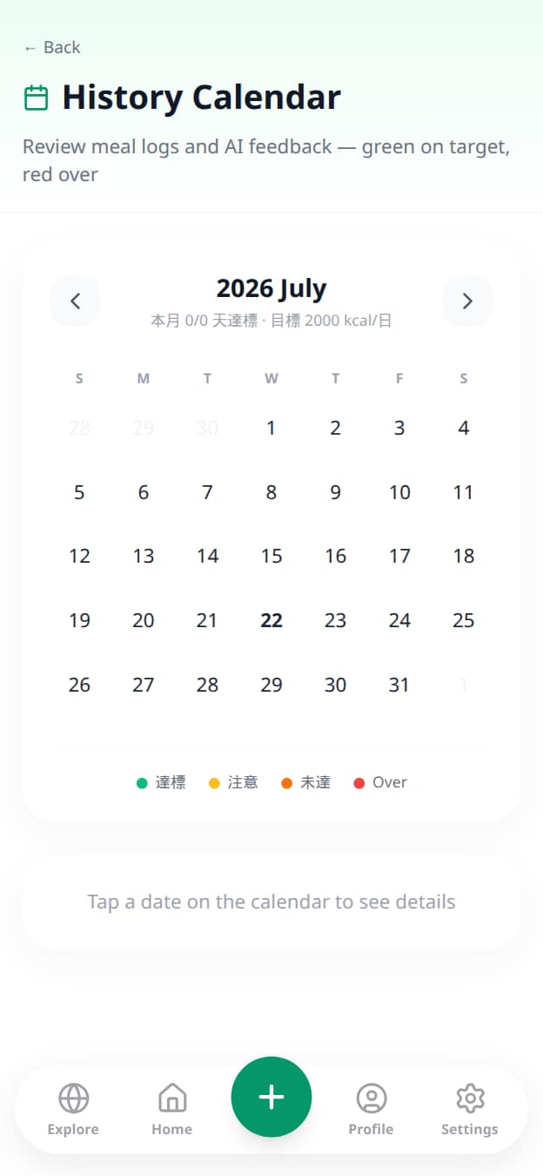
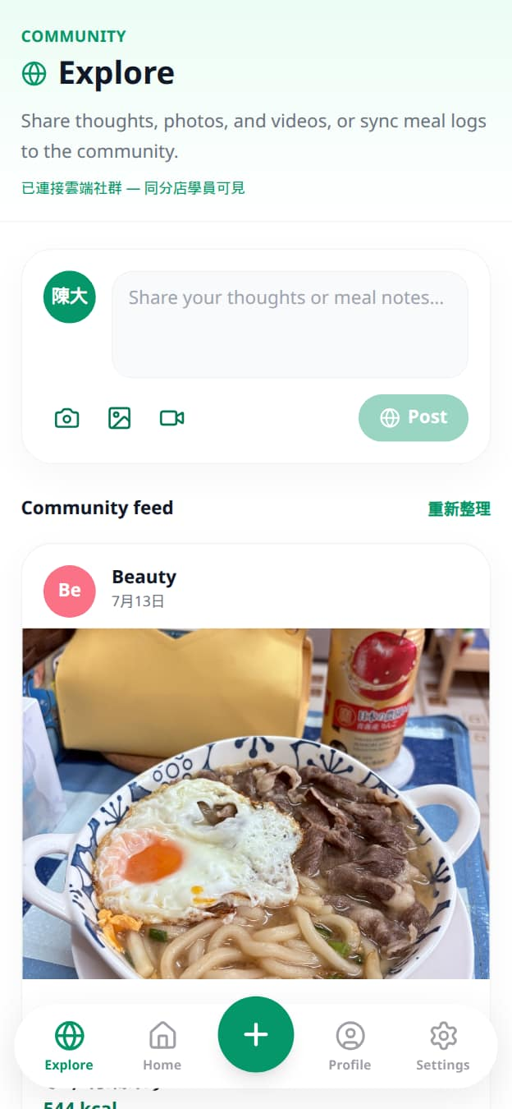
04 LIVE PRODUCT
A working MVP — not a concept deck
Student experience: personalized dashboard, AI meal logging, history compliance and community.
KEY FEATURES
✓ AI meal review
✓ OCR label scan
✓ Food photo logging
✓ Macro targets
✓ Streak & history
✓ Community feed
✓ Multi-language UI
✓ PWA installable

Slide 6
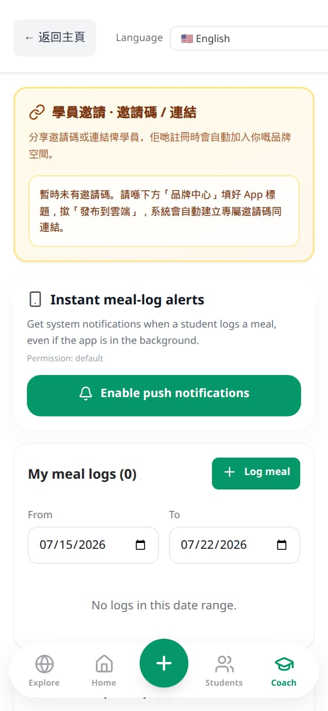
05 COACH OPERATING SYSTEM
From WhatsApp chaos to AI-scalable growth
White-label tools that cut admin time and help coaches serve more clients with better accountability.
AI Dashboard
01
Traffic-light compliance and daily intake visibility for every student.
Instant Alerts
02
Push notifications when students log meals — even in the background.
Targets & Feedback
03
Coach-set goals, comments and review workflows replace scattered chats.
Brand Ownership
04
Custom title, theme and invite links keep the gym brand front-and-centre.

Slide 7
06 BUSINESS MODEL & MARKET STRATEGY
B2B2C SaaS with near-zero CAC viral loop
Target: fitness professionals and their health-conscious clients in Hong Kong and Taiwan.
B2B
B2C
Pro Coach Plan
Solo Plan
HK$399 / month
HK$68 / month
AI-powered dashboard that auto-grades client diets with a traffic-light system — saving ~80% admin time and unlocking client-base scale.
Individuals access AI meal navigation, OCR scanning, history, streak motivation and community support — with or without a human coach.
Includes: student management · targets · review · brand portal · alerts
Viral Loop: 1 coach brings 20–50 clients → high switching barriers

Slide 8
07 COMPETITIVE ANALYSIS
A distinct blue ocean in HealthTech
We bind localized AI navigation to human coaching accountability.
Dimension
B2C Trackers
B2B Coach Tools
Coach! What to do?
UX Paradigm
Passive post-meal logging
Digital worksheets
Proactive pre-meal AI
Localization
Global generic DB
Limited / none
Asia-first food data moat
Coach Value
None / weak
Record-keeping only
AI auto-grade + growth OS
Distribution
Paid B2C CAC
Direct coach sales
B2B2C near-zero CAC loop
Moat
Brand & DB size
Workflow lock-in
OCR network + coach binding

Slide 9
08 SOCIAL IMPACT (ESG)
Technology for preventive healthcare
Democratizing Preventive Care
1
AI lowers the cost of professional guidance, making proactive health management accessible beyond premium coaching.
Data for Public Health
2
We plan to share anonymized, crowdsourced local dietary insights with universities and NGOs for research and policy support.
Ethical AI
3
Privacy-first by design. Models drive positive behavioural change — never exploit user data for third-party advertising.

Slide 10
09 EXECUTION POWER & MANAGEMENT TEAM
Solo founder with founder–market fit
Project Director & Solo Founder: [Your Full Name]
Domain Expertise
ALREADY DELIVERED
As an active, experienced fitness coach, the founder intimately understands the operational pain points of both practitioners and clients — enabling rapid product decisions with real market grounding.
✓ Live product URL
✓ Student + Coach apps
✓ AI OCR / meal flows
Execution Capability
✓ Stripe billing ready
Far beyond the conceptual stage: the founder independently completed full-stack development of the cross-platform Progressive Web App and integrated Stripe automated billing — proving exceptional execution speed with AI-assisted coding.
✓ Supabase cloud backend
✓ PWA / Capacitor path

Slide 11
10 6-MONTH MILESTONES
MVP is done — now scale GTM
Focus: soft launch → monetization → expansion → incubation.
1
2
3
4
M1–2
M3
M4–5
M6
Soft Launch
Monetization
Expansion
Scale
Threads marketing + 100 limited free trials to validate PMF and fine-tune OCR edge cases.
Fully activate Stripe billing and achieve initial Monthly Recurring Revenue (MRR).
Build “What to train?” (AI progressive overload) and start direct B2B sales to boutique gyms.
Reach 500 active paid clients and apply for the Cyberport Incubation Programme.

Slide 12
11 BUDGET ALLOCATION
HK$100,000 CCMF — focused on scale
MVP is 100% developed; capital accelerates infrastructure, acquisition and GTM.
40%
Cloud Infrastructure & AI API
HK$40,000
Scale OpenAI/Vision usage and Supabase hosting for growth performance.
30%
Marketing & User Acquisition
HK$30,000
B2B targeted ads and subsidized Free Trial campaigns.
20%
Product R&D / UI Upgrades
HK$20,000
UI refinements and development of the upcoming training module.
10%
Operations
HK$10,000
Company incorporation, domains and Stripe operational buffer.

Slide 13
Coach! What to do?
Asia's First AI-Driven B2B2C Smart Coaching Ecosystem
A live MVP. A clear B2B2C model.
Ready for Cyberport CCMF commercialization.
LIVE DEMO
fitclub-pearl.vercel.app
Funding Ask: HK$100,000 · 6-month GTM & scale plan
Founder & PIC
[Your Full Name]
Thank you
Cyberport Creative Micro Fund (CCMF) · Business Proposal

