Slide 1

FUNDING APPLICATION
Nutrition Coach
AI-Powered White-Label Nutrition SaaS
for Fitness Businesses
A mobile-first platform that turns everyday meal logging into personalised coaching, measurable adherence and scalable client management.
LIVE PRODUCT
fitclub-pearl.vercel.app
Product Demonstration Deck · July 2026

Slide 2
THE OPPORTUNITY
Fitness businesses need a better adherence engine
Most nutrition tools stop at tracking. Coaches need visibility, intervention tools and a branded client experience.
01
Manual follow-up
02
Low adherence
Meal photos, chat messages and spreadsheets create fragmented workflows for coaches.
Logging feels tedious; clients lose momentum without timely feedback and motivation.
03
Generic advice
04
Weak retention
One-size-fits-all calorie apps do not reflect body profile, goals or coach priorities.
Gyms lack a digital touchpoint that keeps their brand present between sessions.
Nutrition Coach connects the client habit loop with the coach operating workflow — in one white-label platform.

Slide 3
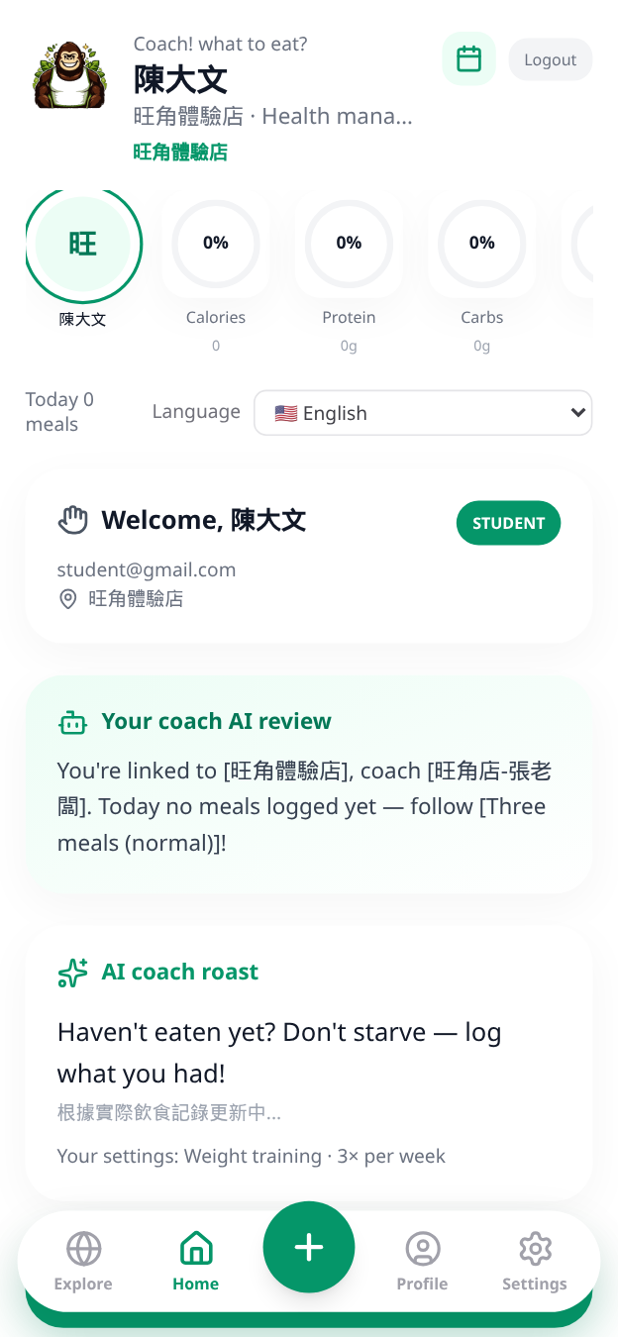
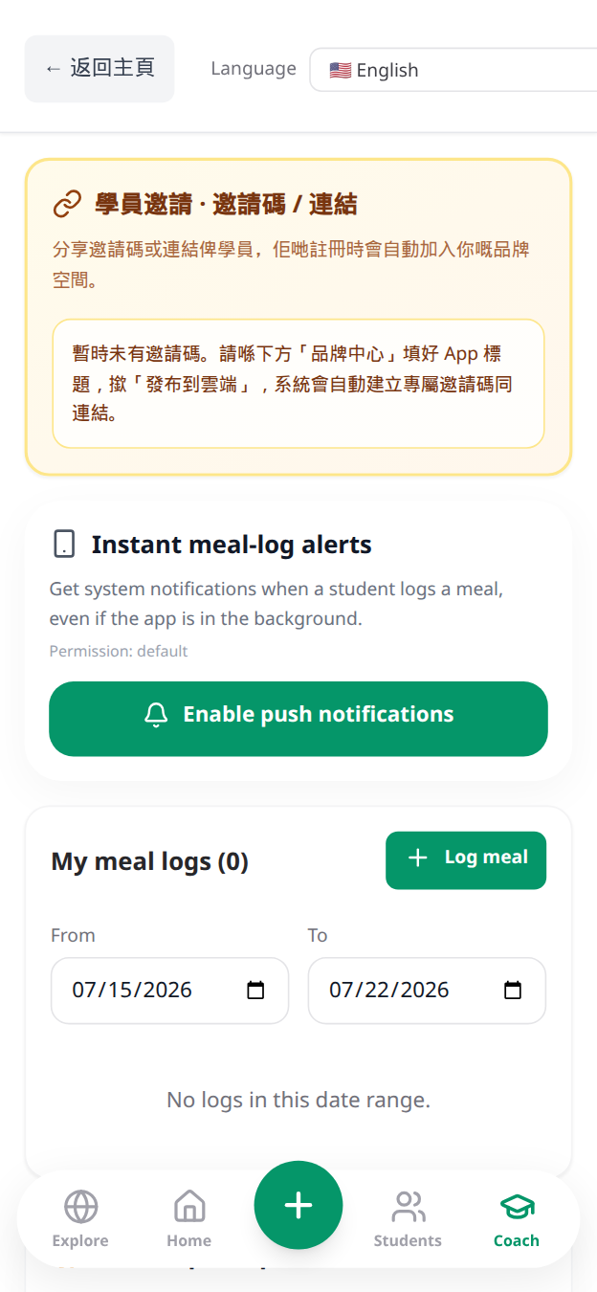
PRODUCT OVERVIEW
One platform. Two connected experiences.
Students build sustainable habits while coaches manage outcomes at scale.
STUDENT APP
COACH PORTAL
1
Personal daily targets
White-label brand control
Calories and macro guidance adapt to body profile, pace and coach-set goals.
Student monitoring
2
AI-assisted meal logging
Photo, food search, barcode and nutrition-label OCR reduce logging friction.
Targets & interventions
3
Feedback that drives action
AI reviews, coach comments, reminders and streak celebrations close the loop.
AI reports & CRM

Slide 4
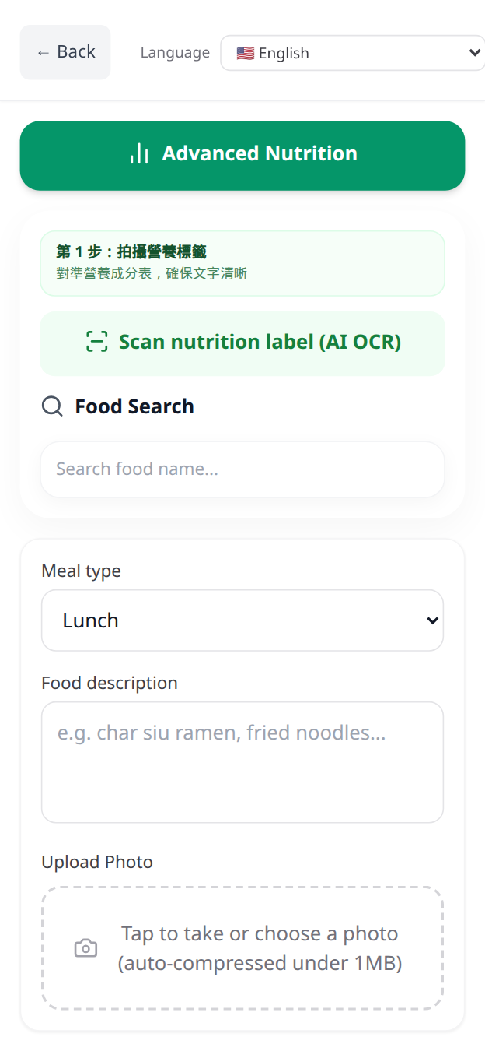
HOW IT WORKS
From meal to meaningful action in four steps
A mobile-first workflow designed for daily use — not occasional reporting.
1
Capture
2
Understand
Take a meal photo, scan a nutrition label, use barcode search or type the food.
AI estimates calories and macros; the user confirms serving size before saving.
3
Coach
4
Act
The platform compares intake with personalised targets and delivers useful feedback.
Coach reviews, nudges, comments and reminders help the student correct course.
PHOTO
AI OCR
BARCODE
LOCAL FOOD SEARCH
PORTION CONTROL

Slide 5
CORE INNOVATION
AI that supports the coach — not replaces the coach
Nutrition Coach combines automation with human accountability and configurable guardrails.
INTELLIGENCE LAYER
Meal understanding
Photo recognition, label OCR and food search support mixed local meals.
AI REVIEW
IN CONTEXT
Goal-aware recommendations
Suggestions use remaining calories, protein, carbs and fats.
Adaptive feedback
Daily compliance prioritises adequate protein while allowing realistic tolerance.
Coach intelligence
Review queues and AI summaries surface where human attention is most valuable.

Slide 6
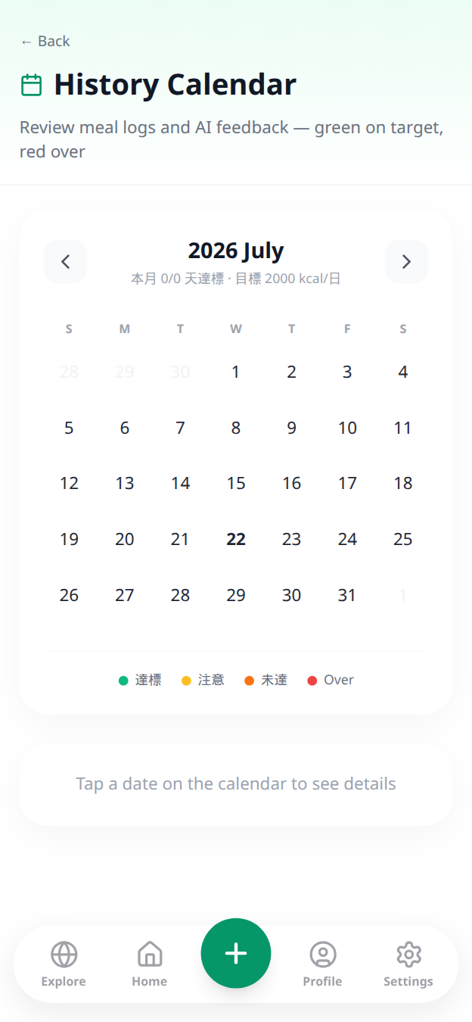
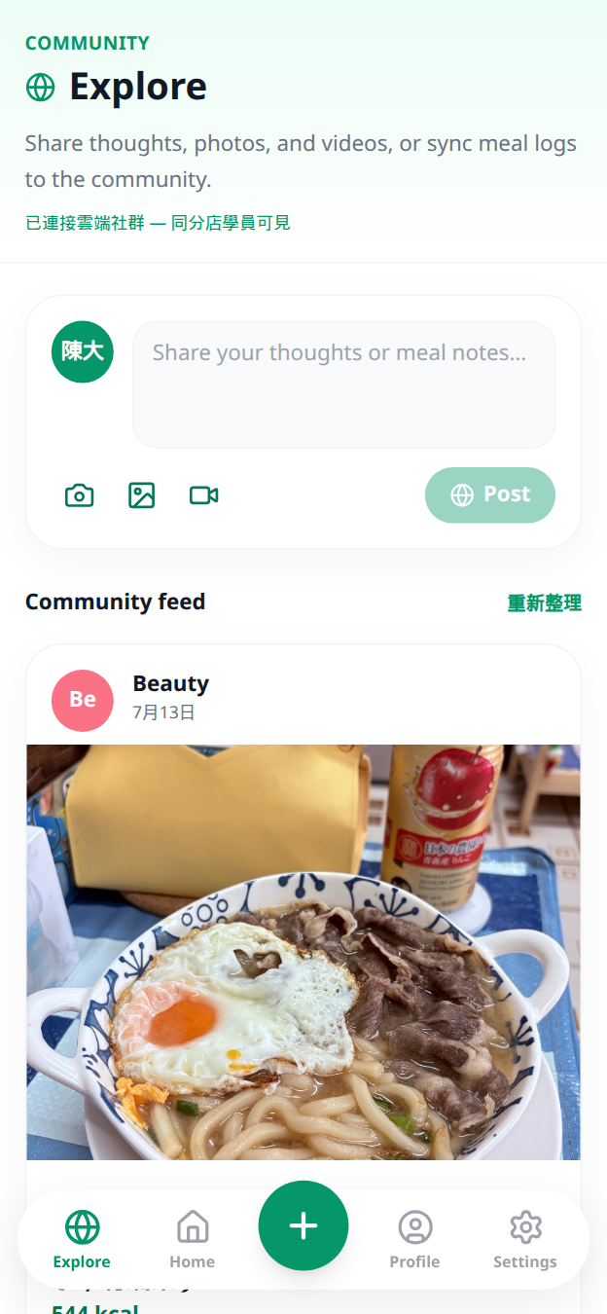
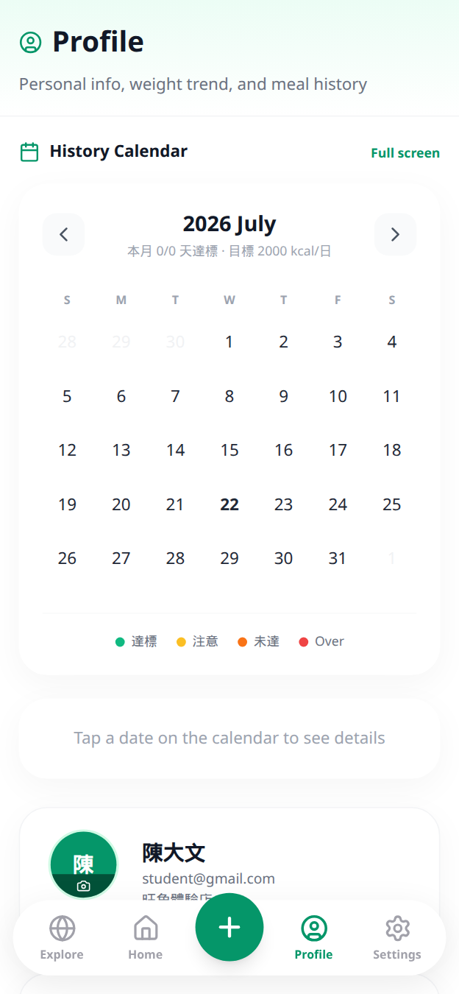
BEHAVIOUR & RETENTION
Make healthy consistency visible — and shareable
The platform turns logging into a motivational loop across progress, streaks and community.
ENGAGEMENT LOOP
LOG
Low-friction daily action
↓
SEE
Immediate progress feedback
↓
CELEBRATE
Streak + shareable card
↓
CONNECT
Coach + community response
Visual progress
Community support
Streak motivation

Slide 7
B2B VALUE PROPOSITION
A digital operating system for coaches and gyms
White-label delivery creates recurring value for both the fitness business and its clients.
01
Brand ownership
02
Actionable oversight
Custom app name, theme, logo and announcements keep the gym at the centre of the client journey.
Daily status, meal review queues and history highlight who needs help now.
03
Remote intervention
04
Operational leverage
Coach targets, comments, stickers and push nudges extend service beyond the gym floor.
AI reports and structured workflows let each coach support more clients consistently.
Designed for gyms, personal trainers, online coaches and wellness programmes

Slide 8
TECHNOLOGY & DEFENSIBILITY
Built to scale as a secure multi-tenant SaaS
A production-oriented architecture supports white-label growth, AI services and cross-platform delivery.
EXPERIENCE
Mobile-first PWA · iOS & Android wrappers · Multilingual UI
WHY IT CAN SCALE
✓
Tenant-level branding and data separation
APPLICATION
Student app · Coach portal · Admin console · Community
✓
Cloud database and storage
✓
Reusable AI service layer
INTELLIGENCE
Vision · OCR · Food search · Recommendations · AI reviews
✓
Automated reminders and CRM workflows
Supabase · Multi-tenant records · Web Push · Scheduled workflows
✓
Single codebase across web and mobile
DATA & AUTOMATION
Production stack
Next.js
TypeScript
Supabase
OpenRouter
Stripe
Web Push
Capacitor

Slide 9
COMMERCIAL MODEL
Recurring SaaS revenue with multiple entry points
The model supports direct-to-consumer acquisition and higher-value business accounts.
SOLO
COACH
GYM
AI Nutrition Companion
Professional Workspace
White-Label Platform
For individuals without a coach
For independent coaches
For fitness businesses
✓
Personal targets
✓
Client dashboard
✓
Custom branding
✓
AI meal insights
✓
Targets & feedback
✓
Multi-coach / multi-client
✓
History & streaks
✓
AI reports & nudges
✓
Admin & engagement tools
Revenue expansion: subscriptions · per-seat / per-client tiers · onboarding · premium AI modules

Slide 10
GO-TO-MARKET
Start with coaches. Expand through their client networks.
A focused B2B2C route lowers acquisition friction and embeds the platform into existing relationships.
1
2
3
4
Design partners
→
Prove retention
→
Package & sell
→
Scale channels
Recruit independent coaches and boutique gyms for structured pilots.
Track activation, meal-logging frequency, coach response and client retention.
Launch tiered coach/gym plans with onboarding and referral incentives.
Partner with fitness networks, wellness programmes and professional bodies.
0–3 months
3–6 months
6–12 months
12+ months
Pilot success metrics
≥60%
≥4×
<24h
≥80%
Weekly active students
(illustrative target)
Meal logs per active user/week
(illustrative target)
Coach response time
(illustrative target)
Pilot retention at 8 weeks
(illustrative target)

Slide 11
FUNDING IMPACT
Convert a working product into a market-ready venture
Funding will accelerate product hardening, validated pilots and repeatable commercial deployment.
35%
Product & AI
Model quality, nutrition workflows, analytics and coach intelligence.
EXPECTED OUTPUTS
✓
Pilot-ready coach & gym onboarding
25%
Pilot delivery
Onboarding, support and structured validation with fitness partners.
✓
Measured engagement and retention evidence
✓
Improved AI accuracy and safety controls
20%
Security & compliance
Privacy controls, auditability, testing and operational resilience.
✓
Commercial pricing and sales playbook
✓
Scalable, secure production operations
20%
Market development
Sales materials, partnerships, customer success and channel experiments.
Note: allocation percentages are proposed and can be adapted to the selected funding scheme.

Slide 12
LIVE DEMO
fitclub-pearl.vercel.app
Nutrition coaching that scales
without losing the human connection.
Demo accounts
Student
student@gmail.com
Coach
owner@gmail.com
A working product. A clear B2B2C model. A measurable path to impact.
Thank you
Government Entrepreneurship Funding · Product Demonstration

