Slide 1
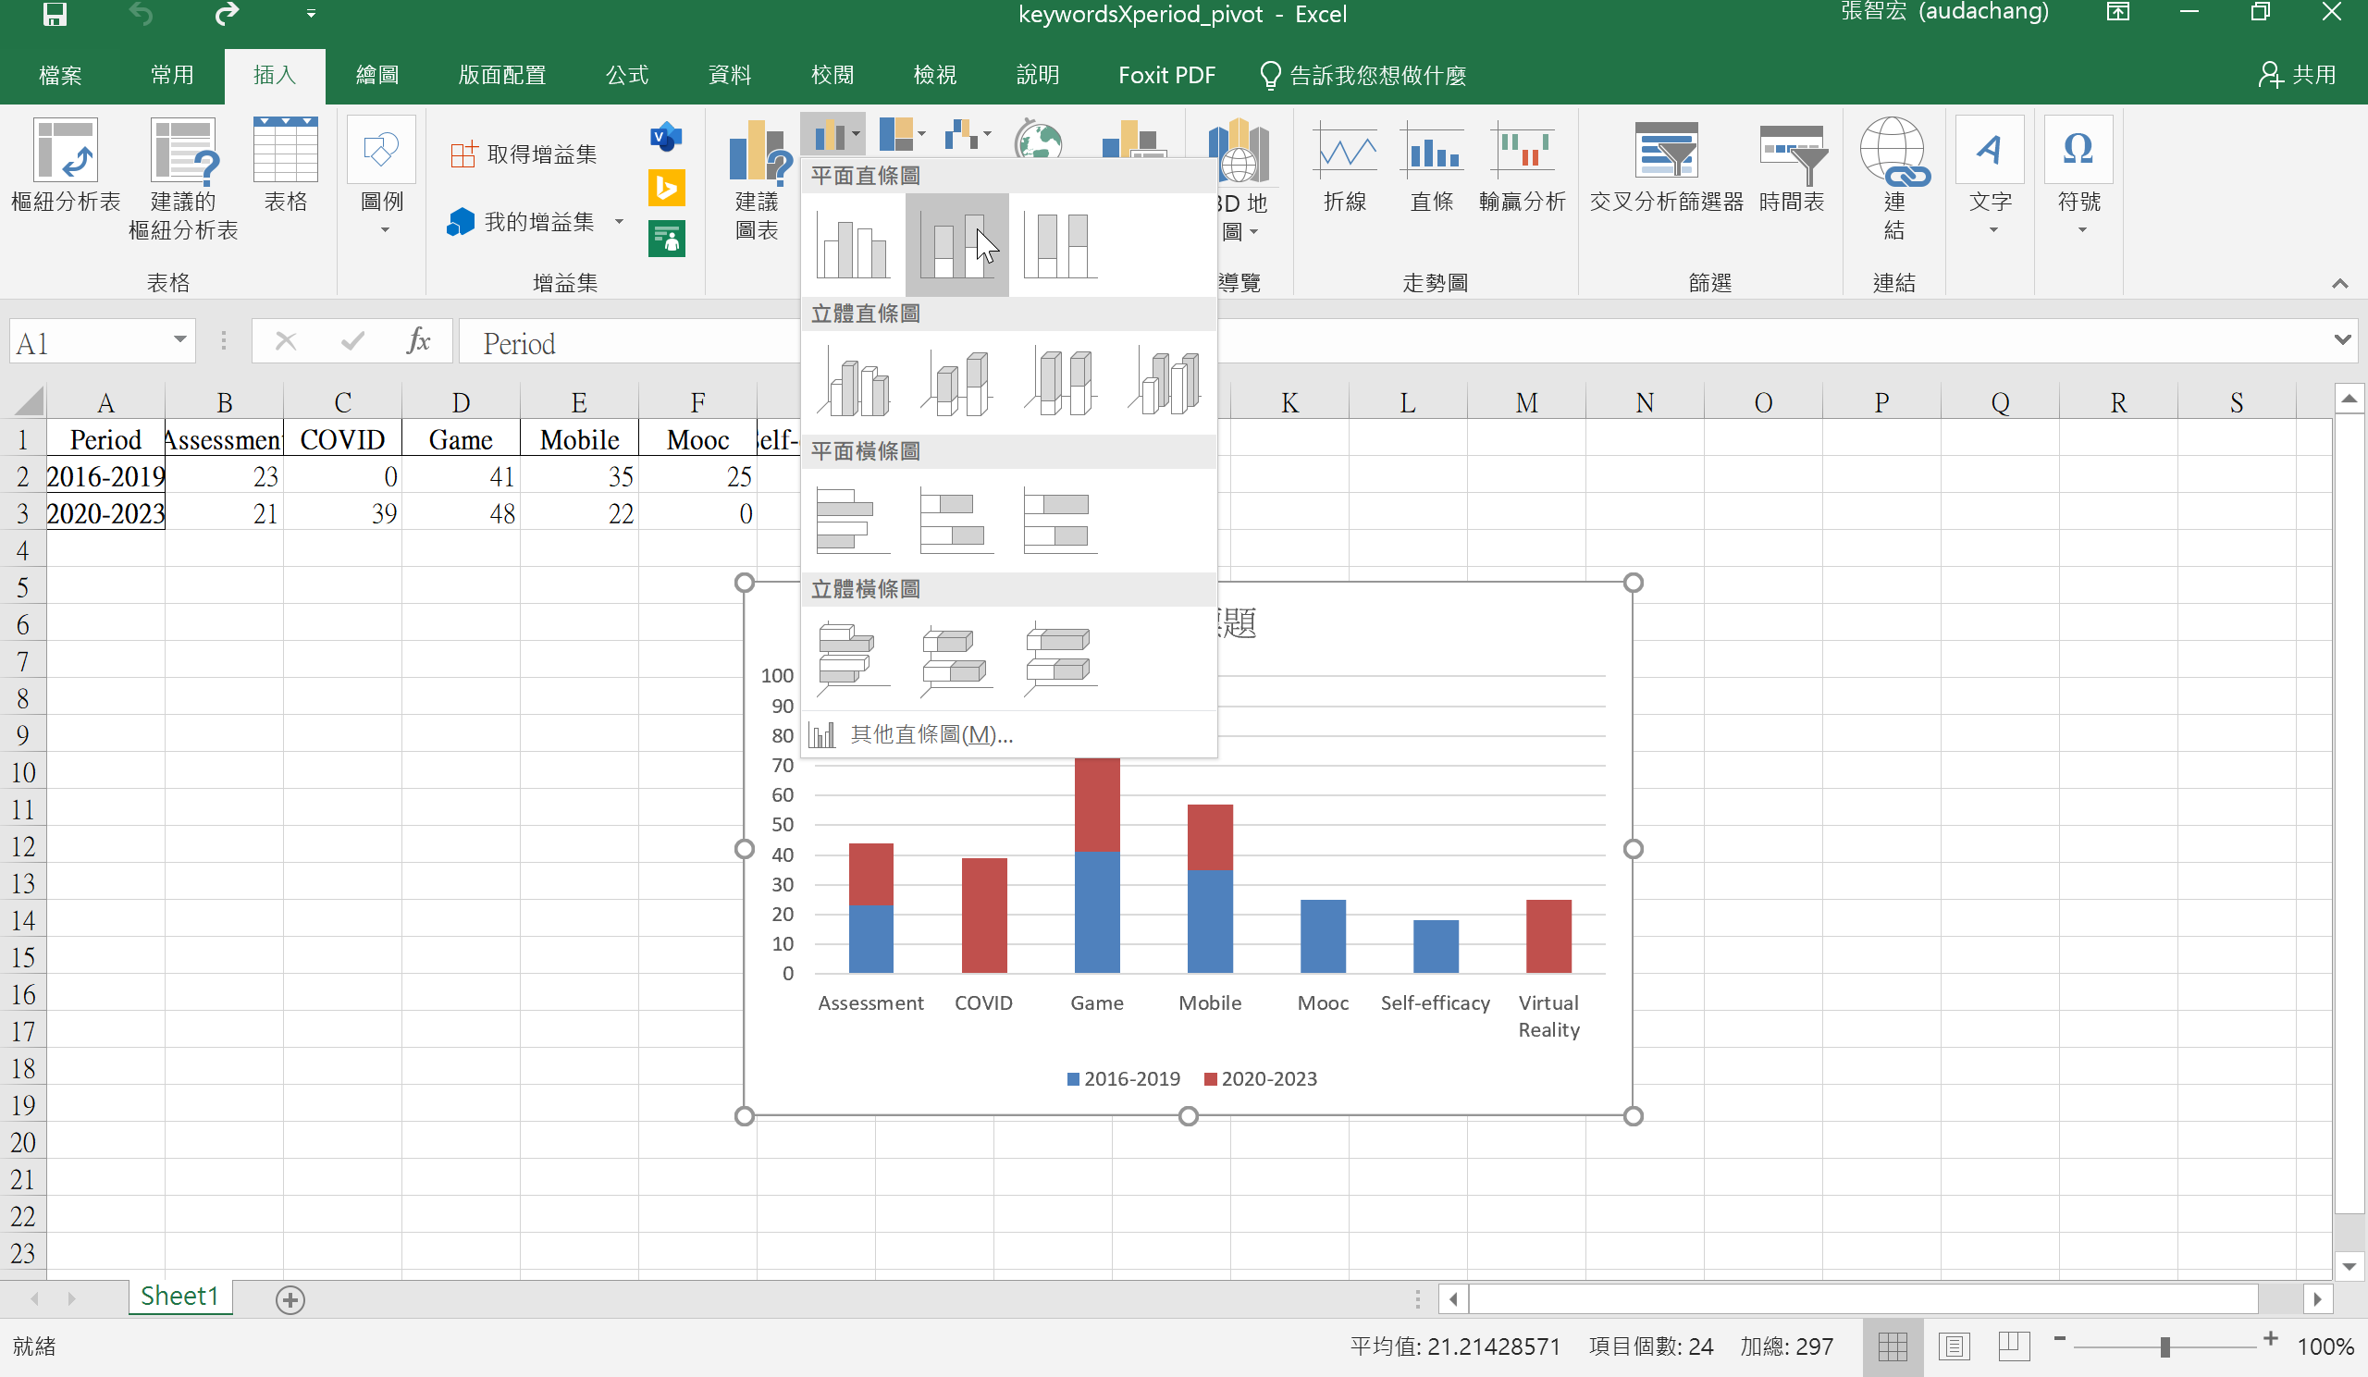
Create the stacked bar first

Slide 2
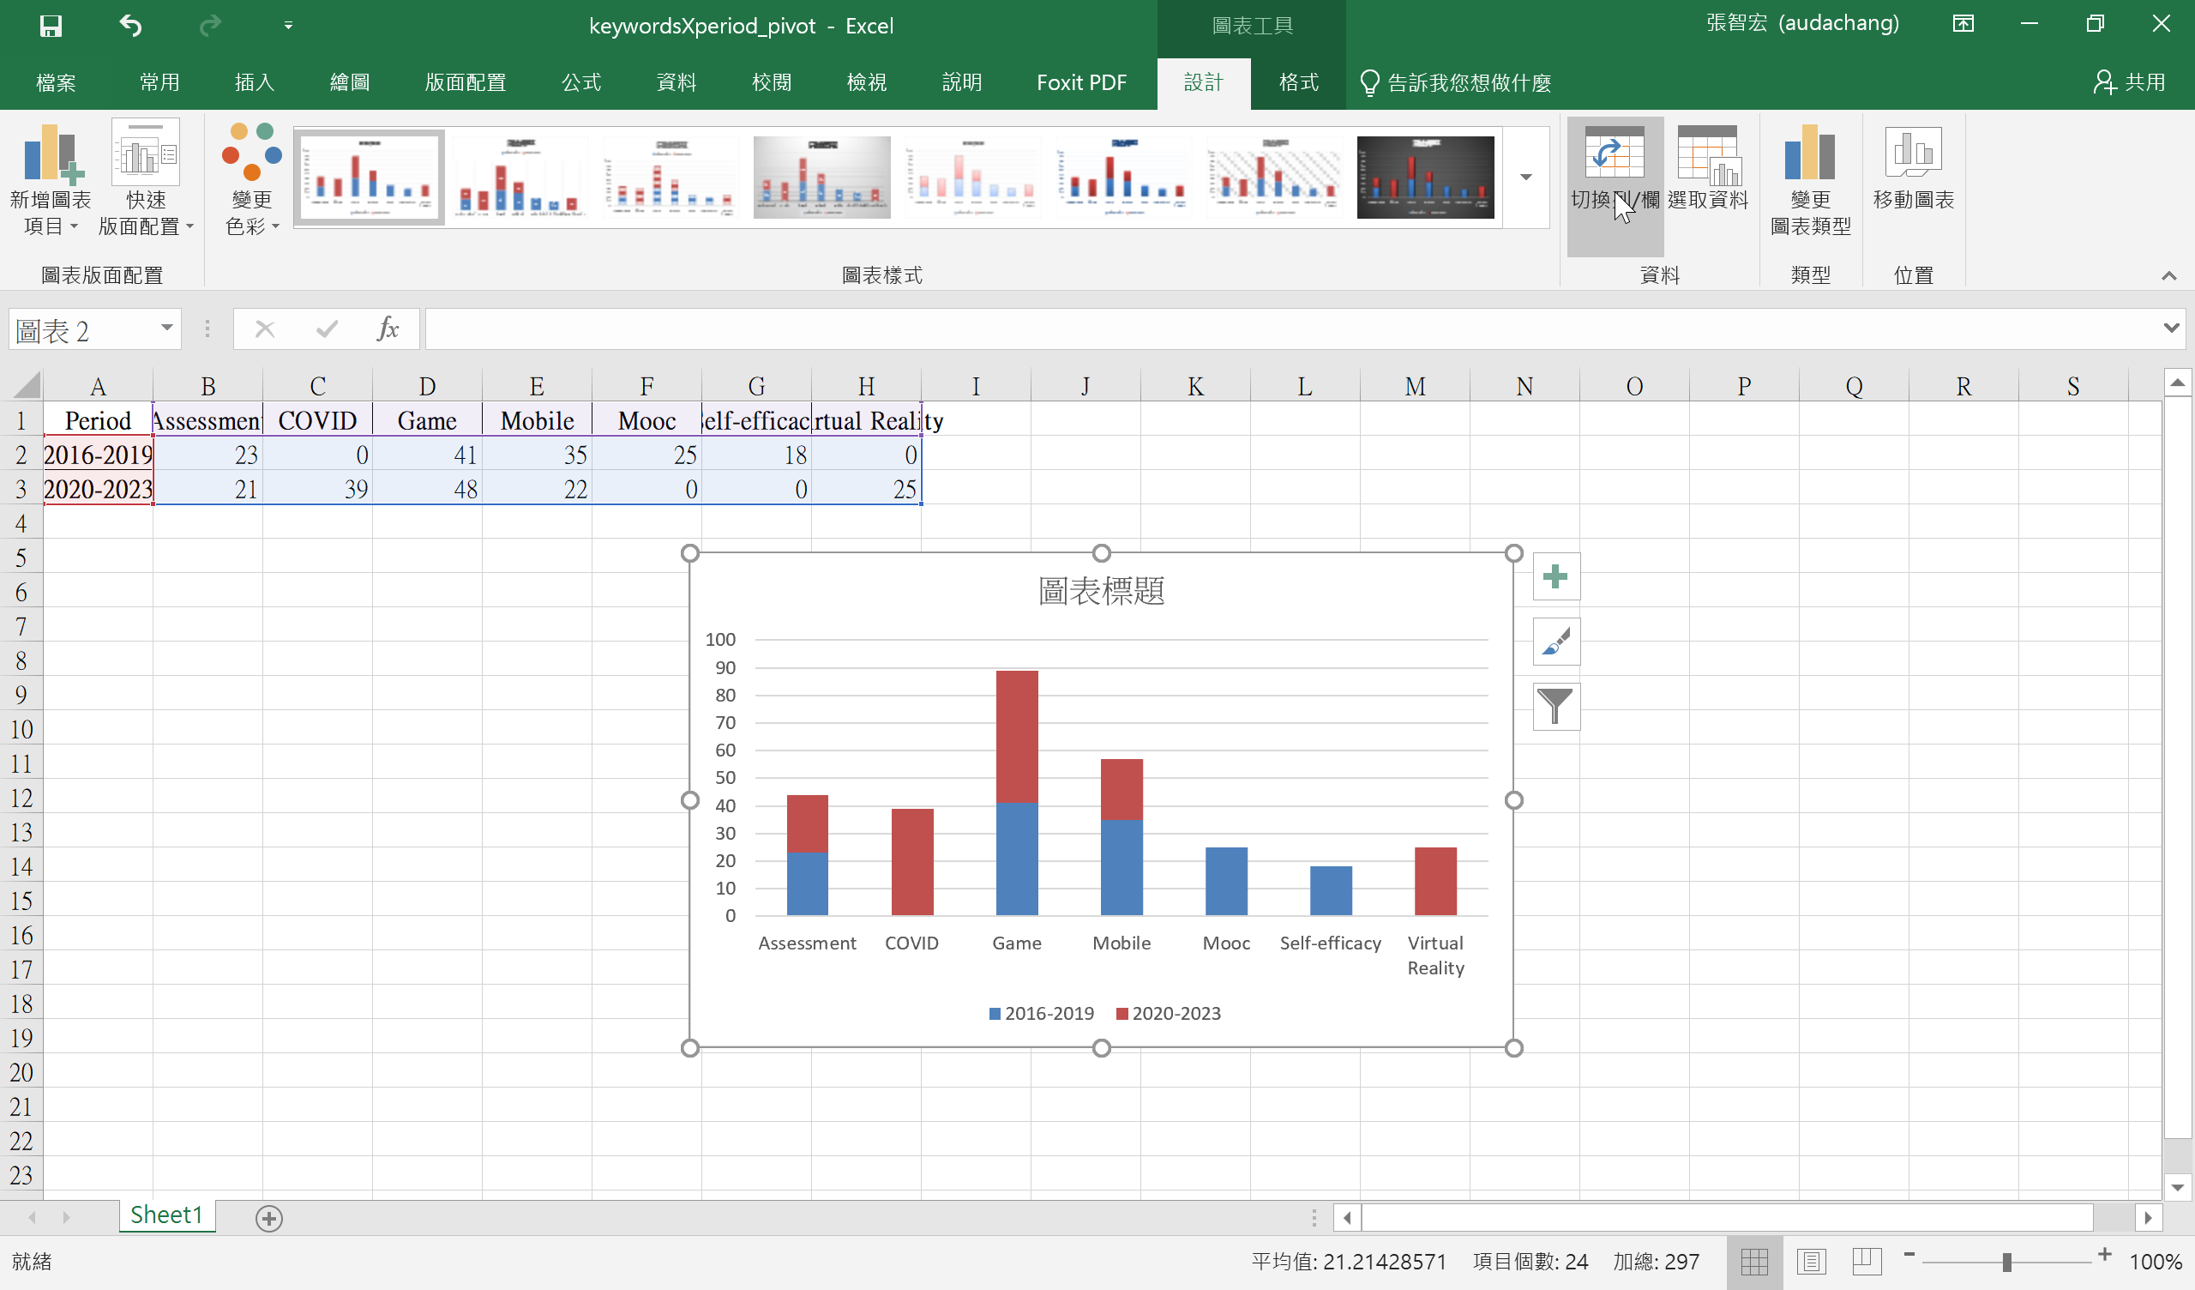
Click on "swapping row/column"

