Slide 1

Foundations of Experiments in Psychology Psychopy Coder
NS5116
電腦硬體與程式語言在行為科學實驗與大數據分析之應用
2025-03-13
講師：張智宏
教室: S5-Ideabrain

Slide 2
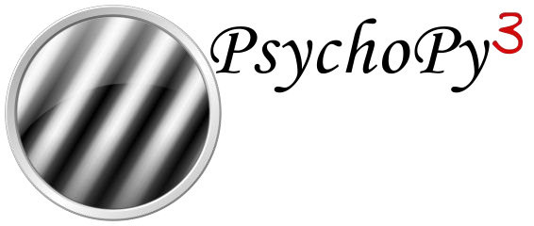
…

Slide 3

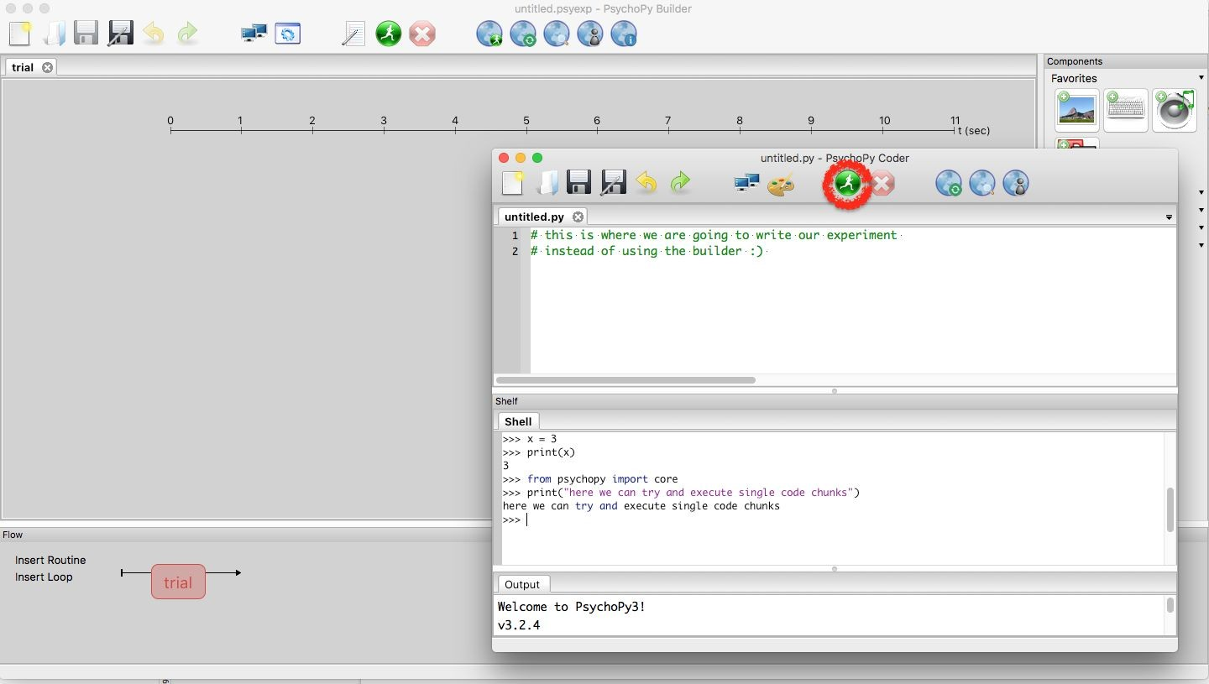


Slide 4

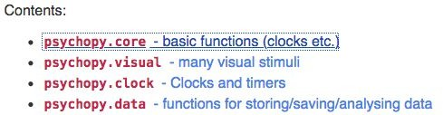

Slide 5





→
→

Slide 6




•
•
•

Slide 7


•
•

Slide 8

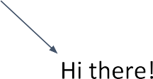




Slide 9


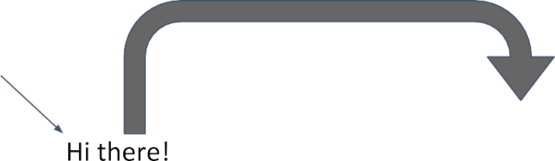

Slide 11

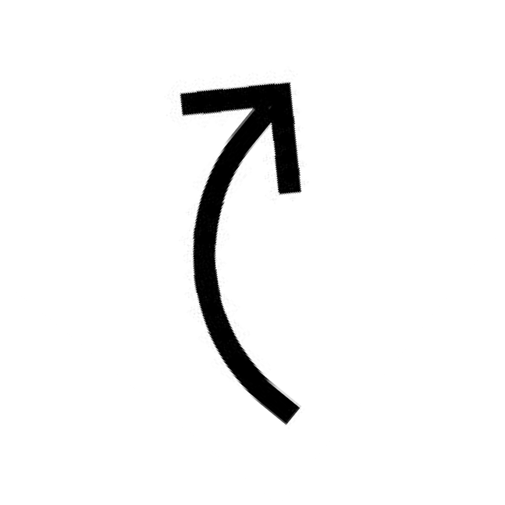



Slide 12










Slide 13





Slide 14




Recording Responses
•
•
•
•
•
•

Slide 15
Exercise: Import Libraries
From psychopy import core, visual, event libraries to access essential functionality
Core module provides timing functions and control flow operations
Visual module contains classes for creating stimuli like text, shapes, and images
Event module allows recording of keyboard and mouse responses from participants

Slide 16
Exercise: Create Window
Create a 500 x 500 pixel window as your visual workspace
This window serves as the display canvas for all your stimuli
Use win = visual.Window(500500) with default background color (usually gray)
Remember to close window at script end using win.close() to free system resources
Forgetting to close the window may lead to memory leaks or frozen PsychoPy sessions

Slide 17
Exercise: Create Text Stimulus
Choose any letter character to display as your visual stimulus
Create using
text = visual.TextStim(win, text='X') with win as your window object
Default settings include centered position, white color, and standard font size
Present stimulus on screen by calling the draw() method followed by win.flip()
The flip() function updates the display to show everything that's been drawn

Slide 18
Exercise: Record Response
Use event.waitKeys() with maxWait=3 parameter to limit response collection time
This function pauses script execution while waiting for keyboard input
Set timeStamped=False initially to focus only on which key was pressed
Save the recorded key to a variable (e.g., key = event.waitKeys(maxWait=3))
Handle case when no key is pressed by checking if return value is None
Implement proper error handling to prevent crashes when participants don't respond

Slide 19
Exercise: Record Reaction Time
Set timeStamped=True to capture both keypress and precise timing information
This returns a tuple containing (keyname, reaction_time) for each response
Store key and RT in separate variables using tuple unpacking: key, rt = event.waitKeys(maxWait=3, timeStamped=True)
Reaction time is measured relative to when waitKeys() was called
Higher precision timing allows for more accurate measurement of cognitive processes
Use these values for later analysis of participant performance

Slide 20
Exercise: Create Loop
Implement a for or while loop to present different letters in sequence
Use the .setText() method to change the letter on each iteration (e.g., text.setText('A'))
This modifies the existing stimulus rather than creating new objects each time
Store all response keys in a keys_list = [] and reaction times in an rt_list = []
Append each new response to appropriate list using .append() method
This creates a complete record of participant performance across all trials
Save Presentation Times

Slide 21
Exercise: Save Presentation Times
Record precise timestamps when stimuli appear using core.getTime() before win.flip()
Store these values in a presentation_times = [] list for later analysis
Timing accuracy is crucial for proper synchronization between stimulus and response
These timestamps can reveal lag between intended and actual stimulus presentations
Compare with reaction times to calculate precise response latencies for each trial

