Slide 1

Psychopy Objects Structure of an Experiment
NS5116
電腦硬體與程式語言在行為科學實驗與大數據分析之應用
2025-03-20
講師：張智宏
教室: S5-Ideabrain

Slide 2

…

Slide 3

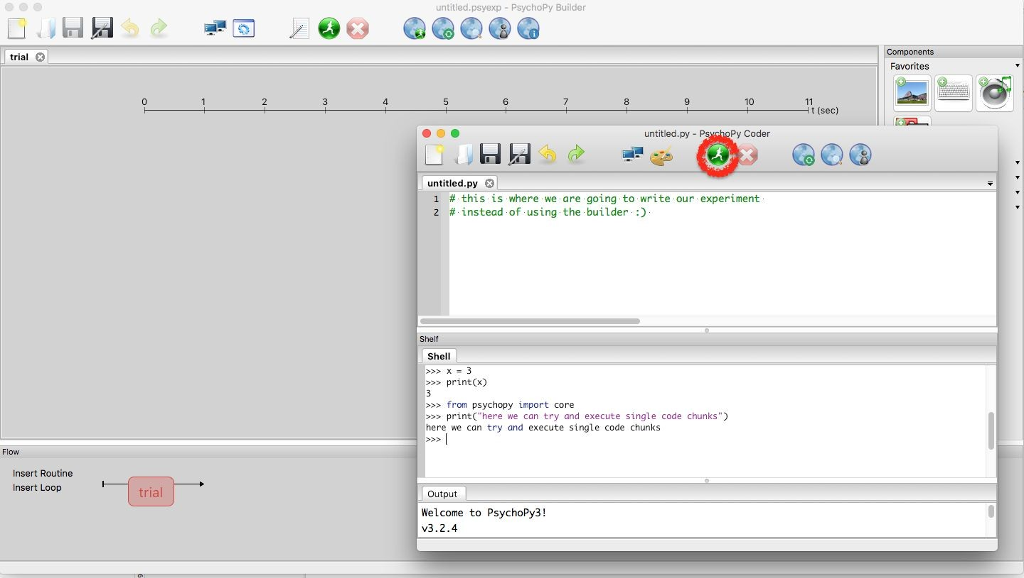

Psychopy: Coder & Builder

Slide 4

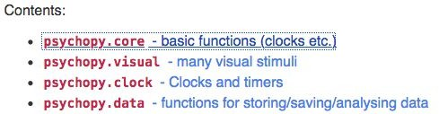
Forum: https://discourse.psychopy.org/

Slide 5
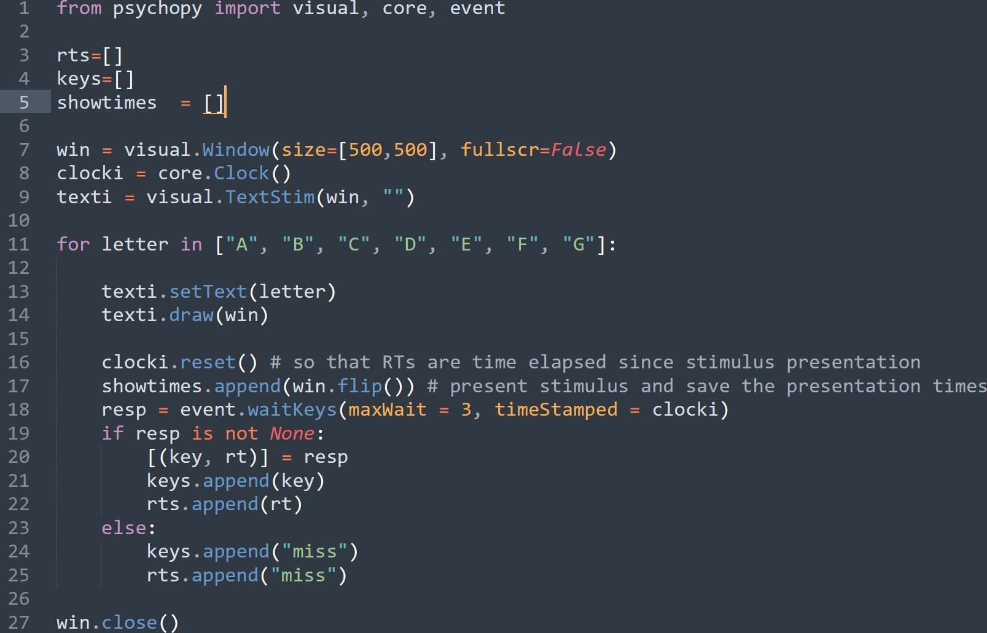
Basic Structure of a Psychopy Code
Module Imports and Initialization
Window and Stimuli Setup
Trial Loop and Stimulus Presentation
Response Collection and Event Handling

Slide 6
Exercise: Import Libraries
From psychopy import core, visual, event libraries to access essential functionality
Core module provides timing functions and control flow operations
Visual module contains classes for creating stimuli like text, shapes, and images
Event module allows recording of keyboard and mouse responses from participants

Slide 7





→
→

Slide 8




•
•
•

Slide 9


•
•

Slide 10










Slide 11
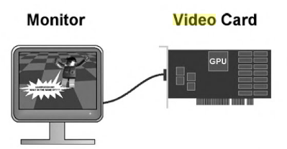
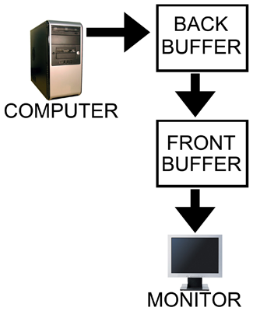
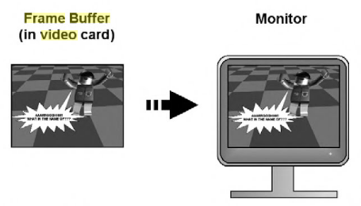
Mechanisms of Computer Graphic & Videos

Slide 12

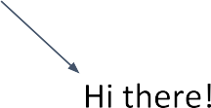




Slide 13


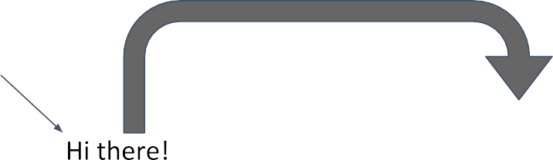

Slide 15

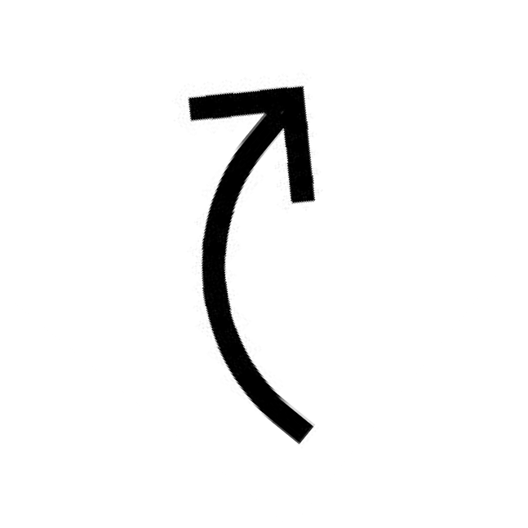



Slide 16
Exercise: Create Window
Create a 500 x 500 pixel window as your visual workspace
This window serves as the display canvas for all your stimuli
Use win = visual.Window(500500) with default background color (usually gray)
Remember to close window at script end using win.close() to free system resources
Forgetting to close the window may lead to memory leaks or frozen PsychoPy sessions

Slide 17
Exercise: Create Stimulus
Choose any letter character to display as your visual stimulus
Create using
text = visual.TextStim(win, text='X') with win as your window object
Default settings include centered position, white color, and standard font size
Present stimulus on screen by calling the draw() method followed by win.flip()
The flip() function updates the display to show everything that's been drawn

Slide 18
Visual Presentation
Temporal issues
Refresh rate
Synchronization
Spatial issues
Visual angle
Pixel size
Viewing distance
Visual fields

Slide 19
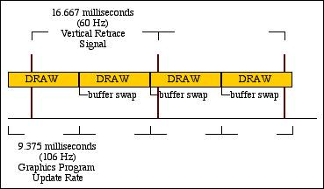
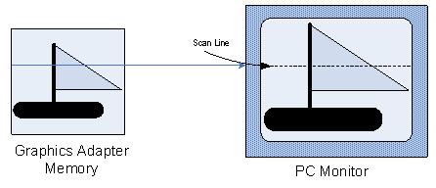
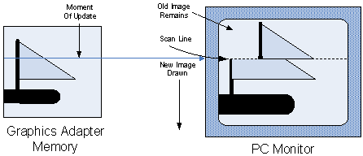
Tearing when flip occurs during drawing
http://andesengineering.com/OSG_ProducerArticles/Synchronization/index.html
https://software.intel.com/content/www/us/en/develop/articles/video-frame-display-synchronization.html?wapkw=(T)

Slide 20
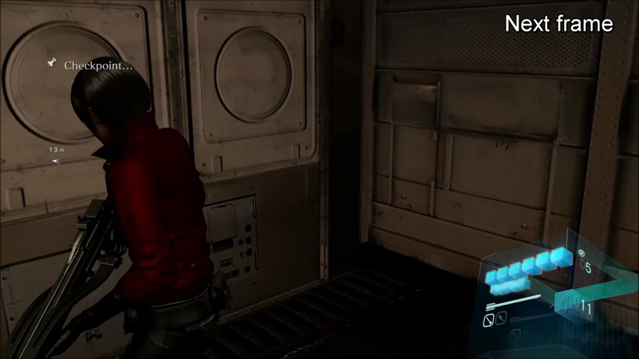

Slide 21
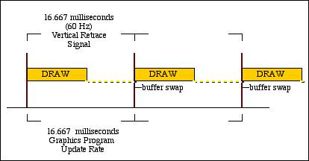
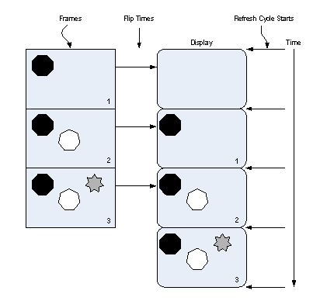
Flip during the Vertical Blanking Interval (Vertical Retrace)

Slide 22
Refresh Rate
Number of times that the image on the display is drawn each second.
Influencing the actual time point when your visual stimuli are presented on the monitor
Determined by horizontal scan rate and resolution
Most monitors
60 Hz ~ update every 16.67 ms .
The refresh rate limits the points in time at which you can present a stimulus.
For example, it will be impossible to display a stimulus for exactly 225 ms, as 225 is not a multiple of 16.67; only 216.71 or 233.38 ms are possible.
https://en.wikipedia.org/wiki/Refresh_rate#/media/File:Waveform_video_comparison.gif

Slide 23
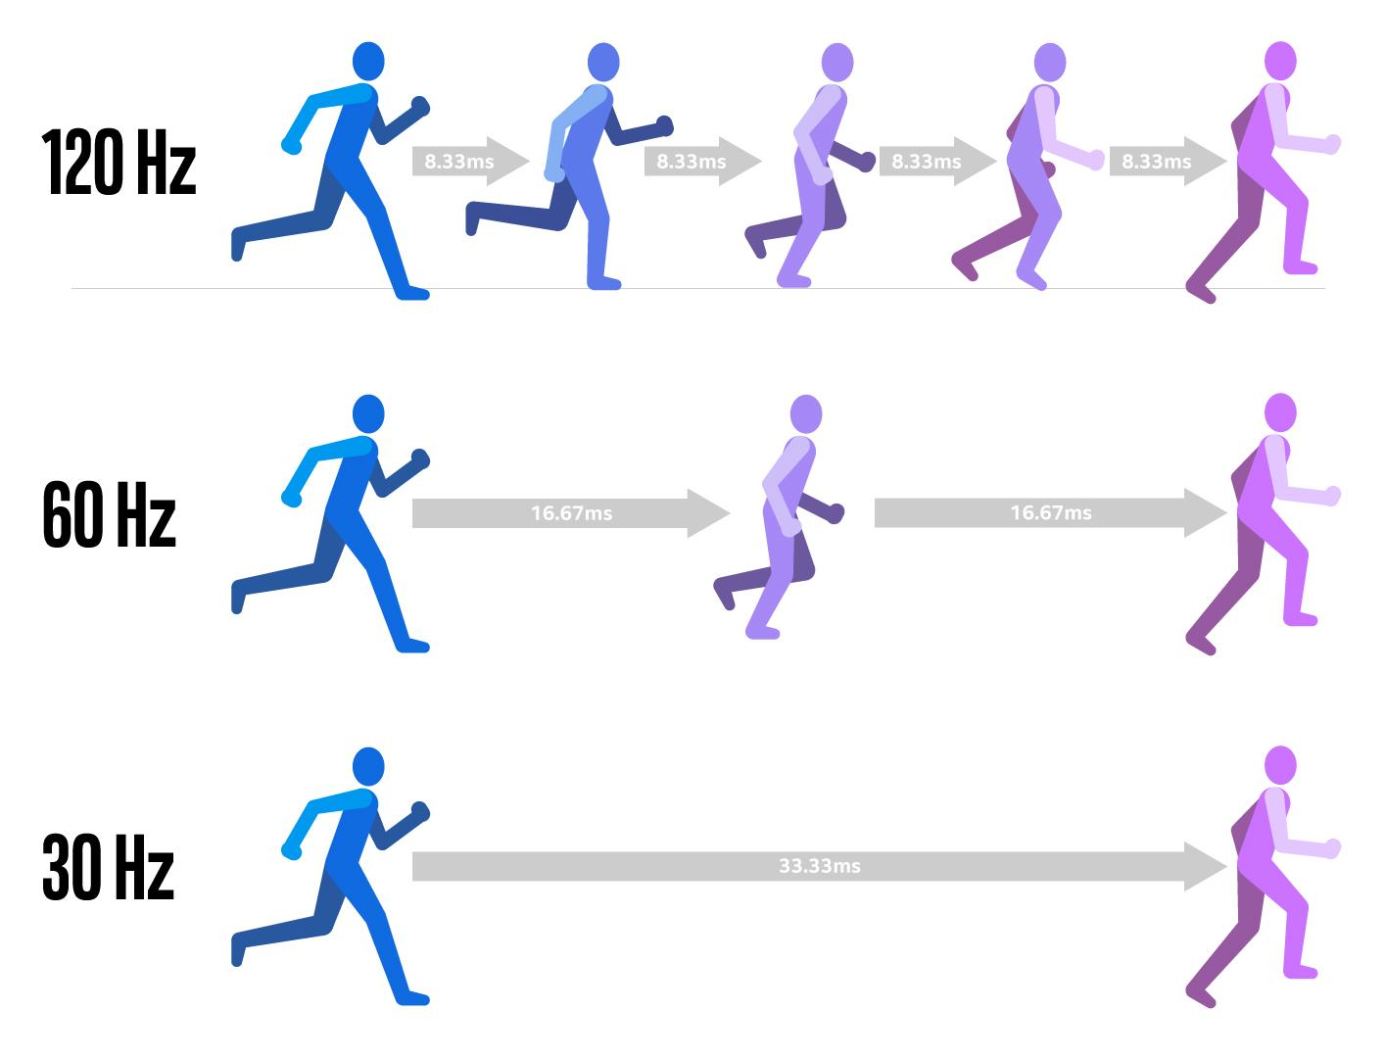
https://www.intel.com/content/www/us/en/gaming/resources/what-to-look-for-in-a-gaming-monitor.html

Slide 24
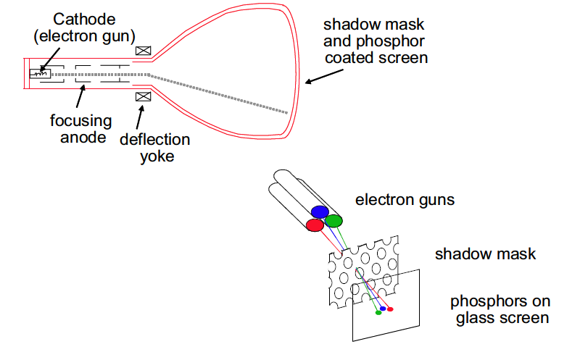
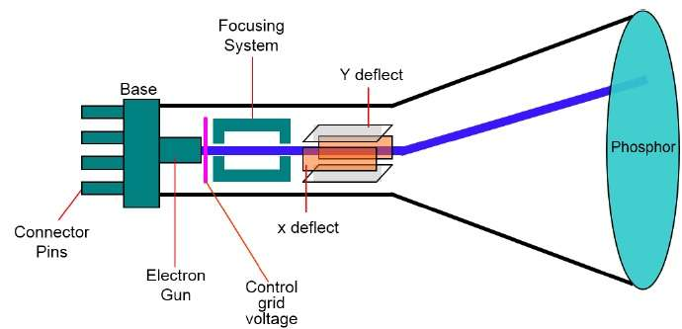
Cathode Ray Tube (CRT)

Slide 25
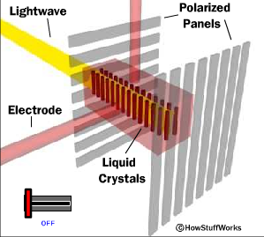
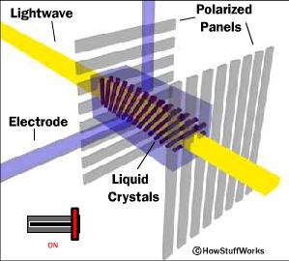
LCD Panels Have No Reliable Refresh Rate
Off
On
LCD monitors have “Response time”, which is quite variable among pixels.

Slide 26



Timing Stimuli

Slide 27
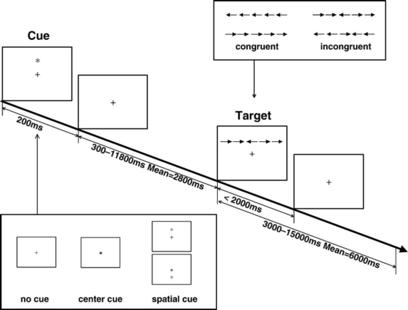
Events, Trials, Blocks, & Run
Trial #1 spatial cue/incongruent target
Trial #2 center cue/congruent target
Trial #3 spatial cue/congruent target
.........
Trial #N no cue/incongruent target
Block #1
Resting Period
Run #1
Trial #1 spatial cue/incongruent target
Trial #2 center cue/congruent target
Trial #3 spatial cue/congruent target
.........
Trial #N no cue/incongruent target
Block #2
......

Slide 28
餐桌
沙發
t₀
t₁
t₂
SOA = t₂-t₀
refresh rate = d,
SOA must be equal to n*d, where n is a positive integer

Slide 29




Recording Responses
•
•
•
•
•
•

Slide 30


Slide 31
Visual Presentation
Temporal issues
Refresh rate
Synchronization
Spatial issues
Visual angle
Pixel size
Viewing distance
Visual fields

Slide 32
Unit of Window
(0, +Y)
(-X, 0)
(0, 0)
(+X, 0)
(0, -Y)

Slide 33
Height Units: For 4:3 aspect ratio
(0, +0.5)
(+0.6667,+0.5)
(-0.667, 0)
(0, 0)
(+0.667, 0)
(-0.6667,-0.5)
(0, -0.5)
Requires : No monitor information

Slide 34
Height Units: For 16:10 aspect ratio
(0, +0.5)
(+0.8, +0.5)
(-0.8, 0)
(0, 0)
(+0.8, 0)
(-0.8,-0.5)
(0, -0.5)
Requires : No monitor information

Slide 35
Normalized (“norm”) Units
(0, +1)
(+1,+1)
(-1, 0)
(0, 0)
(+1, 0)
(-1,-1)
(0, -1)
Requires : No monitor information

Slide 36
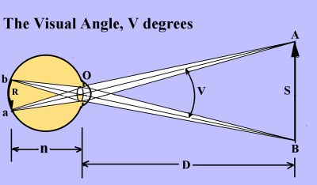
Visual Angle
The relative extent of visual area occupied by the visual image
Expressed in visual degree(s)
In radians
V = 2 arctan(S/2D)
V*180/pi → degrees

Slide 37
Visual Degree and Pixels
Plot a square with known number of pixels
Determine the visual angle of the square
Calculate the visual angle per pixel
Then one can determine the visual angle of any visual stimulus with known number of pixels as the boundary box

Slide 38
100 pixels, 4.5 degree at 57 cm viewing distance
On this particular display, Each pixel is 0.045 degree.
國
Thus if the bounding box of the character is 45 pixels, it is 0.045*25 = 1.125 degree

Slide 39
Exercise: Record Response
Use event.waitKeys() with maxWait=3 parameter to limit response collection time
This function pauses script execution while waiting for keyboard input
Set timeStamped=False initially to focus only on which key was pressed
Save the recorded key to a variable (e.g., key = event.waitKeys(maxWait=3))
Handle case when no key is pressed by checking if return value is None
Implement proper error handling to prevent crashes when participants don't respond

Slide 40
Exercise: Record Reaction Time
Set timeStamped=True to capture both keypress and precise timing information
This returns a tuple containing (keyname, reaction_time) for each response
Store key and RT in separate variables using tuple unpacking: key, rt = event.waitKeys(maxWait=3, timeStamped=True)
Reaction time is measured relative to when waitKeys() was called
Higher precision timing allows for more accurate measurement of cognitive processes
Use these values for later analysis of participant performance

Slide 41
Exercise: Create Loop
Implement a for or while loop to present different letters in sequence
Use the .setText() method to change the letter on each iteration (e.g., text.setText('A'))
This modifies the existing stimulus rather than creating new objects each time
Store all response keys in a keys_list = [] and reaction times in an rt_list = []
Append each new response to appropriate list using .append() method
This creates a complete record of participant performance across all trials
Save Presentation Times

Slide 42
Exercise: Save Presentation Times
Record precise timestamps when stimuli appear using core.getTime() before win.flip()
Store these values in a presentation_times = [] list for later analysis
Timing accuracy is crucial for proper synchronization between stimulus and response
These timestamps can reveal lag between intended and actual stimulus presentations
Compare with reaction times to calculate precise response latencies for each trial

Slide 43
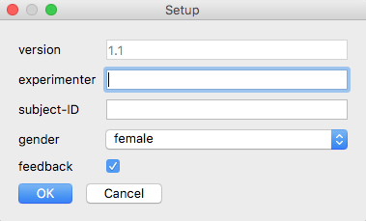
Create dialogue boxes
What?
Creates a little dialogue box that asks for certain inputs from the experimenter.
Why?
Experiments usually need input from the experimenter:
subject-ID
condition
…
psychopy.gui.DlgFromDict(dictionary, title=“title_of_the_window”,
order=[list_of_fieldnames_in_order], fixed=[list_of_unchangeable_fields]…)
creates a dialogue box
pass a dictionary with the following forms “allowed”:
{“field1_name”:[“drop”, “down”, “menu”]}
{“field2_name”: “”}
{“field3_name”: “pre-set value”}
{“field4_name”: True}
important attributes:
.dictionary --> contains the filled-in dictionary
.OK --> returns True or False, depending on whether dialogue box was ended
via “ok” button press or not
Task 1: Try to rebuild this dialogue box! Add it to the experiment script from last session (week5/06_Experiment/Initiate_Experiment_empty.py).
Task 2: If the cancel button has been pressed, have PsychoPy
stop the experiment ( to stop: core.quit() )!

Slide 44
Logging data: Python “standard”
What?
Create a logfile to store all infos like RTs and key presses.
Why?
For analysis!
We can simply use python’s built-in commands to write data to a file. That is, the way of logging data shown on this slide is not at all specific to PsychoPy.
with open(logfile_name, mode=‘a’/’w’/’r’) as some_var:
print(“some string!”, file=some_var)
Task: Create a logfile and first write the subject-ID down. After each trial, write the key press of the respective trial into the logfile (also misses as “miss”). Also, make the subject-ID part of the file name.

