Slide 1
Fundamentals of Accelerated Data Science
NVIDIA

Slide 2
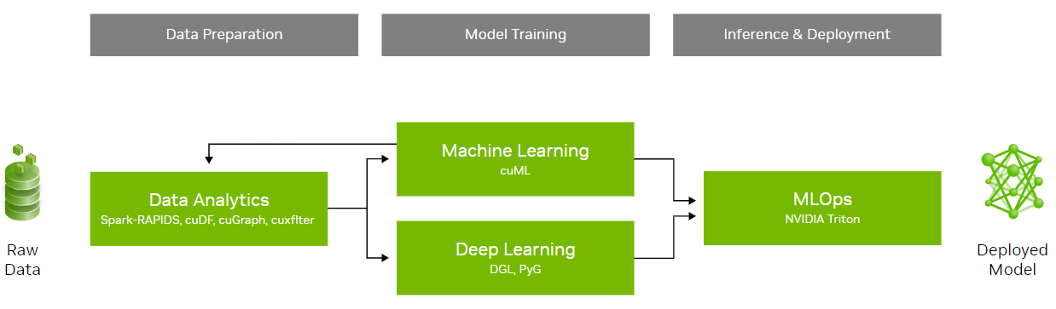
Workshop Overview
An introduction to data science with a focus on speed and efficiency
Learning objectives:
Understand the fundamental concepts of data science and parallel computing
Explore practical examples of accelerated data science pipelines
Examine the methods used to achieve acceleration in data science and discuss their broader implications
This workshop will not cover statistical analysis, neural networks, and distributed computing
 | Workshop Outline
Task 1 | Data science overview Data manipulation
Task 2 | Graph analytics
Task 3 | Machine Learning
Coding Assessment | Biodefense

Slide 3
Section 1 Agenda
• | Data Science Fundamentals
• | GPU Computing & RAPIDS
• | Accelerating and Scaling Data Manipulation
• | Data Visualization
• | Interoperability
• | Hands-On Lab

Slide 4








Data Science Is the Key to Unlocking the Future of Modern Business
Enables data-driven decision making
Retail
Telecom
Healthcare
Manufacturing
Supply Chain & Inventory Management
Price Management / Markdown Optimization
Promotion Prioritization And Ad Targeting
Detect Network/Security Anomalies
Forecasting Network Performance
Network Resource Optimization (SON)
Improve Clinical Care
Drive Operational Efficiency
Speed Up Drug Discovery
Remaining Useful Life Estimation
Failure Prediction
Demand Forecasting
Financial Services
Consumer Internet
Oil & Gas
Automotive
Claim Fraud
Customer Service Chatbots/Routing
Risk Evaluation
Ad Personalization
Click Through Rate Optimization
Churn Reduction
Sensor Data Tag Mapping
Anomaly Detection
Robust Fault Prediction
Personalization & Intelligent Customer Interactions
Connected Vehicle Predictive Maintenance
Forecasting, Demand, & Capacity Planning

Slide 5
Data Science Overview
The study of data to extract meaningful insights
Data science is a multidisciplinary field that combines principles and practices from the fields of mathematics, statistics, artificial intelligence, and computer engineering to analyze large amounts of data.
Helps to ask and answer questions like:
Descriptive Analysis (what happened)
Diagnostic Analysis (why it happened)
Predictive Analysis (what will happen)
Prescriptive Analysis (what can be done with the results)
More than just quantitative analysis - it combines knowledge of tools, methods, and technologies to generate meaning from data
Business
Math & Statistics
Computer Science
Data Science

Slide 6
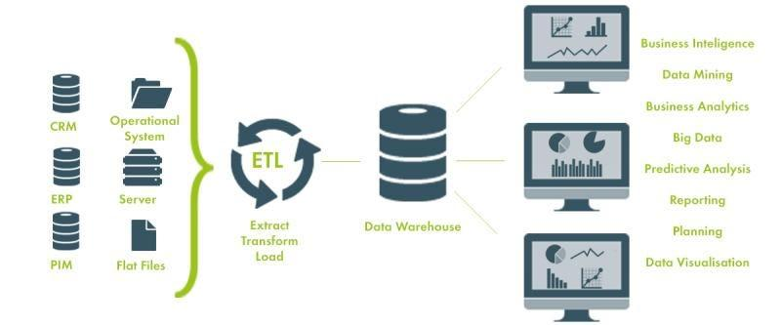
Data Science Is More Than Machine Learning and Analytics
Non-analytical tasks related to data science are equally important
Analytical tasks include:
Machine learning model development
Measuring key metrics
Statistical analysis
Data visualizations
Non-analytical tasks (upstream) include:
Extract, transform, and load (ETL)
Data collection
Data cleaning and preprocessing
Data modeling
Data engineering

Slide 7
Data Science Is More Than Machine Learning and Analytics
Non-analytical tasks related to data science are equally important
Analytical tasks include:
Machine learning model development
Measuring key metrics
Statistical analysis
Data visualizations
Non-analytical tasks (upstream) include:
Extract, transform, and load (ETL)
Data collection
Data cleaning and preprocessing
Data modeling
Data engineering
40% of data scientist’s time

Slide 8
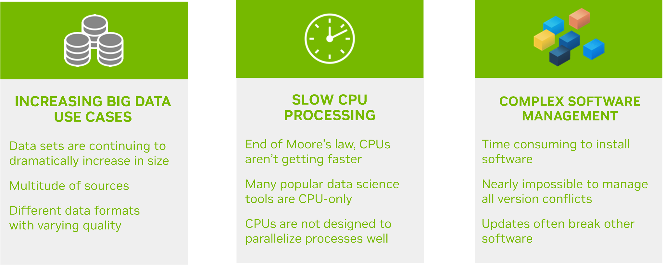
Challenges in Data Science Today
What needs to be solved to empower data scientists
well

Slide 9
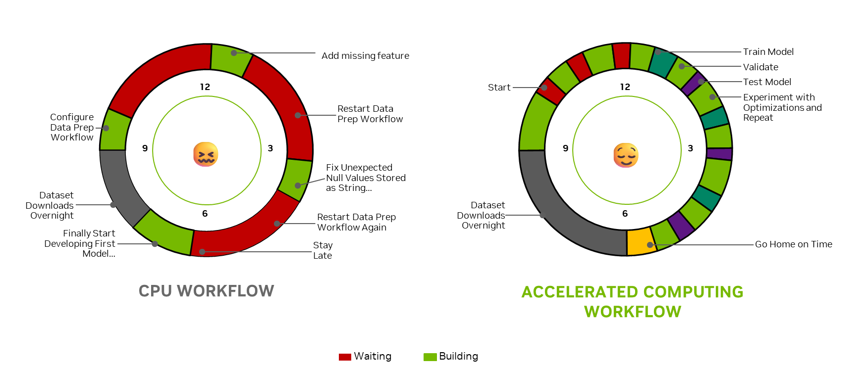
Less Waiting. More Building.
The right solution enables data scientists to focus on delivering value

Slide 10
Less Waiting. More Building.
The right solution enables data scientists to focus on delivering value

Slide 11


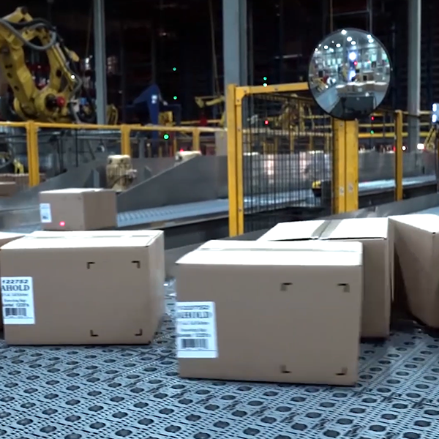
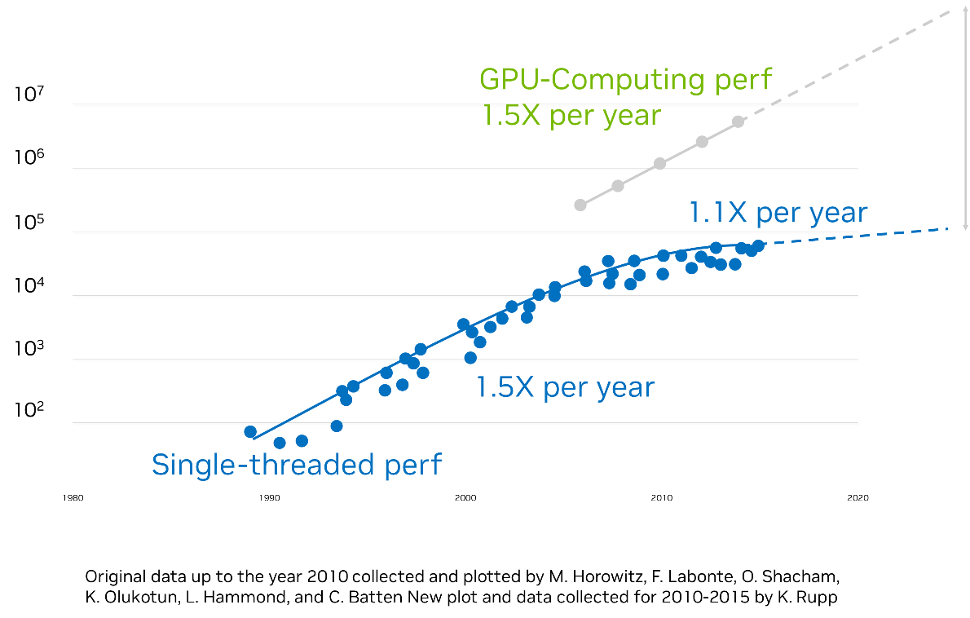



Modern Applications Need Accelerated Computing
Petabyte scale data | Massive models | Real-time performance
1000X by 2025
Recommenders
LLMs
Forecasting
Fraud Detection
Genomic Analysis
Cybersecurity

Slide 12
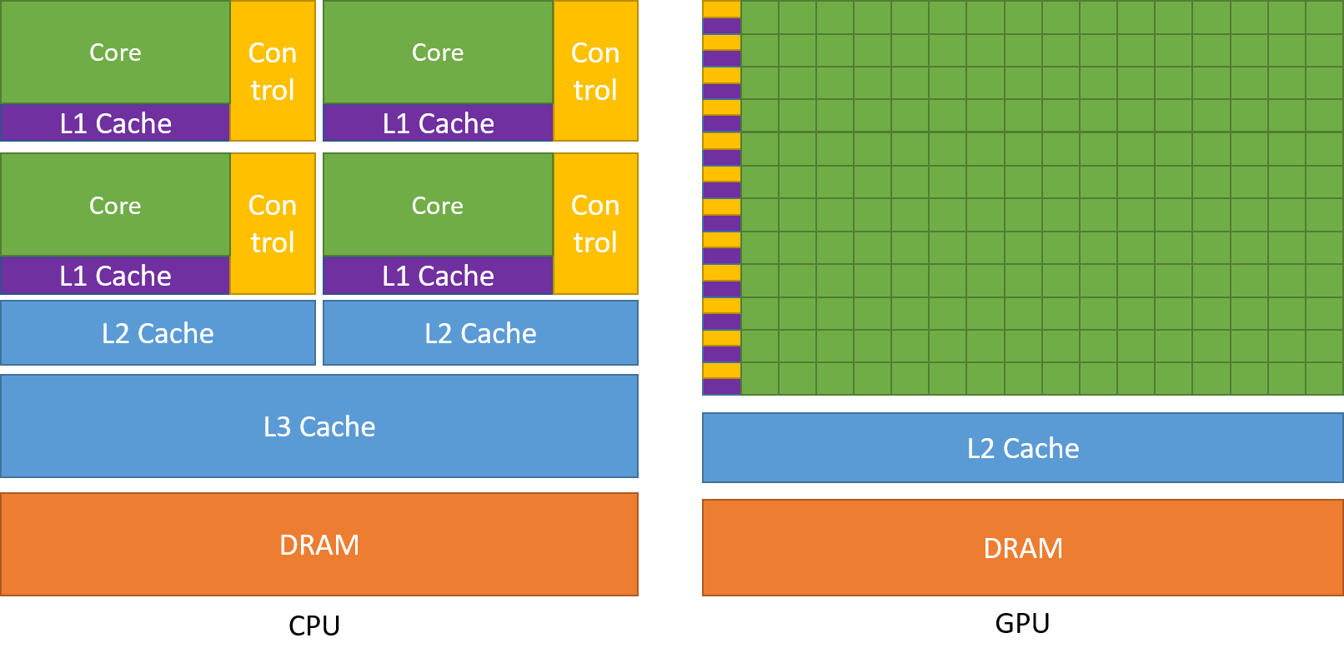
CPU and GPU Comparison
GPUs leverage parallel processing to handle large datasets
https://docs.nvidia.com/cuda/cuda-c-programming-guide/

Slide 13
DataFrame
Two-dimensional labeled data structure with columns of potentially different types
Structured (predefined format/schema):
Tables
Spreadsheets
CSVs
Relational databases
Semi-structured:
Graph
JSONs
Unstructured (doesn’t follow a specific data model or schema):
Texts
Images
Audios
Genes

Slide 14
DataFrame
Two-dimensional labeled data structure with columns of potentially different types
Structured (predefined format/schema):
Tables
Spreadsheets
CSVs
Relational databases
Semi-structured:
Graph
JSONs
Unstructured (doesn’t follow a specific data model or schema):
Texts
Images
Audios
Genes
 | Column 1 | Column 2 | Column 3
Row 1 | 1 | 2 | 3
Row 2 | 2 | 3 | 4
Row 3 | 3 | 4 | 5

Slide 15
DataFrame
Two-dimensional labeled data structure with columns of potentially different types
Structured (predefined format/schema):
Tables
Spreadsheets
CSVs
Relational databases
Semi-structured:
Graph
JSONs
Unstructured (doesn’t follow a specific data model or schema):
Texts
Images
Audios
Genes
 | Column 1 | Column 2 | Column 3
Row 1 | 1 | 2 | 3
Row 2 | 2 | 3 | 4
Row 3 | 3 | 4 | 5
1
2
3
2
3
4
3
4
5

Slide 16
Basic Idea
Vectorized operations are typically much faster than equivalent loops or iterations
Problem: (Column 1 - Column 2) x Column 3:
Sequential:
(1 - 2) x 3 = -3
(2 - 3) x 4 = -4
(3 - 4) x 5 = -5
Parallel (able to leverage vector operations):
 | Column 1 | Column 2 | Column 3
Row 1 | 1 | 2 | 3
Row 2 | 2 | 3 | 4
Row 3 | 3 | 4 | 5
1
2
3
2
3
4
-3
-4
-5
1
2
3
2
3
4
3
4
5
( )
3 4 5

Slide 17
Basic Idea
Total performance scales with both vector width and number of cores
Problem: (Column 1 - Column 2) x Column 3:
Sequential:
(1 - 2) x 3 = -3
(2 - 3) x 4 = -4
(3 - 4) x 5 = -5
Parallel (able to leverage vector operations):
 | Column 1 | Column 2 | Column 3
Row 1 | 1 | 2 | 3
Row 2 | 2 | 3 | 4
Row 3 | 3 | 4 | 5
1
2
3
2
3
4
-3
-4
-5
1
2
3
2
3
4
3
4
5
( )
3 4 5

Slide 18
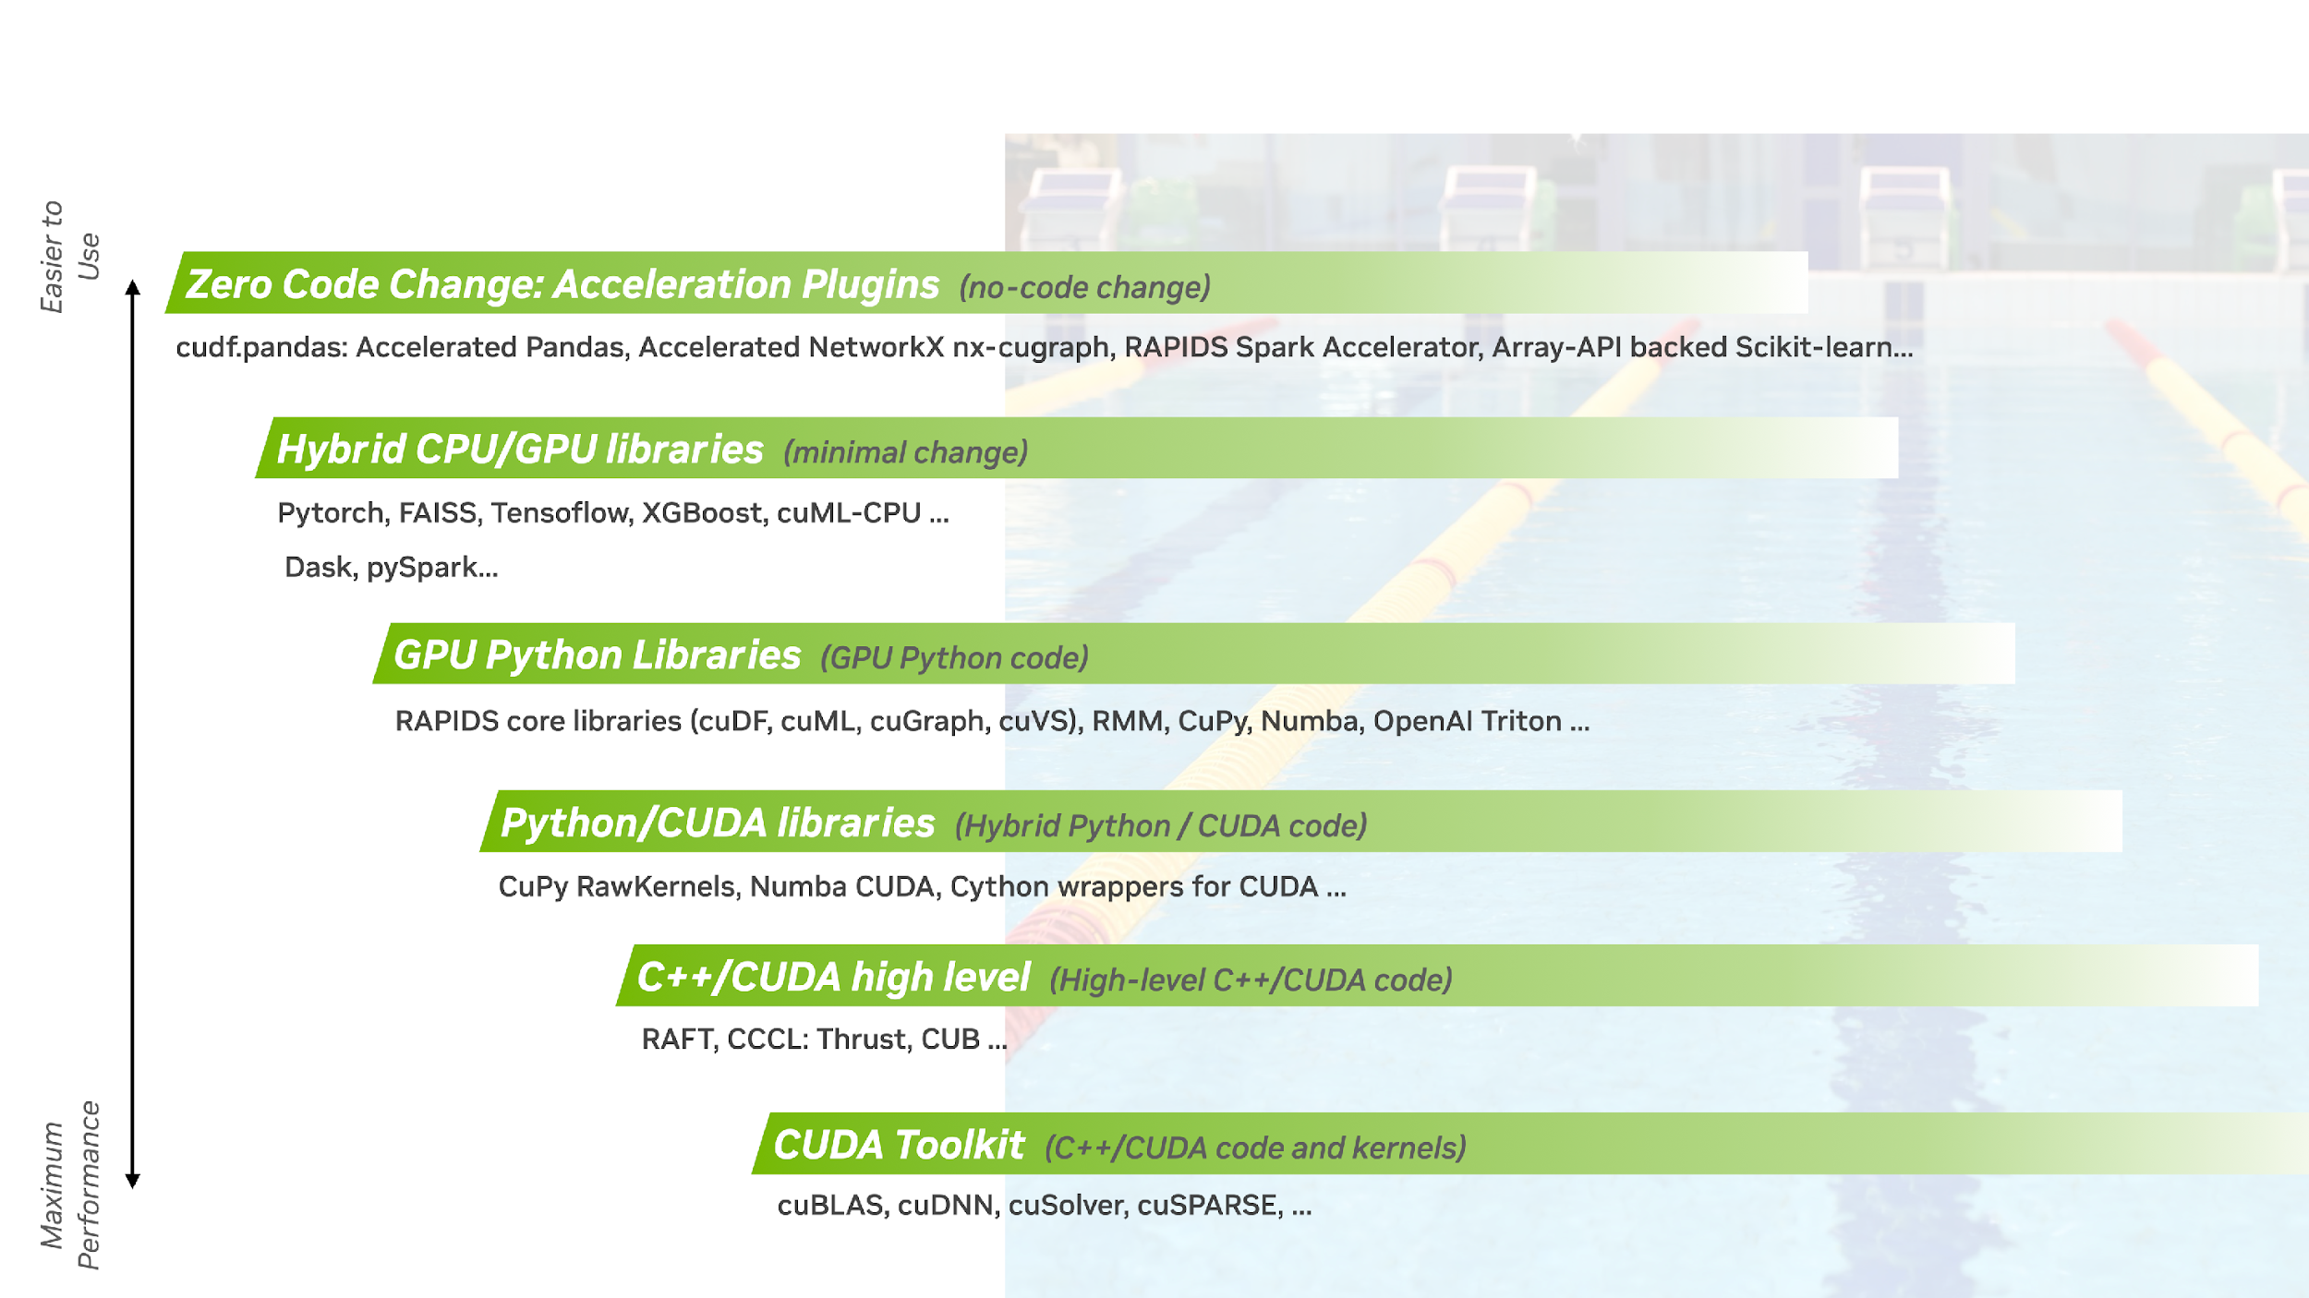
Accelerated Computing Swim Lanes
RAPIDS makes GPU-acceleration more seamless while enabling specialization for maximum performance

Slide 19
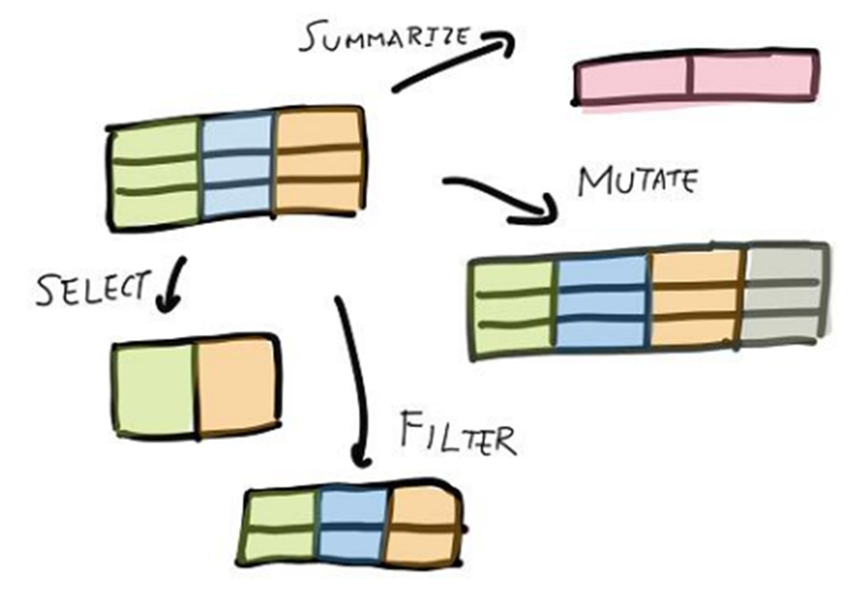
How Data Science Uses cuDF
GPU DataFrame library accelerates ETL, analytical, and data processing for machine learning workflows
Python interface to CUDA C++ libraries for loading, joining, aggregating, filtering, and otherwise manipulating data using a DataFrame style API
Accelerated file readers for prevalent formats in data science
Uses Apache Arrow columnar memory format as its internal data format for efficient processing of tabular data
Powerful aggregation functions using GroupBy
Various string and list manipulation
Ability to write user-defined functions (UDFs), without needing to write CUDA code
JIT compilation of User-Defined Functions (UDFs) using Numba
Resulting in:
Faster statistical analysis
Quicker response from interactive visualization
Data preparation for downstream ML tasks
Remove feature engineering bottlenecks

Slide 20
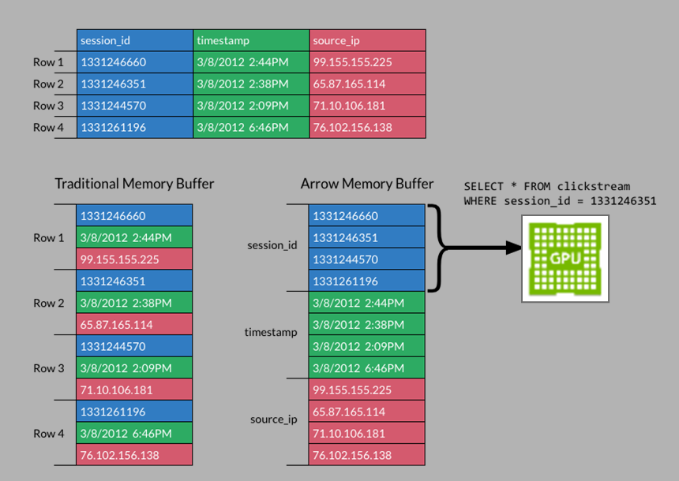
Apache Arrow
Open-source, cross-language development platform for in-memory data processing and analytics
Columnar Format
Data is stored column-by-column instead of row-by-row
Efficient compression by grouping similar data types together
Leverages GPU strengths for vectorized processes using SIMD (single instruction, multiple data) operations
In-memory data structure specification
De-facto standard
Advantages:
Fast access for operations like aggregation, filtering, and vectorized computations
Zero-copy data transfer - can be shared across tools without being serialized, deserialized, or duplicated
Reduced memory requirements enables efficient handling of large datasets
Integrates well with columnar file formats such as Parquet, allowing for efficient reading of data from disk
Interoperability

Slide 21
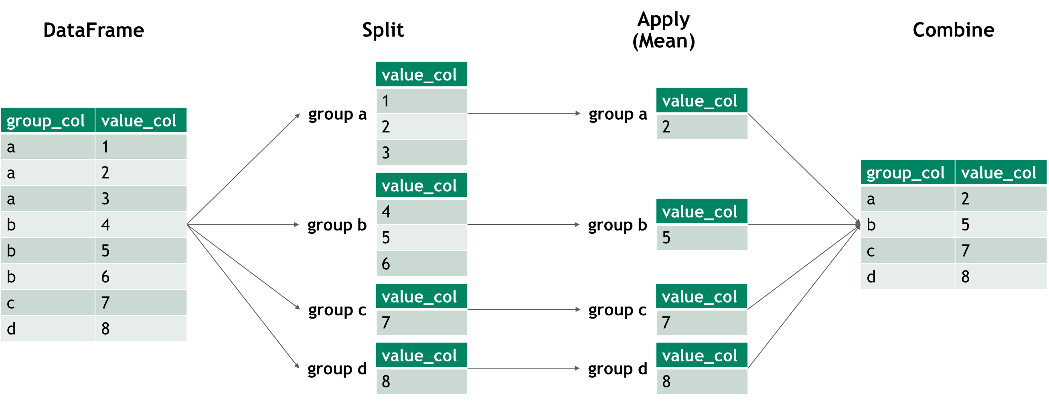
GroupBy Operations
Split-apply-combine
GroupBy operations allow users to separate data into groups based on common characteristics or a defined criteria
.agg/.aggregate - compute a summary statistic (or statistics) for each group
.transform - perform some group-specific computations and return a like-indexed object
.apply - apply function group-wise and combine the results together

Slide 22
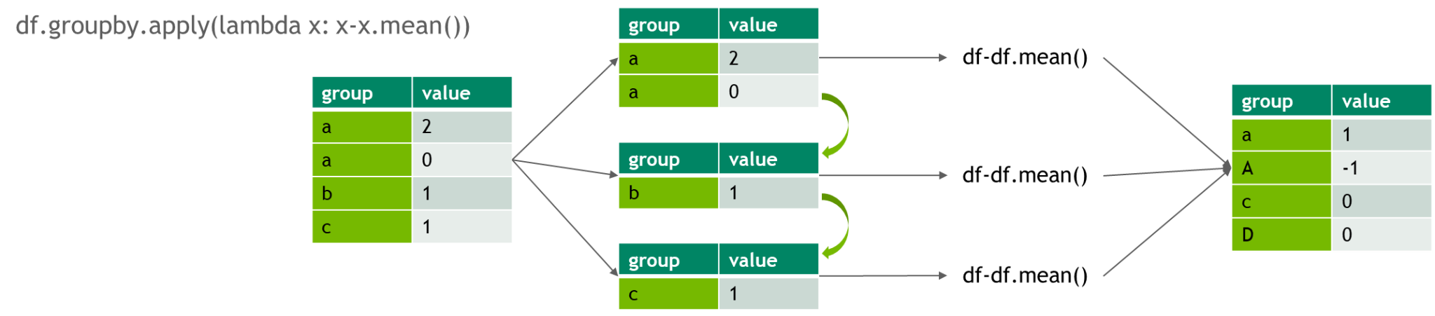
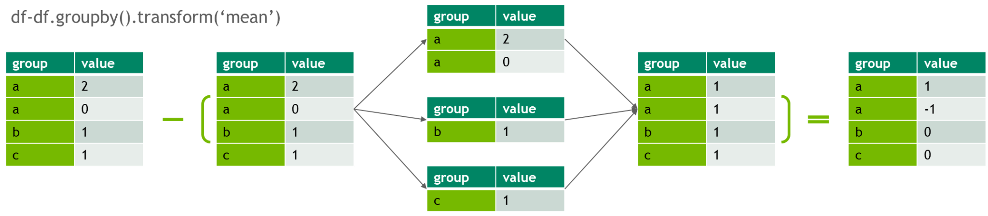
GroupBy Operations
Design for vector operations and minimize iterations

Slide 23
GroupBy Operations
Design for vector operations and minimize iterations

Slide 24



RAPIDS cuDF
Enabler for popular DataFrame libraries
Several ways to use cuDF:
Zero code change acceleration:
cudf.pandas
Write code with the full flexibility of pandas, then load cudf.pandas to accelerate on the GPU, with automatic CPU fallback if needed
Third-party library compatible and accelerates the entire pandas ecosystem
cuDF provides an in-memory, GPU-accelerated execution engine for Python users of the Polars Lazy API
Write cuDF code using DataFrame style API
Dask-cuDF extends Dask & RAPIDS Accelerator for Apache Spark

Slide 25
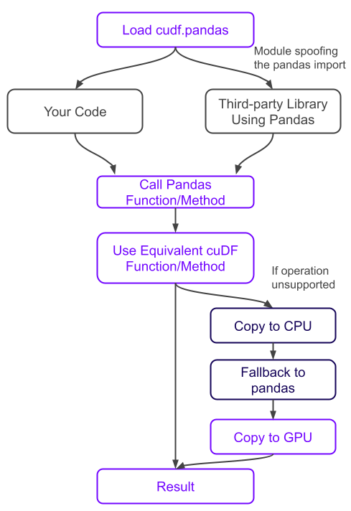
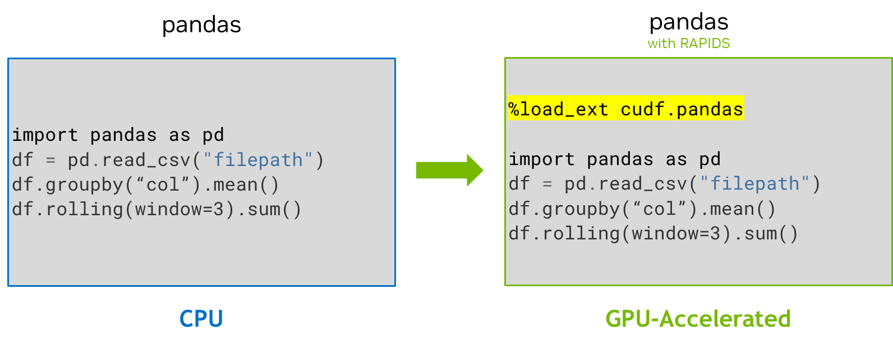
Announcing RAPIDS cuDF Accelerates pandas with Zero Code Change
World’s fastest data analytics with pandas
Most powerful and flexible open-source data analysis / manipulation tool
Over 9.5M pandas users
Accelerated by cuDF
150x Faster than CPU-only
Unified workflow on CPUs and GPUs across laptops, workstation & datacenter
Compatible with third-party libraries built on pandas
Meeting Data Scientists Where They Are

Slide 26
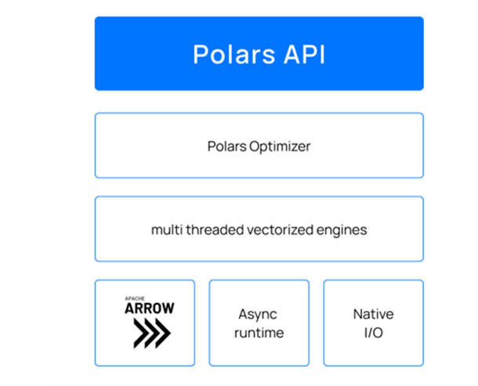
Polars + RAPIDS cuDF
Polars is the fastest growing data analytics library
High Performance DataFrame Library written in Rust
Build on Apache Arrow columnar memory format
Lazy Execution & Query Optimizer
Gaining rapid adoption in data science community as a Pandas alternative
Polars is Accelerated with RAPIDS cuDF
NVIDIA RAPIDS accelerates Polars through a GPU engine built into the lazy API
The GPU Engine object can be passed to query execution for automatic acceleration (collect() function)
Execution Process
Polars builds and optimizes the query plan
cuDF inspects the plan, replacing supported operations with GPU-accelerated versions
Unsupported operations fallback to CPU execution with minimal overhead

Slide 27
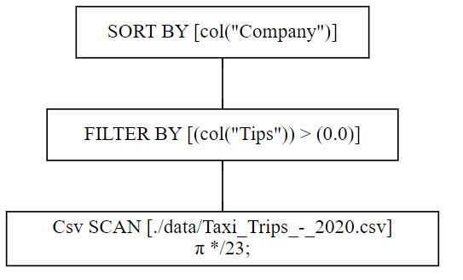
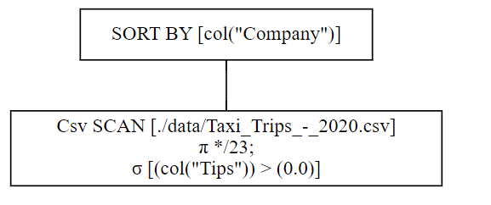
Lazy Execution and Query Optimization
How does it work?
Lazy Execution
Polars uses lazy evaluation by default, but has eager execution available
Queries are not executed immediately, but built into an execution plan
Unoptimized Query
Optimized Query

Slide 28
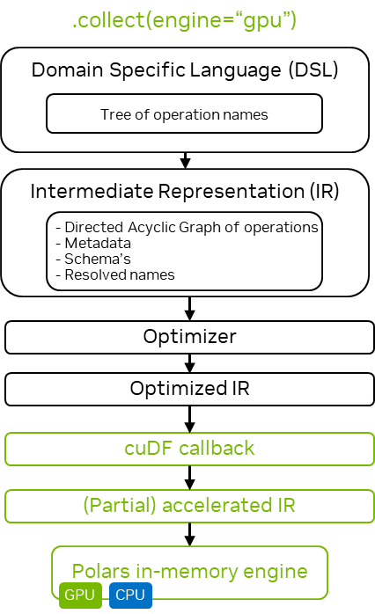
Lazy Execution and Query Optimization
How does it work?
Lazy Execution
Polars uses lazy evaluation by default, but has eager execution available
Queries are not executed immediately, but built into an execution plan
Benefits of lazy evaluation:
Allows global query optimization
Minimizes unnecessary computations and memory usage
Enables out-of-core processing for datasets larger than RAM
Query optimizer:
Analyzes full query plan to determine most efficient execution
Applies optimizations like predicate pushdown and projection pushdown
Parallelizes operations across GPU/CPU cores automatically

Slide 29
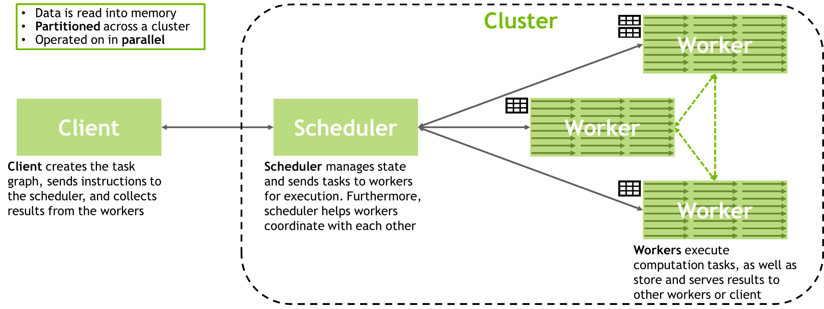
RAPIDS + Dask
Distributed parallel computing on multi-GPU systems
Dask is a parallel computing library built to scale Python workloads from single machines to supercomputer clusters
Executes operations on chunks of data and aggregates results, thus enabling working with datasets that are larger than memory
Scheduler coordinates the actions of several dask-worker processes spread across computing nodes
Lazy execution - operations on a Dask DataFrame build a task graph, which is optimized prior to execution

Slide 30
Accelerating Data Processing
Choosing tools based on use case, data size, performance requirements, and existing infrastructure
Dask | Spark
Complexity
Polars
pandas
Performance
operates in-memory
eager execution
suited for smaller datasets (up to 1GB)
handles larger-than-memory data
lazy execution
suited for medium to large datasets (1GB - low hundreds GB)
distributed computing
lazy execution
suited for massive datasets across cluster of machines
requires more setup, overhead, and resources

Slide 31
Accelerating Data Processing
Choosing tools based on use case, data size, performance requirements, and existing infrastructure
Dask | Spark
Complexity
ACCELERATED BY RAPIDS cuDF
Polars
pandas
Performance
operates in-memory
eager execution
suited for smaller datasets (up to 1GB)
handles larger-than-memory data
lazy execution
suited for medium to large datasets (1GB - low hundreds GB)
distributed computing
lazy execution
suited for massive datasets across cluster of machines
requires more setup, overhead, and resources

Slide 32
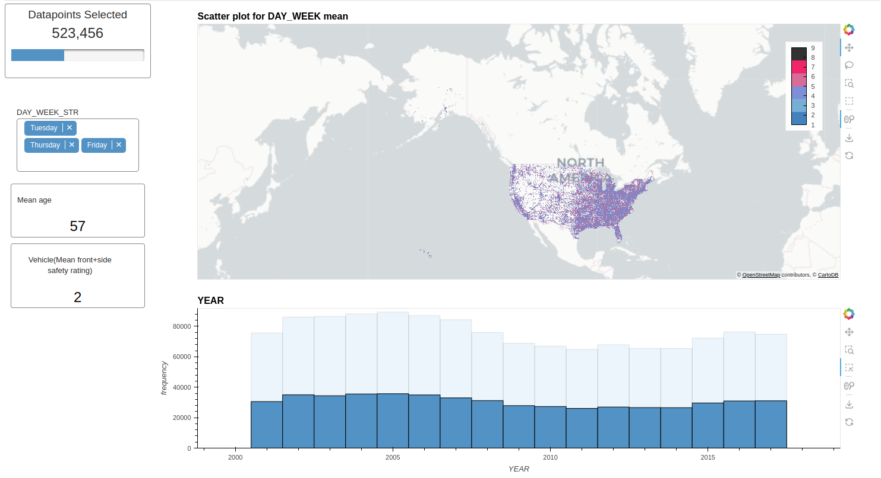
RAPIDS Data Visualization
Popular libraries offer direct cuDF support or easy integration
Scatter, line, bar charts, and more
Interactive dashboards
Disruption due to slow processing speed creates friction in the analysis process
cuxfilter
Built on a host of pyViz ecosystem tools
Cross-filtering apply interactions from one chart as filters to other charts in the dashboard
Efficient GPU-backed in-browser visualization
hvPlot + Datashader + cuxfilter + Plotly Dash

Slide 33
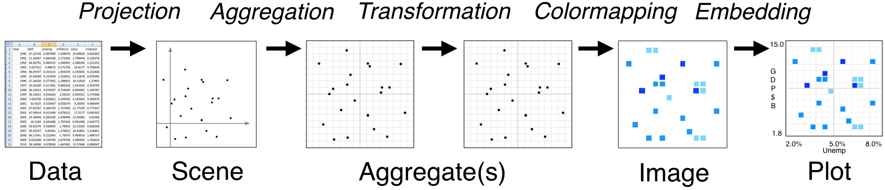
Datashader
Disruption due to slow processing speed creates friction in the analysis process
Datashader - a graphics pipeline system for creating meaningful representations of large datasets quickly and flexibly
Work by rasterizing or aggregating large datasets into regular grids that can be viewed as images
Can be GPU-accelerated by leveraging cuDF or other CPU-accelerated tools for the data aggregation step

Slide 34
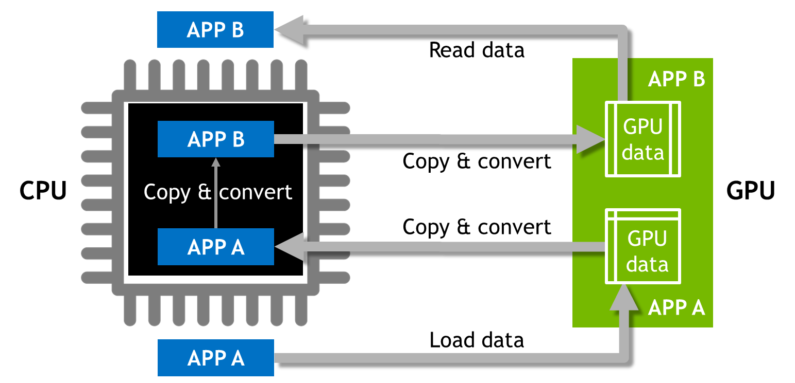
Traditional Model
Too much data movement and too many makeshift data formats require transformation

Slide 35
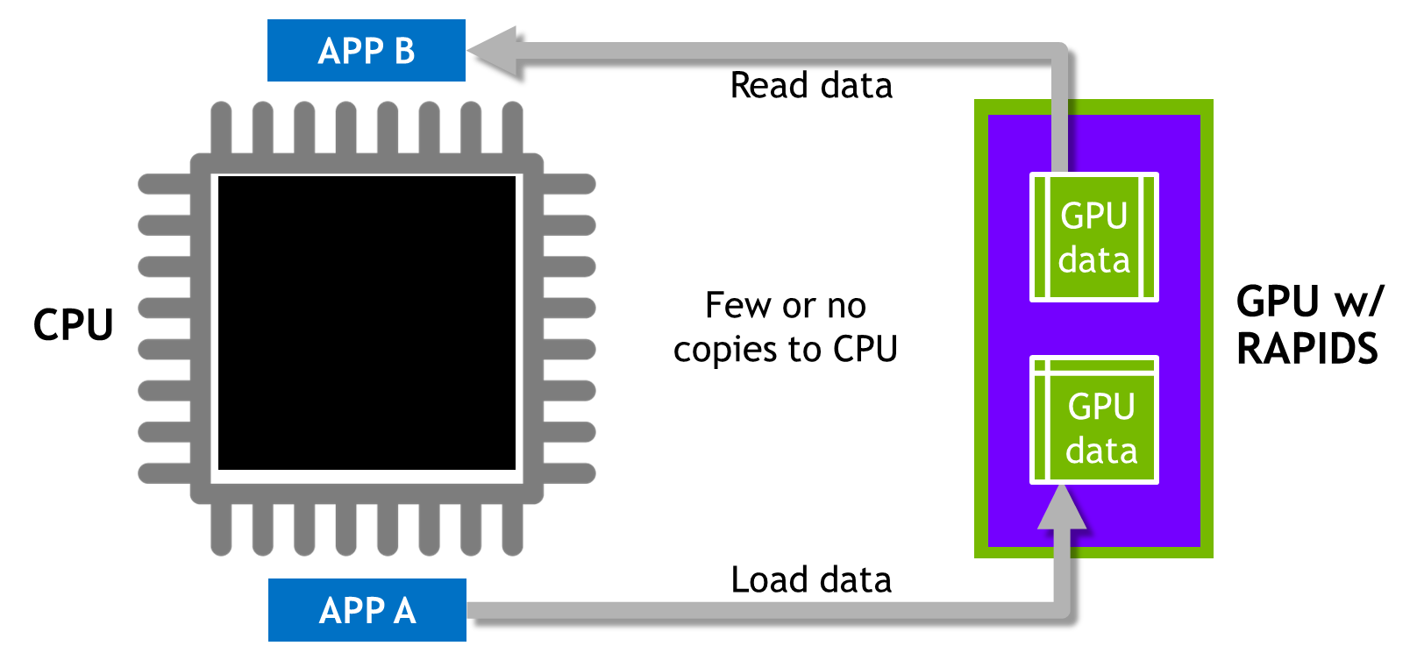
RAPIDS Model
Shared, standard data structures are essential to building an efficient workflow

Slide 36
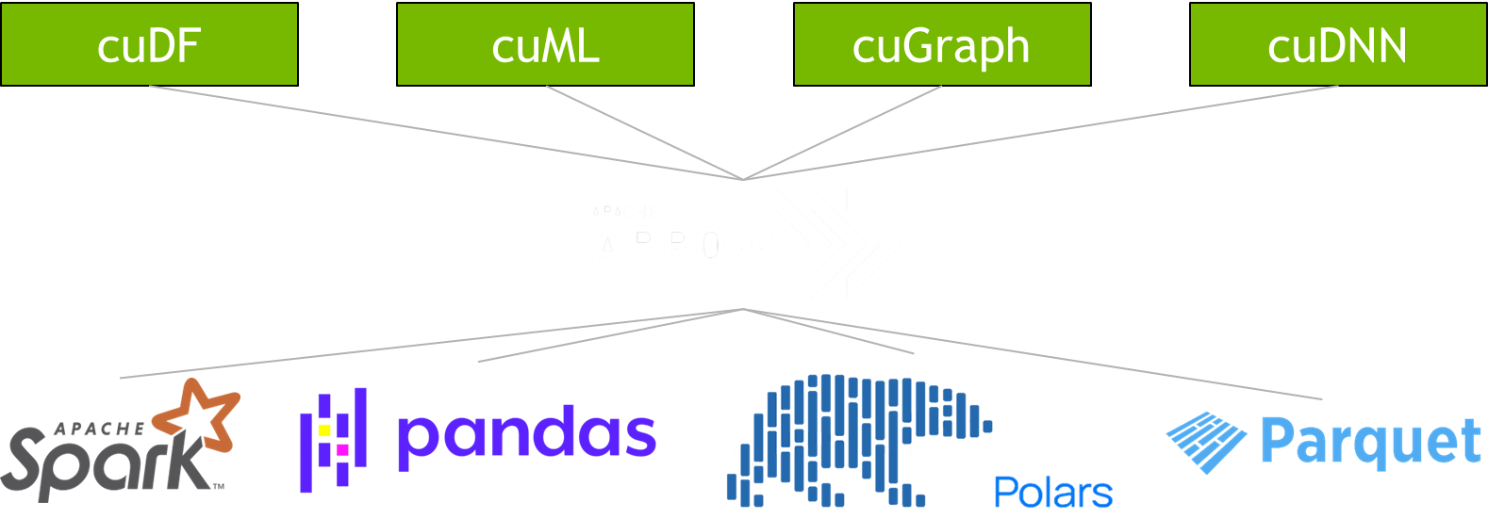

One Format for Interoperability and Efficiency
Standardized, language-agnostic in-memory columnar format for structured data

Slide 37
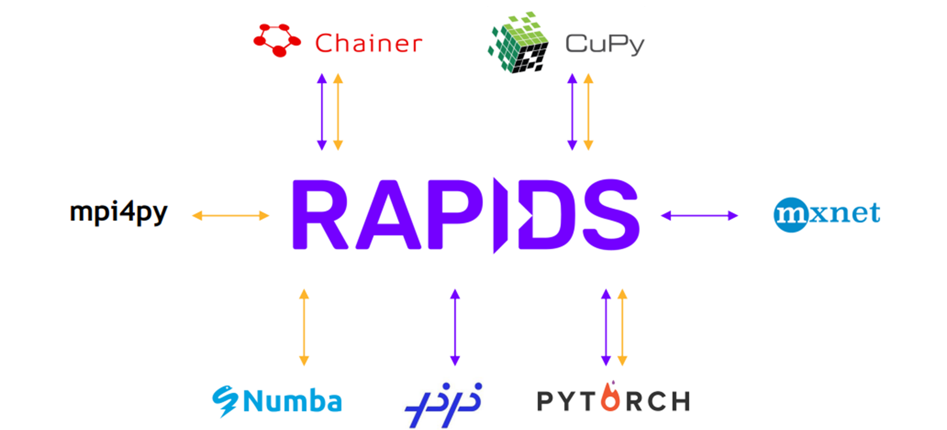
Interoperability with CuPy
Interoperability of the GPU PyData Ecosystem
Using DLPack and __cuda_array_interface__ – the CUDA array interface is a standard format that describes a GPU array to allow sharing GPU arrays between different libraries without needing to copy or convert data

Slide 38
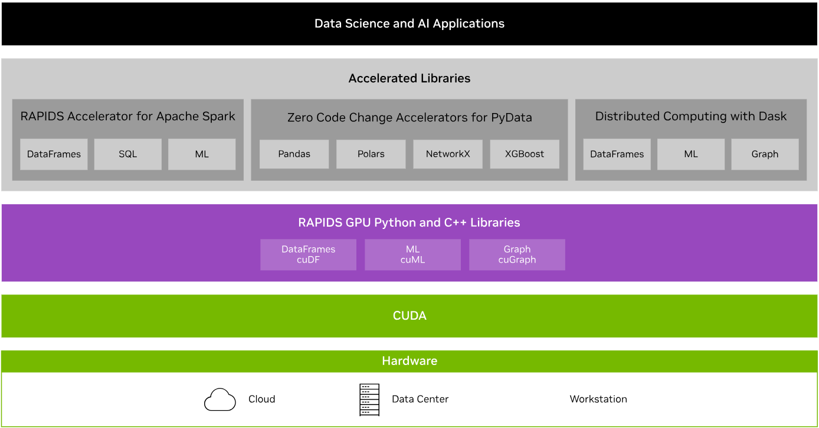

RAPIDS Transforms Data Science
An optimized hardware-to-software stack for the entire data science pipeline

Slide 39
Accelerating End-to-End Data Science Workflows
NVIDIA Data Science aims to provide seamless integration of NV libraries and SDKs for data scientists
Store
Data Acquisition
Data Manipulation
Statistical Analysis
Visualization
Machine Learning
Accelerated by RAPIDS
Tips:
Memory management
Some vectorized operations may create temporary copies of data, which can be problematic for very large datasets
Leverage parallel processing when possible (GPU)
Design operations to use vector operations (groupby.apply is iterative and slow)
Keep data on the GPU as much as possible
Minimize copy/convert operations
Diagnose and remove bottlenecks

Slide 40
Hands-On Lab

