Slide 1

The first data analysis based on cross-data sources

Slide 2


1
What is Ignition Program ?
IGNITION PROGRAM
Leading startups and scaleups companies towards a peaceful and sustainable growth, thanks to 3 services :
RECRUITMENT
TRAINING
CONSULTING
- 2000+ candidates/month
- 1500+ startups as clients
- 800+ love stories launched
One coach team dedicated to candidates
One matchmaker team dedicated to startups
One team dedicated to Tech-profile recruitment
One team dedicated to international development (mainly Portugal and Spain)
- 300+ managers trained
- NPS : 9,5/10 !!!
We teach management, non-violent communication, coaching, recruitment…
- Led and facilitated 20+ off-sites
- Helped 10+ Boards towards better communication and collaboration
…

Slide 3
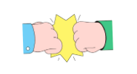
2
Context of the project
PROBLEM
multi-tool : Hubspot CRM, internal Back Office (matching tool), finance and accounting tool…
dirty data
never managed to connect our tools and lead cross-data analysis
Collect data from multiple sources
Cleaning data about deals in our CRM
Cleaning data in our internal back office
Merging both databases
Lead the first cross-data analysis
Nice-to-have : building a predictive model to predict future turnover, considering opportunities open and candidates hired in the program
OBJECTIVES

Slide 4
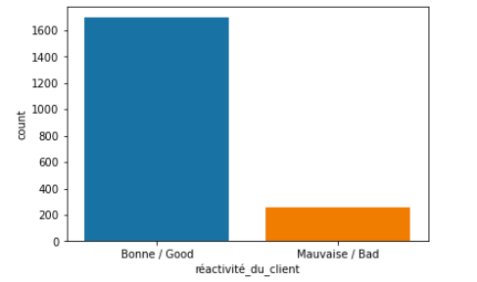
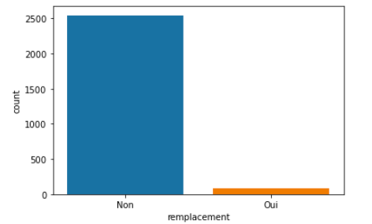
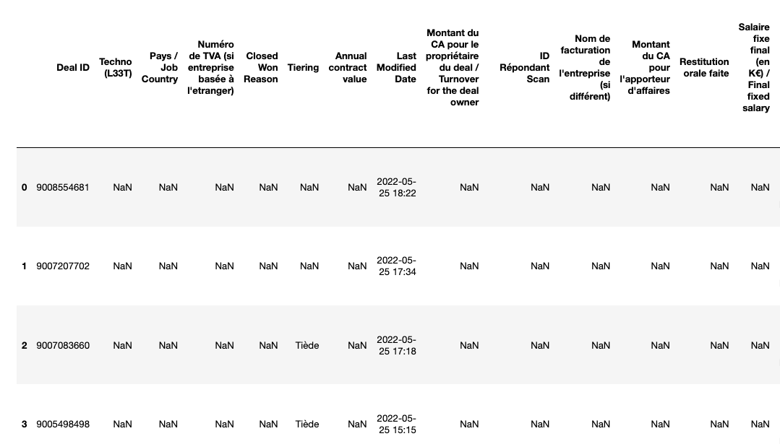
3
I started with… 😱
86% of missing values in the CRM… 30% in the BO
150 columns to clean… but only 3800 rows
VERY dirty data
High class imbalance
VERY bad distributions, with manyyyyy outliers
well… REAL-LIFE DATASETS 😬

Slide 5
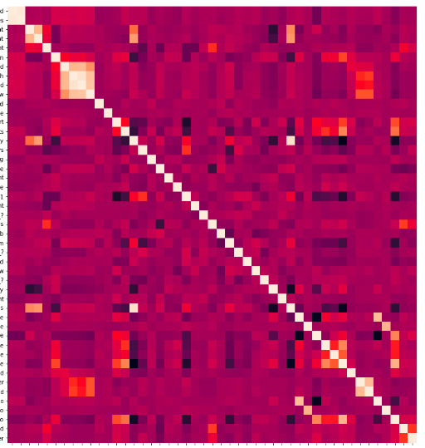

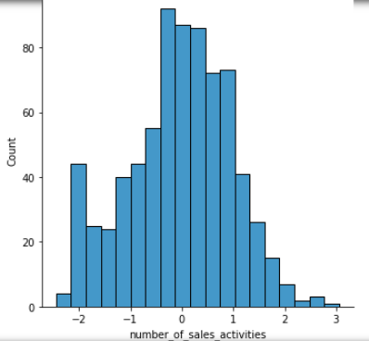
4
METHODOLOGY
DATA CLEANING
DATA EXPLORATION
PREDICTIVE MODEL
DATA VISUALISATION
a- Columns and format cleaning
b- Dropping columns and rows (but a few because I didn’t have much at the beginning…)
c- Cleaning numericals with KNN Imputer
d- Grouping categorical values to reduce class imbalance
e- Encoding and cleaning categoricals with KNN Imputer
f- Exporting 2 final dataframes for each datasets : one for analysis purpose (with non-encoded categorical values) and one for model-building purpose (with encoded values)
a- Merging both dataframes into one : OUR FIRST CROSS-DATABASE 🙌
b- Choose not to remove outliers (because not enough rows)
c- Mainly exponential distribution for continuous data and high multi-class imbalance for discrete
d- Multicollinearity
e- Scaled data with
PowerTransformer to
be as closest as possible to a normal distribution
f- AMOUNT (y, value to predict) already followed a normal distribution, no need for log transfo
a- Objective : predicting AMOUNT c
b- Created a function to try different models : linear, knn-regressor and mlp-regressor
c- Bad results : R2 of 0.23 at best with knn method and 6 neighbors…
a- Using Tableau for better outputs transmission :)
b- Answering the following questions (raised by internal teams)
→ who is our typical client (BU Recruitment) ?
→ who are our ambassadors ? Time wasters ?
→ what is the seasonality of our sales ?
→ why our interview/hiring ratio is decreasing ?
→ how to optimize our chances to close a job (and win a deal) ?
→ how are our sales team performing in terms of matchmaking (not sales) ?
c- >> THE ANALYSIS IS HERE <<

Slide 6

5
Results - Predictive model
BAD PERFORMANCE OF OUR MODEL… 😭
Best R2 computed = 0.23
It could be caused by :
insufficient size of datasets (ending with about 3000 rows)
too many missing values in proportion, replaced by KNN : created bias
too many outliers that we can’t removed (due to insufficient number of rows)
amount not correlated enough with other variables and too many multicollinearity
high class imbalance between variables
only had time to merge data on jobs from our two tools : to complete my model I will also need data from our candidates pipeline !

Slide 7
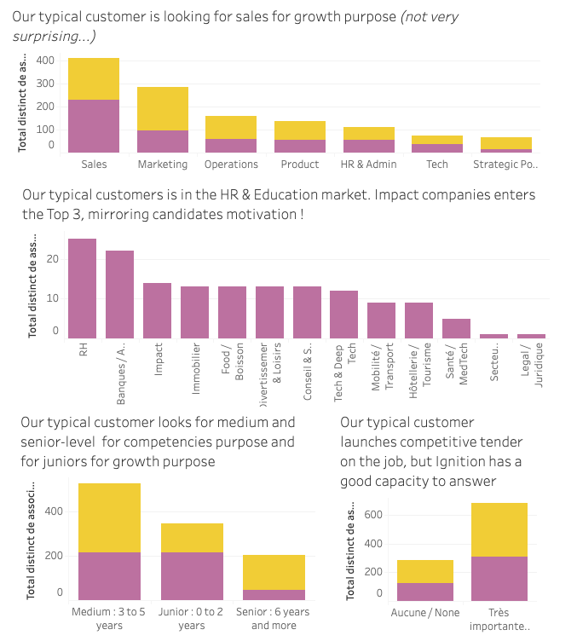
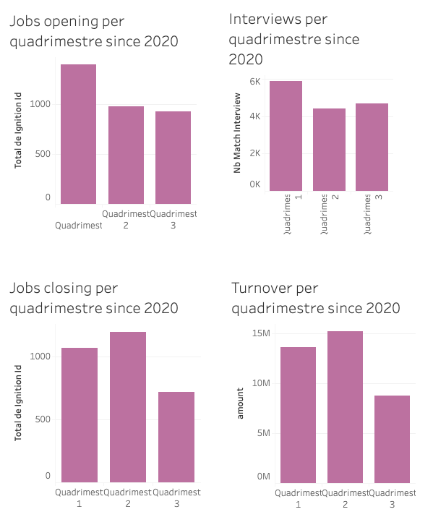
6
Results - Data Analysis : some outputs…
Typical client
Seasonality
A small-sized company in a high-paced and highly competitive environment, operating (mainly) in the service sector, and aiming at professionalizing itself.
For opening jobs and integrating candidates into our program, high season is the first 4 months of the year.
To close jobs and earn $$, high season is from may to july.
The last 4 months of the year are far less profitable for our recruitment business !

Slide 8

6
Results - Data Analysis : some outputs…
THE FULL ANALYSIS RIGHT HERE

Slide 9
Next steps
FOR THE FINAL PROJECT, I WOULD LIKE TO CONTINUE THIS WORK WITH TWO POSSIBLE OPTIONS :
SALES PREDICTIONS
SELECTION PREDICTIONS
Improving the current model by :
improving the cleaning of the current model : no KNN for every columns to avoid too much bias
adding candidates data to the current database (the success factor of a recruitment always depends on our sales variables, but also on our candidates pipeline
using a better performing model (that we will see in the following of the class 😉…)
Improving the selection process of our candidates :
CURRENT SITUATION : done manually today, based on selection grid and criteria, one full-time employee dedicated to it
Objective : building a model analysing previous applications (lost vs won vs admission criteria) to compute the chance of a new application to be admitted in the program + combining this output with our jobs pipeline (do we have opportunities for this candidate ? How much chance to recruit him after integrating him into the program ?)
Output : a probability for being accepted in the program, and then hired by a client, for each application ! 💪

Slide 10

THANKS FOR LISTENING TO ME 😊

