Slide 1
Objectives
In the context of carbon fluxes:
Compare warming treatments
Assess the effect of warming and global change drivers
Conceptualize an efficient setup to measure carbon fluxes under the snow pack in winter

Slide 2
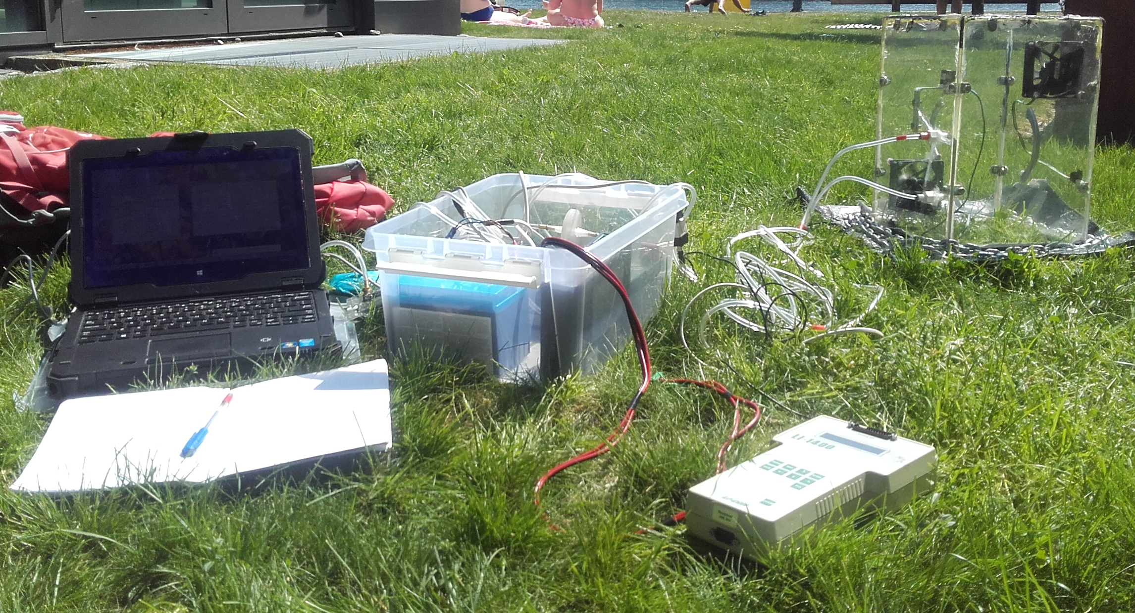
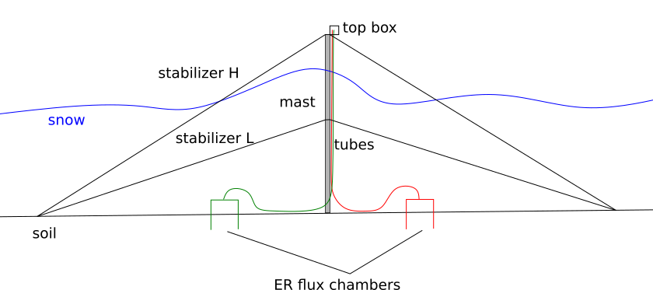
Setup: measuring fluxes
Transparent chamber:
net ecosystem exchange (NEE)
Dark chamber: ecosystem respiration (ER)
Gross ecosystem production (GEP) =
NEE - ER

Slide 3
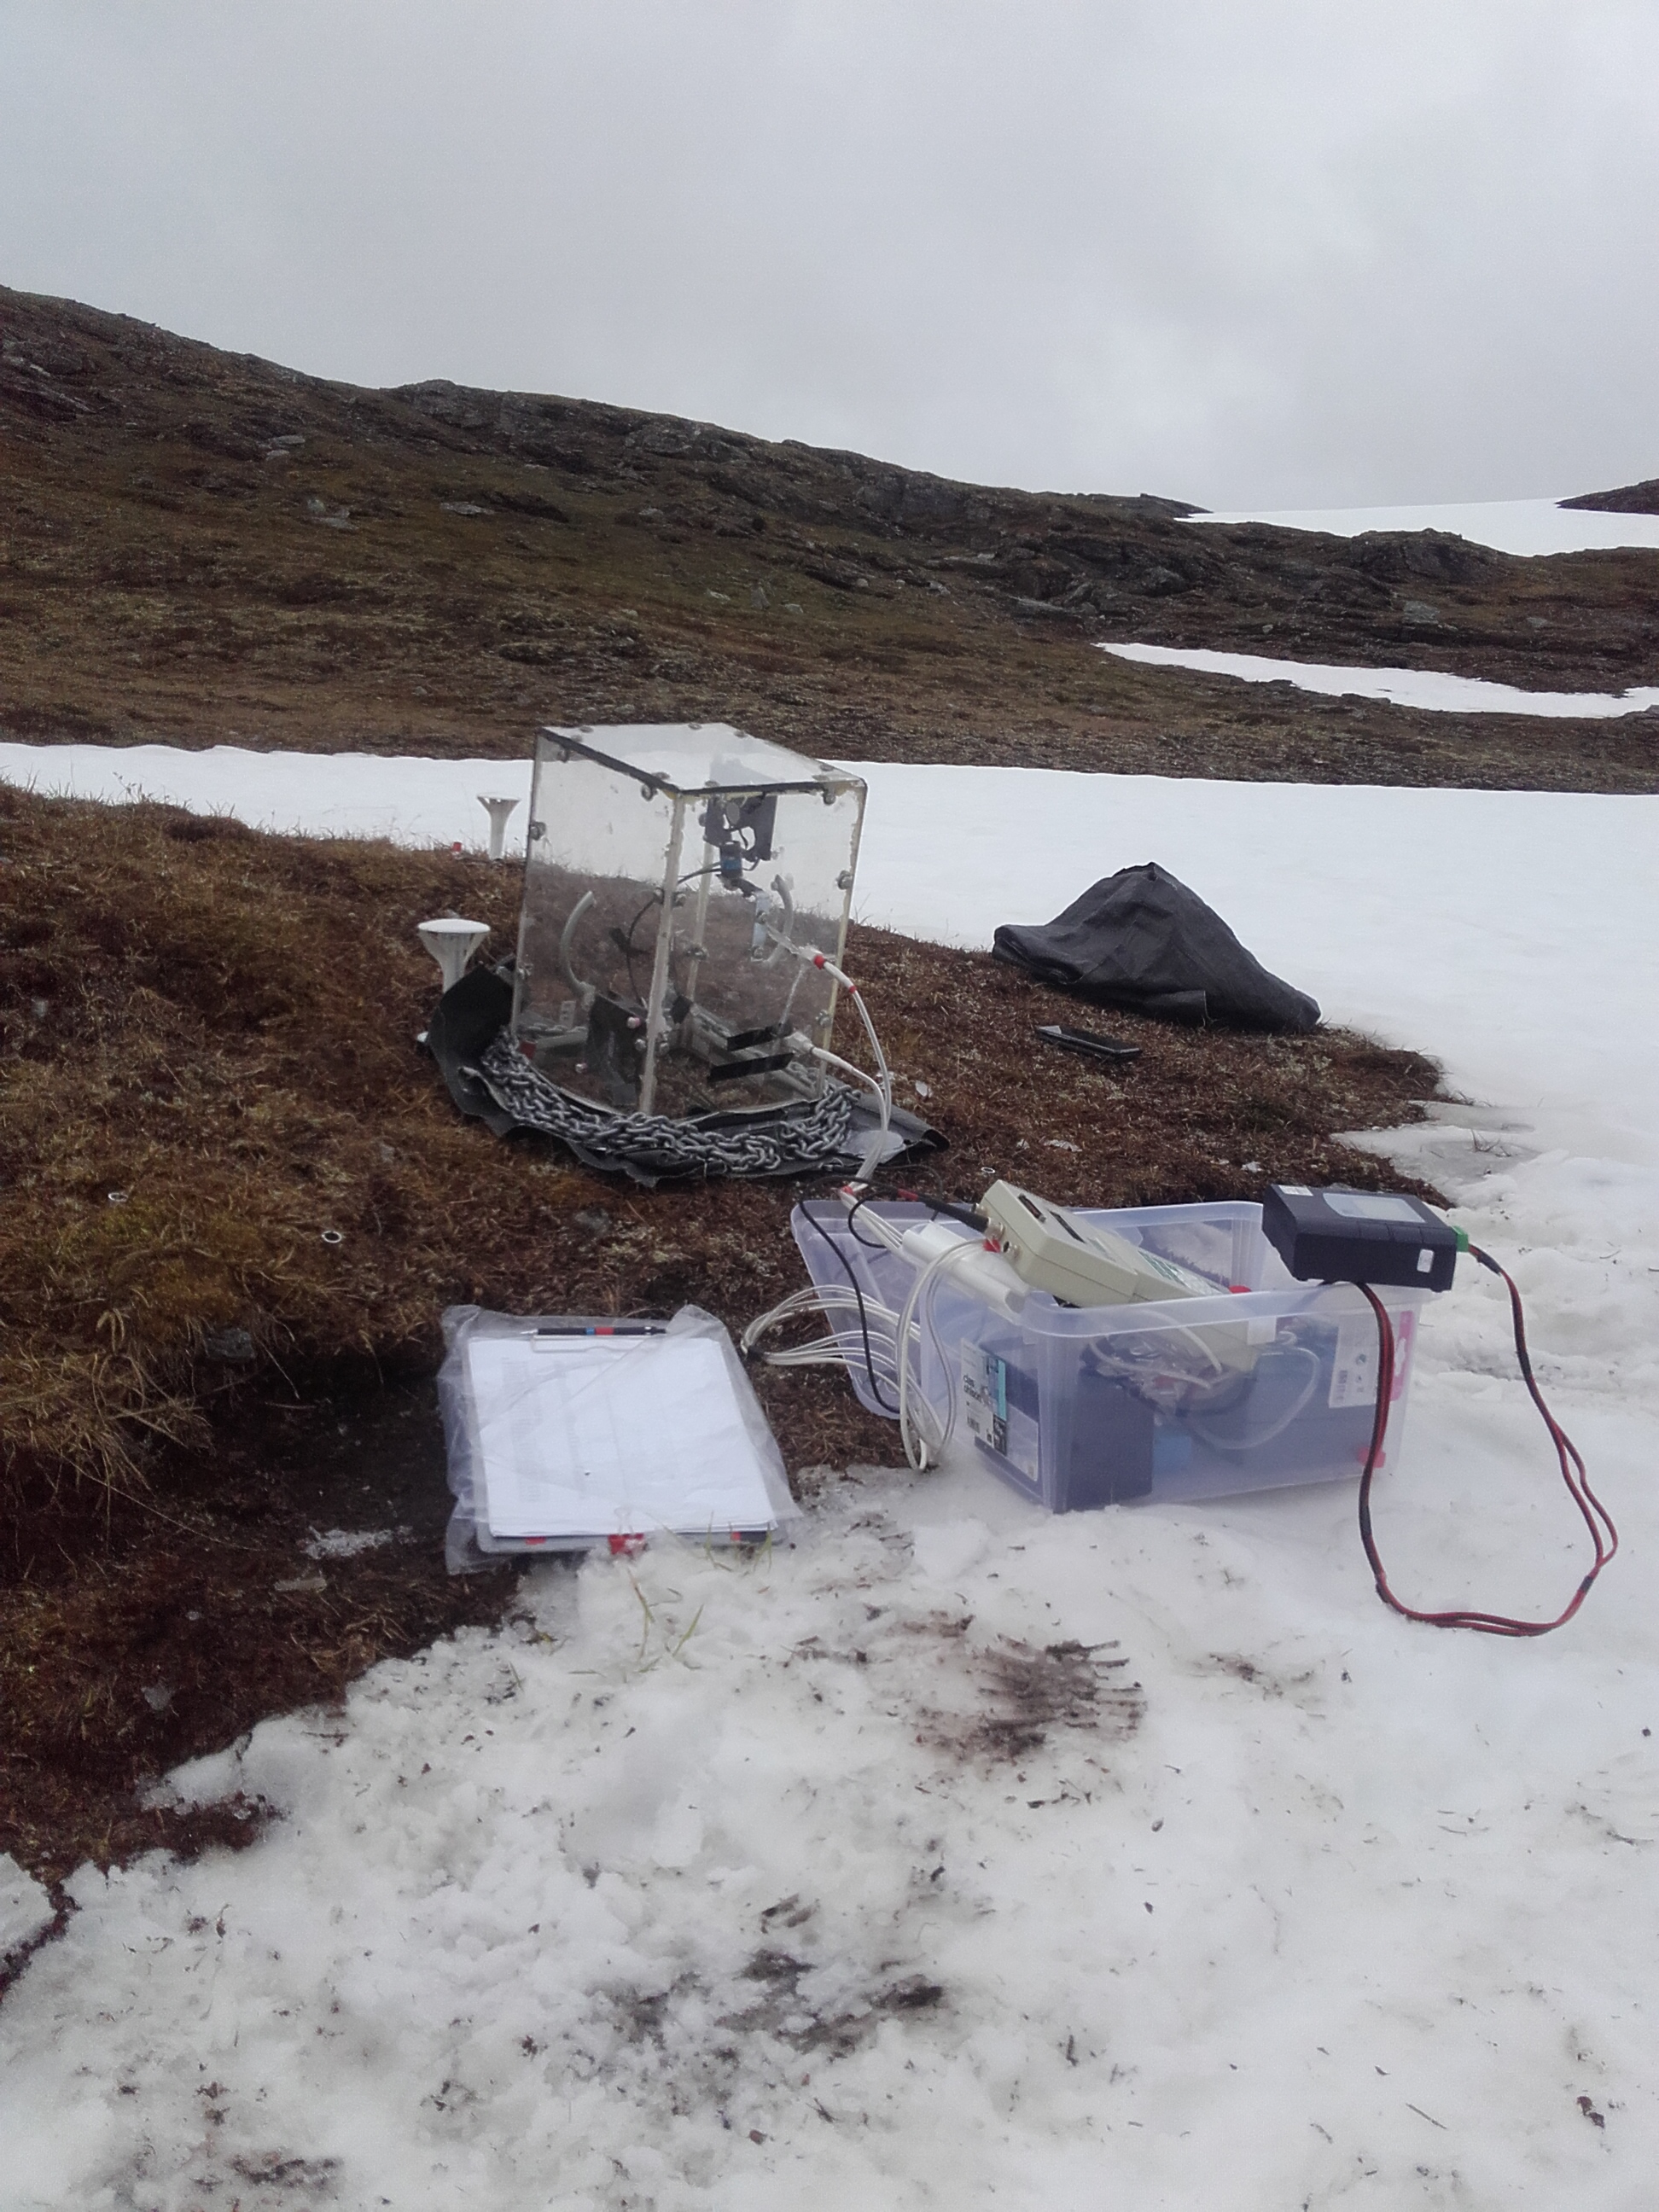
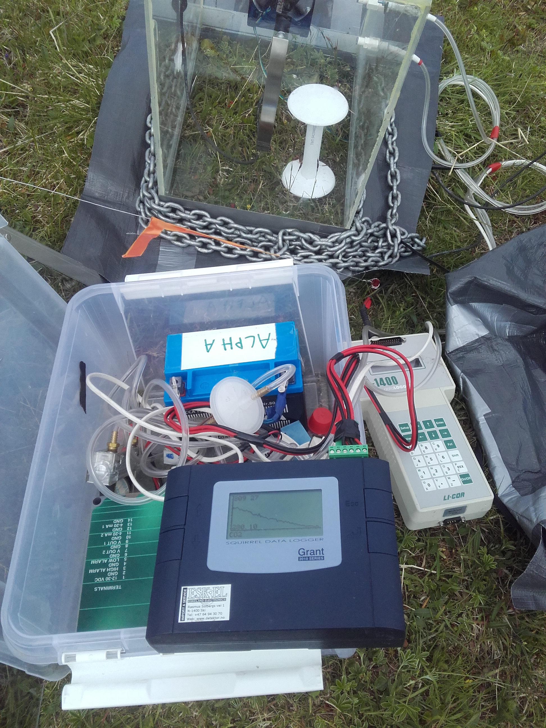
Chamber

