Slide 1
Reinforcement Learning in the Presence of Hidden States
Andrew Howard
Andrew Arnold
{ah679 aoa5}@columbia.edu

Slide 2
The Problem of Texas Hold’em
The Rules:
  2 Cards in the hole, 5 communal board cards
  Best 5 card hand wins
The Challenge:
  Hole cards represent hidden information
  Exhaustive search of game space not practical
  Most pure strategy of the poker family of games
Constraints:
  Choose from only 3 decisions: Fold, Call, Raise
Why Machine Learning:
  Pure probabilistic or rule based player will not take advantage of opponent weaknesses. Brittle to exploitation

Slide 3
Goals of Research
Create a sound poker playing agent
  Build upon a foundation of basic card probabilities
  Off-line training allows acquisition of basic poker strategy
  On-line reinforcement learning incorporates more precise modeling of opponent behavior
  Non-rule based approach allows for implicit incorporation of more complex strategies such as check-raising, bluffing and slow-playing.

Slide 4
Reinforcement Learning and the Q-Algorithm
The Reinforcement Learning Task
  Agent senses current state st
  Choose action at from the set of all possible actions
  Environment responds with
    Reward rt = r(st,at)
    New State st+1 = δ(st,at)
  Learn policy π : S→A, that maximizes future rewards
Q-Table
  A 2-dimensional matrix indexed by states and actions
  Stores rt + Σi γ^{i} r_{t+i} , γ is a discount on future rewards
Recursive approximation for an update rule
  Q*(st, at) ← rt + γ max at+1 Q*(st+1, at+1)

Slide 5

Q-Learning with Hidden States Using EM Clustering
Algorithm maps given inputs into a hidden state, and based on that state, emits an action
  Mapping from input space to states done by EM
  Mapping from state space to action done by Q
Dependencies can be modeled graphically:

Slide 6
A New Approach to EM
Initialize model parameters, θ, and Q-table
The E-Step:
  Compute posteriors, p(s|x^{n}), using Bayes rule
  Convert Q-table to p(a|s)
  Compute p(a|x^{n}) = Σ_{s} p(a|s) p(s|x^{n})
  Select an action by sampling p(a|x^{n})
  collect reward
  update Q-table Q*(s, a) ← γ Q*(s, a) + δ(a,a^{n})p(s|x^{n}) r
  Convert Q-table to p(a|s)
  Compute improved posteriors:
    p(s|x^{n},a^{n}) = p(a^{n}|s) p(s|x^{n}) / p(a^{n}|x^{n})
The M-Step:
  Update θ to maximize log likelihood, p(x^{n}, s), with respect to improved posteriors p(s|x^{n},a^{n})

Slide 7
Input Representation
A priori domain knowledge used in defining features:
Raw card values do not always correlate with a winning hand using clustering
Instead, define more appropriate features:
  Hand Strength
    Given current game state, search all possible opponent hands and return probability of having current best hand
  Hand Potential
    Given current game state, search all possible future cards, and return probability of hand improving
Use betting history of current game to determine opponent hand strength, and, over time, adapt to opponent behavior

Slide 8
Experiment
Training
  Train agent against random players until a consistent winning ratio is achieved
Testing
  Test against different random players to determine how well agent adapts to new opponents
  Anecdotally play against researchers for an additional, subjective, evaluation

Slide 9
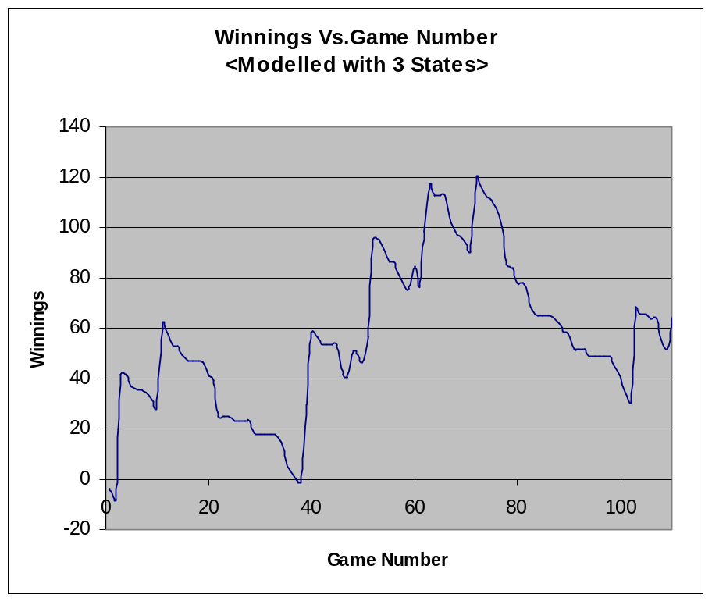
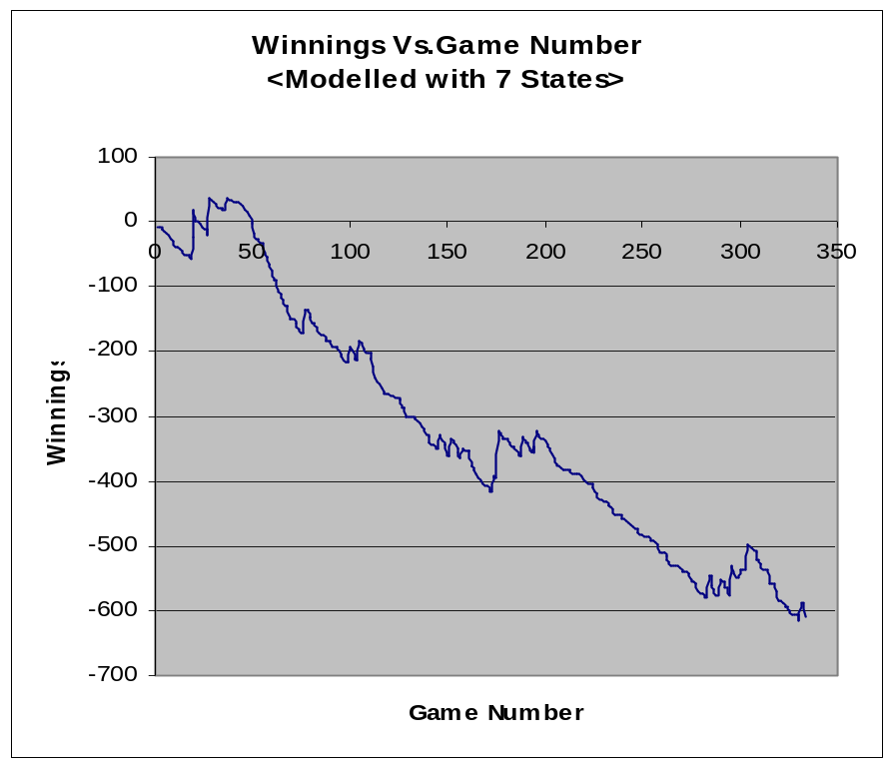
Results
Example of a Successful Agent
Example of a not so Successful Agent

Slide 10
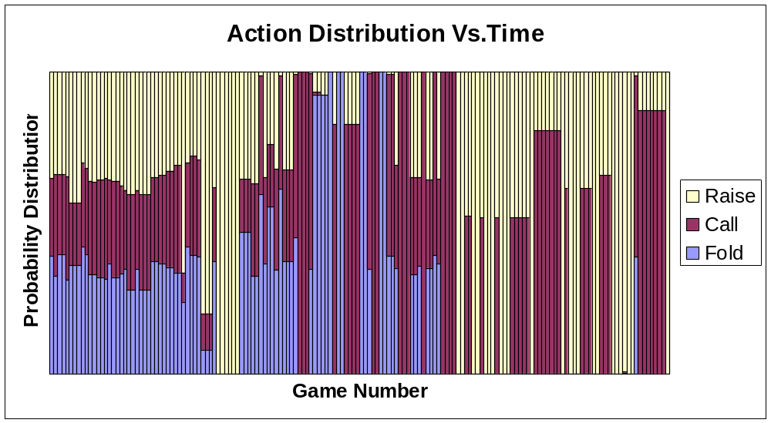
Action Distribution Chart

Slide 11
Conclusions & Future Work
Conclusions
  It was important to try many different test cases to develop a successful learner
  More states did not always lead to better performance
  Larger feature vectors and more states lead to computational inefficiency and numerical issues
Future Work
  Implement EM algorithm on-line to reduce computation time in training and decision processes
  Incorporate more a priori information into feature selection
  Test and train against human players

Slide 12
References
Y. Ivanov, B. Blumberg, A. Pentland. EM For Perceptual Coding and Reinforcement learning Tasks. In 8th International Symposium on Intelligent Robotic Systems, Reading, UK (2000).
Darse Billings, Aaron Davidson, Jonathan Schaeffer, Duane Szafron. The Challenge of Poker, Artificial Intelligence Journal, 2001.
L.P. Kaelbling, M.L. Littman, and A.P. Moore. Reinforcement Learning: A Survey. Journal of Artificial Intelligence Research, 4:237--285, 1996.
M. Jordan and C. Bishop. Introduction to Graphical Models.

