Slide 1
Policies for POMDPs
Minqing Hu

Slide 2
Background on Solving POMDPs
MDPs policy: to find a mapping from states to actions
POMDPs policy: to find a mapping from probability distributions (over states) to actions.
  belief state: a probability distribution over states
  belief space: the entire probability space, infinite

Slide 3
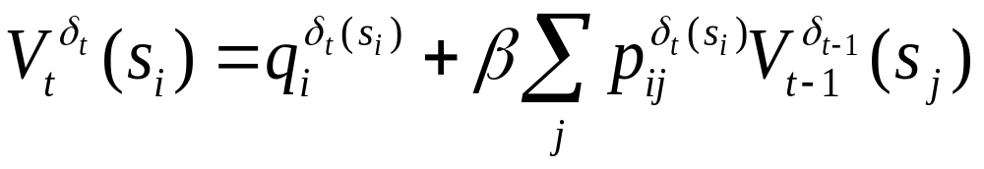
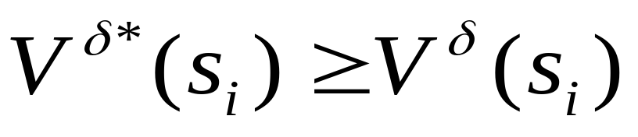
Policies in MDP
k-horizon Value function:
Optimal policy δ*, is the one where, for all states, s_{i} and all other policies,

Slide 4
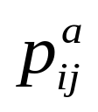
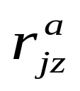
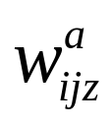
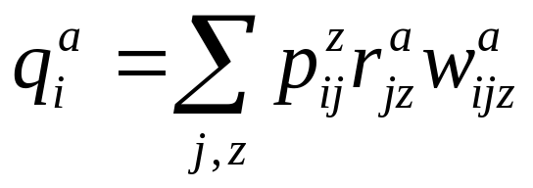
Finite k-horizon POMDP
POMDP: <S, A, P, Z, R, W>
transition probability:
probability of observing z after taking action a and ending in state s_{j}:
immediate rewards:
Immediate reward of performing action a in state s_{i}:
Object: to find an optimal policy for finite k-horizon POMDP
δ* = (δ₁, δ₂,…, δ_{k})

Slide 5

A two state POMDP
represent the belief state with a single number p.
the entire space of belief states can be represented as a line segment.
belief space for a 2 state POMDP

Slide 6
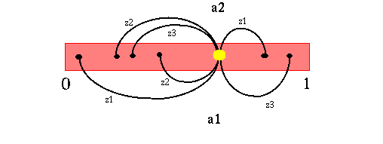
belief state updating
finite number of possible next belief states, given a belief state
  a finite number of actions
  a finite number of observations
b’ = T(b| a, z). Given a and z, b’ is fully determined.

Slide 7
the process of maintaining the belief state is Markovian: the next belief state depends only on the current belief state (and the current action and observation)
we are now back to solving a MDP policy problem with some adaptations

Slide 8
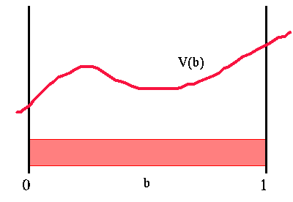
continuous space: value function is some arbitrary function
  b: belief space
  V(b): value function
Problem: how we can easily represent this value function?
Value function over belief space

Slide 9
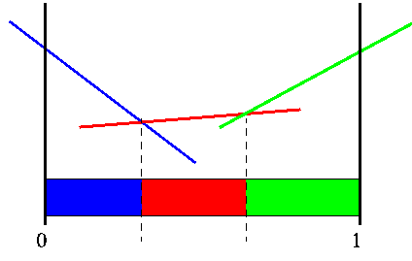
Fortunately, the finite horizon value function is piecewise linear and convex (PWLC) for every horizon length.
Sample PWLC function

Slide 10
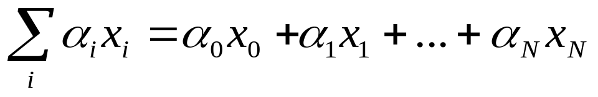
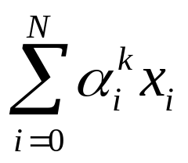

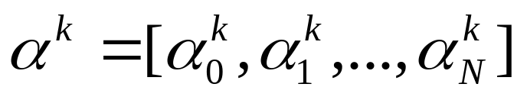
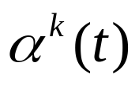
A Piecewise Linear function consists of linear, or hyper-plane segments
  Linear function:
  K^{th} linear segment:
  the -vector
  each liner or hyper-plane could be represented with

Slide 11
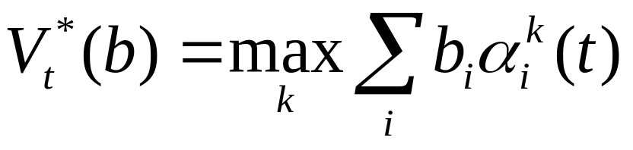
Value function:
a convex function

Slide 12
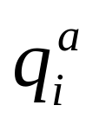
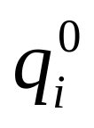
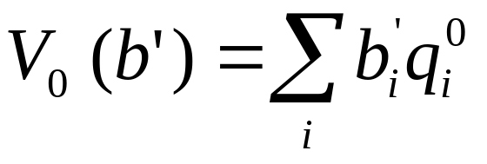
1-horizon POMDP problem
  Single action a to execute
  Starting out belief state b
  Ending belief state b’
    b’ = T(b | a, z)
  Immediate rewards
  Terminating rewards for state s_{i}
  Expected terminating reward in b’

Slide 13
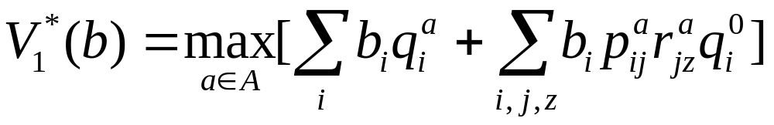
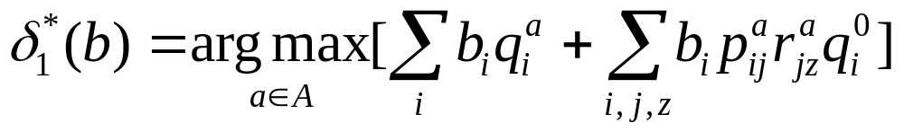
Value function of t =1
The optimal policy for t =1

Slide 14
General k-horizon value function
Same strategy for 1-horizon case
Assume that we have the optimal value function at t – 1, V_{t-1}*(.)
Value function has same basic form as MDP, but
  Current belief state
  Possible observations
  Transformed belief state

Slide 15
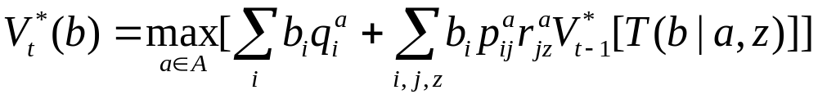
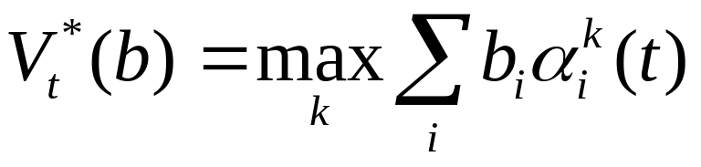
Value function
  Piecewise linear and convex?

Slide 16
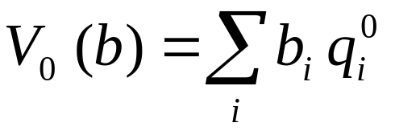
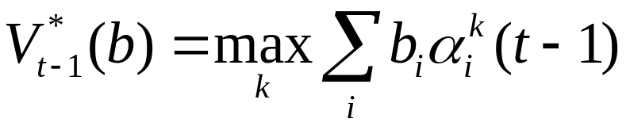
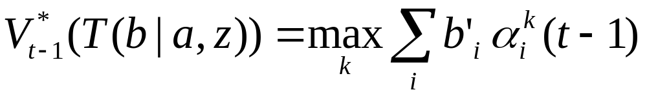
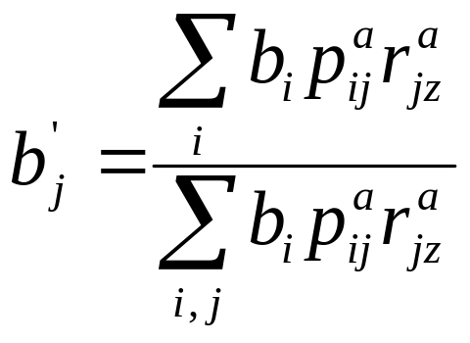
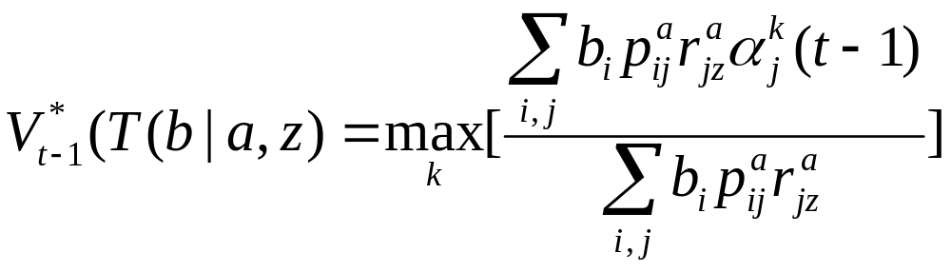
Inductive Proof
Base case:
Inductive hypothesis:
  transformed to:
  Substitute the transformed belief state:

Slide 17
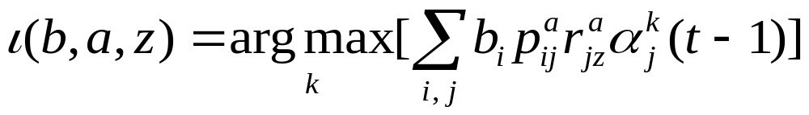
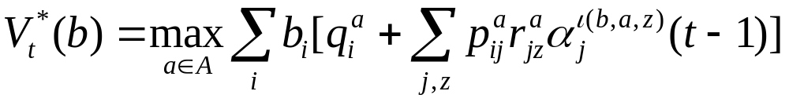
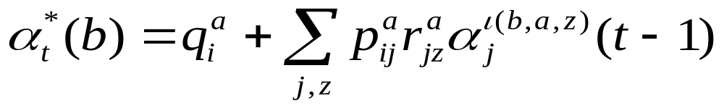
Inductive Proof (contd)
Value function at step t (using recursive definition)
New α-vector at step t
Value function at step t (PWLC)

Slide 18
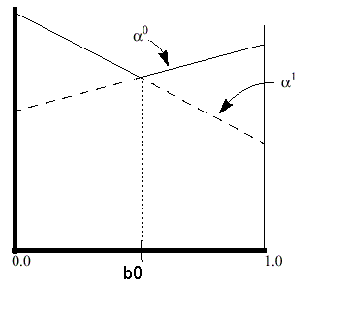
Geometric interpretation of value function
|S| = 2
Sample value function for |S| = 2

Slide 19
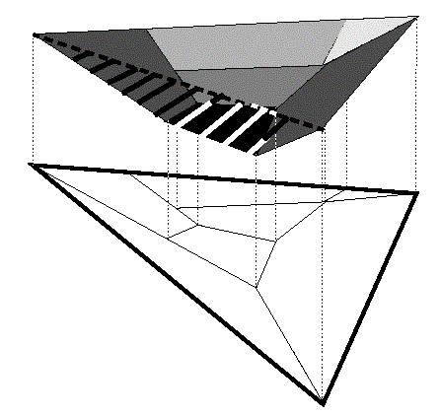
|S| = 3
Hyper-planes
Finite number of regions over the simplex
Sample value function for |S| = 3

Slide 20
POMDP Value Iteration Example
a 2-horizon problem
assume the POMDP has
  two states s1 and s2
  two actions a1 and a2
  three observations z1, z2 and z3

Slide 21
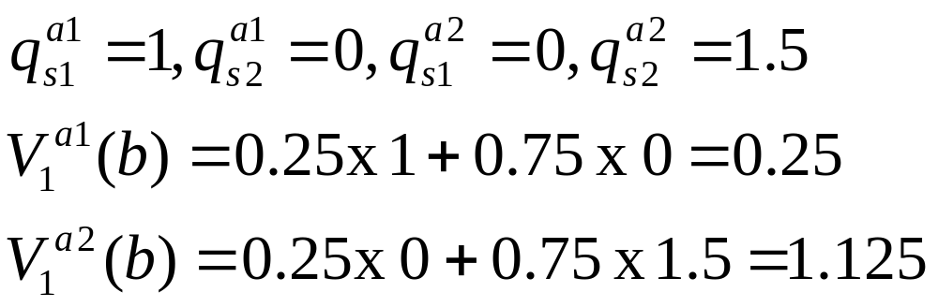
Horizon 1 value function
  Given belief state b = [ 0.25, 0.75 ]
  terminating reward = 0

Slide 22
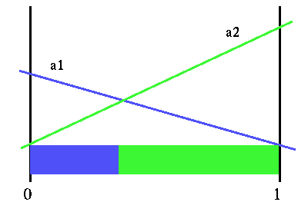
The blue region:
  the best strategy is a1
the green region:
  a2 is the best strategy
Horizon 1 value function

Slide 23
2-Horizon value function
construct the horizon 2 value function with the horizon 1 value function.
three steps:
  how to compute the value of a belief state for a given action and observation
  how to compute the value of a belief state given only an action
  how to compute the actual value for a belief state

Slide 24
Step1:
A restrict problem: given a belief state b, what is the value of doing action a1 first, and receiving observation z1?
The value of a belief state for horizon 2 is the value of the immediate action plus the value of the next action.

Slide 25
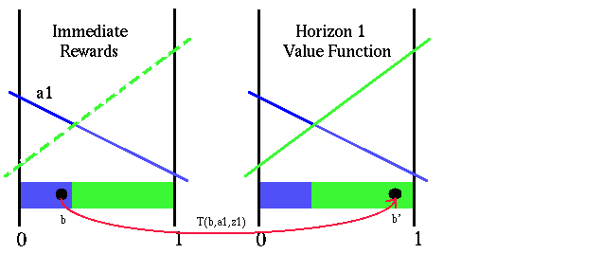
b’ = T(b | a1,z1)
immediate reward function
horizon 1 value function
Value of a fixed action and observation

Slide 26
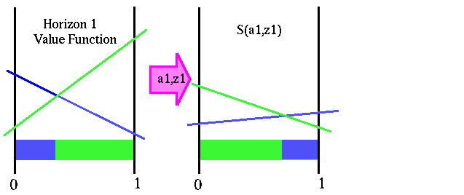
S(a, z), a function which directly gives the value of each belief state after the action a1 is taken and observation z1 is seen

Slide 27
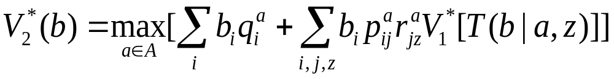
Value function of horizon 2 :
Immediate rewards S(a, z)
Step 1: done

Slide 28
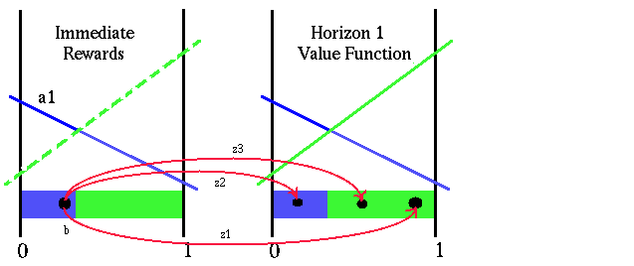
Step 2:
how to compute the value of a belief state given only the action
Transformed value function

Slide 29
So what is the horizon 2 value of a belief state, given a particular action a1?
depends on:
    the value of doing action a1
    what action we do next
      depend on observation after action a1

Slide 30
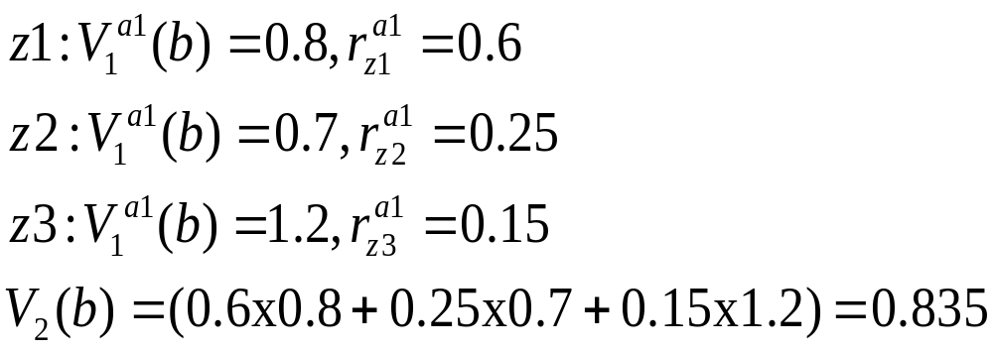
plus the immediate reward of doing action a1 in b

Slide 31
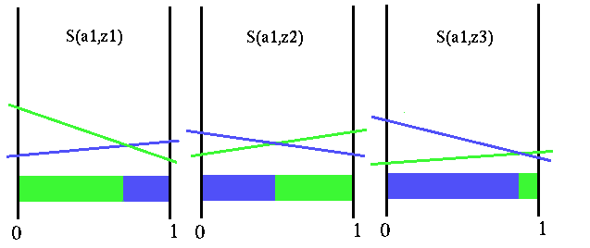
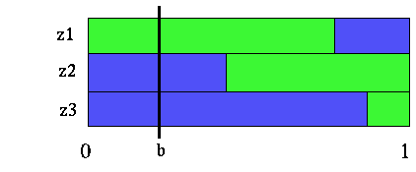
Transformed value function for all observations
Belief point in transformed value function partitions

Slide 32
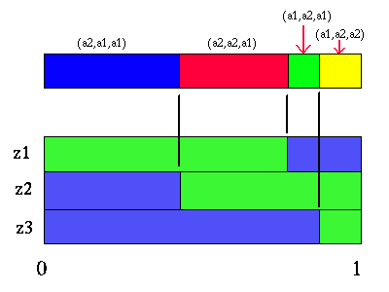
Partition for action a1

Slide 33
The figure allows us to easily see what the best strategies are after doing action a1.
the value of the belief point b at horizon 2
= the immediate reward from doing action a1 + the value of the functions S(a1,z1), S(a1,z3), S(a1,z3) at belief point b.

Slide 34
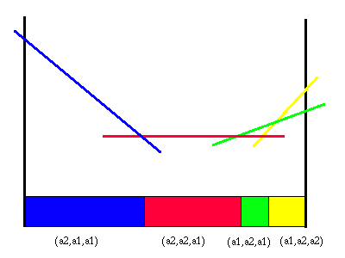
Each line segment is constructed by adding the immediate reward line segment to the line segments for each future strategy.
Horizon 2 value function and partition for action a1

Slide 35
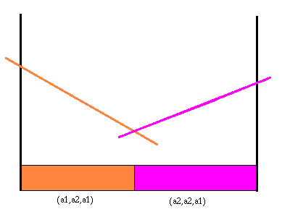
Repeat the process for action a2
Value function and partition for action a2

Slide 36
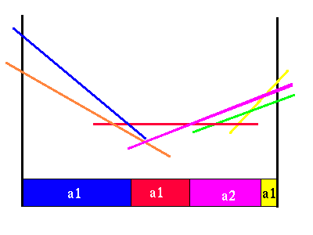
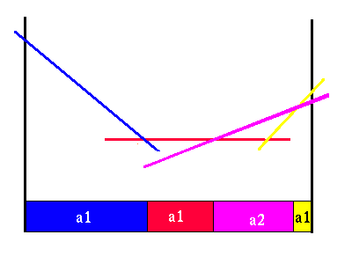
Step 3: best horizon 2 policy
Combined a1 and a2 value functions
Value function for horizon 2

Slide 37
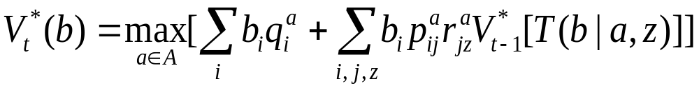
Repeat the process for value functions of 3-horizon,…, and k-horizon POMDP

Slide 38
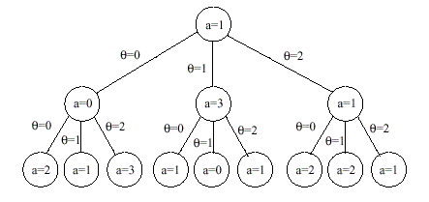
Alternate Value function interpretation
A decision tree
  Nodes represent an action decision
  Branches represent observation made
Too many trees to be generated!

