Slide 1
Career Finder Sprint 1 Presentation
CEN3031-Online Team 6 Robert Caplin Brian Hicks Brian Snow

Slide 2
Career Finder - Background
A career counseling application for a local middle school that should:
be a fun way for students to explore career options they may be unaware of.
allow school staff to manage system content like:
Career Cluster names, icons.
Career names, salary, description, associated DITL and Celebrity articles.
allow school staff to manage student User and staff Admin accounts.
implement a Chat Counselor to make Career Cluster recommendations to students.
track progress and reward students via a point-based system for viewing content in the system.

Slide 3
Career Finder – Tech Stack
MERN
MongoDB
Mongoose
Express
React
Material-UI
Node

Slide 4
Features Delivered During Sprint 1
Deployed Career Finder site.
CF09. Celebrity Profile Page
A page to display celebrity profiles.
Material-UI Front End
Log-in page
main page
career page
DITL page
celebrity profile page

Slide 5
Resource Allocation
Brian Hicks
System Context Model
CF09 Front and Back end development
Material-UI Front End
Brian Snow
User Authentication
Bob Caplin
Story Map
Wireframes
Presentation
CF09 test case

Slide 6
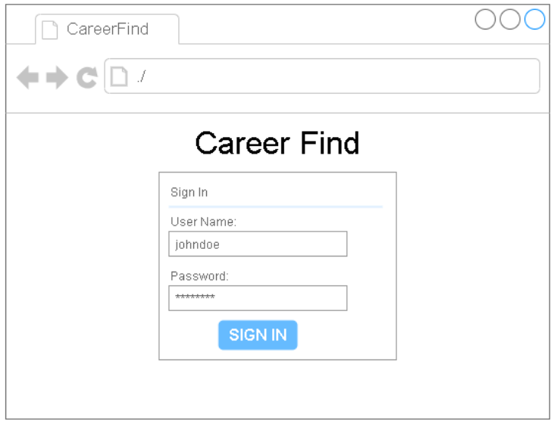
Wireframes – User Authentication
User Login Page: Users of type ‘Student’ and ‘Admin’ can log in with valid credentials.

Slide 7
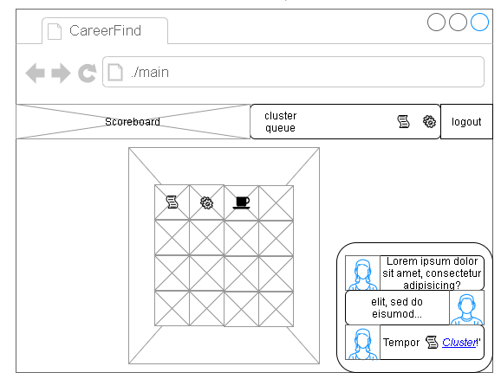
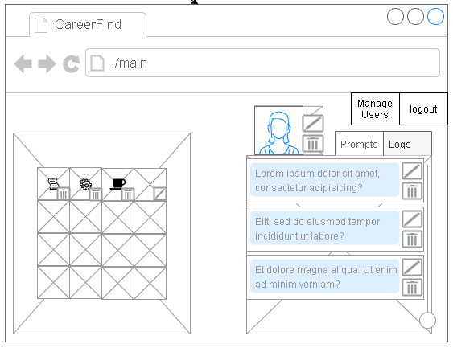
Wireframes – Student and Admin Main Pages
Student Main Page: Displays Career Cluster links and allows User to interact with Chat Counselor.
Admin Main Page: Career Cluster and Chat Counselor management. User Management.

Slide 8
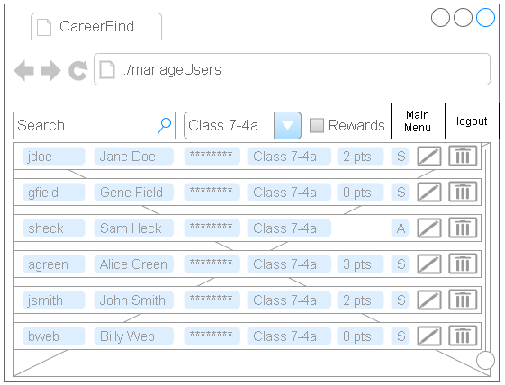
Wireframes – User Management (Admin)
Create, Read, Update, Delete ‘Student’ and ‘Admin’ User types.
‘Student’ accounts track progress via points when ‘Rewards’ system enabled.
Users can be assigned to and filtered by ‘Class’.

Slide 9
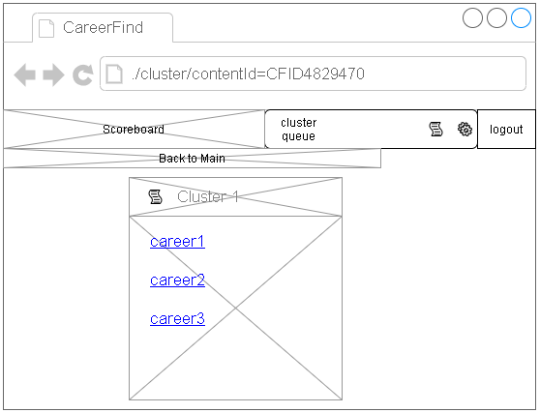
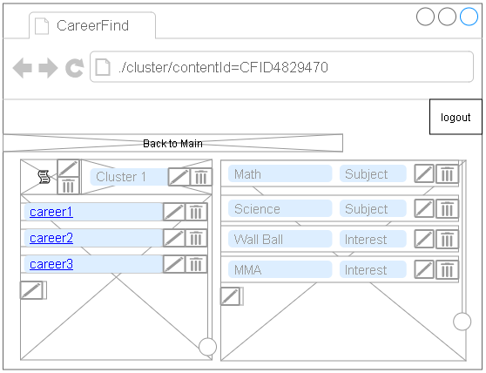
Wireframes – Cluster Detail/ Career List Pages
Student – Drilling down into cluster displays links for associated careers.
Admin – Drilling down into cluster allows it to be edited and associated to keywords, careers.

Slide 10
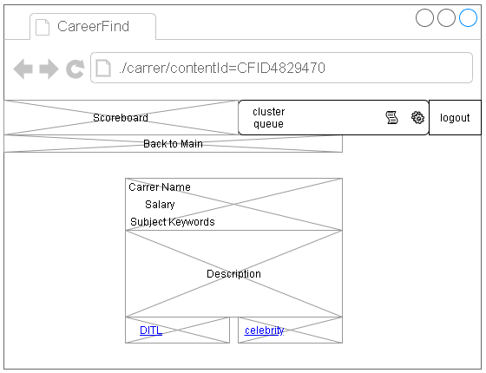
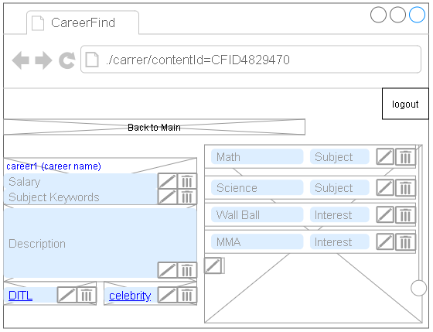
Wireframes – Career Detail Page
Student – Displays Career base data, links to associated DITL and Celebrity profile if available.
Admin – Editable Career base data, links to associated DITL and Celebrity profile, keywords.

Slide 11
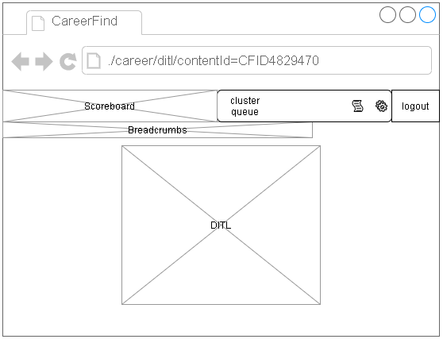
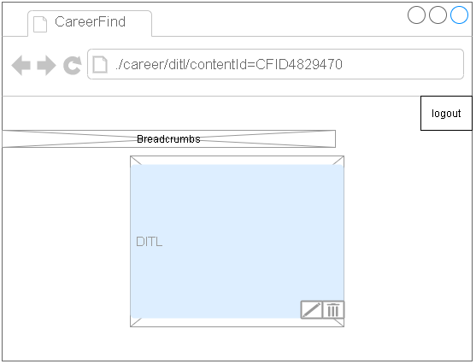
Wireframes – Career DITL
Student – Able to read DITL article.
Admin – Able to edit Day-in-the-Life article.

Slide 12
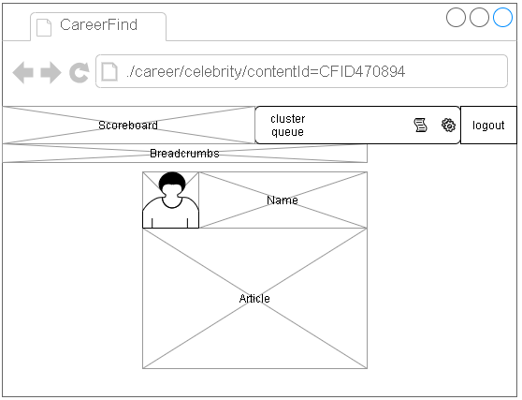
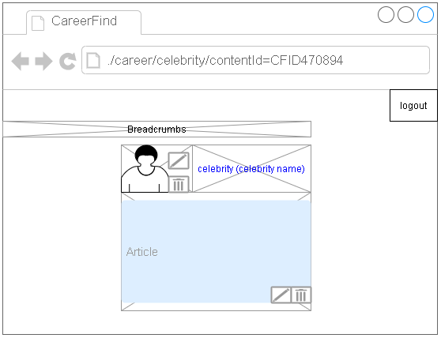
Wireframes – Career/ Celebrity Profile
Student – Able to view celebrity photo, name, and article if available.
Admin – Able to edit celebrity photo and article if available.

Slide 13
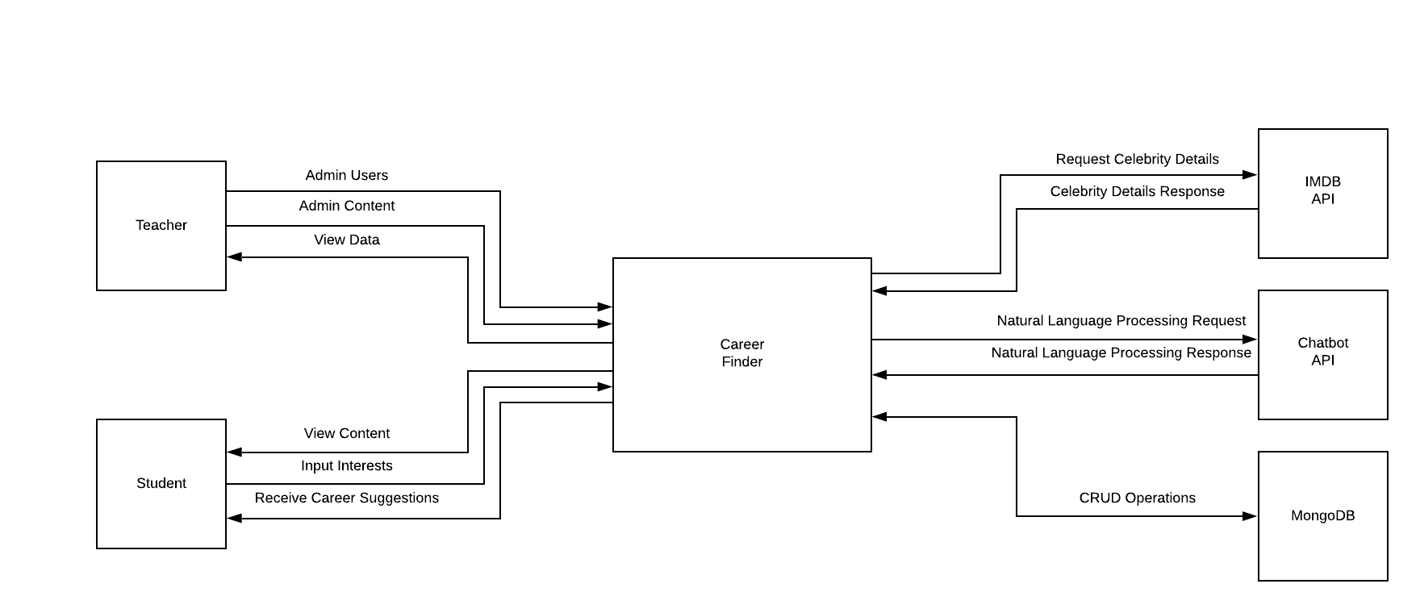
System Context Model

Slide 14
Materials Used (Sources)
CEN3031-Online Bootcamps and associated materials

Slide 15
Career Finder Demo
https://nameless-gorge-50235.herokuapp.com/
Demonstration of current functionality.
Questions?

