Slide 1
Chart #1
What type of license can I earn from passing these exams?
Type of license
General Radiotelephone Operator’s License (GROL)
GMDSS Radio Operator’s License
Restricted GMDSS Radio Operator’s License
GMDSS Radio Maintainer’s License
GMDSS Radio Operator/Maintainer License
Marine Radio Operator Permit
Ship Radar Endorsement
Tip: To navigate between the first level copy and the first level bullet, use the Indent and Outdent button on the Home Ribbon.
Once you are on the second, and third level bullets, you can Tab and Shift-Tab to go back and forth between the bullet levels.

Slide 2

Chart #2
What elements are required for your FCC license?
Type of license | Written Elements
Written Exam Elements | 1 | 3 | 6 | 7 | 7R | 8 | 9
General Radiotelephone Operator’s License (GROL)
GMDSS Radio Operator’s License
Restricted GMDSS Radio Operator’s License
GMDSS Radio Maintainer’s License
GMDSS Radio Operator/Maintainer License
Marine Radio Operator Permit
Ship Radar Endorsement
Tip: To navigate between the first level copy and the first level bullet, use the Indent and Outdent button on the Home Ribbon.
Once you are on the second, and third level bullets, you can Tab and Shift-Tab to go back and forth between the bullet levels.

Slide 3
Chart #3
How many questions are on your elements exams?
Example: Element 1 consists of 24 questions from a questions pool 144 questions, and
you must answer 18 questions (75%) correctly to pass.
Written Elements | Number of questions on the exam | Number of correct questions, required to pass | Number of questions in the pool
Element 1 | 24 | 18 | 144
Element 3 | 76 | 57 | 600
Element 6 | 100 | 75 | 617
Element 7 | 100 | 75 | 600
Element 7R | 50 | 38 | 300
Element 8 | 50 | 38 | 300
Element 9 | 50 | 38 | 300
Tip: To navigate between the first level copy and the first level bullet, use the Indent and Outdent button on the Home Ribbon.
Once you are on the second, and third level bullets, you can Tab and Shift-Tab to go back and forth between the bullet levels.

Slide 4
Road to your FCC GROL/Radar Endorsement
Start
Fill-out forms:
1) FCC 605-Main Form
2) FCC 605-Schedule E
Mail to FCC:
1) FCC 605-Main Form
2) FCC 605-Schedule E
3) Original Proof-Of-Passing Certificate
Become a member of PassFCCExams.com
Start studying your FCC element exams
Register for your FCC Registration Number (FRN)
Within 6-8 weeks you will receive your FCC license
Score 90% consistently on your practice exams
Retained your
Original Proof-Of-Passing certificate
CONGRATULATION!!
Schedule your exam date with PSIEXAMS
Take and pass your FCC element exams

Slide 5
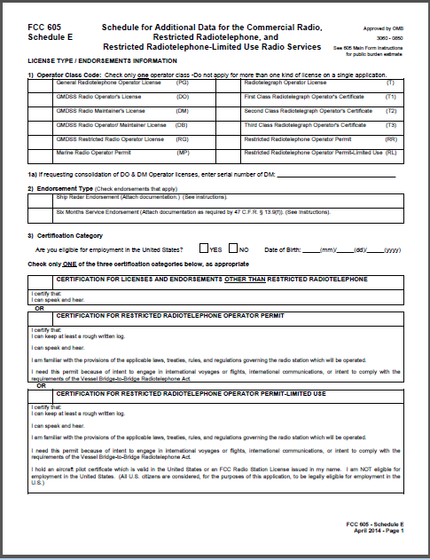
Ship Radar Endorsement form FCC 605 Schedule E
1
3
1) Check the box “General
Radiotelephone Operator
license”
3) Check the box “Are you
Eligible for employment
In the united States”
4
2
3) Fill-out your “Date of Birth
2) Check the box "Ship
Radar Endorsement”
5
3) Check the box “Certification for
Licenses And endorsements other
than restricted radiotelephone”

Slide 6
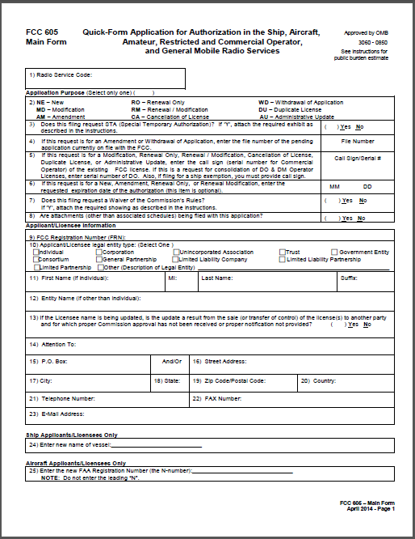
General Radiotelephone Operator License (GROL) FCC 605 Main Form
2) Select NE-New for
“Application Purpose”
3) Put “N” in the box for NO
9) Fill-out your “FCC
Registration Number
(FRN)”
7) Put “N” in the box for NO
Select “Individual’ for
Applicant/Licensee legal
entity type
8) Put “N” in the box for NO
Fill-out your First Name,
MI, and Last Name
15, 16, 17, 18, 19, 20) fill-out your
PO Box, or Street Address, City,
State, Zip Code, and Country
21) Fill-out your Telephone
Number. 22) Your fax Number,
if you have one.
23) Fill-out your E-mail Address

Slide 7
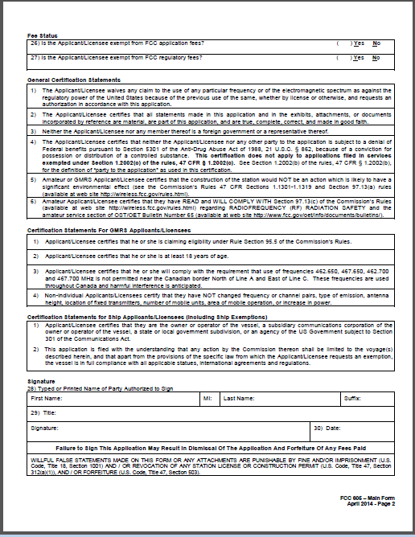
General Radiotelephone Operator License (GROL) FCC 605 Main Form
26) Put “Y” in the box “Is the
Applicant/Licensee exempt
from FCC Application fees?”
27) Put “Y” in the box “Is the
Applicant/Licensee exempt
from FCC regulatory fees?”
28) Fill-out your “First name,
MI, and Last name”
30) “Signature and Date”
”

