Slide 1
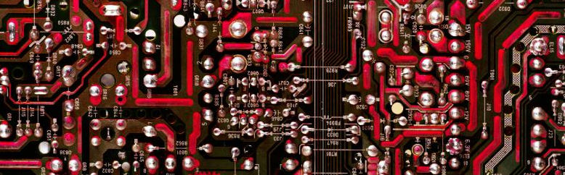
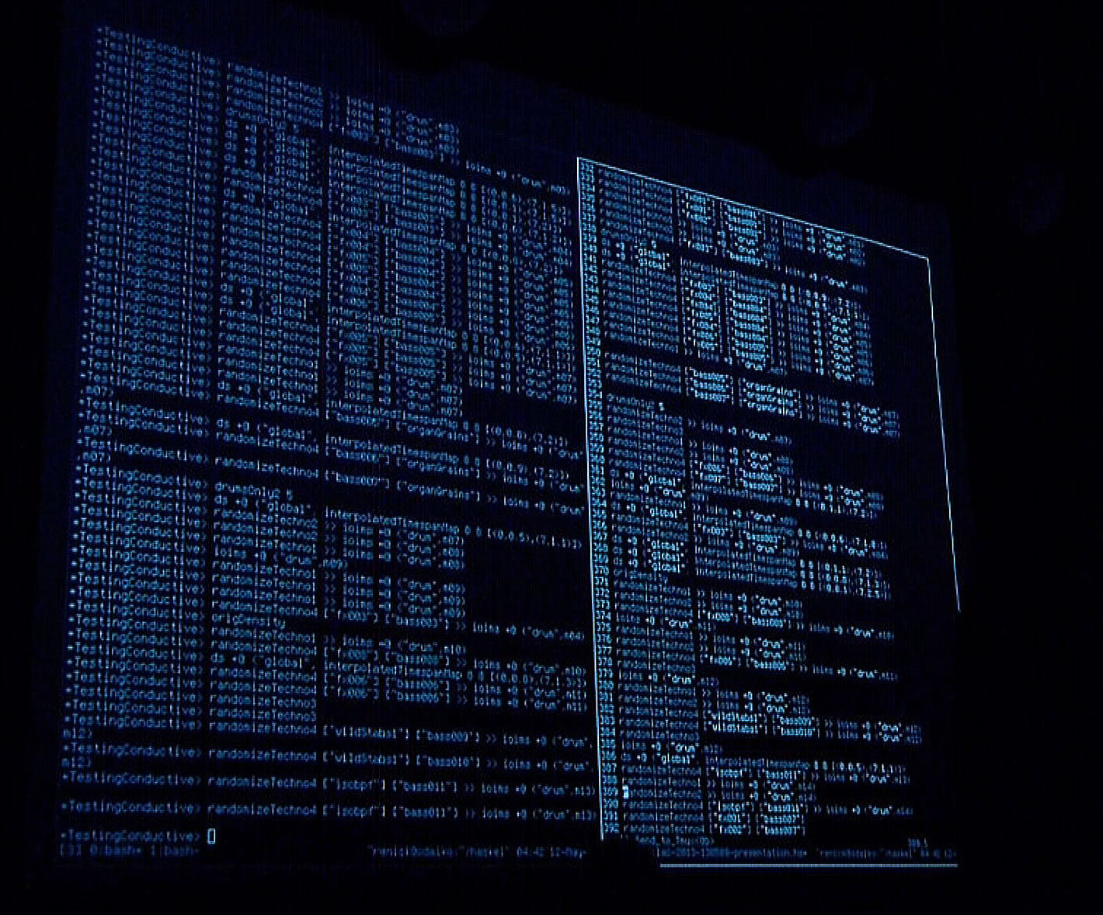
Introduction to Linux
Y. Collette (ycollette.nospam@free.fr)
https://audinux.github.io

Slide 2
The Live Coding 1/5
SuperCollider : https://supercollider.github.io
Play {sinosc.ar (onepole.ar (mix (lfsaw.ar ([1,0.99], [0,0.6], 2000,2000) .trun ([400,600])*[1, -1]), 0.98).
https://www.youtube.com/watch?v=wNWFSIadAH8
Chuck : https://chuck.cs.princeton.edu
CSound : https://github.com/csound/csound
// set the global gain
.1 => dac.gain;
// connect
SinOsc a => dac;
110.0 => a.freq;
1::second => now;
SinOsc b => dac;
220.0 => b.freq;
sr = 44100
ksmps = 32
nchnls = 2
0dbfs = 1
instr 1
iflg = p4
asig oscils .7, 220, 0, iflg
outs asig, asig
miniAudicle
QuteCsound
https://www.youtube.com/watch?v=BHooZu5xzAs
https://www.youtube.com/watch?v=vNrRdyDIniQ

Slide 3
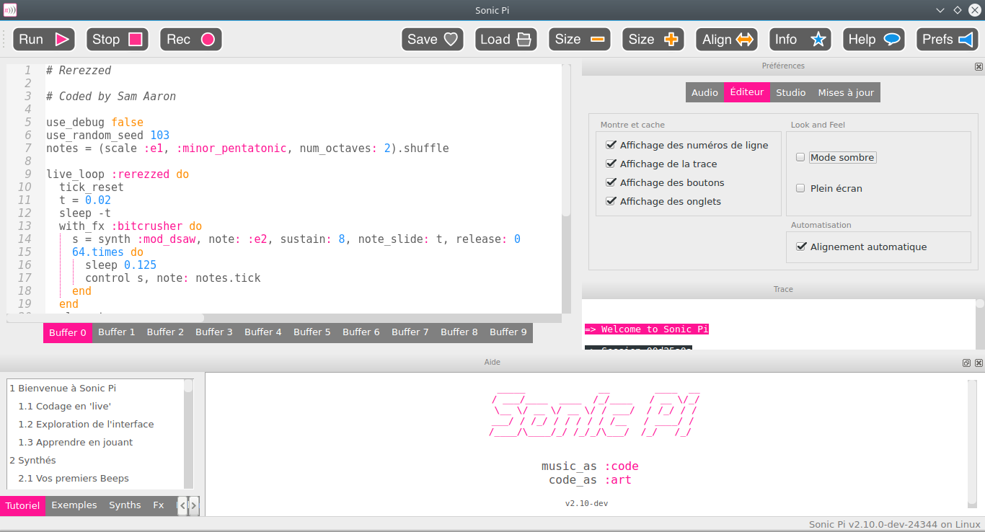
The Live Coding 2/5
https://sonic-pi.net

Slide 4
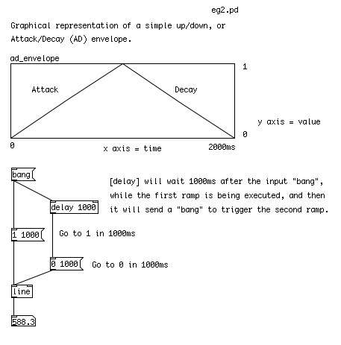
The Live Coding – 3/5
Pure Data : https://puredata.info
A visual programming tool dedicated to audio and video.

Slide 5
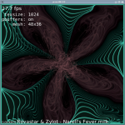
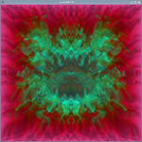
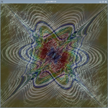
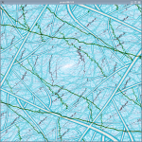
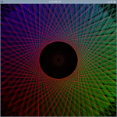
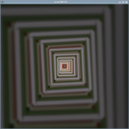
The Live Coding – 4/5
ProjectM: a video diffuser synchronized at the audio
https://github.com/projectm-visualizer/projectm
ProjectM code from Winamp.
To launch the Jack version of Projectm
$ projectM-jack
To launch the Pulseaudio version of Projectm
$ projectM-pulseaudio
F1: Help
F2: song title
F3: Preset name
F4: Rendering configuration
F5: FPS
F11: Full screen
L: Ventu / delay the preset
M: displays the menu
A: random preset
N: Next preset
P: Previous preset

Slide 6
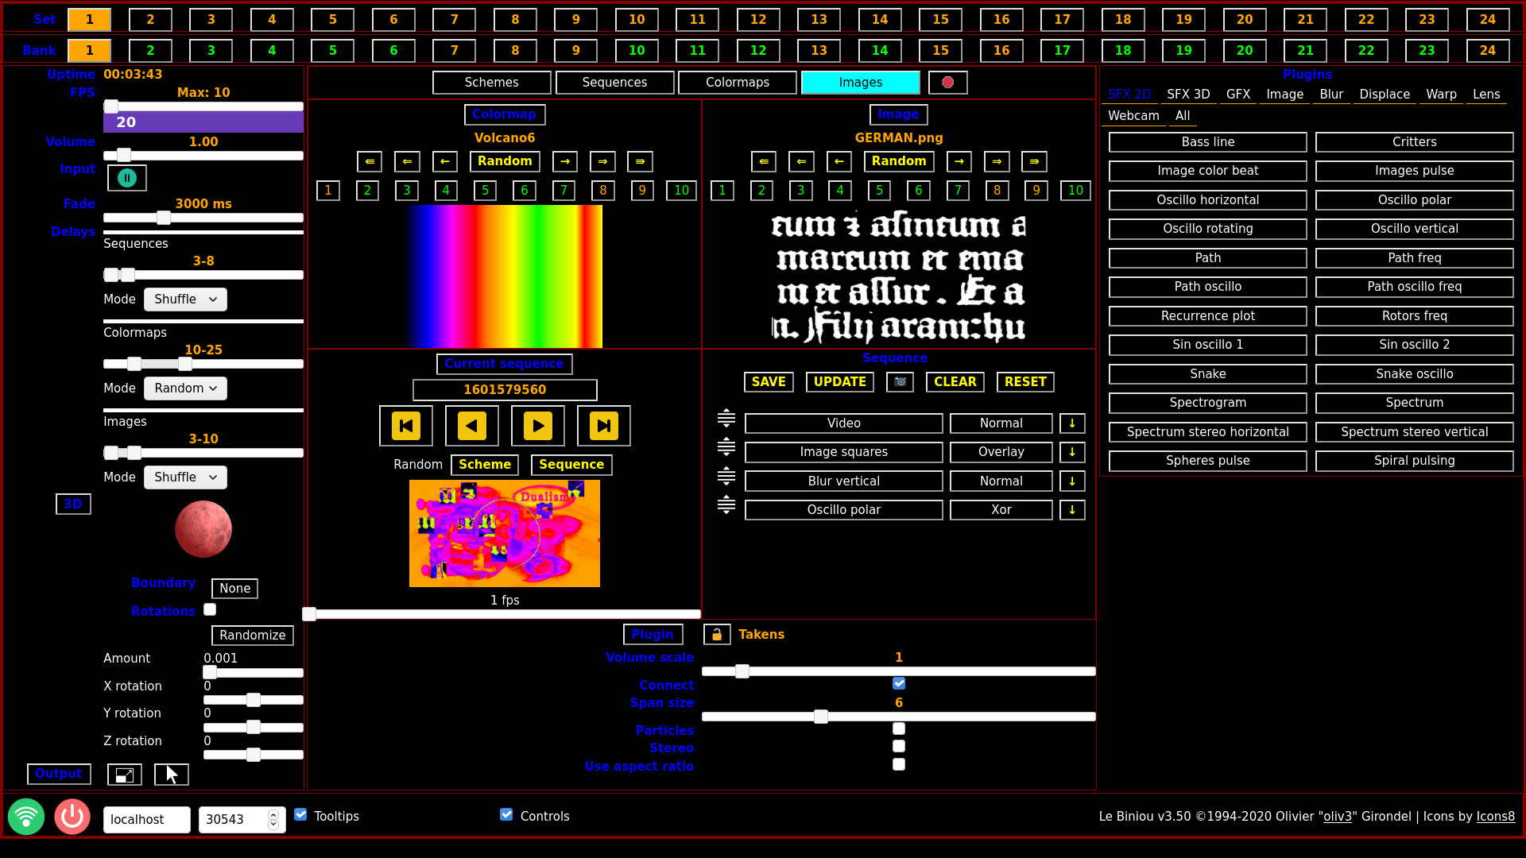
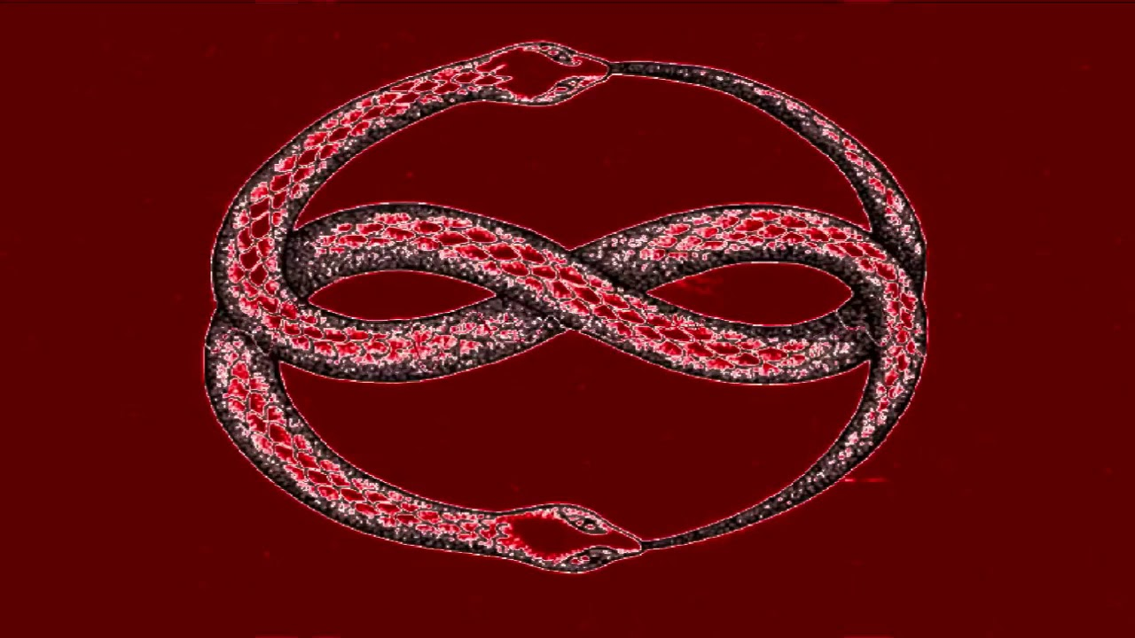
The Live Coding – 5/5
https://biniou.net
To start Lebiniou:
$ lebiniou -Input Jackaudio
And in the event of a conflict on access to the webcam:
$ lebiniou -Input Jackaudio -Wabcams 0
Lebiniou starts a control window (left) and an animation window (right).
You must then connect the lebiniou input to an audio output.

Slide 7
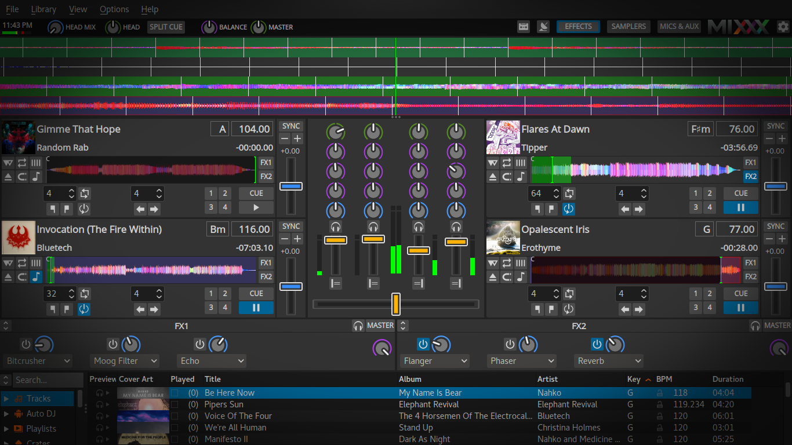
Mixxx
For the Djing
https://www.mixxx.org

Slide 8
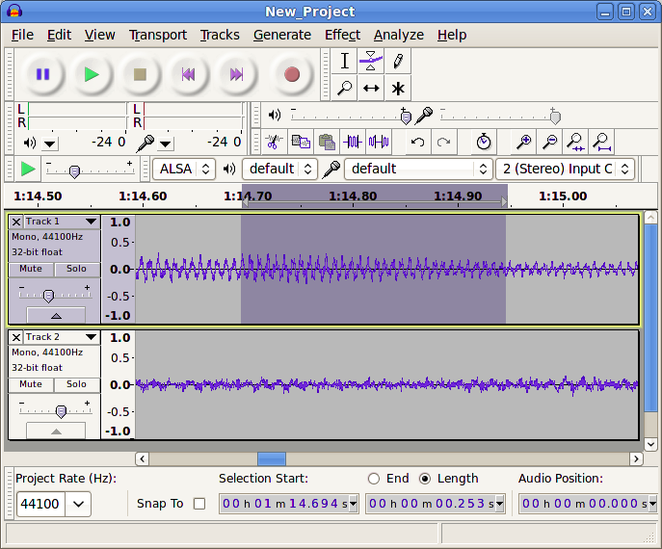
Audacity
The audio editor
When we use Audacity with Jack, take care to adjust the sampling frequency:
Edition → Preferences → Quality
It will be necessary to match this sampling frequency with that of Jack.
https://www.audacityteam.org/

Slide 9
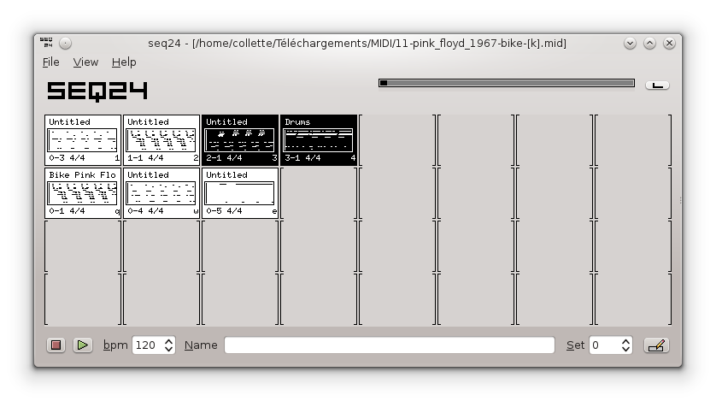
SEQ24
A matrix sequencer
https://launchpad.net/seq24
https://github.com/ahlstromcj/sequencer64

Slide 10
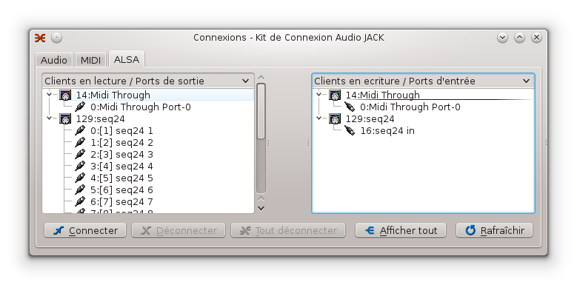
SEQ24
Jack side
Recommended command line start:
$ seq24 -m
-M, - -Manual_alsa_ports: SEQ24 will not reserve Alsa ports

Slide 11
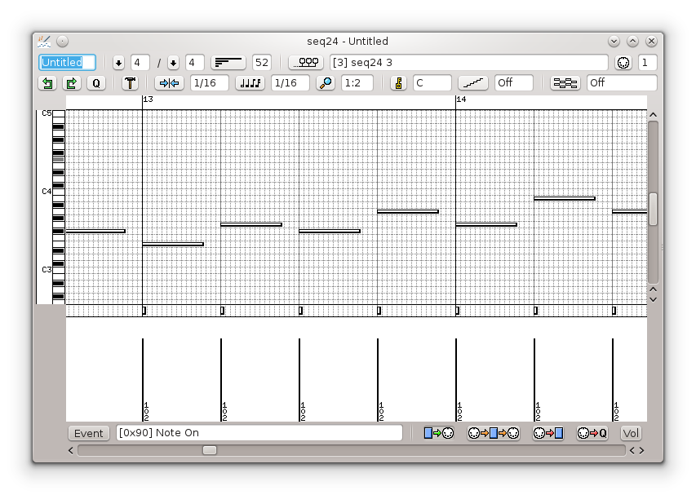
SEQ24
The MIDI editor
seq192
seq24
seq42
seq66

Slide 12
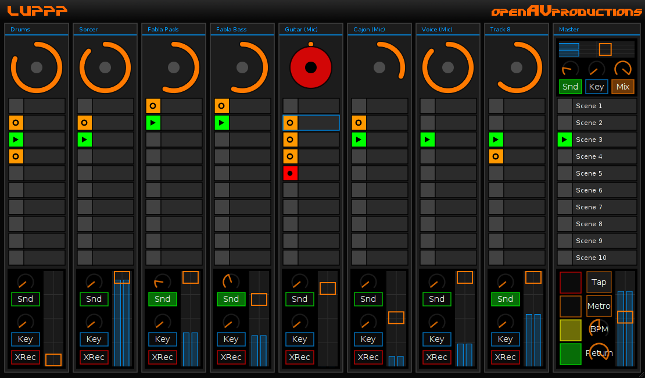
OPENAV / LUPPP
A matrix sequencer
http://openavproductions.com/luppp

Slide 13
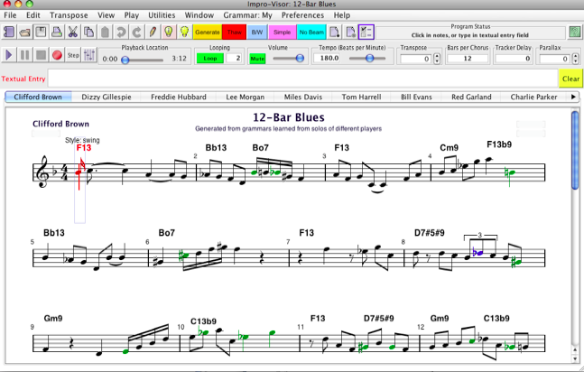
Improvisor
For jazz
$ dnf install Impro-Visor
https://www.cs.hmc.edu/~keller/jazz/improvisor/

Slide 14
Improvisor
For jazz
To connect improvisor to Qsynth, you must launch the MIDI virtual interface of Alsa:
$ sudo modprobe snd-virmidi
We obtain 4 Virtual Raw Midi as shown the following image:
In Alsa Out, we have:
14: Midi Through
20: Virtual RAW MIDI 1-0
21: Virtual RAW MIDI 1-1
22: Virtual RAW MIDI 1-2
23: Virtual RAW MIDI 1-3
In Alsa in, we have:
14: Midi Through
20: Virtual RAW MIDI 1-0
21: Virtual RAW MIDI 1-1
22: Virtual RAW MIDI 1-2
23: Virtual RAW MIDI 1-3
128: Timidity
After that, just connect improvisor to a virtual Rawmidi and Qsynth input to a virtual Rawmidi output.

Slide 15
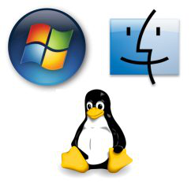
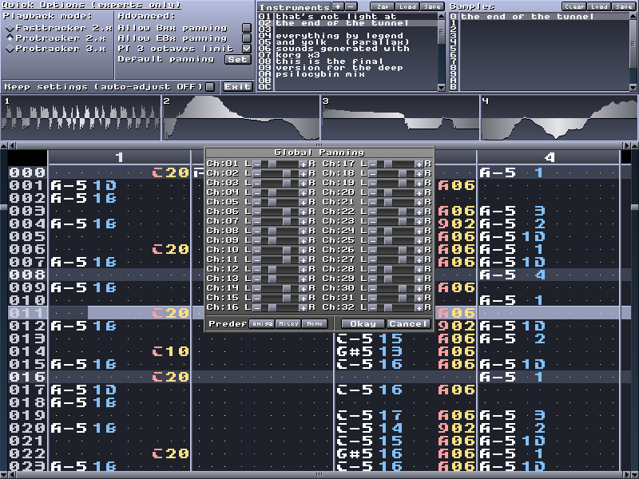
Milkytracker
https://milkytracker.org/
Historical
Soundtracker – 1987 (Amiga)
Protracker – 1990 (Amiga)
Octamed – 1991 (Amiga)
Scream Tracker 3 – 1993 (PC)
Fast Tracker 2 – 1995 (PC)
Impulse Tracker 2 – 1996 (PC)
Renoise – 2000 (PC & Mac)
Skaletracker – 2003 (PC)
File type :
XM - MOD - IT - S3M
See Wikipedia article

Slide 16
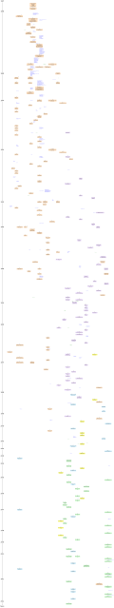
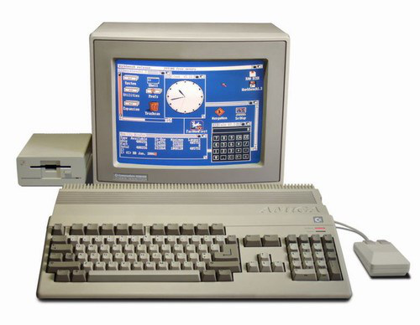
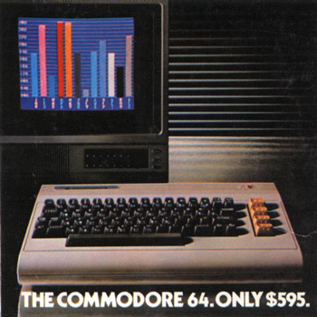
Milkytracker
https://upload.wikimedia.org/wikipedia/commons/1/14/Trackers-historygraph-2012-01.svg
Amiga - 1987
Commodore - 1982

Slide 17
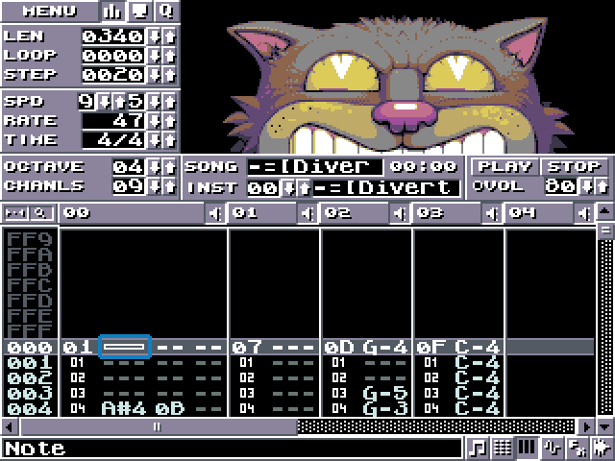
Klystrack
https://kometbomb.github.io/klystrack/

Slide 18
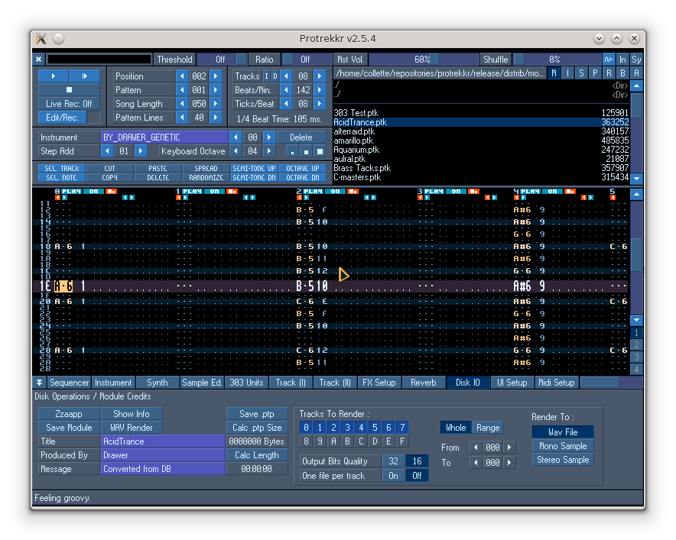
Protrekkr
https://github.com/falkTX/protrekkr
Two versions of Protrekkr exist:
- an OSS version
- a jack version
The version hosted on Github is Jack compatible.

Slide 19
Trackers
$ dnf install BambooTracker
$ dnf install famitracker
$ dnf install fasttracker2
$ dnf install goatracker
$ dnf install hivelytracker
$ dnf install plebtracker
$ dnf install protracker2
$ dnf install schismtracker
$ dnf install tiatracker
$ dnf install soundtracker
$ dnf install furnace
$ dnf install protrekkr
$ dnf install protrekkr2
$ dnf install tutka
$ dnf install zytrax

Slide 20
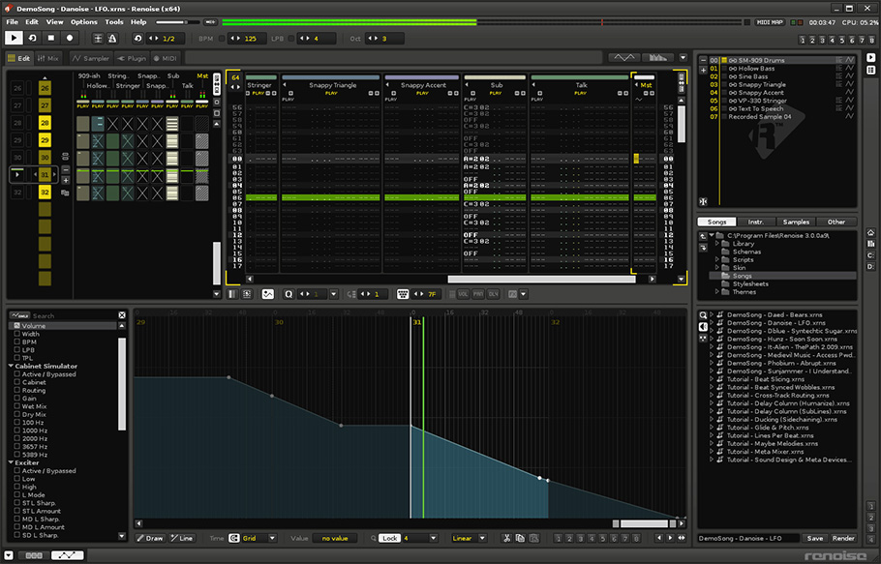
Renoise
https://www.renoise.com

Slide 21
Various
Files for Protrekkr and Milkytracker:
https://modarchive.org
Rivendell - Open Source radio
https://www.rivendellaudio.org
Jack Net / Jamulus / Ninjam
Music via Internet
https://jamulus.io
https://www.cockos.com/ninjam

Slide 22
Webography
Presets of all kinds for Linux tools:
https://musical-artifacts.com
Sources of samples:
https://freesound.org
https://archive.org
https://wiki.laptop.org/go/free_sound_samples
Documentations of various tools:
https://en.flossmanuals.net
Community site:
http://linuxmao.org/accueil
https://librearts.org/
https://www.linuxaudio.org
https://linuxmusicians.com
https://linuxdaw.org/
Files for mixing:
Nine Inch Nails songs:
https://nindestruct.com/remix.html
Different songs:
https://www.cambridge-mt.com/ms/mtk
Live Coding resources:
https://sccode.org/

