Slide 1
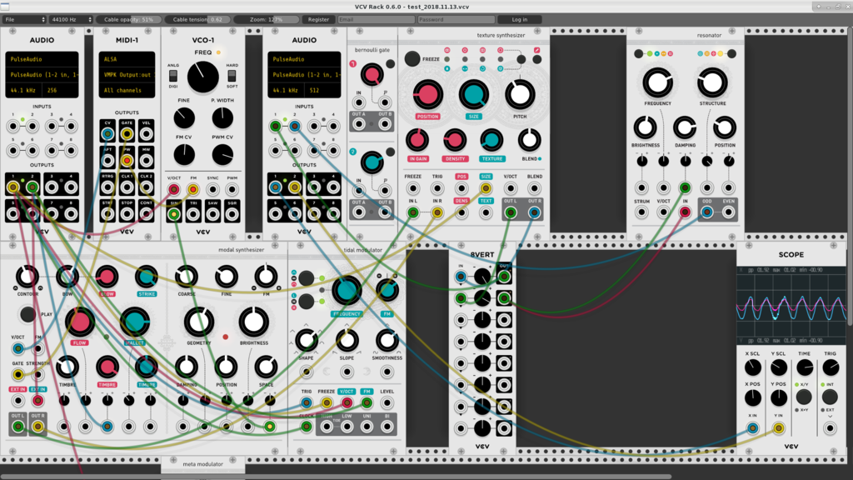
VCVRack
Y. Collette (ycollette.nospam@free.fr)
http://ycollette.free.fr

Slide 2
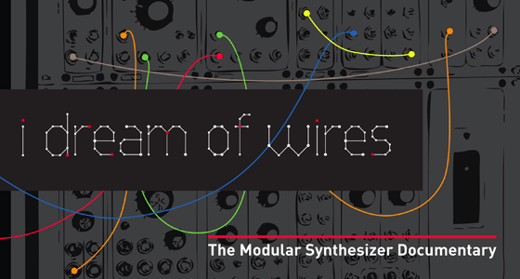
Modular Synthesis
http://www.idreamofwires.org/
A documentary on modular synthesis.

Slide 3
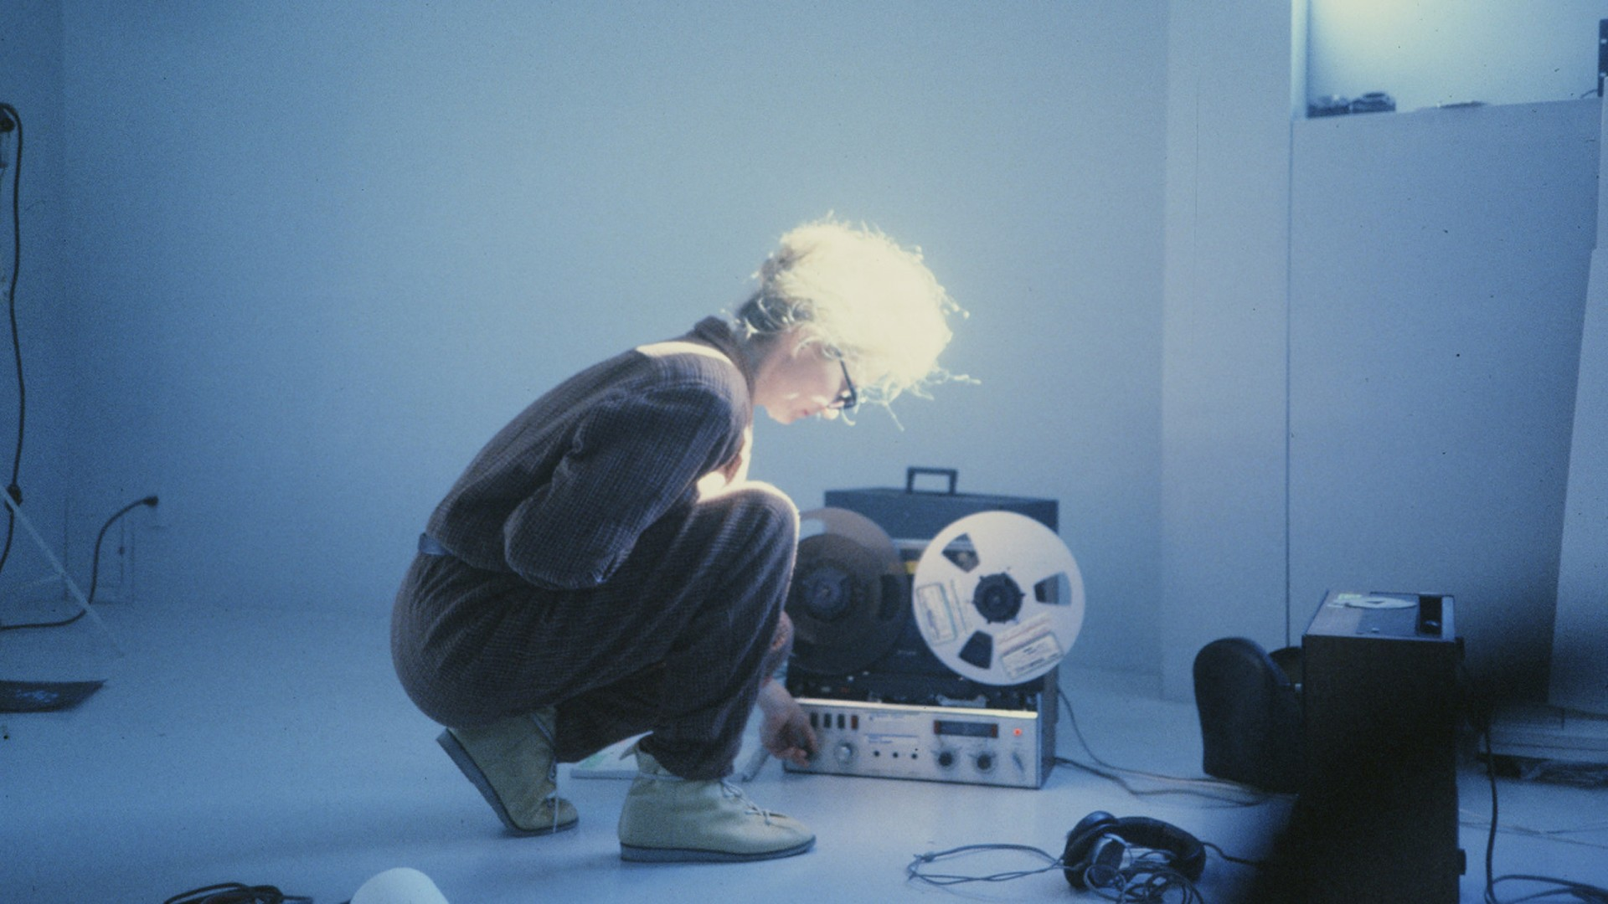
Modular Synthesis
https://sisterswithtransistors.com/
A documentary on the female pioneers of modular synthesis.

Slide 4
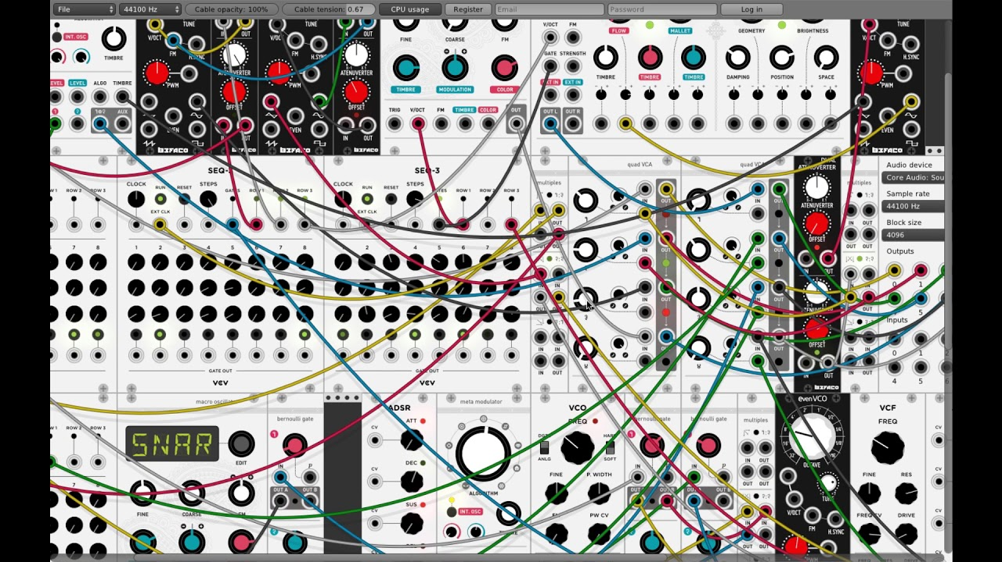
VCVRack
https://vcvrack.com/

Slide 5
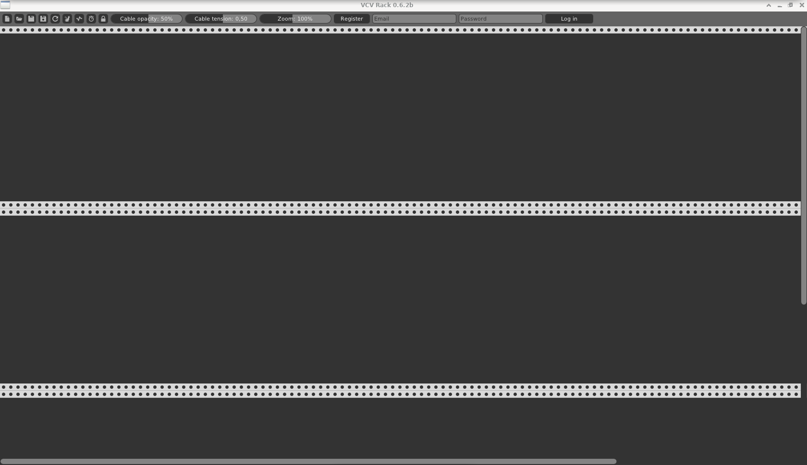
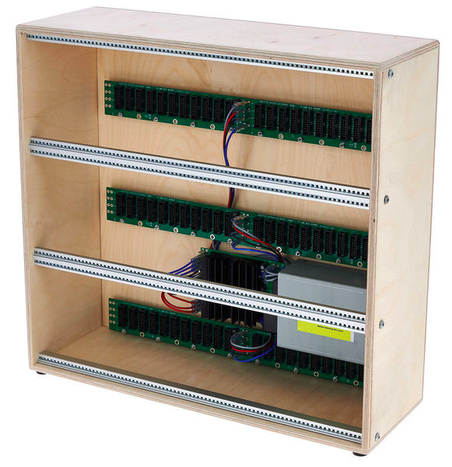
The starting Window
$ Rack &

Slide 6




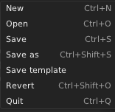

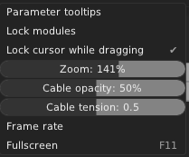
Menu bar

Slide 7
Before we start
We will use the following modules from VCV Rack :
- Fundamental - https://vcvrack.com/Fundamental
- SV modular - https://vcvrack.com/DrumKit
- AS - https://library.vcvrack.com/AS
- Impromptu - https://library.vcvrack.com/ImpromptuModular
- Audible Instruments - https://library.vcvrack.com/AudibleInstruments
- Squinky labs - https://library.vcvrack.com/squinkylabs-plug1
- aridacity - https://library.vcvrack.com/aridacity
- Befaco - https://vcvrack.com/Befaco
- Eseries - https://vcvrack.com/ESeries
- Aaron Static - https://library.vcvrack.com/AaronStatic
- BogAudio - https://library.vcvrack.com/Bogaudio
- Valley - https://library.vcvrack.com/Valley
- Bark - https://library.vcvrack.com/Bark

Slide 8
Before we start
To install these modules :
- on MacOS / Windows : create an account (it’s free) and then click on each of the links and register to this module. An installation will be perfomed and once this is done, you will have to restart VCV Rack.
On Linux / Fedora :
$ dnf install rack-v1-DrumKit rack-v1-AS rack-v1-ImpromptuModular \
rack-v1-AudibleInstruments rack-v1-squinkylabs-plug1 \
rack-v1-aridacity rack-v1-Befaco rack-v1-ESeries \
rack-v1-AaronStatic rack-v1-Bogaudio \
rack-v1-Valley rack-v1-Bark
And then start Rack &.

Slide 9
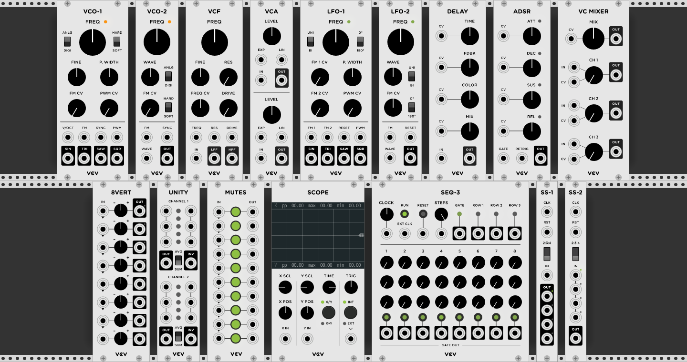
Fundamental Modules

Slide 10
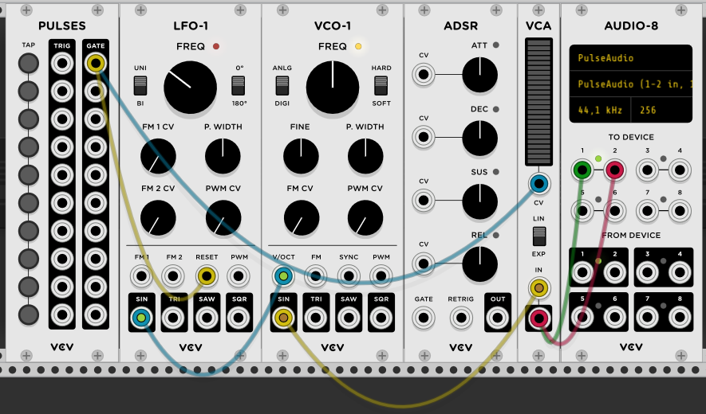
Fundamental Modules
The fundamental modules gives you access to all the basic modules we can find in modular synthesis. Really useful to learn modular synth.
We will present all these modules some slides after ...

Slide 11
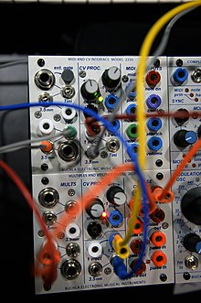
VCV Rack
Control Voltage / Gate /Trigger
Two methods exist to control via a voltage (CV) :
The CV (in octave per volt), which Robert Moog invented, is used by the majority of modular synth manufacturer, and also by the EuroRack norm.
To go to the next octave, you just have to add one volt (this will multiply by 2 the frequency), and substract one volt to go to the lowest octave (this will divide the frequency by 2).
The GATE signal is used to notify the switching on / off of an action.
The TRIGGER signal is a pulse notifying the switching on / off of an action.
https://fr.wikipedia.org/wiki/CV/gate

Slide 12
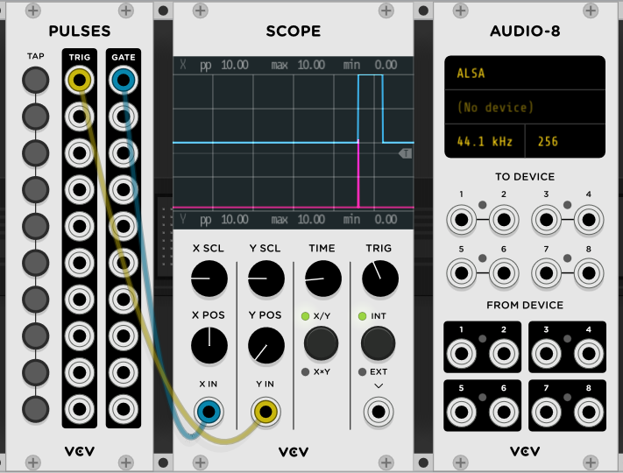
Gate / Trigger

Slide 13
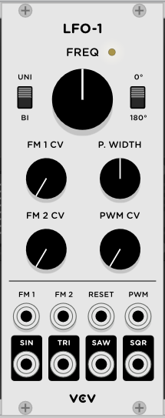
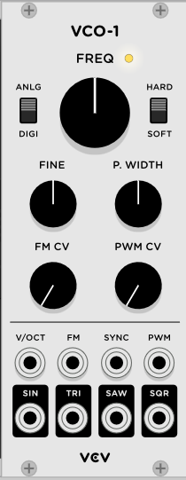
VCO / LFO
VCO : Voltage Control Oscillator
Black connectors : outputs
Grey connectors : CV inputs
This oscillator produces audible frequencies
LFO : Low Frequencies Oscillator
The oscillator produces low frequencies. It will be used to control other devices.

Slide 14
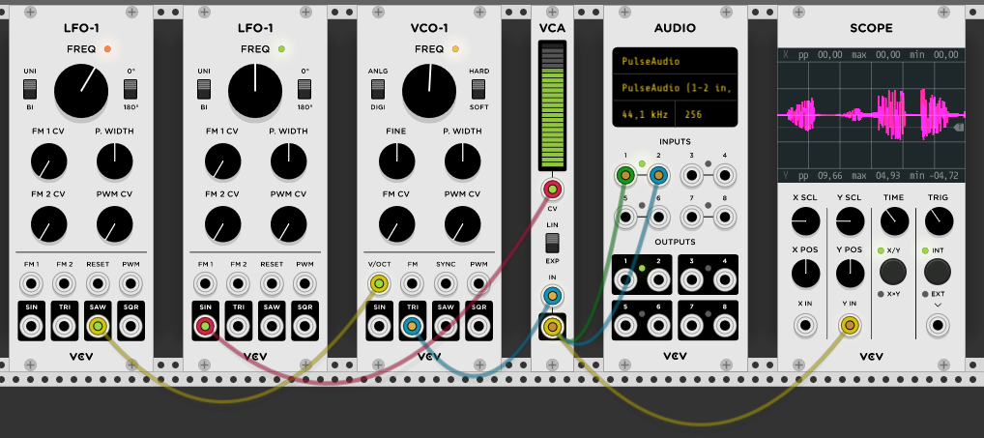
A Simple Example
Fundamental
LFO1
Fundamental
VCO1
Core
Audio
Fundamental
LFO1
Fundamental
VCA1
Fundamental
Scope

Slide 15
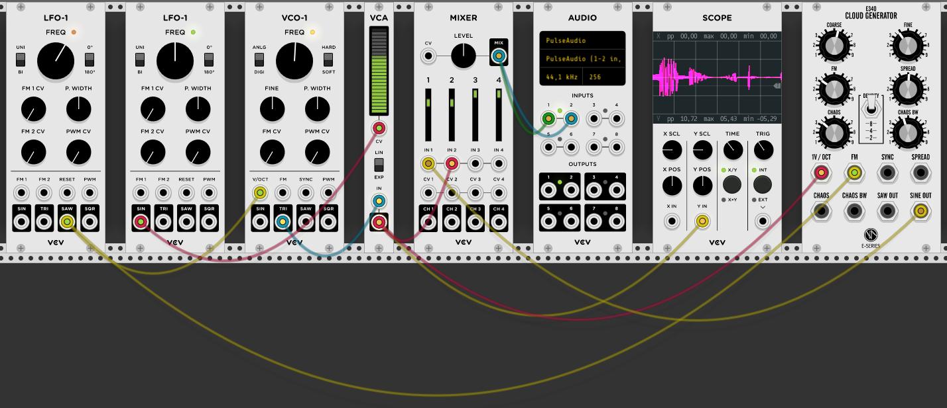
An Example with the Cloud Generator
Fundamental
LFO1
Fundamental
VCO1
Fundamental
Mixer
Fundamental
Scope
Fundamental
LFO1
Fundamental
VCA1
Core
Audio
Befaco
Cloud Generator

Slide 16
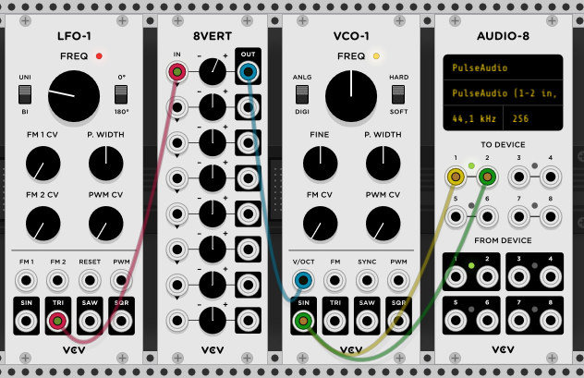
VCO / LFO
Example
You can use an attenuverter
Audio-8 Input / Output
Attenuator
To speaker
From Microphone

Slide 17

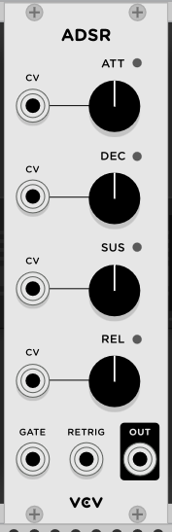
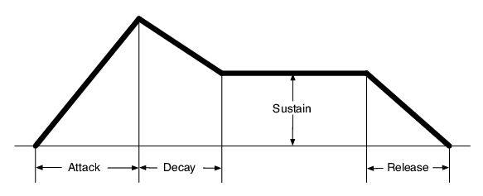
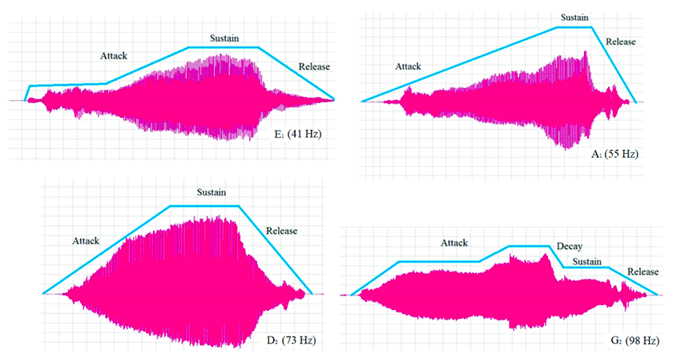
ADSR / VCA
ADSR :
Attack
Decay
Sustain
Release
Produces a signal which will be used to control the amplitude of a sound
VCA : Voltage Control Amplifier
Most of the time, an ADSR enveloppe is used with a VCA

Slide 18
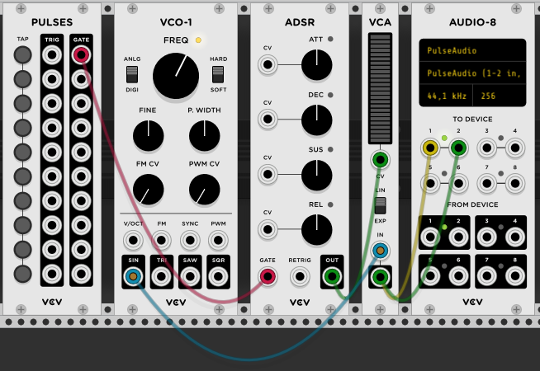
ADSR / VCA
Example
Pulses generator
This button will trigger the sound modulated by the enveloppe

Slide 19
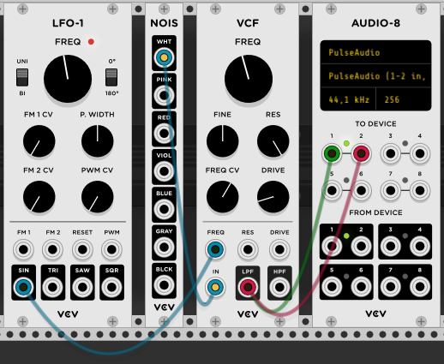
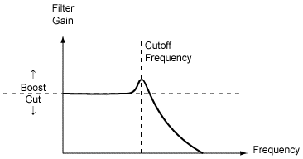
VCF
Example
VCF : Voltage Control Frequency
A filter (low pass or high pass) controled by a CV signal.
FREQ/CV : the sensivity to the of the cutoff frequency wrt the CV signal amplitude.
RES : The resonance of the filter

Slide 20
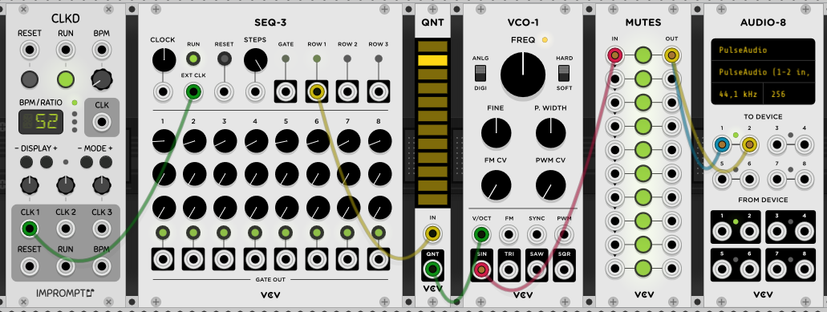
Sequencer
Example
Clock module
To adjust the speed of the sequencer
Quantizer
To transform the continuous signal into discrete levels
You can disable some levels by clicking on them
8 notes sequencer

Slide 21
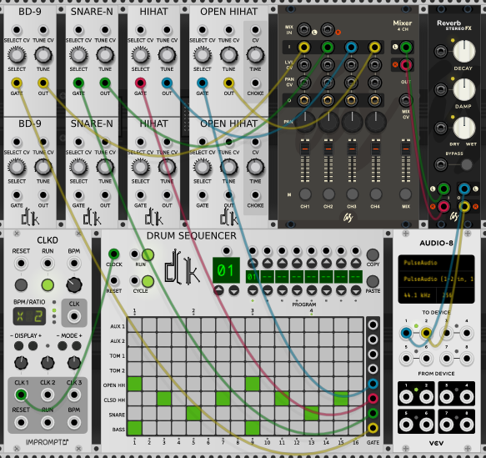
Drum Sequencer
Bass drum, snare, hit hat from SV modular
Drum sequencer from SV modular
Mixer and Reverb from AS
Clock from Impromptu

Slide 22
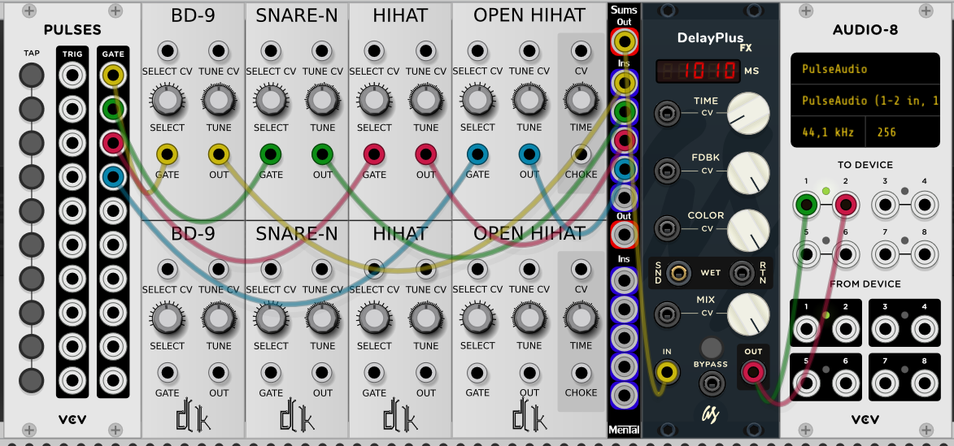
Drum Sequencer 2
Bass drum, snare, hit hat from SV modular
AUDIO-8 from Fundamental
PULSES from Fundamental
Sums from Mental
DelayPlus from AS

Slide 23
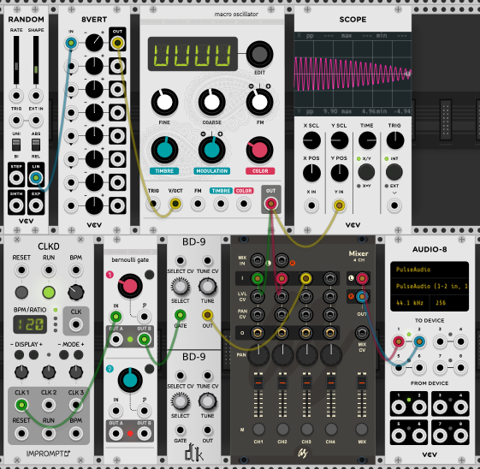
Playing with randomness
Macro oscillator and Bernouilli gate from Audible Instruments
Clock from Impromptu
Bass drum from SV Modular
Mixer from AS
All the other modules from Fundamental

Slide 24
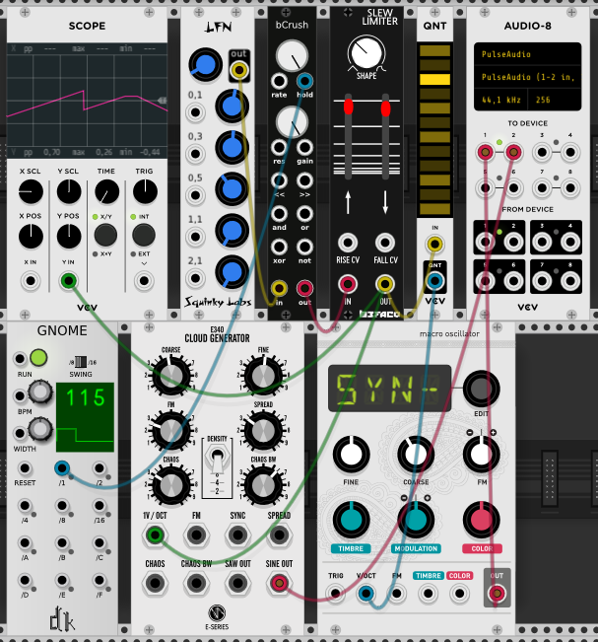
Some melodies ?
A random generator from Squinky lavs
bCrush from aridacity
Slew Limiter from Befaco
Cloud Generators from Eseries
Clock from SV Modular
Macro oscillator from Audible Instruments

Slide 25
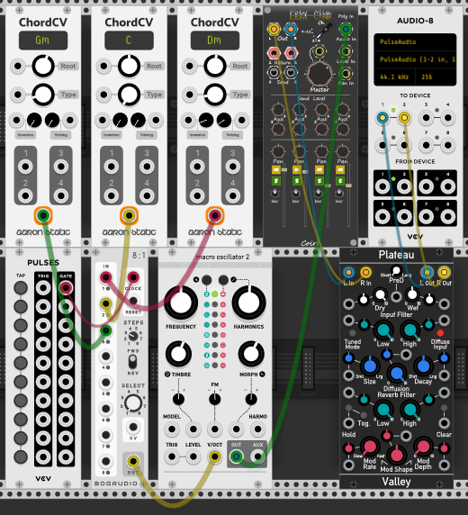
Chords progression
ChordCV from Aaron Static
8 to 1 from BogAudio
Macro Oscillator 2 from Audible Instruments
Plateau from Valley
Coirt from Bark (Poly to stereo mixer)

Slide 26
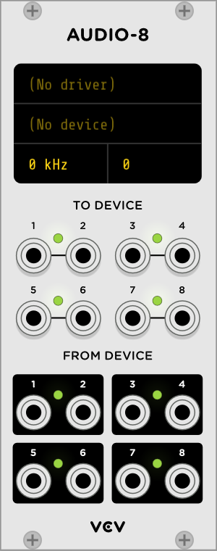
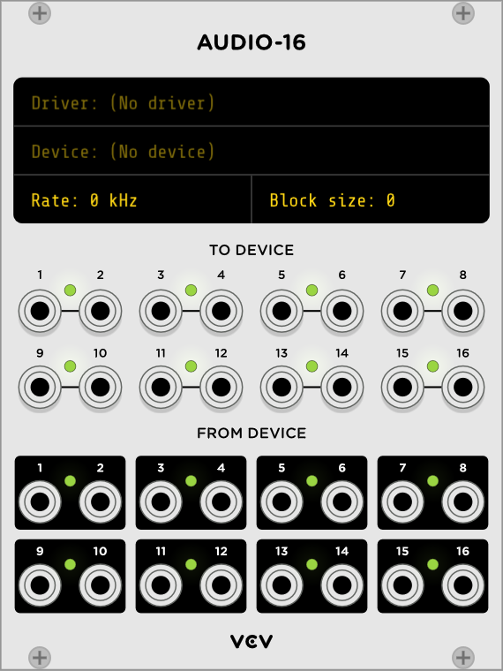
The Core Plugins https://vcvrack.com/manual/Core
Audio Driver
Audio Inputs
Sampling Frequency
Outputs
Inputs

Slide 27
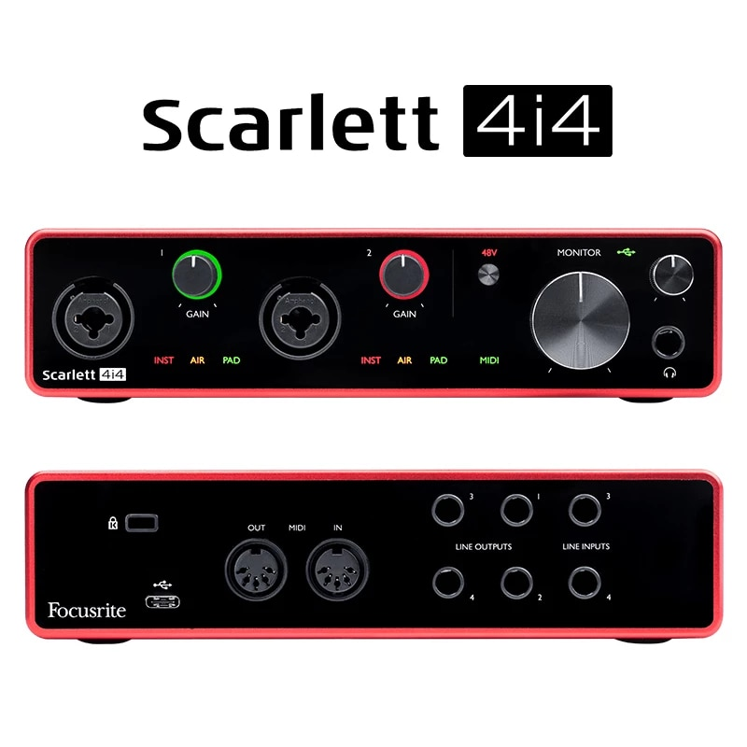
The Core Plugins https://vcvrack.com/manual/Core

Slide 28
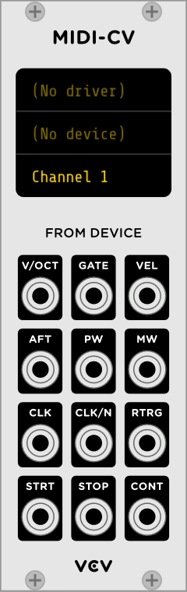
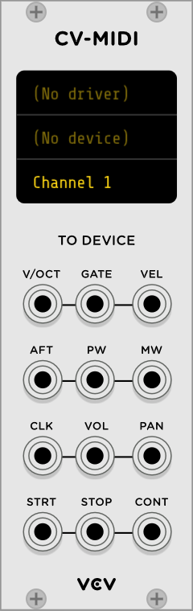
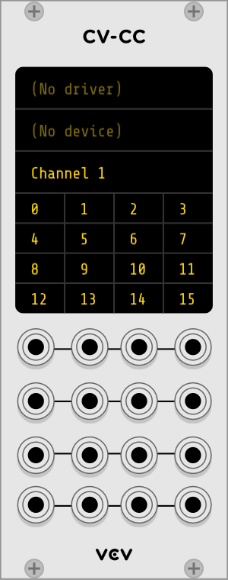
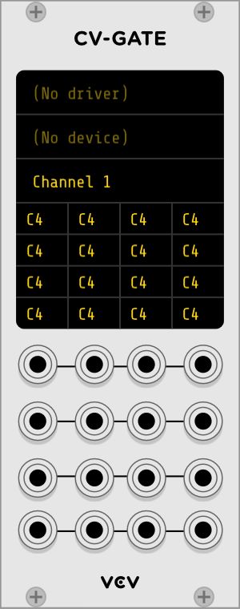
The Core Plugins https://vcvrack.com/manual/Core

Slide 29
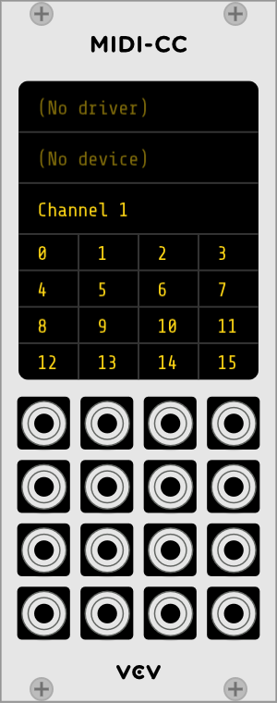
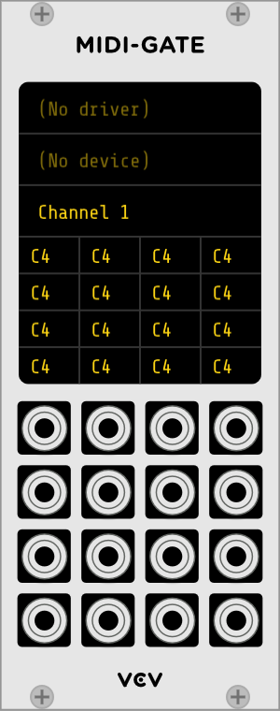
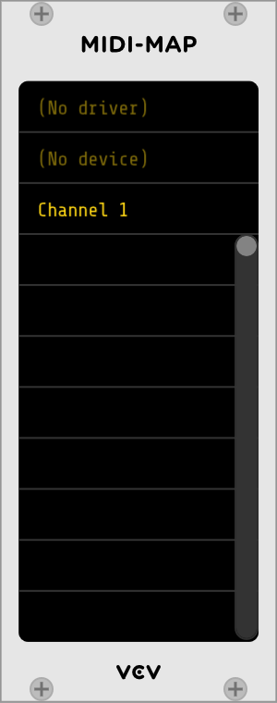
The Core Plugins https://vcvrack.com/manual/Core

Slide 30
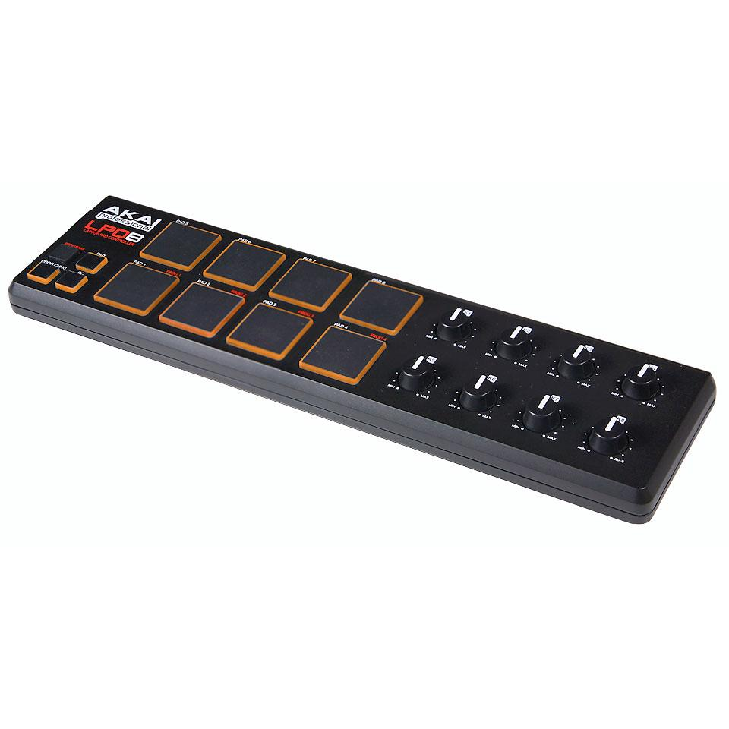
Control via MIDI
Rotage the knob in the module
Click on one empty space
And now the real knob is connected to the VCV Rack knob
Rotate the knob

Slide 31
Webbography
VCV Rack : https://vcvrack.com/
Forum : https://community.vcvrack.com/
Omri Cohen : https://www.youtube.com/channel/UCuWKHSHTHMV_nVSeNH4gYAg
Fedoramagazine article : https://fedoramagazine.org/vcv-rack-modular-synthesizers/
Eurorack :
- FR : https://fr.wikipedia.org/wiki/Eurorack
- EN : https://en.wikipedia.org/wiki/Eurorack
Mutable Instruments :
- https://mutable-instruments.net/

