Slide 1
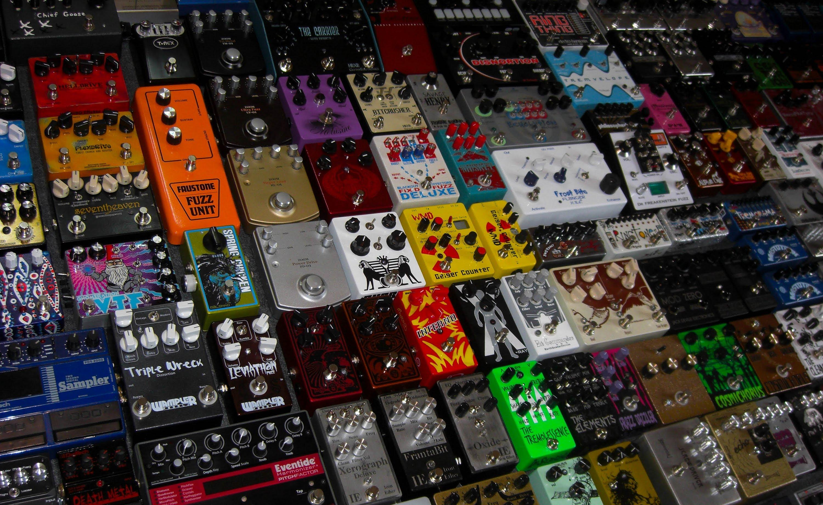
Guitar Effects Chain

Slide 2
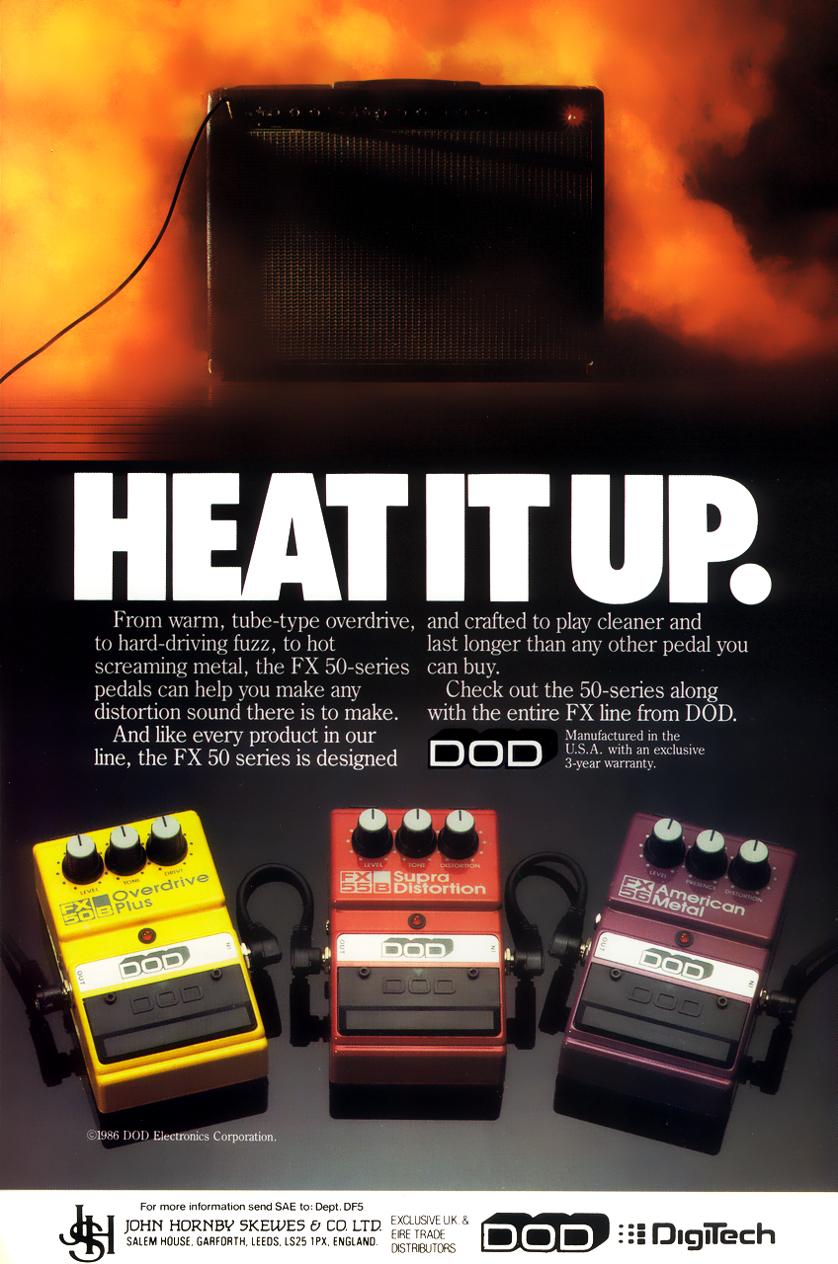
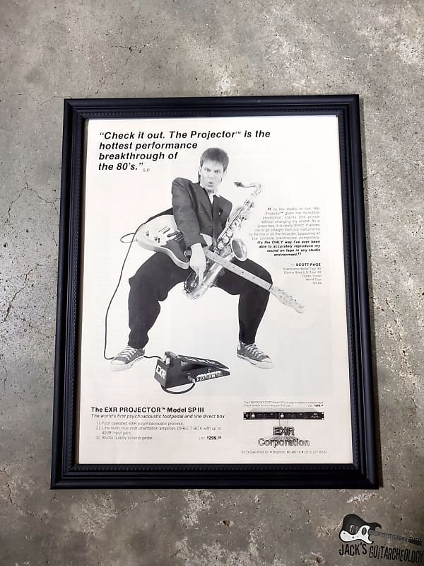
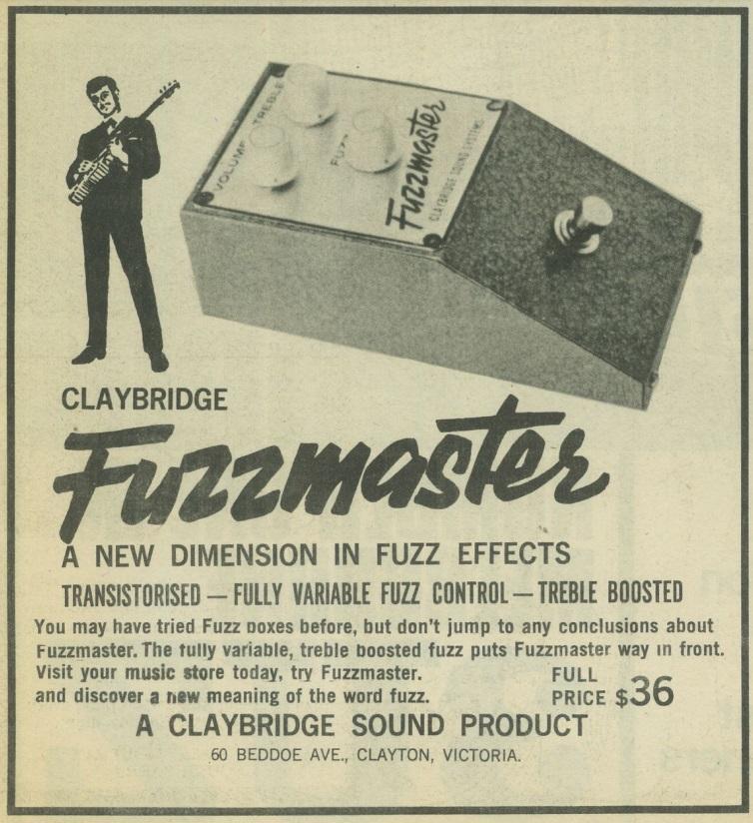
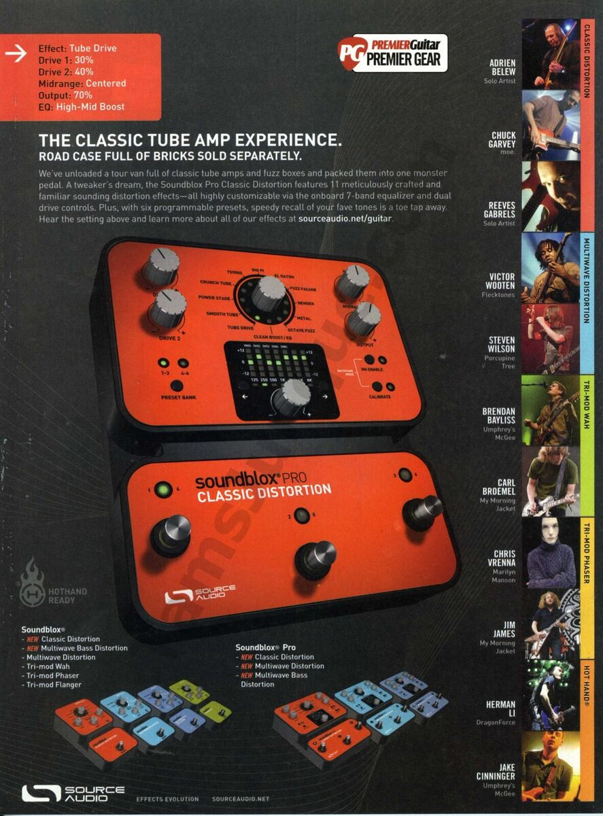
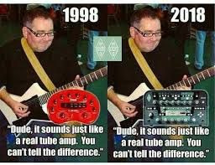
Some old ads

Slide 3
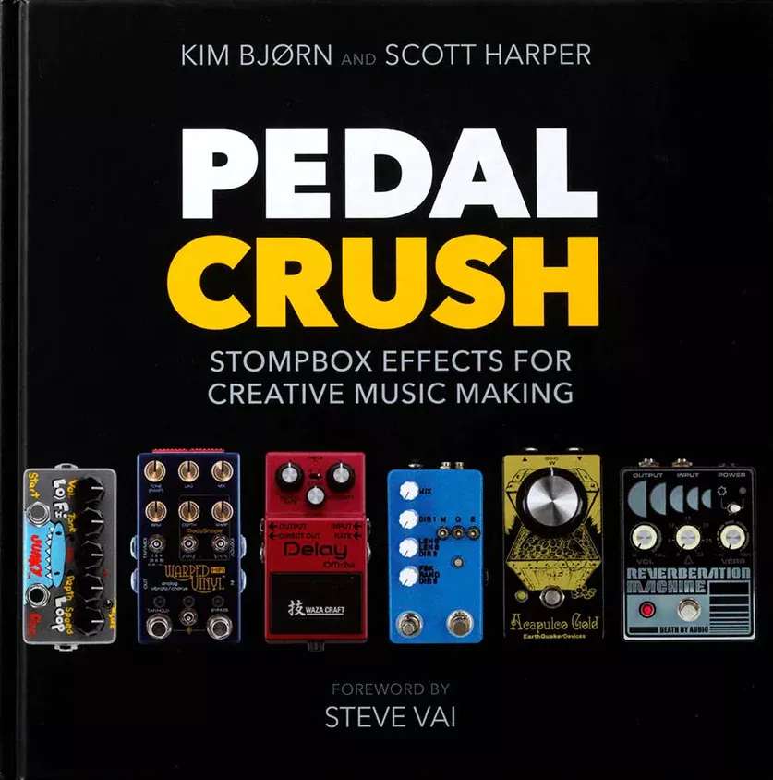
References
Book about pedals, pedals and people building pedals :
Pedal Crush
A lot of good information in this book

Slide 4
Plugins used
- mod-pitchshifter / mod-gxpitchshifter : pitch shifting plugins. The gx version is a modified version of mod-pitchshifter useable with Guitarix
- spectra.lv2 : A spectrum analyser from x42 as a LV2 plugin
- sisco.lv2 : an oscilloscope from x42 as a LV2 plugin
- lsp-plugins-lv2 : some LV2 plugins. A nice spectrum analyzer is available in the package
- guitarix : a lamp amplifier simulator. A complete Guitar amplifier with nice effects
- lv2-calf-plugins-gui : some nice plugins. We will use the compressor
- raysession : a jack session manager
- audacity : a powerful sound recorder
- Carla : a plugin rack. We will use carla to manage the oscilloscope and the spectrum analyzer
- Zam : a collection of audio plugins for high quality processing

Slide 5
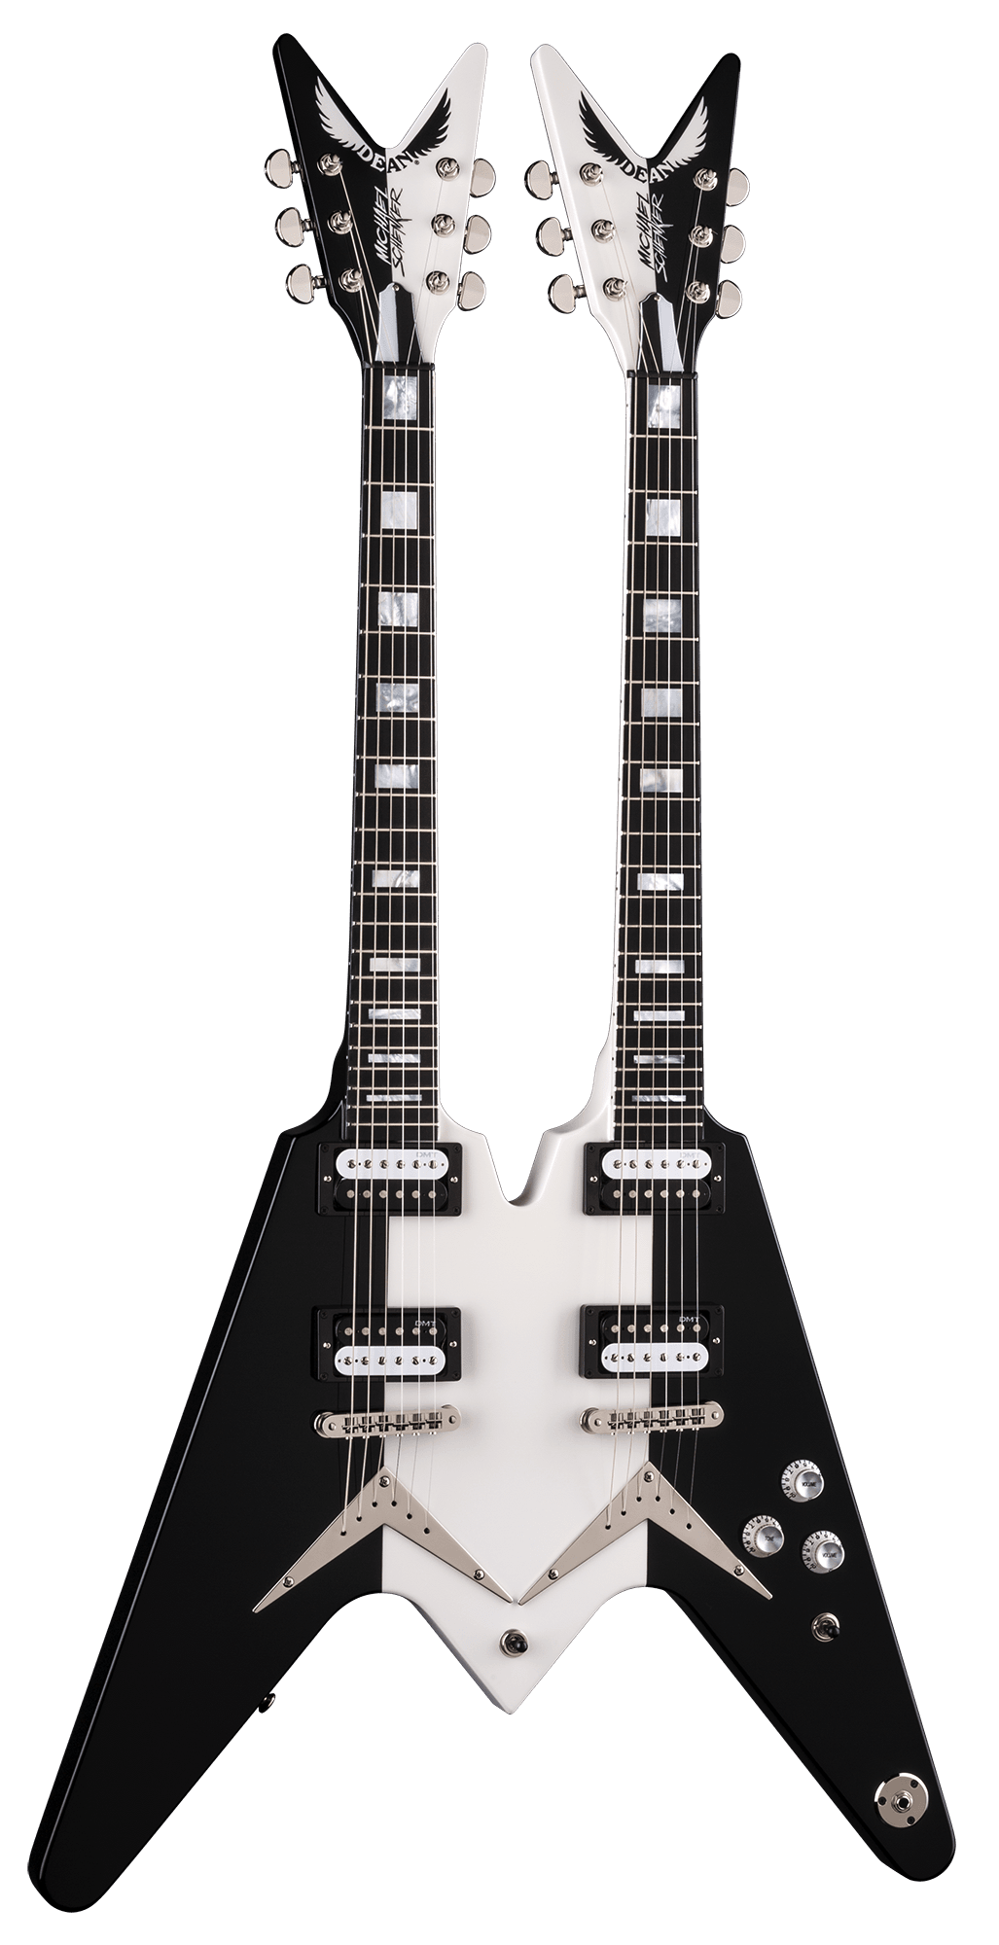
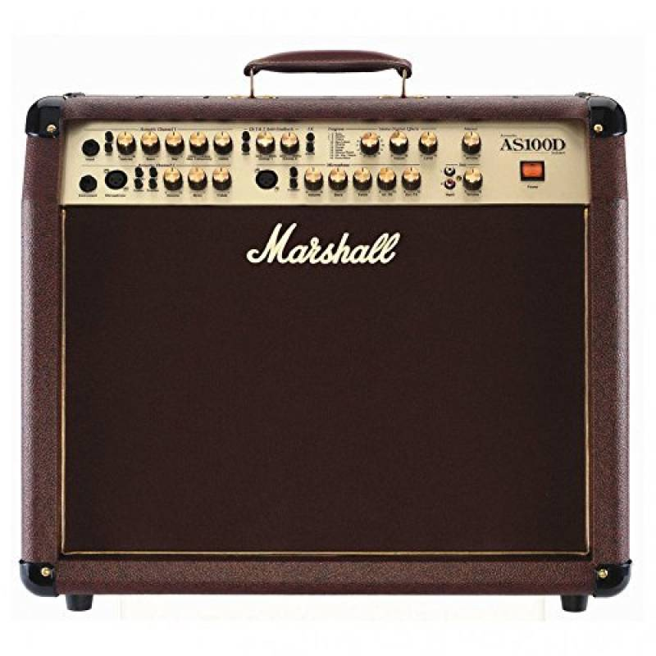
Guitar Effects Chain
Pre-Amp
Pitch
Comp.
Dist.
Mod.
Delay
Wah
Eq.
Gate
Reverb
Volume

Slide 6
Guitar Effects Chain
Defining a good guitar effects chains is hard :
- there is no general rule
- you can put the noise gate at the beginning or after the distortion
- you can put the wah pedal at the beginnig of after the distortion
- you can put the equalizer everywhere you can (but it has a good job to do at the beginning)
- the distortion you put before the head of the amplifier is just used as an amplifier, the drive level has nearly no effect
Follow a general schema, but try to move elements, it can be best for you

Slide 7
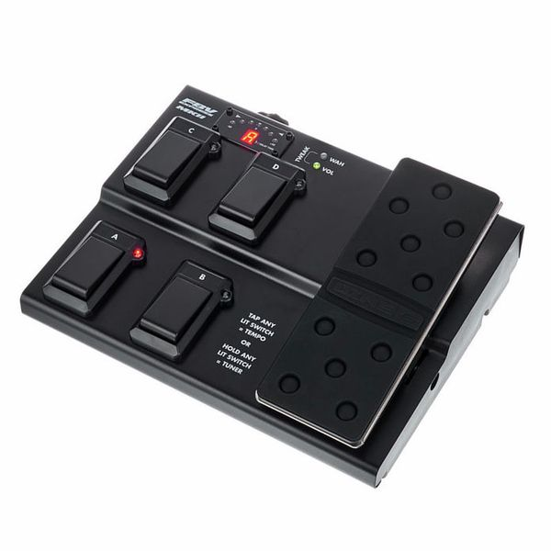
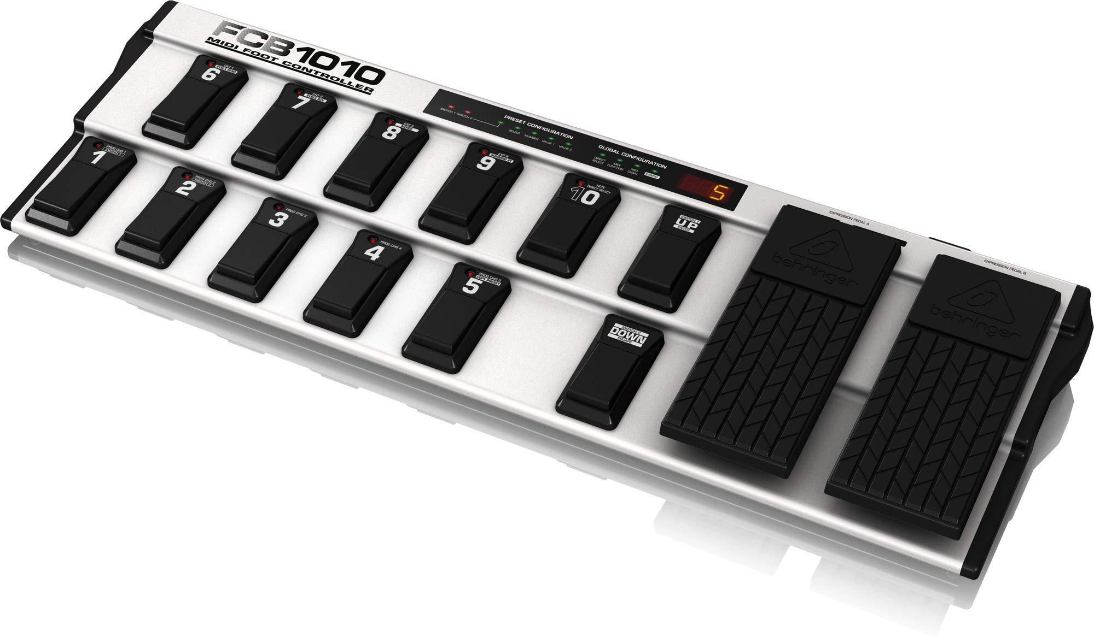
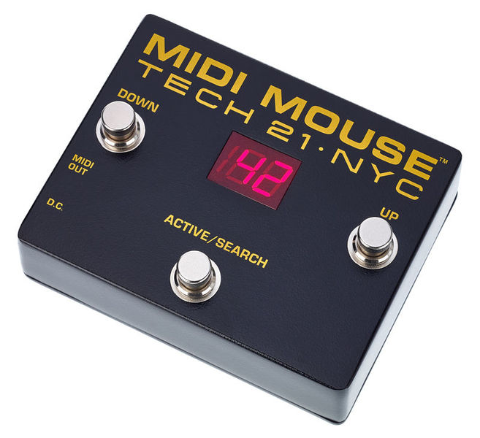
MIDI Pedal Board
Behringer Fcb1010
Line6 FBV Express MKII
MIDI Mouse Tech 21
Some interesting MIDI pedal board used to control Guitarix or other applications

Slide 8
Pitch Shifter Effect 1/2
Pitch
Pitch
Dist.
Adding a small level of distortion after a pitch shifter can add a some missing pieces of frequencies when downtuning a guitar

Slide 9
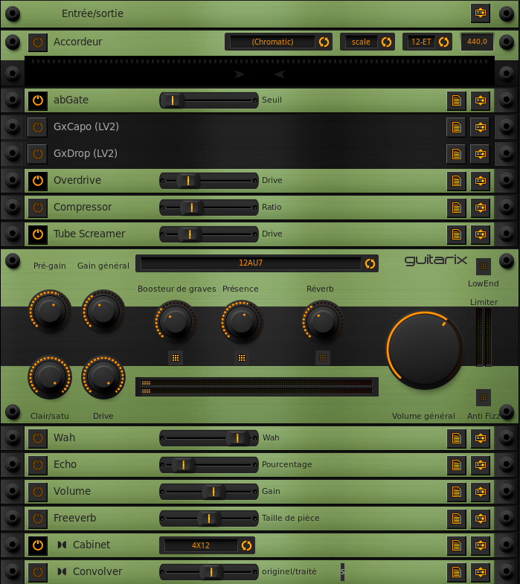
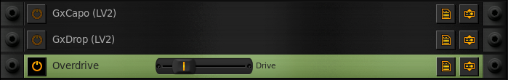
Pitch Shifter Effect 2/2
GxCapo : a LV2 plugin used to tune up the guitar
GxDrop : a LV2 plugin used to tune down the guitar
Overdrive : an LV2 used to add a little distortion to help fill the missing bits in the spectrum

Slide 10
Wah Pedal Position
Pre-Amp
Pitch
Comp.
Dist.
In the pre-amp we have a quasi-sinusoïd from the guitar.
The wah pedal which is a filter will just filter a quasi-sinusoïd and will behave more or less as a volume pedal.
Wah
Pre-Amp
Pitch
Comp.
Dist.
After the distortion pedal, the signal has a richer specter and when processed by the wah, the wah effect will be more pronounced.
Wah

Slide 11
Volume Pedal Position
Pre-Amp
Pitch
Comp.
Dist.
Placed at the beginning of the chain, the volume can have an impact on the sound. Compressor and distortion are tuned for a given level of signal.
Vol.
Gate
Reverb
At the end of the chain, the identity of the sound will be preserved if we reduce the level of signal via the volume pedal.
Volume

Slide 12
Noise Gate Position
Gate
Pre-Amp
Pitch
Comp.
Dist.
Placed at the beginning of the chain, the volume can have an impact on the sound. Compressor and distortion are tuned for a given level of signal.
Dist.
Gate
At the end of the chain, the identity of the sound will be preserved if we reduce the level of signal via the volume pedal.
… Or both. At the beginning (for guitar mic noise) and at the end (for pedal noise).

Slide 13
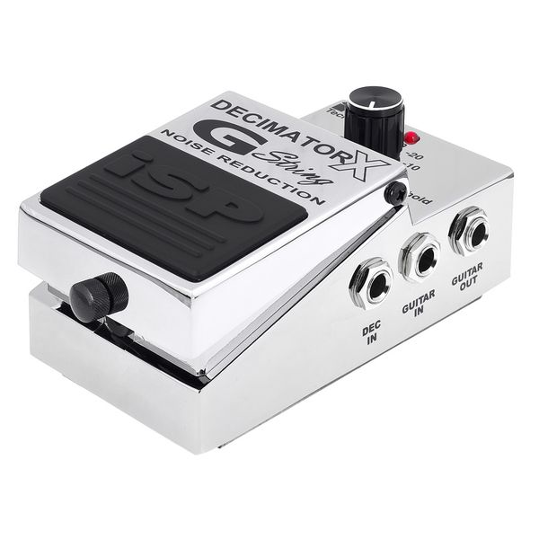
Sidechained Noise Gate 1/2
Gate 1
Pre-Amp
Pitch
Comp.
Dist.
Gate 2
The sidechained noise gate will get the enveloppe from the input signal (Gate1) and will use this enveloppe to cut off the processed signal at the end of the effect chain. So, it will remove the noise produced by all the pedal using information from the beginning of the effect chain (check the ISP Technologies Decimator X G-String Noise Red).

Slide 14
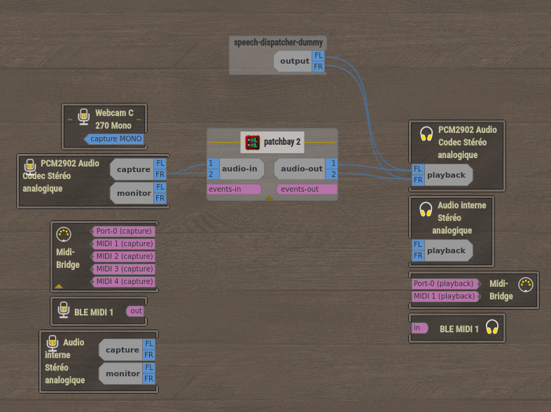
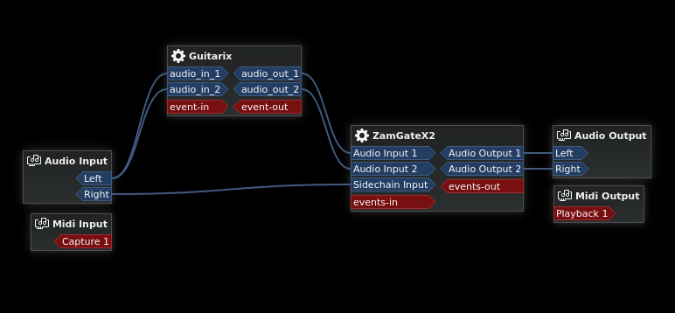
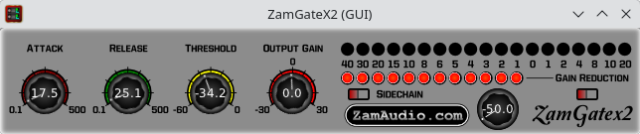
Sidechained Noise Gate 2/2
The connexions in carla-patchbay :
- Guitarix launched as application
- ZamGatex2 loaded as a plugin
- carla-patchbay loaded in Ray Session
The ISP Decimator (289 € on Thomann) do the same thing as ZamGate. Here is an example from Tosin Abasi pedalboard : Abasi / YouTube
The connexions in Ray Session

Slide 15
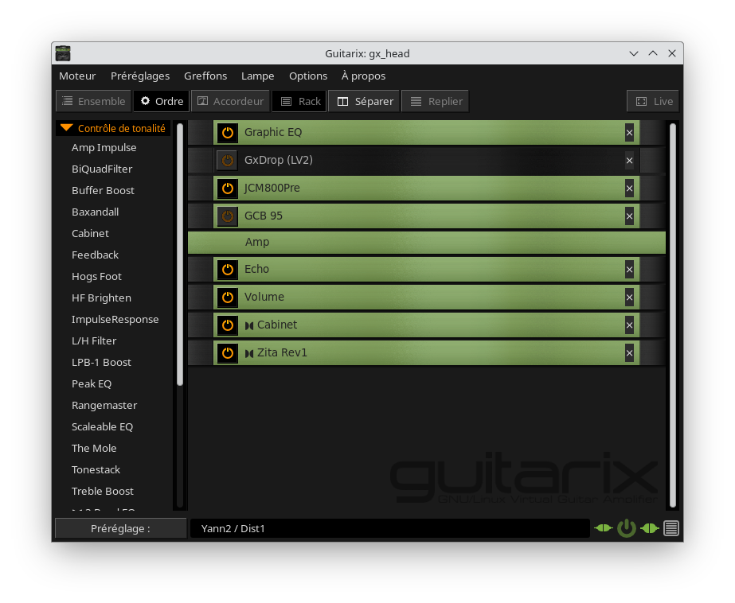
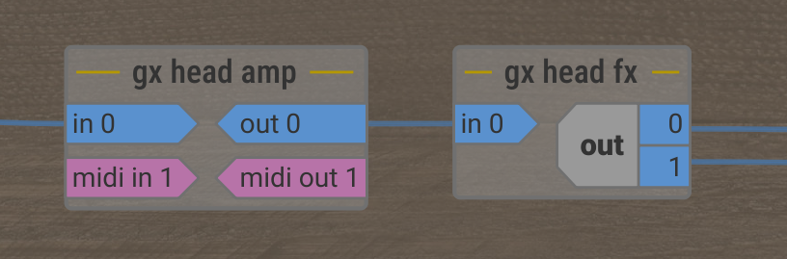
Guitarix Rack Structure
Mono Effects
Stereo Effects

Slide 16

Guitarix Default Racks
Level of the threshold compressor at the top of the rack
Clipping level at the bottom of the rack
Level of the noise gate at the top of the rack
Gain of the preamp at the bottom of the mono rack

Slide 17
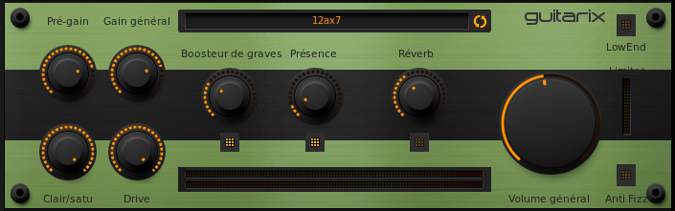
Guitarix Default Racks
Gain at amp input
Gain at amp output
Lamp configuration selection
Allow freq below 31 Hz
Mix level
Gain of the lamp stage
Bass level
High frequency boost
Amp internal reverb level
Hiss remover

Slide 18
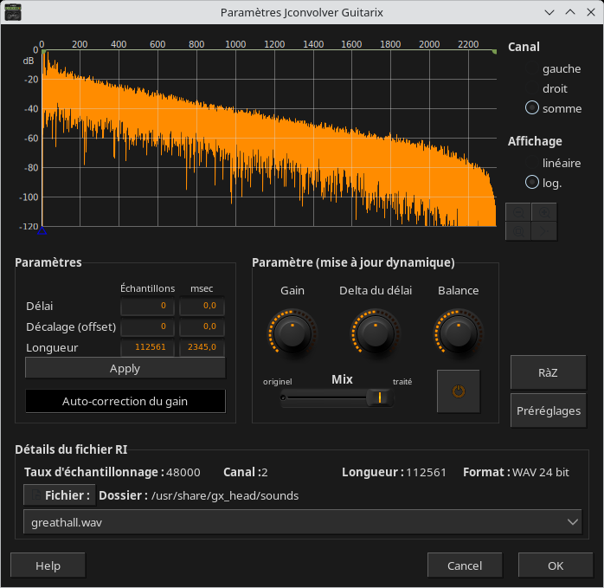
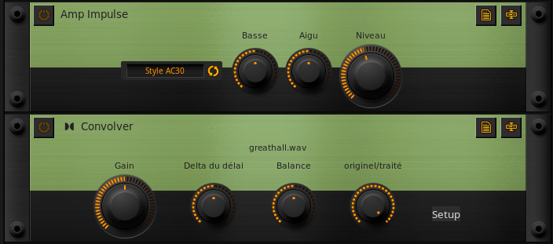
Guitarix Default Racks
Convoler : to copy the style of a given band
Amp Impulse : to copy an amplifier style
Convolver Window Setting

Slide 19
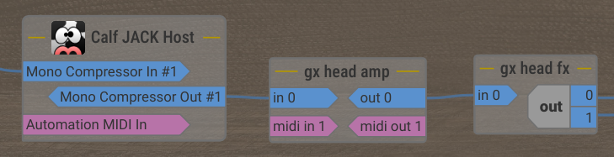
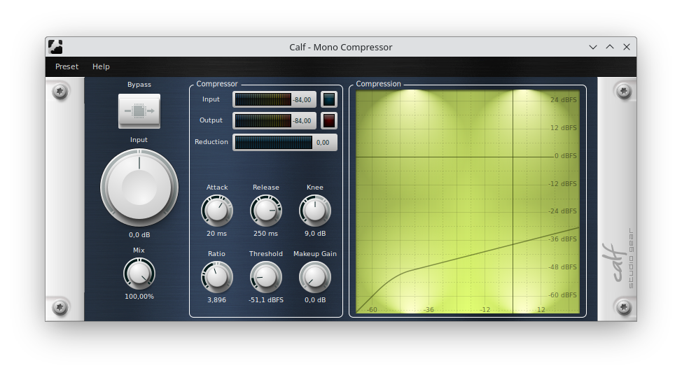
Compressor Experiment
We use the compressor from Calf plugins. This one has a nice GUI which eases the tuning of the compressor.
We then use audacity to generate a special signal using Generate -> Silence + Generate -> Tone to show the compressor behavior.
This signal is sent to calf / compressor and audacity records the audio of calf / compressor

Slide 20
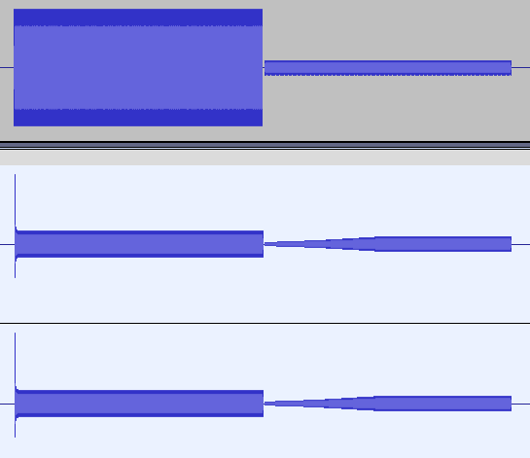
Compressor Experiment
The first part of the signal is above the threshold and the second part is below.
I set a huge release and a huge attack level.
With the attack set to a non nul value, the output signal start with the original level and then reach the level defined by the compressor at the speed defined by the attack level/
With the release set to a non nul value, at the amplitude change, the compressor keeps its gain and apply the gain to the low amplitude and slowly reach the unity gain and the speed defined by the release level.

Slide 21
Compressor
How to use the compressor :
- you can use a compressor at the beginning of the signal chain. In this position, it is mostly used for sustain.
- you can use it after the « last » effect in the chain (like after the distortion). In this position, it will be mostly efficient for adjusting the sound for tapping / sweeping for example.
Comp.
Pre-Amp
Pitch
Gate
Dist.
Example of Guitarix / Compressor settings for tapping / sweeping :
Ratio : 2.5
Threshold : -18
Knee : 6
Attack : 0.01
Release:0.25
Pre-Amp
Pitch
Gate
Dist.
Comp.

Slide 22
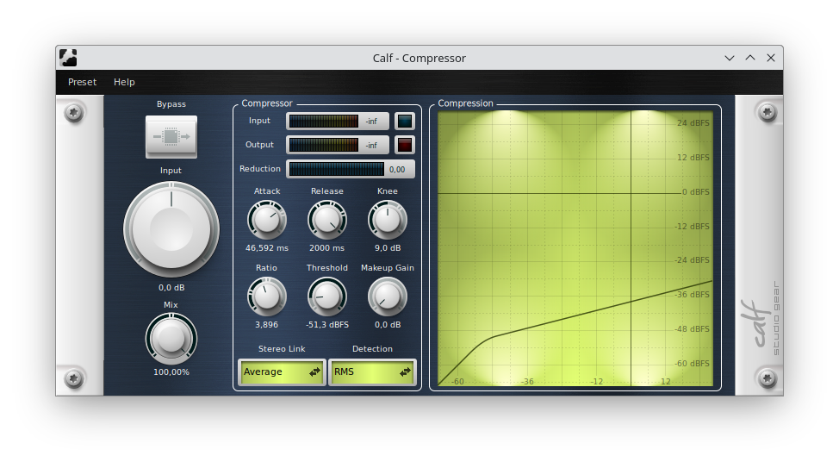
Compressor : Tuning
How to tune the compressor :
- Play some tapping or legato notes and set the threshold so that the notes are above the threshold in the Calf compress graph
- Play some notes using the pick and set the compressor level to reduce the level difference between a legato or tapping note and the note played with the pick.

Slide 23
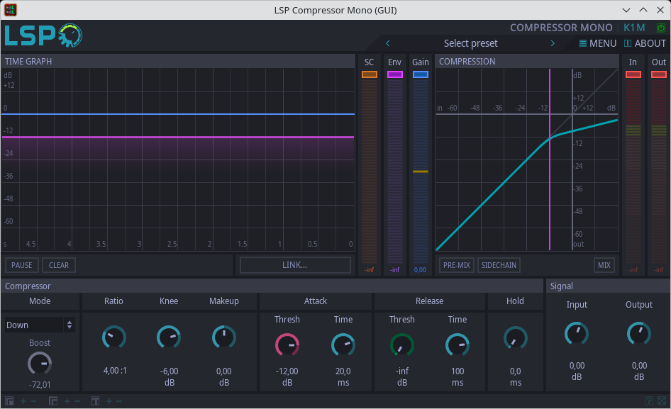
Compressor : LSP
LSP Compressors are good.
There are many available :
Compressor LeftRight
Compressor MidSide
Compressor Mono
Compressor Stereo
Sidechain Compressor LeftRight
Sidechain Compressor MidSide
Sidechain Compressor Mono
Sidechain Compressor Stereo

Slide 24
Distortion
Overdrive
Overdrive simulates an amp pushed to its limits, and early overdrives (like the Tube Screamer) were designed to push the preamp stage of an already hot tube amp into natural saturation.
But an overdrive itself produces slight distortion - it's simply a smooth, asymmetrical saturation that clips the signal gradually and organically, while retaining a lot of dynamics. Play softly → almost clean sound. Play hard → natural saturation.
This responsiveness to touch is what characterizes it.
Distortion
A distortion pedal clips the signal symmetrically and aggressively, often to the point of total clipping (square). The result is denser, more consistent, less responsive to touch - the sound is saturated regardless of how hard you play.

Slide 25
Distortion
Overdrive Distortion
Clipping Type: Asymmetrical, smooth. Symmetrical, aggressive.
Dynamic: Very touch-sensitive. Not very responsive.
Harmonics: Even (2nd, 4th) → warm. Odd (3rd, 5th) → aggressive.
Amp Interaction: Strong Weak
The real rule
It's not so much the final stage that matters, but rather the frequency coloration introduced at each stage that survives. Cascading distortion erases dynamics but preserves tonal balance.
This is why guitarists often layer an overdrive before a distortion pedal before a saturated amp - each stage colors the spectrum differently, even if the dynamics are compressed from the very first stage.

Slide 26
Distortion
Why the final stage dominates :
Distortion is a destructive process - once the signal is clipped, the original dynamic information is lost. No matter what you add upstream afterward, you're working with an already depleted signal.
This is the principle of cascading non-linearities: if your amp saturates heavily, it will re-distort everything that comes in, whether it's already distorted or not.
The final saturation stage imposes its characteristic tone.
But that's not entirely accurate.
Several things happen beforehand that survive the final distortion:
Equalization: the Tube Screamer cuts the bass frequencies before distortion - this characteristic mid-boost remains audible even after a saturated amp, because distortion amplifies differently depending on the frequencies present.
Input level: the more input you send to the amp, the more you push it into its own saturation - this is the whole point of a boost or overdrive in front of a tube amp.
Residual dynamics: a slightly overdriven signal still retains some dynamic range, which the amp will process differently than a clean signal.

Slide 27
Distortion
Use scopes to see the shape of the signal as you add effects (compressor, distortion, an overdrive, etc …)
Use spectrum analyzer to check the shape of the spectrum :
Clipping
Too much distortion may produce high frequencies
50Hz from power supply may produce parasitic frequencies like 200 Hz peak

Slide 28
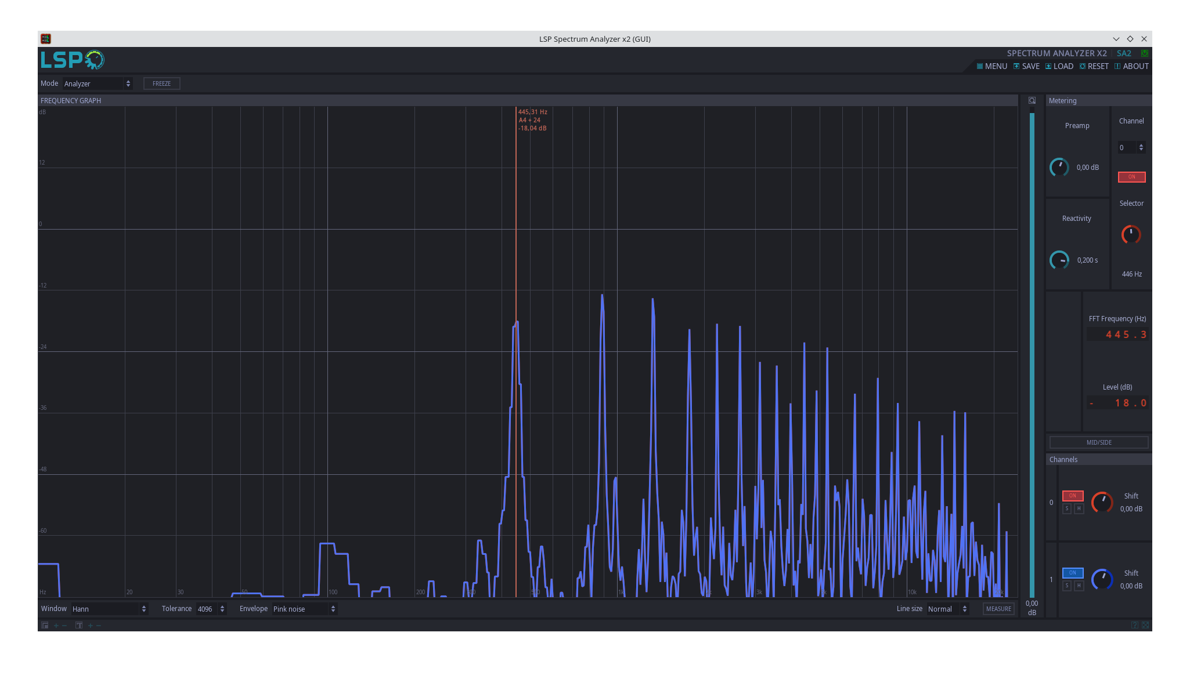
Distortion
Here is a A (440 Hz) played on a guitar with a lot of distortion.
As you can see the first harmonic has a level above the fundamental.
The content of the spectrum as a lot of high frequencies and you may need to reduce a little bit the distortion to keep some limits on higher frequencies.
LSP spectrum analyzer

Slide 29
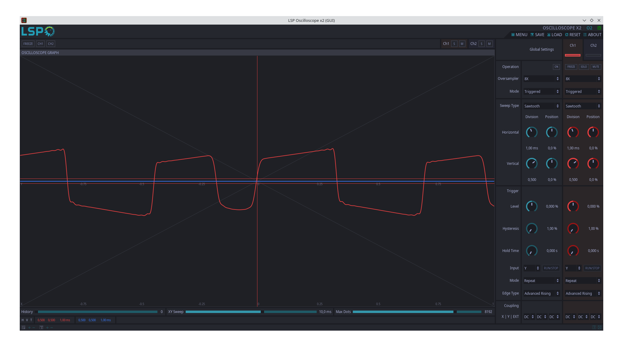
Distortion
Use a scope to check the shape of the sound and see how parameters can change the sound
LSP Oscilloscope

Slide 30
Some Distortions tuning
Dist.
Pre-Amp
When using a distortion before the pre-amp or the amplifier head, the first drive / tone distortion tuning has nearly no effects. Use a little drive in the first distortion.
For the second one (the pre-amp or the amplifier head), use the level of drive you want, but after that, to limit the aliasing effects due to the spectre extension produced by the distortion, use a low pass filter to limit the frequencies after the Nyquist frequency.
Aliasing can produce some unwanted noises like ike crackling, harshness and metallic noises.

Slide 31
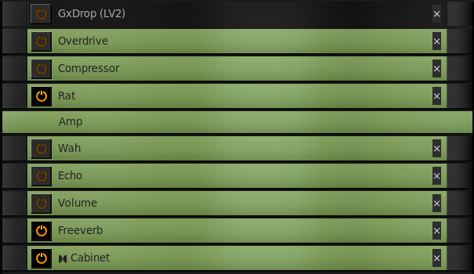
Example of Guitarix settings
Overdrive : 5.1 / 100 %
Compressor : 4.5 / -51.1 / 2 / 0 / 0
Rat : 0.86 / -4.8 / 0.75
Amp : See after
Wah : ColorSound Wah / 0 / 52
Echo : 150 / 15.0
Volume : 6.3
Freeverb : 0.78 / 0.50 / 40
Cabinet : 4x12 / -0.5 / 0.6 / 3.8

Slide 32
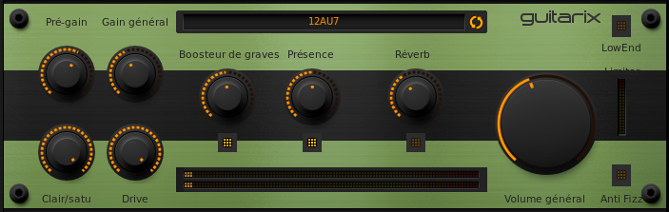
Example of Guitarix settings

Slide 33
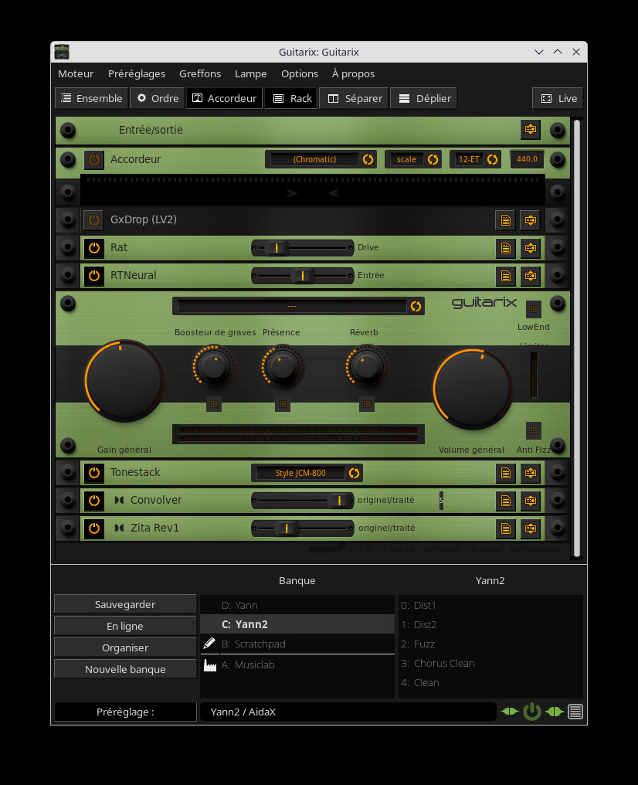
AIDA-X
AIDA-X are neural amplifier models developed for the MOD Device. These models a lightweight enough to be used in real time.
You can load an AIDAI-X model via the RTNeural Guitarix plugin.
The LV2-AIDA-X plugiin is not yet compatible with Guitarix but can be loaded into Carla-Rack.
You can find some good AIDA-X models on :
https://www.tone3000.com/
On this web site you can also find IR of cabinets.
The NAM model is quite big and when I tried it, the load was too high and produced X-runs.

Slide 34
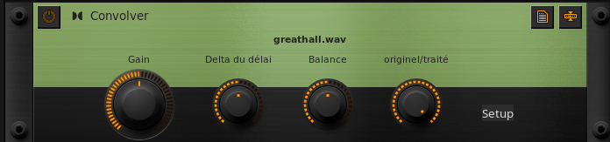
Convolver
The convolver allows you to applied an Impulse Response (IR) on an input signal.
The tool allows to ‘copy‘ a given sound.
With guitarix, you can find a lot of preinstalled IR for bands and for amplifier.
Another usage of IR is to reproduce a reverberation. You can find a lot of IR for reverberation on the internet.
The last usage is to mimic a cabinet (and ensemble of speakers). Same as for reverberation, you can find a lot of IR for cabinets on the internet.

Slide 35
NAM
Neural Amp Modeler is an open-source project that uses deep learning to create models of guitar amplifiers and pedals with state-of-the-art accuracy.
There are 2 NAM version :
- A1 : the old standard
- A2 : a new version with a new parameter controlling the level of accuracy and so, the CPU load required for evaluation
Both models are available now on Fedora :
- lv2-neural-amp-modeler
- lv2-neuralrack
- mod-neural-amp
- a2core
- ratatouille

Slide 36
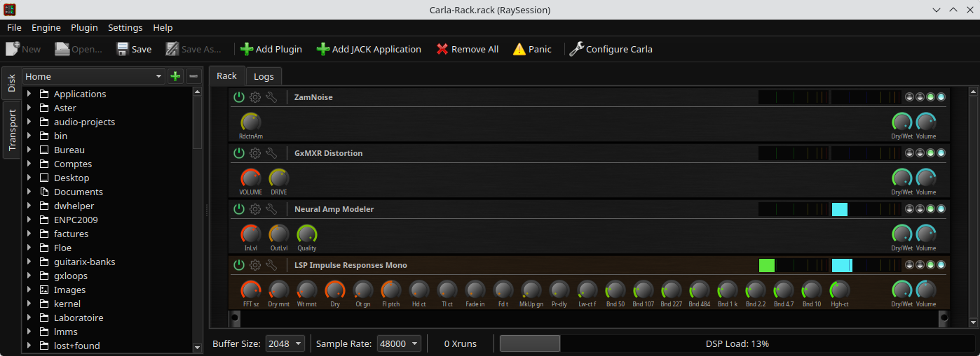
NAM A2
This preset uses :
- ZamNoise : as a noise gate
- GxMXR Distortion : as an overdrive for the NAM modl
- Neural Amp Modeler : as a NAM A2 loader (model downloaded from https://www.tone3000.com)
- LSP Impulse Response Mono : as an IR loader for the Cabinet simulation

Slide 37
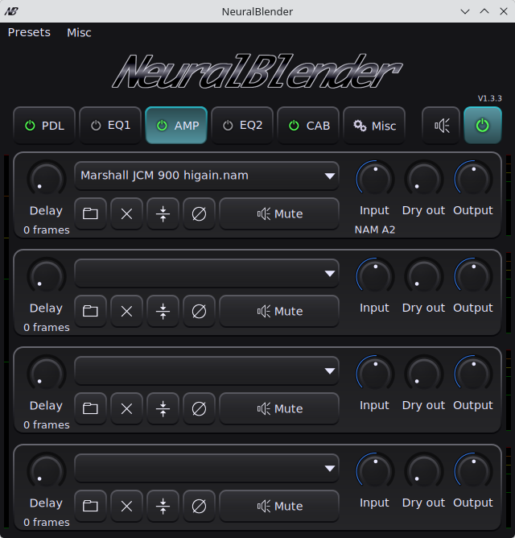
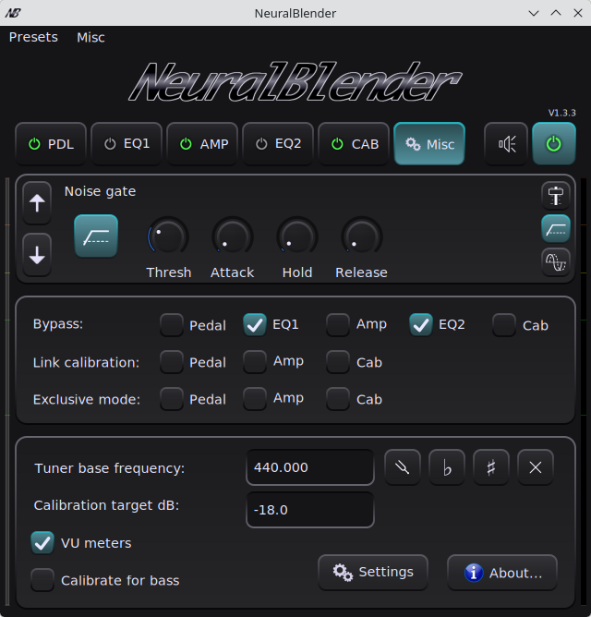
NeuralBlender
A tool which allow to mix / blend several NAM A2 / IR models for amplifier / cabinets and effects.
https://sourceforge.net/projects/neuralblender/

Slide 38
Rehearse with TuxGuitar
Applications used :
- guitarix : guitar amplifier simulator
- tuxguitar : to play GuitarPro scores
- timemachine : to record some audio
- jack_mixer : to fine tune the audio level between tuxguitar and guitarix
- non-mixer-xt : (another option to replace jack_mixer)
- ray session : to start all these applications and reconnect them

Slide 39
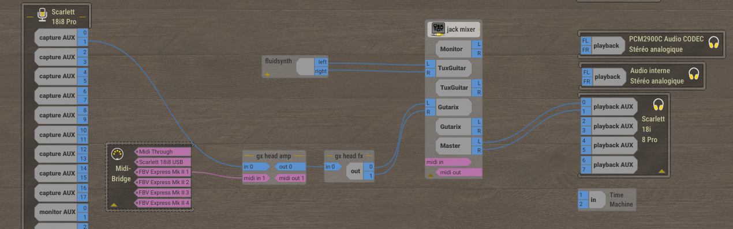
Rehearse with TuxGuitar

Slide 40
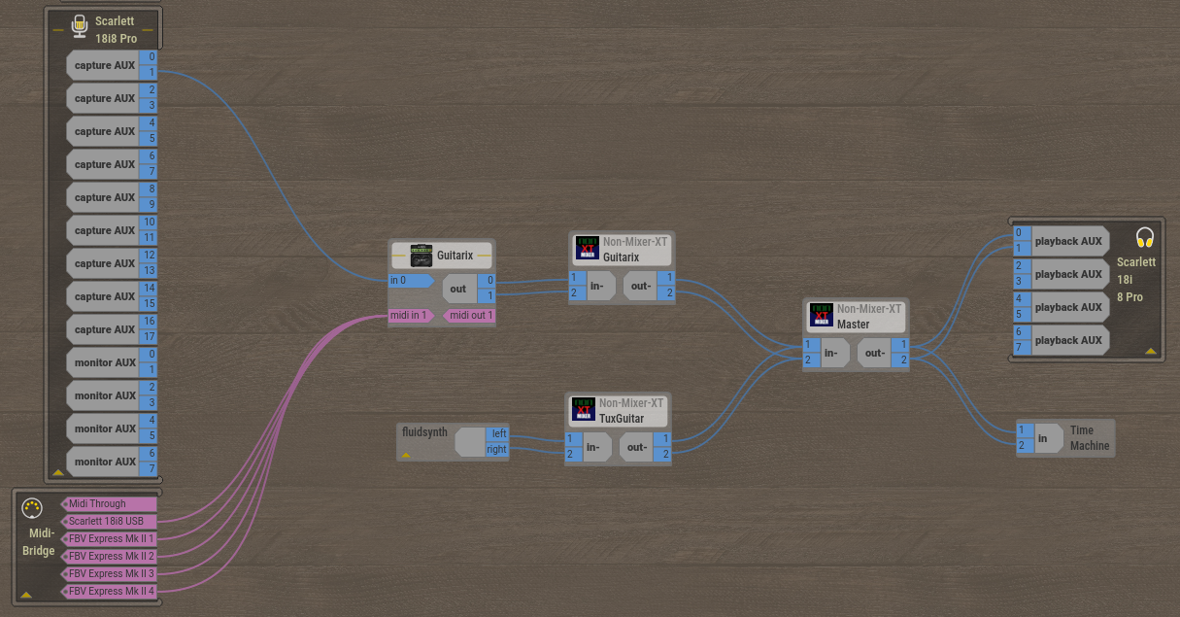
Rehearse with TuxGuitar - 2

Slide 41
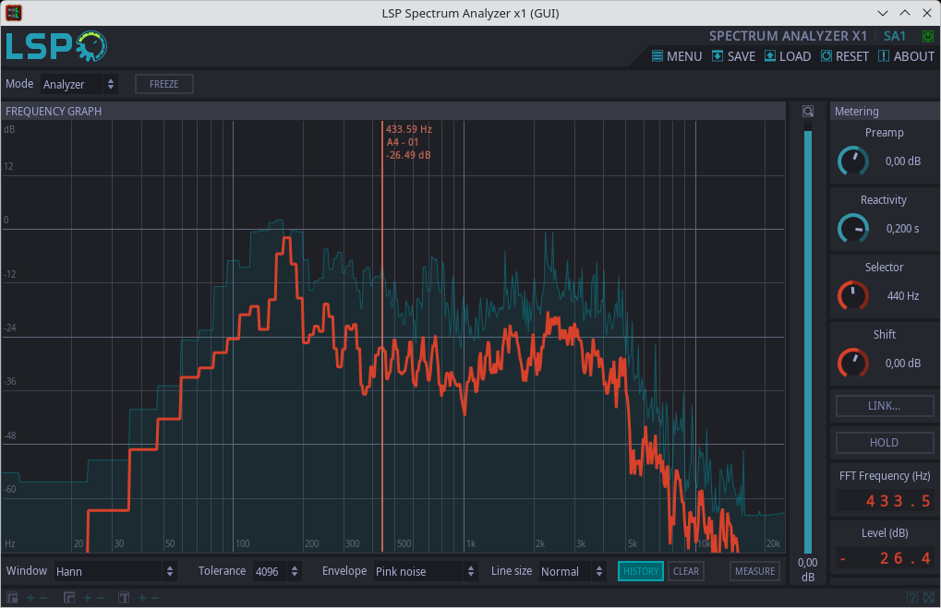
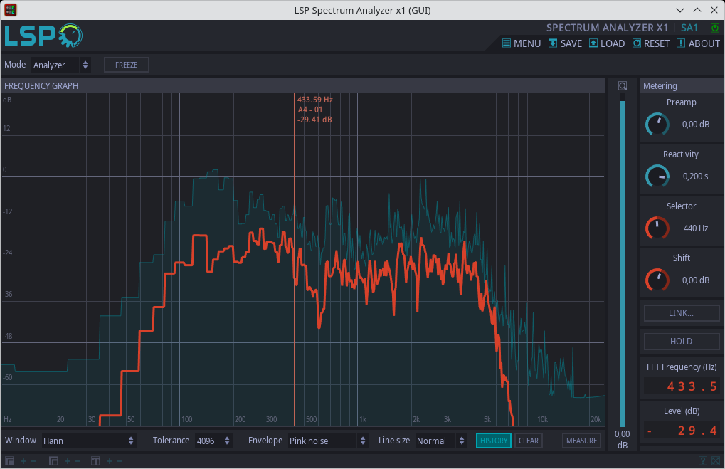
Spectral Comparison of Sounds
Sound with standard Guitarix distortion settings
Sound with AIDA-X model and high gain
The spectral pic at 2500 Hz is due to the IR of the cabinet. Pic not present with another cabinet

Slide 42
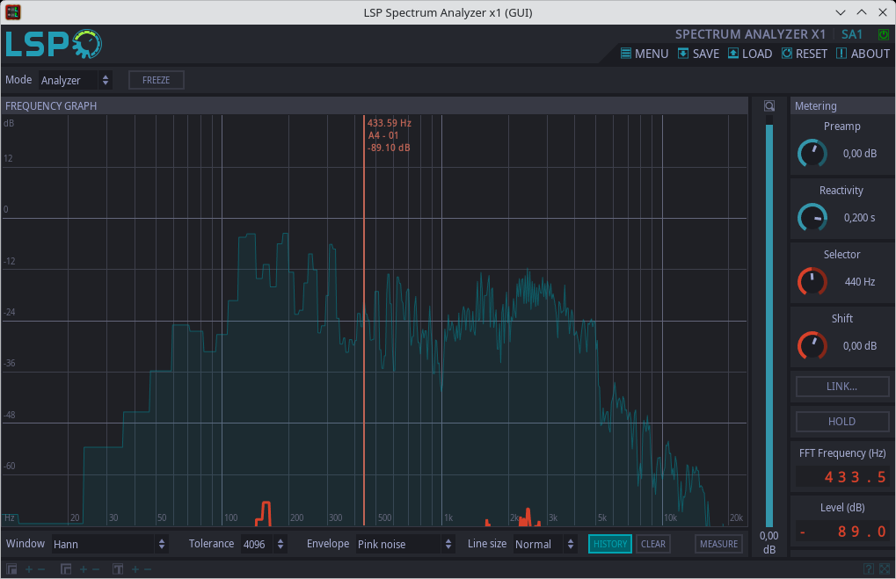
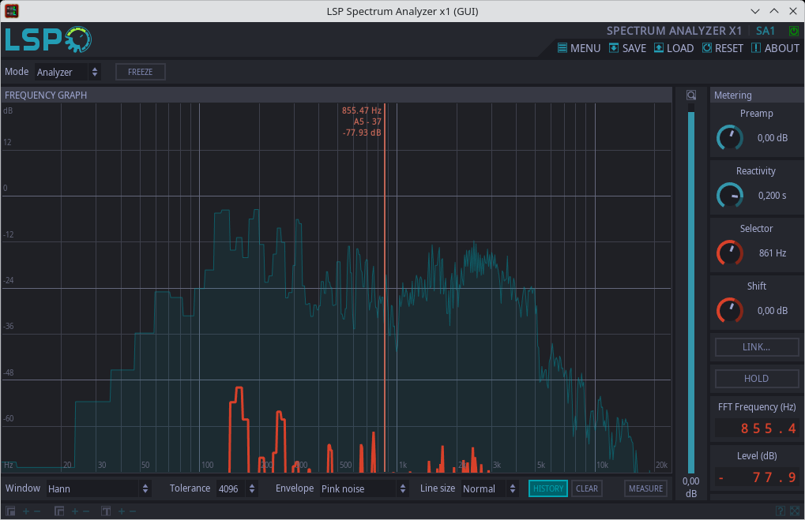
Spectral Comparison of Sounds
Spectrum with a humbucker coil
Spectrum with a single coil
A small peak at 50 Hz and a small peak at 2500 Hz
A big peak at 50 Hz with some harmonics and a bigger peak at 2500 Hz
The n x 50 Hz harmonices are due to power supply + distortion

Slide 43
Additional effects for Solo
We can add to the current settings :
- a volume pedal adding +3 to +6 dB
- an echo with a delay between 300-450 ms or 120-250 ms for a subtil echo and add a feedback between 20-35 %. The wet/dry mix is around 15-25 %. The echo is placed before the reverb. ChatGPT suggest to add a high pass filter with a cutting frequency between 150-200 Hz.
For a compressor for tapping / standard play :
Threshold : around -20 dB (adjust to correspond to the signal level – lower this value until the tapping trigger compression).
Ratio : 3:1 to 4:1.
Attack : 10 to 20 ms → let pass the mediator attack to have a percussive sound.
Release : 80 to 150 ms → fast enough so that compression breathe between note.
Makeup gain : tune so that tapping and mediator play are at the same level.
Knee : soft knee if available → the compression acts softly and avoid pumping effect.

